Slide 1
Generation of a primary event
Ruhani Khanna (INFN-LNS)
XVI Seminar on Software for Nuclear, Sub-nuclear and Applied Physics
Tuesday 28th May, 2019 – Alghero, Italy

Slide 2
Lesson Outline
Introduction to some classes
Primary Generation Action class
Implementation
Generators
Further details/ examples
Task
Notes:
Initiates primary generator
Sets shooting values to it in Generate Primaries method

Slide 3
Classes
Global - only exists in memory for 1 instance, shared by all threads
Thread-local - instance of each action class exists for each thread
G4UserDetectorConstruction
G4VUserPhysicsList
G4VUserActionInitialization
G4VUserPrimaryGeneratorAction
G4UserRunAction
G4UserEventAction
G4UserStackingAction
G4UserTrackingActio
G4UserSteppingAction
At Initialisation:
At Execution:
To define use
G4RunManager::SetUserInitialization()
Invoked at initialisation
To define use
G4RunManager::SetUserAction()
Invoked during an event loop
Notes:
G4RunManager is a class and inherits method ()

Slide 4
Primary Generator Action
At Execution:
G4VUserPrimaryGeneratorAction
Mandatory user class
Doesn’t generate primaries
Invokes GeneratePrimaryVertex() (method to make the primary)
Sends the primary particles to G4Event object
Primary vertex and the primary particle are added to a GEANT4 Event
Notes:
Particles
Vertex = position in space
UPGA – computes desired primary properties
PG –vertices and particles created
Event – primaries are stored in stacks for tracking later

Slide 5
Implementation in the src file
ExP02PrimaryGeneratorAction::ExP02PrimaryGeneratorAction()
G4VUserPrimaryGeneratorAction(),
fParticleGun(0)
{
G4int n_particle = 1;
fParticleGun = new G4ParticleGun(n_particle);
G4ParticleTable* particleTable = G4ParticleTable::GetParticleTable();
G4String particleName;
fParticleGun->SetParticleDefinition(particleTable->FindParticle(particleName="geantino"));
fParticleGun->SetParticleEnergy(1.0*GeV);
fParticleGun->SetParticlePosition(G4ThreeVector(0.0, 0.0, 0.0));
}
ExP02PrimaryGeneratorAction::~ExP02PrimaryGeneratorAction()
{
delete fParticleGun;
}
void ExP02PrimaryGeneratorAction::GeneratePrimaries(G4Event* anEvent)
{
G4ThreeVector v(1.0,0.1,0.1);
fParticleGun->SetParticleMomentumDirection(v);
fParticleGun->GeneratePrimaryVertex(anEvent);
}
Class constructor
Initiation of primary generator -> G4ParticleGun()
Setting of default values
GeneratePrimaries()
- Randomises particle-by-particle values
- Sets values to primary generator
Class destructor
Invokes GeneratePrimaryVertex() -> method of primary generator
Notes:
Particle gun addresses the pointer we defined to an address, the particle gun

Slide 6
Generators

Slide 7
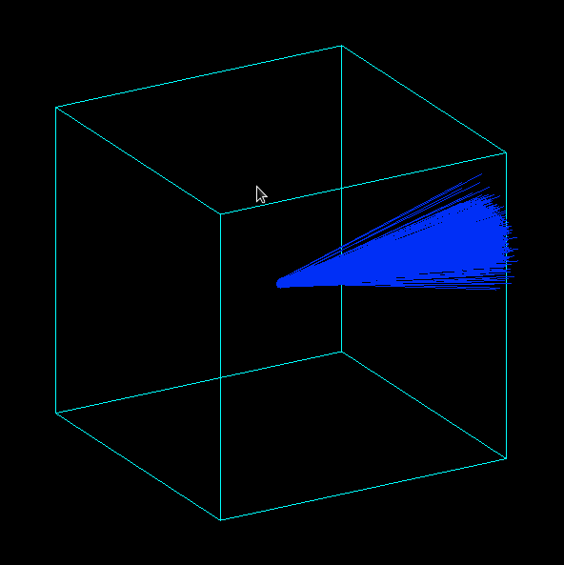
G4VPrimaryGenerator
Introduction to some classes GeneratePrimaries(G4Event*aEvent) (mandatory event)
Geant4 provides 3 G4VPrimaryGenerators: (all concrete implementation
G4ParticleGun
G4HEPEvtInterface
G4GeneralParticleSource

Slide 8
G4ParticleGun
Shoots one primary particle of a certain energy from a certain point at a certain time to a certain direction
Various ‘Set’ methods available (/source/event/include/G4ParticleGun.hh)
Void SetParticleEnergy (G4Double aKineticEnergy)
Void SetParticleMomentum (G4double aMomentum)
Methods can be repeated for generating more than one primary particle
particleGun = G4ParticleGun();
Notes:
Beams, mainly using macros

Slide 9
Implementation example
Can be repeated for generating more than one primary particles
Notes:
Chooseparticle, set particle, setkinetic energy, generate event

Slide 10
G4HEPEvtInterface
GEANT4 provides an ASCII file interface (unlike usual FORTRAN code) for event generators
G4HEPEvtInterface reads this ASCII file produced by an Event generator to reproduce the G4PrimaryParticle objects (in particular the /HEPEVT/ fortran block)
Does not place for the primary particle so the interaction point must be set by the User
Notes:
Experiment specific generators

Slide 11
G4GeneralParticleSource
Designed to replace G4ParticleGun class
Allows specification of multiple particle sources each with independent definition of particle type, position, direction and energy distribution
Primary vertex can be chosen on the surface of a certain volume (randomly)
Momentum, direction and kinetic energy can also be randomised
Distribution defined by UI commands
fGenerateParticleSource = new G4GenerateParticleSource();
…/source/event/include/G4GeneralParticleSource.hh
Notes:
Capability of event biasing, energy and primary vertex for example several options and bias
For example, enhance certain particle types, certain vertex point distributions
General purpose, using volume and surfaces sources, useful in space applications

Slide 12
Implementation example
Source: point like, 100 MeV proton along z
/gps/pos/type point
/gps/particle proton
/gps/energy 100 MeV
/gps/direction 0 0 1
Source: plane source(2x2), 100 MeV proton along z
/gps/pos/type/plane
/gps/pos/shape square
/gps/pos/centre x y z
/gps/pos/Halfx
/gps/pos/Halfy
Notes:
UI commands

Slide 13
Comparison
Particle Gun | General Particle Source | HEP event interface
Simple and native | Powerful | Doesn’t give place of primary particle
Shoots one track at a time | Controlled by UI commands | Interaction point must be set by user
Easy to handle | Capability of shooting particles from a surface of a volume and of randomising kinetic energy, position, direction, following (complicated) user specified distribution

Slide 14
Further details
Online manual:
(http://reat.space.qinetiq.com/gps/)

Slide 15
Thank you

Slide 16
Tasks to do:
Task 2a: Particle Gun
Task 2b: General Particle Source
http://geant4.lngs.infn.it/alghero2019/task2

