Slide 1


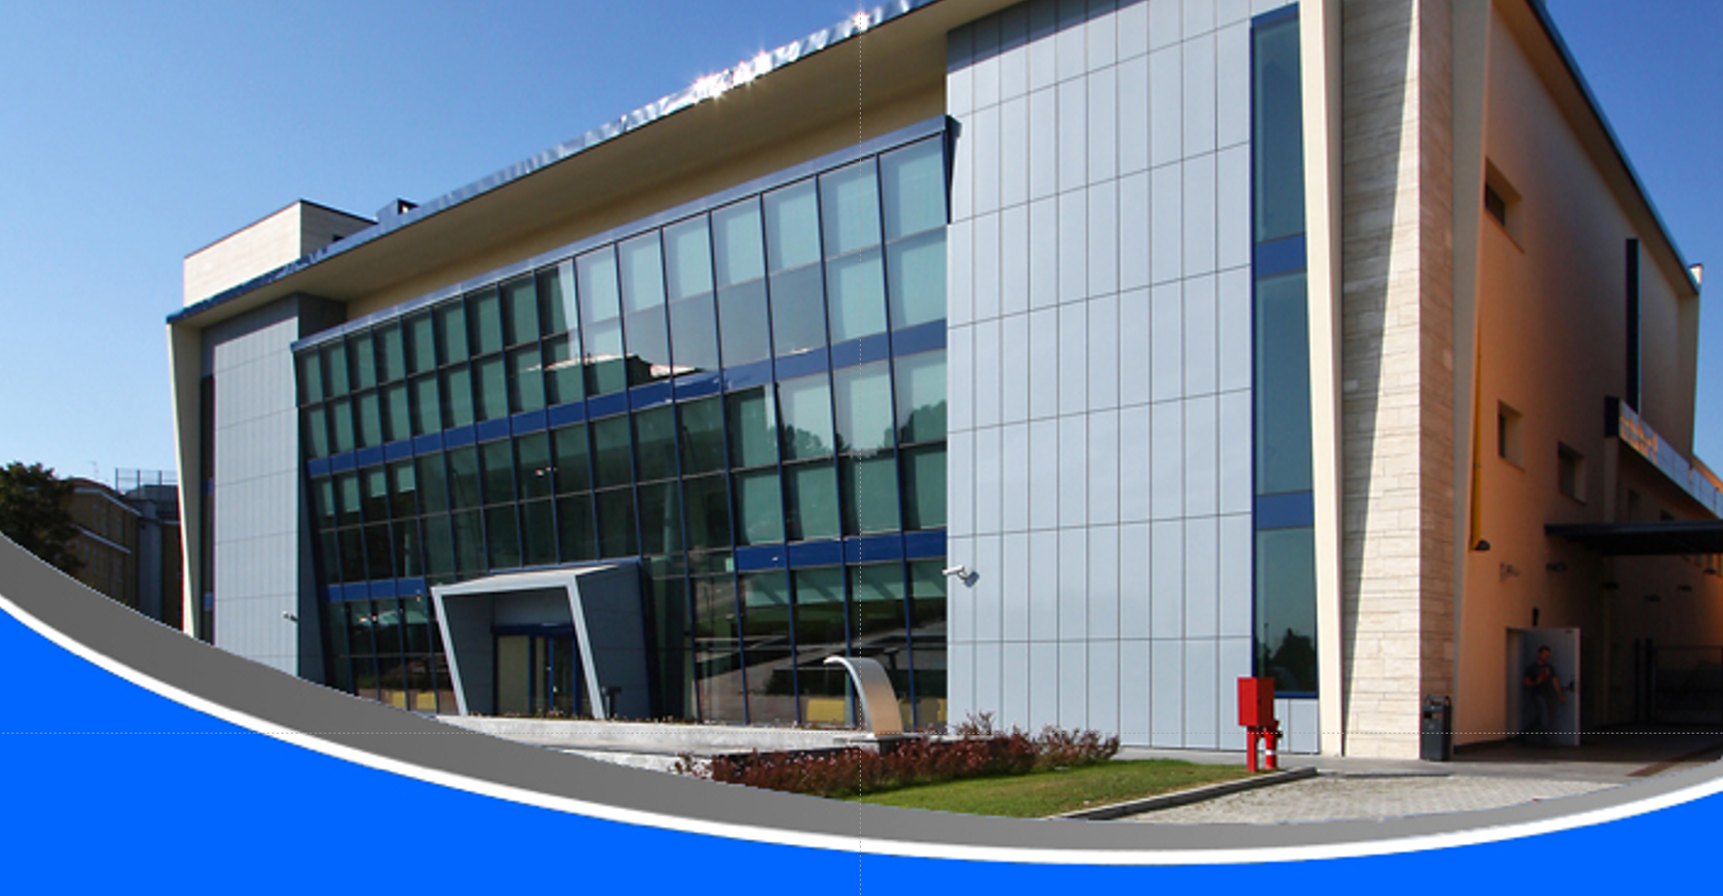

Commissioning of the AISHA Ion Source
L. Celona, S. Gammino, D. Mascali, G. Castro, F. Chines, O. Leonardi, A. Miraglia, G. Torrisi
Istituto Nazionale di Fisica Nucleare
Laboratori Nazionali del Sud
Plenary XPR Meeting
Pavia, 29 October 2018

Slide 2
AISHA motivations
Advanced Ion Source for HAdrontherapy
Most of the existing Clinical Centers for Hadrontherapy are based on proton beams;
However, new frontiers are now being explored such as the use of heavier species like C or Li;
It is reasonable to envisage future R&D requiring versatile ion sources for production of high currents of several species;
AISHa is a ECR Ion Source prototype suitable for operations in hospital facilities, but ensuring high performances both in terms of currents and charge states;
AISHa

Slide 3
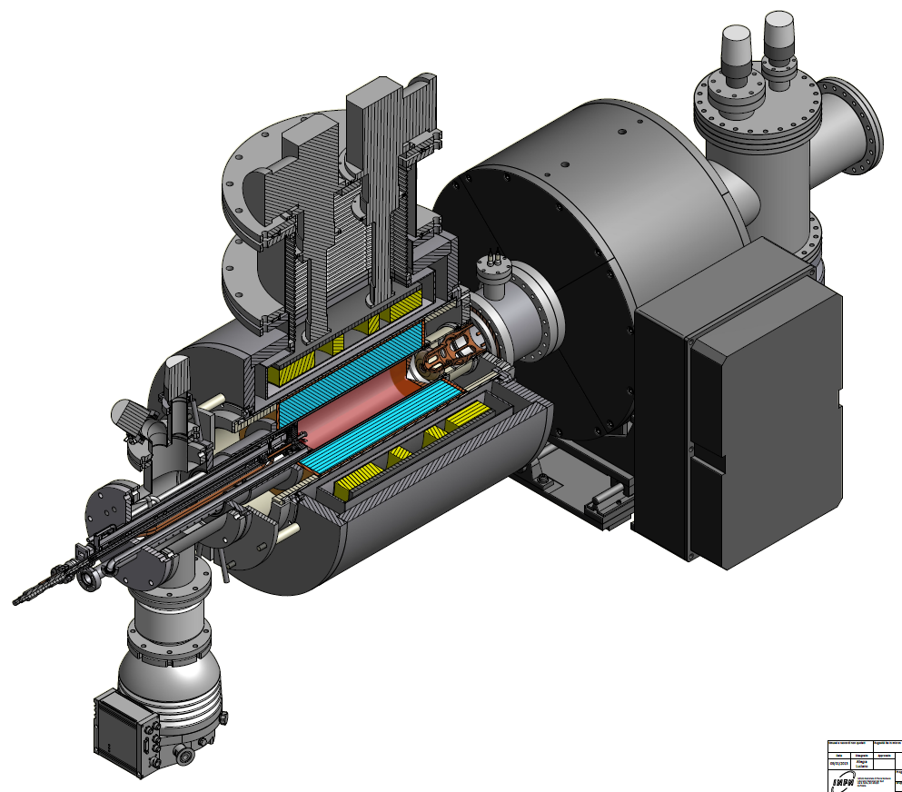
AISHA: Design Strategy
Advanced Ion Source for HAdrontherapy
  high stability and high reproducibility
  low maintenance time
  low space occupation and minimization of electrical consumption
  highly charged ion beams with low ripple
BUT…
we want to keep high performances as much as possible
Implementation of state-of-art strategies on magnetic field/RF coupling optimisation

Slide 4
AISHA: Design Strategy
Advanced Ion Source for HAdrontherapy
FINE TUNING OF ECRIS PARAMETERS ( B , f )
The CSD, the plasma density, the density distribution and the Electron Energy Distribution Function can be tuned by the magnetic field and pumping wave frequency adjustments.
The tuning of the magnetic field changes the distribution of the charge states and the temperature of the hot component of the plasma;
Evidence of plasma structure changes for slight variations of microwave frequency

Slide 5
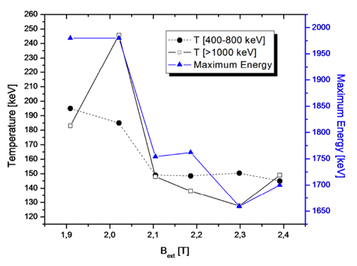
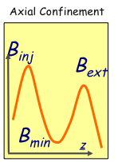
Evidence of hot electrons generation for only slight variations of the mirror ratio
[S. Gammino, D. Mascali, L. Celona and G.Ciavola, Plasma Sources Science & Technol. 18 045016 (2009)]
Spectral temperature and Emax
“jump” of T_{e}^{Spec}
The tuning of the magnetic field changes the distribution of the charge states and the temperature of the hot component of the plasma!!
Low magnetic gradients at the resonance boost the production of very high energy electrons: up to 2 MeV of γ−rays emitted in last generation ECRIS.

Slide 6
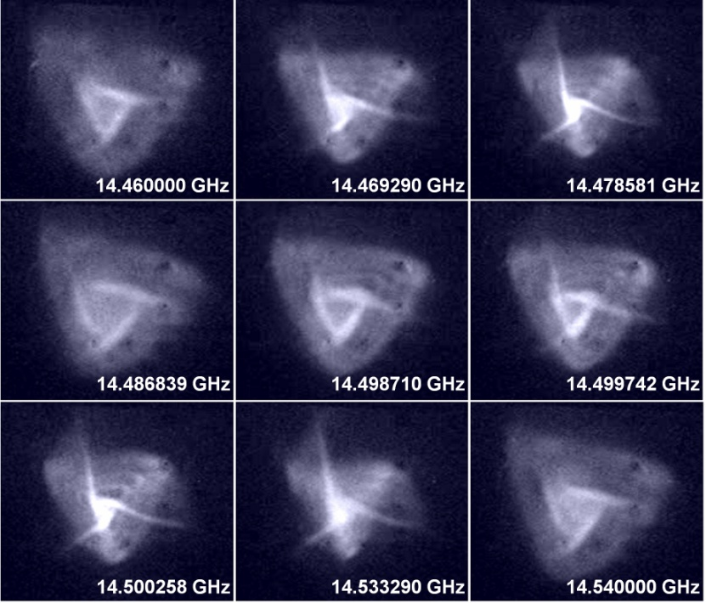
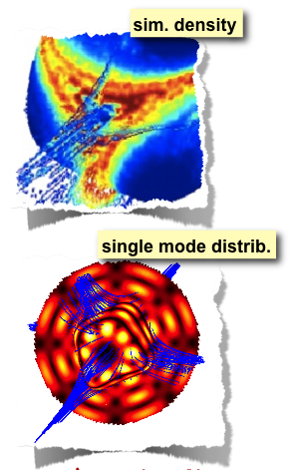
Evidence of plasma structure changes for slight variations of microwave frequency
[L. Celona, G. Ciavola, S. Gammino, F. Maimone, D. Mascali, Review of Scientific Instrument 79, 023305 (2008)]
[L. Celona, S. Gammino, G. Ciavola, F. Maimone and D. Mascali, Review of Scientific Instrument 81, 02A332 (2010)]
INTERPLAY between plasma structure and beam parameters (current, shape, brightness, emittance)
[ D. Mascali et al., Review of Scientific Instrument 87, 02A510 (02/2016)]

Slide 7
THE MAIN CLUE
The beam structure depends on
the plasma structure
Maximum flexibility on the frequency is required
  (the plasma structure changes with the cavity frequency)
Maximum flexibility on the axial B-field is requested (no matter about the radial one, it is less influent)

Slide 8



POR – U.E. funds for regional development
Regione Siciliana
Topics: Health and Life Sciences
Proponents (public-private partnership):
    Laboratori Nazionali del Sud – INFN
    Hitec2000 srl
    C3SL srl
    Unico srl
AISHa

Slide 9
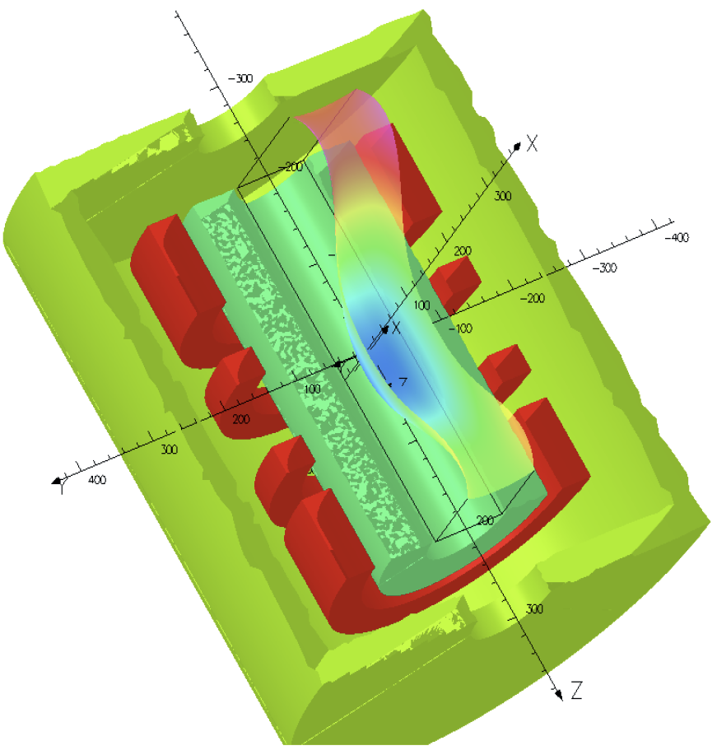
AISHA
Advanced Ion Source for HAdrontherapy
4 (SC) coils system
AISHA is a hybrid ECRIS: the radial confining field is obtained by means of a permanent magnet hexapole, while the axial field is obtained with a Helium-free superconducting system.
The operating frequency of 18 GHz will permit to maximize the plasma density by employing commercial microwave tubes meeting the needs of the installation in hospital environments.
Radial field | 1.3 T
Axial field | 2.7 T - 0.4 T - 1.6 T
Operating frequencies | 18 GHz – 21 GHz
Operating power | 1.5 + 1.5 kW (max)
Extraction voltage | 40 kV (max)
Chamber diameter / length | Ø 92 mm / 360 mm
LHe | Free
Warm bore diameter | 274 mm
Source weight | 1400 kg
Permanent magnets hexapole
AISHa

Slide 10
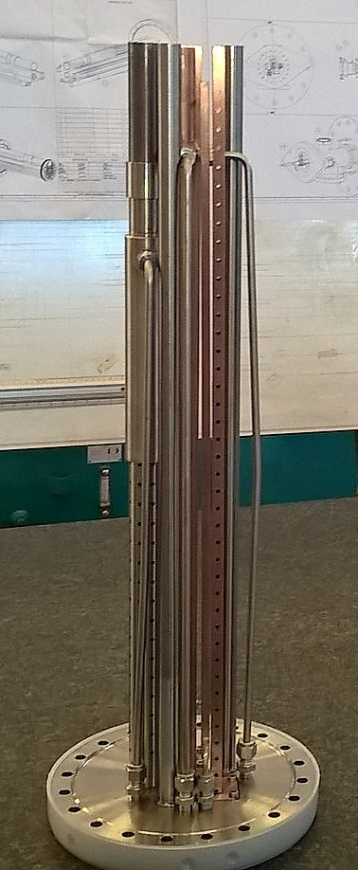
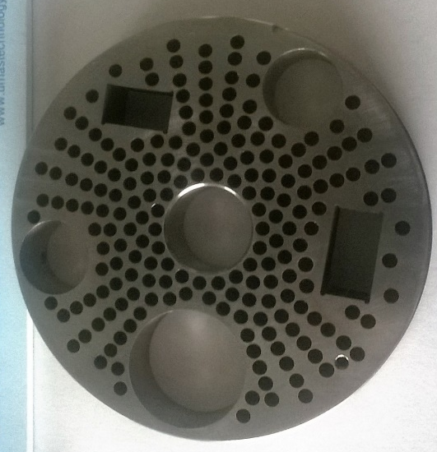
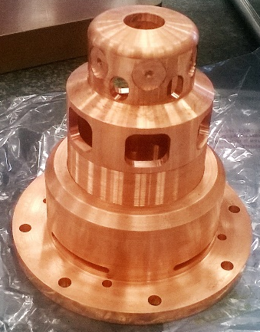
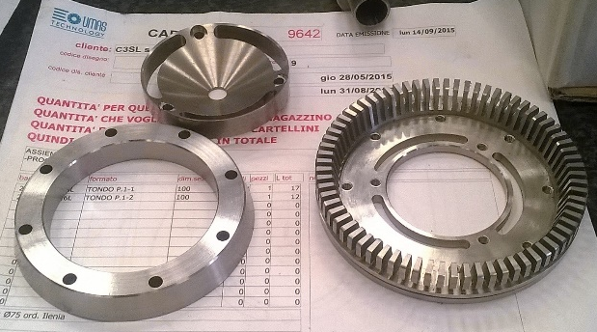
AISHA
Advanced Ion Source for HAdrontherapy
The set of four superconducting coils independently energized realize a flexible magnetic trap, which is fundamental also to test alternative heating schemes based on Bernstein waves excitation and heating in sub-harmonics.
The use of a broadband microwave generator able to provide signal with complex spectrum content, will permit to efficiently tune the frequency increasing the electron density and therefore the performance in terms of current and average charge state produced.
The chamber dimension and the injection system are designed in order to optimize the microwave coupling to the plasma chamber taking into account the need of space to house the oven for metallic ion beam production.
An adequate study of the extraction system has been carried out taking into account the production of high current and high charge states.
AISHa

Slide 11
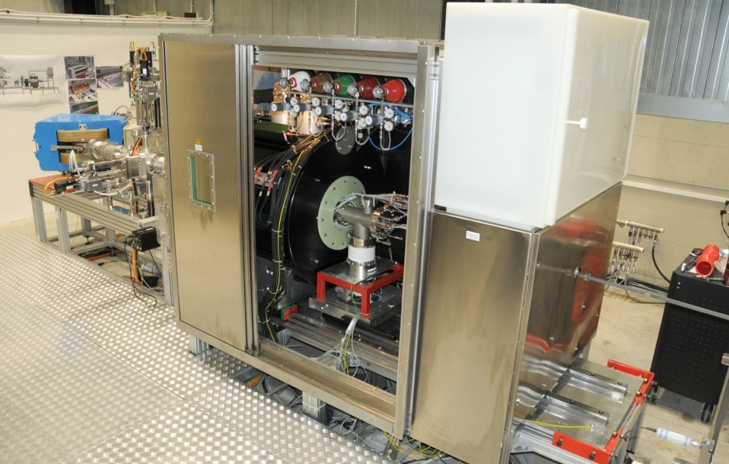
Experimental setup
AISHa

Slide 12
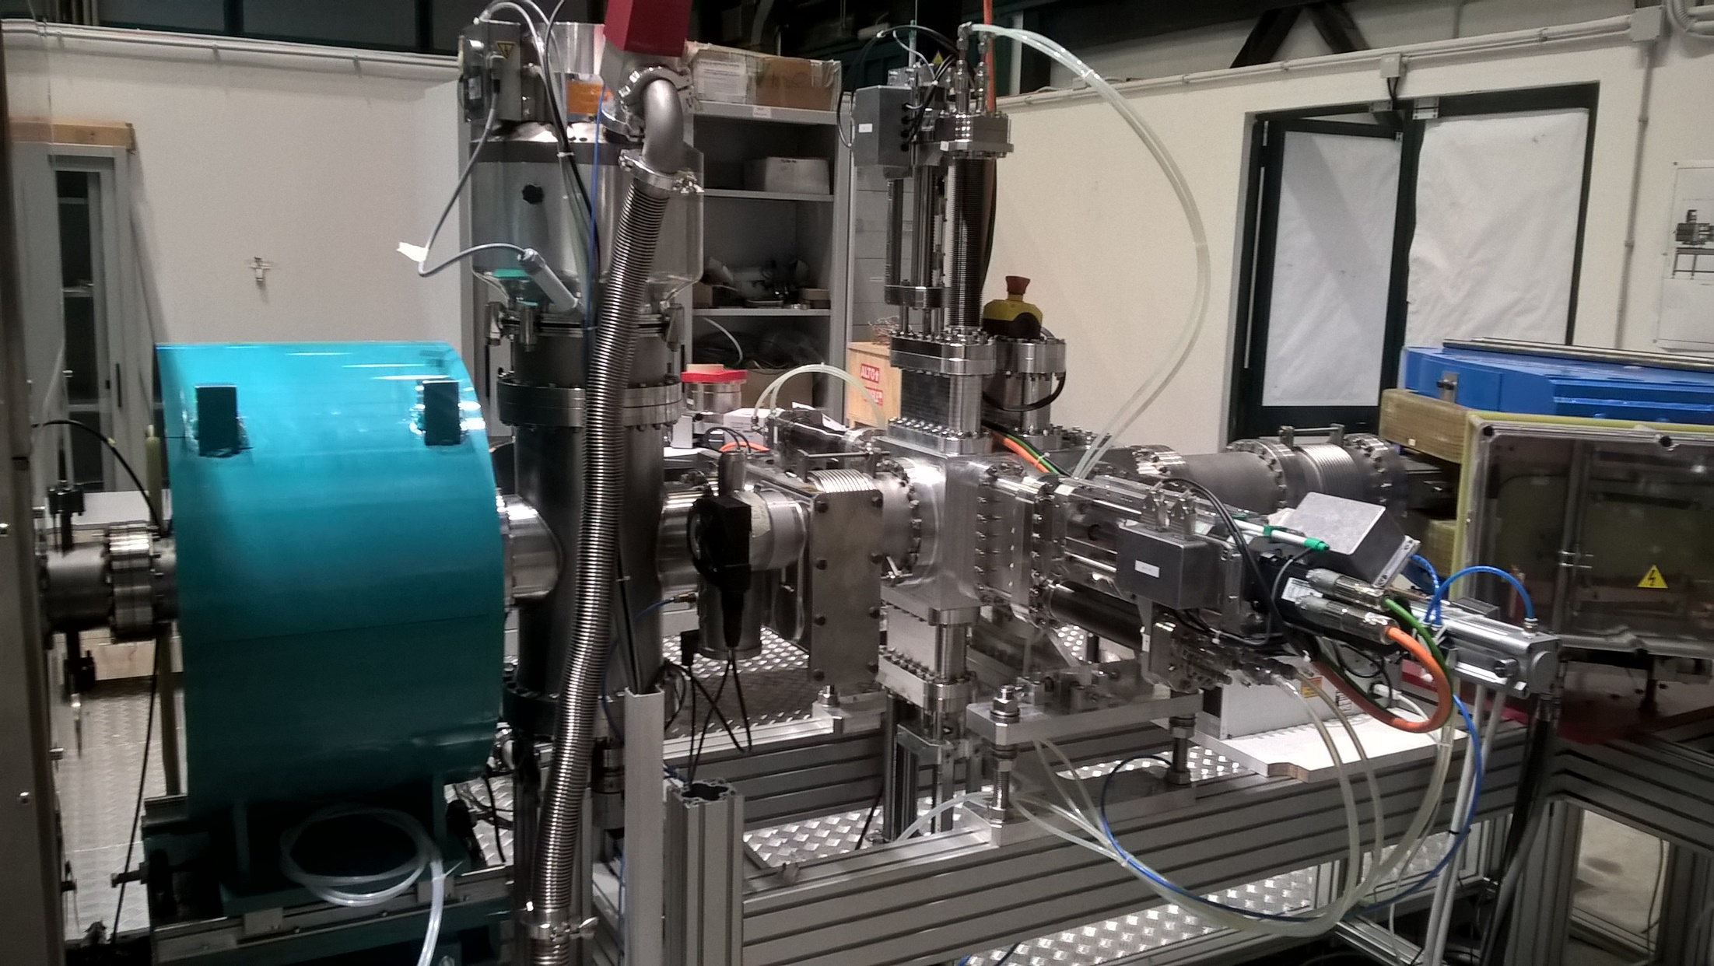
Experimental setup
AISHa

Slide 13
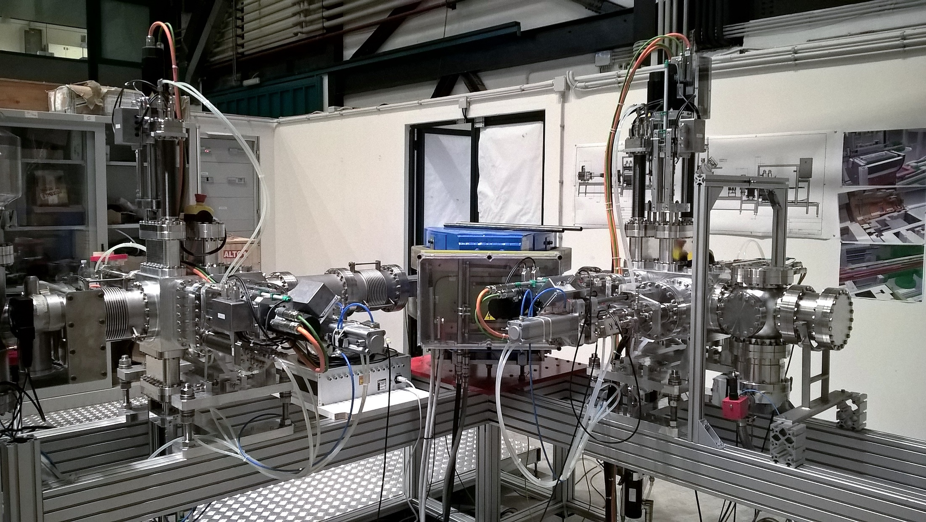
Experimental setup
AISHa

Slide 14
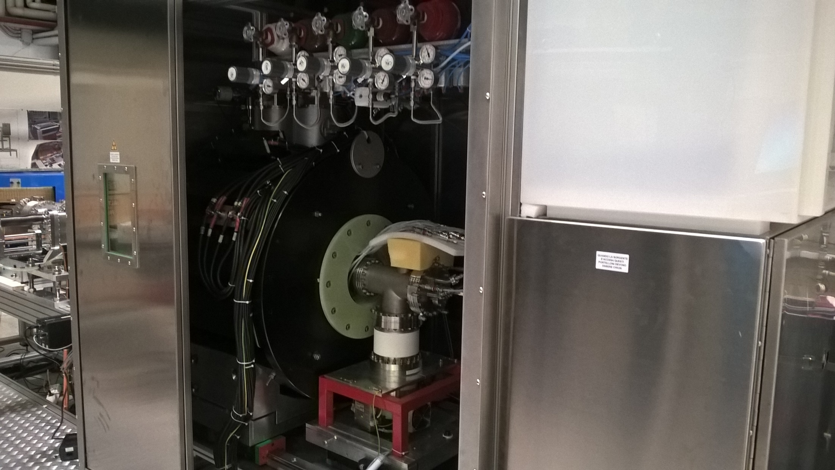
Ion source platform
New gas-box for fast tuning/switching of species during source’s operations
AISHa

Slide 15
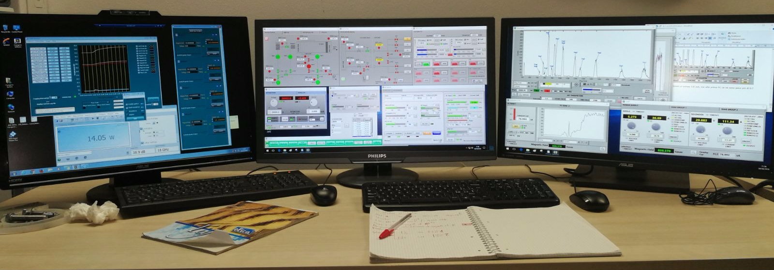
Control consolle
AISHa

Slide 16
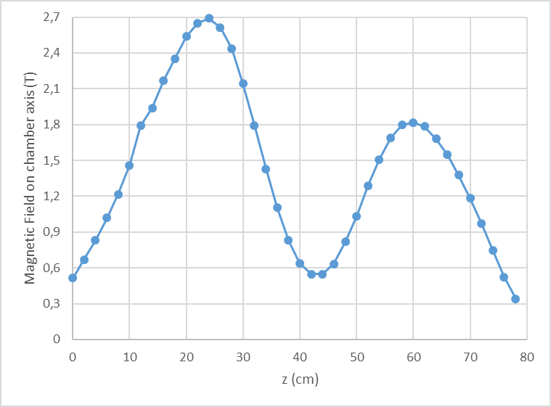
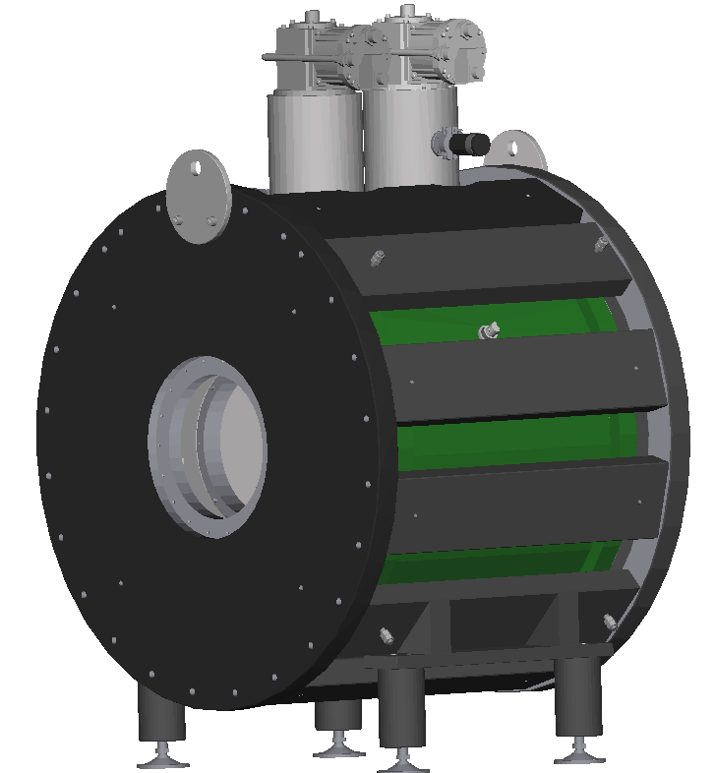
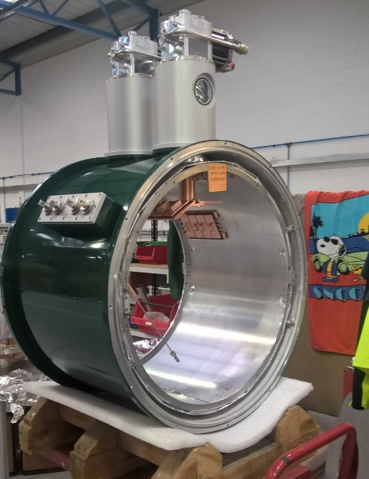
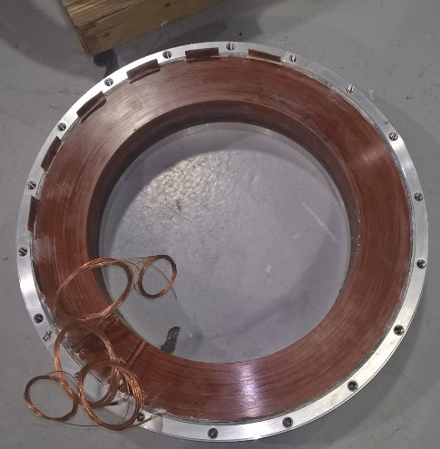
SC magnetic system assemby
AISHa

Slide 17
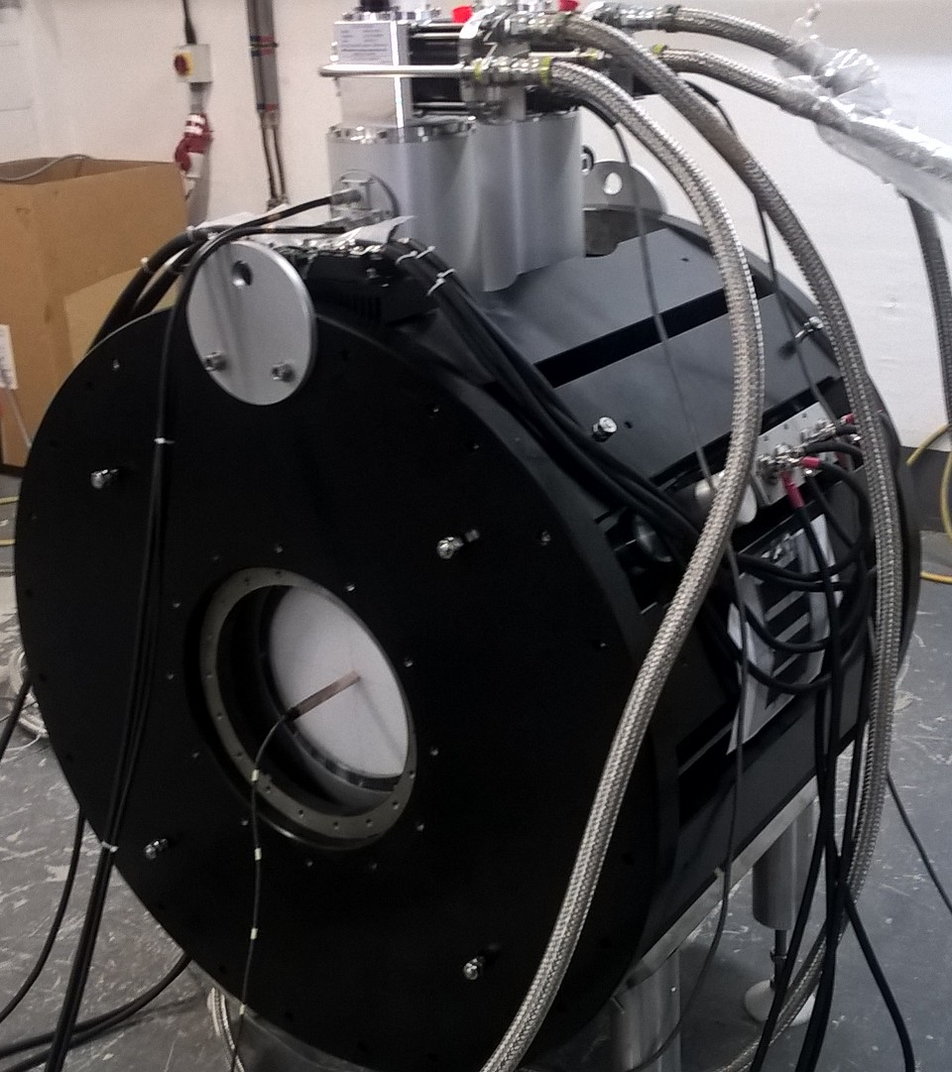
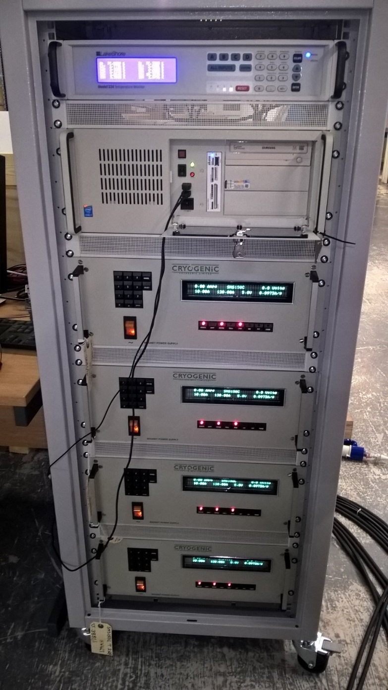
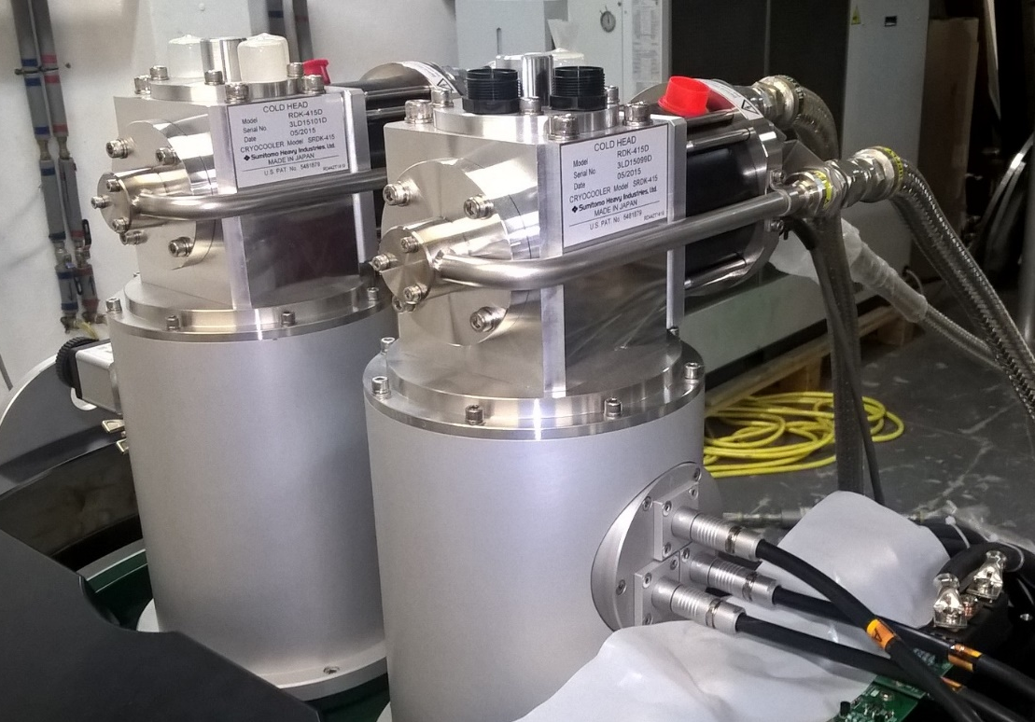
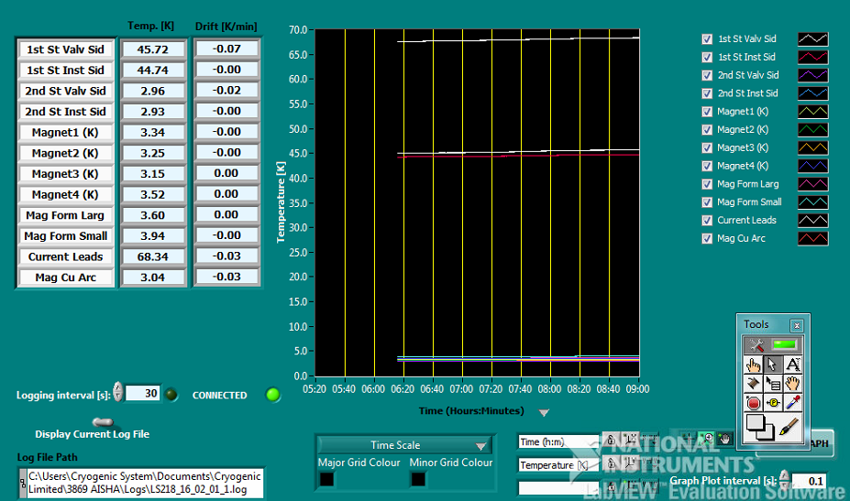
FAT Magnetic system@Cryogenic
AISHa

Slide 18
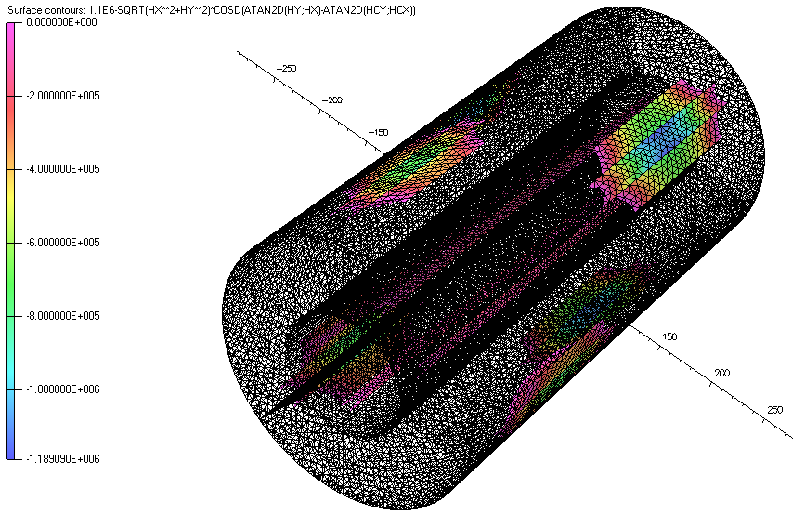
Radial magnetic confinement
Demagnetization issues
  Compact permanent magnet hexapole with new VAC compounds permits to achieve 1.3 T at plasma chamber wall at room temperature
  DEMAGNETIZATION issues
    Fields generated by SC coils can cause a local demagnetization of the hexapole. Avoided with grain boundary diffusion process!
    Temperature of external part of plasma chamber MUST be kept low to avoid demagnetization
    VAC745HR coercitivity 1.195×10⁶ A/m
    VAC677HR coercitivity 2.465×10⁶ A/m
AISHa

Slide 19
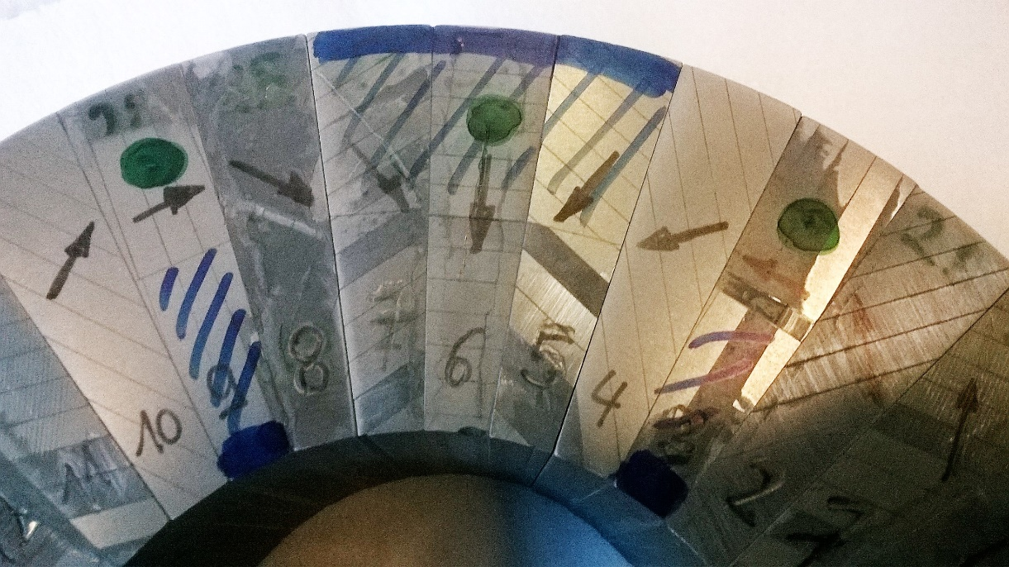
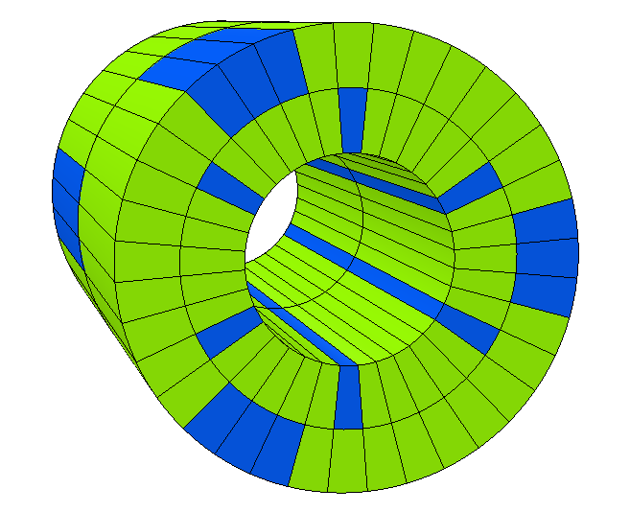
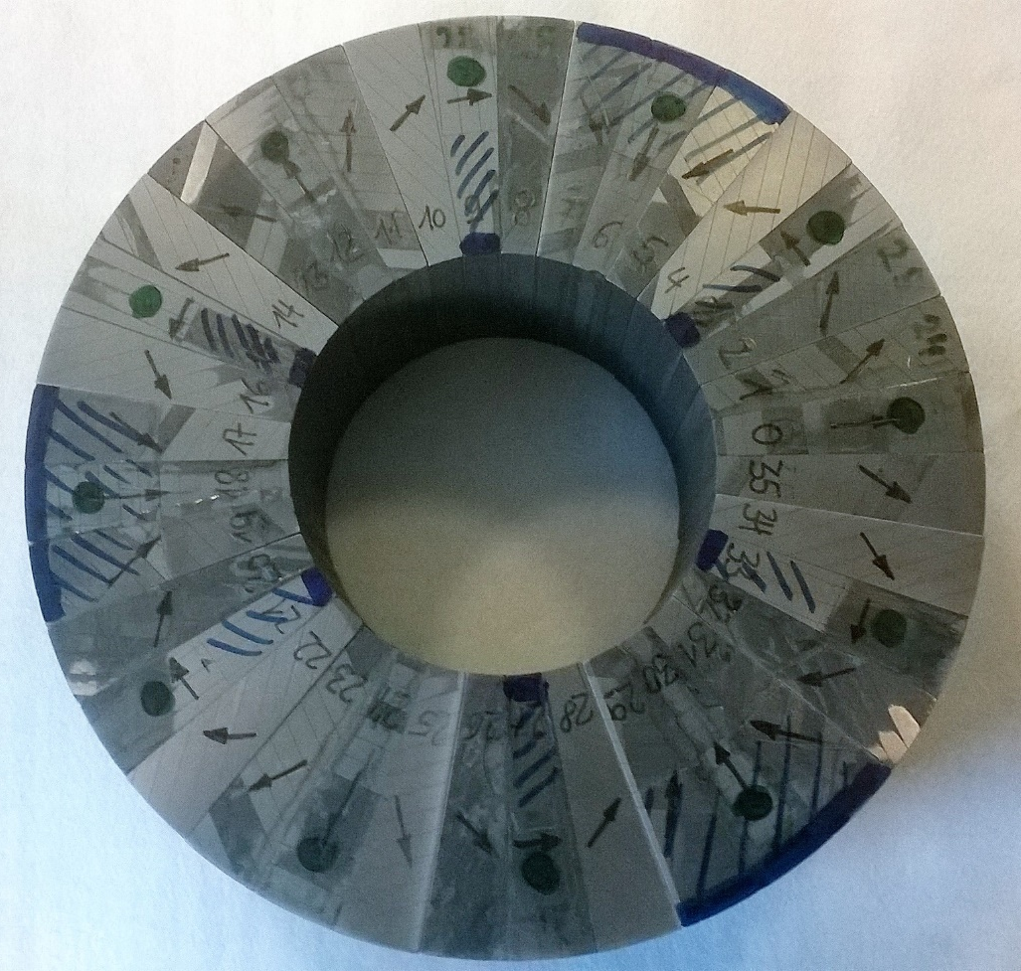
AISHa hexapole
Grain boundary diffusion process to enhance coercitivity on both materials
Green= VAC 745 HR
Blue= VAC677 HR
AISHa

Slide 20
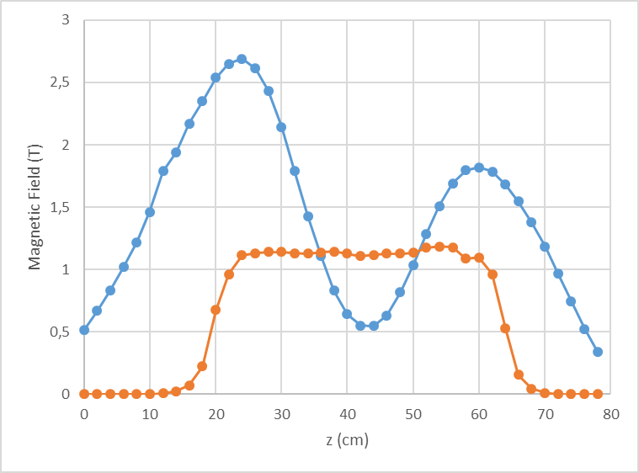
Magnetic measurements
Axial magnetic field profile on chamber axis @130A
Radial magnetic field profile on chamber wall
AISHa

Slide 21
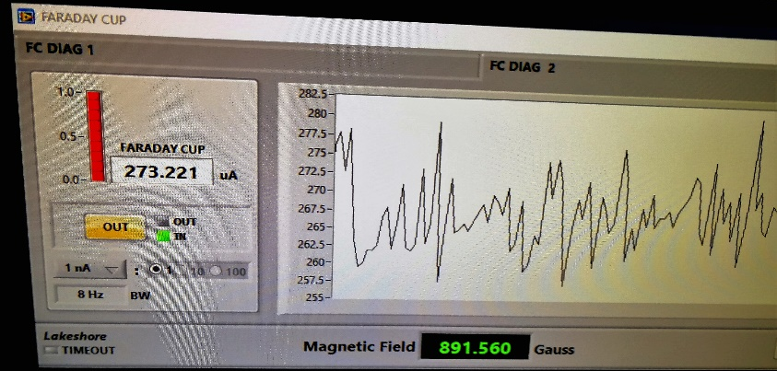
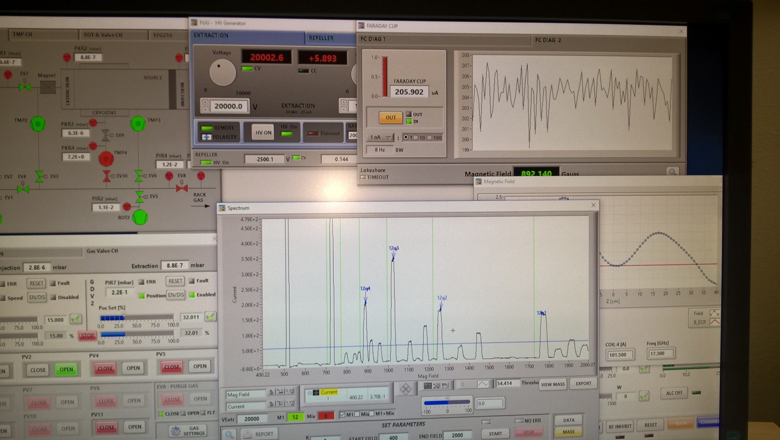
Preliminary tests: first C4+ beam analyzed in May 2017
AISHa

Slide 22
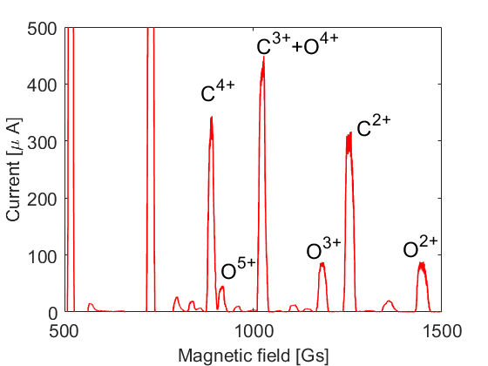
Charge State Distribution for Carbon ions (09/17)

Slide 23
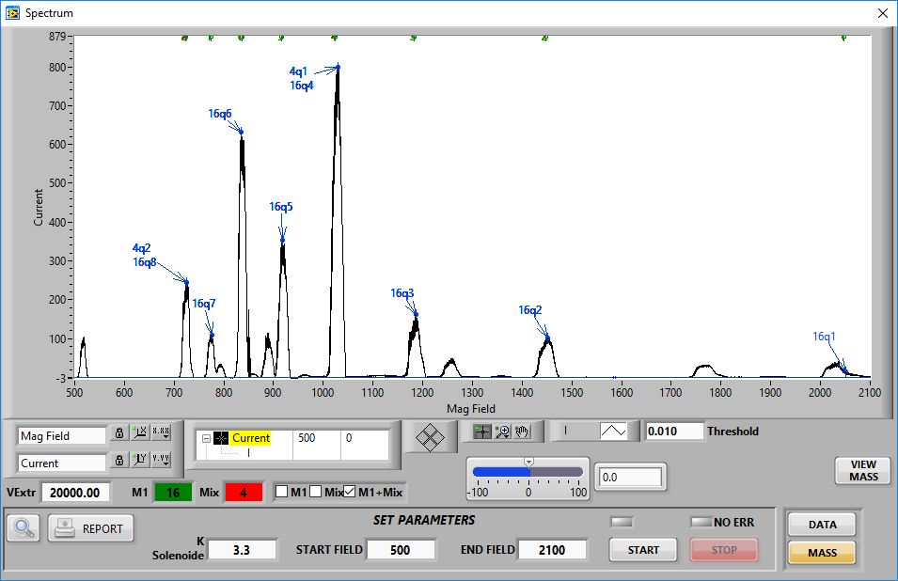
Charge State Distribution for Oxygen ions (04/18)
Vextr= 20kV
1kW@17.3GHz
He mixing
no frequency tuning
Max currents achieved:
O⁶⁺ 846 uA,
O⁷⁺ 300 uA (not optimized)
AISHa

Slide 24
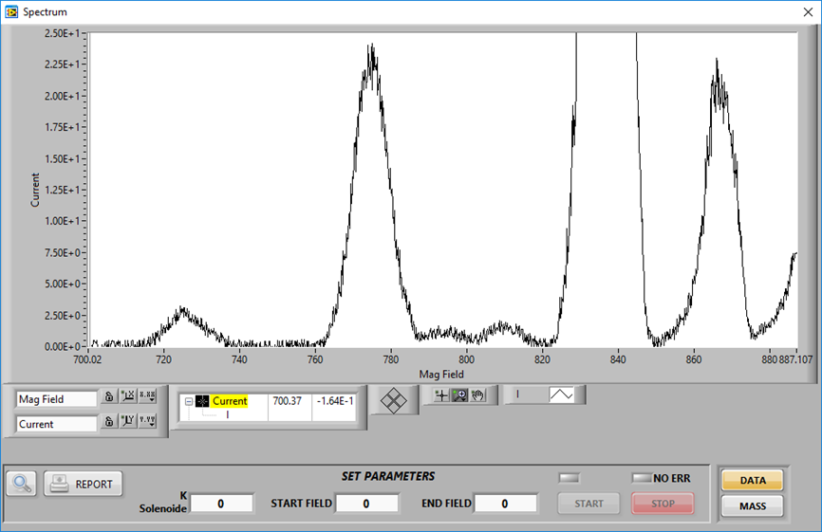
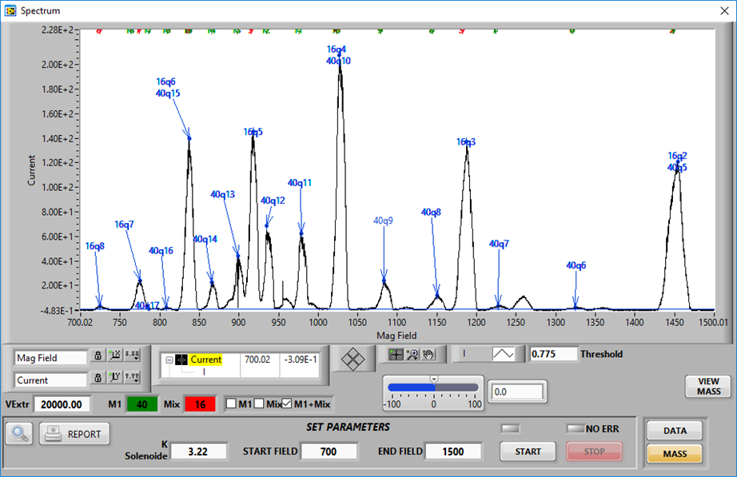
Charge State Distribution for Argon ions (06/18)
Vextr= 20kV
1kW@17.3 GHz
O mixing
no frequency tuning
Max currents achieved:
Ar¹¹⁺ 190 uA - Ar¹³⁺ 80 uA - Ar¹⁶⁺ 2 uA
Ar¹²⁺ 140 uA - Ar¹⁴⁺ 40 uA
AISHa

Slide 25
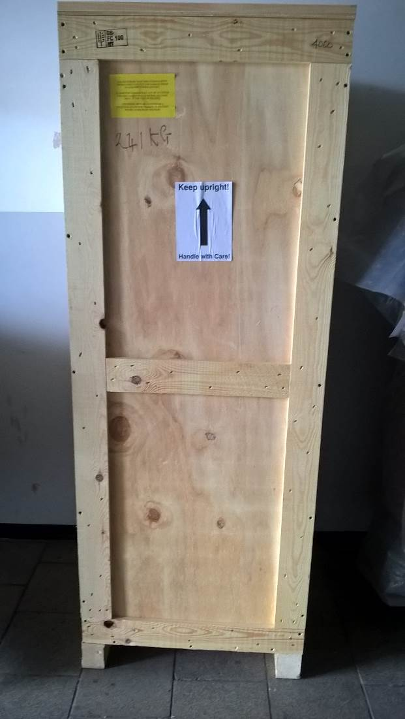
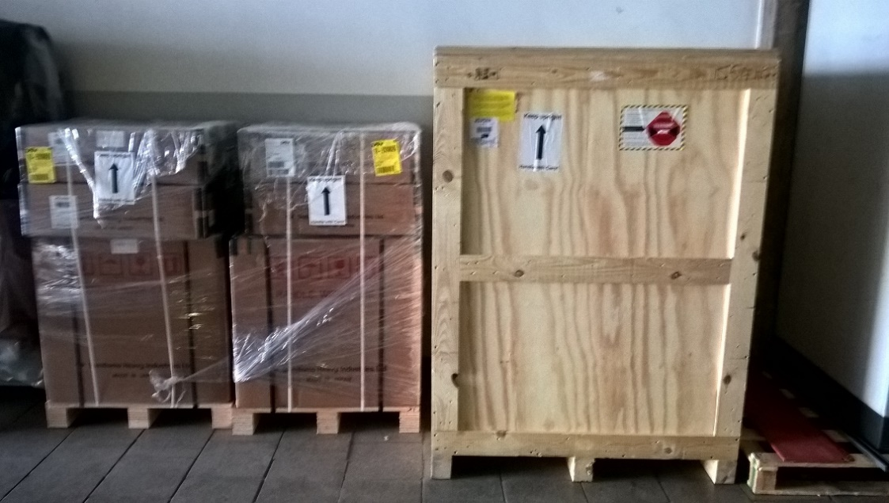
AISHa-2 in the frame of IRPT, the italian national grant for hadrontherapy
  He-free SC system and permanent magnet hexapole already purchased and delivered
  Optimized design of the entire mechanics in progressber 2017
AISHa

Slide 26
AISHa-2 in the frame of IRPT, the italian national grant for hadrontherapy
Delivery
time
Already purchased
Standard devices:
max d.t. expected
9 months
Ad hoc devices:
max d.t. expected
9 months
Standard devices:
max d.t. expected
11 months
Travels and Transports: TBD
AISHa

Slide 27
AISHa-2 in the frame of IRPT, the italian national grant for hadrontherapy
  MANPOWER:
      LNS: 1 engineer for 18/24 months
      CNAO: 2 engineers/technicians
  INSTALLAZIONE:
      Sito già definito?
AISHa

Slide 28
Conclusions and Perspectives
  First LHe free compact high performance ECR ion source;
  Commissioning and optimization will take the entire year (next beams: Xe, again C). Significant performance improvements are expected using classical techniques such as frequency tuning (on single and double frequency).
  Extraction optics and mechanics needs to be improved (beam transmission improvements), minor changes to injection side and to chamber needed. Optimized design of the entire mechanics in progress
  Software and procedures for beam emittance measurements under development in collaboration with an external company (SIATEL).
  Costs needed to finish the second source around 600 k€ + VAT
AISHa

Slide 29
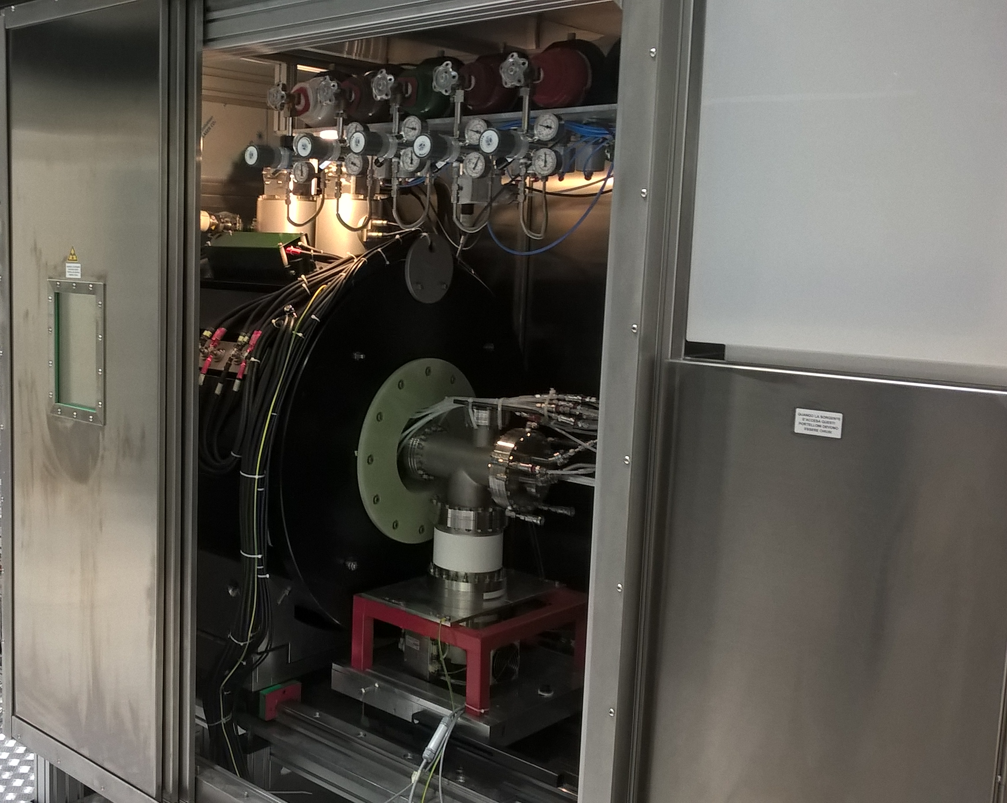
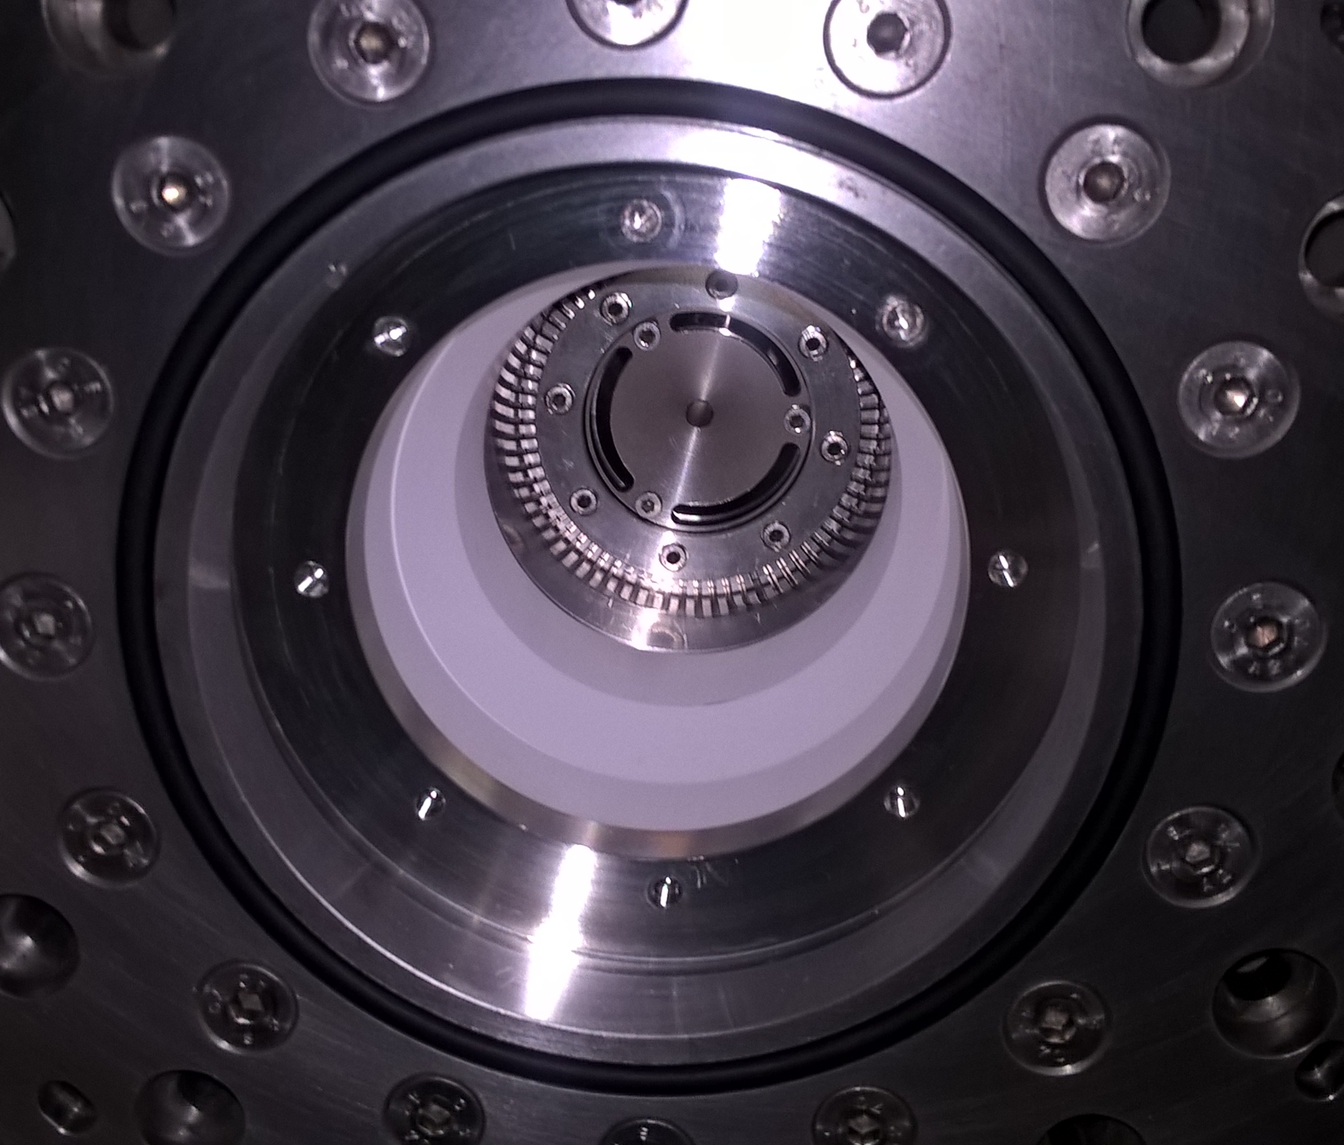
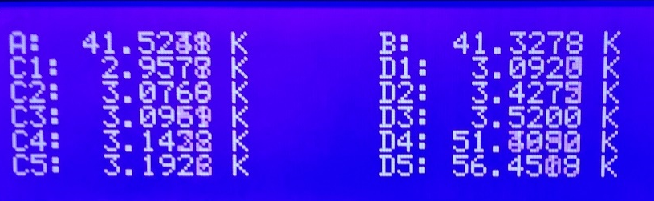
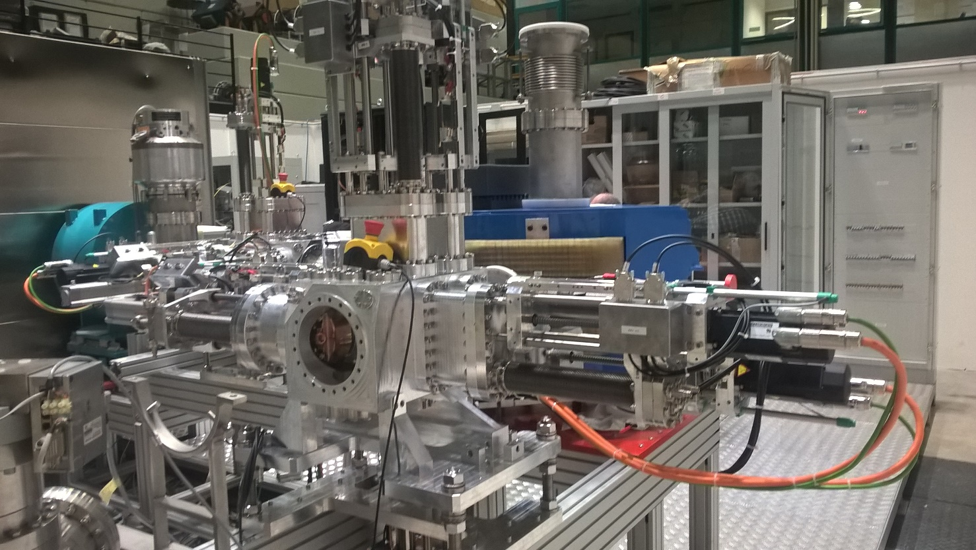
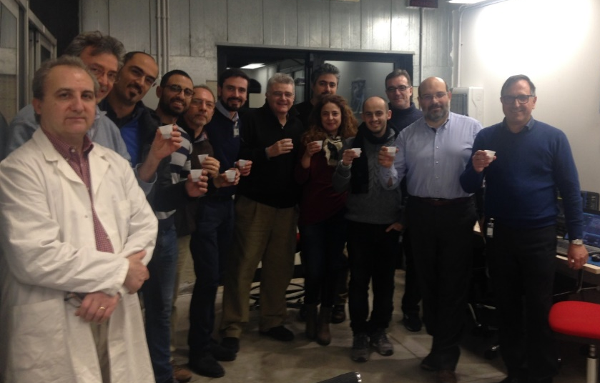
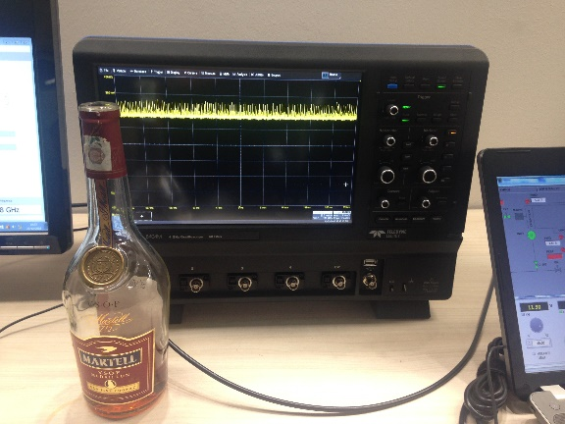
Thanks for your attention!
AISHa

