Slide 1
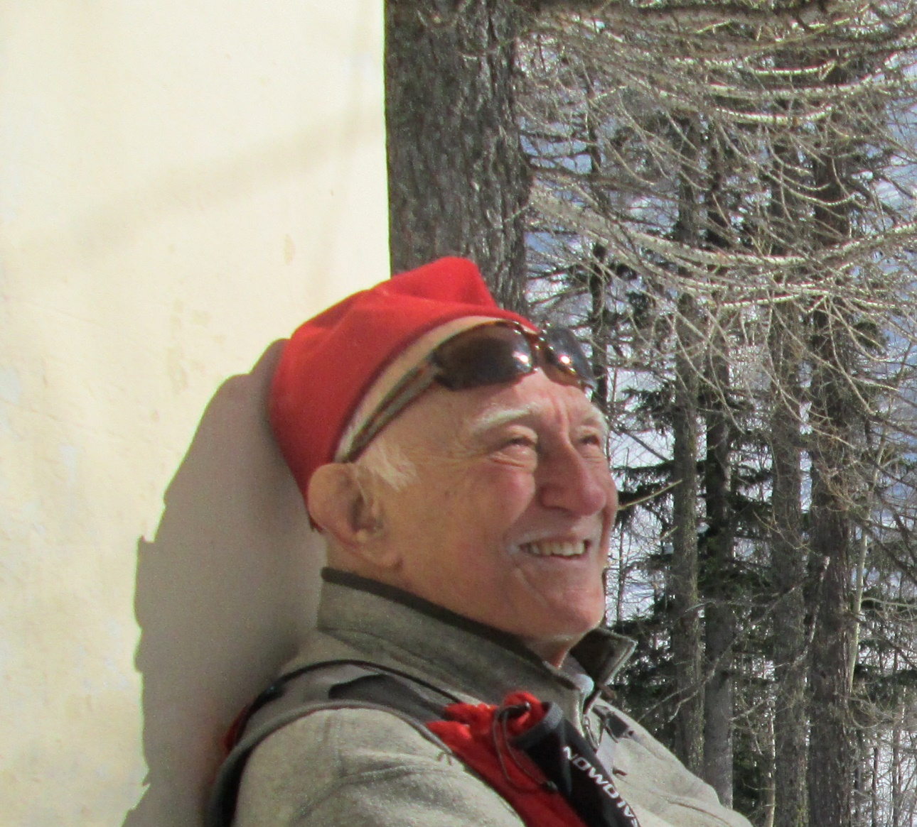
Remembering
Emilio Chiavassa
Teacher
Colleague and Friend

Slide 2
The school
«Giornate di studio sui Rivelatori»
was launched by Franco Bonaudi and Emilio Chiavassa in 1991
They took care of organizing this school for many years.
Althoug other persons took part in the organisation of the different editions, they remain the creators of this school.

Slide 3
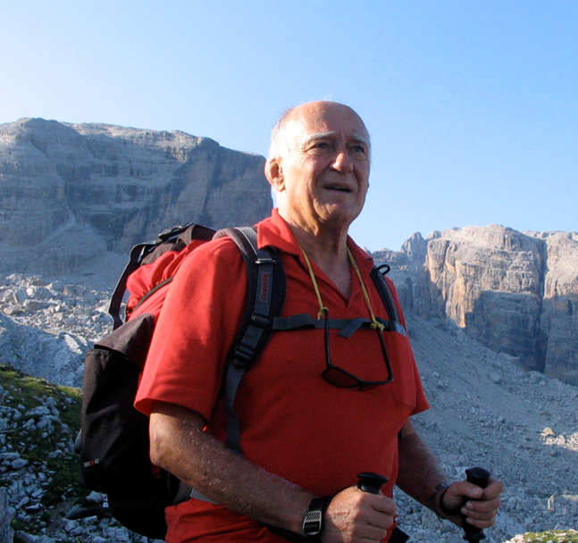
Scientific research - I
Relevant role in several experiments in the frame of INFN – CSNIII, including:
  Hypernuclei at CERN pion beams
  Pion production at CERN SC
  Antineutrons at LEAR
  Eta-mesons at SATURNE
  Heavy-ions at SPS
  Heavy-ions at LHC
Driving interest: detector and instrumentation development: from detector physics to applications
Driving concept: experimental research is carried out by a team of scientists

Slide 4
Scientific research - II
Important contributions in the organization of research activities:
  → by promoting new lines of research:
    Eta-meson physics at SATURNE
    Participation of italian teams to the SPS and LHC heavy-ion programme
  → by playing coordination roles:
    National responsible of the ALICE experiment
    President of the INFN - III Scientific Committee

Slide 5
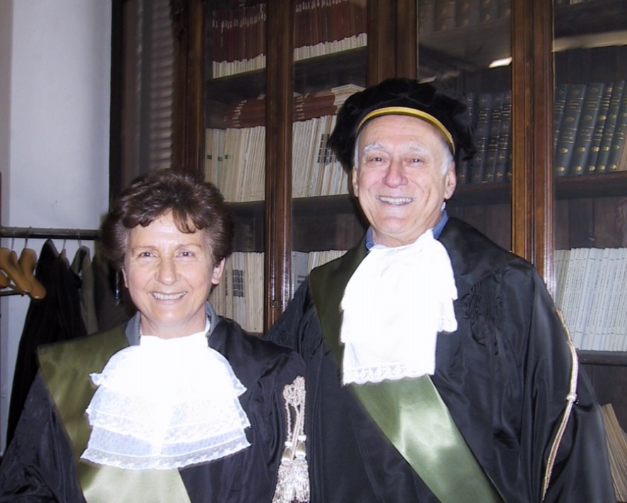
Teaching and formation activities – I
Innovator in didactics at University level:
  Thanks to his intuition, detectors (together with applications of nuclear sciences) become a topic accessible to undergraduate students for the first time at UniTo.
  «Fisica dei Neutroni» was an immediate success, attended by generations of students (some of them, are at present colleagues...)
  The very same topics are at present included in the Laurea Magistrale program.

Slide 6
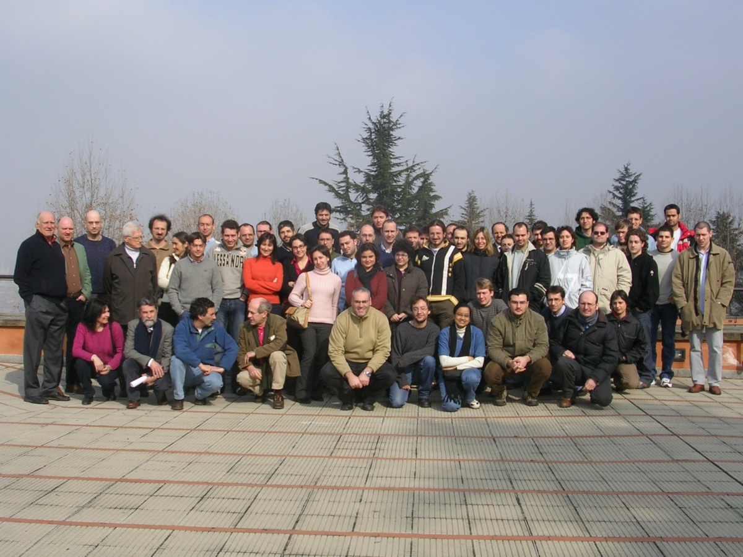
Teaching and formation activities - II
Deeply involved in the formation of graduate students:
  Giornate di studio sui rivelatori (also known as «Villa Gualino» school)
  Seminario nazionale di fisica Nucleare e Subnucleare (Otranto)
Driving concept: students and young researchers relevant!

Slide 7
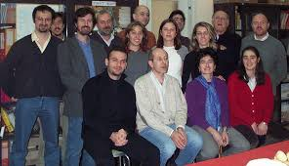
Human qualities
Uncommon capabilities
  in establishing genuine relations with colleagues, technicians and students;
  In gathering together people;
  In motivating and supporting.
Well known and appreciated both in Italy and abroad (with a special link to France)
Genuine passion for sports

Slide 8
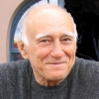
Thanks Emilio
for what you have given to all those who had the privilege to pastime with your good company
Henry VIII

