Slide 1
Getter Pumping for Particle Accelerators
C. Benvenuti, CERN (horary staff member).

Slide 2
Overview
1. What getters are:
Evaporable Getters (EG), Non Evaporable Getters (NEG)
2. NEG strips for pumping the Large Electron Positron collider (LEP)
3. NEG thin film coating for the vacuum chambers
of the Large Hadron Collider (LHC)
4. NEG coating of metal foils by a roll-to-roll sputtering machine

Slide 3
Introduction
Getters are materials able to fix on their surface gas molecules to form stable chemical compounds.
During pumping the Getter surface is progressively saturated and finally its pumping is lost.
To restore pumping
For EGs, a fresh Getter over-layer is produced by evaporation/sublimation
For NEGs, the Getter surface is cleaned by heating
Heating provides the energy needed to diffuse the adsorbed gas into the NEG bulk ( Activation).

Slide 4
EG pumping was first adopted at the end of the 1800s
(A. Malugnani and D.G. Fitz-Gerald)
During the second half of 1900s EG Titanium Sublimation pumps were widely used (including for particle accelerators)
For the last 100 years, NEGs have been the standard choice to maintain the vacuum inside sealed devices
But
Operating at high temperatures (typically 400°C) and not at pressures in the UHV range.

Slide 5
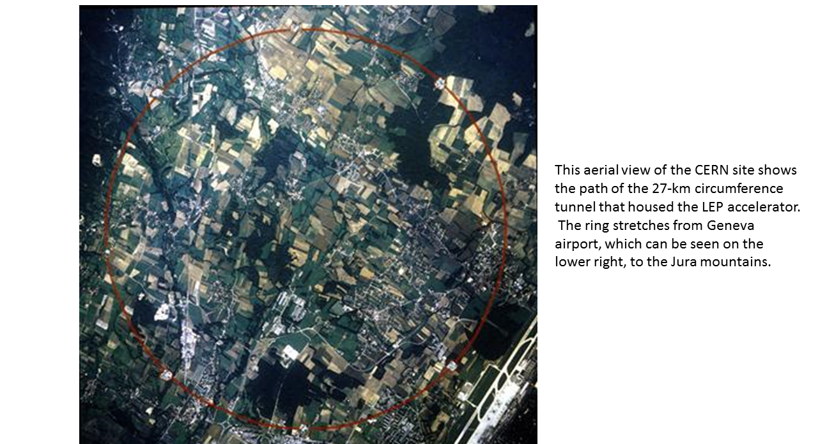
Fig. 2. LEP

Slide 6
The Large Electron Positron collider (LEP)
LEP, the largest accelerator ever built, was a circular electron-positron collider of 27km in circumference at about 100 m underground in the Geneva area. In a second phase (LEP2) the initial beam energy of 50 GeV was upgraded to about 100 GeV.
To reduce particle loss due to interactions with residual gas, UHV conditions are mandatory
To cope with the substantial degassing induced by synchrotron light, a large, evenly distributed pumping was needed
Traditionally, integrated sputter-ion pumps, making use of the magnetic field of the bending magnets, were adopted.
but
at the LEP injection energy the magnetic field was too low to ignite these pumps.

Slide 7
However,
Continuous NEG heating was not feasible and there was no experience with using NEGs at room temperature
It was not evident that the LEP vacuum requirements could be fulfilled.
Therefore, a vigorous programme was undertaken, based on both
Laboratory measurements, and
Tests in a real machine environment (Petra at DESY, Hamburg).
This led to the selected NEG:
Zr-16%Al powder cold pressed on a 30mm wide constantan strip.

Slide 8
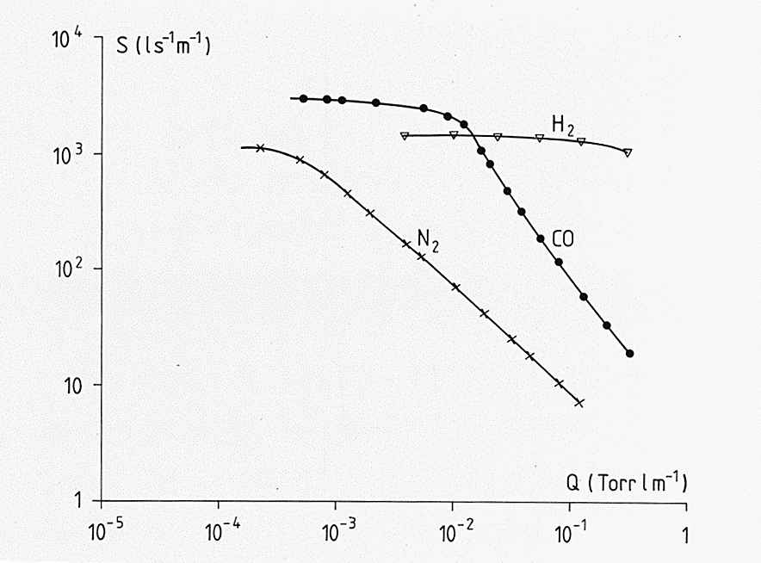
Fig.3. pumping curves of LEP NEG.

Slide 9
The results of this work showed that
The NEG strip at room temperature was able to produce ultimate pressures lower than 10⁻¹¹ torr
Due to NEG porosity, large pumping speeds could be achieved, even after pumping large quantities of the various gases
Testing at DESY showed that NEG was well behaved in the presence of circulating beams.

Slide 10
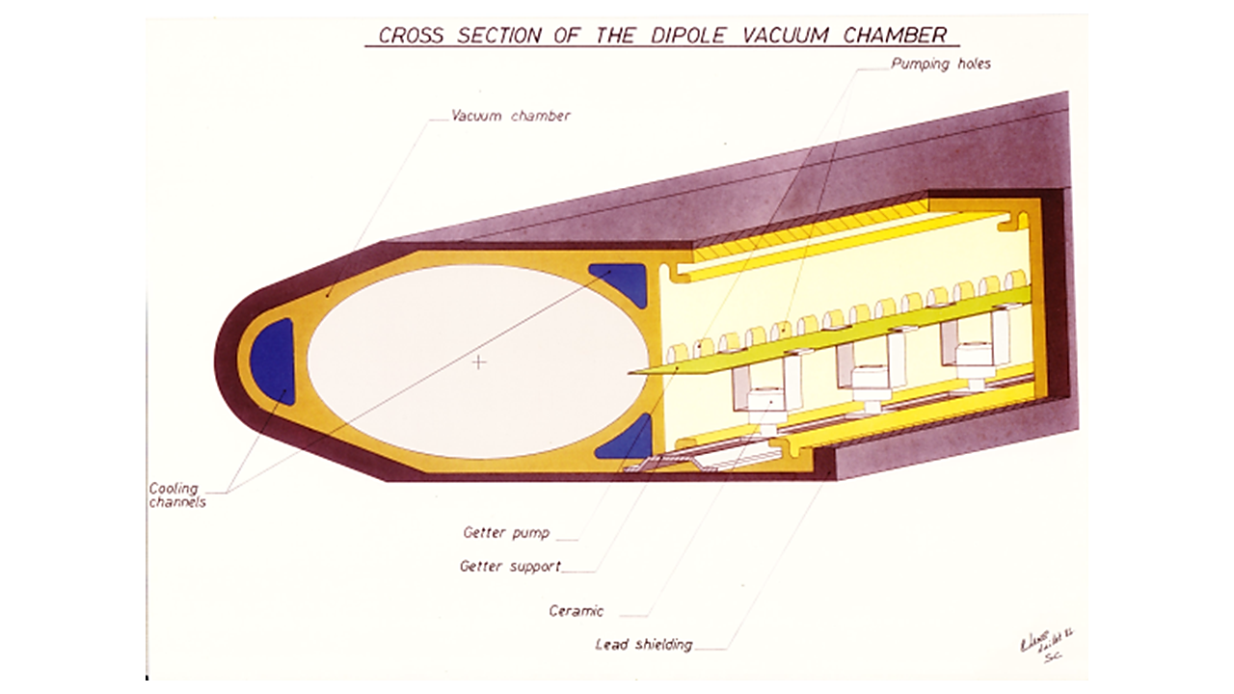
Fig. 4. The LEP vacuum chamber.

Slide 11
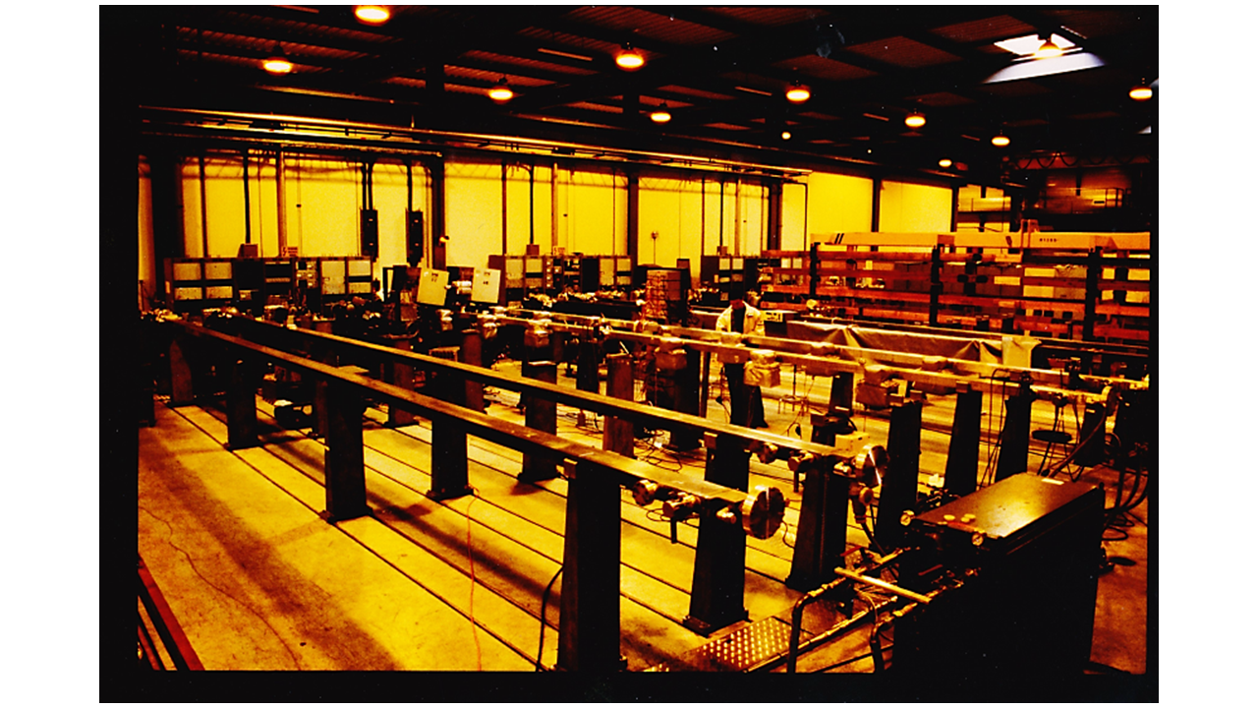
Fig. 5. Testing of the long LEP vacuum chambers.

Slide 12
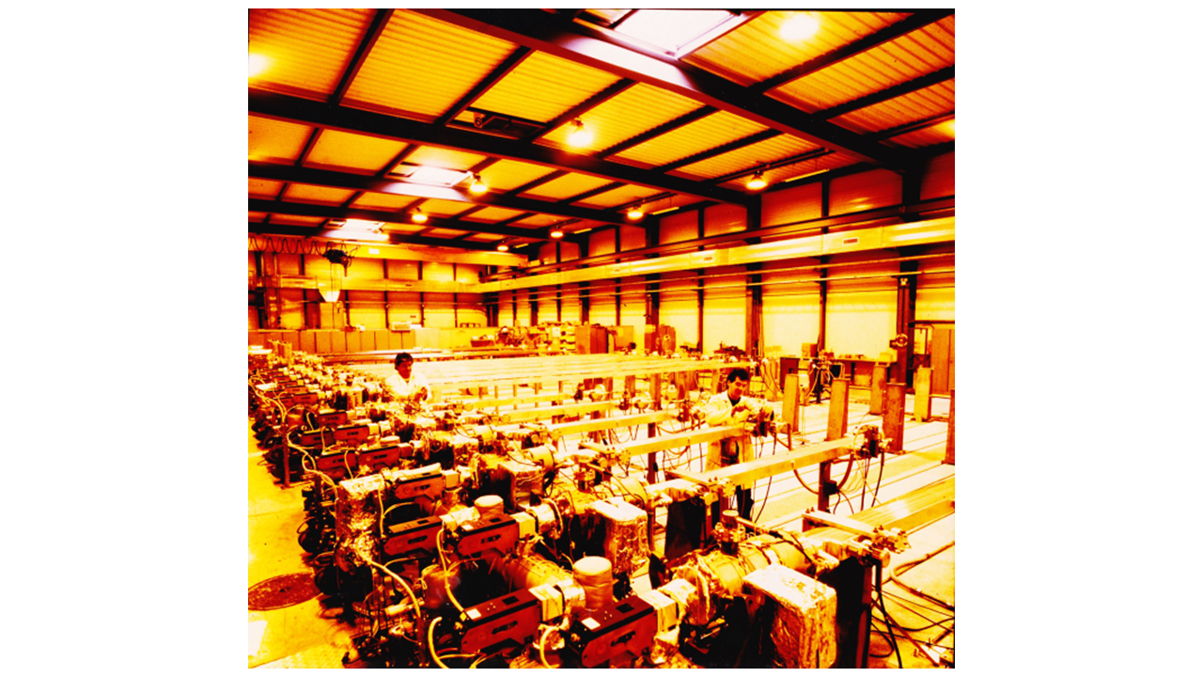
Fig. 6. Testing of the short LEP vacuum chambers.

Slide 13
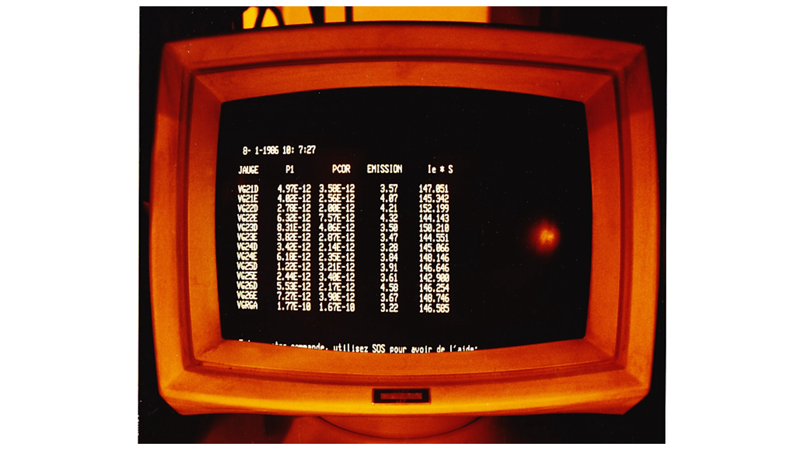
Fig. 7. Typical readout showing the ultimate pressure obtained in the LEP vacuum chamber.

Slide 14
About 2000 vacuum chambers (most of them 12 m long), equipped with a NEG strip and initially pumped by turbomolecular pumping stations, were tested in a dedicated test laboratory
The specified acceptance pressure was 2x10⁻¹¹ torr after 24 hours of baking at 150°C
Most chambers reached the 10⁻¹² torr range
The vacuum performance of LEP was fully satisfactory over the about 10 years of its operating life.

Slide 15
The Large Hadron Collider (LHC)
The LHC is a proton collider installed in the LEP tunnel. The specified beam energy is 7 TeV (or 7000 GeV)
The bending magnets, which are superconducting, operate at 1.9 K. At this temperature, the vacuum chamber becomes a gigantic cryopump, so there is no need for additional pumping
For the remaining approximately 6 km of room temperature chambers, NEG pumping looked interesting
However,
Space was not available for a LEP-type NEG pump, so
Magnetron sputtering of NEG thin film coating on the internal walls of the vacuum chamber was envisaged.

Slide 16
Important requirements for NEG coating :
Non-toxic
Non-pyrophoric
Non-magnetic
High melting temperature (cathode heating!)
Good adhesion to the substrate
Low secondary electron yield
Most important: an activation* temperature not higher than 200°C.
(*Activation implies heating the vacuum chambers, some of which, made of aluminium, would lose mechanical strength when heated above this temperature. No previously known NEG provided such a low temperature of activation)
THIN FILM NEG COATINGS HAD NEVER BEEN USED BEFORE LHC

Slide 17
The coating process
Coatings, about 1 micrometre thick, are produced by magnetron sputtering from a central cathode (a rod)
Producing cathodes of different alloys is time consuming and expensive, so
The rod cathode was replaced by inter-twisted wires of pure metal, relatively cheap and readily available
The desired alloy was obtained by the combination of the elements during the coating process

Slide 18
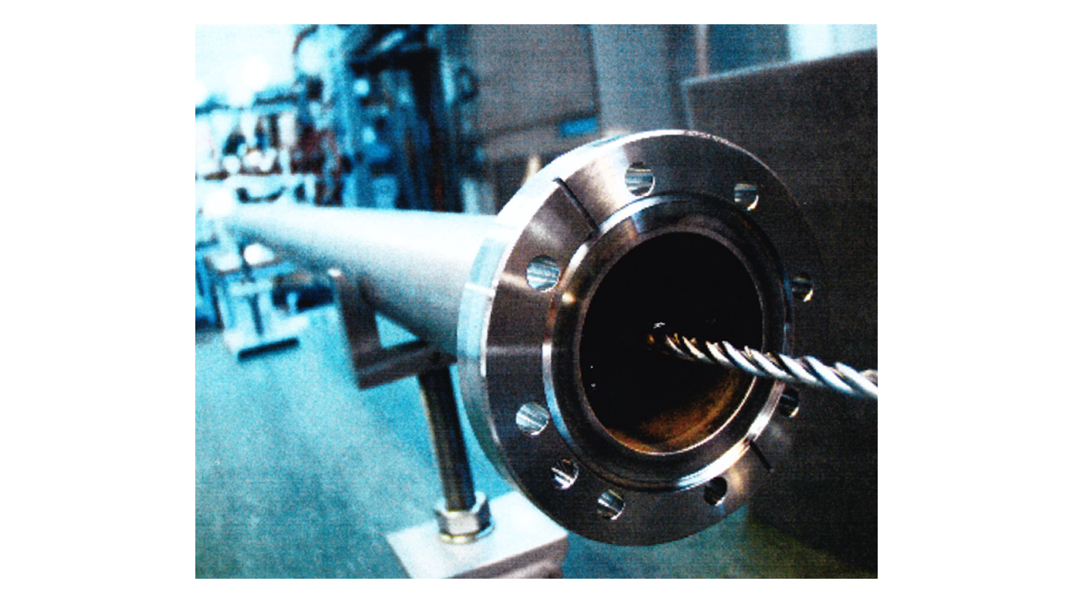
Fig. 8. Chamber with cathode.

Slide 19
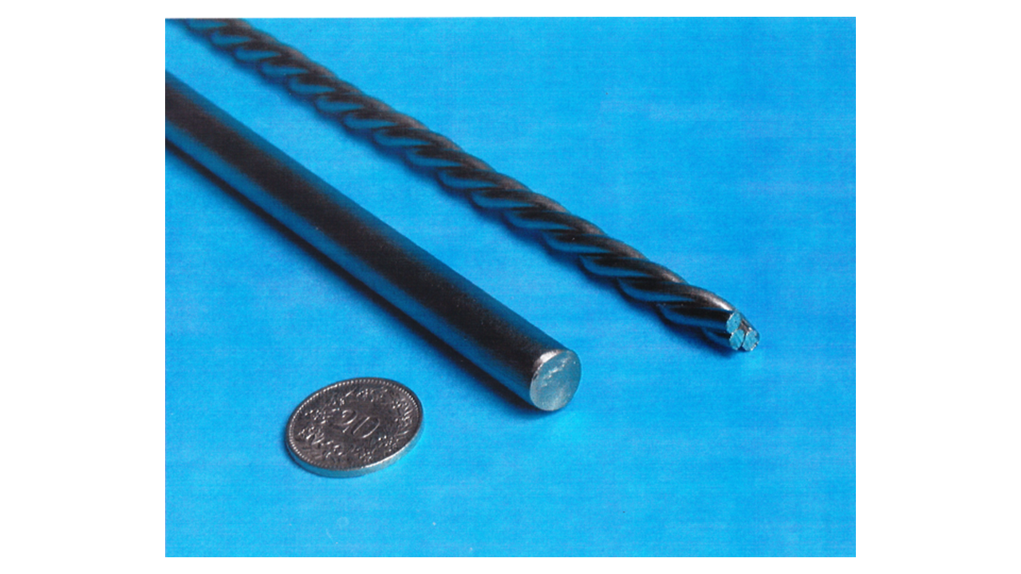
Fig. 9. Rod and twisted wires (cathode)

Slide 20
The NEG alloy
Ti-Zr was a good starting point, but its activation temperature (250°C) was still too high
Many ternary alloys, obtained by adding a third element, were studied
Finally, Ti-Zr-V was chosen (activation temperature about 180°C)

Slide 21
The LHC chambers
About 6 km of LHC circular chambers were coated at CERN
Pressures lower than 10⁻¹¹ torr were regularly achieved
Large amounts of gas, equivalent to those pumped by the much thicker coating of the LEP strip, were pumped in spite of the very small thickness of the coating
The electron production (Secondary Electron Yield) was low enough to prevent electron multiplication
NEG coatings were later adopted for other accelerators under licence of a CERN patent.

Slide 22
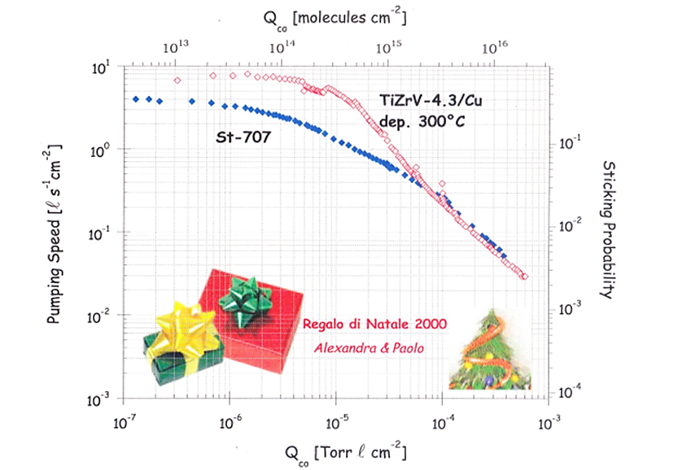
Fig. 10. Xmas gift.

Slide 23
An alternative approach
In 2005 a company (SRB Energy) was created to produce and commercialise an evacuated solar thermal collector, protected by a CERN patent.
The collector is equipped with a NEG pump, heated by the sun
The pressure inside the collector varies between HV (full sun exposure) to UHV ( cold nights).

Slide 24
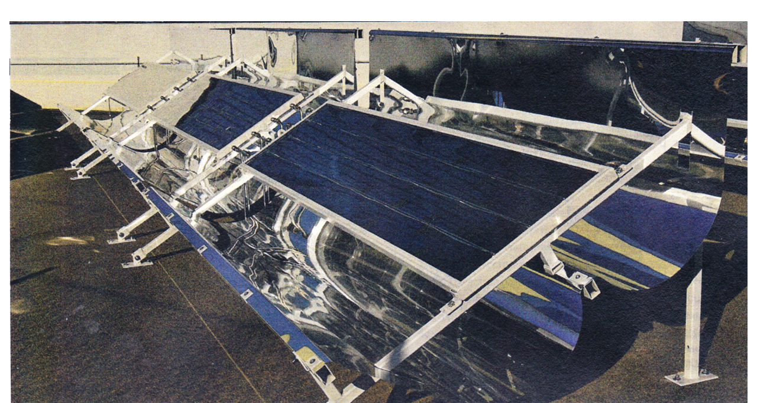
Fig. 11. The SRB solar collector.

Slide 25
The NEG is produced by a dedicated coating machine
An aluminium foil, 30 micrometre thick and 30 cm wide, is coated on both sides by two magnetrons, while moving between two rolls
About 4 m/h could be coated with a film 1 micrometre thick
The machine could coat a few hundred metres of foil without human intervention, excepted for replacing the rolls.

Slide 26
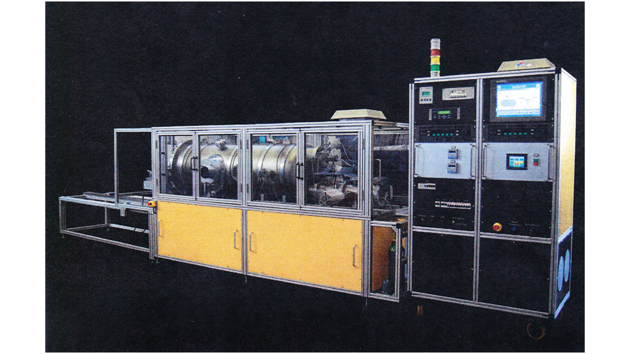
Fig. 12. The coating machine.

Slide 27
What is the relevance for accelerators?
A NEG coated foil, shaped as a liner, could be inserted in a vacuum chamber of any geometry to replace (or complement) the chamber coating.
This idea is not new, but a bent foil liner would be easier to make and more transparent to particles than the equivalent NEG strip solution.

Slide 28
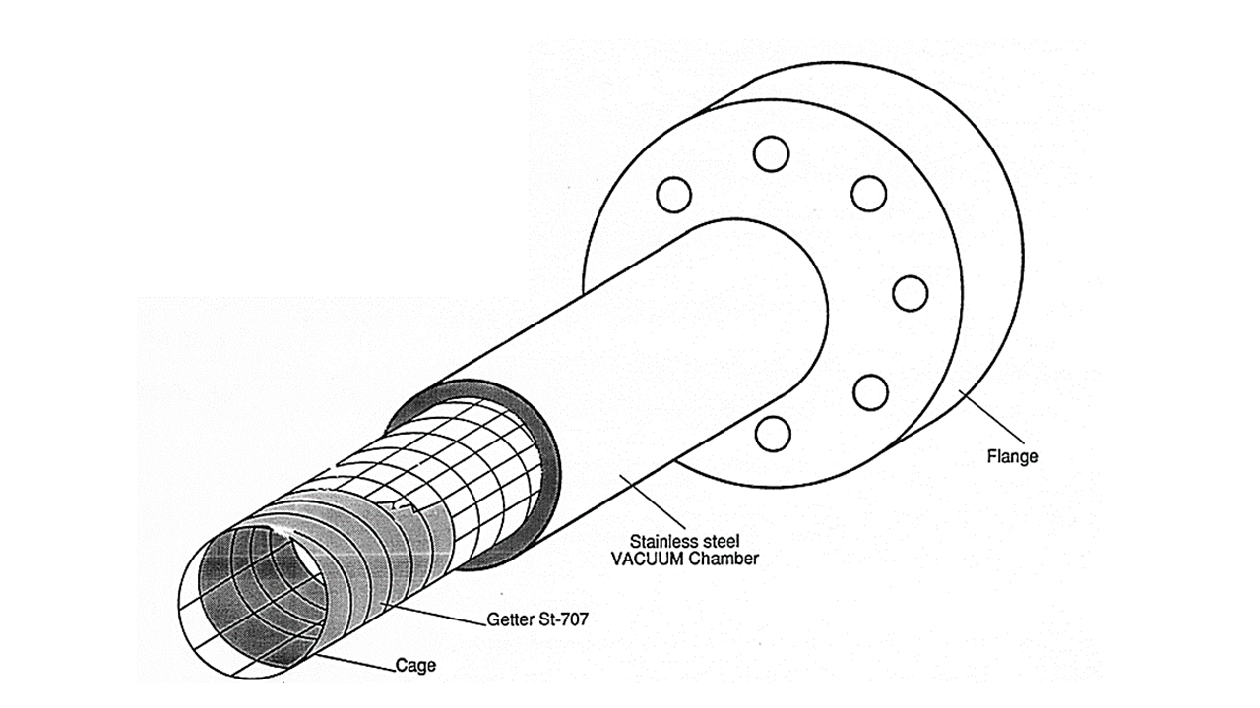
Fig. 13. The NEG strip liner.

Slide 29
Conclusions
The developments described cover a time span of about 40 years, and were possible thanks to the enthusiasm and the motivation of many clever CERN staff members
However, many important ISR innovations became later obsolete due to other technical innovations.
The careful vacuum chamber outgassing and surface cleaning are made superfluous by NEG coatings, which provide the additional bonus of a very low secondary electron yield, which prevents the build-up of electron clouds.
NEG coatings provide very large pumping speeds in a much simpler way than cryopumping.
The ISR pressure gauges are still used when very low pressures are required, as for LHC, ion traps, and the Antimatter Decelerator (AD) at CERN

Slide 30
The NEG coating technique, protected by a CERN patent, has been licensed to many companies and institutions, including
SAES Getters (now SAES RIAL) Milano, Italy
VARIAN (now AGILENT Technology), Leini’ (Torino), Italy
SRB Energy SARL, Valencia, Spain
FMB, Berlin, Germany
ESRF, Grenoble, France
DESY, Hamburg, Germany
KEK, Tsukuba, Japan
SIRIUS (Campinas) Brazil
GSI (Darmstadt), Germany

Slide 31
NEG coatings have been used in many projects, for example
ALS (Berkeley), APS (Argonne), CESR/CHESS (Cornell), NSLS and RHIC (Brookhaven) in the United States
Elettra (Trieste), SOLEIL (Orsay), ALBA ( Barcelona), SLS (Villigen)
Petra-4 (Hamburg), FAIR (Darmstadt), KATRIN (Karlsruhe) MAX-4 (Lund)
Diamond (Oxfordshire), BESSY-2 (Berlin), SOLARIS (Cracow), ELENA (CERN)
PUMA (CERN), SESAME (Amman), Australian Light Source (Melbourne) etc.
In all, about 50 synchrotron light machines on 4 continents have adopted the NEG coating technique.

Slide 32
NEG coated strips have also been used to pump large tanks for experiments, e.g. Katrin
10 m diameter tank for the spectrometer of the Katrina experiment at KIT, which measures neutrino mass by studying the electron spectrum from tritium decay

Slide 33
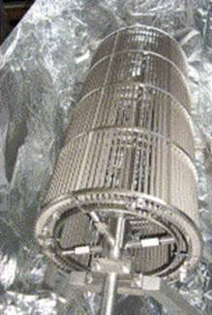
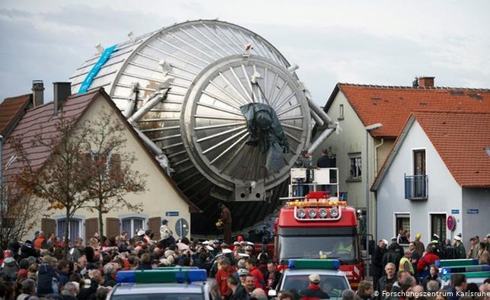
NEG strip module for Katrin spectrometer
Tank for Katrin experiment during transport to Karlsruhe

Slide 34
Finally
A more detailed description of some of the various projects cited in this talk may be found in the recently published book
Technology meets Research

