Slide 1
FOOT Physics Performances 24 Oct 2018 Introduction
G. Battistoni

Slide 2
Outline
Towards the next Collaboration Meeting:
Update of the design of the magnetic setup
Organization of a new production of simulated data
About software development
Towards a future Biophysics Network
Today’s agenda

Slide 3
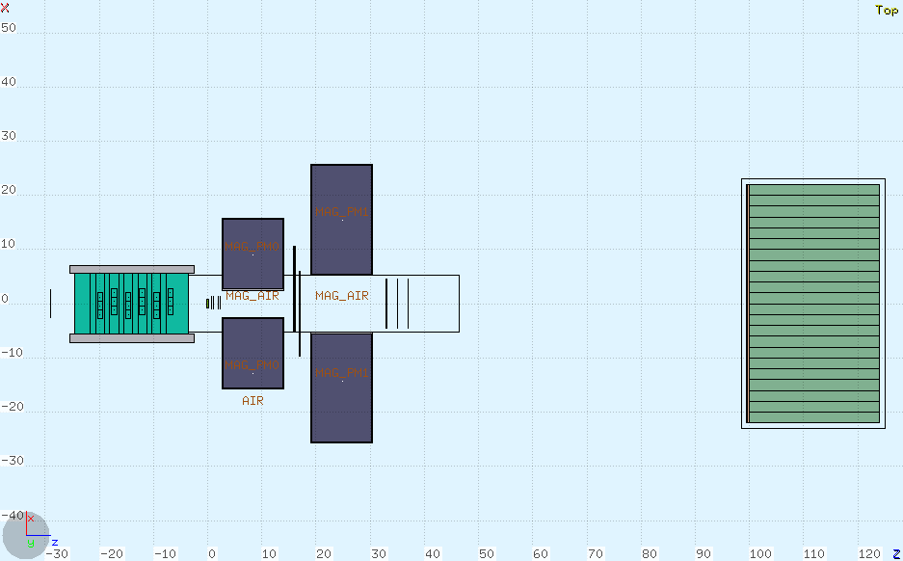
New Design of Magnet System
By C. Sanelli & E. Spiriti @LNF
Following the discussion post Elba Meeting
two different magnets, each one 11 cm long
Magnet 1:
Internal diam. 5 cm
External diam. 31 cm
Magnet 2:
Internal diam. 10.6 cm
External diam. 51 cm
5 cm gap
Simulation Version now becoming V15

Slide 4
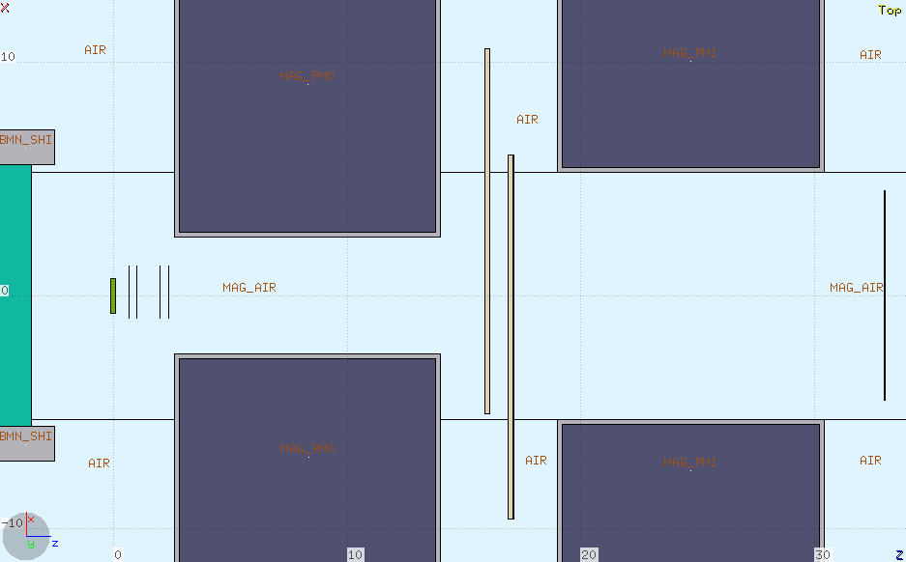
New Design of Magnet System
Target at 3 cm
from magnet 1
10° aperture
B_{peak 1} = 13 kG
B_{peak 1} = 8.7 kG
B*L = 0.316 T*m
Repulsive force between the 2 magnets is ~2000 N !!

Slide 5
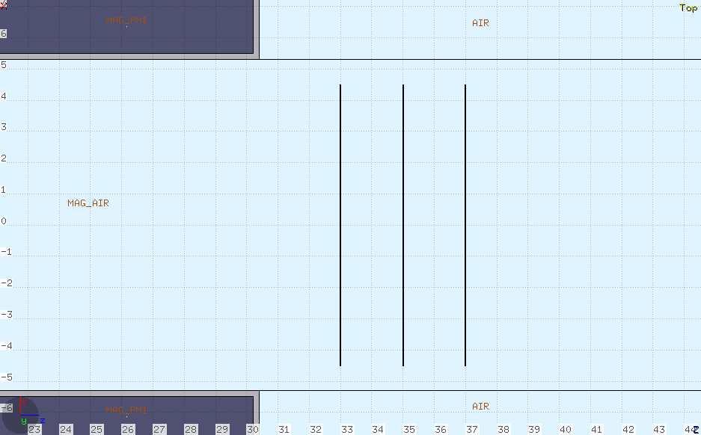
New Design of Magnet System
The size of MSD is smaller than 10.6 cm…
We have to optimize the distance of MSD from the exit of Magnet 2:
As close as possible!

Slide 6
New Design of Magnet System
Actual design of magnetic blocks (SmCo-2:17)

Slide 7
New Design of Magnet System
Magnetic field (B_{y}) map along the central axis

Slide 8
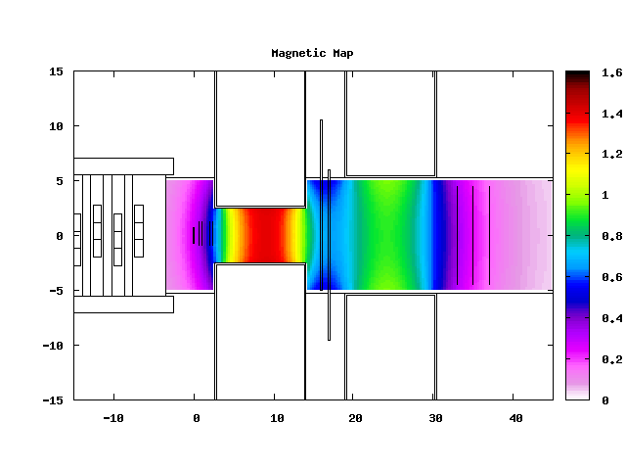
New Design of Magnet System
Magnetic field (B_{y}) map along the central axis

Slide 9
New Design of Magnet System
Longitudinal component (B_{z}) along the central axis
Responsible of the repulsive force between the two magnets.

Slide 10
Organization for a new production in view of next Collaboration Meeting
The new V15 geometry + map is being checked. This should become now the reference version of Simulation setup.
A dedicated SHOE branch should be prepared
The team has to be organized now
Main focus at short time: p resolution and related Analyses (like Roberto’s ones)
Next steps:
Among many other things: a full exercise to achieve a full-chain analysis for the measurement of pN cross sections ha to be implemented and carry on (repeating at higher level the exercise performed by Naples months ago)

Slide 11
Some issues left from the previous meeting
The management of geometry by means of SHOE is working but appears to be somewhat complex and clumsy… Can it be improved?
There are now too many different versions of Simulation setup. There are now a lot of different SHOE branches
How do we proceed toward a good merging and management of work organization?
How do manage to have an ordered bookkeeping of simulation production? This would become particularly urgent in view of future work which will be possibly divided among different people in different places

Slide 12
In parallel: a dedicated software group
Software Meeting (Technical):
16 November
Conveners: A. Sarti, C. Fink, M. Franchini

Slide 13
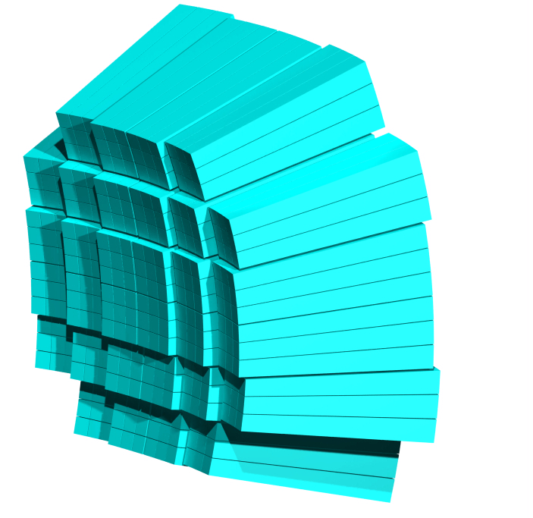
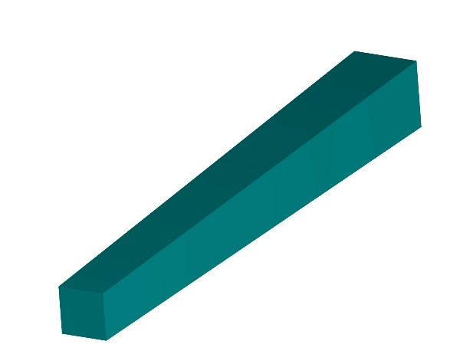
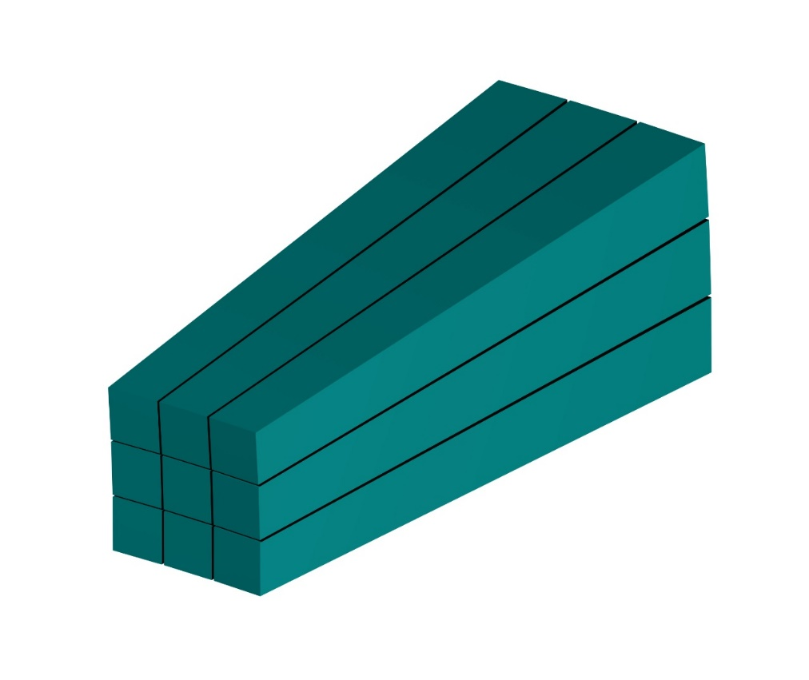
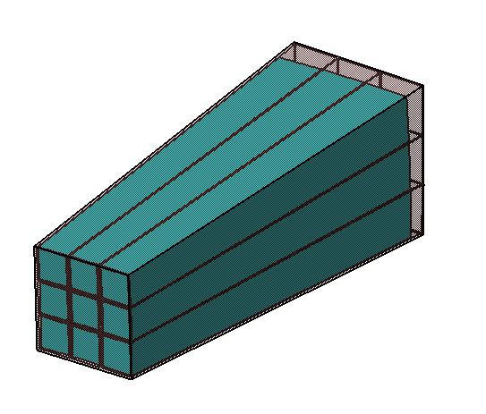
Yet to be done!
arrangement of 32 modules
1 plastic box design
Module definition
Plastic box
Matrix 3x3 crystals
Calorimeter Modules layout

Slide 14
Towards a new Biophysics Network

Slide 15
Towards a new Biophysics Network
In spite of the central role that GSI will have, because of FAIR, they are very open, actually searching for, international collaborations.
This meeting at GSI is a timely opportunity to think the possibilty of a real enlargment of physics program, in case also with correlated extension of the collaboration.
We have to figure out a possible evolution for our physics program and (maybe) of our detector (a starting point could be the FOOTnote project focused on the neutron measurements)
Our main focus must be on the exploiting of the present physics targets, but it could be crucial to arrive at the GSI may meeting with a sound idea about our future, so to have the chance to widen our role in the international community

Slide 16
Today’s Agenda
https://agenda.infn.it/conferenceDisplay.py?confId=17182

