Slide 1

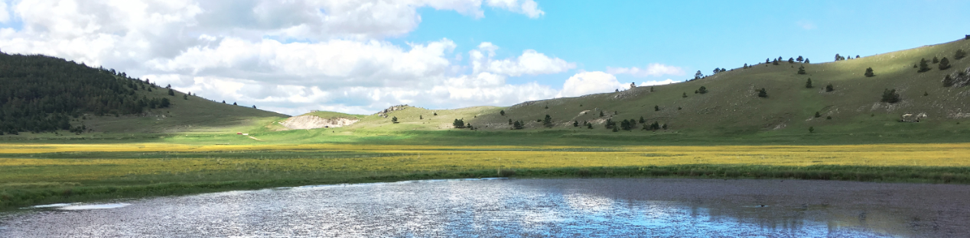
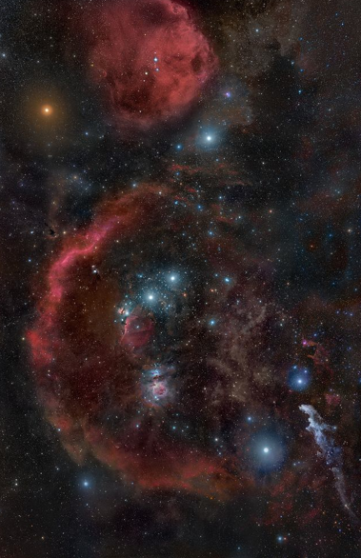
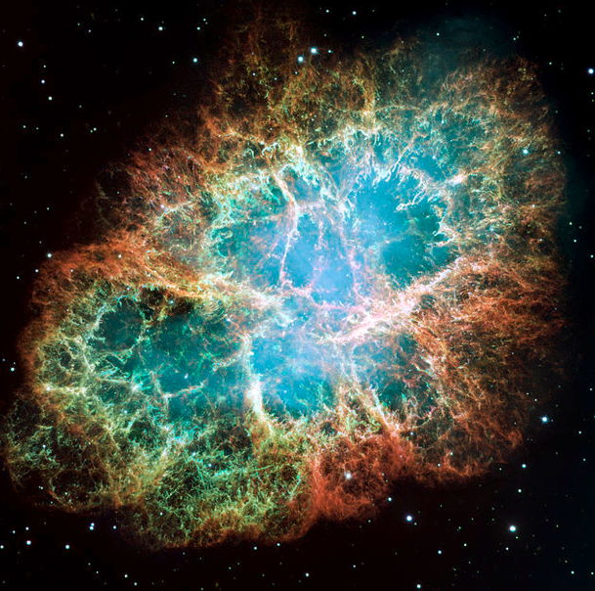
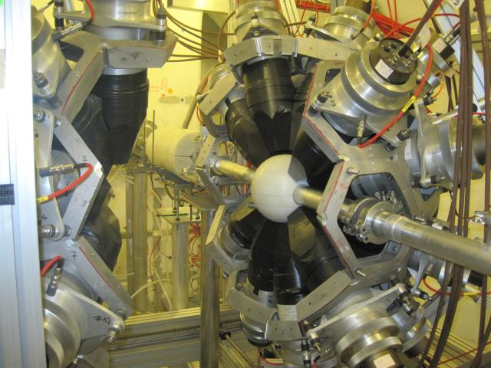
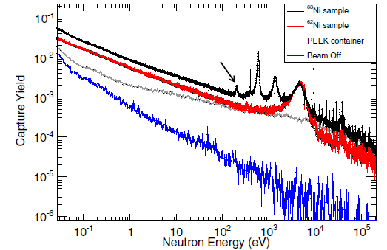
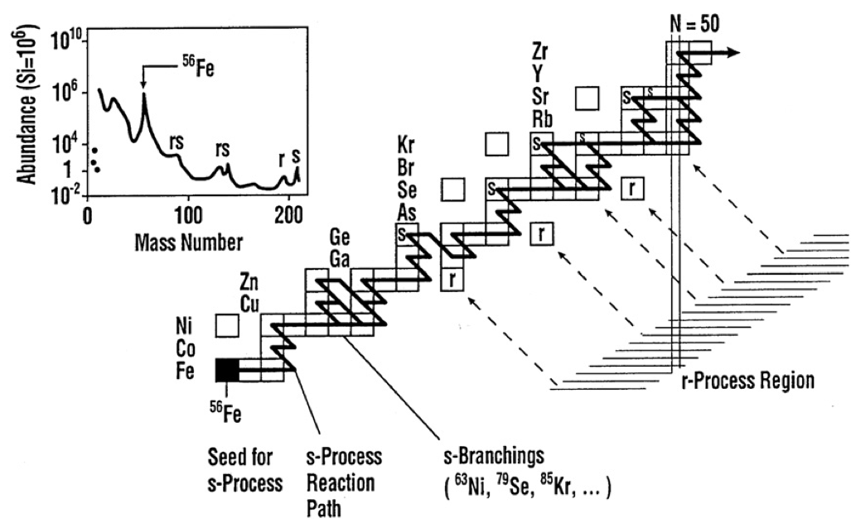


Assergi, 24-29 June 2018
Data for s process
from n_TOF
Cristian Massimi
for the n_TOF Collaboration
Nuclear data and
Astrophysics
Notes:
This is an overview on nuclear astrophysics at cern n_TOF

Slide 2
Outline
The n_TOF project
  Objectives, basic parameters, instrumentation
Examples of measurements and their impact on s-process nucleosynthesis
  Branch-point isotopes, neutron sources, s-only isotopes, s-process bottleneck, weak component
Future program
  Facility upgrade 2019-2021, measurements 2021-2030
Notes:
Before presenting some recent results of measurements and their impact on NA, I will introduce the n_tof project

Slide 3

















The n_TOF project
Atominstitut, Technische Universität Wien, Austria
University of Vienna, Faculty of Physics, Austria
European Commission JRC, Institute for Reference Materials and Measurements (IRMM)
Department of Physics, Faculty of Science, University of Zagreb, Croatia
Charles University, Prague, Czech Republic
Centre National de la Recherche Scientifique/IN2P3 - IPN, Orsay, France
Commissariat à l’Énergie Atomique (CEA) Saclay - Irfu, Gif-sur-Yvette, France
Johann-Wolfgang-Goethe Universität, Frankfurt, Germany
Karlsruhe Institute of Technology, Campus Nord, Institut für Kernphysik, Karlsruhe, Germany
National Technical University of Athens (NTUA), Greece
Aristotle University of Thessaloniki, Thessaloniki, Greece
Bhabha Atomic Research Centre (BARC), Mumbai, India
ENEA Bologna e
Dipartimento di Fisica, e Astronomia, Università di Bologna
Sezione INFN di Bologna, INFN Bari, Bologna, LNL, Perugia, Trieste, LNS
Uniwersytet Łódzki, Lodz, Poland
Instituto Tecnológico e Nuclear, Instituto Superior Técnico, Universidade Técnica de Lisboa, Portugal
Horia Hulubei National Institute of Physics and Nuclear Engineering – Bucharest, Romania
Centro de Investigaciones Energeticas Medioambientales y Tecnológicas (CIEMAT), Madrid, Spain
Instituto de Fìsica Corpuscular, CSIC-Universidad de Valencia, Spain
Universitat Politecnica de Catalunya, Barcelona, Spain
Universidad de Sevilla, Spain
Universidade de Santiago de Compostela, Spain
Department of Physics and Astronomy - University of Basel, Basel, Switzerland
European Organization for Nuclear Research (CERN), Geneva, Switzerland
Paul Scherrer Institut, Villigen PSI, Switzerland
University of Manchester, Oxford Road, Manchester, UK
University of York, Heslington, York, UK
~ 130 researchers
Notes:
In the n Collaboration there are about 130 researchers from 30 institutes mainly from europe

Slide 4
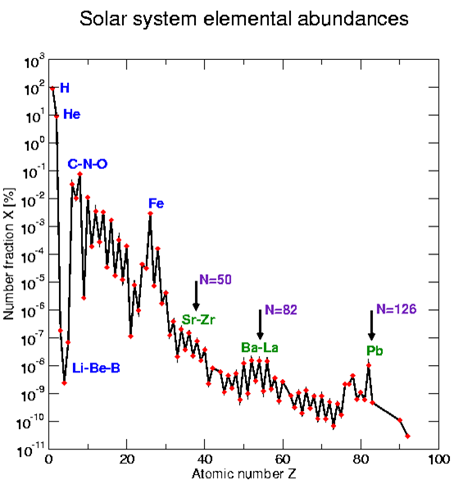
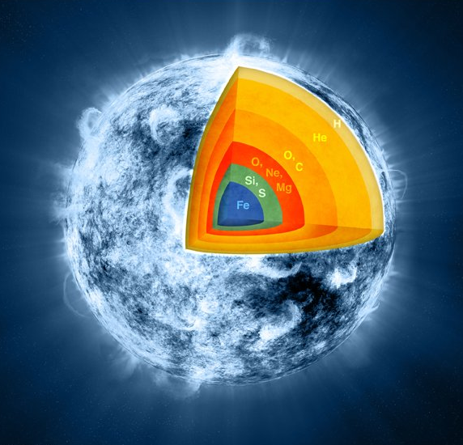
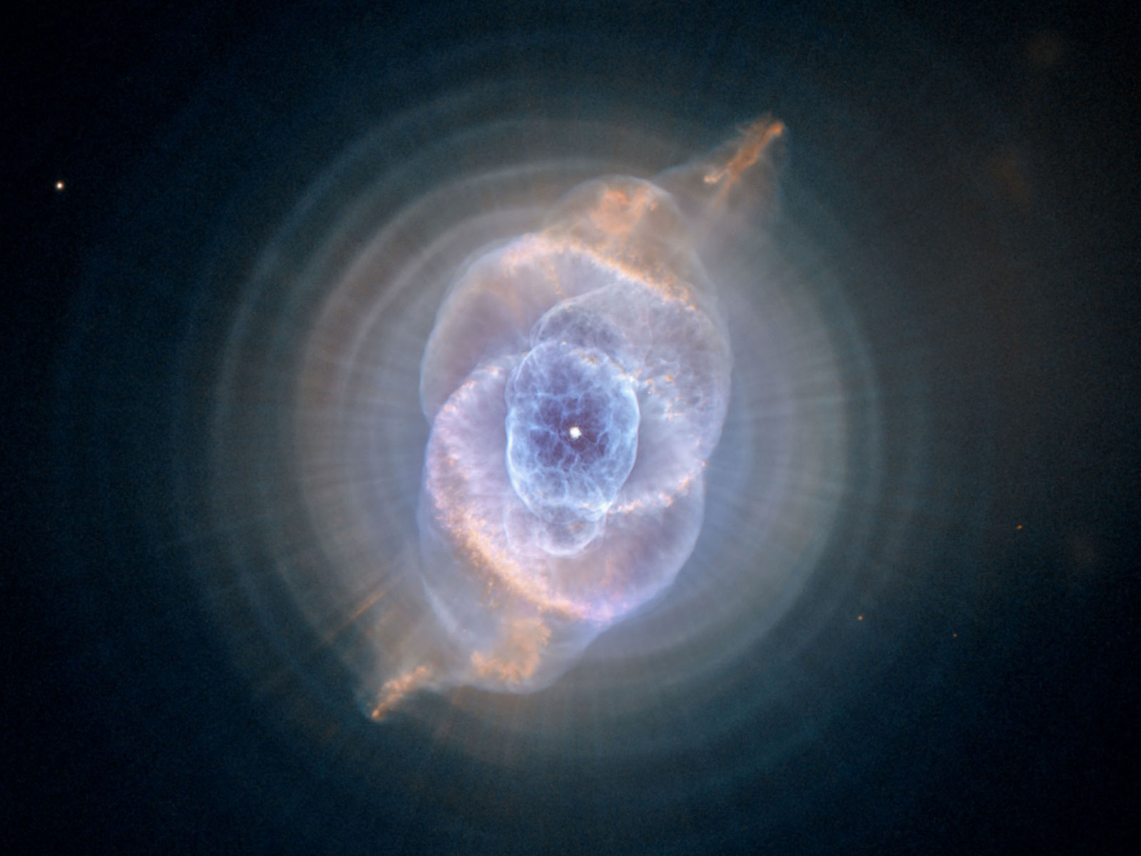
The n_TOF project
Objective: to provide Nuclear Data for Science (and Technology)
How the elements are synthesized in the Universe?
Big
Bang
Notes:
The aim of the collaboration is to provide … Here I will present the studies about NA and in particular the formation of elements.
Looking at the elemental abundances os the SUN, 3 processes can be identified:

Slide 5
The n_TOF project
Objective: to provide Nuclear Data for Science (and Technology)
How the elements are synthesized in the Universe?
s process:
Neutron induced reactions in Astrophysics, by C. Lederer, Wednesday 27 12:00
Posters
The neutron capture cross section measurement of the thallium isotopes ²⁰³Tl, ²⁰⁴Tl and ²⁰⁵Tl at the n_TOF facility at CERN, A. Casanovas
Measurement of the ¹⁶O(n,α)¹³C reaction cross-section at the CERN n_TOF facility – S. Urlass
The Stellar ⁷²Ge(n,γ) Cross Section: A First Measurement at n_TOF, M. Dietz
BBN:
⁷Be(n,p) cross section measurement for the Cosmological Lithium Problem at the n_TOF facility at CERN, L. Damone Wednesday 27, 10:00
Notes:
The aim of the collaboration is to provide … Here I will present the studies about NA and in particular the formation of elements.
Looking at the elemental abundances os the SUN, 3 processes can be identified:

Slide 6
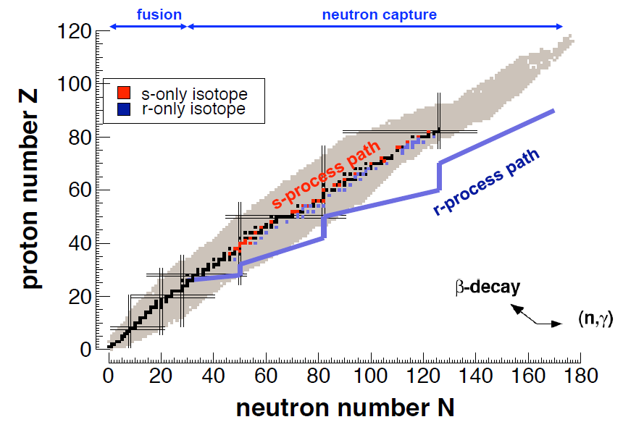
The n_TOF project
Element production beyond Fe
Neutron beams
Radioactive beam facilities
s-process (Red Giants)
r-process (Supernovae
Neutron Star Merger)
s-process (slow process):
  Capture times long relative to decay time
  Involves mostly stable isotopes
  N_{n} = 10⁸ n/cm³ , E_{n} = 0.3 – 300 keV
r-process (rapid process):
  Capture times short relative to decay times
  Produces unstable isotopes (neutron-rich)
  N_{n} = 10²⁰⁻³⁰ n/cm³
Notes:
The other half of elemental abundances is produced by rapid neutron capture process. Typically this take place in explosve scenario like for example supernovae, ans are associated with extremely high neutron densities which drive the reaction flow towards the neutron rich side. In practice the neutron capture is faster than beta decay

Slide 7
The n_TOF project
s-process nucleosynthesis proceeds through neutron capture reactions and successive β decay.
  The abundance of elements in the Universe depends on:
  thermodinamic conditions (temperture and neutron density);
  β-decay rate;
  neutron capture cross-sections.
Need of accurate (n,γ) cross-sections:
  refine models of stellar nucleosynthesis in the Universe;
  obtain information on the stellar environment and evolution
Along the β-stability valley
⁶²Cu
9.74 m
⁶³Cu
69.2%
⁶⁴Cu
12.7 h
key quantity
σ(n,γ)
⁶⁰Ni
26.2%
⁶¹Ni
1.14%
⁶²Ni
3.63%
⁶³Ni
100 y
⁶⁴Ni
0.93%
⁵⁸Co
70.86 d
⁵⁹Co
100%
⁶⁰Co
5.272 y
⁶¹Co
1.65 h
⁵⁶Fe
91.7%
⁵⁷Fe
2.2%
⁵⁸Fe
0.28%
⁵⁹Fe
44.5 d
⁶⁰Fe
1.5·10⁶ y
⁶¹Fe
6 m
s process
Notes:
Going back to s-process, the reaction flow follow the stability valley because the b-decay are faster than subsequent neutron capture.
And there are case where the abundances depend on the thermodinamic condition of the star. The main nuclear physics input is the sigma, which determines the efficiency for the production of heavy elements

Slide 8
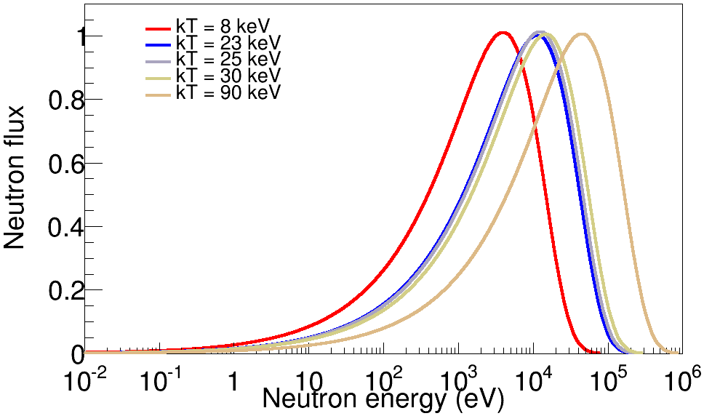
The n_TOF project
Stellar spectra: AGB (8, 23 keV) and Massive stars (25, 90 keV)
Notes:
These are MB distribution of neutron flux inside the star during s-process
The s process takes place during different burning stages of the star and temperatures range from 0.1 to 1 GK, corresponding to 8-90 keV thermal energy.

Slide 9
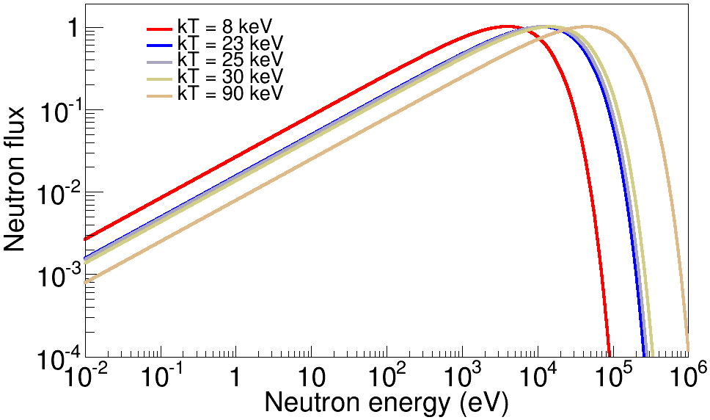
The n_TOF project
Stellar spectra: AGB (8, 23 keV) and Massive stars (25, 90 keV)
Notes:
Here the log scale help us in understanding which is the energy region of interest

Slide 10
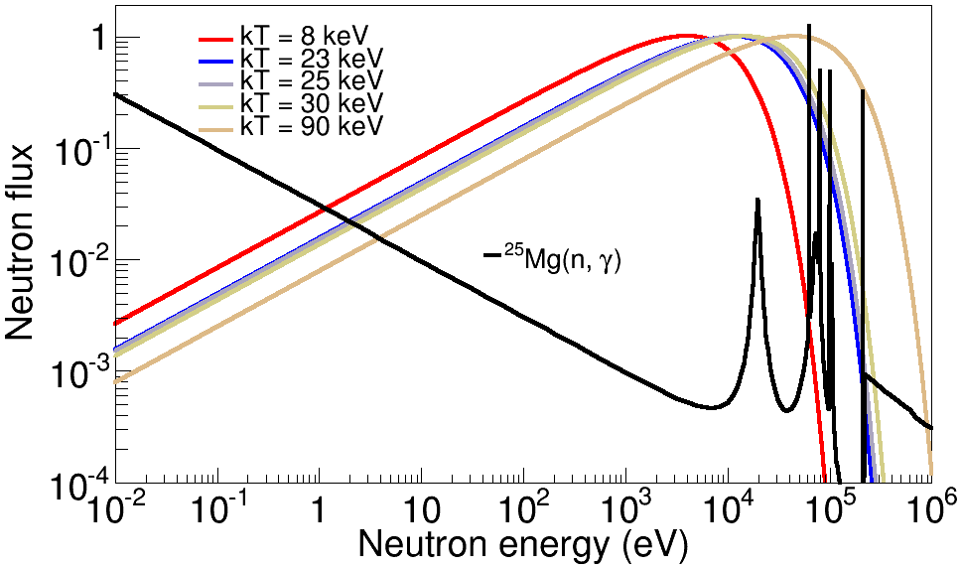
The n_TOF project
Stellar spectra: AGB (8, 23 keV) and Massive stars (25, 90 keV)
Notes:
Capture measurements must cover the region between thermal to about 1 MeV, neutron energy

Slide 11
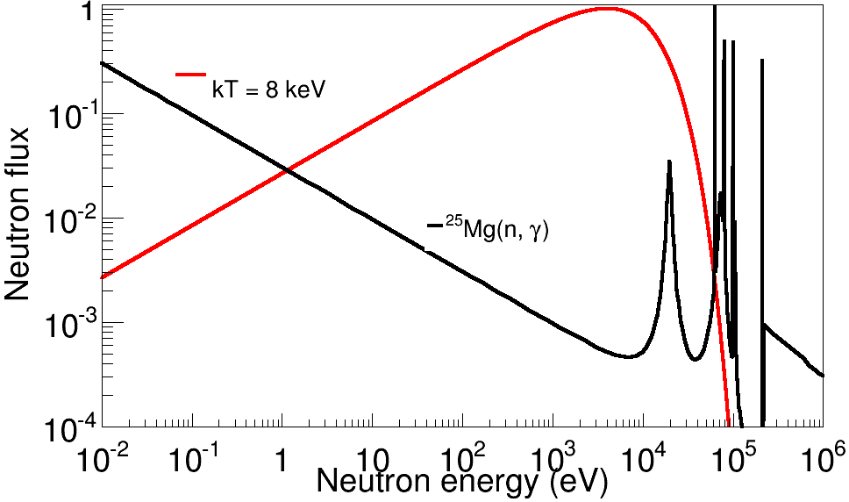


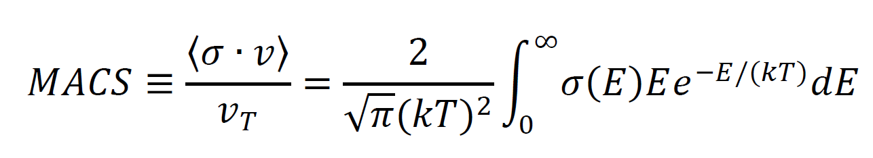
The n_TOF project
For Astrophysical applications it is important to determine Maxwellian Averaged Cross-Sections (MACS), for various temperatures (kT depends on stellar site).
Reaction rate (cm⁻³s⁻¹):
Notes:
the required quantity for the calculation of s process abundances is the reaction rate, which is linked to the cross section.
What is important here is the average of ccs over the stellar neutron flux: the so called MACS or stellar cross section

Slide 12
The n_TOF project
For Astrophysical applications it is important to determine Maxwellian Averaged Cross-Sections (MACS), for various temperatures (kT depends on stellar site).
Reaction rate (cm⁻³s⁻¹):
Two methods are used to determine MACS:
  measurement of energy dependent neutron capture cross-sections;
  integral measurement (energy integrated) using neutron beams with suitable energy spectrum.
Notes:
Thw methods for obtaining this quantity

Slide 13
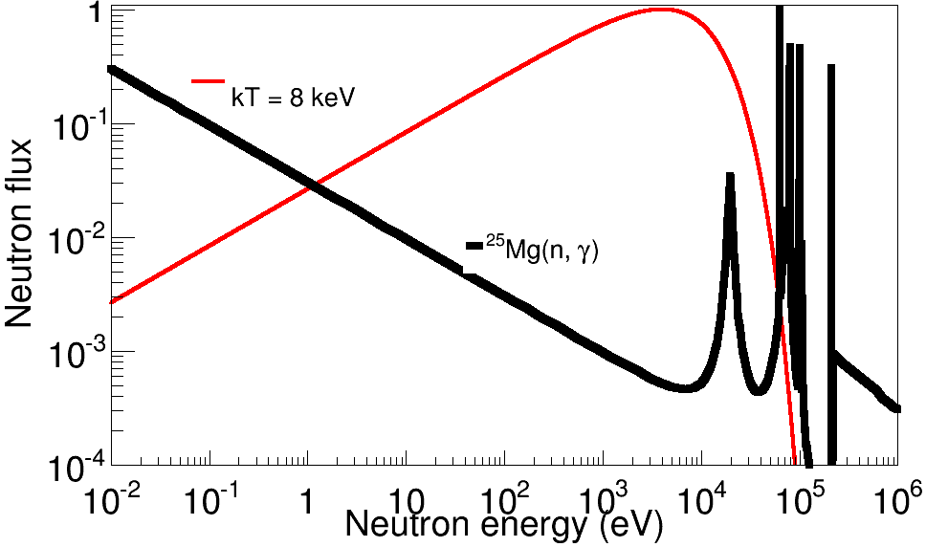
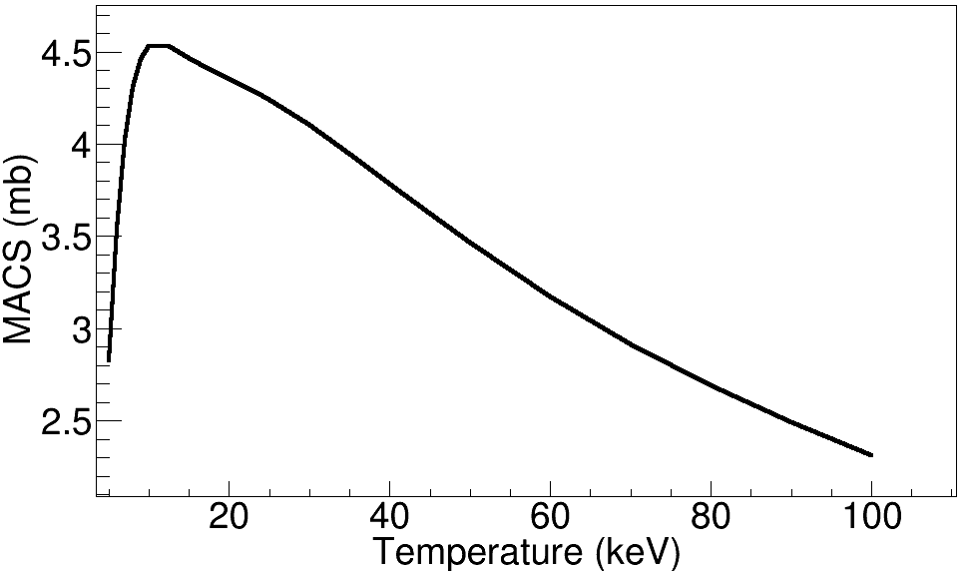
The n_TOF project
For Astrophysical applications it is important to determine Maxwellian Averaged Cross-Sections (MACS), for various temperatures (kT depends on stellar site).
Reaction rate (cm⁻³s⁻¹):
Two methods are used to determine MACS:
  measurement of energy dependent neutron capture cross-sections;
  integral measurement (energy integrated) using neutron beams with suitable energy spectrum.
Notes:
Measure CS with TOF and perform the average → MACS as a function on temperature

Slide 14
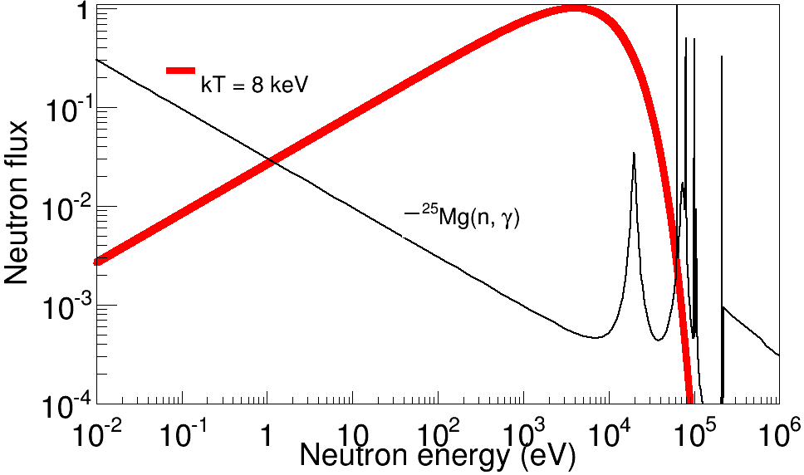
The n_TOF project
For Astrophysical applications it is important to determine Maxwellian Averaged Cross-Sections (MACS), for various temperatures (kT depends on stellar site).
Reaction rate (cm⁻³s⁻¹):
Two methods are used to determine MACS:
  measurement of energy dependent neutron capture cross-sections;
  integral measurement (energy integrated) using neutron beams with suitable energy spectrum.
Notes:
Activation, where neutron flux with MB distribution are used and the MACS is directly determined

Slide 15
The n_TOF project
For Astrophysical applications it is important to determine Maxwellian Averaged Cross-Sections (MACS), for various temperatures (kT depends on stellar site).
Reaction rate (cm⁻³s⁻¹):
Two methods are used to determine MACS:
  measurement of energy dependent neutron capture cross-sections;
  integral measurement (energy integrated) using neutron beams with suitable energy spectrum.
n_TOF@ CERN
Notes:
Measure CS with TOF and perform the average → MACS as a function on temperature

Slide 16

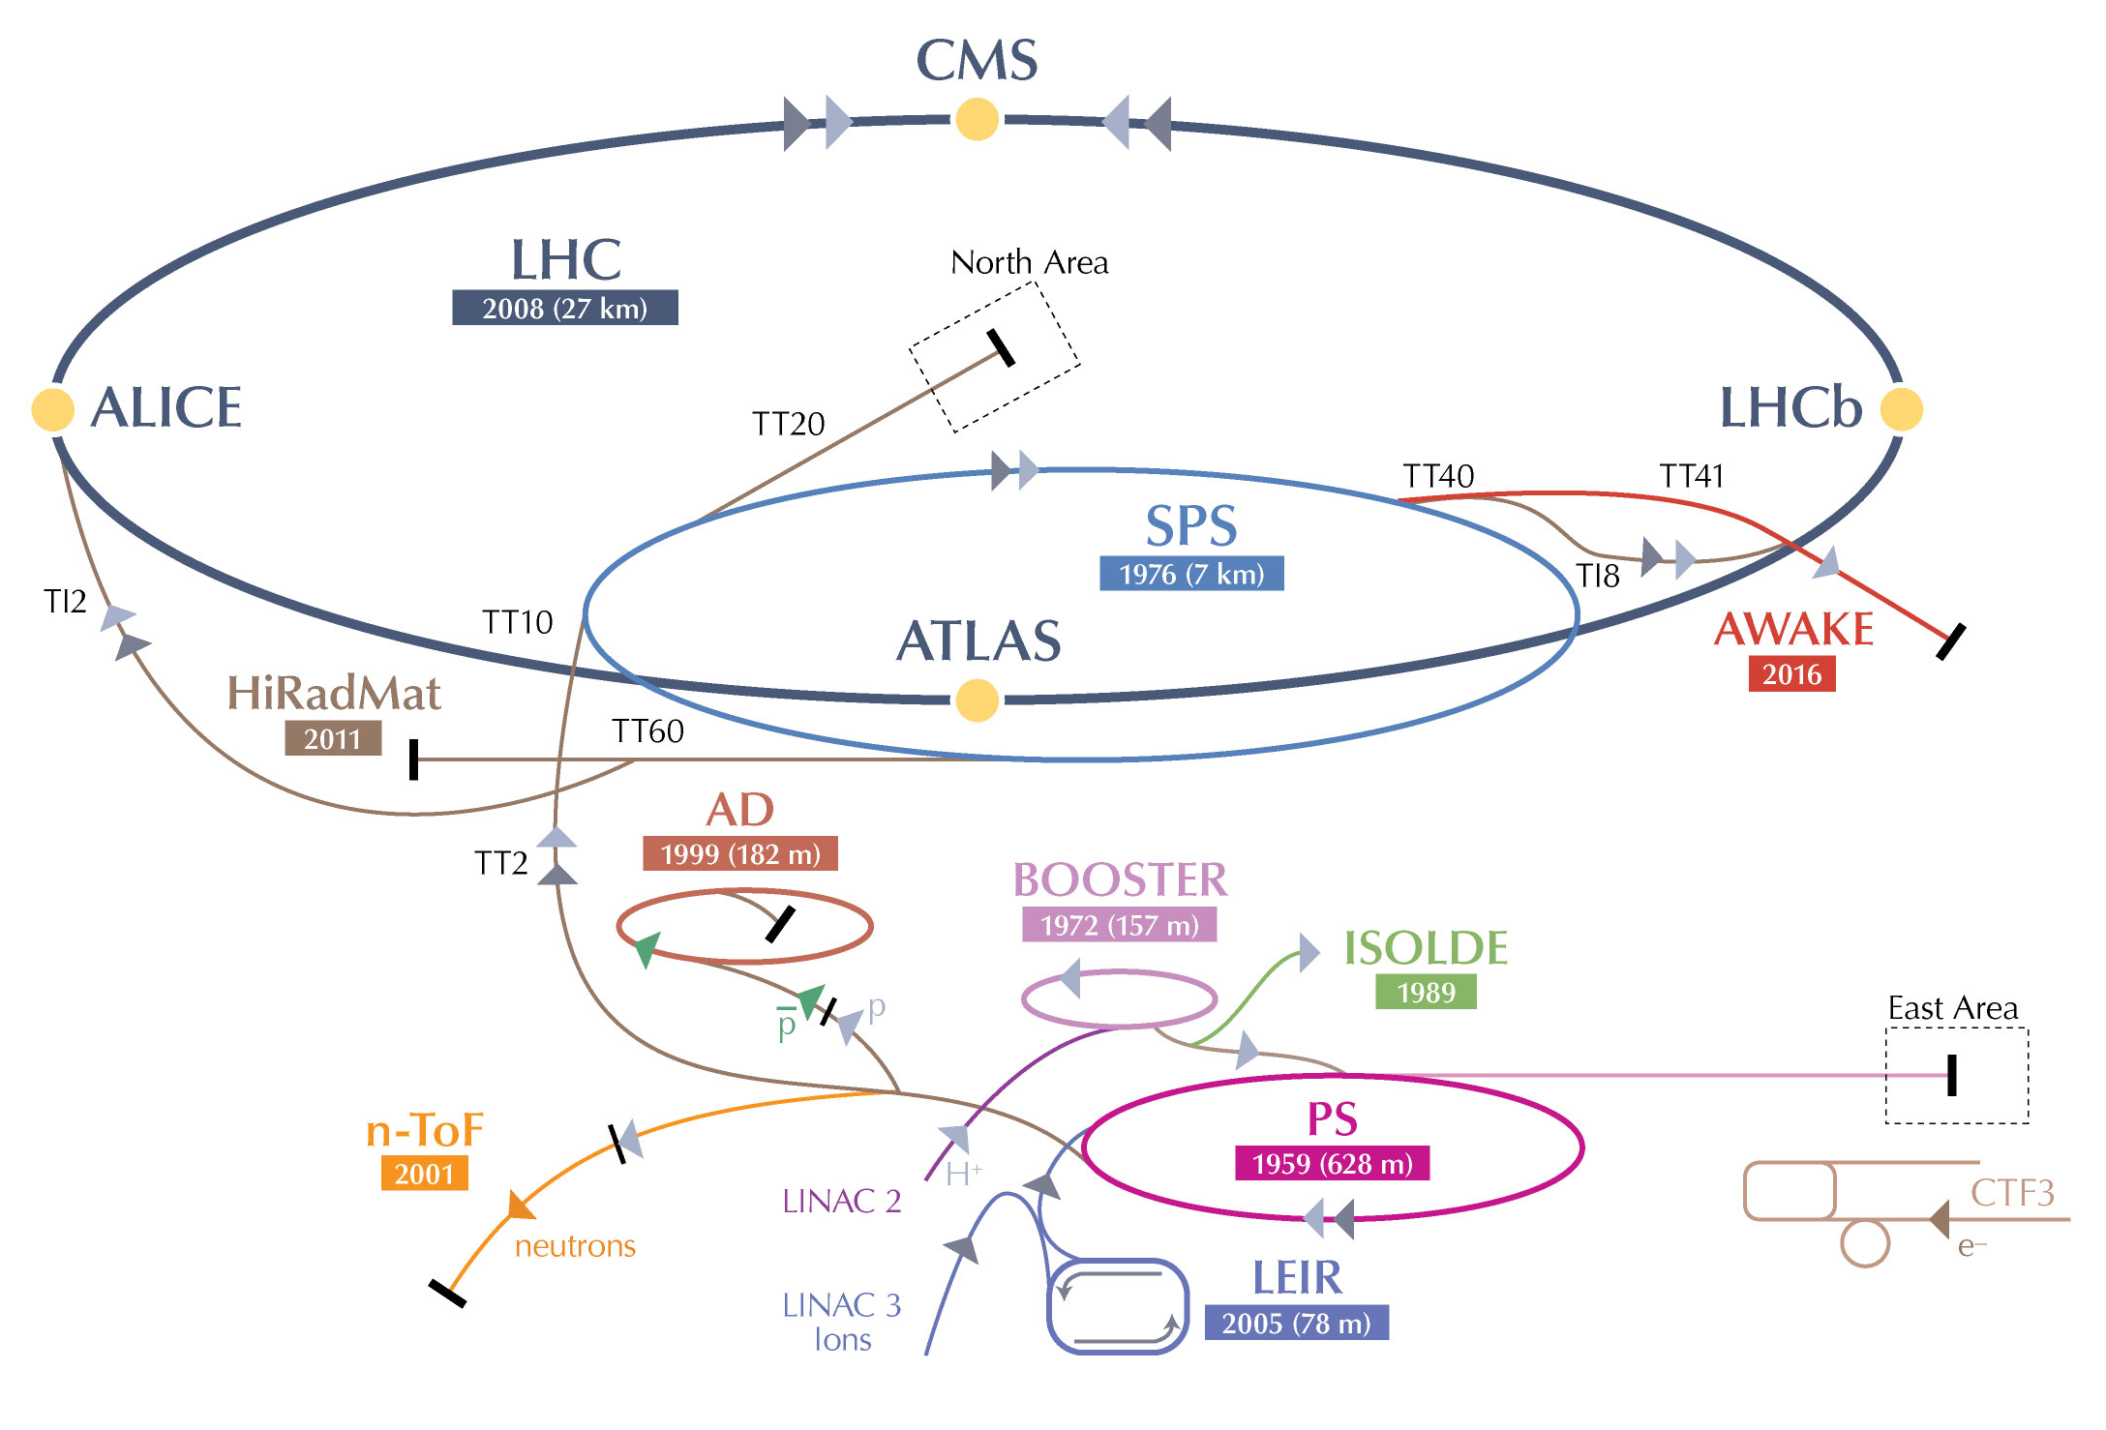
The n_TOF project
Neutron Time-Of- Flight facility: n_TOF

Slide 17
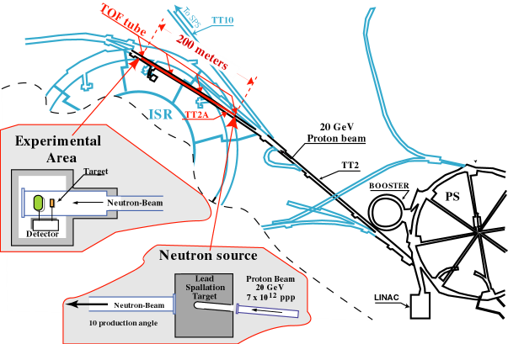
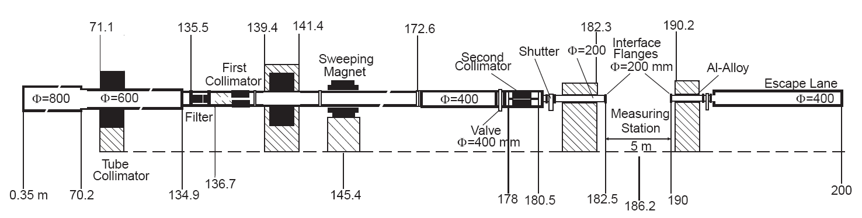
The n_TOF project
n_TOF is a spallation neutron source based on 20 GeV/c protons from the CERN PS hitting a Pb block (~300 neutrons per proton and ~ 7x10¹² ppp).
Experimental area at 185 m and 18.5 m.

Slide 18


The n_TOF project
The advange of n_TOF are a direct consequence of the characteristics of the PS proton beam: high energy, high peak current, low duty cycle.
EAR2
18.5 m
EAR1
20 GeV/c
protons
Spallation
Target
185 m

Slide 19
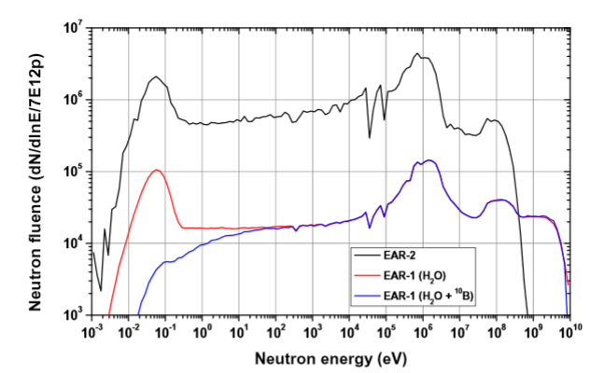
The n_TOF project
The advange of n_TOF are a direct consequence of the characteristics of the PS proton beam: high energy, high peak current, low duty cycle.
EAR2
18.5 m
EAR1
20 GeV/c
protons
Spallation
Target
185 m

Slide 20
The n_TOF project
The advange of n_TOF are a direct consequence of the characteristics of the PS proton beam: high energy, high peak current, low duty cycle.
EAR2
Wide energy range:
25 meV < E_{n} < 1 GeV
18.5 m
EAR1
20 GeV/c
protons
Spallation
Target
185 m

Slide 21
The n_TOF project
The advange of n_TOF are a direct consequence of the characteristics of the PS proton beam: high energy, high peak current, low duty cycle.
EAR2
Wide energy range:
25 meV < E_{n} < 1 GeV
  High neutron flux
  EAR2 10⁶ n/cm²/pulse
  EAR1 10⁵ n/cm²/pulse
18.5 m
EAR1
20 GeV/c
protons
Spallation
Target
185 m

Slide 22
The n_TOF project
The advange of n_TOF are a direct consequence of the characteristics of the PS proton beam: high energy, high peak current, low duty cycle.
EAR2
Wide energy range:
25 meV < E_{n} < 1 GeV
  High neutron flux
  EAR2 10⁶ n/cm²/pulse
  EAR1 10⁵ n/cm²/pulse
18.5 m
Good
energy resolution
ΔE/E ~10⁻⁴ @ EAR1
EAR1
20 GeV/c
protons
Spallation
Target
185 m

Slide 23
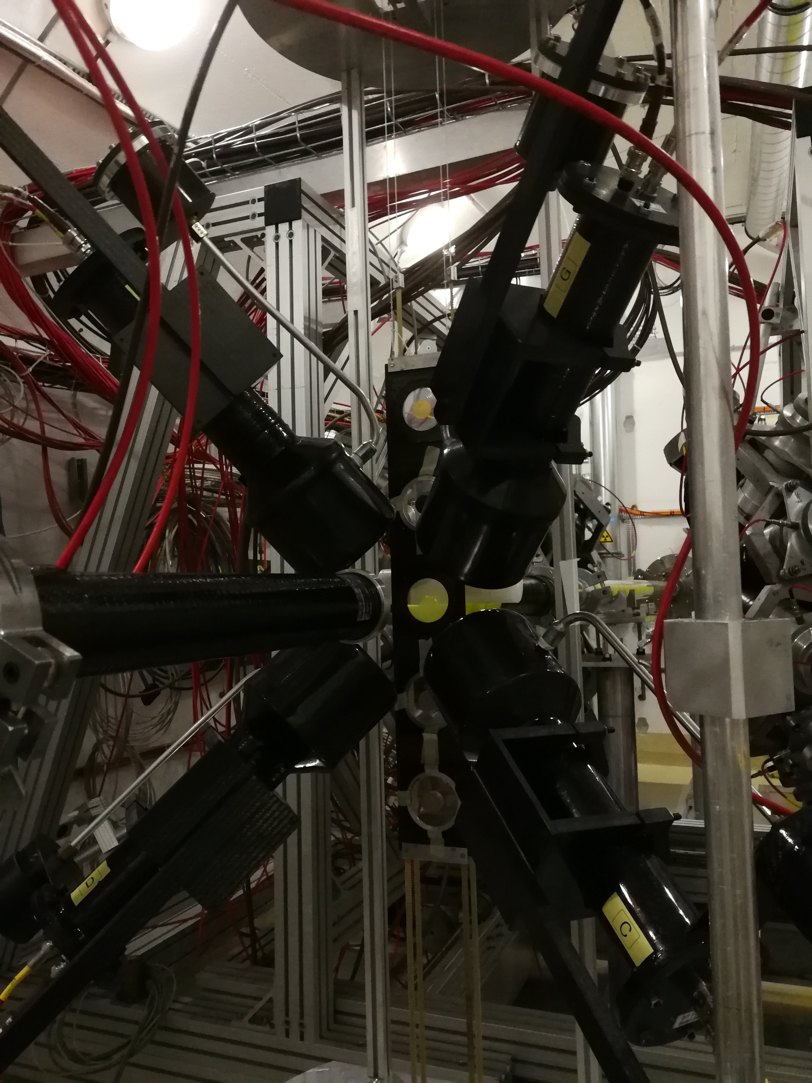
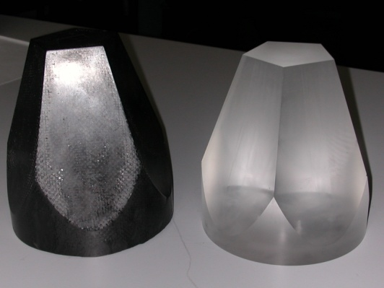
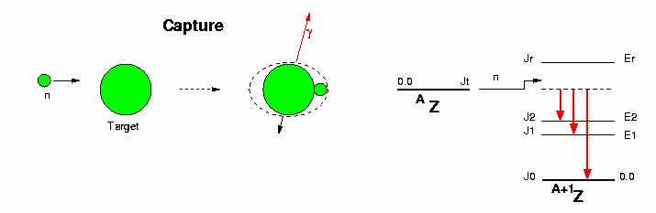
The n_TOF project
Detectors for (n,γ) reaction
Capture reactions are measured by detecting γ-rays emitted in the de-excitation process. Two different systems, to minimize different types of background
BaF₂ scintillator
4π geometry
C₆D₆ scintillator
Low neutron sensitivity
¹⁰B loaded
Carbon Fibre Capsules

Slide 24
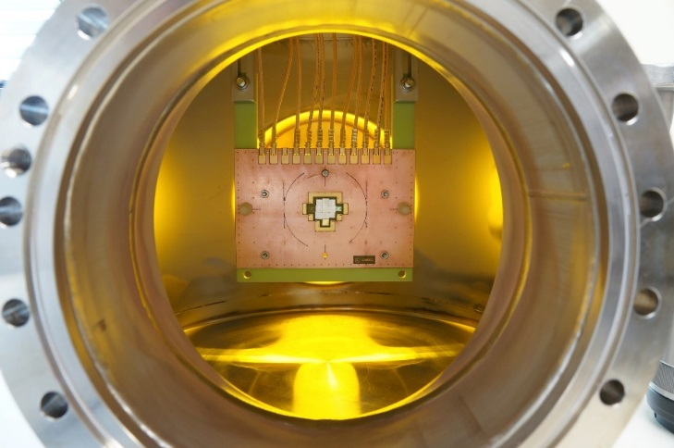
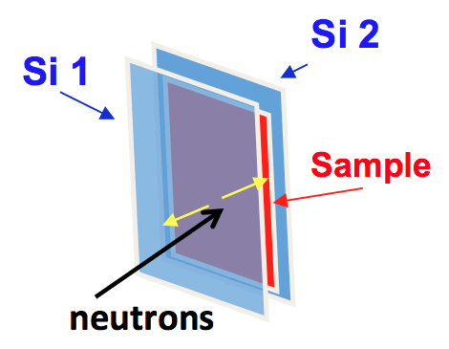
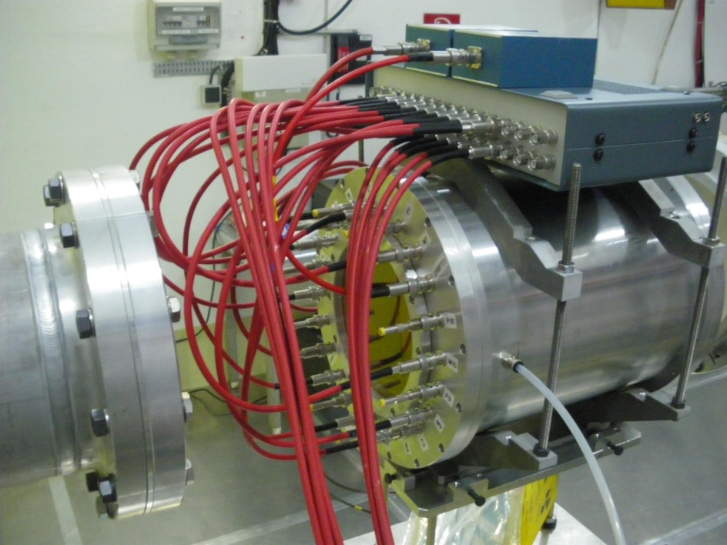
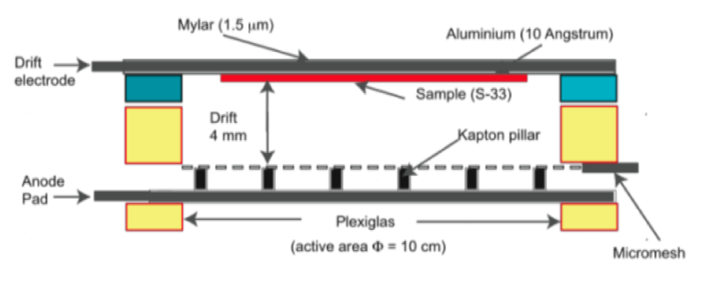
The n_TOF project
Detectors: (n,p) and (n,α) reactions
Gas and solid state detectors are used for detecting charged particles, depending on the energy region of interest and the Q-value of the reaction
Silicon detectors Silicon sandwich
Diamond detector
ΔE-E Telescopes
Micromegas chamber
low-noice, high-gain, radiation-hard detector

Slide 25
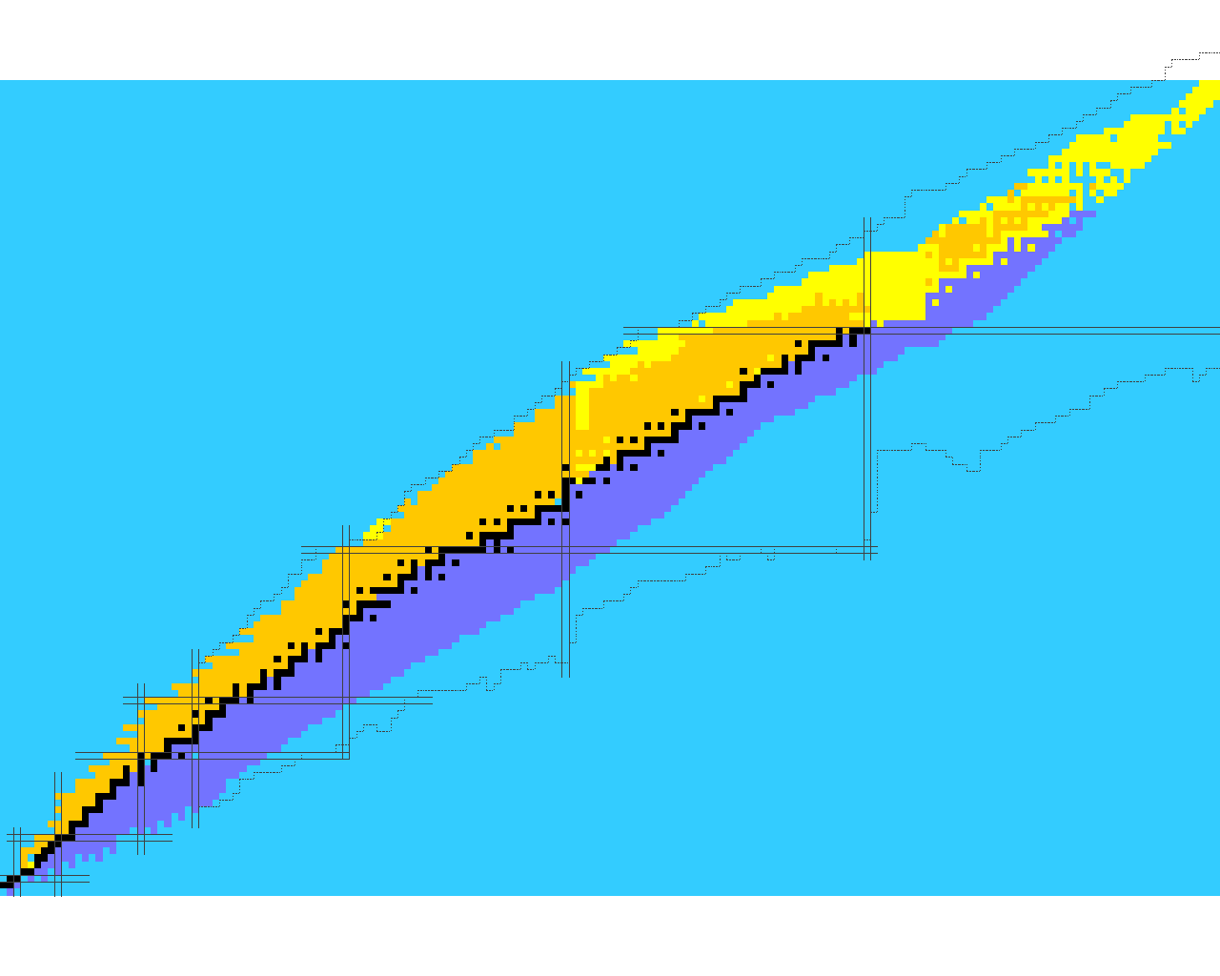
Data for s process
Cross sections measured in 2001 - 2018
Branching point isotopes:
  ¹⁵¹Sm, ⁶³Ni, ¹⁴⁷Pm, ¹⁷¹Tm, ²⁰³Tl
Abundances in presolar grains:
  ^{91,92,93,94,96}Zr
Magic Nuclei and end-point:
  ¹³⁹La, ¹⁴⁰Ce, ⁹⁰Zr, ⁸⁹Y, ⁸⁸Sr, ^{204,206,207,208}Pb, ²⁰⁹Bi
Seeds isotopes:
  ^{54,56,57}Fe, ^{58,60,62}Ni, ⁵⁹Ni(n,α)
Isotopes of special interest:
  ^{186,187,188}Os (cosmochronometer),¹⁹⁷Au (reference cross section), ^{24,25,26}Mg, ³³S(n,α), ¹⁴N(n,p), ³⁵Cl(n,p), ²⁶Al(n,p), ²⁶Al(n,α) (neutron poison), ¹⁵⁴Gd (s-only isotope), ⁶⁸Zn, ^{69,71}Ga, ^{70,72,73,74,76}Ge, ^{77,78,80}Se (weak component)
Neutron Sources ²²Ne(α,n)²⁵Mg and ¹³C(α,n)¹⁶O:
  n+²⁵Mg, n+¹⁶O

Slide 26
Data for s process
Cross sections measured in 2001 - 2018
Branching point isotopes:
  ¹⁵¹Sm, ⁶³Ni, ¹⁴⁷Pm, ¹⁷¹Tm, ²⁰³Tl
Abundances in presolar grains:
  ^{91,92,93,94,96}Zr
Magic Nuclei and end-point:
  ¹³⁹La, ¹⁴⁰Ce, ⁹⁰Zr, ⁸⁹Y, ⁸⁸Sr, ^{204,206,207,208}Pb, ²⁰⁹Bi
Seeds isotopes:
  ^{54,56,57}Fe, ^{58,60,62}Ni, ⁵⁹Ni(n,α)
Isotopes of special interest:
  ^{186,187,188}Os (cosmochronometer),¹⁹⁷Au (reference cross section), ^{24,25,26}Mg, ³³S(n,α), ¹⁴N(n,p), ³⁵Cl(n,p), ²⁶Al(n,p), ²⁶Al(n,α) (neutron poison), ¹⁵⁴Gd (s-only isotope), ⁶⁸Zn, ^{69,71}Ga, ^{70,72,73,74,76}Ge, ^{77,78,80}Se (weak component)
Neutron Sources ²²Ne(α,n)²⁵Mg and ¹³C(α,n)¹⁶O:
  n+²⁵Mg, n+¹⁶O
The neutron capture cross section measurement of the thallium isotopes ²⁰³Tl, ²⁰⁴Tl and ²⁰⁵Tl at the n_TOF facility at CERN, A. Casanovas
@ NICXV
The Stellar ⁷²Ge(n,γ) Cross Section: A First Measurement at n_TOF, M. Dietz
Measurement of the ¹⁶O(n,α)¹³C reaction cross-section at the CERN n_TOF facility – S. Urlass

Slide 27
Branching point isotopes
Z
Low φ_{n} “compared” to T_{1/2}
STABLE
Unstable against β⁻
(n,γ) reaction
β⁻ decay
N

Slide 28
Branching point isotopes
Z
Low φ_{n} “compared” to T_{1/2}
STABLE
Unstable against β⁻
(n,γ) reaction
β⁻ decay
s-process
branching point
N
Z
High φ_{n} “compared” to T_{1/2}
N

Slide 29
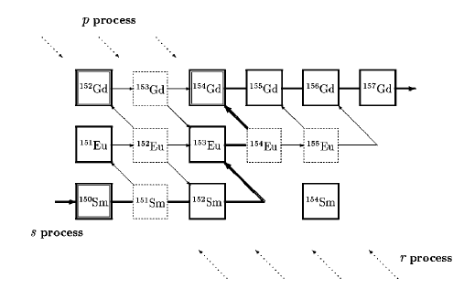
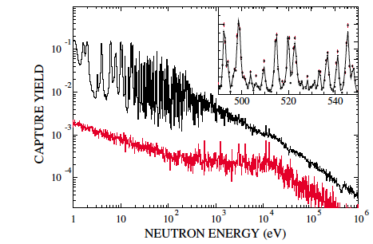

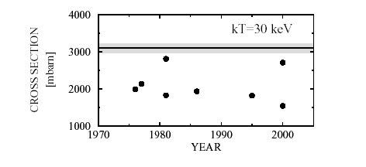

¹⁵¹Sm: s process in AGB
Phys. Rev. Lett. 93, 161103 (2004)
AGB
CO core
<σ> = 3.1±0.16 b
at kT=30 keV

Slide 30

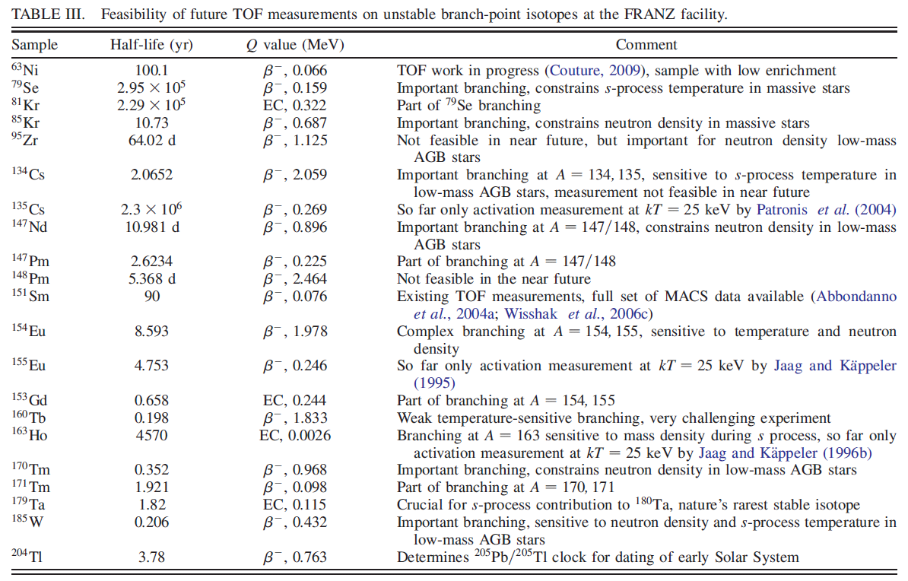

Branching point isotopes
The s process: Nuclear physics, stellar models, and observations, Vol. 83, 2011
PRL 110, 022501 (2013)
PRL 93, 161103 (2004)

Slide 31
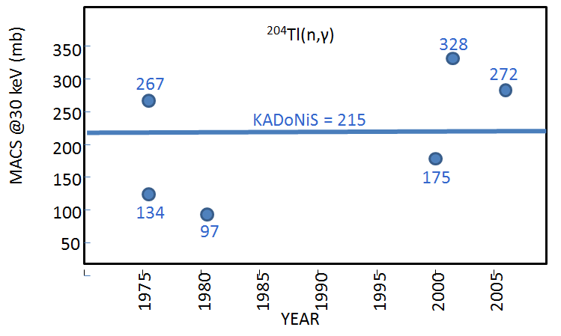
Branching point isotopes
²⁰⁴Tl(n,γ)
¹⁷¹Tm(n,γ)
¹⁴⁷Pm(n,γ)
Ongoing studies
Short-lived branching isotopes (a few years) have either never been measured before or have been measured only by activation (a few tens of ng) at a fixed temperature.

Slide 32
s-only isotopes
Elements beyond Iron are synthesized
½ by the s process
½ by the r process
Notes:
The reaction rate of this neutron source is determined by the level density of the compound nucleus formed in the reaction 26Mg, above the alfa threshold
Here ony states with natural spin parity can be formed

Slide 33
s-only isotopes
Elements beyond Iron are synthesized
½ by the s process
½ by the r process
Notes:
The reaction rate of this neutron source is determined by the level density of the compound nucleus formed in the reaction 26Mg, above the alfa threshold
Here ony states with natural spin parity can be formed

Slide 34
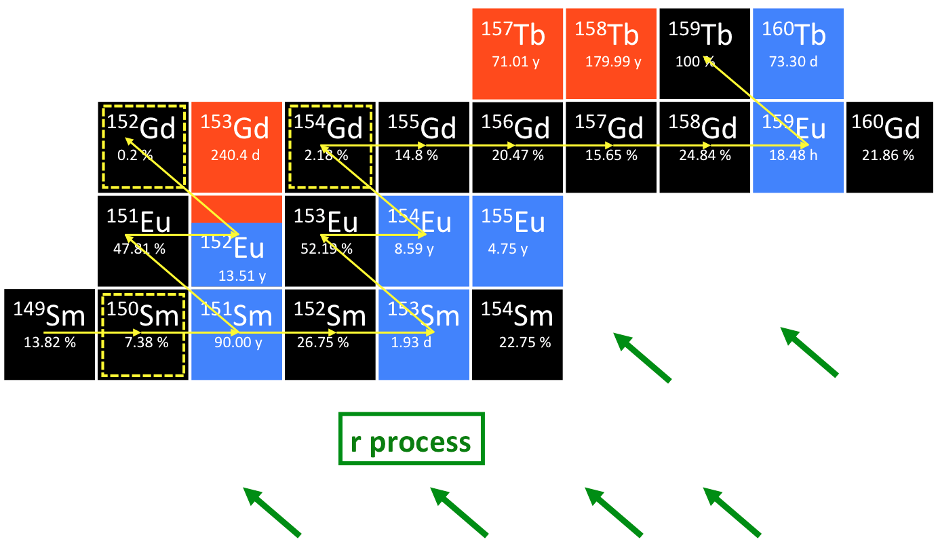
s-only isotopes
β⁺
stable
β⁻
¹⁵⁴Gd = s-only isotope, it can be produced only via s process because they are shielded against the β-decay chains from the r-process region by the isobars samarium
Notes:
The reaction rate of this neutron source is determined by the level density of the compound nucleus formed in the reaction 26Mg, above the alfa threshold
Here ony states with natural spin parity can be formed

Slide 35
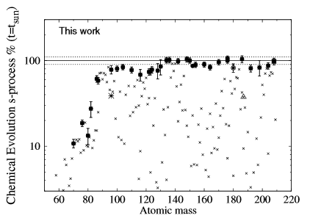
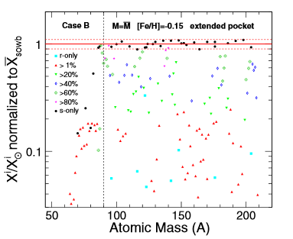
s-only isotopes
3 very recent and independent studies:
S. Bisterzo, et al., The Astrophysical Journal 787 (2014) 10
C. Trippella, et al., The Astrophysical Journal 787 (2014) 41
S. Cristallo, et al., The Astrophysical Journal 801 (2015) 53
Disagreement of more than 20% between observation and model calculation of s-process abundances
Notes:
The reaction rate of this neutron source is determined by the level density of the compound nucleus formed in the reaction 26Mg, above the alfa threshold
Here ony states with natural spin parity can be formed

Slide 36
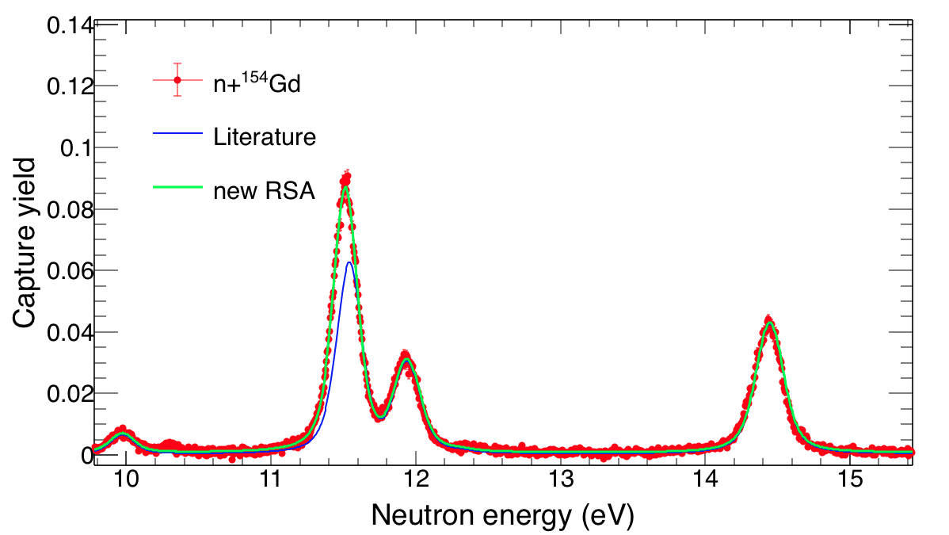
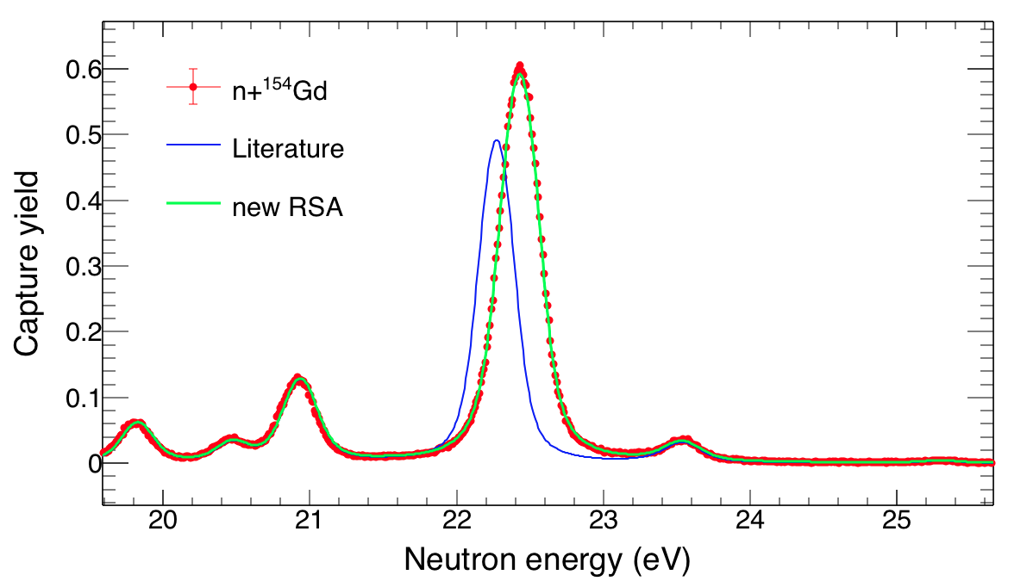
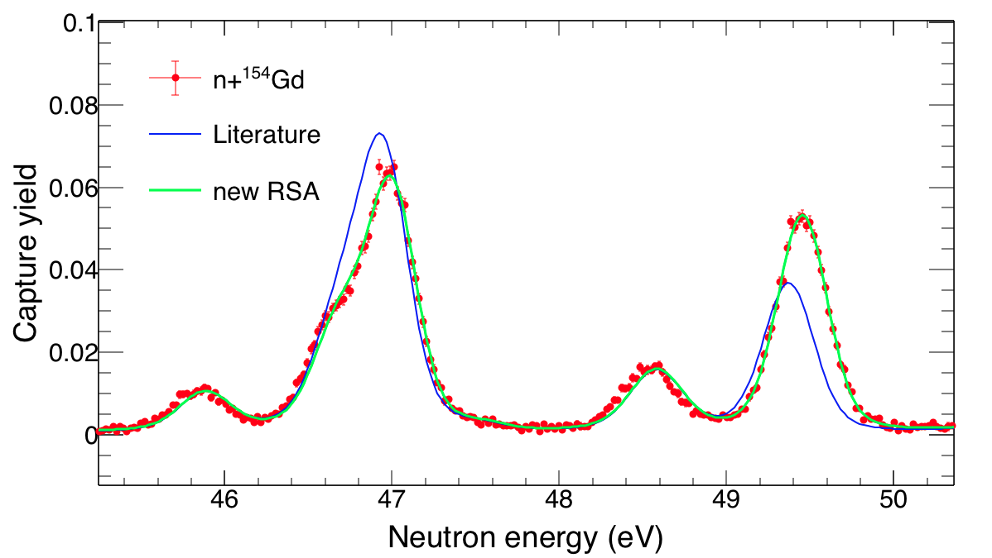
s-only isotopes
Measurement August 2017
Preliminary R-Matrix analysis of ¹⁵⁴Gd(n,γ) seems to largely deviate from literature
Notes:
The reaction rate of this neutron source is determined by the level density of the compound nucleus formed in the reaction 26Mg, above the alfa threshold
Here ony states with natural spin parity can be formed

Slide 37
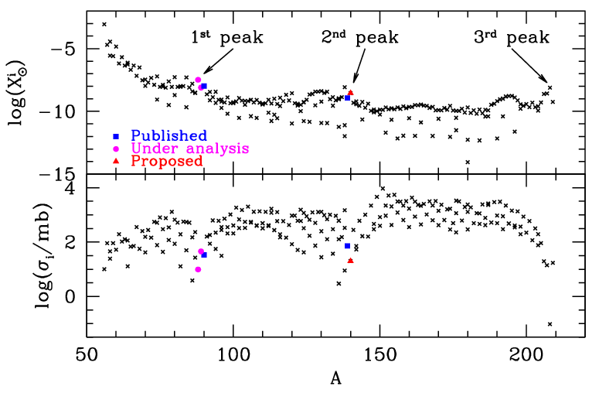
Magic nuclei: s process peaks
Notes:
The reaction rate of this neutron source is determined by the level density of the compound nucleus formed in the reaction 26Mg, above the alfa threshold
Here ony states with natural spin parity can be formed

Slide 38
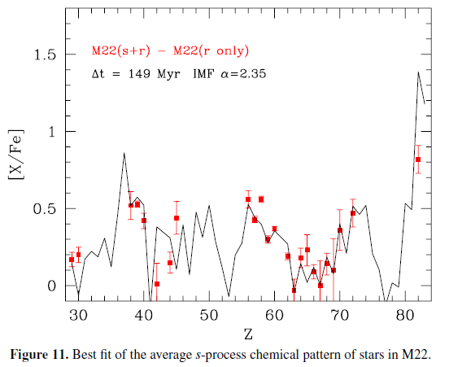
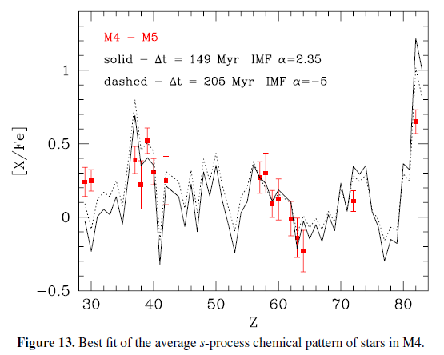
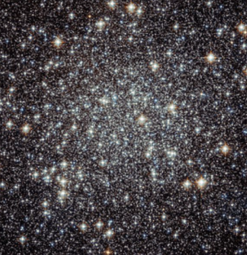
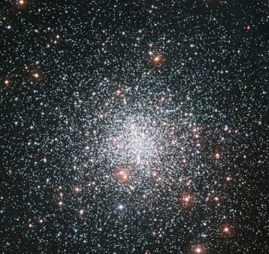
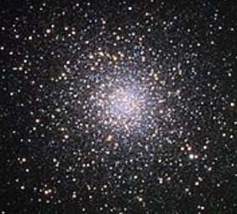
Magic nuclei: s process peaks
Straniero, Cristallo & Piersanti 2014
Abundances of elements in the
s-process peak are well reproduced apart from Cerium.
The pollution of AGB stars with a mass ranging between 3 to 6 M_{SUN} may account for most of the features of the s-process enrichment of M4 and M22.
Globular Cluster
M22
M4
M5
Notes:
The reaction rate of this neutron source is determined by the level density of the compound nucleus formed in the reaction 26Mg, above the alfa threshold
Here ony states with natural spin parity can be formed

Slide 39
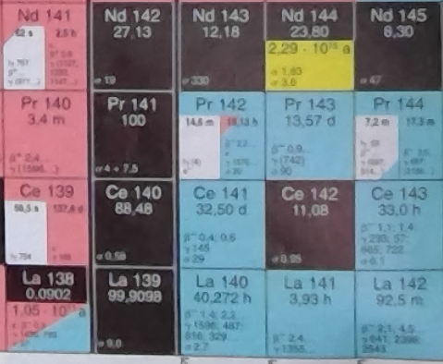
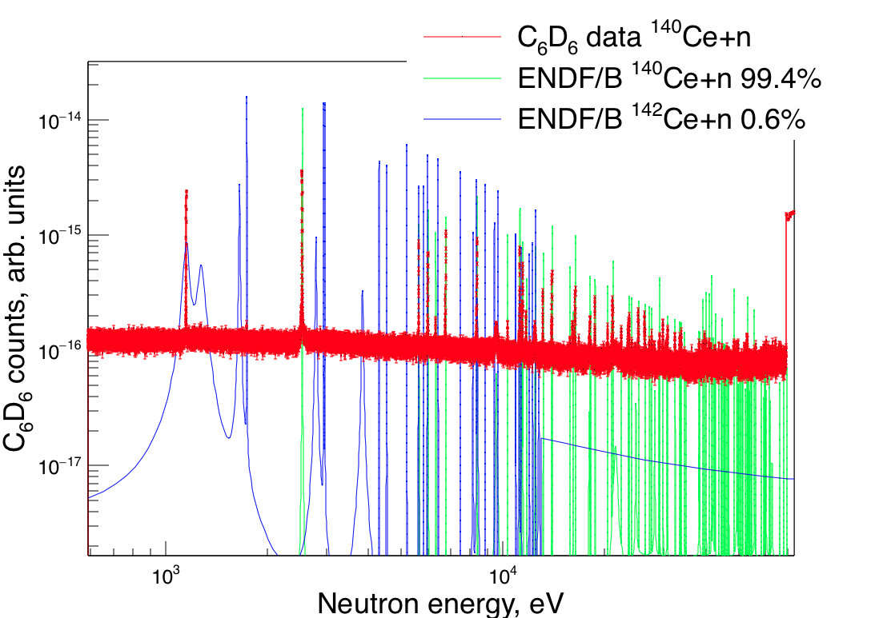
Magic nuclei: s process peaks
¹⁴⁰Ce is the most abundant cerium isotope (88%)
Measurement May 2018
Notes:
The reaction rate of this neutron source is determined by the level density of the compound nucleus formed in the reaction 26Mg, above the alfa threshold
Here ony states with natural spin parity can be formed

Slide 40
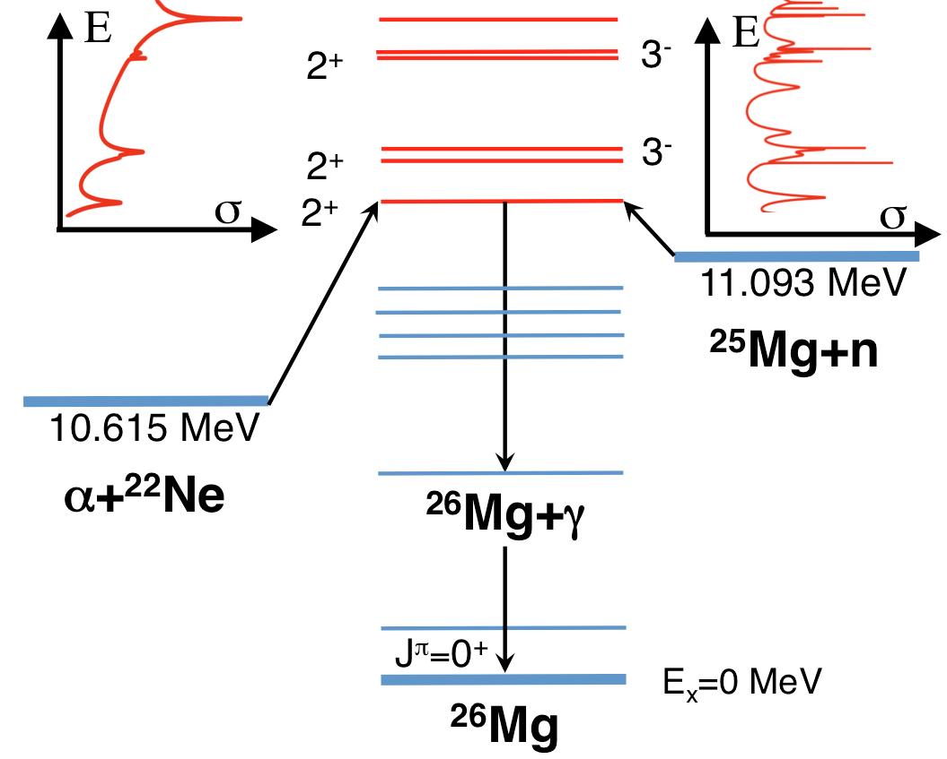
The case of ²⁵Mg
Constraints for the ²²Ne(α,n)²⁵Mg
²²Ne(α,γ)²⁶Mg reactions
Experimental evidence of natural spin parity states in the energy region of interest
 | J^{π}
²⁵Mg | 5/2⁺
n | 1/2⁺
 | J^{π}
²²Ne | 0⁺
α | 0⁺
Notes:
The reaction rate of this neutron source is determined by the level density of the compound nucleus formed in the reaction 26Mg, above the alfa threshold
Here ony states with natural spin parity can be formed

Slide 41




The case of ²⁵Mg
s abundance
Constraints for the ²²Ne(α,n)²⁵Mg
²²Ne(α,γ)²⁶Mg reactions
M. Jaeger, PRL 87 (2001) 20
R-Matrix
analysis
?
Notes:
The reaction rate of this neutron source is determined by the level density of the compound nucleus formed in the reaction 26Mg, above the alfa threshold
Here ony states with natural spin parity can be formed

Slide 42





Future 2021 - 2030
Upgrade: new spallation target ready by 2020
More flux
Notes:
We have observed experimental evidence of natural spin parity states in the energy region of interest

Slide 43


Future 2021 - 2030
Upgrade:
new detector concept
γ
C₆D₆
captured neutron
γ
n-beam
scattered neutron
C₆D₆
Radiation detectors
Notes:
We have observed experimental evidence of natural spin parity states in the energy region of interest

Slide 44




Future 2021 - 2030
Upgrade:
new detector concept
=
γ
C₆D₆
captured neutron
γ
n-beam
scattered neutron
C₆D₆
Radiation detectors
Nucl. Instr. Meth. A 825 (2016), CDP
Notes:
We have observed experimental evidence of natural spin parity states in the energy region of interest

Slide 45

Conclusions
The n_TOF effort to improve cross section data for s process
Notes:
We have observed experimental evidence of natural spin parity states in the energy region of interest

Slide 46

Conclusions
The n_TOF effort to improve cross section data for s process
In the future (~ 2021 – 2030) challenging measurements: upgrade of the n_TOF facility
and instrumentations
Notes:
We have observed experimental evidence of natural spin parity states in the energy region of interest

Slide 47

Conclusions
The n_TOF effort to improve cross section data for s process
In the future (~ 2021 – 2030) challenging measurements: upgrade of the n_TOF facility
and instrumentations
refine our knowledge on
s process nucleosynthesis
Notes:
We have observed experimental evidence of natural spin parity states in the energy region of interest

Slide 48

Conclusions
s process
“Easy” to be reproduced with an exponential distribution of neutron exposures.
CLAYTON 1968
Moreover, given that the s-process occurs in a relatively low neutron-density environment, the neutron flow reaches equilibrium between nuclei with magic neutron numbers, where the product of the Maxwellian averaged stellar (n,γ) cross section of a nuclide, <σ>, and its corresponding abundance, N_{s}, remains almost constant (the difference in the two product is much smaller than the magnitude of either one of them):
<σ>_{A}N_{A} ≈ <σ>_{A+1}N_{A+1}
LOCAL
APPROXIMATION
Notes:
We have observed experimental evidence of natural spin parity states in the energy region of interest

Slide 49

Conclusions
r process
CLAYTON 1968
Do we see any distribution?
Notes:
We have observed experimental evidence of natural spin parity states in the energy region of interest

Slide 50

Cristian Massimi
Dipartimento di Fisica e Astronomia
massimi@bo.infn.it
www.unibo.it

