Slide 1
Influence of the boron impurities on the physical-chemical properties and electronic structure of boron-carbon nanotubes
Nanoscience
and Nanotechnology 2018 INFN-Laboratori Nazionali di Frascati, Italy 18-20 December 2018
Boroznin Sergei Zaporotskova Irina
Boroznina Natalia

Slide 2
Aim and Problem
Boron-carbon nanotubes are one of the novel nanostructured materials. They showed better electrical and sorption properties comparing with carbon nanotubes in respect to some atoms.
But the mechanisms of adsorption and electronic structure of the novel nanocomposite materials haven’t been studied completely!
The aim of this project was to investigate the dependence of electronic and surface structure from the concentration of the boron atoms, which are located instead of carbon atoms on the nanotube surface.

Slide 3
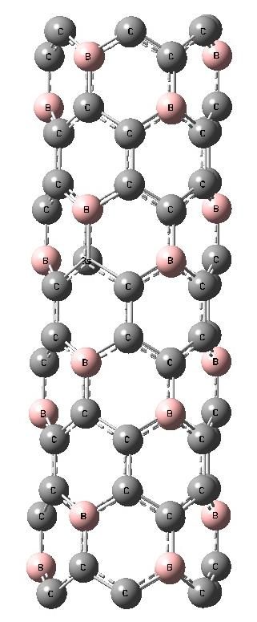
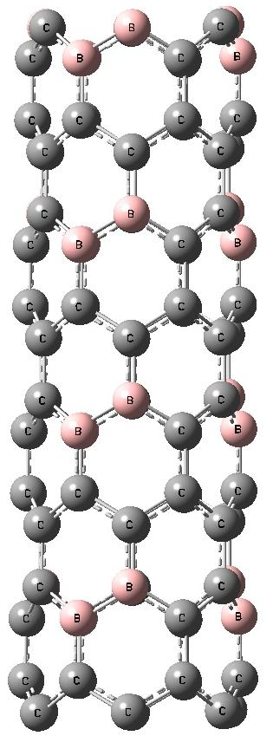
Energy characteristics of BC₃ nanotube
Zig-zag
(n, 0) | D, Å | ΔE_{g}, eV | Strain Energy, eV
Type А
(4, 0) | 3,03 | 2,54 | 0
(6, 0) | 4,77 | 1,21 | 0,04
(8, 0) | 6,35 | 1,07 | 0,13
(10, 0) | 7,72 | 0,77 | 0,2
(12, 0) | 9,57 | 0,12 | 0,19
Type B
(4, 0) | 3,03 | 0,27 | 0,1
(6, 0) | 4,77 | 0,07 | 0,11
(8, 0) | 6,35 | 0,35 | -0,12
(10, 0) | 7,72 | 0,03 | -0,08
(12, 0) | 9,57 | 0,29 | -0,14
а) b)
Fig.1 Extended elementary cell of BC₃ nanotube:
a) atom location in type A;
b) atom location in type B.

Slide 4
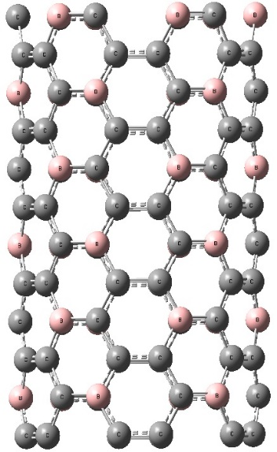
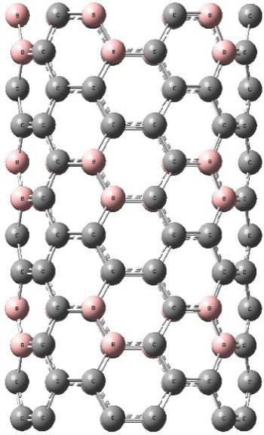
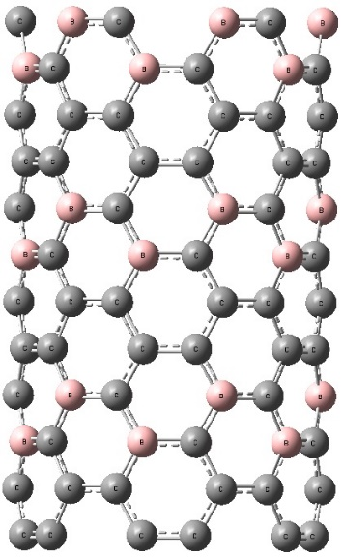
Arm-chair
(n, 0) | D, Å | ΔE_{g}, eV | Strain Energy, eV
Type А
(4, 4) | 5,42 | 6,44 | 24,05
(6, 6) | 8,14 | 6,41 | 31,93
(8, 8) | 10,85 | 4,89 | 33,25
(10, 10) | 13,56 | 3,11 | 42,55
(12, 12) | 16,27 | 2, 98 | 70,94
Type B
(4, 4) | 5,42 | 4,19 | 53,62
(6, 6) | 8,14 | 5,33 | 31,27
(8, 8) | 10,85 | 3,76 | 10,45
(10, 10) | 13,56 | 2,59 | 40,06
(12, 12) | 16,27 | 2,25 | 31,44
а) b) c)
Fig.2 Extended elementary cell of BC₃ nanotube:
a) atom location in type A; b) atom location in type B;
c) atom location in type C
Type C
(4, 4) | 5,42 | 8,79 | 16,58
(6, 6) | 8,14 | 8,78 | 26,60
(8, 8) | 10,85 | 5,47 | 26,97
(10, 10) | 13,56 | 3,88 | 30,21
(12, 12) | 16,27 | 3,96 | 10,00

Slide 5
Fig. 3 Strain energy as a function of corresponding diameter of BC₃ nanotubes:
a) zig-zag; b) arm-chair
Fig. 4. Energy gap as a function of corresponding diameter of BC₃ nanotube:
a) zig-zag; b) arm-chair

Slide 6
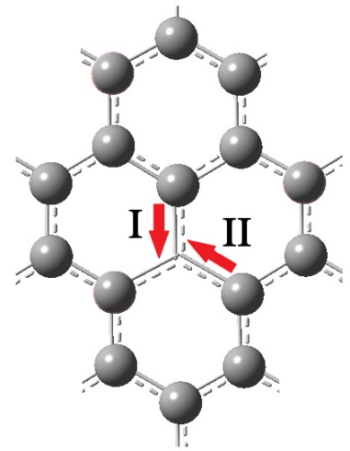
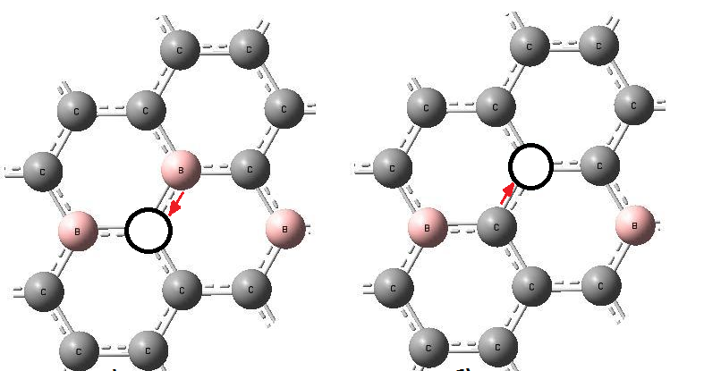
Vacancy migration
Fig. 5. Ways of migration: a) zig-zag; b),c),d) arm-chair
Way of migration | Zig-zag |  | Arm-chair, eV
 | Е_{а}^{А} , eV | Е_{а}^{B} , eV
I | 2,38 | 2,44 | 3,05
II | 3,44 | 1,63 | 5,46
Atoms, which are located near the vacancy, have been charged.
So, the vacancy migration is equal to ion migration on the nanotube surface

Slide 7
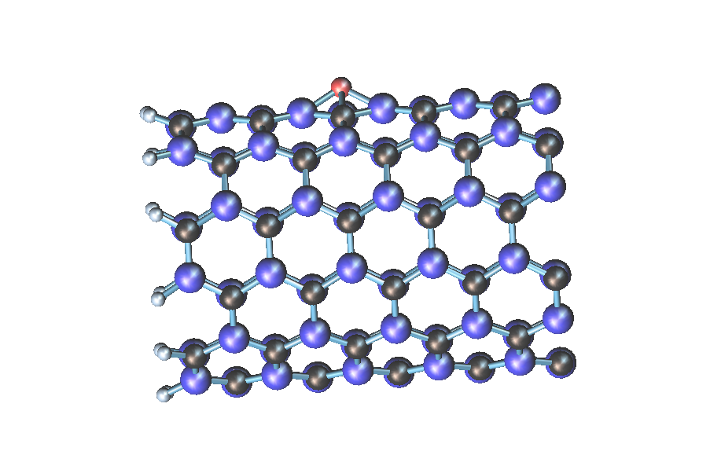
Adsorption H and O on BC

Slide 8
Adsorption H and O on BC
Adsorption variants | E activation | R_{ad}, Å | Е_{ad}, eV
H on Centre | - | 1,3 | -9,17
H on B-C | - | 1,2 | -7,3
H on C | - | 1,3 | -5,87
H on B | - | 1,2 | -6,36
O on Centre | 1,058 | 1,6 | -9,475
O on B-C | 4,242 | 1,3 | -6,85
O on C | 1,039 | 1,4 | -13,479
O on B | 5,633 | 1,4 | -13,213
Fig. 6 Potential energy curves of atom H and O interaction with the surface of boron-carbon nanotube; a) H atom above BC nanotube;
b) O atom above BC nanotube

Slide 9
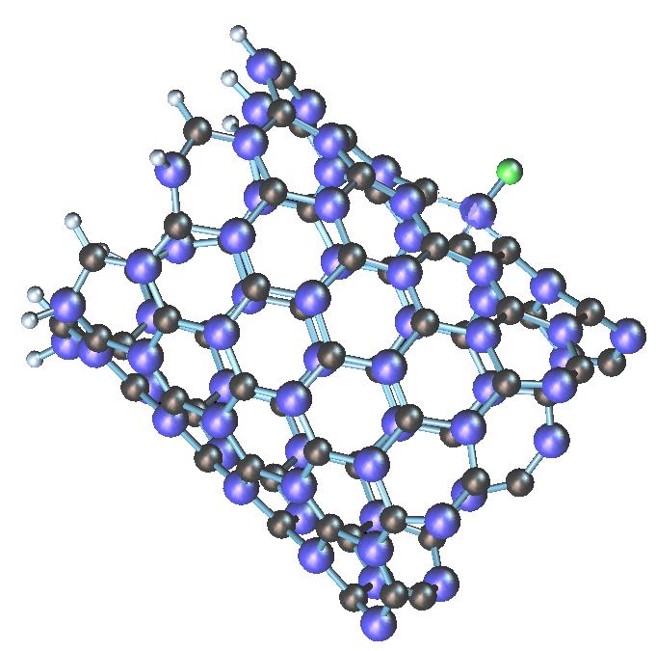
Adsorption Cl on BC
Fig. 7 Potential energy curves of atom Cl interaction with the surface of boron-carbon nanotube and the view of the adsorption complex
Adsorption variants | E activation | R_{ad}, Å | Е_{ad}, eV
Cl on Centre | - | 1,4 | -5,19078
Cl on B-C | - | 1,4 | -10,92
H on C | - | 1,4 | -6,2006
H on B | - | 1,6 | -13,101

Slide 10
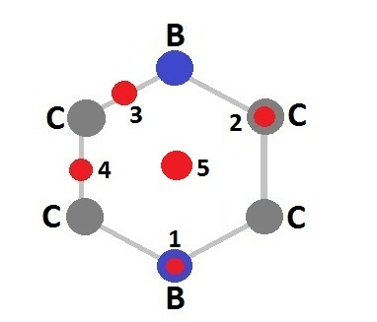
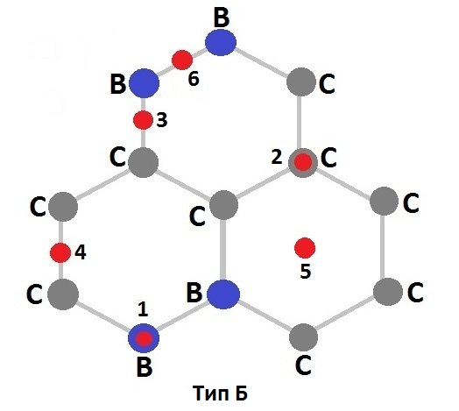
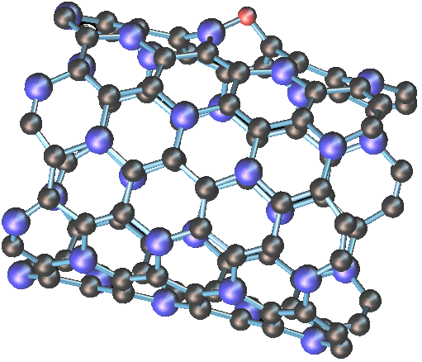
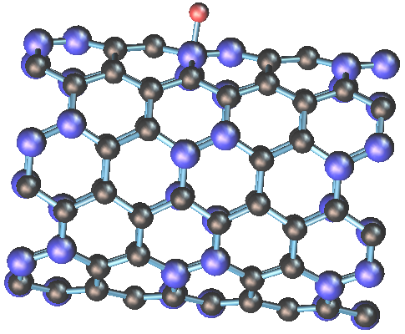
Adsorption atom O on BC3 A and B type
Fig. 8 Options of arrangement of atoms concerning a surface of a nanotube of type A and type B:
over pine forest atom;
over carbon atom,
over communication center V-with,
over communication center of C-C,
over the center of hexarutting,
over communication center of V-century.

Slide 11
Adsorption O on BC3 type A and type B
Adsorption variants | E activation | R_{ad}, Å | Е_{ad}, eV
TYPE A
O on B | 2,15 | 2,4 | -9,56
O on C | 7,94 | 2,2 | -5,67
O on C-B | 2,07 | 1,3 | -9,56
O on C-C | 6,09 | 1,3 | -11,66
O on Centre | 2,15 | 2,4 | -6,44
TYPE B
O on B | - | 1,4 | -9,54
O on C | 1,85 | 1,4 | -6,62
O on C-B | 2,3 | 1,3 | -9,63
O on C-C | - | 1,3 | -11,51
O on Centre | 3,74 | 2,2 | -6,06
O on B-B | - | 1,3 | -11,69

Slide 12
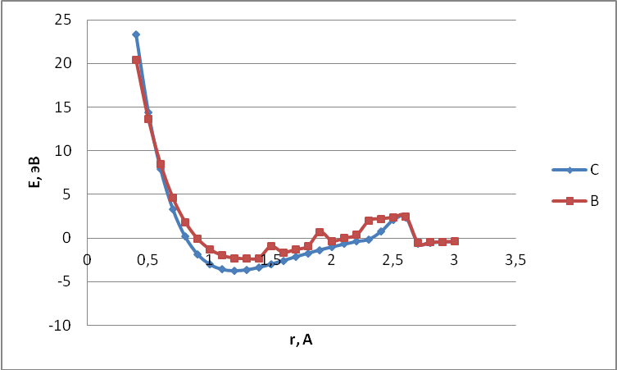
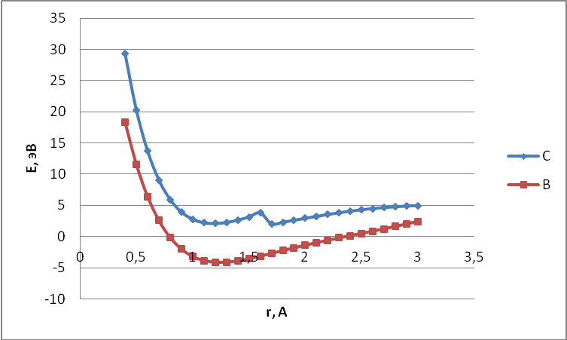
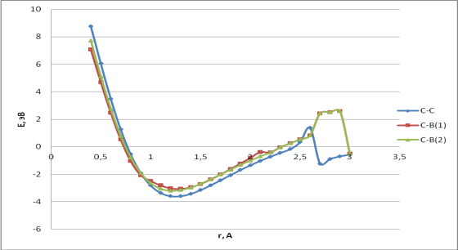
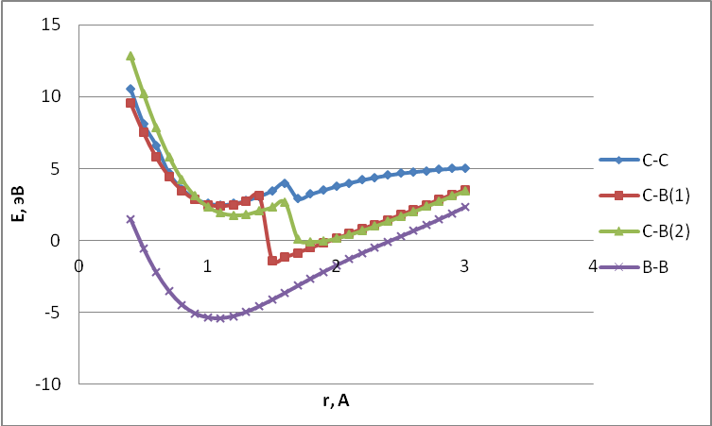
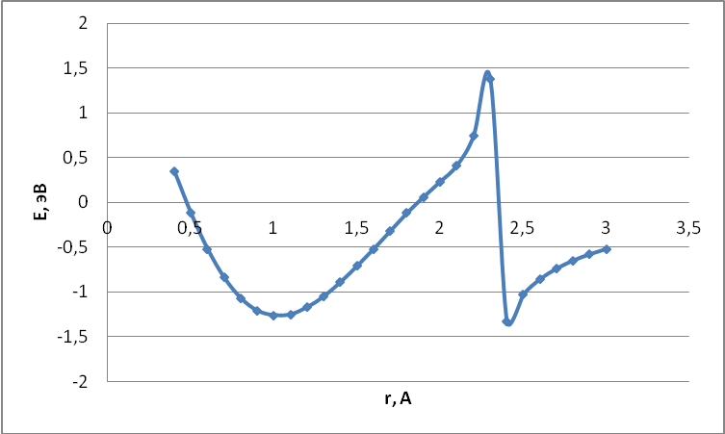
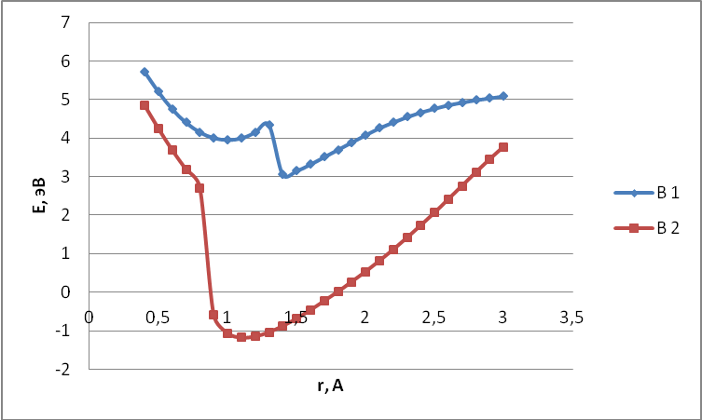
Adsorption H on BC3 type A and type B
Adsorption variants | Qa | R_{ad}, Å | Е_{ad}, eV
TYPE A
H on B | 0,11 | 1,3 | 2,37
H on C | 0,17 | 1,2 | 3,77
H on C-B | 0,22 | 1,3 | 3,06
H on C-C | 0,24 | 1,2 | 3,59
H on Centre | 0,51 | 1,0 | 1,26
TYPE B
H on B | -0,09 | 1,2 | 4,12
H on C | 0,16 | 1,2 | 0,16
H on C-B | 0,15 | 1,5 | 1,4
H on C-C | 0,16 | 1,0 | 2,59
H on Centre | 0,21 | 2,2 | -6,06
on B-B | 0,02 | 1,1 | 0,05
Type A
Type B
Fig. 9 Potential energy curves of atom H interaction with the surface of boron-carbon nanotube and the view of the adsorption complex for A and B type

Slide 13
Adsorption atom Cl on BC3 A and B type
Type A
Type B
Adsorption variants | E activation | R_{ad}, Å | Е_{ad}, eV
TYPE A
Cl on Centre | 0,39 | 1,6 | -3,43
TYPE B
Cl on B-B | 0,37 | 1,9 | -4,58
Fig. 10 Potential energy curves of atom Cl interaction with the surface of boron-carbon nanotube and the view of the adsorption complex for A and B type

Slide 14
Conclusion
Six modifications of boron-carbon nanotubes have been investigated. It has been proved that BC₃ nanotubes zig-zag type are semiconductors, while arm-chair type is insulator.
Vacancy formation causes increasing of the energy gap for both types of the BC₃ nanotubes.
Vacancy migration is possible for both ways. Activation energy for BC₃ nanotubes smaller then for clear carbon nanotubes. It makes the defect formation more energetically favorable in boron-carbon nanotubes.
Hydrogen adsorption on the external surface of boron carbon nanotubes has been investigated. It was proved, that adsorption is possible for all variants of hydrogen atom location above the nanotube surface. The process of adsorption becomes energetically more favorable if some boron atoms are located near the place of adsorption!

Slide 15
Conclusion
Also adsorption of oxygen on a surface of boron-carbon nanotubes of BC and BC3 of type has been investigated. During the research it was established that there is chemical adsorption of atom to the tubulene surface. The analysis of results of geometry found out that approach of oxygen to a tube of type A leads to deformation of a surface: boron and carbon atoms moved to the adatom from the nanotube surface
By analogy with the previous researches chlorine atom interaction with boron-carbon nanotubes has been modeled. It was established that only physical adsorption is implemented. Also interaction with atom of chlorine does not cause deformation of a tubulene.

Slide 16
Thank you for your attention!

