Slide 1
Activities of Data Acquisition Unit at LNS

Slide 2
Divisione Ricerca
Resp.
Stefano Romano
Servizio Calcolo e
Tecnologie informatiche
Resp.
Emidio Giorgio
Reparto Reti e
Trasmissione dati e
Acquisizione dati
Resp.
Giovanni Barbagallo
Del Tevere Francesco
Ferrera Francesco

Slide 3
Tasks
Maintenance
Support
Development

Slide 4
Maintenance DAQ/test systems
Chimeracq
TatoCamac
TatoVME
Wavedump

Slide 5
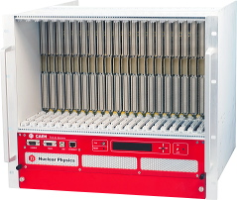
Chimeracq
(C++ / Xforms TK / PAW)
V2718
V977
V785 (4x32Ch)
VME
f.o.
ethernet
Server
Server
xconsolle (control)
xchimerafdl (analysis)
pawchi (histograms)
xmonitor (monitoring)
chireadout (acquisition)

Slide 6
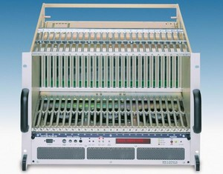
TatoCamac
1° version: Fortran (ifc) / Dislin / PAW
2° version: C / TCL-TK / PAW
SCSI
Jorway 73A
LAM Gen/TINA
Silena 4418
PC
CAMAC

Slide 7
TatoVME
(C / TCL-TK / PAW)
f.o./USB
V2718/V1718
V977
V785
PC
VME

Slide 8
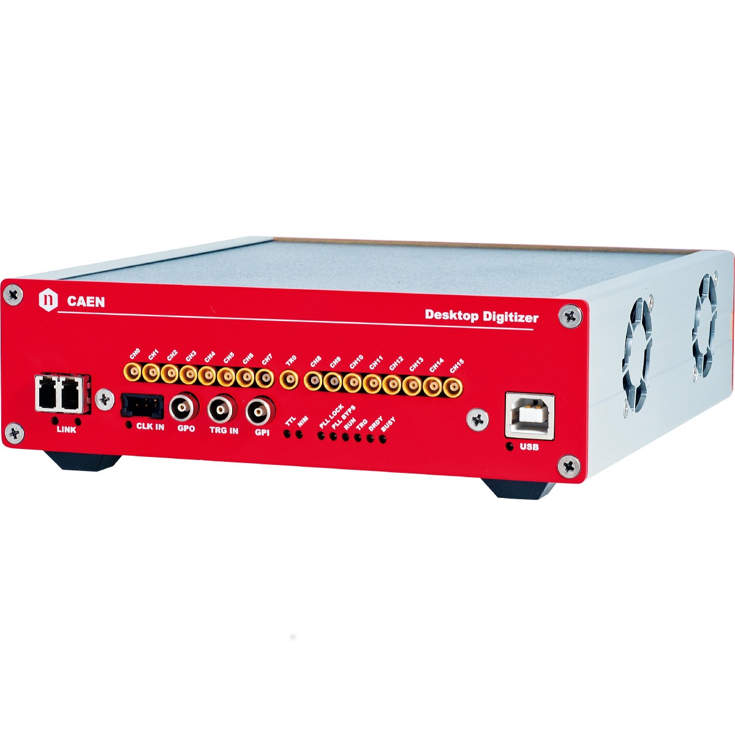
Wavedump
(C / GNUPLOT)
f.o./USB
DT5742
DT5725
PC
Digitizer

Slide 9
Support
DAQ use and configuration
OS, drivers, libraries, applications
devices test
“stock spare parts”
…..

Slide 10
Development
Daq/test systems
New devices integration
Debug
…..

Slide 11
Things to do (?)
Paw -> Root
Tcl-Tk -> Python-Tkinter
Wavedump -> TatoDigit
Others DAQ software (CAEN, Mesytec, …)
…..

