Slide 1
Status of ⁸⁸Sr, ⁸⁹Y

Slide 2
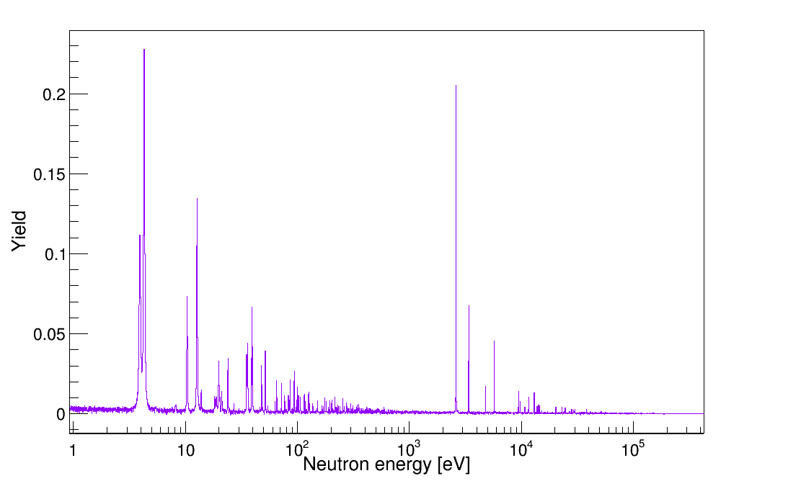
PRELIMINARY
⁸⁹Y

Slide 3
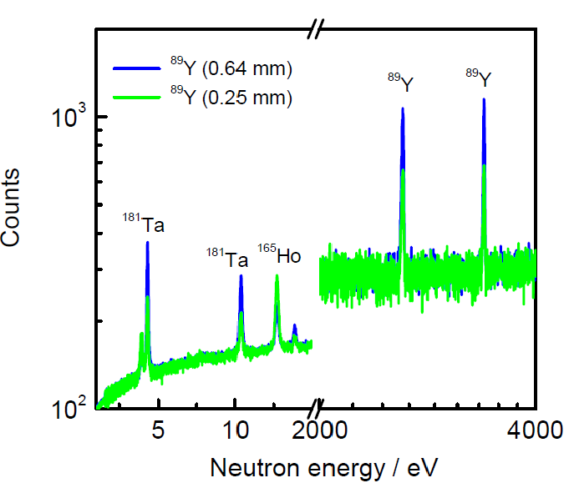
PRELIMINARY

Slide 5
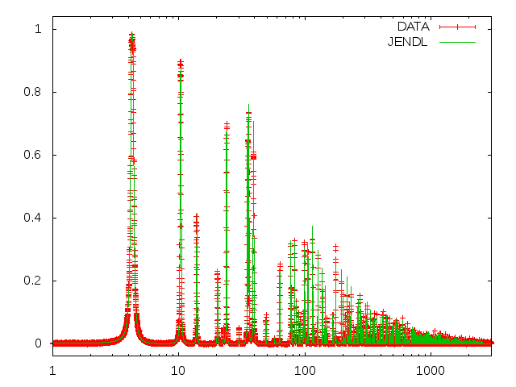
Studio dei contaminanti
YIELD
En (eV)

Slide 6
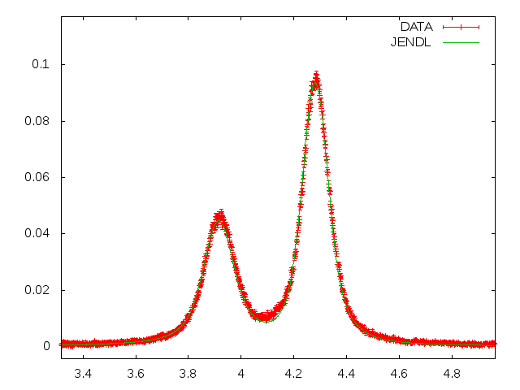
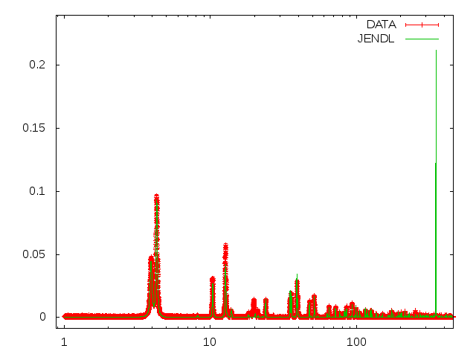
Studio dei contaminanti
YIELD
Ta
Ho
Ho
Ho
Ta
Ho
Ho
En (eV)
Ta
Ta
Ta = 0.295%
Ho = 0.226%
Ta
Ta
Ho
Ta
Ta
Ta
Ho
Ta
En (eV)

Slide 7
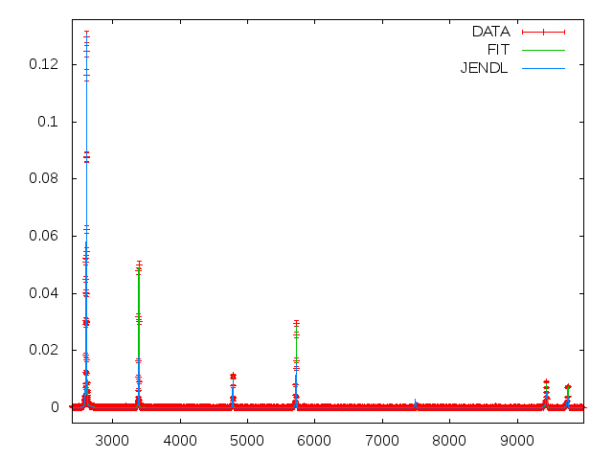
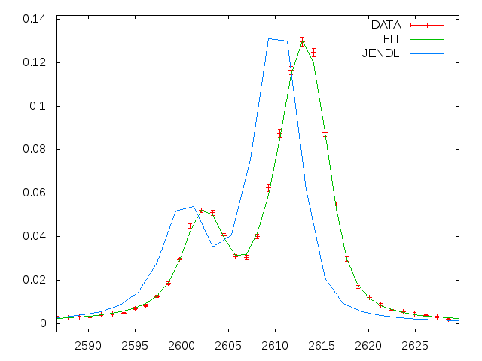
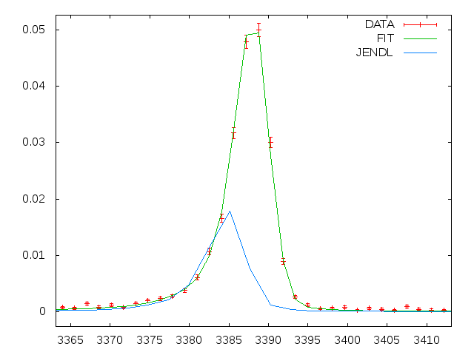
YIELD
YIELD
En (eV)
YIELD
En (eV)
En (eV)

Slide 8
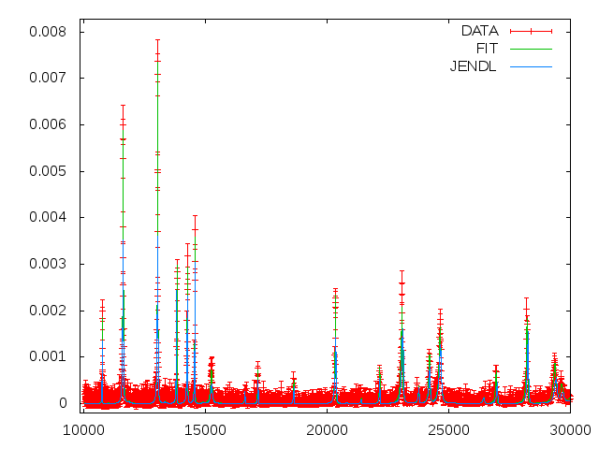
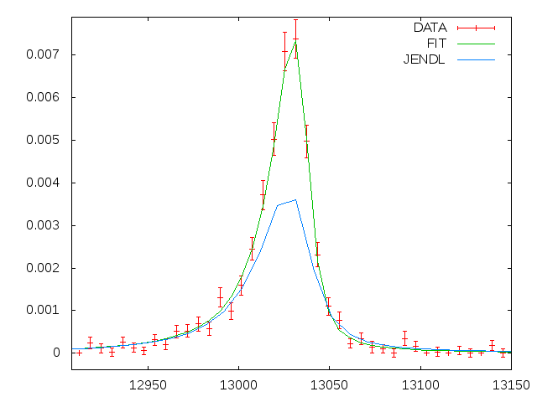
YIELD
YIELD
En (eV)
En (eV)

Slide 9
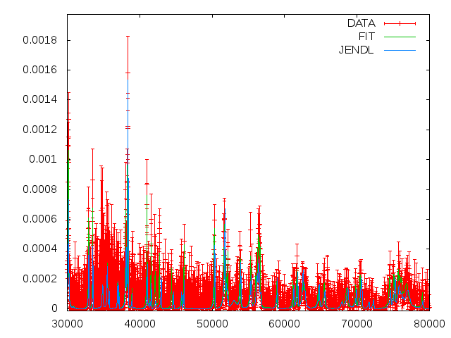
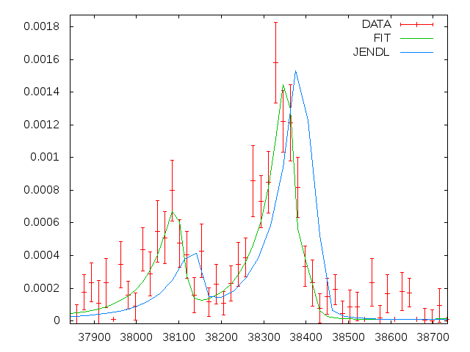
YIELD
YIELD
En (eV)
En (eV)

Slide 13
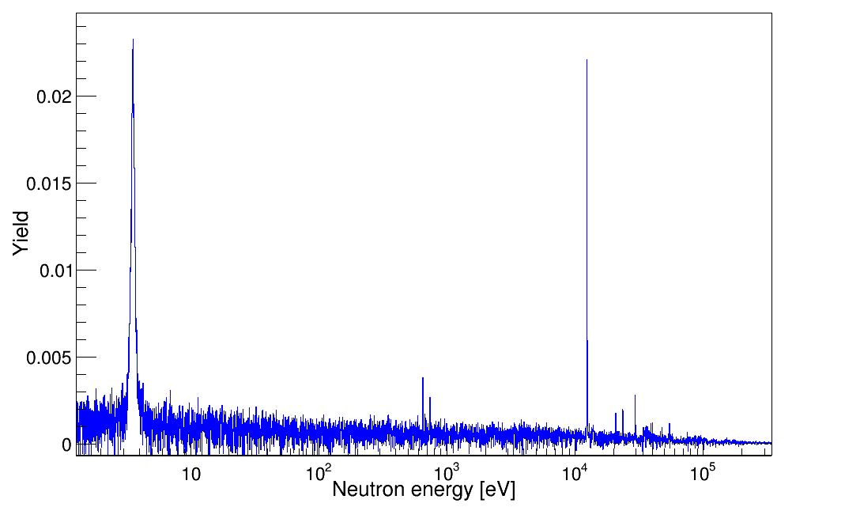
PRELIMINARY
⁸⁸Sr
⁸⁷Sr

Slide 14
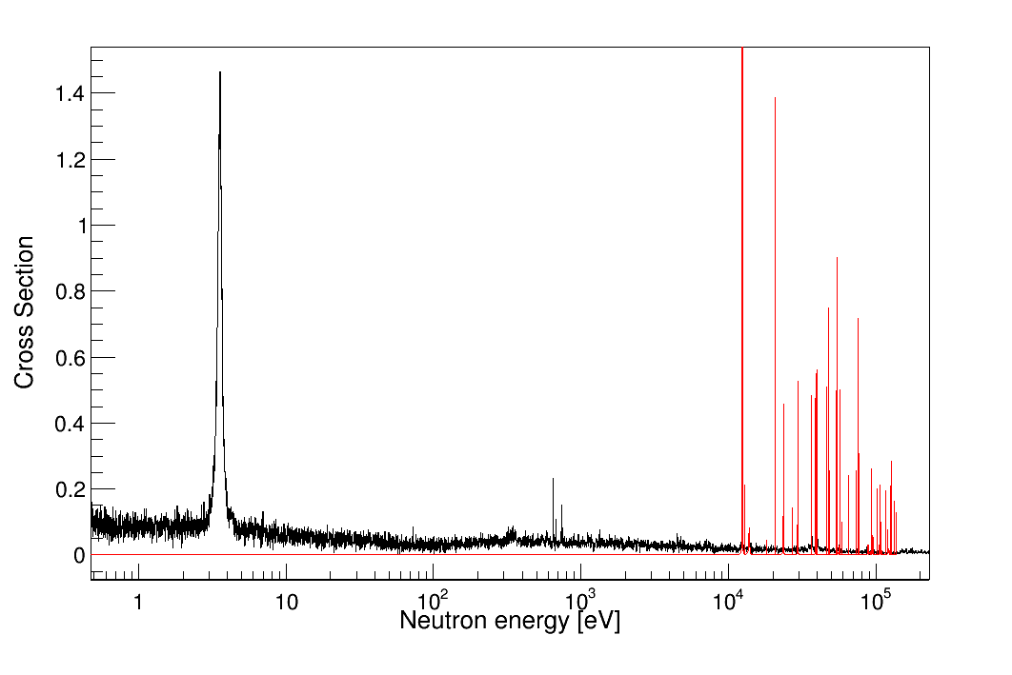
___ n_TOF
___ ENDF

Slide 15
___ n_TOF
___ ENDF

Slide 16
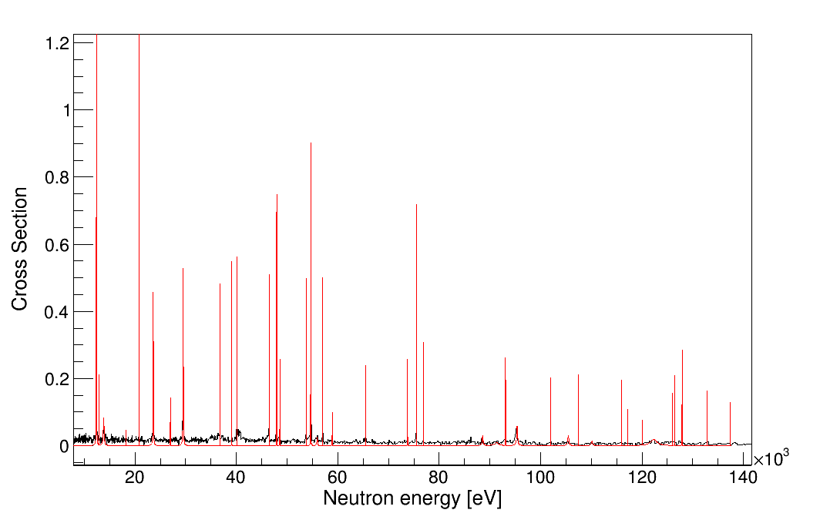
___ n_TOF
___ ENDF

Slide 17
Status of ⁹²Zr

Slide 18
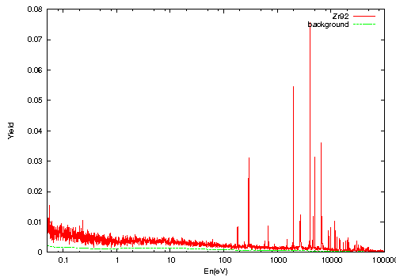
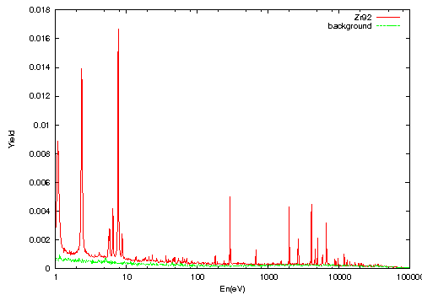
n_TOF phase II (2012)
n_TOF phase I (2002)

Slide 19
Cattura GELINA

Slide 21
Confronto Yirld GELINA n_TOF

Slide 23
Refit:
Γγ: 55 meV
Γn: 24809 meV
SAMMY:
Γγ: 53 meV
Γn: 24809 meV

Slide 24
Refit:
Γγ: 286.9meV
Γn: 4002 meV
SAMMY:
Γγ: 283.3 meV
Γn: 4002 meV

Slide 25
Refit:
Γγ: 64.9 meV
Γn: 14447 meV
SAMMY:
Γγ: 59.7 meV
Γn: 14447 meV
But it was too nice to be true, after this resonance I have problem

