Slide 1
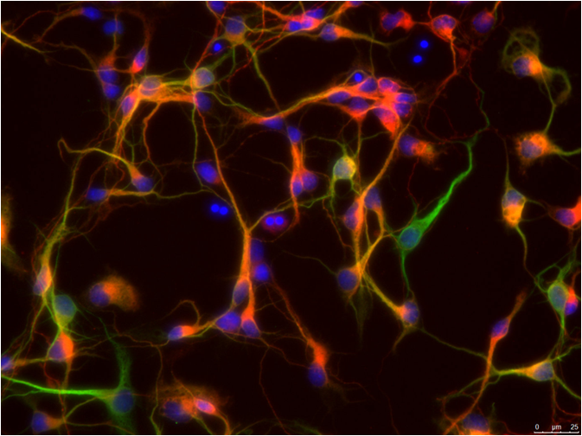


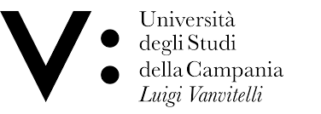
Spontaneous vs. stimulated brain activity:
A statistical physics approach
Lucilla de Arcangelis
University of Campania “Luigi Vanvitelli”
INFN
SM&FT 2019 Challenges in Computational Theoretical Physics
Bari, December 11-13 2019

Slide 2
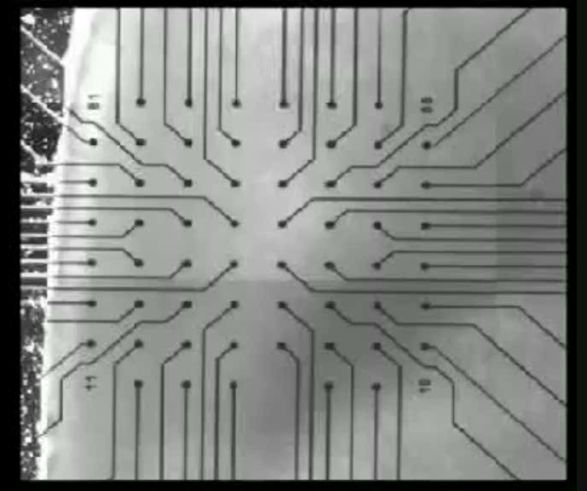
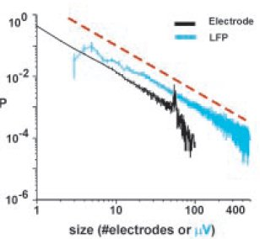
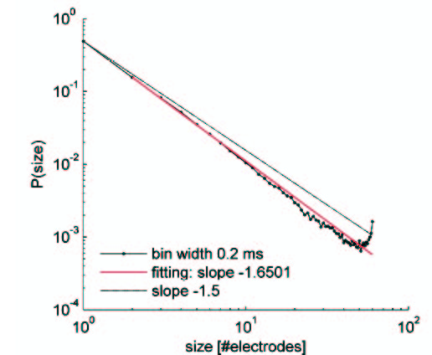
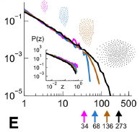
Neuronal avalanches
Beggs & Plenz (J. Neuroscience 2003, 2004) have
measured LFP in mature cultures of rat cortex
in vitro and in vivo (rat & monkey) (PNAS 2008, 2009)
dissociated neurons
(V. Pasquale et al Neurosci. 2008; Mazzoni et al PLoS ONE 2007)
Size distribution of activity cascades scales with exponent -1.5
Shriki et al (J. Neurosci. 2013)
Avalanche size distribution is a power law with an exponent close to -3/2
Avalanche duration distribution is a power law with an exponent close to -2.0
Critical state implies long-range
spatio-temporal correlations

Slide 3
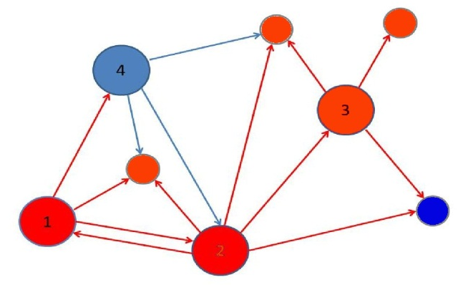
MODEL WITH SHORT AND LONG-TERM PLASTICITY
We assign to each neuron a potential v_{i}
and to each synapse a strength ω_{ij} (directed)
Neurons can be excitatory or inhibitory
A neuron fires when the potential is at
or above threshold v_{max} (-55mV)
Remains quiescent for one time step (refractory time)
Long-term (Hebbian) plasticity and pruning
Activity is triggered by random stimulation of a single neuron
LdA et al PRL 2006; LMvK et al PRE 2018
Model inspired in self-organized criticality
available neurotransmitter
recovers by
after each avalanche
tunes the system at criticality

Slide 4
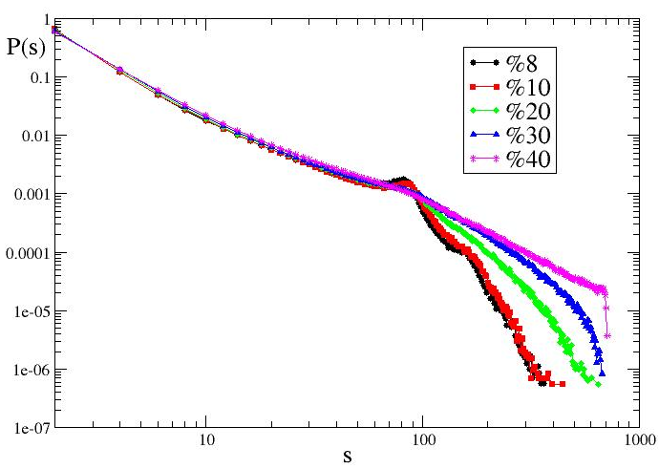
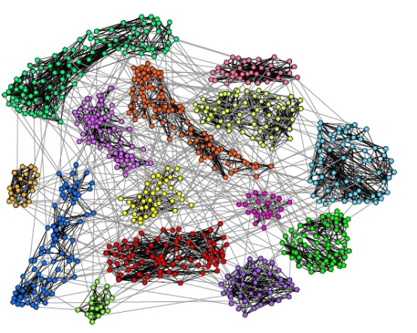
Avalanche size distribution
Avalanche duration distribution
Power spectra
Lombardi et al, Chaos 2017
Russo et al Sci. Rep. 2013

Slide 5
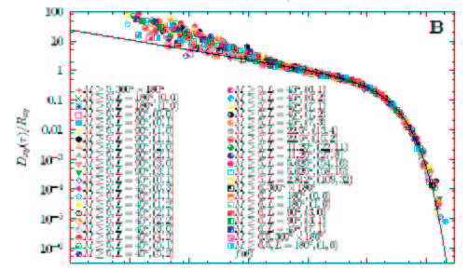
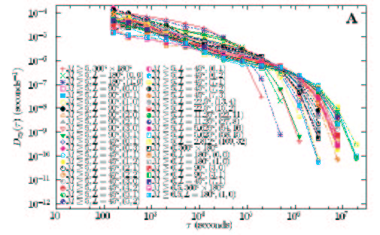
Intertime distribution
II
M
I
Probability distribution of intertimes
between consecutive events
is an exponential for a Poisson process
It exhibits a more complex structure as temporal correlations are present in the process
Δt
t
Corral (PRL, 2004) rescaling by the average rate in the area obtained a universal scaling law for the probability density

Slide 6
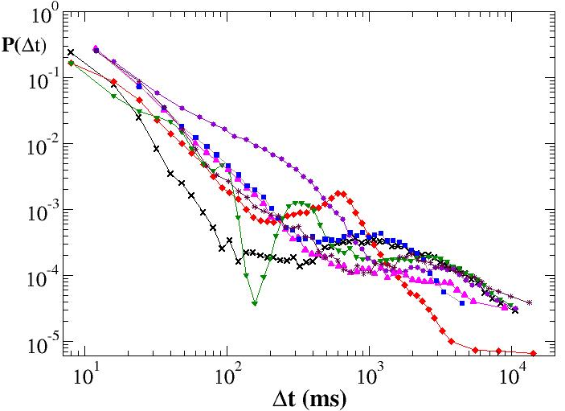
Experimental avalanche inter-time distribution
Experiments by D. Plenz on coronal slices from rat dorsolateral cortex (Lombardi et al PRL 2012)
Initial power law regime with exponent
Minimum at about
Maximum at about

Slide 7
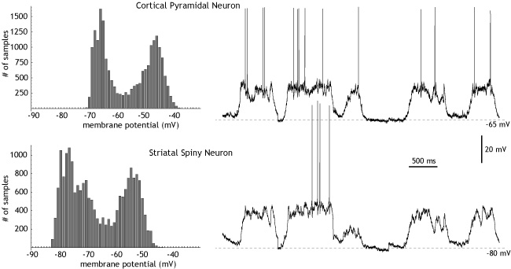
Up-states and down-states
Spontaneous neuronal activity can exhibit slow oscillations between bursty periods, or up-states, and quiet periods, called down-states.
Down-states due to a decrease in the neurotransmitter release (exhaustion of available synaptic vesicles or increase of a factor inhibiting the release, as nucleoside adenosine), the blockade of receptor channels by the presence of external magnesium, spike adaptation…
“Down-state of the network is a state of mutually-enforced quiet”
Network properties explain the up-state: Any input may trigger some mutual excitation and the network will re-excite itself to the up-state
Avalanches are critical in the up-state and subcritical in the down-state (Millman et al Nat Phys 2010)
The alternation between US and DS is expression of the balance between excitation and inhibition
Wilson, Scolarpedia
Neuron state:
Neurons toggle between two preferred membrane potentials: a hyper-polarized one in the down state, and a more positive, depolarized one, in the up-state.

Slide 8
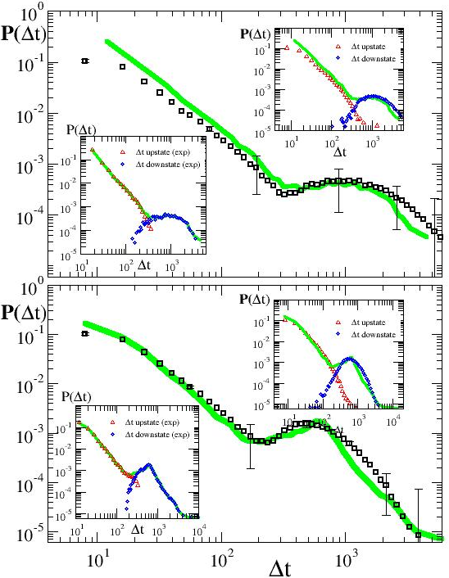
Spontaneous neuronal activity exhibits
slow oscillations between
up-states, and down-states
Small correlated avalanches,
neurons depolarized after firing
Disfacilitation period after large avalanches
Neurons hyperpolarized after firing
Balance between excitation and inhibition
Homeostatic regulatory mechanism

Slide 9
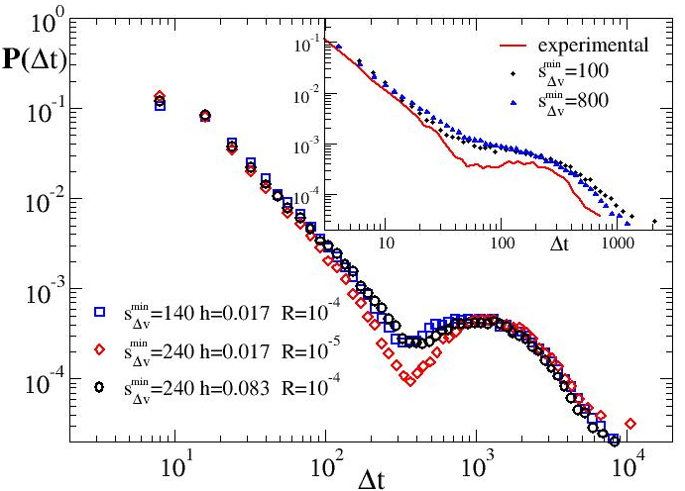
espressing the balance between excitation and inhibition
is the unique parameter controlling the distribution
Homeostatic regulatory mechanism

Slide 10
Critical vs. supercritical systems

Slide 11
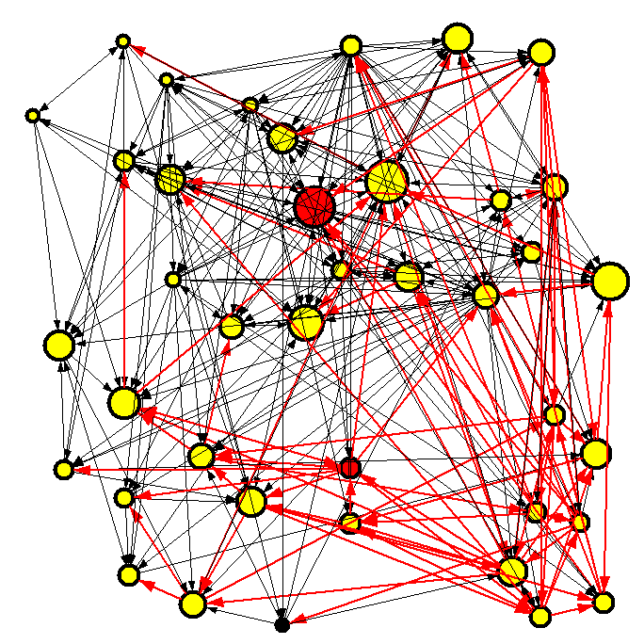
LEARNING
LdA and HJH, PNAS 2010
2 input (red) and 1 output (black)
neurons at fixed distance k_{d} on a scale free
network where
OR, AND, XOR,
random rule with 3 inputs:
1/0 firing/not firing
Let the avalanche propagate
Check state of output neuron
Non uniform negative feedback with plasticity
parameter α (Bak & Chialvo PRE 1999):
If the answer is right, do nothing
If the answer is wrong, adjust synaptic strengths
Dopamine-mediated synaptic plasticity
(Ikemoto Brain Res.Rev. 2007)
+ false negative
- false positive
distance from the output neuron

Slide 12
XOR
The percentage of success is higher for slower plastic adaptation (Lewis et al PNAS 2009)
Learning performance increases with the level of connectivity of the system
Learning performance decreases with the input-output distance
Larger systems learn more efficiently
Second chance dependence on the initial state
Dumb systems have less hubs than smart ones
Memory depends on the rule and the intensity of perturbation
What is the role of inhibitory synapses?

Slide 13
MULTI-TASK LEARNING:
Learning vs. forgetting
Capano et al, Sci.Rep 2015
Curves are no longer monotonic
Learning new rules proceeds via forgetting rules previously learned

Slide 14
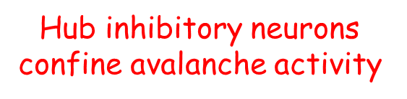
Optimal Percentage of Inhibitory Synapses
By increasing p_{in} (disorder)
entropy increases
average excitability decreases
Younger and best performing brains have a higher variability than older and poorer performing brains
(Garrett et al J. Neurosci. 2010, 2011)

Slide 15
Pattern recognition
output regions
Handwritten digits
MNIST:
60000 training images
10000 testing images
scale-free
network
input
Back-propagation is very efficient
but requires the knowledge of
the full path of
propagation
LMvK et al PRER 2019

Slide 16
Learning occurs through negative feedback mechanisms (Bak & Chialvo PRE 2001) :
For correct response, no synaptic modification
If the system makes a mistake, all output neurons release learning signal
strengthening/weakening incoming synapses
Intensity of learning signal decreases with distance from output neurons
Dopamine-mediated synaptic plasticity (Ikemoto Brain Res.Rev. 2007)
firing rate

Slide 17
Entropy decreases as the system learns
and response becomes more predictable

Slide 18
Cosine similarity measures difference
between activity regions
average firing rate vector for patterns in class k
as the system learns, segregated activity regions emergefor different pattern classes
distinct cortical columns in the primary visual cortex V1 respond to different patterns
Segregated activity areas emerge naturally from an untrained neural network through the mechanism of negative feedback

Slide 19
Spontaneous vs. stimulated activity
Arieli et al, Science 96
Optical imaging and and LFP in the visual cortex of the cat (areas 17-18)
under repeated visual stimulations
Average reproducible
Response
Initial ongoing activity
Predicted response
Measured response

Slide 20
Stochastic Wilson Cowan model
Ohira Cowan 1997
In terms of fluctuations
where

Slide 21
Fluctuation - dissipation relation
Sarracino et al 19
MEG data by O. Shriki
average response
to an impulsive perturbation

Slide 22
Collaborations
Hans J. Herrmann, ETH Zurich
Alessandro Sarracino, Unicampania
Carla Perrone Capano, University of Naples
Laurens Michiels von Kessenich, ETH Zurich
Damian Berger, ETH Zurich
Fabrizio Lombardi, ETH Zurich, BostonU
Emanuele Varriale, University of Naples
Vittorio Capano, University of Naples
Gianluca Pellegrini, University of Naples
Roberta Russo, University of Naples
Dietmar Plenz, NIH Bethesda
Oren Shriki, Ben-Gurion U

