Slide 1


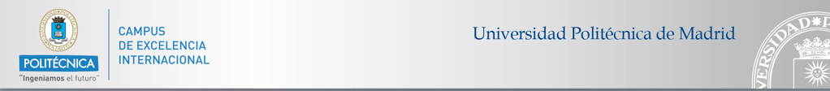
Graphene Technology for PTOLEMY Project
Javier Martínez¹, R. Santorelli²,, P. Garcia Abia², I. Garcia-Cortes², S. Cabrera², A. Moroño² ,
J. P. González², D. Sanz González², J. Morales Merino², S. Fernández², J. Cárabe²,
A. Molinero², J.M. Barcala², M.B. Gómez-Mancebo², R. Fernández², I. Rucandio²,
G. Garcia³, A. Boscá¹, J. Pedrós¹, F. Calle¹
¹ Instituto de Sistemas Optoelectrónicos y Microtecnología, Universidad Politécnica de Madrid, Madrid, Spain
² CIEMAT, Centro de Investigaciones Energéticas Mediambientales y Tecnológicas Madrid, Spain
³ CSIC, Consejo Superior de Investigaciones Científicas, Madrid, Spain
Contact: javier.martinez@upm.es

Slide 2
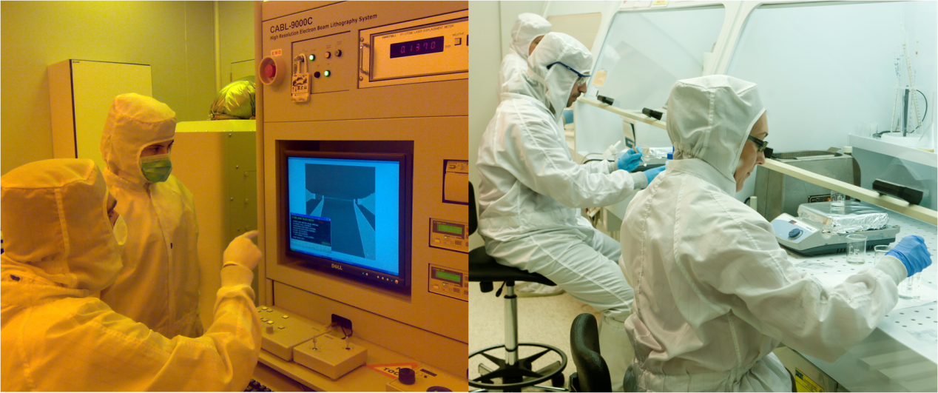
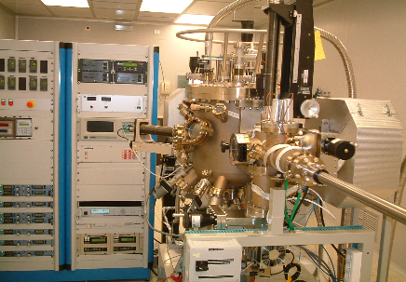
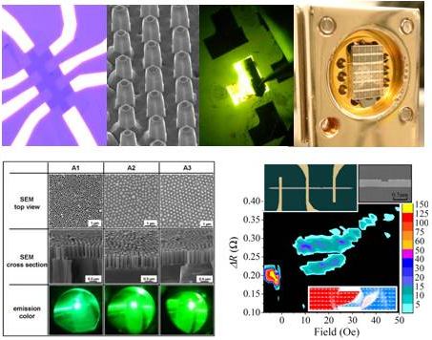


MICRO NANO FABRICATION NETWORK
400 m² Clean Room
300 m² Characterization Laboratories
200 m² Instrumentation and electronic Laboratories

Slide 3
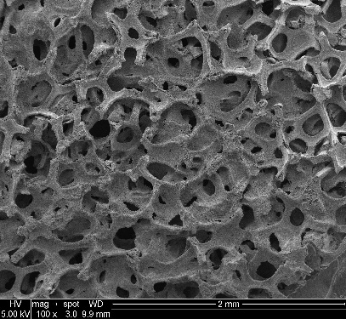
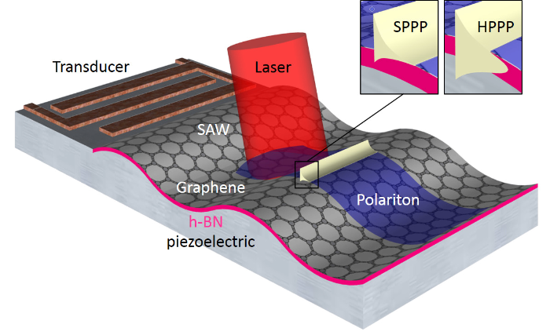
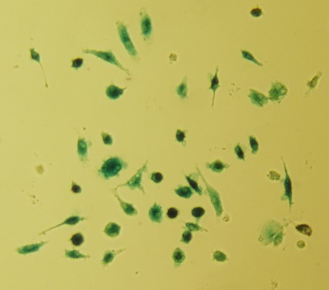
www.isomgraphene.es
Research lines
Green energy
  Supercapacitors
  Solar cells
Information and communication
  Plasmon resonators
  GFETs
  2D materials / III-V devices
Health
  Graphene-macrophage patches

Slide 4
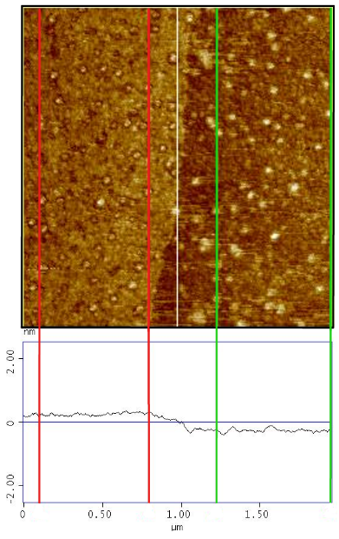
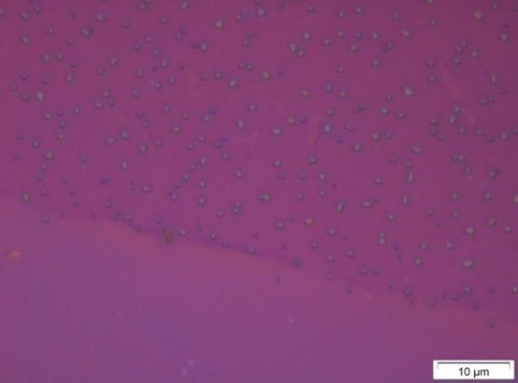
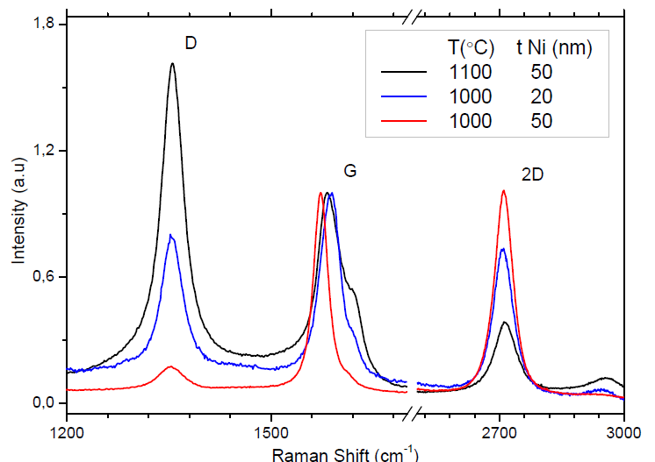
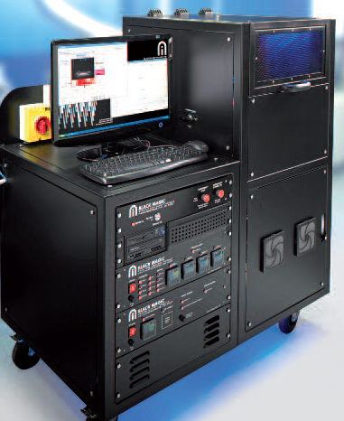
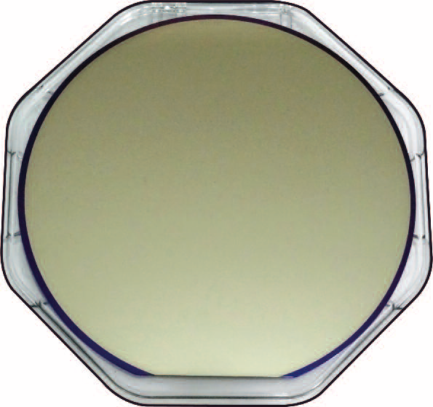
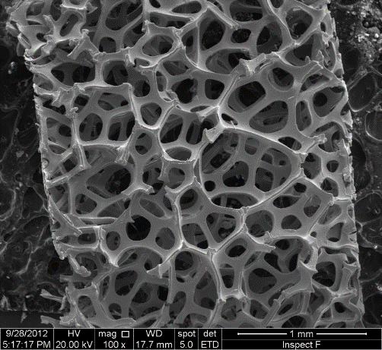
GRAPHENE FABRICATION
Exfoliation from pyrolythic graphite
2 µm
Large area graphitization from polymers
2 µm
Nomarski x100
Step: 0.5 nm
50 µm
PECVD on metal foils and foams
φ = 4 inch
Notes:
25 nm PMMA
50 nm Ni

Slide 5
GRAPHENE GROWTH BY CVD

Slide 6
QUALITY IN GRAPHENE FABRICATION
Adapted from K. S. Novoselov, V. I. Fal′ko, L. Colombo, P. R. Gellert, M. G. Schwab, and K. Kim, Nature, vol. 490, no. 7419, pp. 192–200, (2012).

Slide 7
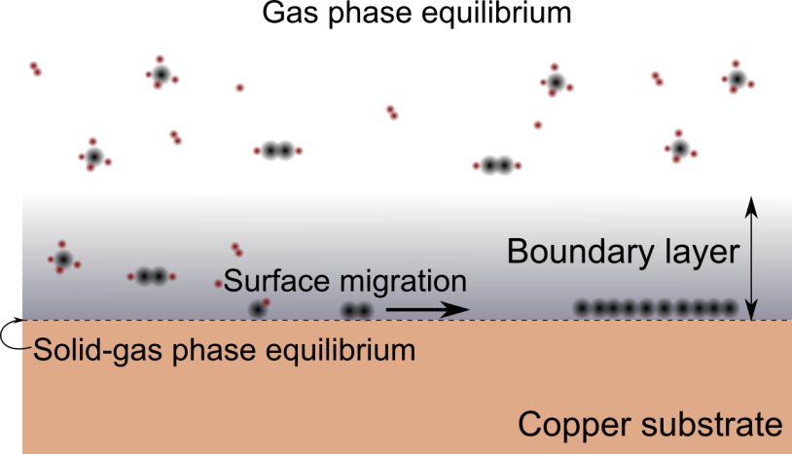
GRAPHENE FABRICATION BY CVD
Gas phase conditions (flux, temperature and pressure) establish growth in solid-gas phase
Reactive H*
  Etch of graphene grain edge
  Nucleation density mitigation
Dissociated C
  Increase growth speed
  Increase nucleation density

Slide 8
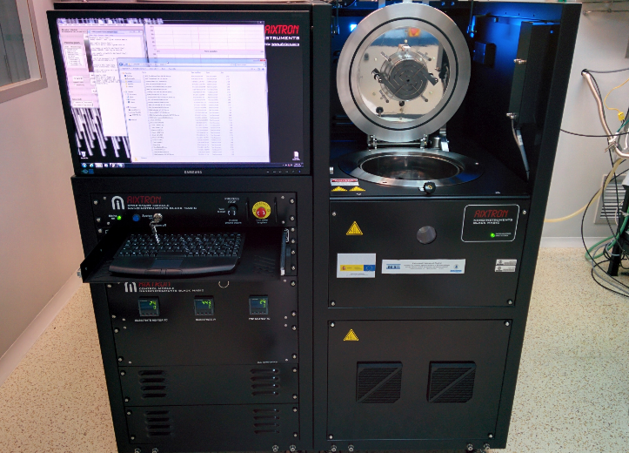
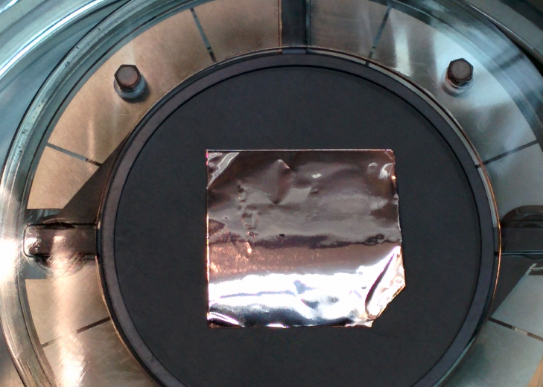
IMPROVEMENT IN CVD FABRICATION
CVD system: Aixtron Black Magic pro
  Cold wall reactor. Fast ramp-up and cool-down rates
  Industry-ready
  Prepared for 4” wafers. Typically 1/3 of the size of hot wall reactor
  Methane (CH₄) and acetylene (C₂H₂) as gaseous precursors
  In-situ, controlled oxidation is possible
  Showerhead structure for the gas inlet

Slide 9

IMPROVEMENT IN CVD FABRICATION
CVD is the preferable method for electronics.
  High crystallinity → Increased mobility
  Nucleation density must be decreased
  Large area → Higher throughput
  Lateral growth rate must be increased
  Moderate cost → Scalability
  Cold wall reactors for improved efficiency
Areas of research
  Systematic study of growth thermodynamical conditions
  Pretreatment of the catalytic substrate
    Electropolishing
    Oxidation
    Annealing
  Precursor flux reduction

Slide 10
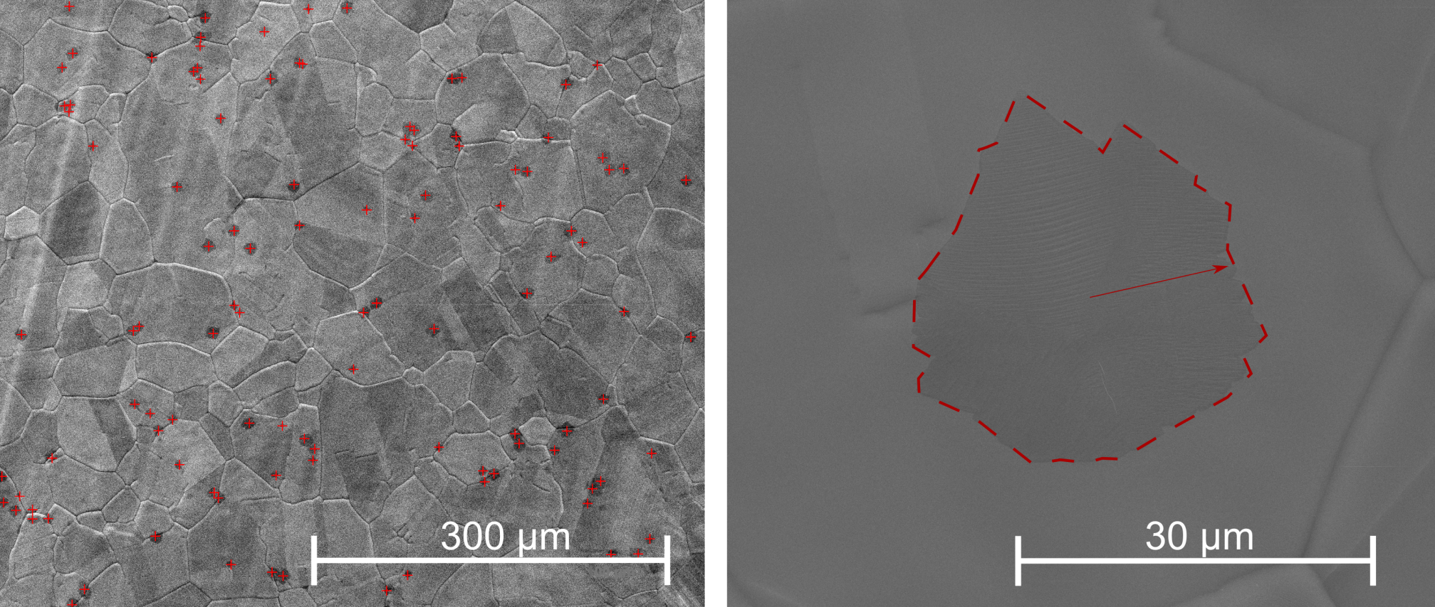
CHARACTERIZATION OF CVD GRAPHENE
SEM Imaging
  Need of partial growth
  Nucleation density (in grains / cm²)
  Lateral growth speed
    Area → Mean diameter → Growth speed (in µm/ min)
Cu foil with small graphene grains. Visible boundaries are from Cu microcrystallinity

Slide 11
GROWTH PARAMETERS: PRESSURE
No growth for pressure higher than 250 mbar
Best results for the lowest pressure
  Sublimation issues

Slide 12
GRAPHENE TRANSFER TO DIFFERENT SUBSTRATES

Slide 13
STARTING POINT IN THE FABRICATION
Manual graphene transfer:
  Requires handling skills
  Is laborious and time consuming
  Induces mechanical stress
  Results in off-centered samples
S. Bae, H. R. Kim et al., Nat. Nanotechnol., vol. 5, (2010), p. 574.
Current automatic systems are:
  Designed for flexible substrates (roll-to-roll)
  Not for sale yet
➔ An automatic transfer for arbitrary substrates is needed

Slide 14
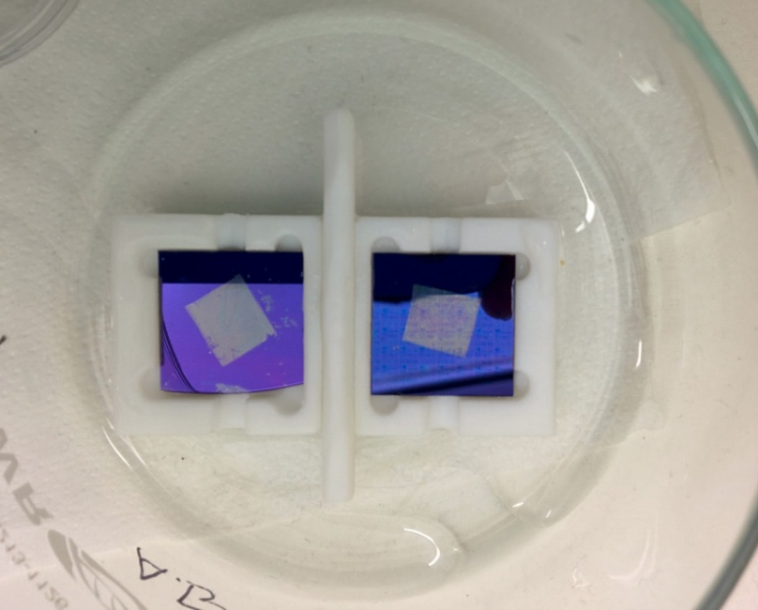
AUTOMATIC SYSTEM PROCESS ALGORITHM
System outcome

Slide 15
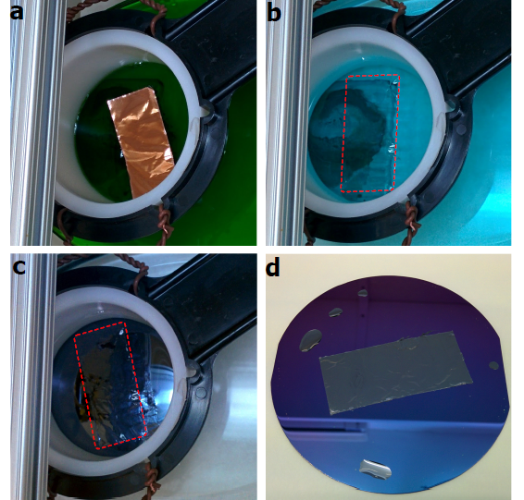
AUTOMATIC SYSTEM PROCESS ALGORITHM
A. Boscá,, J. Pedros, J. Martínez, T. Palacios, F. Calle, Scientific Reports 6, 21676 (2016)

Slide 16
GRAPHENE CHARACTERIZATION

Slide 17
GRAPHENE SUSPENDED MEMBRANES
SEM analysis
Images acquired with SEM of the sample with holes and sample with graphene transferred on top of the holes

Slide 18
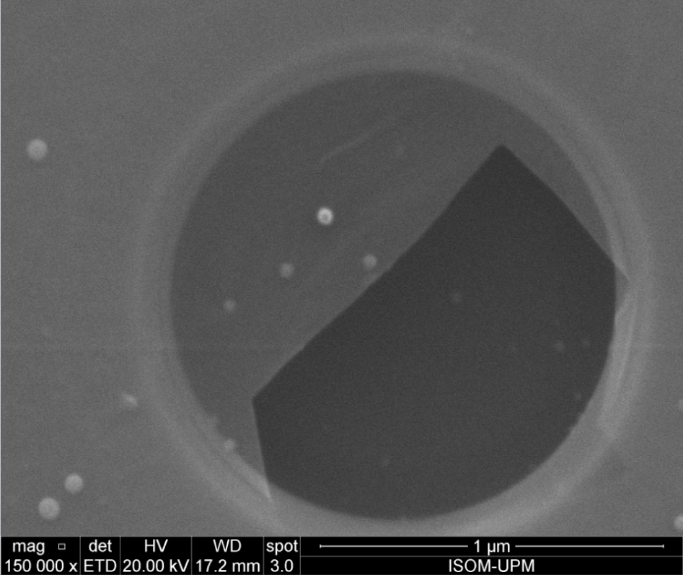
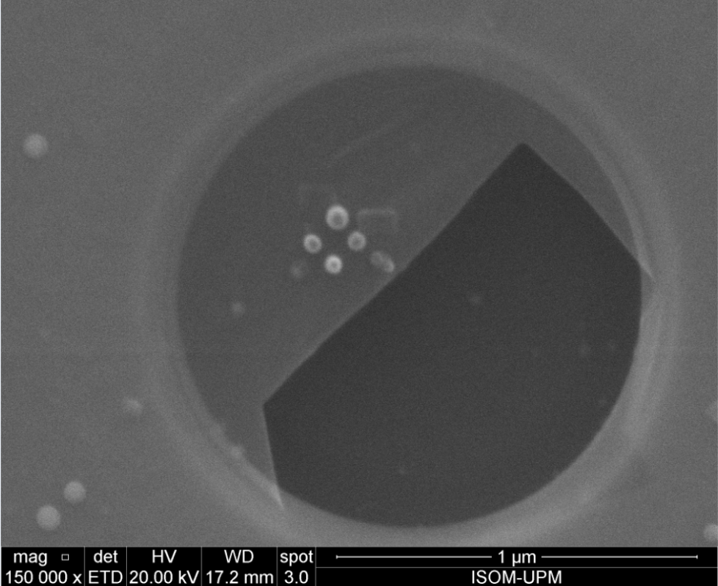
GRAPHENE PATTERNING WITH SEM

Slide 19
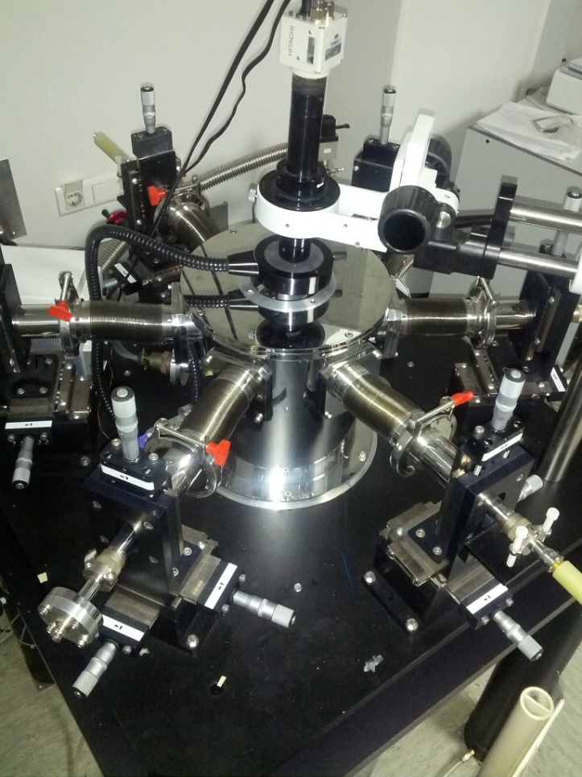
SYSTEM TEST: COMPARISON WITH GFETs
Vacuum annealing for adsorbent removal
Dirac point displacement monitoring
3-terminal characterization
Use of an extraction method for the electrical parameters
JANIS high/low temperature vacuum probe station
A. Boscá, J. Pedrós, J Martínez and F. Calle, J. Appl. Phys., vol. 117, (2015), p. 044504

Slide 20

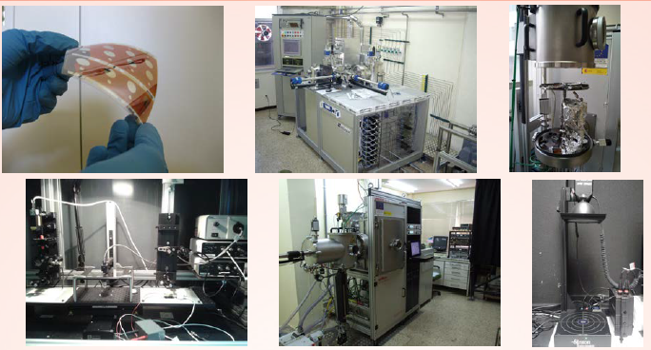
OTHER CHARACTERIZATION TECHNIQUES
✓ Optical Characterization: UV/Vis/NIR and FTIR.
✓ Electrical Characterization: J-V with or without light
✓ Photocurrent measurement: QSSPC and SUNS−V^{OC}.
✓ Laser Beam Induced Current system (LBIC).

Slide 21
GRAPHENE DEVICE FABRICATION

Slide 22
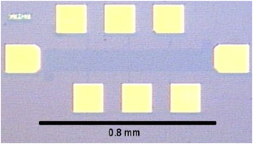
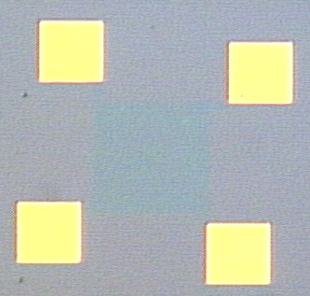
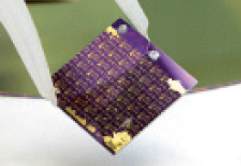
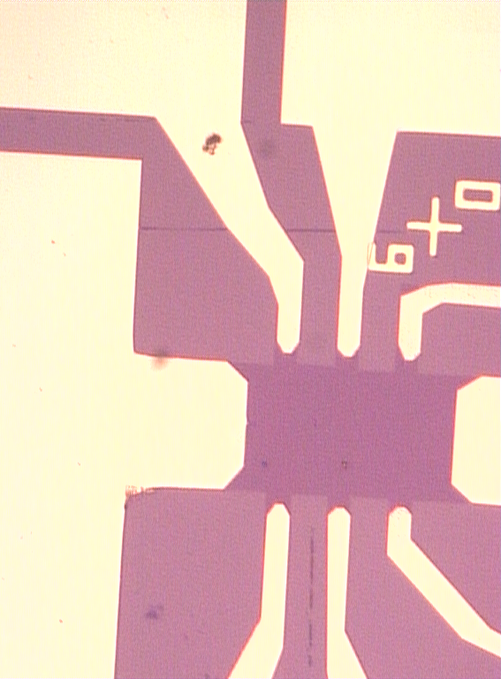
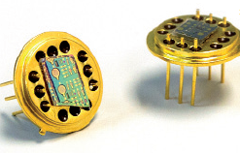
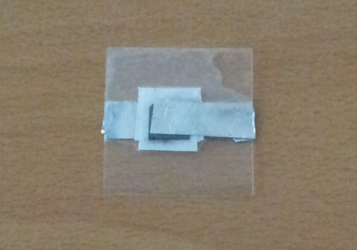
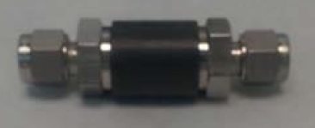
Electronic Devices
GRAPHENE GROUP AT ISOM
Hall bars
TLMs
Van der Pauw
Transistors
Flexible electronics
Supercapacitors

Slide 23
GRAPHENE IRRADIATION WITH DEUTERIUM

Slide 24
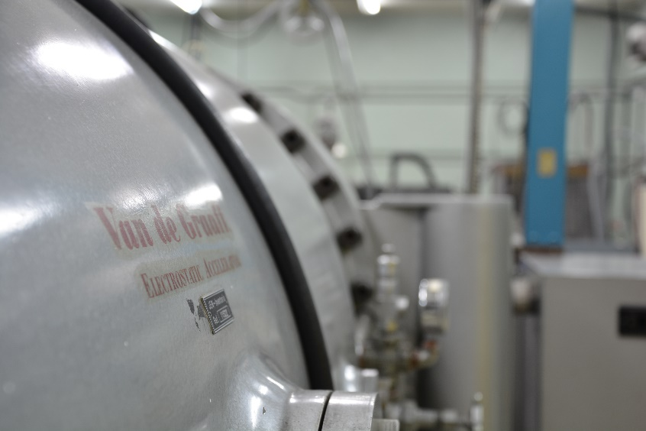
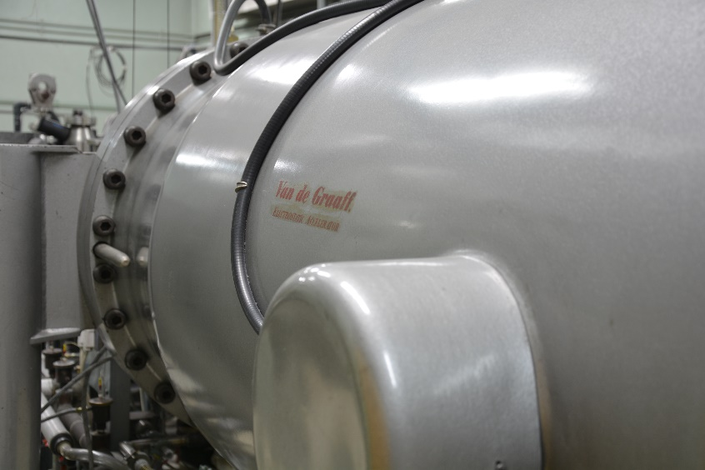
ELECTRON IRRADIATION FOR DEUTERIUM IN GRAPHENE
The 2 MeV electron Van de Graaff Accelerator permits material irradiation either by electron beam or by Bremsstrahlung induced by stopping of the electron beam.
High vacuum, air, or controlled atmospheres like D₂
Electron energy: 0.25 to 2.0 MeV
Electron current: 10 pA to 150 μA.
Dose rates up to 10⁵ Gy/s.

Slide 25
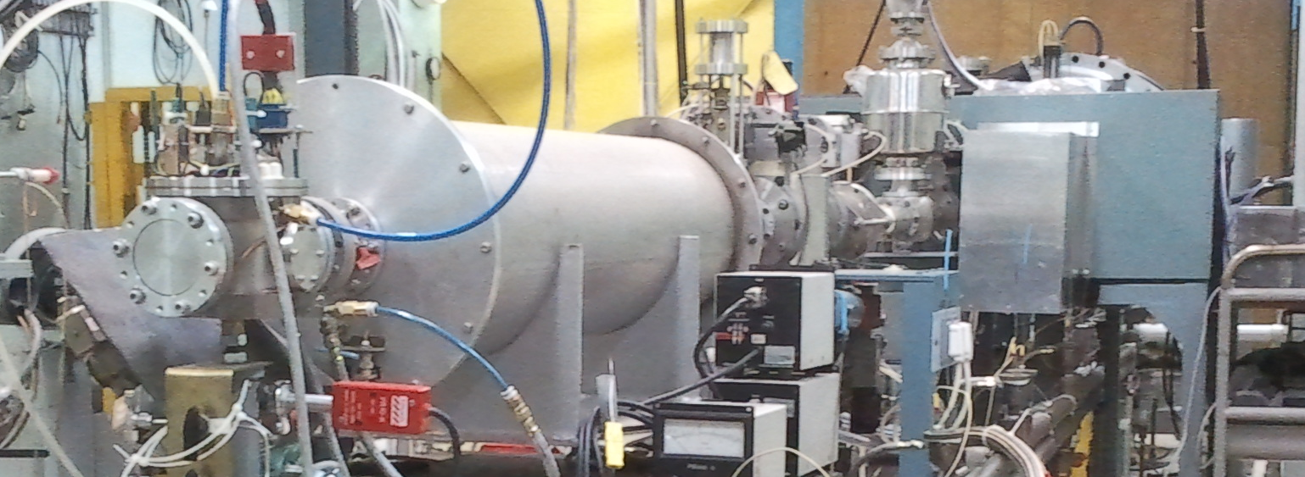
Radiation induced absorption chamber connected to the end of the 2 MeV Van de Graaff Accelerator
Range of parameters for the experiments:
Temperature ( RT-800 ºC)
dose rate ate up to 10 kGy/s
gas pressure range: 1-1500 mbar
Atmosphere (High vacuum, air, He, etc. in this case D₂)
Tritium is radioactive isotope and a laboratory with sufficient radiological protection is necessary in the future experiments.
Meanwhile, D₂ loaded in graphene by electron irradiation is being carried out by at CIEMAT (Van de Graaff)

Slide 26
Experiments in chamber connected to the end of the 2 MeV Van de Graaff Accelerator
Experiments to study the role of the radiation in D₂ absorpcion are underway since June-2018 for different graphite and graphene samples:
Procedure:
The chamber is filled with D₂ gas 1250 mbar
Sample holder with and oven (T= 55 ºC)
@1.8 MeV, dose rate 500 Gy/s and total dose: 11 MGy
Other set of samples have been maintained in D₂ gas (same P, T and time: 6 hours) without irradiation to compare with D₂ loading under irradiation.
Analysis by SIMS, TDS, FTIR, XRD, RAMAN, XPS are available in Ciemat.

Slide 27
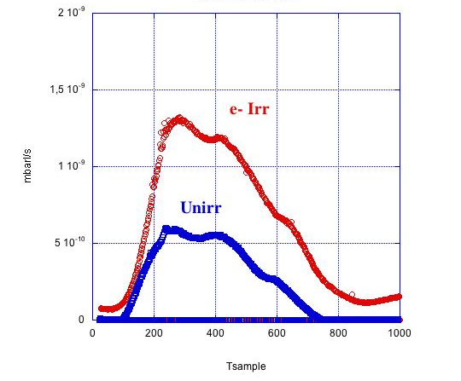
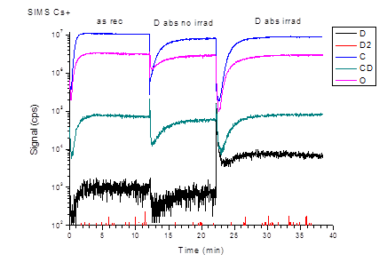
Preliminary results for GR (Graphite rod) samples
TDS: Thermal Desorption Spectroscopy
SIMS: Secondary Ion Mass Spectrometer
A clear increase of Deuterium absorption due to the electron irradiation is observed by different techniques

Slide 28
GRAPHENE INTERACTION WITH ELECTRONS

Slide 29

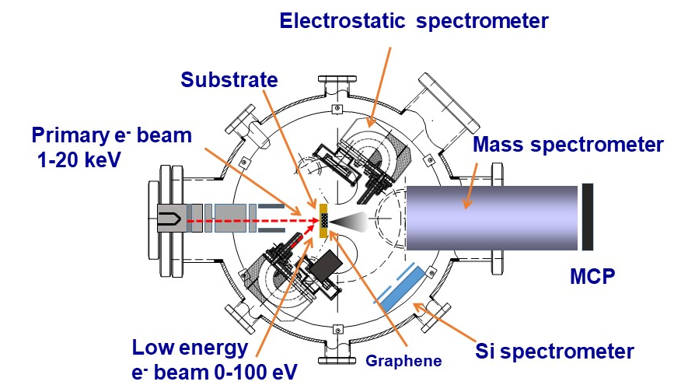
SETUP FOR ELECTRON-GRAPHENE INTERACTIONS
Low (0-100 eV) and intermediate (1-20 keV) energy electron interactions with graphene

Slide 30
WORK TO BE DONE IN NEXT SEMESTER

Slide 31
Graphene growth
  High mobility graphene monolayer in 4”
Graphene Nanoribbons fabrication
  Nanoribbons 100 nm wide in 4” wafer.
Deuterium on Graphene Nanoribbons
  Integration of deuterium in 4” wafer
Electron interaction on Graphene Nanoribbons
  Interaction on devices fabricated in 4” wafer

Slide 32
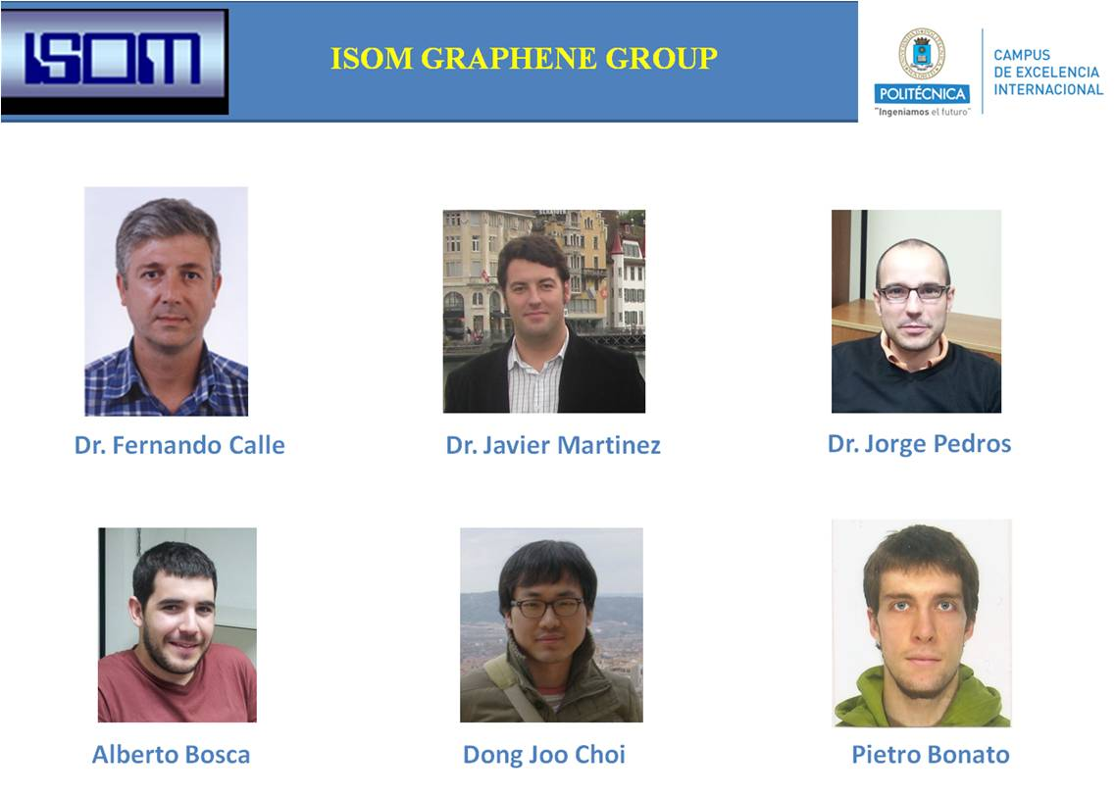
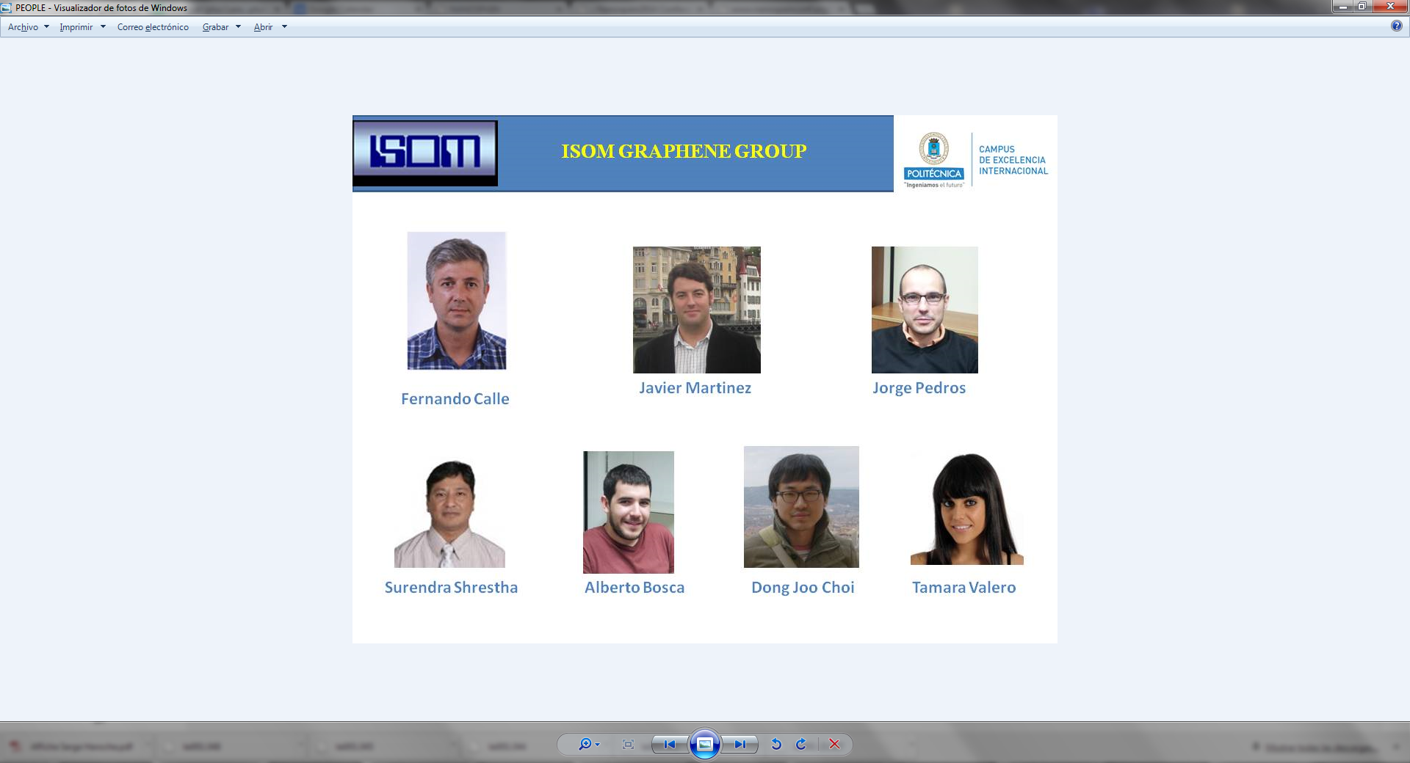

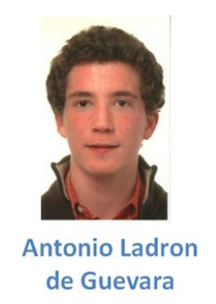



ACKNOWLEDGEMENTS
R. Santorelli
P. Garcia Abia
J. Carabe
I. Rucandio
A. J. Quejido
S. Fernandez
A. Molinero
R. Fernandez
G. Garcia
T. Palacios

Slide 33
Graphene Technology for PTOLEMY Project
Javier Martínez¹, R. Santorelli²,, P. Garcia Abia², I. Garcia-Cortes², S. Cabrera², A. Moroño² ,
J. P. González², D. Sanz González², J. Morales Merino², S. Fernández², J. Cárabe²,
A. Molinero², J.M. Barcala², M.B. Gómez-Mancebo², R. Fernández², I. Rucandio²,
G. Garcia³, A. Boscá¹, J. Pedrós¹, F. Calle¹
¹ Instituto de Sistemas Optoelectrónicos y Microtecnología, Universidad Politécnica de Madrid, Madrid, Spain
² CIEMAT, Centro de Investigaciones Energéticas Mediambientales y Tecnológicas Madrid, Spain
³ CSIC, Consejo Superior de Investigaciones Científicas, Madrid, Spain
Contact: javier.martinez@upm.es

