Slide 1


Review of the PTOLEMY detector geometry
Chris Tully
Princeton University
PTOLEMY Collaboration Meeting
LNGS, 27 November 2018
2015 Targeted Grant Award from the
and additional support from the
Notes:
It’s an honor for me to be here today. I’m going to discuss the physics of the Universe at a ripe young age of 1 second, at least as best we understand it, and I’d like to share with you an experiment called PTOLEMY that aims to detect evidence for relics left over from this period in history.
I should say that PTOLEMY is the only experimental program of its kind and would not have been possible without the support of the Simons Foundation.
Recalling Wolfgang Pauli’s remark shortly after conceiving of the neutrino in 1930
In the words of Wolfgang Paul in 1930 said: “I’ve done a terrible thing today, something which no theoretical physicist should ever do. I have suggested something that can never be verified experimentally.” Pauli was talking about the neutrino – from which we have learned a great deal.

Slide 2
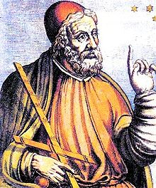
Overview of Detectors
P
T
O
L
EM
Y
PTOLEMY Collaboration, M.G. Betti et al. (51 authors), arXiv:1810.06703 (astro-ph);
E. Baracchini et al., arXiv:1808.01892; S. Betts et al., arXiv:1307.4738 (astro-ph)
@LNGS
New Concept: Transverse Drift Filter
18.6 keV → 0.01 eV in 0.7 meters
18.6 keV
~0.7 m
0.01 eV
Transverse Filtering
Parallel Motion w/ ExB Drift
Notes:
PTOLEMY developed a transverse kinetic energy selection filter that acts very rapidly (but still adiabatically) in space. If you consider a solenoid and start at the center where the field is strongest. The most rapid route of the high magnetic field region is not by going out the end of the solenoid, it's by passing between the coils transversely. That is essentially what we do and can achieve 6 orders of magnitude in the selection of the transverse kinetic energy in 0.7 meters in length, confined transversely to within approximately 1 cm. We can go beyond the filter precision of KATRIN in roughly 1,000 times less filter volume.

Slide 3
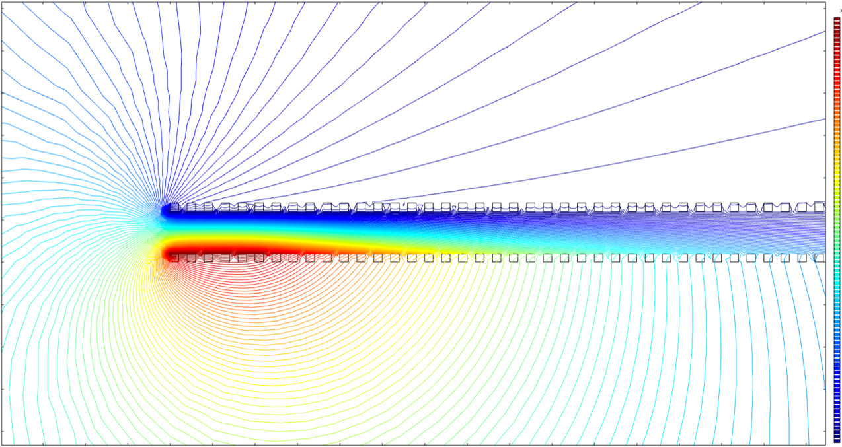

Transverse Drift Filter
0.02
18
15
Position Y (m)
12
0.01
10
μx𝛁B drift
8
6
4
0.0
2
Voltage (kV)
0
y
-2
total ExB drift
-4
-0.01
-6
vertical ExB drift
-8
z
-10
-0.02
vertical ExB drift balances Grad-B drift
-12
-14
-16
-18
-0.02
-0.01
0.0
0.01
0.02
0.03
0.04
0.05
0.06
Position Z (m)
B field strength falls off exponentially
x
High field
𝛁B
Low field
z
Kassiopeia simulations by Wonyong Chung
Notes:
Transverse drift filter: have to always turn your head to figure out where the field directions are pointing.
The B field is shown below.
As one moves from the high B field region of the tritium source on the left to the low field region on the right - the B field is dropping off exponentially in a controlled way. This is done with concentric layers of windings of the coil.
Looking from the side, we show the voltage potentials in a filter element set by a configuration of electrodes.
There are two types of motion the electron undergoes from these fields.
There is a desire to drift vertically from the gradient of the magnetic field. To the left the cyclotron radius is small than to the right, so the drift wants to be vertical.
At the same time we have configured the constant voltage surfaces for ExB drift to have both a vertical component, that is adjusted to cancel the corresponding gradient drift and a horizontal components to cause the electron to drift along the length of the filter.
The electron is pushed up a voltage gradient while maintaining motion at the same vertical position and leaves the filter with a reduced transverse kinetic energy.
If the electron had too little kinetic energy, it will hit the bottom plate, and for too high, it flies upward to the top plate.

Slide 4
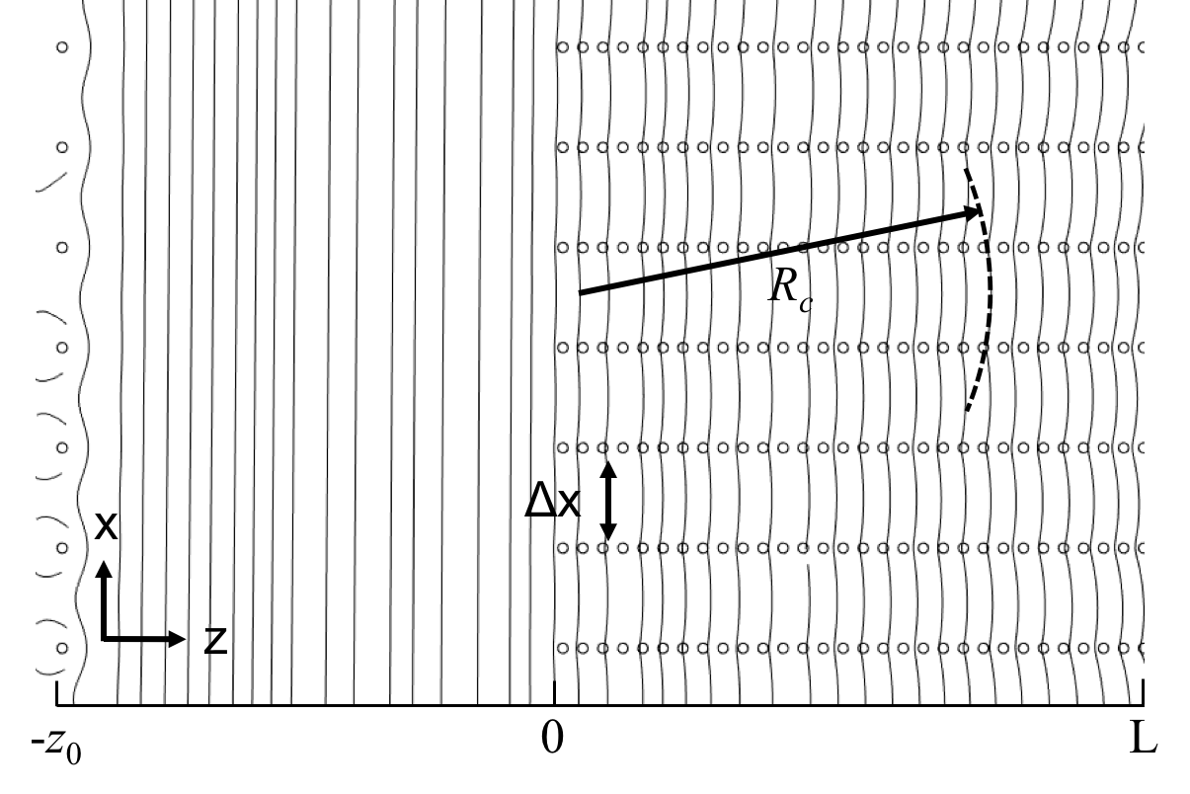
Magnetic Field Gradient

Slide 5
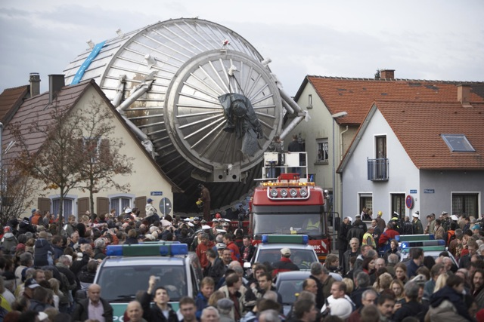
Parallel Motion
PTOLEMY implements a “reflector” method that is several orders of magnitude more compact along the direction of the B field
Transverse Drift Filter
E*B ~0.1-0.01m
E*B ~10m
Notes:
A similar situation exists for magnetic spectrometers – the single big focal plane methods have outgrown small cities in Germany.
The reflector method is scalable, but still under development.

Slide 6
Project 8 – RF Antennas
Phase I (^{83m}Kr)
D. M. Asner et al.,
Phys. Rev. Lett. 114, 162501
PTOLEMY
Notes:
The filter needs an estimate for the transverse kinetic energy.
That is done with RF antenna in advance of the filter.
This is a development from Project 8 to measure the ~ 1 fW emission of a semi-relativistic electron from cyclotron radiation emission and has achieved resolutions of ~3.3eV for ~1msec timescales.
This uses the relativistic correction to the cyclotron frequency to make the measurement in addition to sideband information.
To go beyond the RF measurement precision, we use the filter to separate out the range of interest on the endpoint and then feed electrons into a micro-calorimeter for the final level of measurement precision.

Slide 7
Neutrino Mass and CNB Detection
Substantial boost in tritium endpoint statistics ✅
  KATRIN ~50cm² (equiv. to ~0.5m² planar from gas column)
  PTOLEMY ~several sq. meters in R&D phase II
Filter precision and differential measurements ✅
  Transverse drift filter precision no longer a limitation (KATRIN ~0.93eV), limited by RF estimate (~1msec) and finite cyclotron radius (10⁻⁴ filter → ~4.6mm at 1 mTesla)
  Differential measurements from calorimeter are likely to improve to better than 0.05eV and will average statistically
Molecular smearing
  T₂ ~4000K(~0.34eV), Graphene ~700K(<~0.06eV),
  Cu(111) ~350K(<~0.03eV), Au(111) ~111K(<~0.01eV), Atomic?
Scaling up target area ~10⁴ sq. meters (1 gram T)
  ~100 meter long hall (~100Cu/meter) ~100-500 sq. meter filter
  Parallel motion multiplexing (“factorized”) ~x2000 filter area
  Time-multiplexed RF instrumentation ~x1000

Slide 8
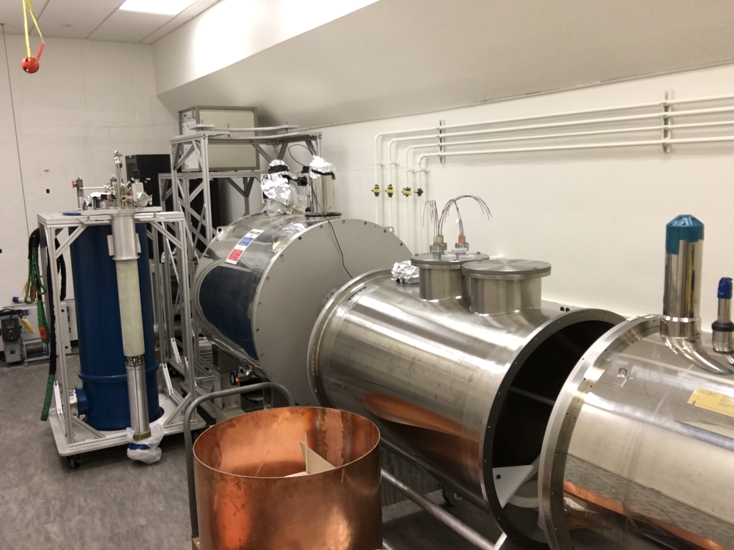
PTOLEMY Prototype
Princeton Tritium Observatory
for Light, Early-universe, Massive-neutrino Yield
R&D Prototype @ PU
(June 7, 2017)
Supported by:
The Simons Foundation
The John Templeton Foundation
Notes:
This is a view of the prototype setup of the PTOLEMY experiment in the basement of the Princeton University physics department to do a full end-to-end evaluation of these technologies.
This setup was supported by the Simons Foundation.

Slide 9
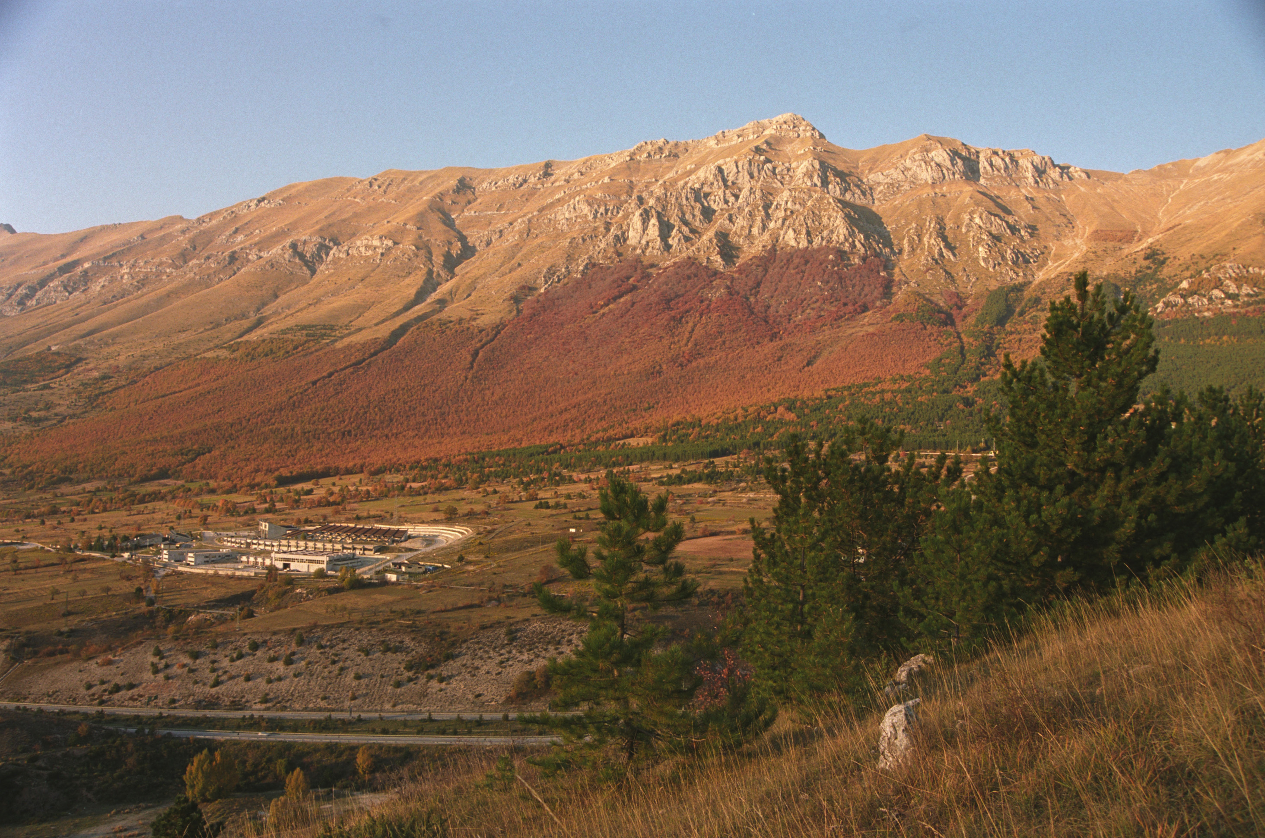
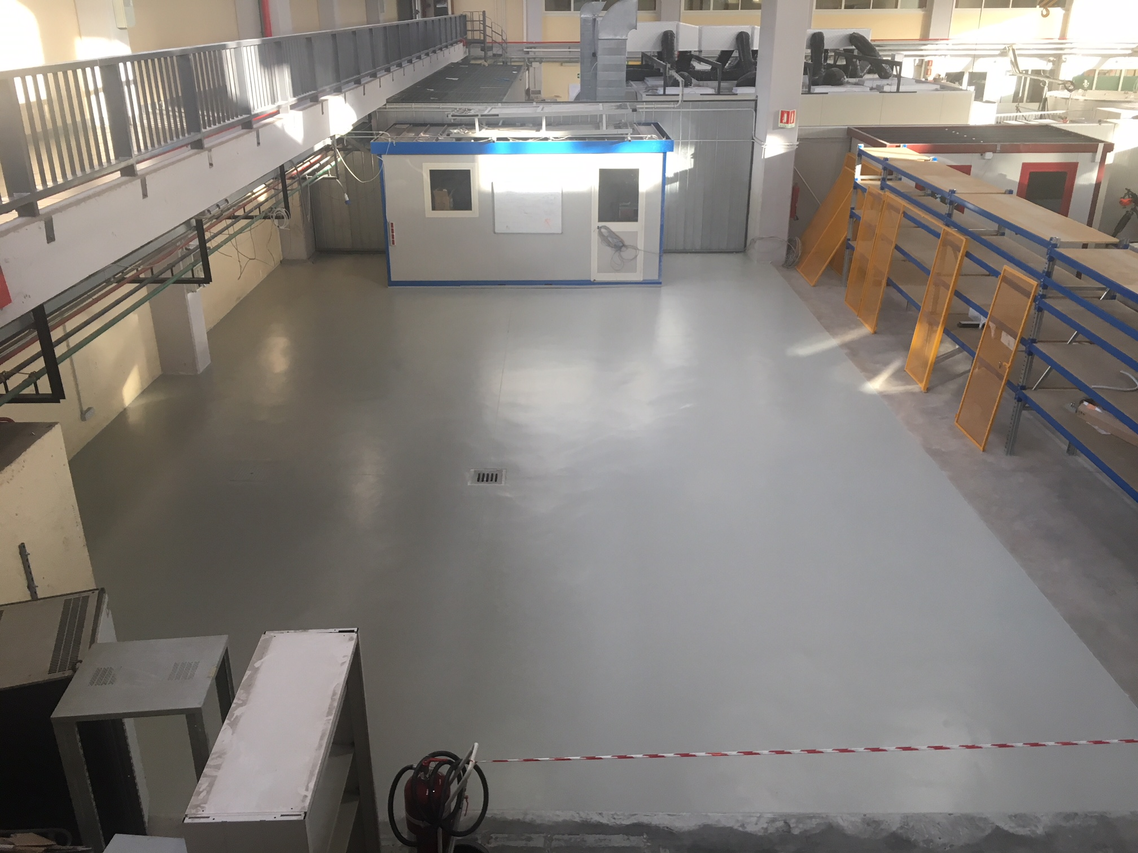
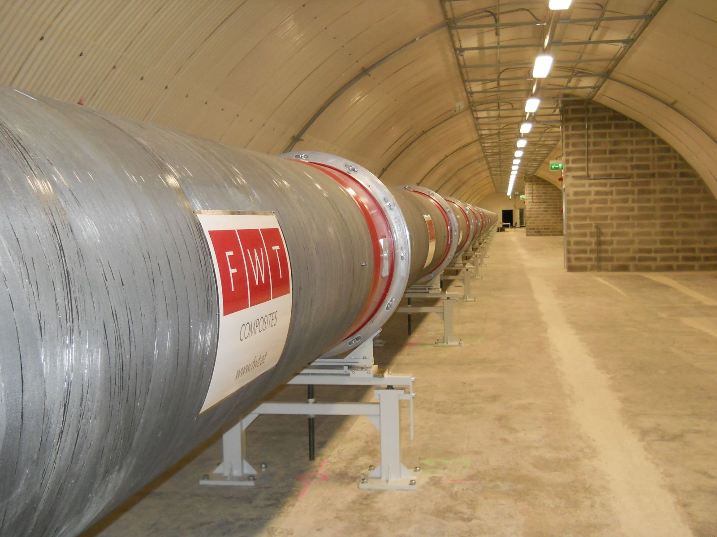
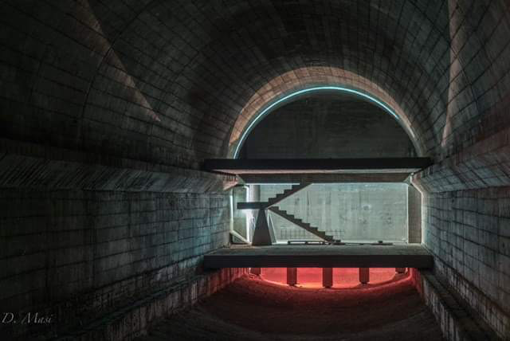
Present and Possible Future Sites
Gran Sasso
National Laboratory, Italy
Tunnel in Predappio near Bologna
Soratte Mountain near Rome
Notes:
To here. The Gran Sasso National Laboratory – about 2 hours east of Rome by car. If you hold you hands together and make an area about this size,
approximately one cosmic rays passes through that area per second. The rate of that happening under what is the equivalent of 3 km of water overburden is down by
a factor of one million. We need to get to those levels to see the relic neutrino signal – which will only be roughly 10 per year.

Slide 10
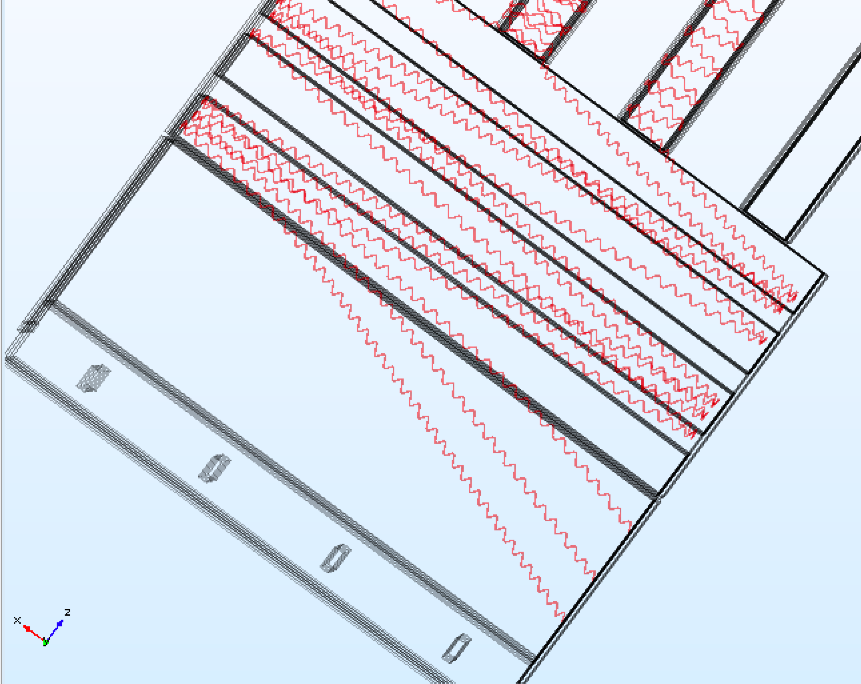
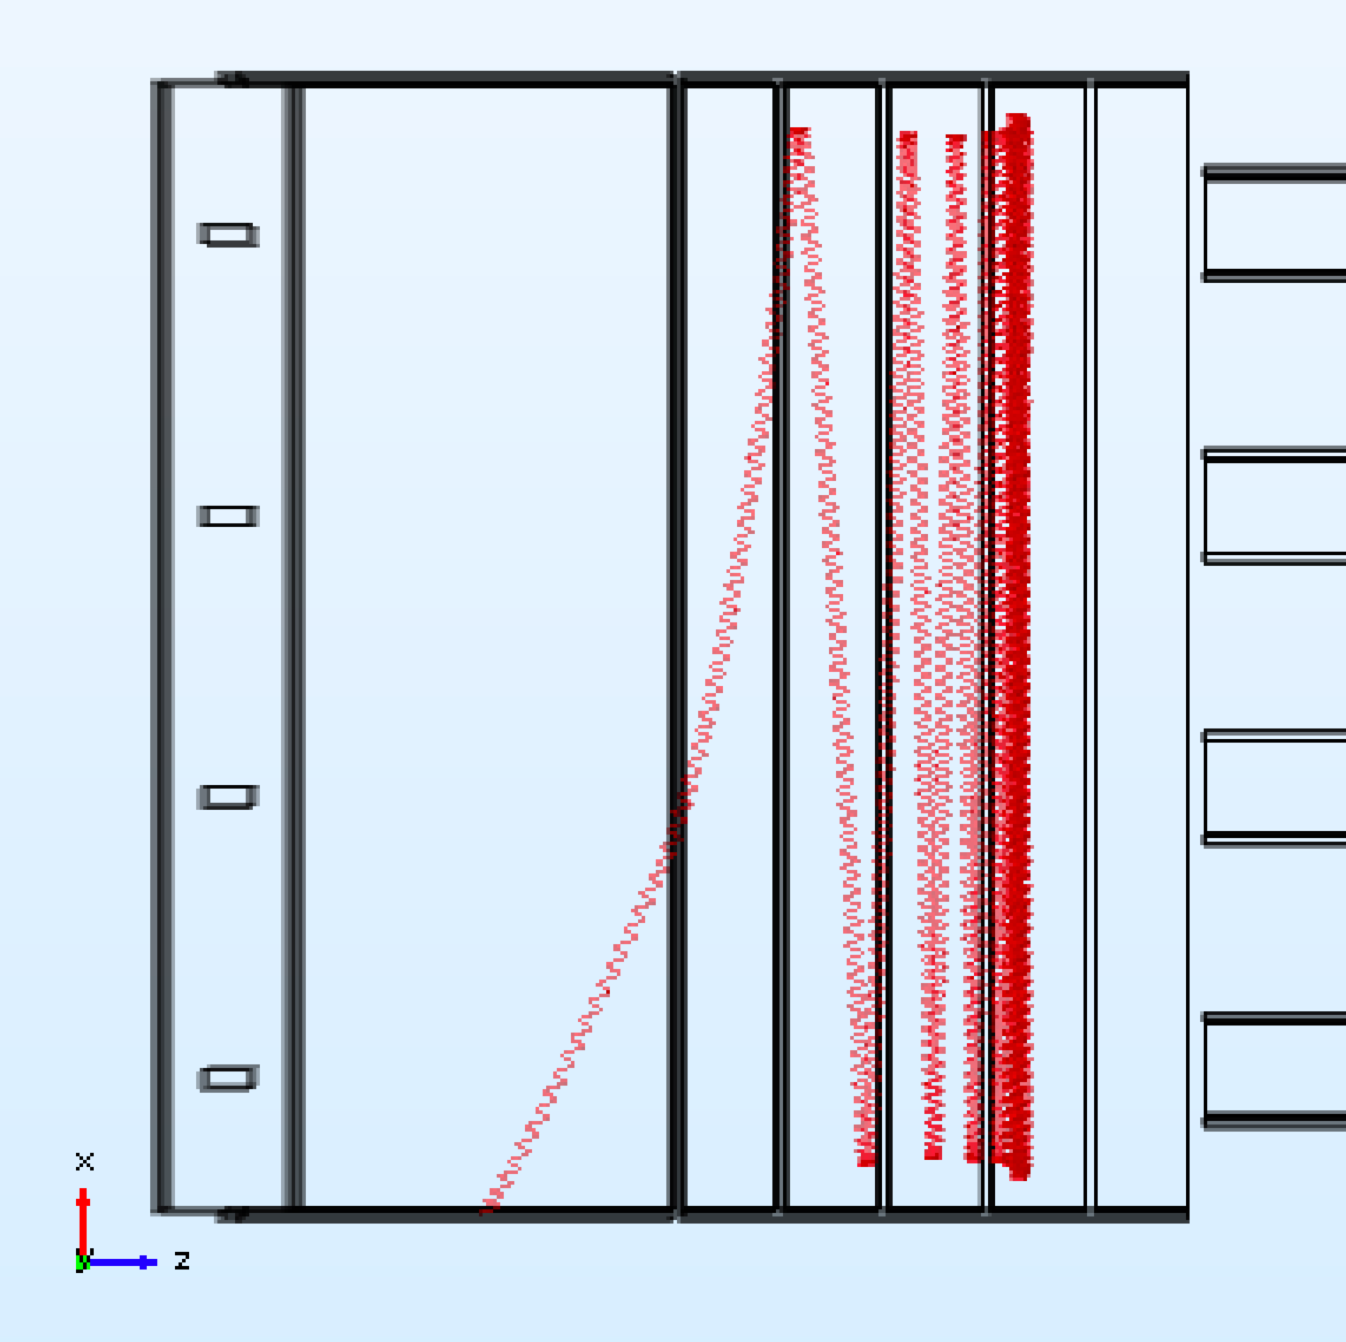
Target and RF
Initial Idea
Large V_{D}
Target
Target
Very Low V_{D}
has problems

Slide 11
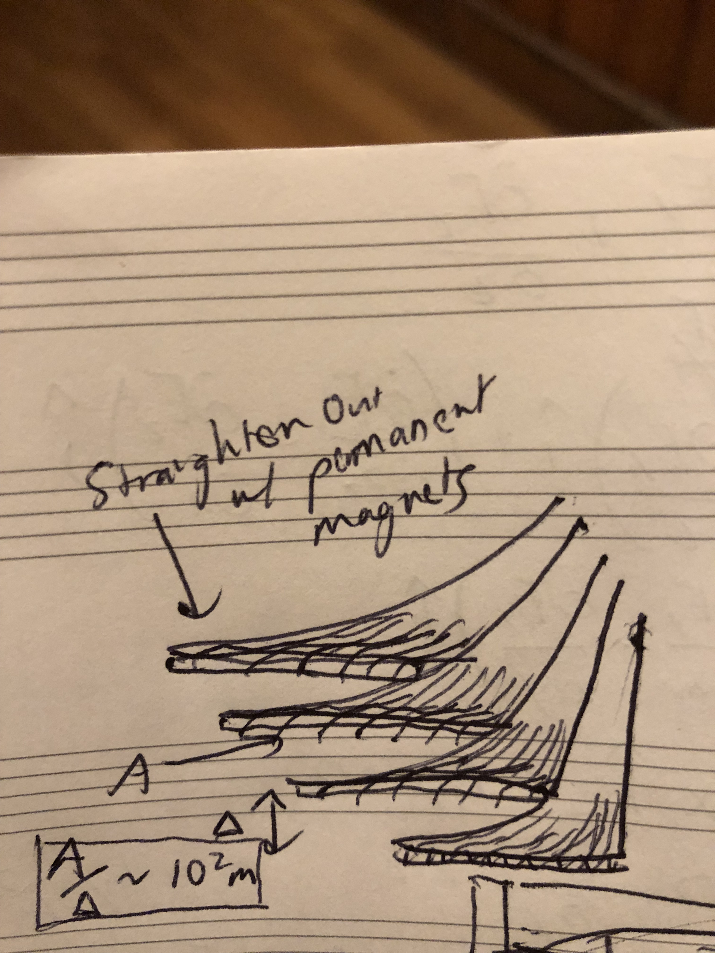
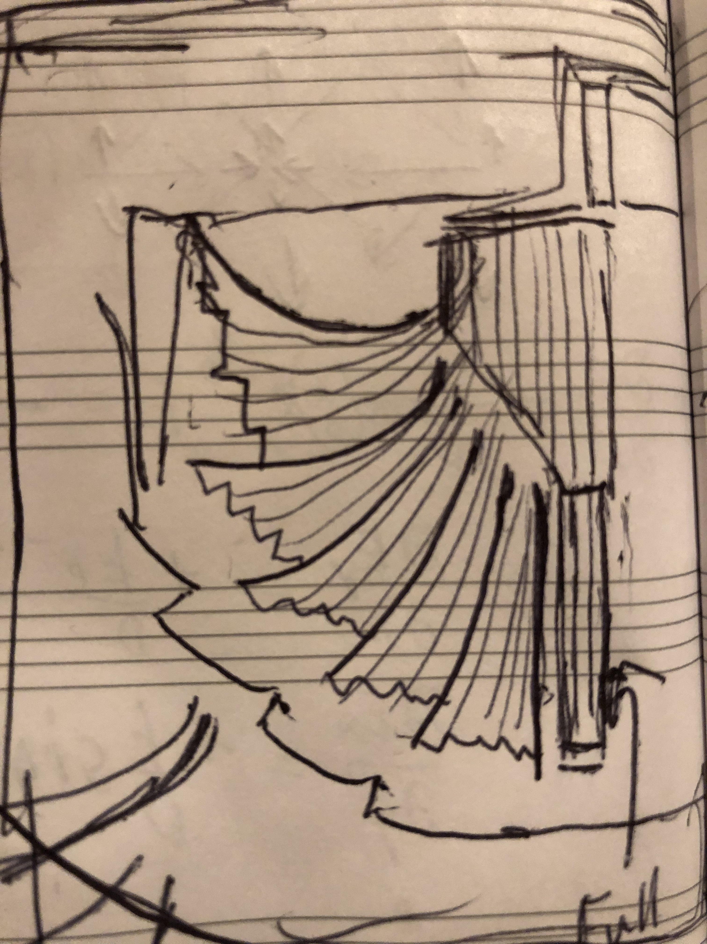
Flux Concentrator
~10 mg/m

Slide 12
Additional Slides

Slide 13

Project 8 (Harmonic Trap)

Slide 14
Project 8 – RF Antennas
Phase I (^{83m}Kr)
Phase II (tritium, just started)
courtesy J. Formaggio, RGH Robertson

