Slide 1
MANGO Design
Research Division
Mechanical Engineering Service

Slide 2
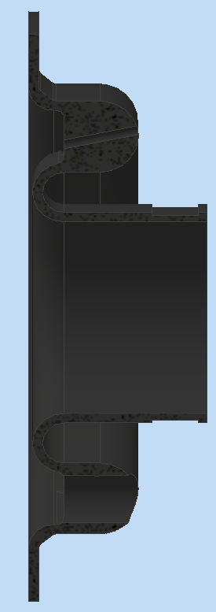
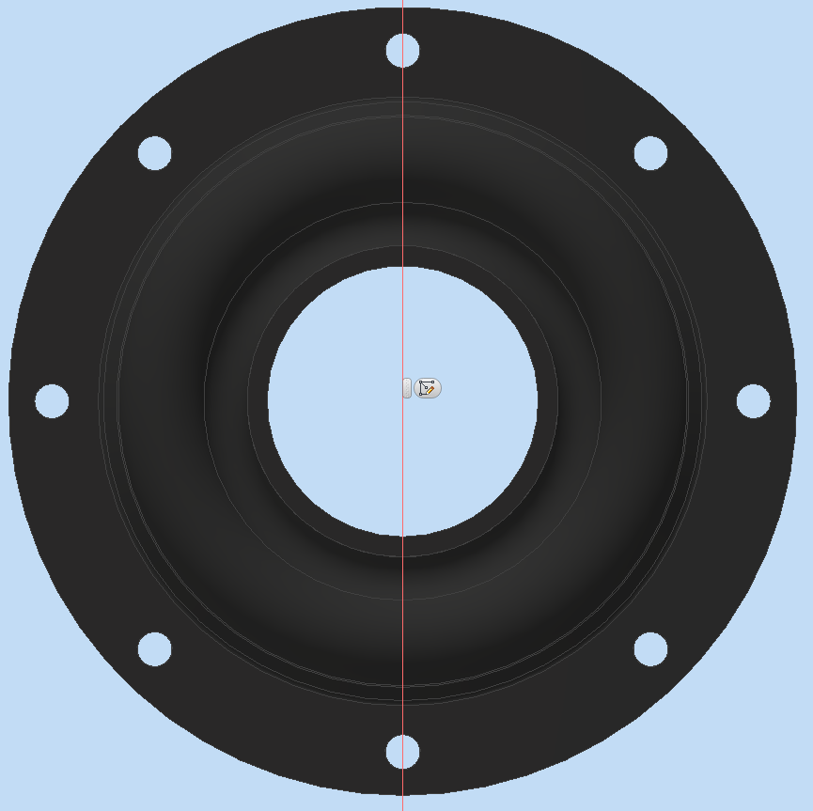
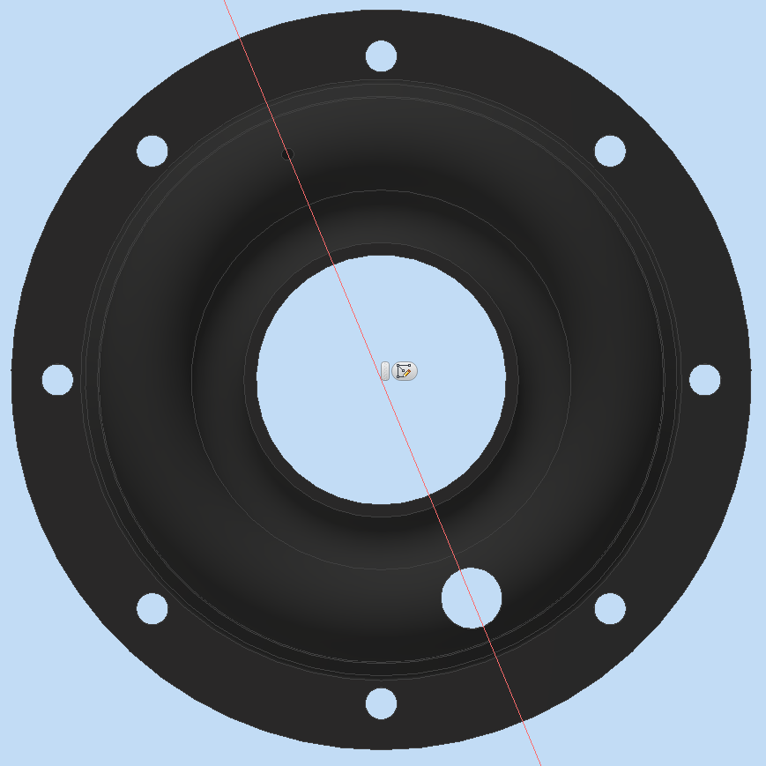
MANGO Design- Gasket
Before
After
Improvement:
Added two holes for Phototube and OPT fiber. Increased material to sustain the elements.
Thickness reduced from 3 mm to 2 mm.

Slide 3
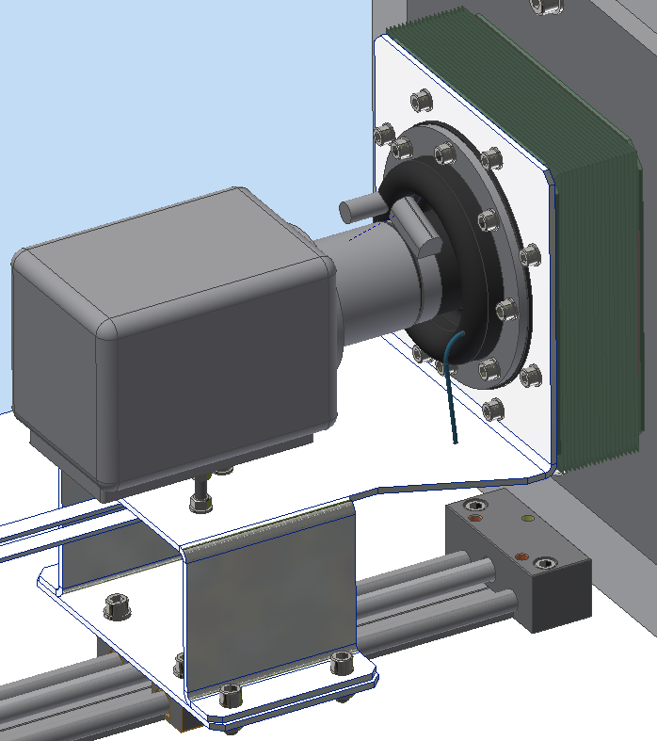
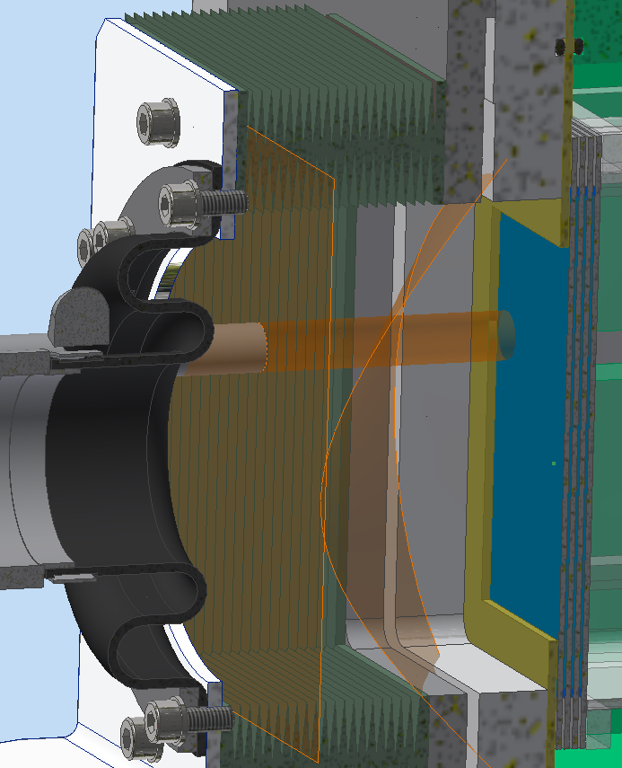
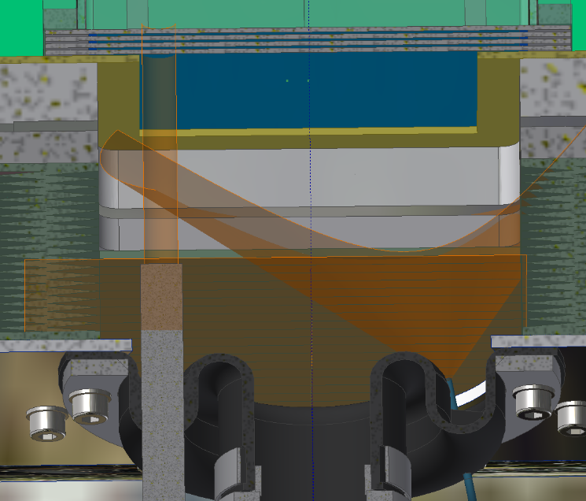
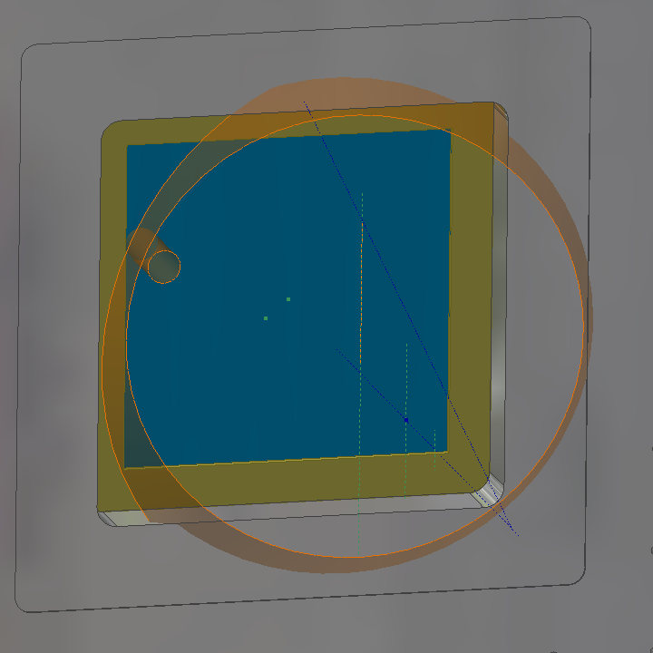
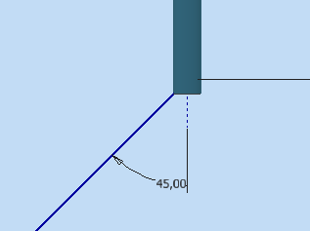
MANGO Design- Gasket
The Phototube sees the GEM surface without any interference with FR4 plate (yellow).
The optical fiber with cone of light (approximated to 45°) hits the most of GEM surface.

Slide 4
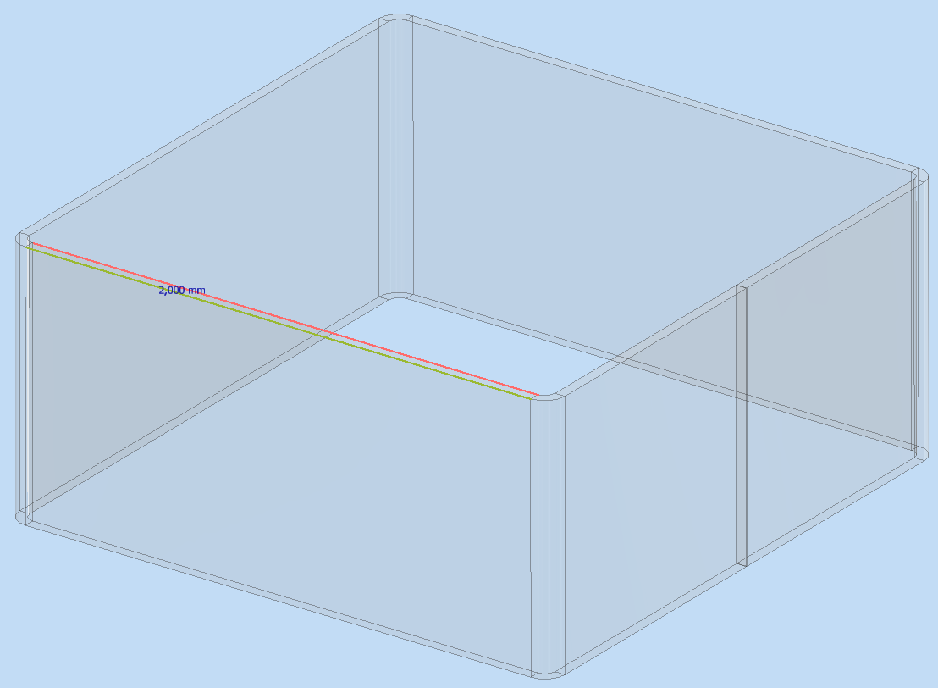
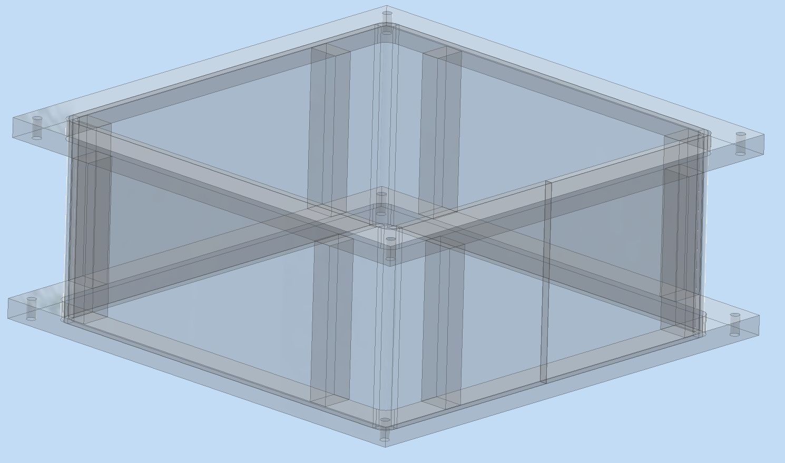
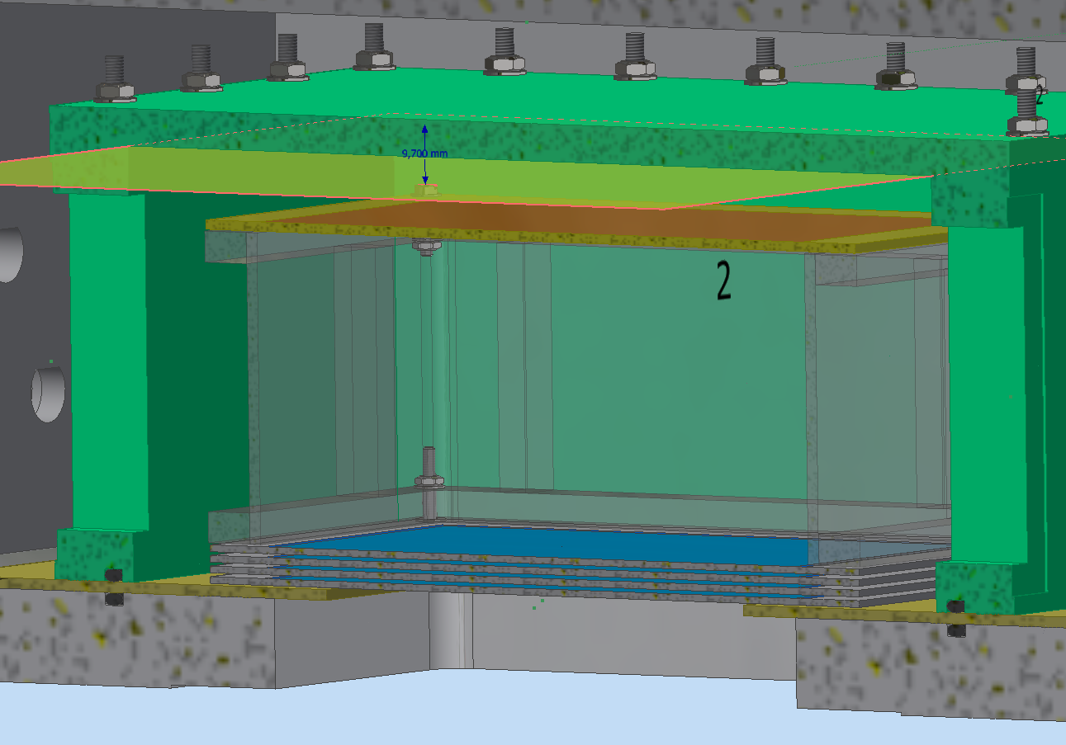
MANGO Design- FC
Field cage case internal dimensions 105x105 mm, height 50 mm. Thickness 2 mm.
Case and support structure parts assembled by bonding. Material PMMA
Three FC case will be made with same section: two with height 50mm and one of 35 mm. Different types of FC: copper strip and film with copper foil.

Slide 5
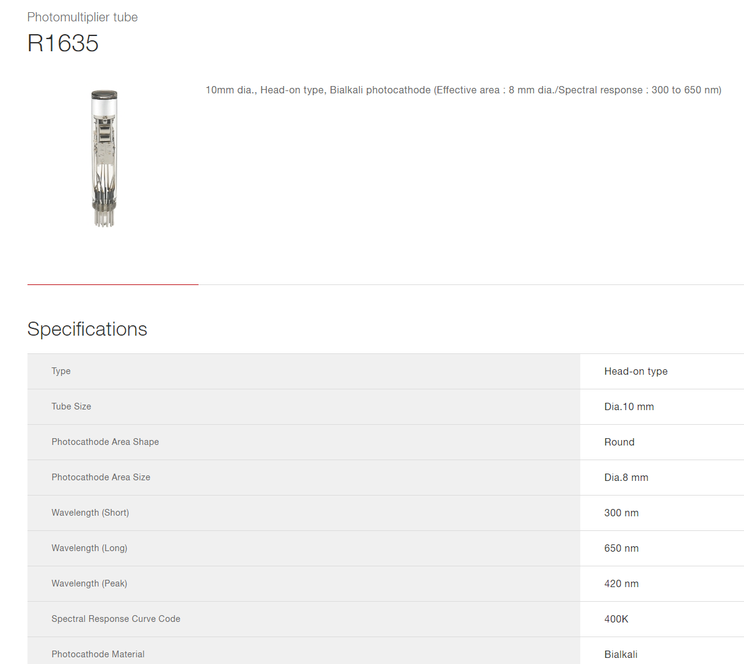
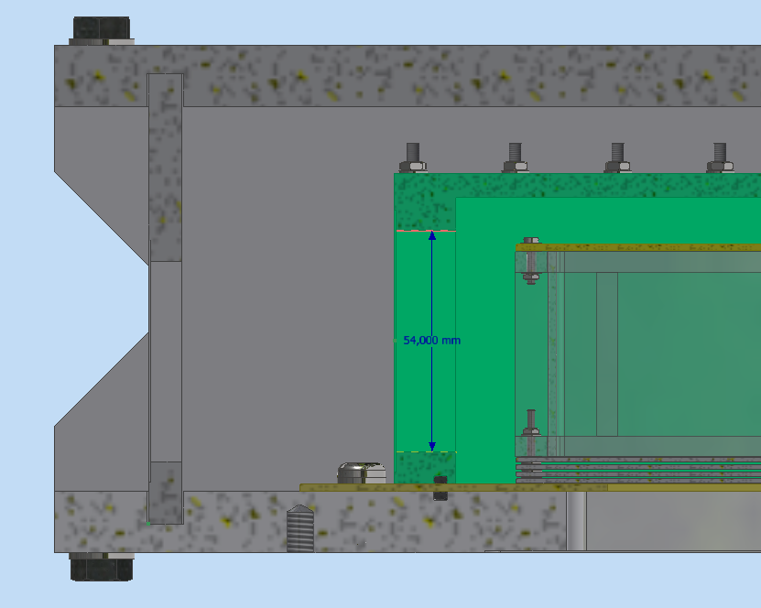
MANGO Design
Open Point:
Assial length of fotocathode - diameter.
Diameter of OPT fiber: 1 mm? length?
Beam Blocker for output window- More info.
Internal block windows reduction of 4 mm.

