Slide 1

BTF/LINAC upgrade status
P. Valente
Acc. Div. Meeting, 15 Oct. 2018
What has been going on in the last months
Plans up to the end of PADME run-1

Slide 2
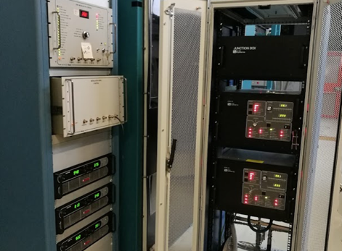
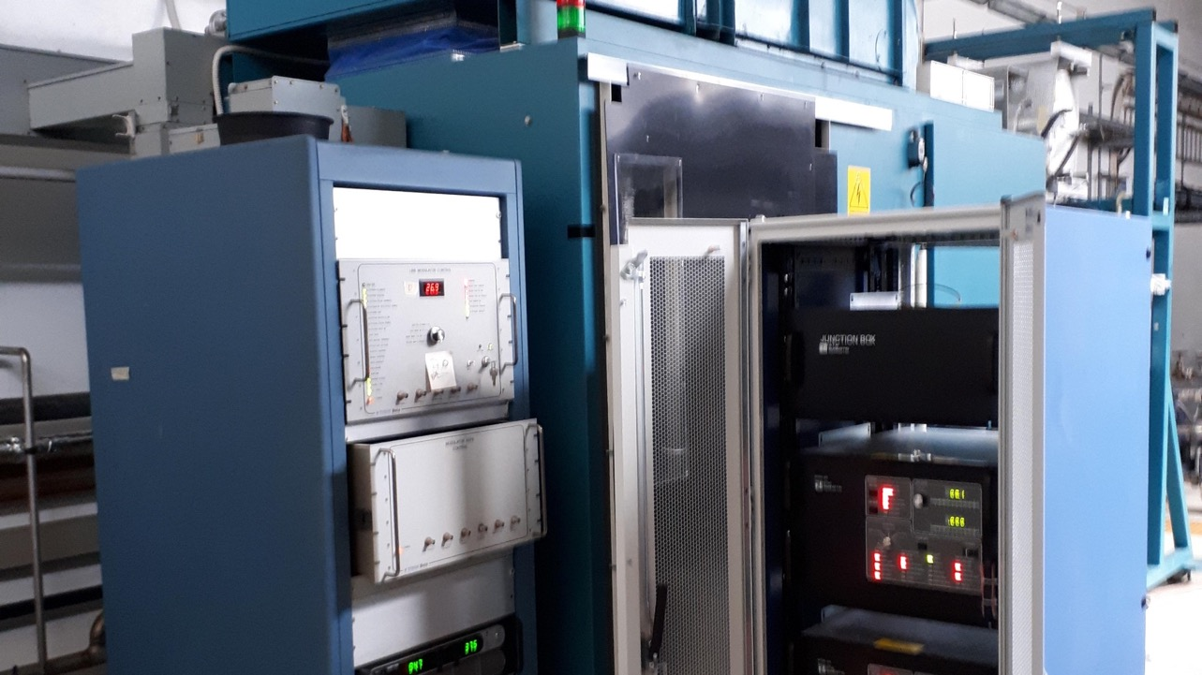
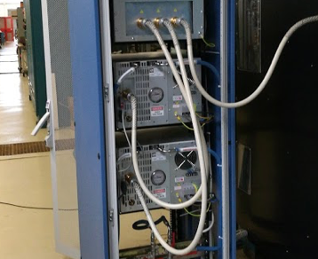
PFN charging modulator upgrade
Installed on modulator D
2 weeks dedicated setup
Integrated with present control system
In operation from March 2018

Slide 3
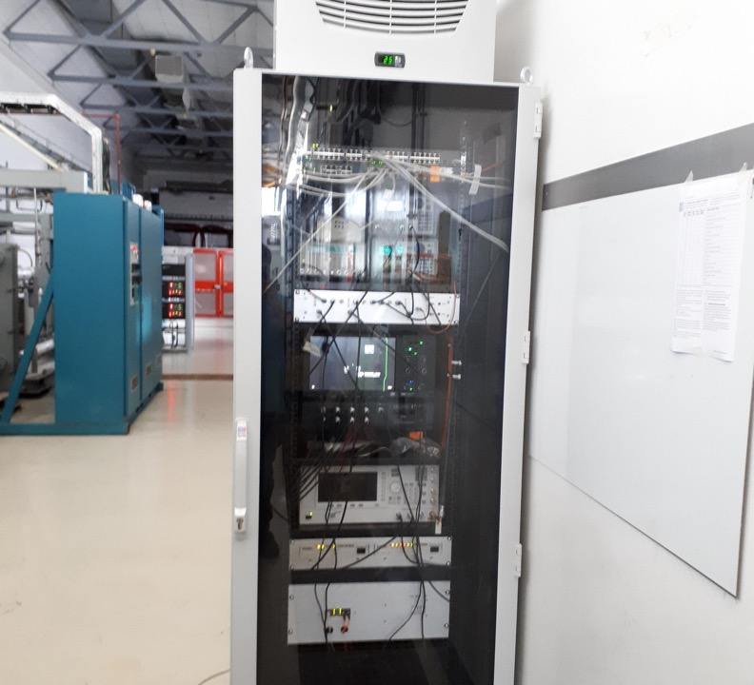
Timing system upgrade
New cooled rack for timing system
New RF source 4.5 us gated
  In operation
New phase shifter
  Installed in test setup
  More stable

Slide 4
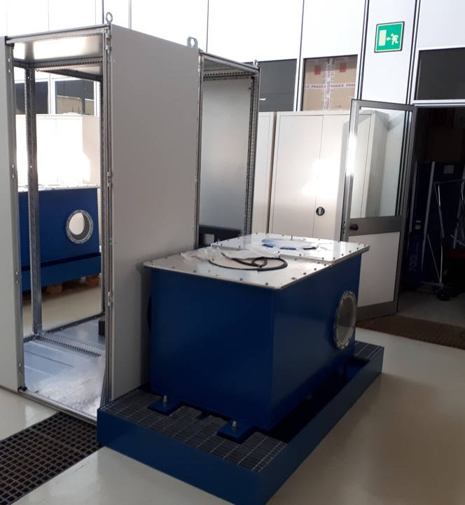
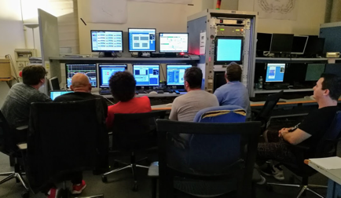

New modulator commissioning
All the components delivered in July 2018
Commissioning started
Progress slower than expected, since staff is busy with in the operation of DA$Φ$NE and SPARC linacs

Slide 5
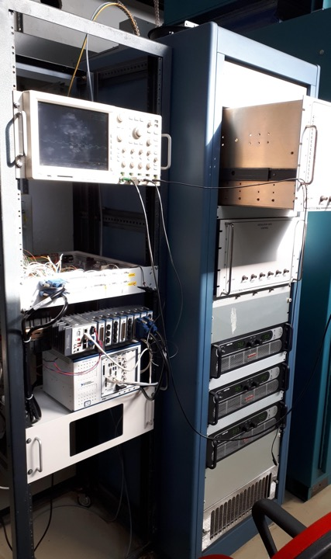
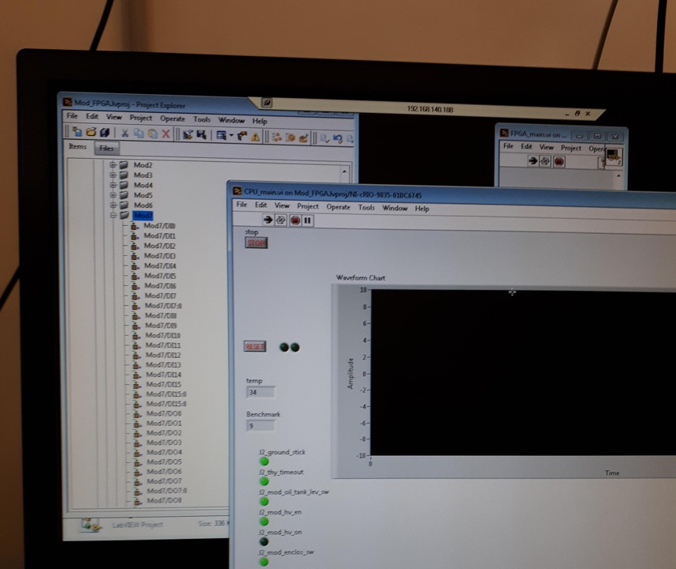
Control system upgrade
The new control system based on National Instrument modular electronics installed on Modulator B in «spy» mode.
  The FPGA DAQ run but does not control the modulator, only monitor it.
  Installed in October 2018

Slide 6
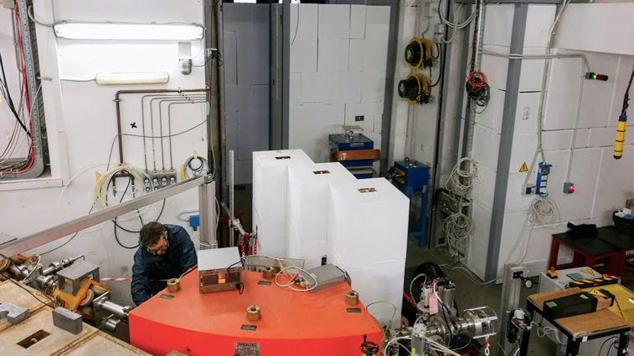
BTF line splitting

Slide 7
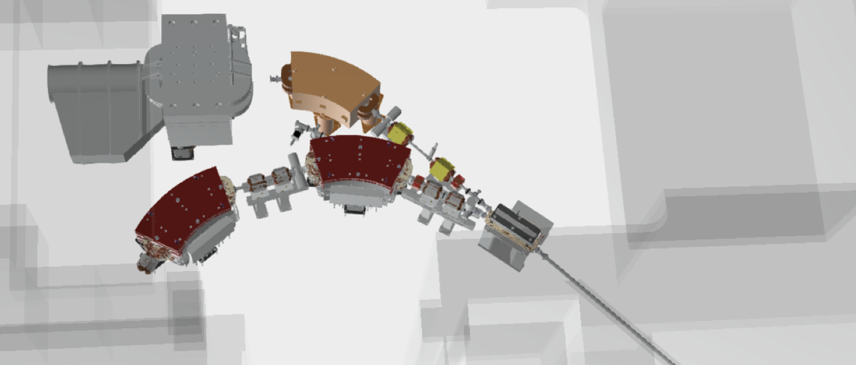
New BTF layout
BTF-1
DHRTB102 (PADME)
DHSTB02
SLTTB05
QUATB04
QUATB03
CHHVVTB03
DHPTB102
QUATB203
QUATB204
DHSTB201
QUATB201
QUATB202
TGTTB02
QUATB205
DHSTB202
BTF-2

Slide 8
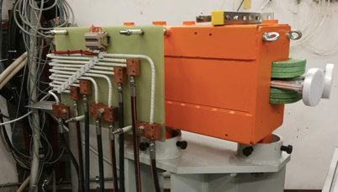
DHPTB102 (pulsatino)

Slide 9
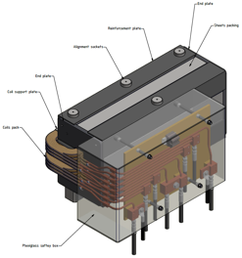
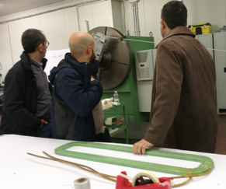
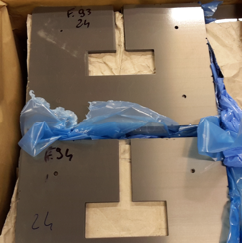
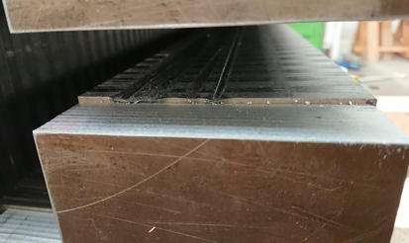
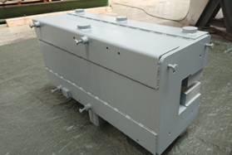
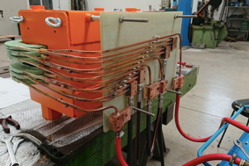
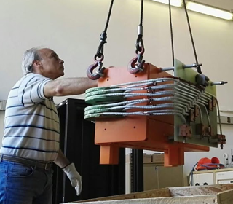
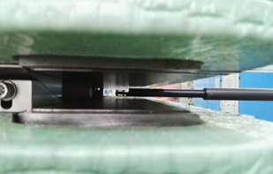
DHPTB102 (pulsatino)
11 Jul. ’17
15 Nov. ’17
5 Feb.
17 Apr.
29 May
11 Jun.
20 Jun.

Slide 10
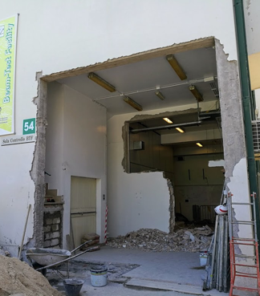
Dismantling & civil engineering

Slide 11
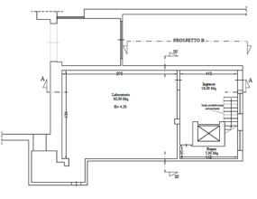
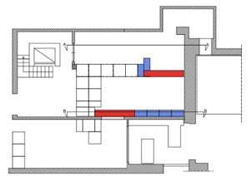
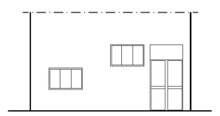
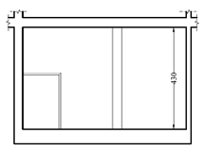
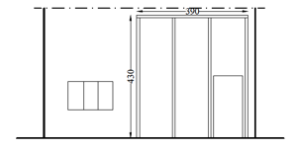
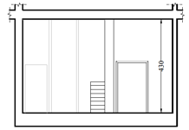
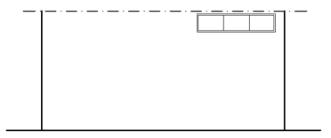
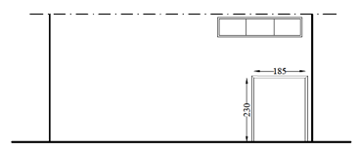


Before
After
DA$Φ$NE racks
DA$Φ$NE racks
Control room
BTF-2
BTF-1
BTF-1

Slide 12
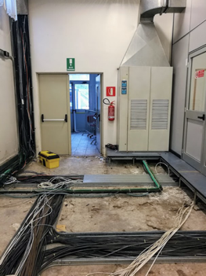
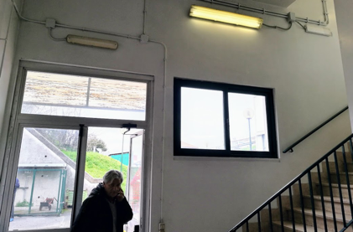
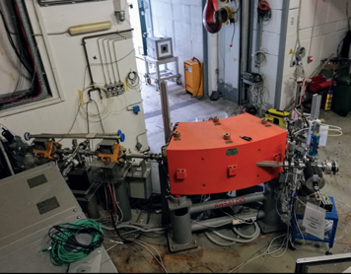
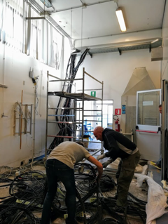
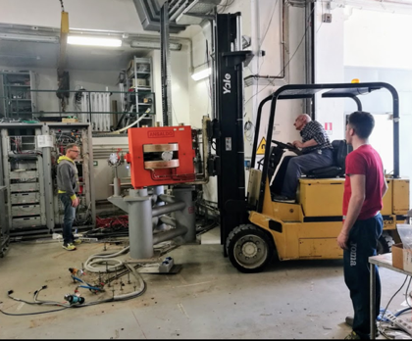
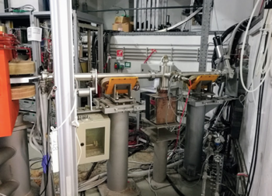
16 Mar.
21 Mar.
14 Feb.
11 Apr.
3 Apr.
6 Apr.

Slide 13
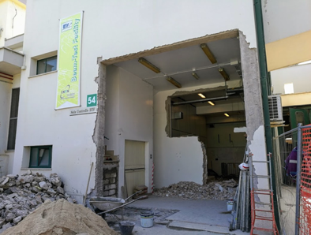
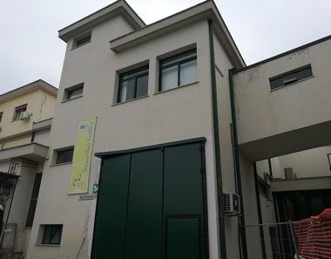
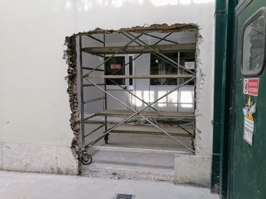
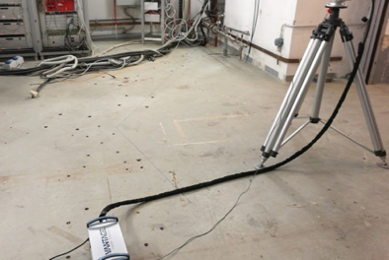
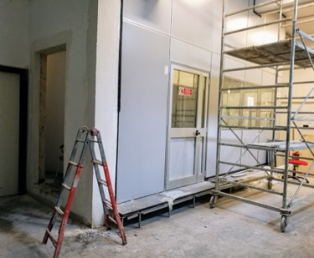
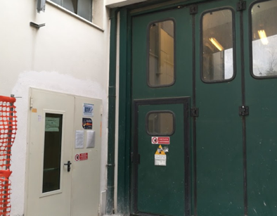
19 Apr.
2 May
30 Apr.
8 May
10 May
10 May

Slide 14
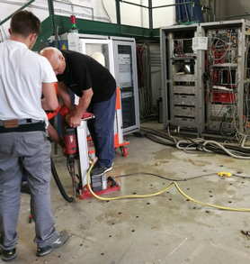
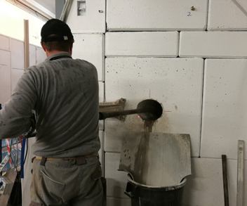
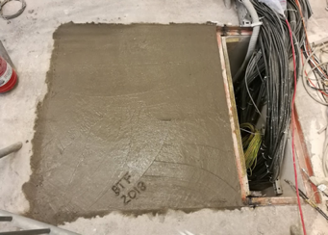
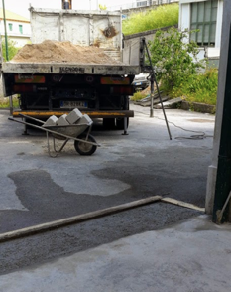
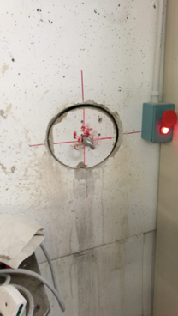
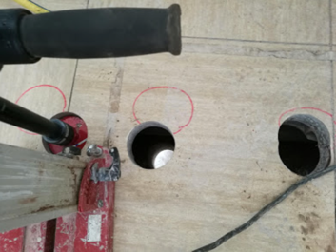
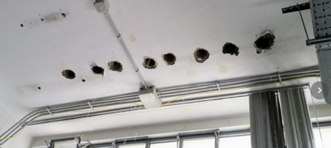
11 May
17 May
18 May
29 May
7 Jun.

Slide 15
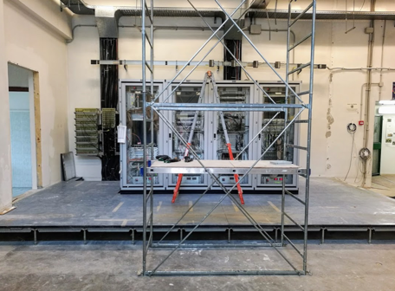
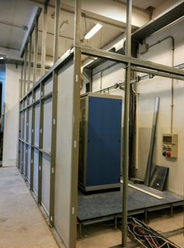


19 Jun.
22 Jun.
26 Jun.

Slide 16

Power, cooling, conditioning

Slide 17




19 May
14 Jun.
15 Jun.
11 Sep.
Should be ready for new magnets

Slide 18

BTF-1 installation and commissioning

Slide 19




5 Jun.
19 Jun.
25 Jun.

Slide 20





26 Jun.
28 Jun.
29 Jun.
2 Jul.
6 Jul.

Slide 21

Calorimeter
Small angle
PADME setup
Target
External vessel
Internal vessel
Internal vessel

Slide 22



30 May
27 Jun.
2 Sep.

Slide 23




4 Jun.
13 Jun.
6 Jul.

Slide 24




6 Sep.
14 Sep.
4 Oct.

Slide 25

Beam restart

Slide 26





Linac restart: 5 Jul.
Chicane rebuilt: 10 Jul.
BTF-1 first beam: 12 Jul.

Slide 27




200 ns
Long pulse for PADME

Slide 28

New dipoles

Slide 29



Tender assigned to Sigmaphi: 6 Feb.
Last iteration on details of the design (yoke, coils) in May
31 May
7 May

Slide 30




28 Sep.
4 Oct.

Slide 31

LNF staff visit: 23 Oct. in order to:
Check yoke at the end of machining
Check coils
OK for final assembly
Delay for final delivery: 1 month

Slide 32

New quadrupoles

Slide 33
Tender assigned to Sigmaphi: Sep. 2018
Reviewing some details of coils, mechanical tolerances
Delivery due: Feb. 2019

Slide 34

New power supplies

Slide 35




Quadrupoli
90 ms ramp
Tender assigned: 6 Feb.
Factory acceptance tests:
9-10-11 Oct.
Delivery: end of October
Dipoli DC
Pulsatino

Slide 36


Safety and radioprotection
Orders issued

Slide 37

New bunker

Slide 38














Order for concrete blocks: issued
Delivery: end of Oct. 2018

Slide 39
Budget

Slide 40


2018
2019
Spesi:
417 k
Mancano:
40 k blocchi
40 k Camere a vuoto
30 k Chiller
75 k Dipolo
47 k Impianti
Totale:
649 k
145 k Schede NI
50 k Alimentatori focalizzatori
Su infrastrutture:
60 k Camere a ionizzazione e radio-protezione

Slide 41
Plans

Slide 42

To do list: power supplies
Prepare new power supplies room (upstairs of BTF): power and cooling
Cabling for new magnets
Installation of new power supplies
Software and testing
New power supplies at LNF by end of Oct.
Get ready before the end of 2018

Slide 43

To do list: new bunker and new conditioning
Concrete blocks available $\sim$end of Oct.
Interference with PADME running (access to BTF experimental hall 1)
Need to build the bunker for the installation of new conditioning pipings

Slide 44

To do list: new magnets
Magnetic field characterization of:
  2 DC dipoles (delivery Dec. 2018)
  7 quadrupoles (delivery Feb. 2019)
Magnetic measurement lab should be available from Jan. 2019

Slide 45


To do list: BTF-2 installation
Installation and alignment of:
  Supports
  2 DC dipoles
  6 quadrupoles
Vacuum
  Pipes (to be ordered)
  Valves and pumps
Services:
  Connect water, cables, control cables
  New iron staircase for passing over the beam-lines
New magnets ready for installation $\sim$Mar. 2019.

Slide 46


Slide 47

PADME run status

Slide 48













PbF₂
calorimeter
BGO calorimeter
Scintillating bars veto
Diamond target
BTF beam

Slide 49



Issues with PADME run
Not running at nominal intensity:
  5000 positrons/40 Hz, instead of 20000 positrons/50 Hz
  G9 ionization chamber close to 5 uSv/h, due to particles escaping from BTF target
  Possible solution #1: add shielding close to BTF target
  Possible solution #2: use primary positrons from LINAC

Slide 50


Issues with PADME run
Need to install
  Timepix3 large area downstream beam monitor and soft Bremsstrahlung veto
  Final piece of scintillator veto (again for soft Bremsstrahlung)
    ADVACAM coming for installation on 22 Oct.
In parallel
  Add valve on scroll pumps
  Installation of fast valve on BTF-1 line
In parallel
  Check alignment of calorimeters

