Slide 1
Studio e Produzione di Radioisotopi di Interesse in Medicina
Adriano Duatti
Department of Chemical and Pharmaceutical Sciences and
National Institute of Nuclear Physics
University of Ferrara, 44121 Ferrara, Italy

Slide 2

All science is either physics or stamp collecting
Ernest Rutherford

Slide 3
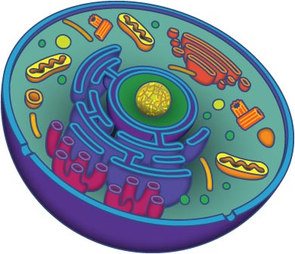
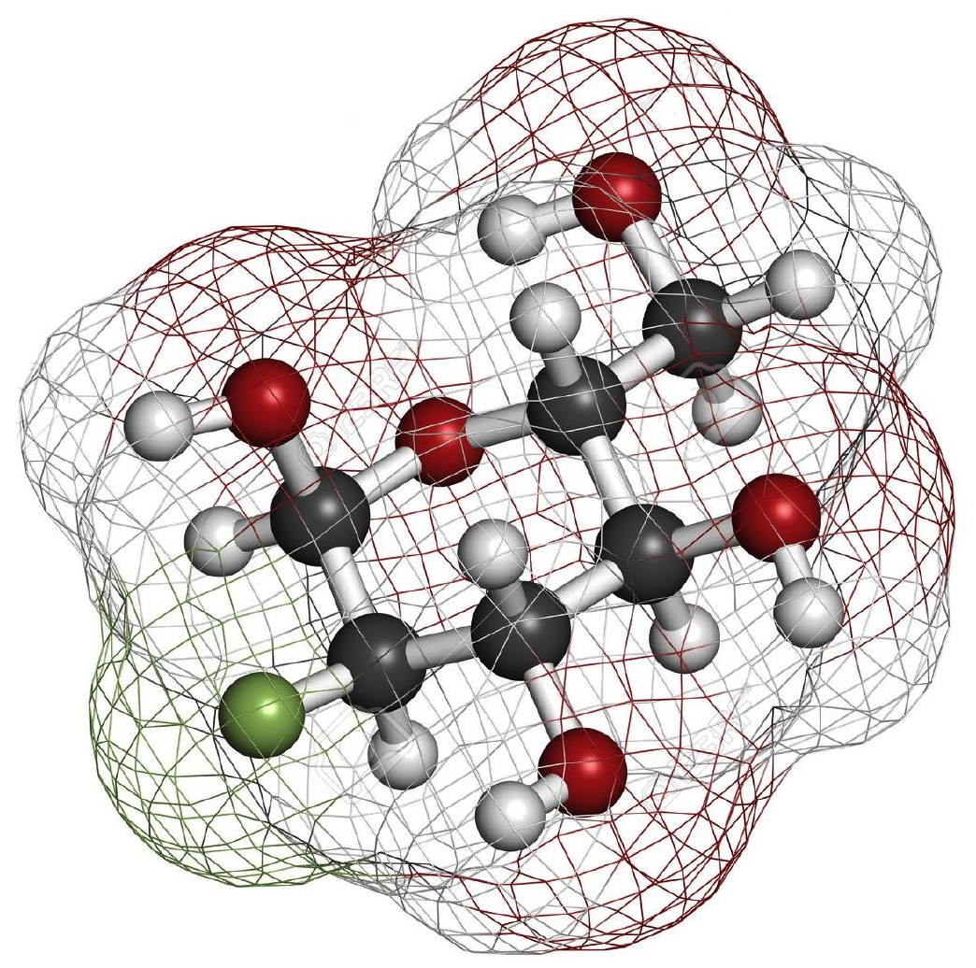
La Complessità Molecolare di una Cellula
Fatty and tricarboxylic acid metabolism
Receptors and transporters)
Enzymes
Neurotransmitters
Glucose metabolism

Slide 4

IL PROBLEMA:
E’ POSSIBILE VISUALIZZARE I COMPLESSI PROCESSI BIOMOLECOLARI CHE AVVENGONO ALL’INTERNO DI UNA CELLULA?

Slide 5
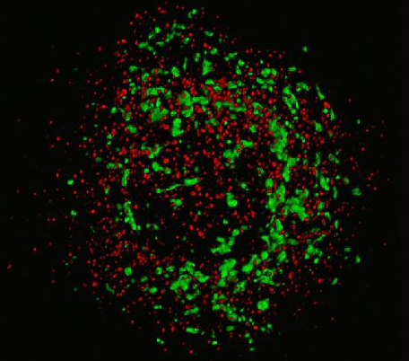
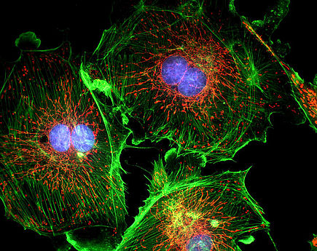
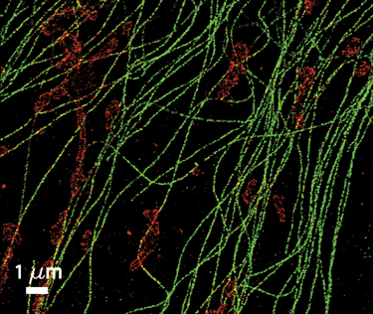
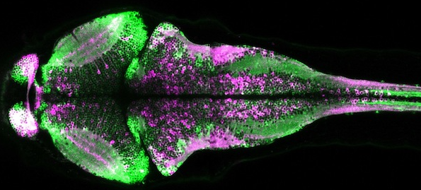
IMAGING OTTICO DI CELLULE ISOLATE

Slide 6
UN PROBLEMA PIU’ AMBIZIOSO:
E’ POSSIBILE VISUALIZZARE LA COMPLESSITA’ MOLECOLARE DI UNA CELLULA QUANDO SI TROVA ALL’INTERNO DI UN ORGANISMO VIVENTE?

Slide 7
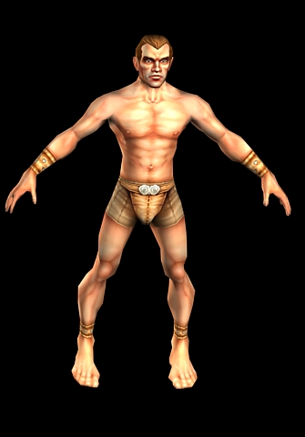
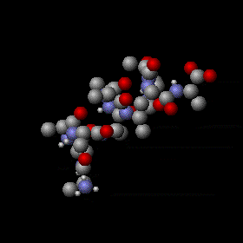
DAL FENOTIPO AL CHEMIOTIPO
1 m
10⁻⁹ m

Slide 8
SE E’ POSSIBILE, COME SI FA?

Slide 9
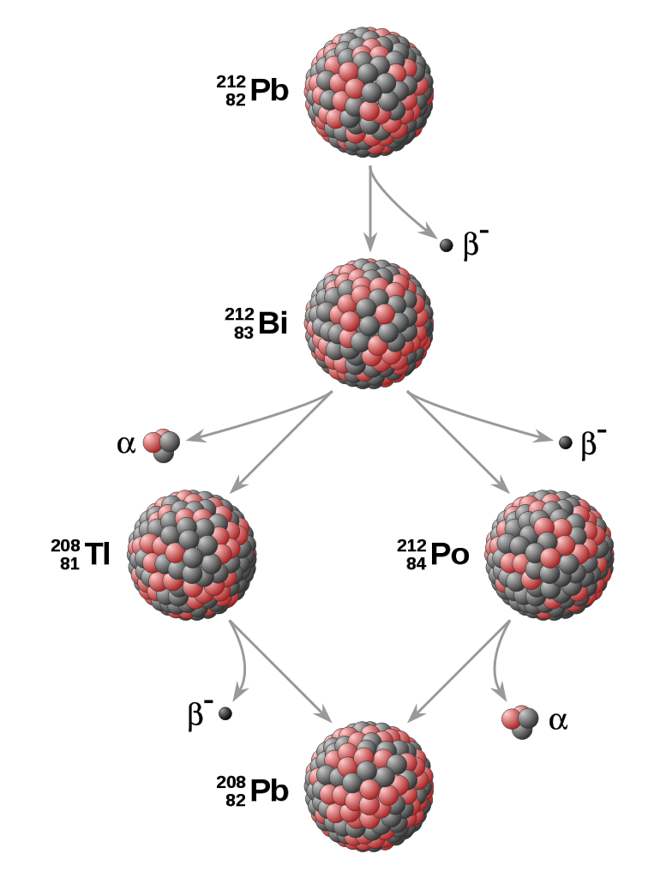

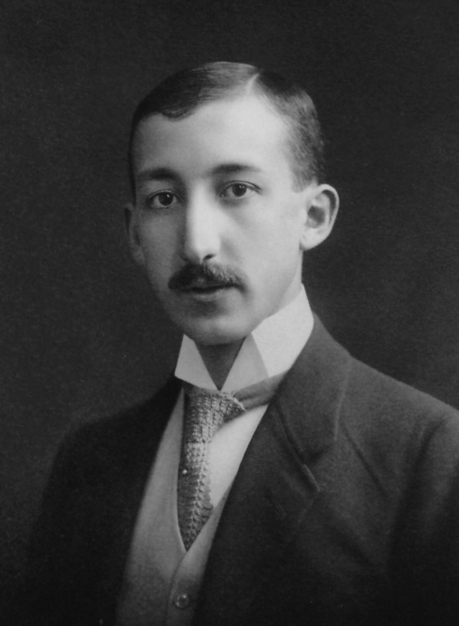
Il Principio Tracciante
George de Hevesy

Slide 10
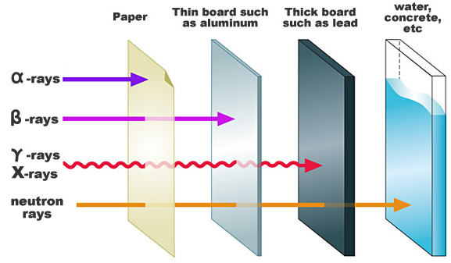
TIPI DI RADIAZONE

Slide 11


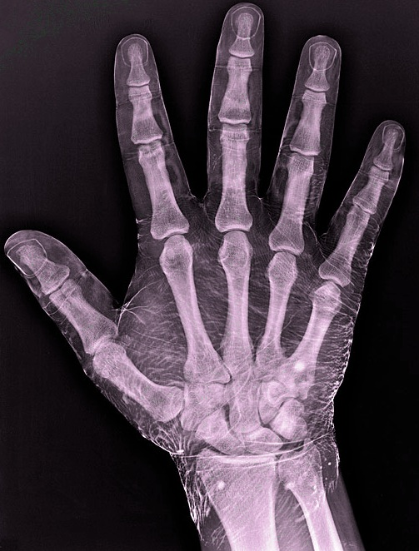
RADIOLOGIA
Anatomy

Slide 12

IMAGING NUCLEARE
Medicina Nucleare

Slide 13
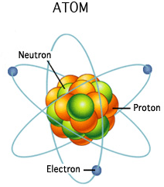
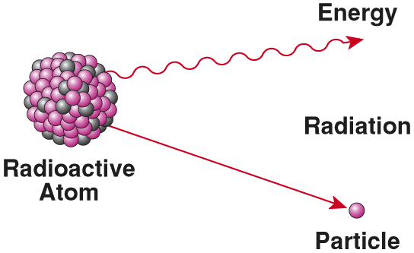
COME SI FA?

Slide 14
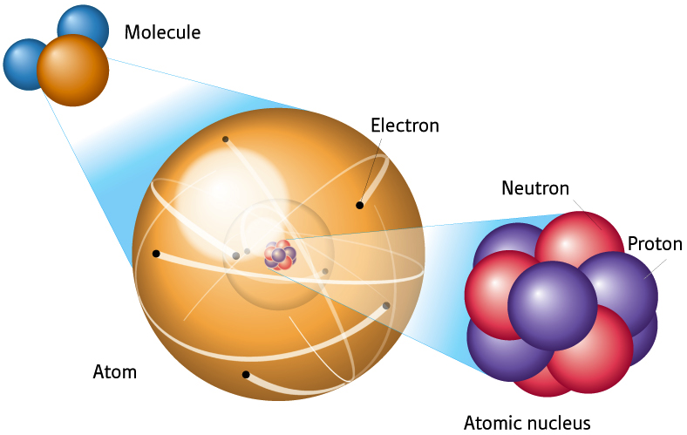
IMAGING MOLECOLARE
Water
β⁺-decay
ϒ-rays
Oxygen
¹⁵O

Slide 15
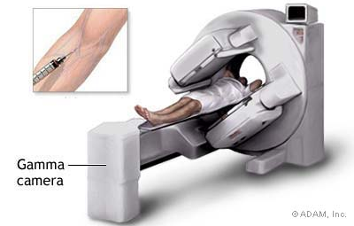


RADIOTRACCIANTI (RADIOFARMACI)

Slide 16
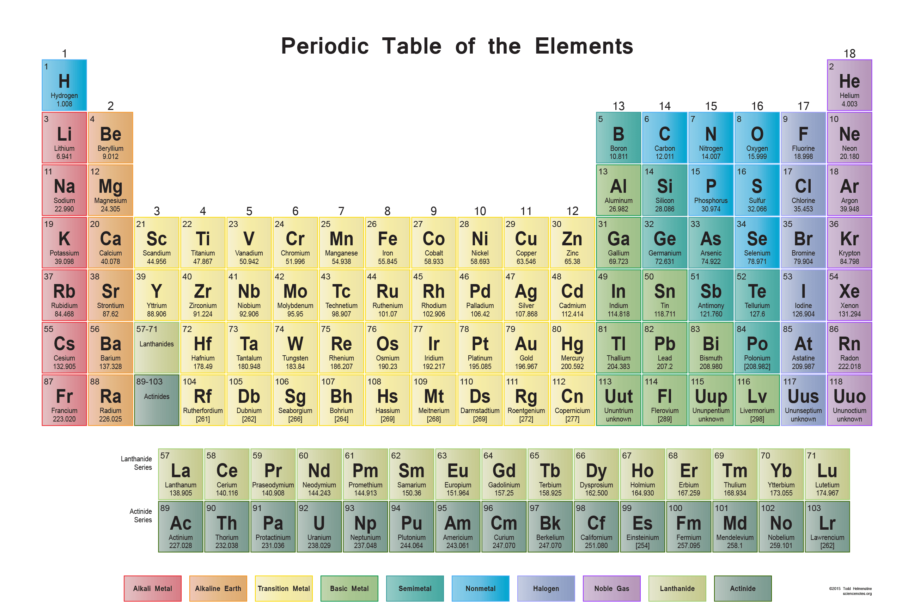

Slide 17
Gamma-Emitting Radionuclides
Positron-Emitting Radionuclides
Isotope | Half-life (hours) | Decay Mode* | production
Tc-99m | 6.0 | IT | generator
I-123 | 13.0 | EC | cyclotron
Tl-201 | 73.5 | EC | cyclotron
In-111 | 67.3 | EC | cyclotron
Ga–67 | 78.3 | EC | cyclotron
Isotope | Half-life | Max. Energy | range(mm) | production
C–11 | 20.4 mins | 0.96 MeV | 0.4 mm | cyclotron
N–13 | 9.96 mins | 1.20 MeV | 0.7 mm | cyclotron
O–15 | 123 secs | 1.74 MeV | 1.1 mm | cyclotron
F–18 | 110 mins | 0.63 MeV | 0.3 mm | cyclotron
Cu–62 | 9.74 mins | 2.93 MeV | 2.7 mm | generator
Cu-64 | 12.7 hours | 0.65 MeV | 0.3 mm | cyclotron
Ga–68 | 68.3 mins | 1.83 MeV | 1.2 mm | generator
Br-76 | 16.1 mins | 1.90 MeV | 1.2 mm | cyclotron
Rb–82 | 78 secs | 3.15 MeV | 2.8 mm | generator
I–124 | 4.18 days | 1.50 MeV | 0.9 mm | cyclotron
Alpha-Emitting Radionuclides
Radionuclide | Half-life | α Decay Energy (keV) | γ Decays Energy (keV)
Tb-149 | 4.12 min | 4077 | (β+) 352
At-2111 | 7.21 h | 5867 | 79
Bi-212 | 60.6 min | 8785 | 727
Bi-213 | 45.7 min | 8378 | 440
Ra-223 | 11.4 d | 5348 | 269
Ra-224 | 3.62 d | 5094 | 241
Ac-225 | 10.0 d | 5450 | 86
Th-226 | 30.9 min | 6338 | 111
Th-227 | 18.7 d | 5562 | 236
Fm-255 | 20.1 h | 7022 | 16
β-EMITTING RADIONUCLIDES
Radionuclide | Half-life | Mode of decay | E_{βmax} (keV)
⁹⁰Y | 64.00 h | β⁻ | 2280.1
¹³¹I | 8.02 d | β⁻, γ | 970.8
¹⁵³Sm | 46.28 h | β⁻, γ | 808.4
⁸⁹Sr | 50.53 d | β⁻ | 1496.6
¹⁷⁷Lu | 6.73 d | β⁻, γ | 498.3
¹⁸⁸Re | 16.98 h | β⁻, γ | 2120.4
¹⁸⁶Re | 3.72 d | β⁻, γ | 1069.5
³²P | 14.26 d | β⁻ | 1709.0

Slide 18
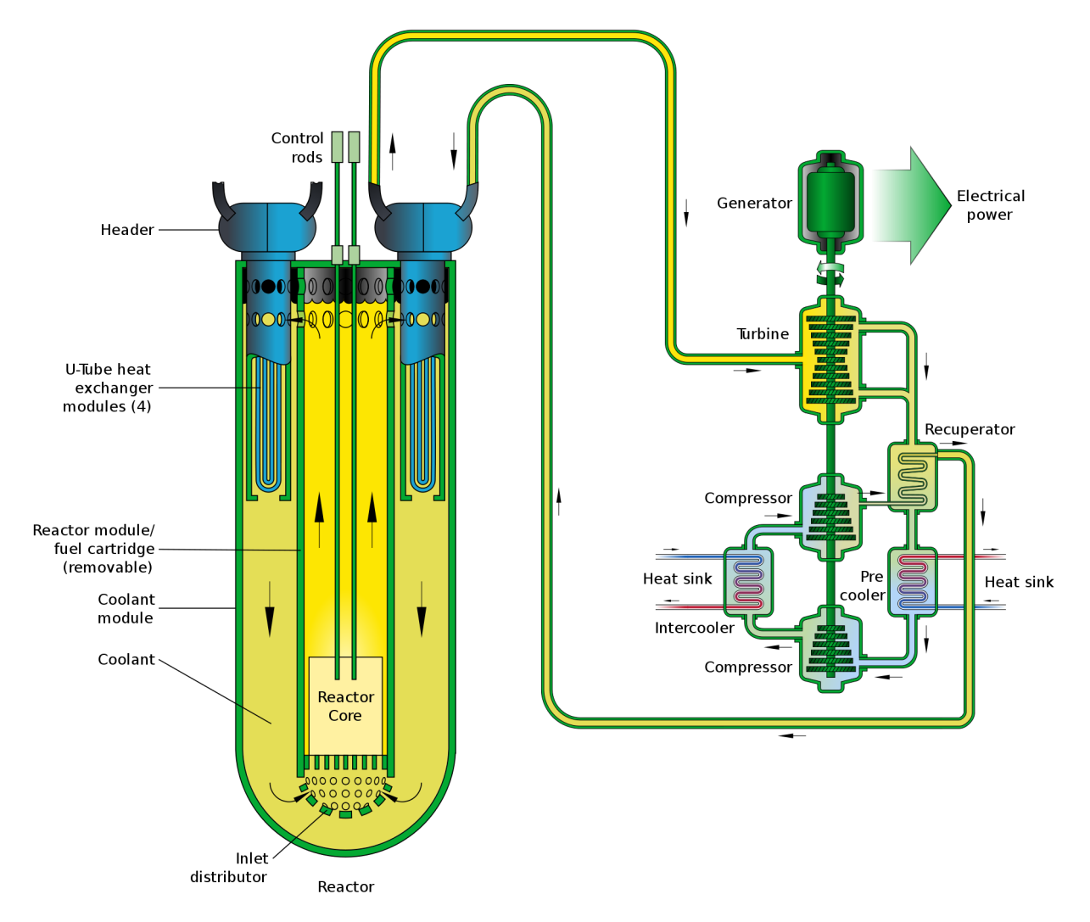
Reattori Nucleari

Slide 19
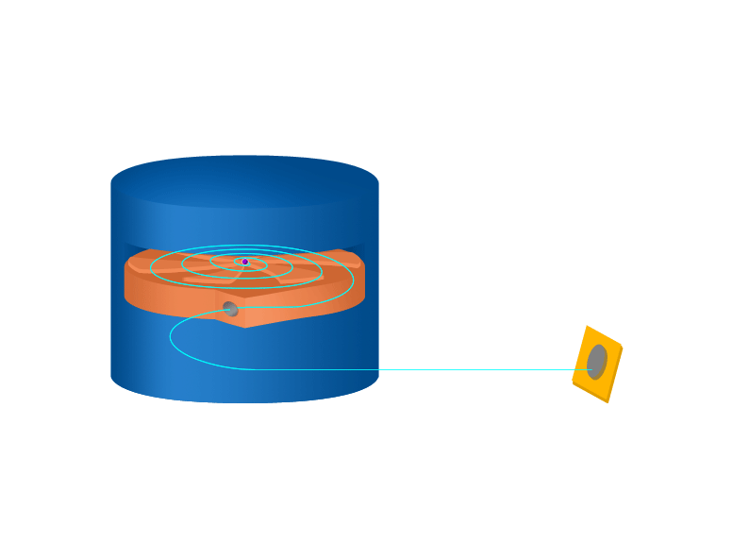
Acceleratori di Particelle
(Ciclotroni)
β⁻
β⁺
d
^{A’} Y
γ
p
^{A}X
^{Z’}
α
^{Z}
p
n

Slide 20
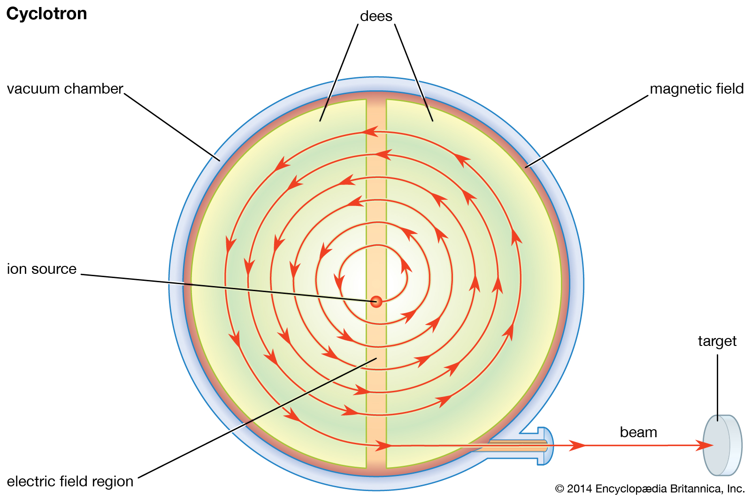
Lorentz Force
➔
➔
➔
➔
F = q(E + v × B)

Slide 21
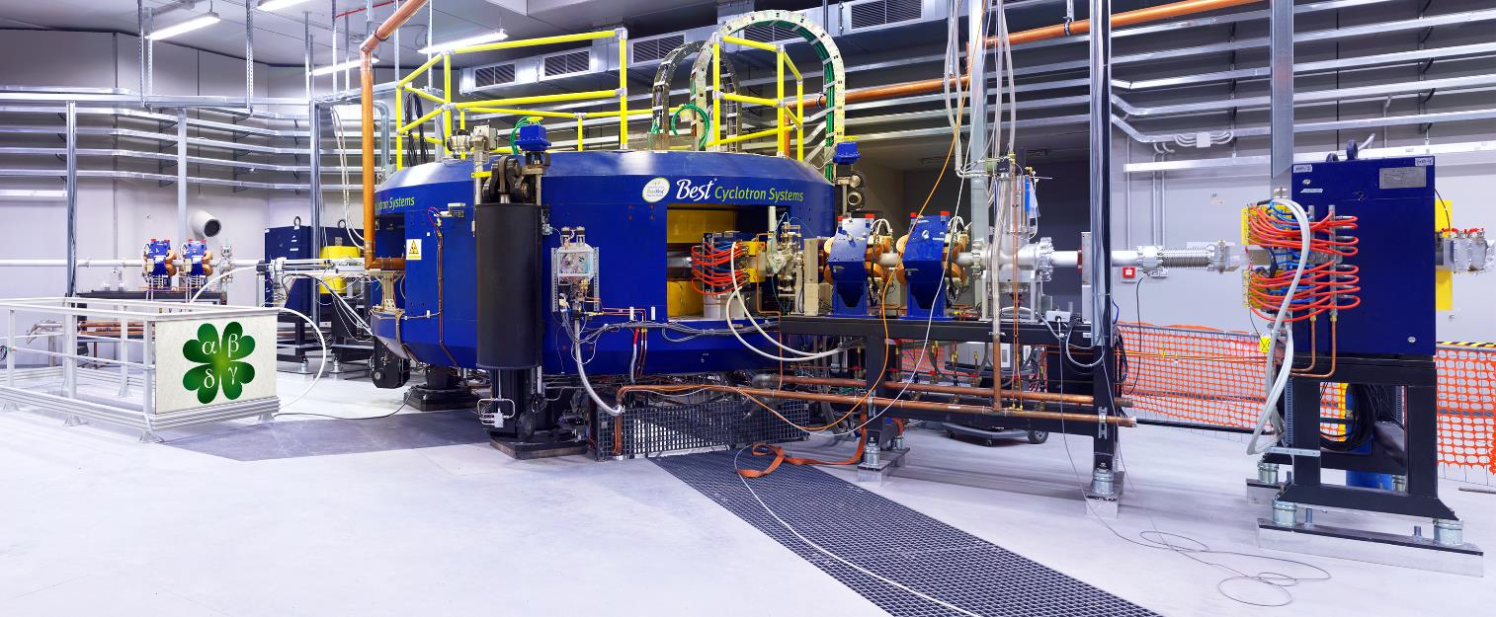


Il Nuovo Ciclotrone da 70-MeV a LNL-INFN

Slide 22
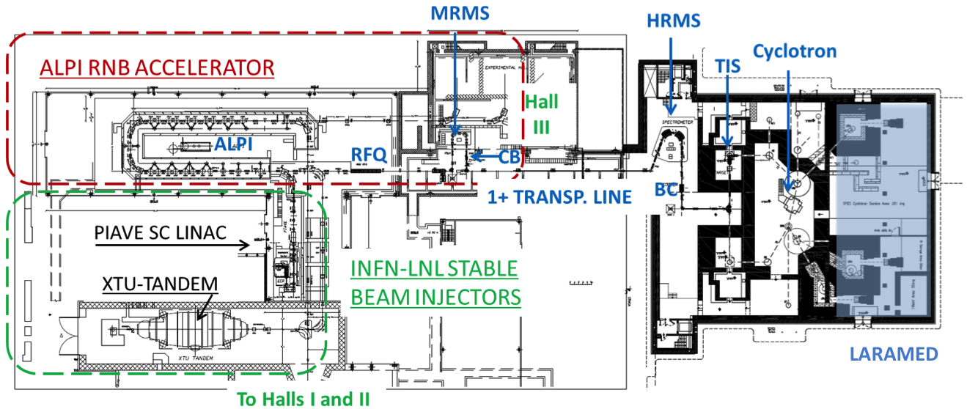
THE SPES AND LARAMED LABORATORIES

Slide 23
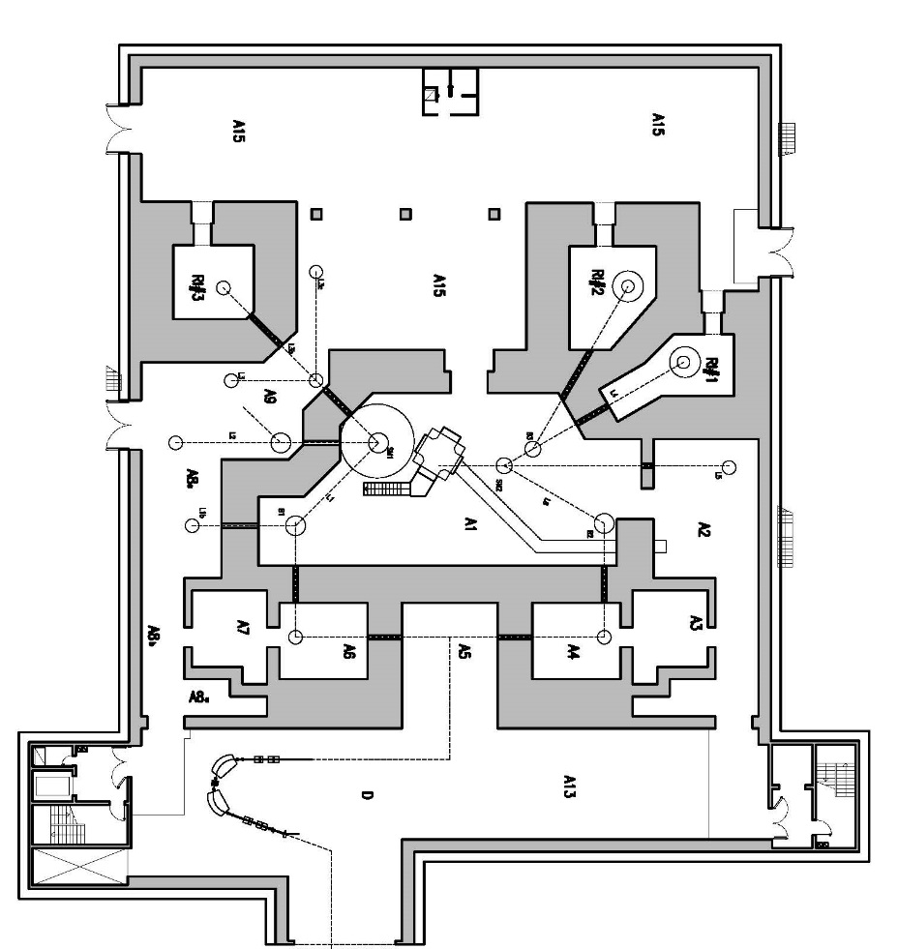
RI-LAB & RI-FAC

Slide 24
Single Photon Emission Computed Tomography
(SPECT)
γ

Slide 25
Positron Emission
Tomography
(PET)
γ, 511 keV
β⁺
β⁻
γ, 511 keV

Slide 26
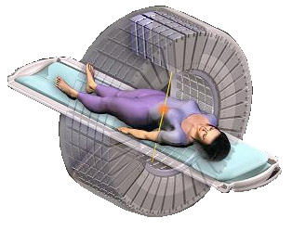
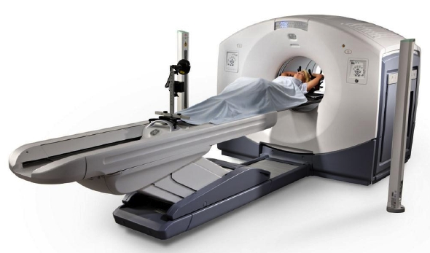
PET-CT

Slide 27
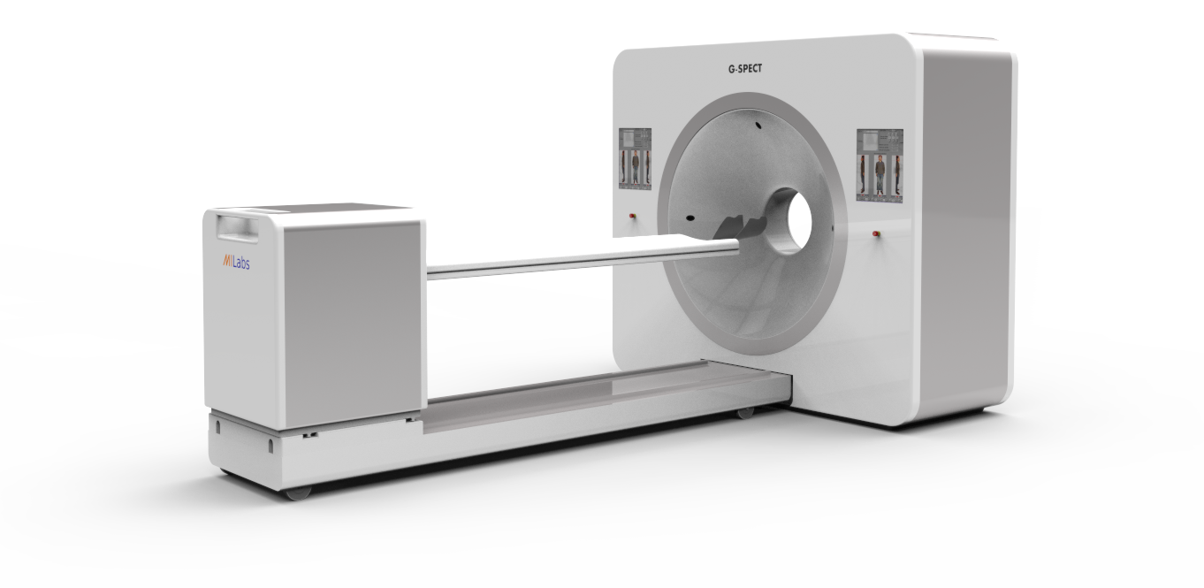
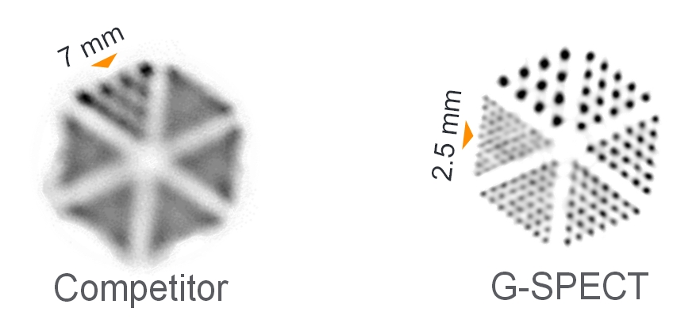
SPECT-CT

Slide 28
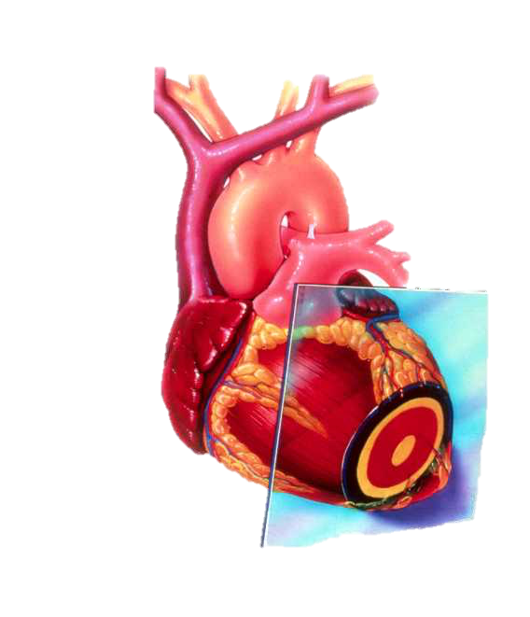
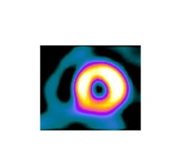
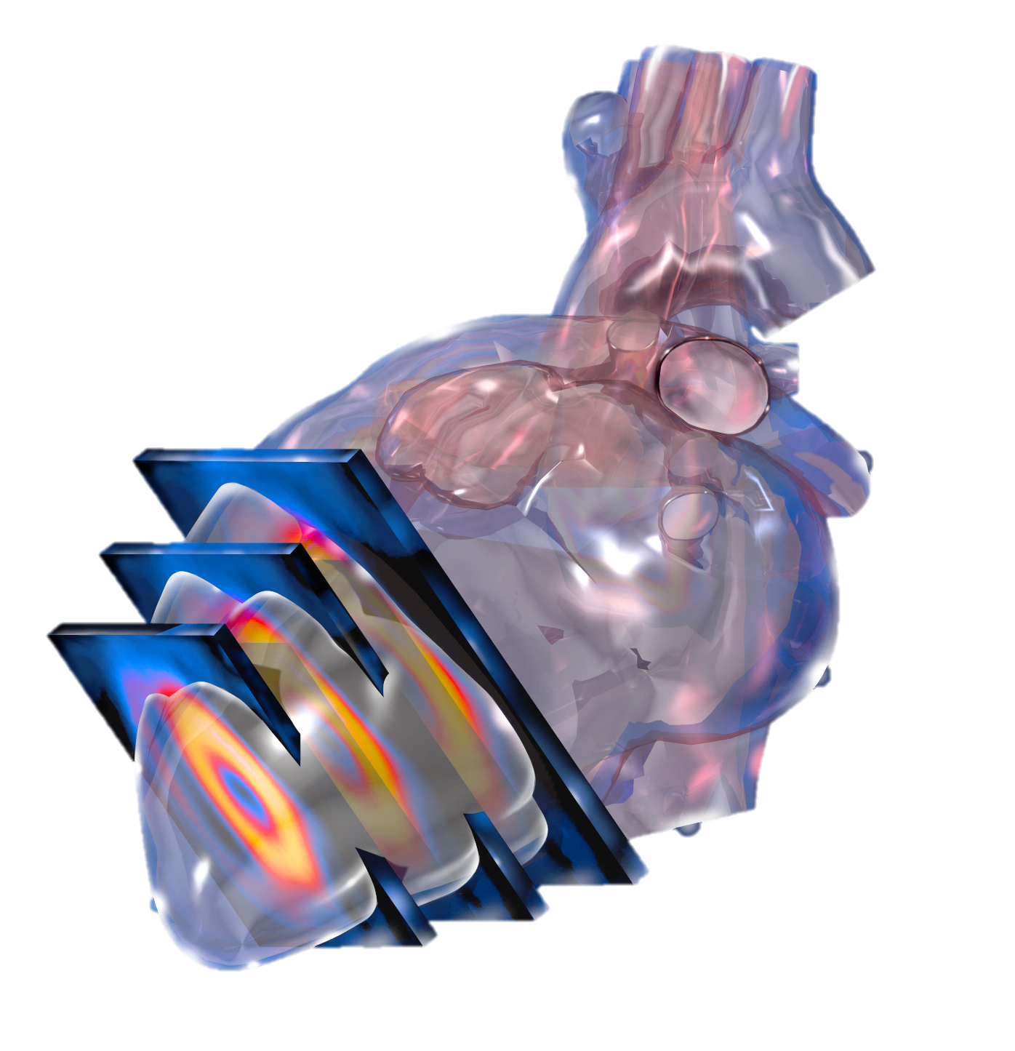
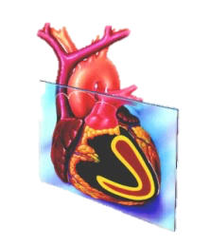
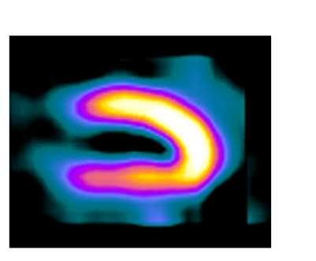
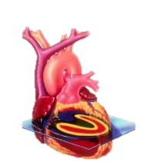
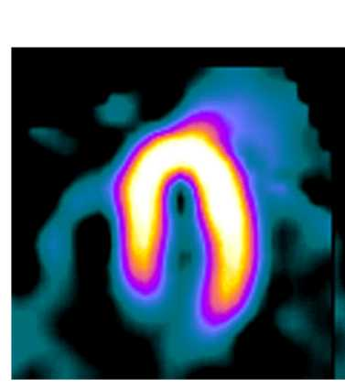
CARDIOTOMOGRAFIA NUCLEARE

Slide 29
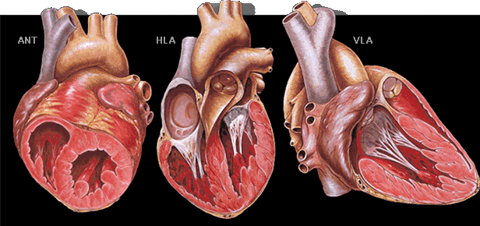
CARDIOTOMOGRAFIA NUCLEARE

Slide 30
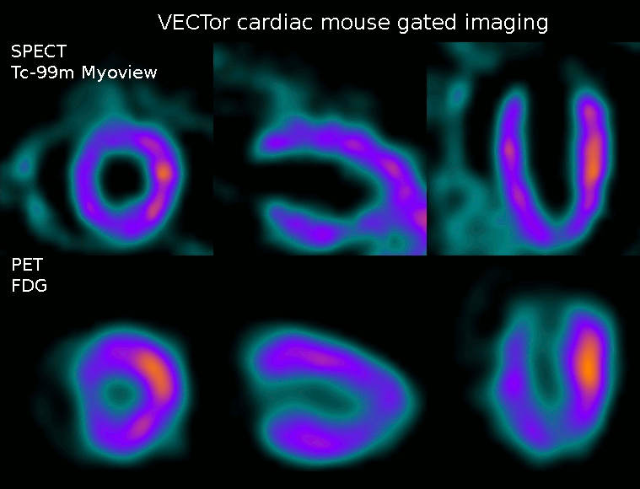
CARDIOTOMOGRAFIA 4D

Slide 31
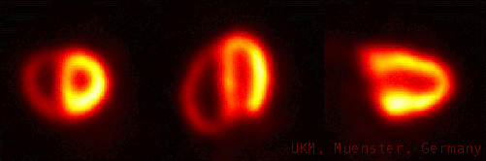
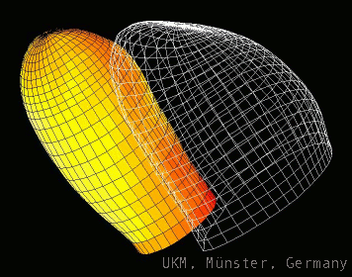
CARDIOTOMOGRAFIA 4D

Slide 32
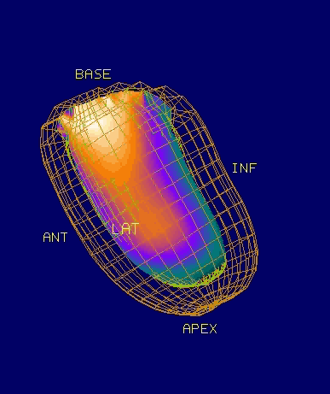
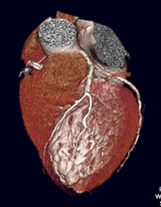
CARDIOTOMOGRAFIA 4D

Slide 33
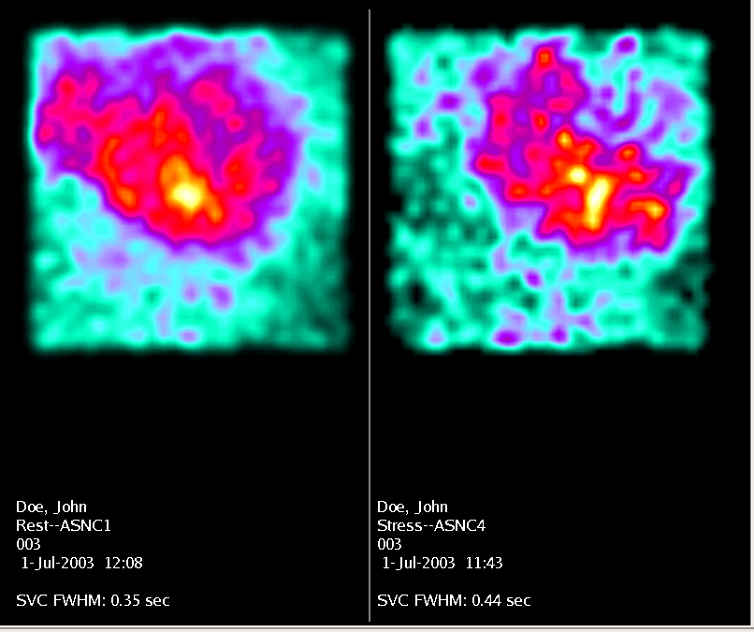
Imaging del Flusso Sanguigno Cardiaco (First Pass)

Slide 34
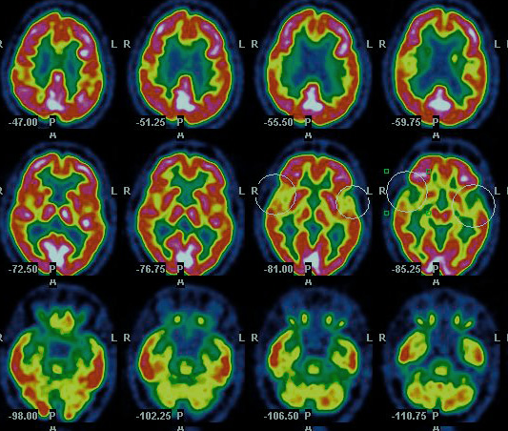
TOMOGRAFIA CEREBRALE

Slide 35
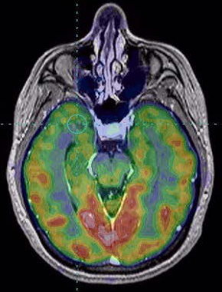
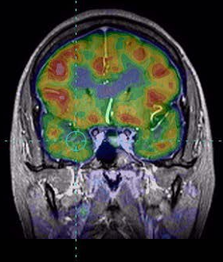
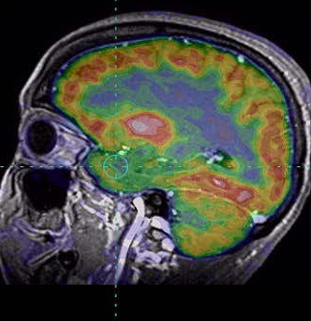
TOMOGRAFIA CEREBRALE IBRIDA (PET/CT)

Slide 36
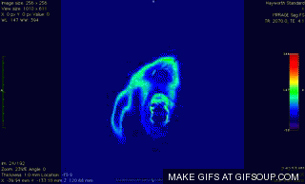
TOMOGRAFIA CEREBRALE 4D

Slide 37

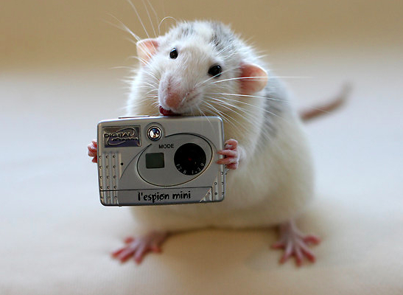
Tomografi per Piccoli Animali

Slide 38
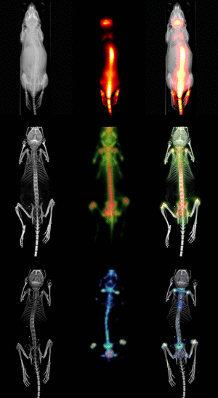
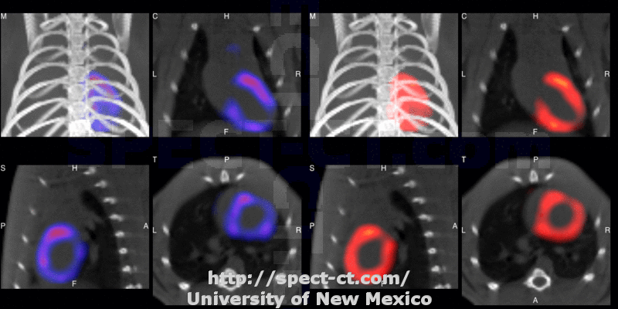
Tomografi per Piccoli Animali

Slide 39
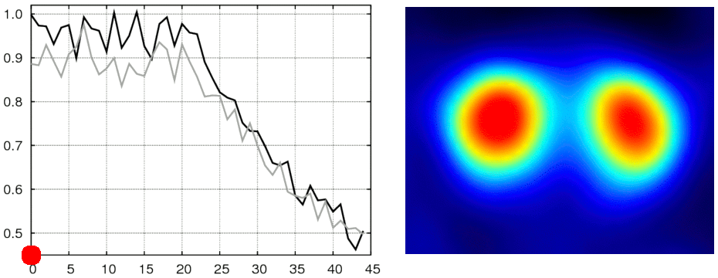
4D Misura In vivo della Densità dei Recettori Dopaminergici (D2) nel Sistema Nervoso Centrale

Slide 40

4-D CARDIOTOMOGRAFIA

Slide 41
Technetium-99m
⁹⁹Mo
(67 h)
100% β⁻
^{99m}Tc
(6.6 h)
γ, 98.6%
140.5 keV
(6.6 h)
γ, 1.4%
142.6 keV
2.2 × 10⁵ y
β⁻
⁹⁹Ru
(stable)

Slide 42


Prodotti di Fissione

Slide 43


Il Generatore di Mo-99/Tc-99m

Slide 44


L’Anione Pertechnetato
[^{99m}TcO₄]⁻

Slide 45


Imaging Tiroideo con Tc-99m

Slide 46





Cardiologia
Cardiologia
Nefrologia
Neurologia
Neurologia

Slide 47
Weekly Global Demand of Tc-99m

Slide 48


Cyclotron Production of Tc-99m
¹⁰⁰Mo(p,2n)^{99m}Tc
Radionuclide
Production
Target
Processing
Radionuclide
Separation

Slide 49







Automated Purification Modules
Silica
Alumina
H₂O₂
MEK
Waste
^{99m}Tc
Reactor

Slide 50
Production and Decay of Fluorine-18
γ
¹⁸F
(1.8 h)
e⁻
96.86% β⁺
e⁺
¹⁸F
p
γ
¹⁸O
¹⁸O
(stable)
n

Slide 51

[¹⁸F]Fluoruro

Slide 52


Metodo Bifunzionale
Radioactive tag
Bioactive molecule

Slide 53


2-[¹⁸F]Fluoro-desossiglucosio [¹⁸F-FDG]

Slide 54

2-[¹⁸F]Fluoro-desossiglucosio [¹⁸F-FDG]

Slide 55


¹⁸F-FDG
Normal
Abnormal

Slide 56


Rb-82

Slide 57


Slide 58

[¹³N]Ammonia
T_{1/2} < 10 min
Cyclotron produced
Metabolic trapping (glutamine synthase)
Non-linear relationship between uptake and flow.
Heterogenous uptake (inferior in the lateral left ventricular wall)
Not well-suited for peak stress gated imaging

Slide 59

[¹³N]Ammoniaca

Slide 60


Octreotide

Slide 61
Gallium-68
Production = ⁶⁸Ge/⁶⁸Ga generator (275 d)
Modes of decay = β⁺, EC
t_{1/2} = 1.13 h

Slide 62

⁶⁸Ga-DOTATATE
OH
NH
= Ga-68

Slide 63


TERAPIA CON RADIONUCLIDI

Slide 64
Decadimento del ²²³Ra
²²³Ra
α, 5.7 MeV
11.43 d
²¹⁹Rn
α, 6.8 MeV
3.96 s
²¹⁵Po
α, 7.4 MeV
1.78 ms
β, 0.4 MeV
β (0.27%)
²¹¹Pb
²¹¹Bi
²¹¹Po
36.1 min
2.17 min
α, 99.7%
2.17 min
α
516 ms
β
²⁰⁷Tl
²⁰⁷Pb
4.77 min

Slide 65


Radium-223 Chloride (XoFigo)
Tai-Lung Cha, T-L., et al., Optimal usage of radium-223 in metastatic castration-resistant prostate cancer. Journal of the Formosan Medical Association, 2017, 116, 825⎼836.

Slide 66
Radium-223 Chloride

Slide 67
Anticorpo

Slide 68
²¹³Bi-DOTATOC

Slide 69
Therapy with ²¹³Bi-DOTATOC
Kratochwil, C. et al., ²¹³Bi-DOTATOC receptor-targeted alpha-radionuclide therapy induces remission in neuroendocrine tumours refractory to beta radiation: a first-in-human experience. Eur. J. Nucl. Med. Mol. Imaging 2014, 41, 2106–2119 DOI 10.1007/s00259-014-2857⏤2859.

Slide 70

Rame-64

Slide 71
Rame-64
Production = ⁶⁴Ni(p,n)⁶⁴Cu
Modes of decay = β⁺ (17%), β⁻ (39%),
t_{1/2} = 12.701 h
β⁺
β⁻
⁶⁴Cu
p
⁶⁴Ni
n

Slide 72
Production of Cu-64
⁶⁴Ni(p,n)⁶⁴Cu
Electrodeposition of highly enriched ⁶⁴Ni over a gold backing plate
Irradiation of the target by protons (100 μA)
Transfer of the irradiated target by a pneumatic system
Dissolution and purification of ⁶⁴Cu by a dedicated separation module
Sterilization and dispensing

Slide 73
Il Ruolo Biologico del Rame
Lutsenko, S., et al., Physiol Rev 87: 1011–1046, 2007

Slide 74





^{64/67}Cu
hCTR1
CSS
MT
SOD
COX17
Nucleus
ATOX
SCO1
Mithocondria
Golgi
ATPase

Slide 75


Imaging of Glioma with Cu-64
Panichelli, P., et al., Cancer Biother Radiopharm 31: 159–167, 2016

Slide 76

Imaging of Glioma with Cu-64

Slide 77


Liver Cancer

Slide 78

Bladder Cancer

Slide 79


⁶⁴Cu²⁺ in prostate cancer
⁶⁴Cu²⁺
⁶⁴Cu²⁺
¹⁸F-Choline
Positive lymph node

Slide 80


⁶⁴CuCl₂ in prostate cancer

Slide 81


Therapy of Glioma with Cu-64 Dichloride

Slide 82


Therapy of Glioma with Cu-64 Dichloride

Slide 83
Copper-67

Slide 84
⁷⁰Zn(p,2p2n)⁶⁷Cu
β⁻
γ
⁶⁷Cu
p
⁷⁰Zn
2n
2p

Slide 85

GRAZIE

