Slide 1
Status of WP5.2 activity
What has been done
Agenda/Topics of the Krakow meeting
Status of the current actions of WP5.2
Overall Status of WP5.2 actions
Sources of data and existing database: some ideas
Krakow talk
About the deliverable D5.1

Slide 2
What has been done
Meeting industry (Round table)
Meeting with FUSUMATECH
Several meeting between French institutes (CNRS and CEA)
Visit to DESY – Meeting of Database expert (Vladimir GUBAREV)
Meeting with IPNO IT department including Database expert
Meeting at Krakow with IFJ-PAN Overall and detailed discussion on AMICI-DB
Reports to WP5 leader and to AMICI SC
Bibliography
Mailing to academia and industry to get experts lists
Survey of existing database useful for AMICI

Slide 3
Agenda of the Krakow meeting
Tuesday 23/10/2018
Philosophy and goal of AMICI-DB
Structure/Skeleton of AMICI-DB
Content of AMICI-DB: what kind of information and/or data should be included
Data collected. How to manage?
Functionality
Architecture proposal
Working plan
Wednesday 24/10/2018
Minutes Report of the meeting
Visit of IFJ-PAN infrastructure

Slide 4
Topics of Krakow talk
Main Goal of Task 5.2
Philosophy of Database structure
ESS linac as example of how to proceed
What are the properties needed for design, fabrication?
What should be included in AMICI database?
Some critical components
From academia knowledge and industry Know How to AMICI-DB
Materials and Components
SRF cavity Database for the Tesla Test Facility
Choice of software for database development and configuration/architecture at Desy
New configuration for XFEL/R&D Cavity databases at Desy (In development)

Slide 5
Status of the current actions of WP5.2
# | Description | Goal | Deadline | Who | Status
1 | Mailing to academia experts (industry?) | Description of each main part of accelerator (particle source, MEBT,….) | 21/12/18 | M. Fouaidy | Done CNRS, STFC
4 | Contact and meeting with FUSUMATECH Task and/or WP leader in charge of data base | Cooperation for sharing the job/data. Discussion about the functionality, keywords | 14/01/19 | M. Fouaidy | To do
6 | Description of full dressed superconducting magnet including the cryostat | General layout of cryostat for superconducting magnet | 18/01/19 | F. Rondeaux | To do
7 | Description of room temperature (RT) RF cavities and ancillaries | Layout of RT RF accelerating section | 14/01/2019 | M. El Khaldi | In progress

Slide 6
Status of the current actions of WP5.2
# | Description | Goal | Deadline | Who | Status
2 | Key words: input to AMICI-DB | From IEEE list, else? | 14/01/19 | All | Done
3 | Bibliography | Collect data |  | All | Done
7 | Description of room temperature (RT) RF cavities and ancillaries | Layout of RT RF accelerating section | 14/01/2019 | M. El Khaldi | To do

Slide 7
Overall Status of WP5.2 actions
Philosophy and goal of AMICI-DB Finished
Structure/Skeleton of AMICI-DB Finished
Content of AMICI-DB: what kind of information and/or data should be included? Open
What are the properties needed for design, fabrication? In progress- Help needed (experts)
Data collected. How to manage? In progress – Help from IFJ PAN??
Functionality In progress, Help needed
Choice of software and configuration/architecture proposal Finished
Key words First proposal – Advise/Feedback from experts needed In progress
Source of data and survey of existing database useful for AMICI In progress

Slide 8
Sources of data and existing database: some ideas
Cryodata industrial software
ASM HANDBOOK
Techniques de l’ingénieur
CAS
Published papers
Books
Cryogenics (general, liquid helium, cryogenic engineering)
Fundamental and/or Applied superconductivity
RF engineering
NIST https://www.nist.gov/
Other existing databases, softwares (Survey to be done: academia )

Slide 9
Main Goal of Task 5.2
What is stated in the AMICI proposal?
“Establish a common knowledge, background and use among Technological Infrastructures and related laboratories and industries in relation to material and components involved in accelerator and large superconducting magnets. “
Motivations for developing a dedicated database.
Accelerator performances are determined by: 1) The design and engineering of the machine,
2) Material and/or component choice and specifications.
Data and characteristics properties of material and components, when available, are not easy to find in literature. Some of these are transmitted via private communications.
Lack of data on materials and components suited for use and reliable operation in the specific accelerator environment (e.g. radiation, cryogenic temperature…).
Main objective:
Create a common reference database for materials and components used in accelerators (accelerating structures, magnets, diagnostics, ancillaries…) and start to fill it with relevant data.

Slide 10
Philosophy of Database structure
Functionnal breakdown structure
Part # 1 Particle Production (Source)
Part # 2 Low Energy Beam Transport (LEBT)
Part #N
Machine structure (layout)
Properties
Suppliers
Component #1
Component #n
Element #1
Element #p

Slide 11
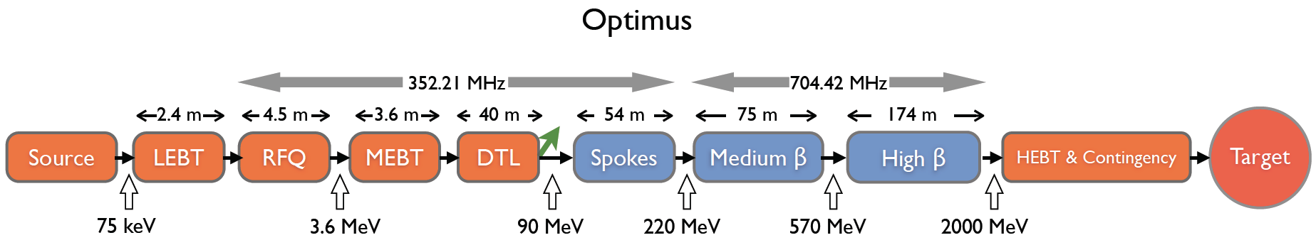
ESS linac as example of how to proceed
We focuse on the spoke linac section
Section | Cavity β | Total number of Modules | Cavity frequency | # Cavity per module | # Cavity per section | Cryomodule length | Section length
Spoke | 0.50 | 14 | 352 MHz | 2 | 28 | ~ 2.9 m | 58.5 m
Medium-beta | 0.67 | 15 | 704 MHz | 4 | 60 | ~ 6.7 m | 113.9 m
High-beta | 0.92 | 30 | 704 MHz | 4 | 120 | ~ 6.7 m | 227.9 m
Total |  | 59 |  |  | 208 |  | ~ 400 m

Slide 12
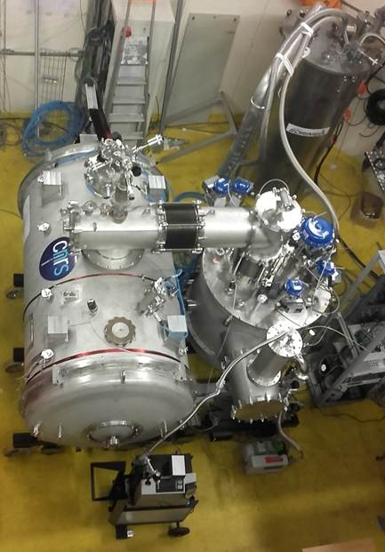
ESS accelerating spoke crymodule main parts
Cryomodule housing two fully equipped Double Nb spoke cavities
Vacuum insulated Cryogenic line
Cold tuner,
Magnetic shielding,
Power coupler,
Instrumentation
Gaseous helium heating system
Power resistors
Heat exchanger
Temperature controller
Jumper
Cold box
Vacuum insulation
Leak tightness
MLI
Special Bellows
Heat exchanger
JT valves
Tubing, bellows, connections
MLI
Instrumentation
Magnetic coils
Pumping system

Slide 13
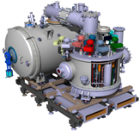
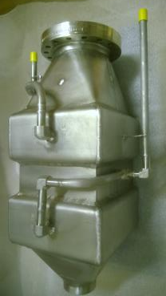
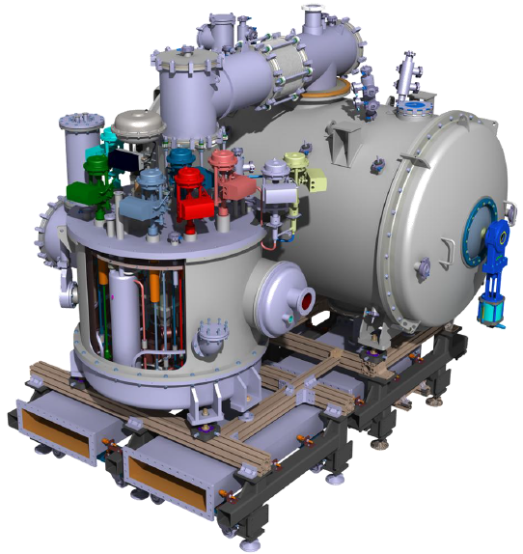
ESS spoke cryomodule and cold box
Some critical components
Cryogenic line
Feedthrough
Vacuum vessel
(Stainless steel)
Vacuum vessel
(Stainless steel)
Bellows
Gasket
MultiLayer Insulation (MLI)
Thermal radiation shields
(Cu or Al)
Gate valve
JT valves
Cryomodule
Cryogenic heat
exchanger
Vacuum vessel
(Stainless steel)
Cooling pipes
Thermal radiation shields
(Cu or Al)
Instrumentation (P,T, cryofluid, level,..)
Cold box
RF waveguide

Slide 14
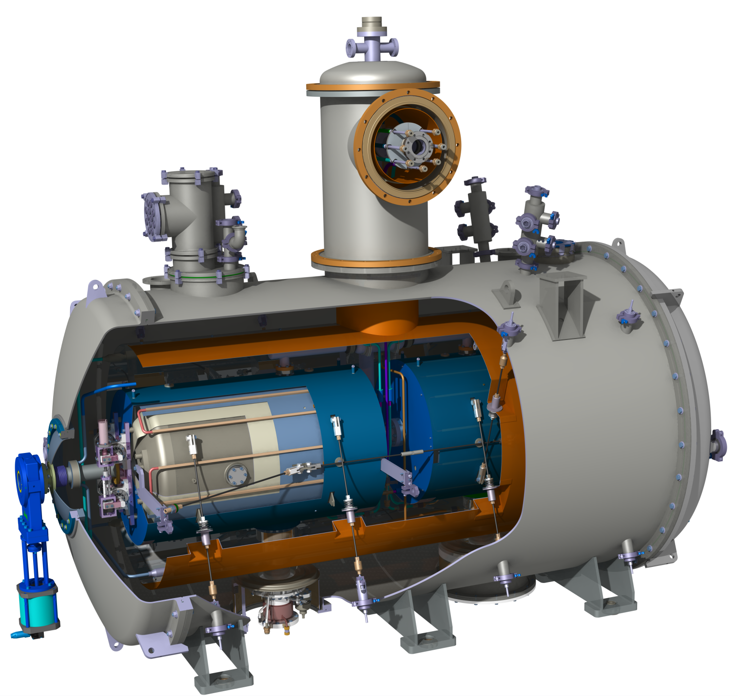
What are the properties needed for design, fabrication?
Database Keyword (input)
Vacuum vessel
Thermal radiation shields
(Cu or Al)
Accelerating SRF
Cryomodule
Property | Impacted parameters
Material, Grade Purity | Fabrication process (machining, welding,..), cost, availability
Mechanical properties | Vacuum, stress vs strain curve
Thermal properties | Cryogenic performance
Magnetic properties | SRF cavity dynamic losses
Radiation (neutrons, Xrays,..) | Reliability, lifetime, performance
Gate valve
Flowrate
Response time
Leakrate
Supporting rods (Epoxy)
Magnetic shields
(Cryoperm,…)
Cooling pipes
Database output

Slide 15
How AMICI works?
Database input
Key word : SRF cryomodule
Material
Properties
Components
Cavity : Nb
Flanges : SS, NbTi
Material, Grade, Purity treatment, metallurgy
Mechanical (Young and shear modulus, YS,UTS,)
Thermal (Conductivity, diffusiviy,
Electrical (Resistivity
Superconducting (TC, HC,JC..)
Magnetic properties (permeability,
Radiation (neutrons, Xrays,..)
SRF cavity
Lhe Tank
Cold Tuner
Power Coupler
Magnetic shields
Thermal Shields
Vacuum vessel
Tank : SS, Ti
Thermal Shield: Cu, Al
Vacuum vessel: SS
Database output

Slide 16
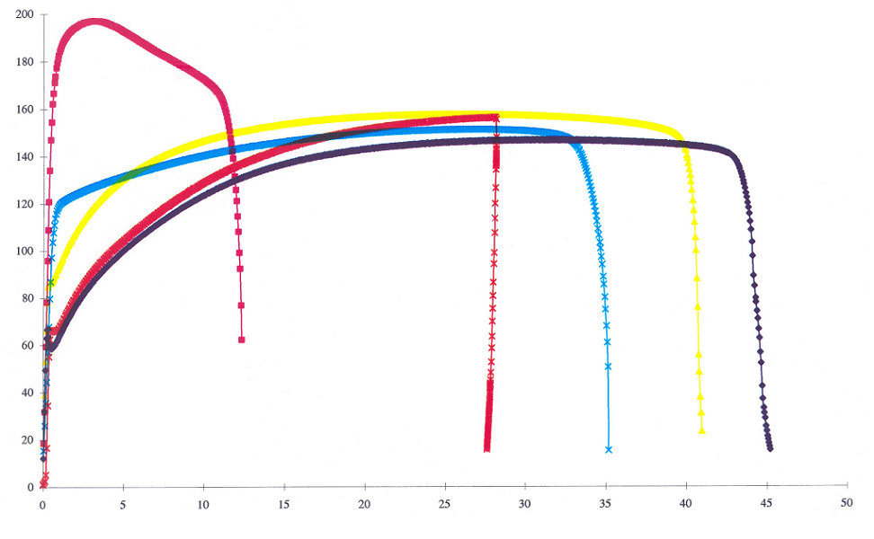
Example of data: Strain versus strain: metallurgy, heat treatment
Laminé (73%)
Contrainte (MPa)
600° C, 2h
700° C, 2h
900° C, 2h
800° C, 2h
À réception
Déformation (%)

Slide 17
Examples of Niobium thermal data
Annealed
k(W/m.K)
k(W/m.K)
Phonon peak
T(K)
Recrystallisation effect on k(T) and hardness
T(K)
2
Phonon peak depend strongly on mechanical deformation

Slide 18
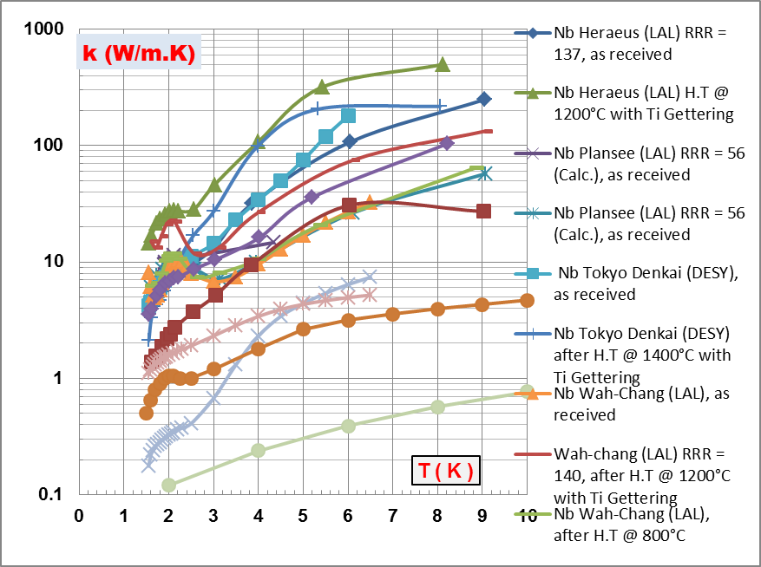
Niobium thermal conductivity data of IPNO

Slide 19
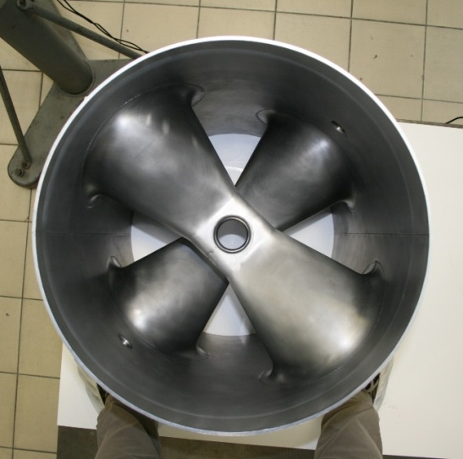
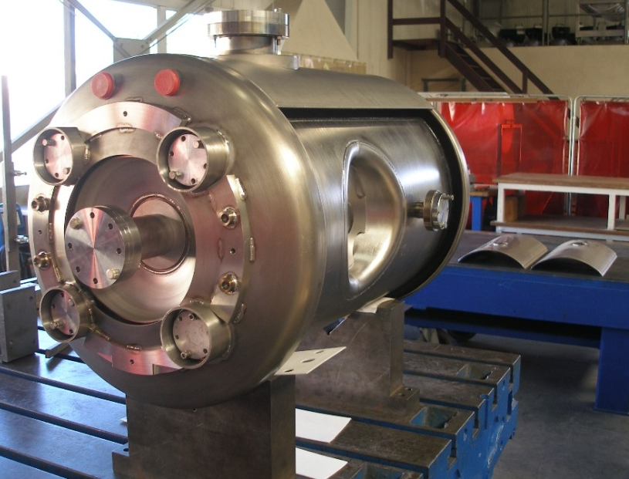
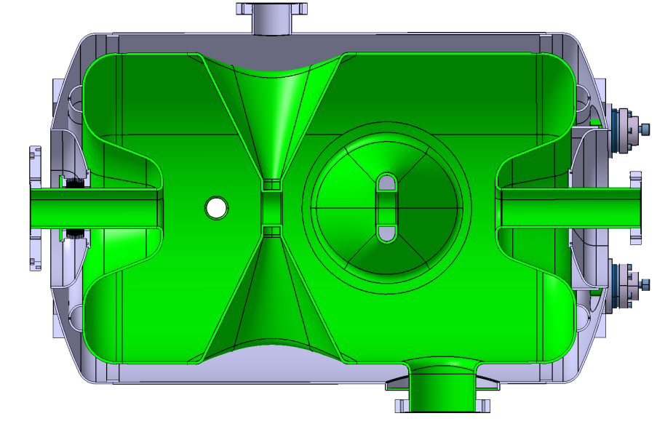
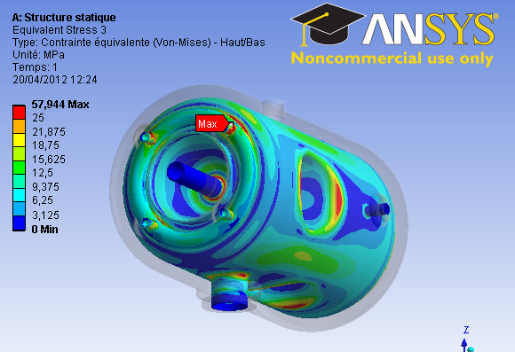
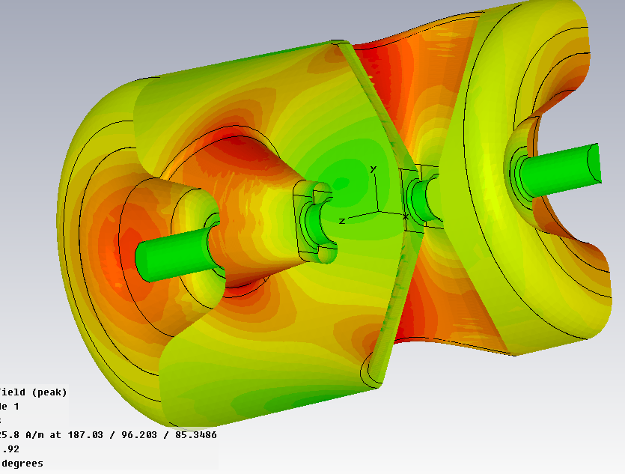
What should be included in AMICI database?
Design and computation using Industrial codes
Mechanical behavior under pressure
Material:
Cavity: High purity Nb RRR~300
Helium tank: Ti
Flanges: SS or Ti
Bellows: Ti
Industry know how:
Deep drawing
EBW
Brazing
H field
AMICI DB
Material data needed for design and fabrication:
Structural (grain size), mechanical properties (E, v, Strain vs stress curve)
Superconducting, electrical (RRR), thermal properties (Conductivity),…

Slide 20
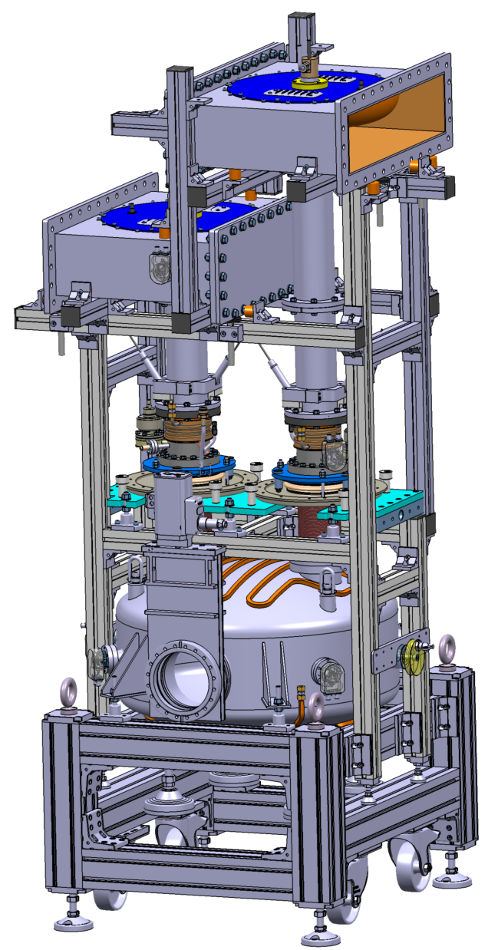
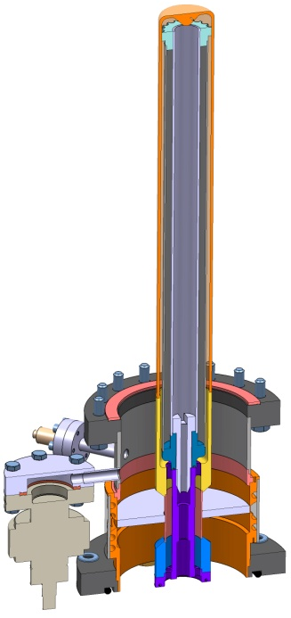
Some critical components: RF Power coupler
Informations about referenced industrial know how (Past successfull experience)
High RF power (Klystrons, IOT,..)
RF components (WG, loads, ..)
Alumina window
Vacuum brazing (RF window)
Surface treatment (Copper plating: inner& outer conductors, TiN coating Al2O3 window )
Mechanical fabrication and assembly
Instrumentation: vacuum, light, electron activity
Inner conductor:
OFHC copper
e- pick-up
Alumina
disc
Room temperature cavity (coupler conditioning)
Outer conductor
AMICI-DB
Vacuum gauge

Slide 21
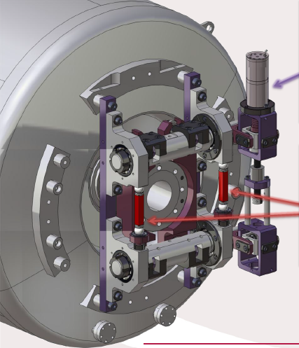
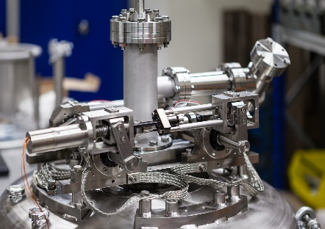
Some critical components: Fast Active Cold Tuning System ( FACTS
Slow and coarse tuner
Function: slow and long range (~2mm, 500 kHz) resonant frequency adjustment during cool down from RT to 2-4.2 K.
Actuator: Stepping motor&planetary gear box
Mechanical properties (Young modulus, thermal contraction,)
Lifetime and reliability (motor, piezo actuator)
Radiation hardness at Lhe temperature
FACTS needed for
Matching cavity frequency to RF source frequency resulting in
Improving Beam quality
Increasing Acceleration efficiency
Reducing Operating cost
Fast and fine tuner
Function: Fast active compensation of short range (~4µm, 1kHz) Lorentz detuning during cavity operation.
Actuator: Piezoelectric actuator

Slide 22
From academia knowledge and industry Know How to AMICI-DB
Reliability studies, lifetime tests, specific data (cryogenic temp., radiation)
Component design and fabrication
Design and computation using Industrial codes
AMICI-DB
Published Data (Review Papers)
Issue:
Intellectual property!
Characterization of Cu and TiN at institutes (Dedicated facilities: cryogenic tests, SIMS, SEM…)
Actuators characterization in superconducting accelerator environment (low temperature, radiation (X rays, neutrons) ,…)
Steeping motor lifetime tests
Need of strong collaboration agreement rules (IP, technology transfer)between academia and industry

Slide 23
Materials and Components (1)
What should be included in the database?
MATERIAL
Some examples:
Raw material, as used to fabricate accelerator systems
  Niobium, Nb3Sn, NbTi, Stainless steel, Titanium,…
  Ceramics (power couplers)
  Magnetic material (µmetal ,co-netic, …)
  …
Material as used during processing/preparation
  Chemical etching mixture
  Ultra-pure water
  Media for mechanical polishing
  …

Slide 24
Materials and Components (2)
2. COMPONENT
Some examples:
Ancillaries, as used to implement accelerator systems
  Cables,
  RF feedthrough, HV feedthrough
  Screws, bolts
  Gaskets
  …
Sensors/Instrumentation as used in accelerator environment ? Specially when they are very specific
  Temperature sensors
  Piezo actuators
  Vacuum gages

Slide 25
Materials and Components (3)
Apart from material and component, other category to add to the database ?
Design and Numerical Simulation tools (ex: Mechanical, Thermal, RF software, Multipacting and field emission )?
Procedures (Preparation, mounting, assembling, testing, …)
What about equipment of technological infrastructures ?
Should be listed in the database or is within Amici/WP3 ?

Slide 26
SRF cavity Database for the Tesla Test Facility
Heat treatment
Mechanical
Meas.
Material properties
Pulsed Tests
100 MB
CW Tests
Database
Chemistry
Tuning
P.D. Gall et al. Desy 10 th SRF workshop, 2001, Tsukuba, Japan

Slide 27
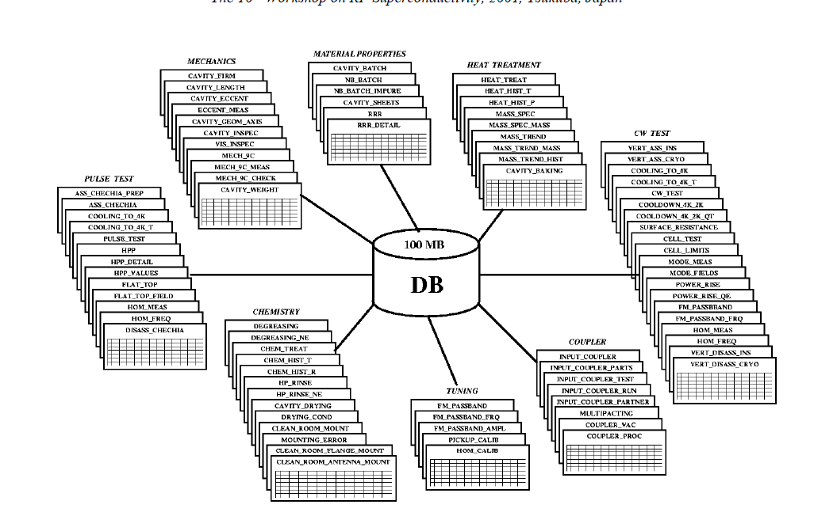
SRF cavity Database for the Tesla Test Facility

Slide 28
Choice of software for database development and configuration/architecture at Desy
Visit to Desy: discussion with the expert who developed database concerning SRF cavities for TTF, FLASH and XFEL.
Initial plan: to benchmark different softwares in order to choose the best one for AMICI-DB.
But following the meeting at Desy and discussion with database expert at IPNO IT department , ORACLE seems to be suited for AMICI-DB development.
Meeting with IPNO IT department team for discussion/validation of the version based on Desy XFEL DB. General agreement and feedback needed once IFJ PAN started the work on AMICI-DB (e.g. configuration, architecture, functionalities,…)

Slide 29
New configuration for XFEL/R&D Cavity databases at Desy (In development)
Courtesy Vladimir GUBAREV (Expert SRF cavity database at Desy)

Slide 30
About the deliverable D5.1
Deliverable of the task WP5.2:
D5.1 Definition of the possible structure and content of a database for materials and components due for 14/04/2019 (M26).
1- Collect an initial set of basic data and data sheets relevant to the issue of Material specifications and Components specifications. This subset should be sufficiently large, significant and agreed by experts to guide in defining the structure of the database: content, categories, key words, parameters description, etc…
Status: well advanced. Need help from experts: definition of critical components and relevant material properties for each main part of an accelerator and magnets. Actions: 1) list of expert and mailing, 2) organize collected data
2- Provide one, or possibly a few, tentative structure for the database, as described above.
Status: well advanced. Action: work on fine structure and functionality.
Steps 1&2 financially supported by current AMICI
3- Develop a professional database
Step 3 to be financially supported and achieved within the EU project (AMICI Phase 2?)

