Slide 1
MUonE
Muon Electron Elastic Scattering
U. Marconi
INFN Bologna
On behalf of the proponents
“When all else fails, you can always tell the truth.” A. Salam

Slide 2
Content
Introduction
Test beam 2018 results
  Implications on the detector design
Plans for 2019
Measurement technique
Progresses with the theory

Slide 3
Test beam 2018
The setup has been located downstream COMPASS, behind the Tungsten hadrons filter.
  Aim of the measurement campaign: ese muons, mainly from pion decays, to study the muon – electron elastic scattering.
    Estimated beam momentum p = (187±7) GeV
    Correlation between the scattering angles:
    muon angle vs the electron angle;
    Electron energy vs the electron angle correlation and PID.
The detector consists of:
  Tracking system: stations equipped with the AGILE silicon strip sensors: 400 micron thick, single sided,
  ~40 micron intrinsic hit resolution.
  Electromagnetic calorimeter: 3x3 cell matrix.

Slide 4
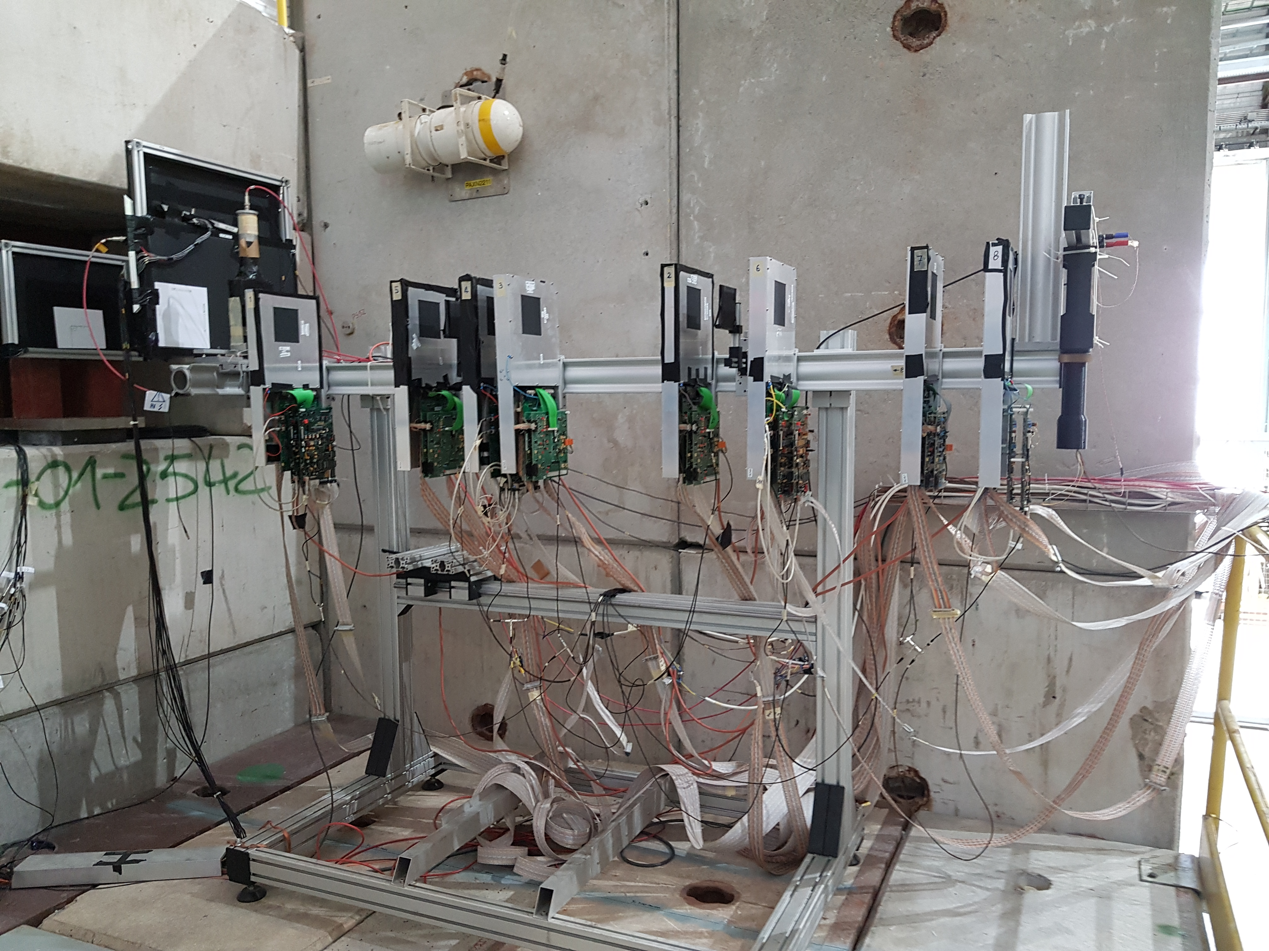
Test beam 2018
beam

Slide 5
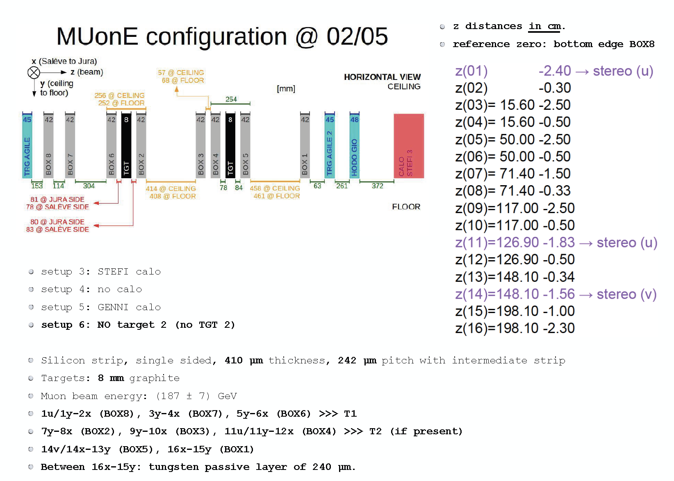
Test beam 2018: arrangements
beam
Tracking station positioning
Δz ~ 1mm

Slide 6
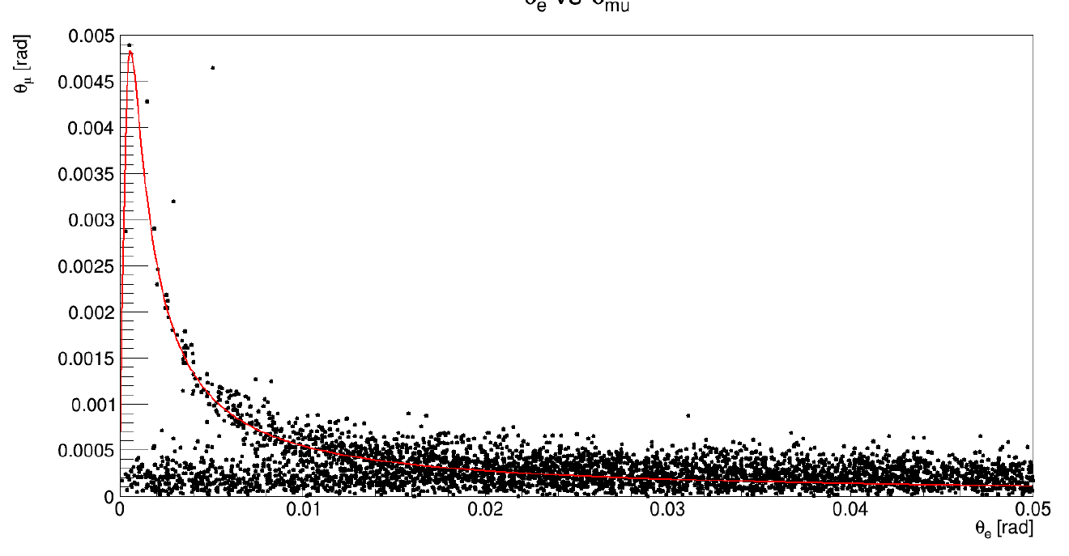
Simulation: Test beam 2018, GEANT4
Tracking algorithm applied.
Configuration: without T2, using the downstream boxes 2, 4 and 5
Box 3 removed since it was not working properly
150 million incoming muons → 5742 reconstructed events
angle_µ vs angle_e
40µm hit resolution
angular ~ 0.1 mrad
5 mrad
Elasticity curve: beam momentum at 187 GeV
50 mrad

Slide 7
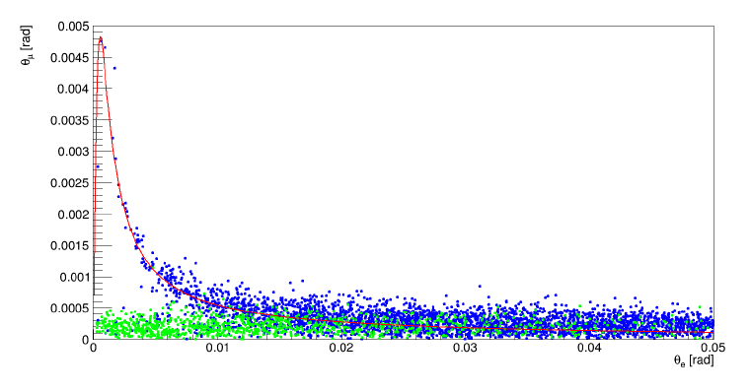
Simulation: Test beam 2018, GEANT4
angle_µ vs angle_e
Signal
Background
Pair production

Slide 8
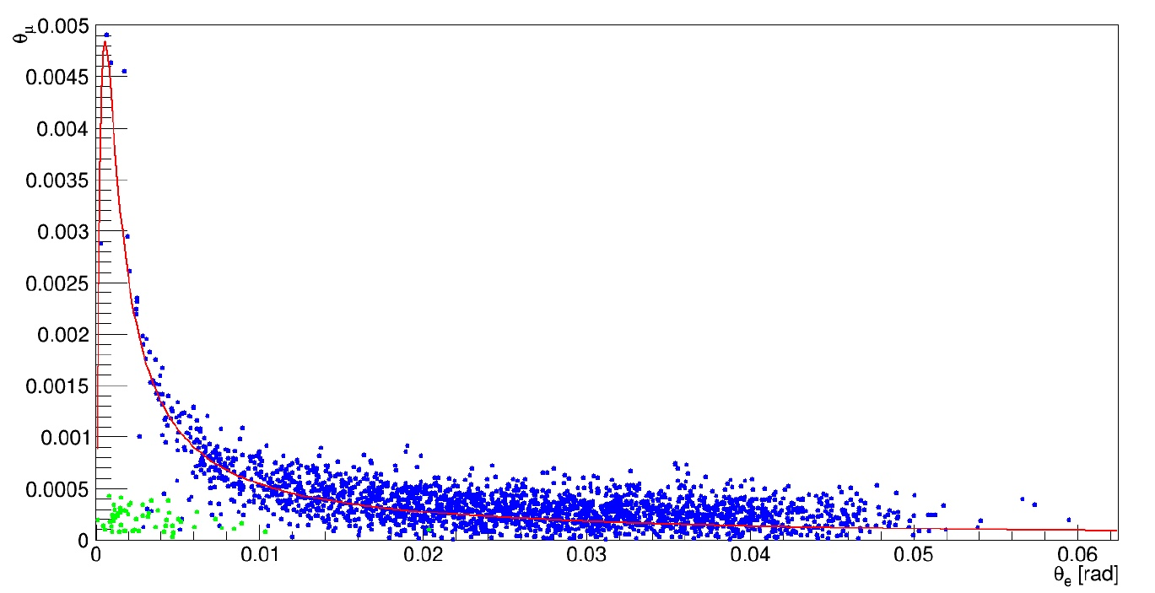
Simulation: Test beam 2018, GEANT4
Electron candidate: E_{e} > 1 GeV
Signal
Background
Pair production

Slide 9
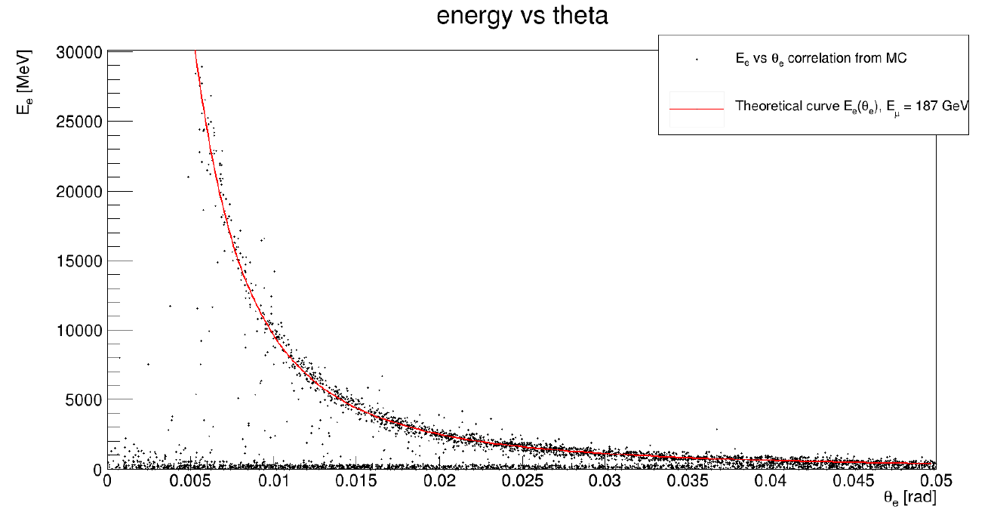
Simulation: Test beam 2018, GEANT4
Electron energy angle correlation
Energy_e vs angle_e

Slide 10
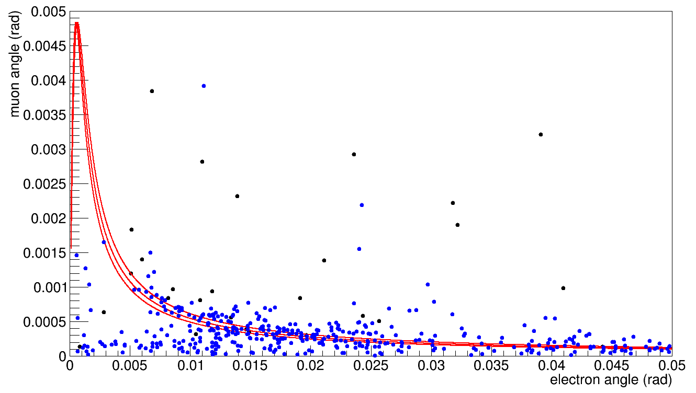
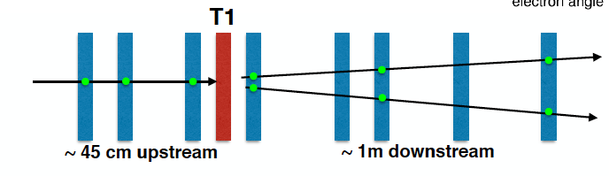
Data: using the Calorimeter
angle_μ vs angle_e
Elasticity curve: beam momentum (187 ± 7) GeV
Data with E > 1 GeV
ECAL

Slide 11
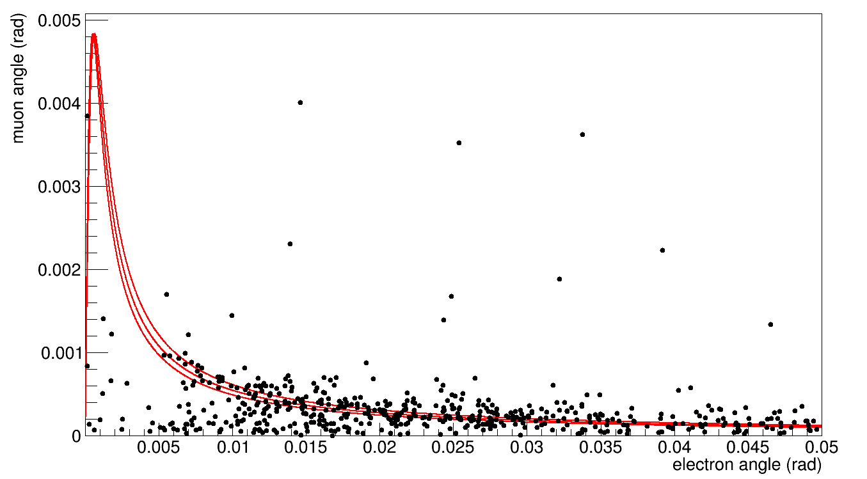
Data: using the Calorimeter
angle_μ vs angle_e
Elasticity curve: beam momentum (187 ± 7) GeV
Data with E > 0.5 GeV
ECAL

Slide 12
Ongoing studies
Efficiency of the selection
  χ² of the tracks
  Coplanarity of the three direction vectors.
  Elasticity: d= d(P,γ) of the angles from the elasticit curve. Not used yet.
  Common vertex constraint at the target of the tracks (muon in, muon out, electron candidate)
  Energy

Slide 13
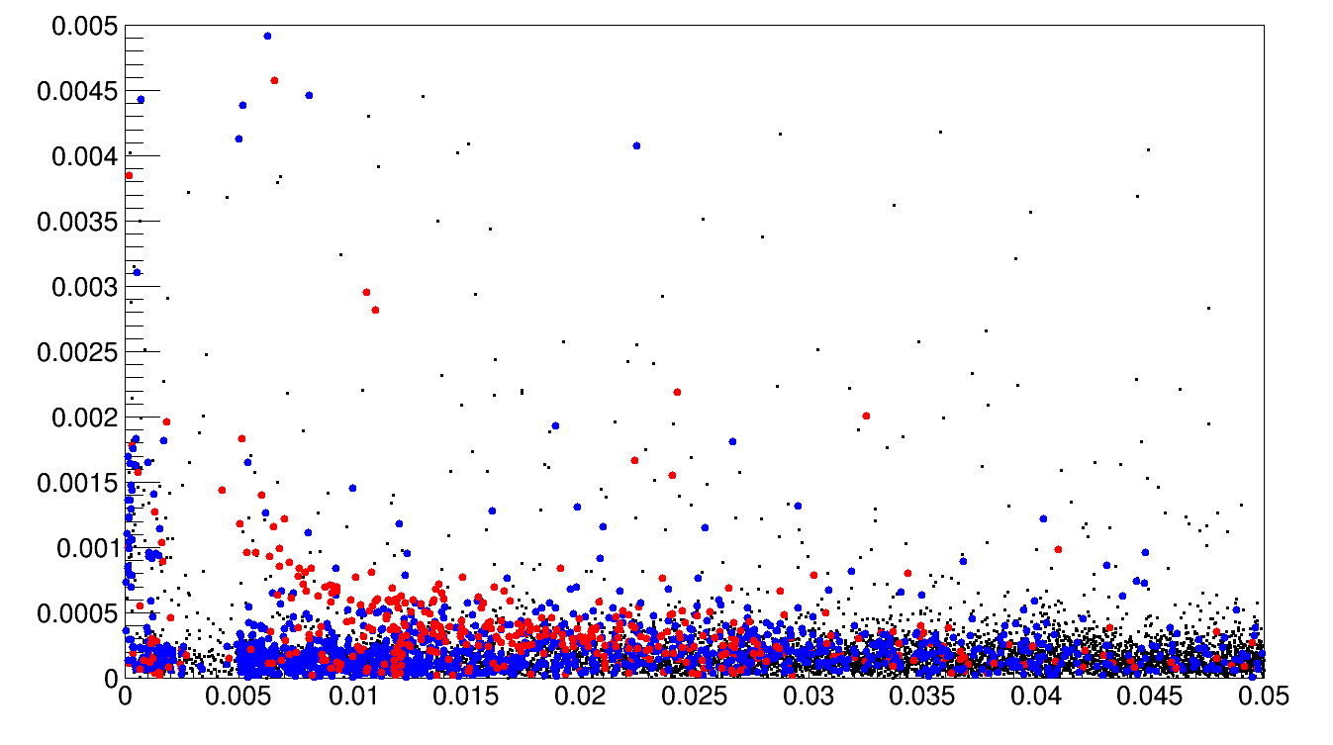
Effects of the selection cuts
Signal candidates

Slide 14
How relevant is the hit resolution?

Slide 15
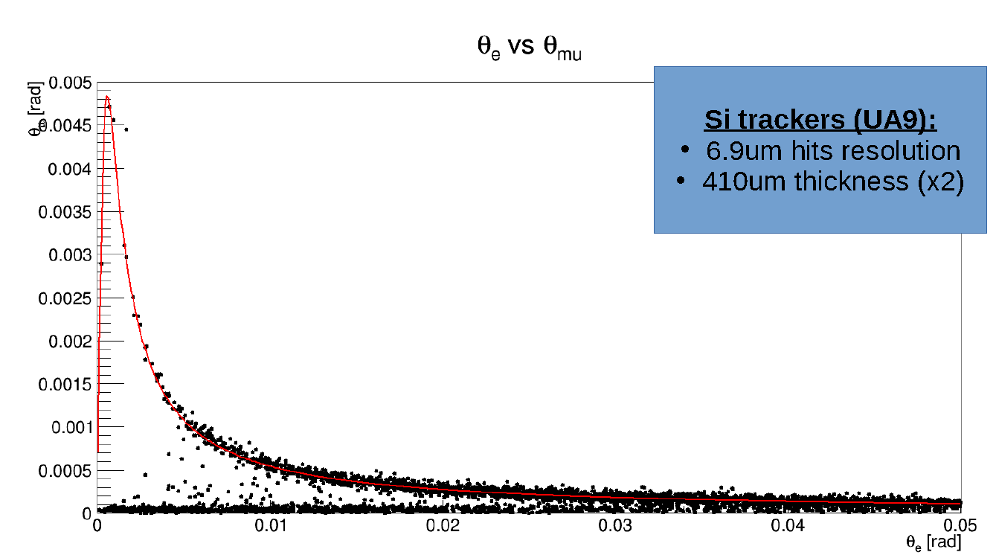
Effect of the resolution: GEANT4
UA9 resolution 7μm
angle_µ vs angle_e
angle_µ vs angle_e

Slide 16
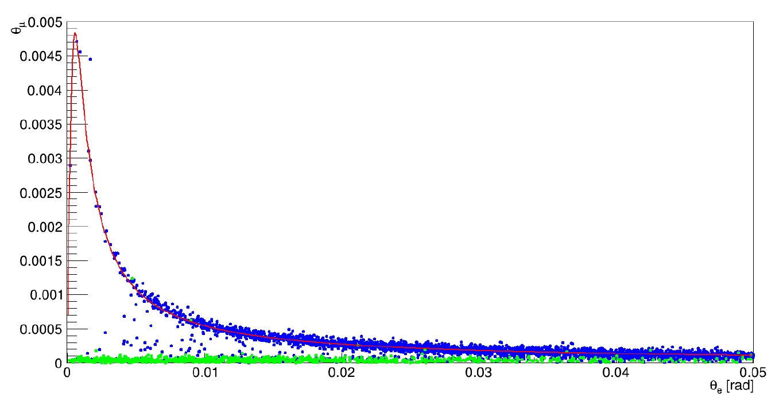
Effect of the resolution: GEANT4
UA9 resolution 7μm
Signal
Background

Slide 17
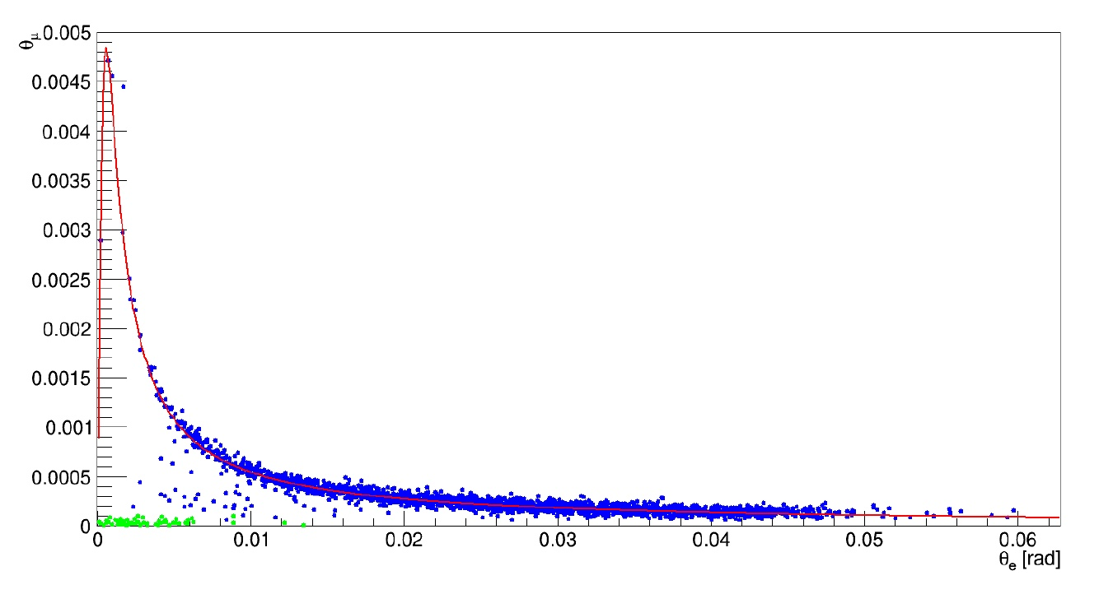
Effect of the resolution: GEANT4
UA9 resolution 7μm
E_{e} > 1 GeV
Signal
Background
Who are them?
Notes:
Che cosa sono I punti blue sotto la curva di elasticità?
Dunque, cosa sono quelli verdi?

Slide 18
Sensors comparison
Angular resolution
20 μm hit resolution
10 μm hit resolution
Electron energy (GeV)

Slide 19
Sensors
Requirements:
  Dimensions: 10 cm × 10 cm
  Single hit resolution: r ≤ 10 μm
  Clock rate: 40 MHz
  Minimal thickness: d ≤ 300 μm
Possible implementation:
  strip pitch p ≤ 50μm and floating electrodes charge sharing to get a resolution better than the geometrical σ=p/sqrt(12), depending on S/N
  1028 channel hybrid per sensor single sided

Slide 20
Requests for funding
Sensor: 3 kE each, if to be built on purpose.
Hybrid circuit, to host the ASICs: 1 kE each.
DAQ system: 10 kE
Mechanics: 2 kE
To build 8 detector planes (XY coordinates):
8 × 4 + 10 + 2 = 44 kE
We assumed the cost would be order ~50 kE , sub-judice:
  Do ASICs providing the required features exist?

Slide 21
Plans for 2019
Sensors and ASIC:
  Surface: 10 cm x 10 cm
  Rate: 40 MHz
  Hit resolution: 5 - 10 μm
  Sensors’s thickness ≤ 300 μm
  Charge division, i.e. floating strip technology
Mechanics support to get ~10 μm z precision
Test beam:
DESY, MAINZ and Fermilab.
Measure the energy or the momentum of the electron candidates
  In order to reject the background due to muon pair production and to get rid of low energy MSC electrons

Slide 22
Plans for 2019 (2)
Detailed MC description of the detector:
  Needed to perform detailed feasibility studies.
  Correct for MSC effects, account for detector’s efficiency and selection cuts.
Measuring the running of α = α (q²) with simulated data
  LO based feasibility studies ongoing
  NLO
  We can’t rely on a mathematical function expression for the cross-section:
  It might turn to be rather an involved procedure.

Slide 23
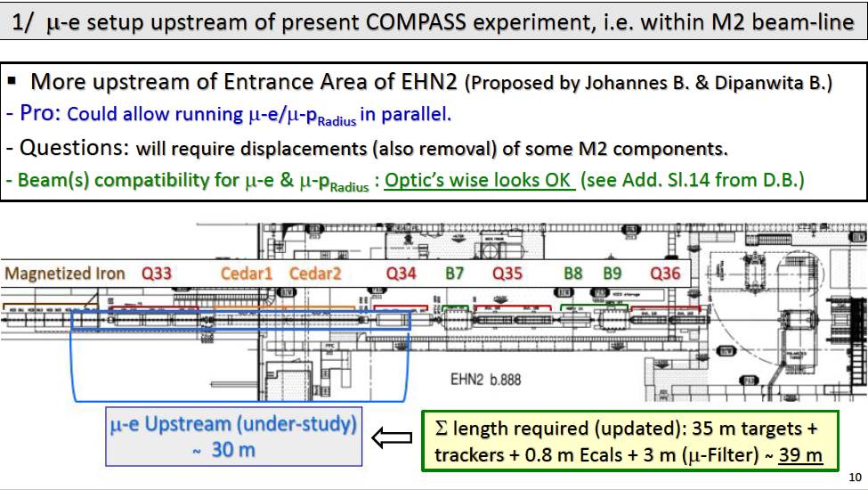
Possible location at CERN M2
Between BSM and COMPASS
A. Magnon & C. Valle document

Slide 24
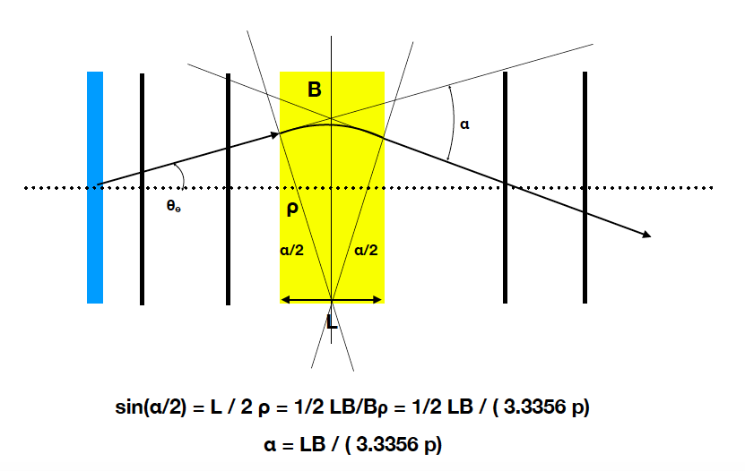
Measuring the momentum
B
C dipole magnet

Slide 25
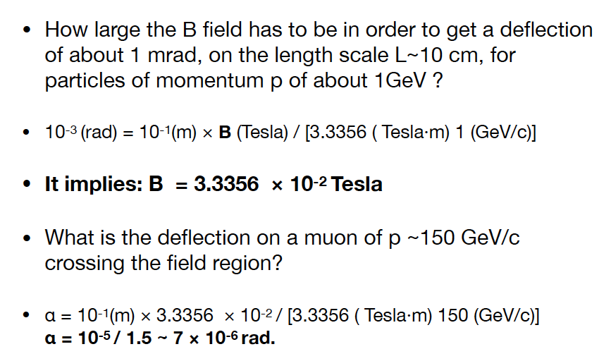
Measuring the momentum (2)

Slide 26
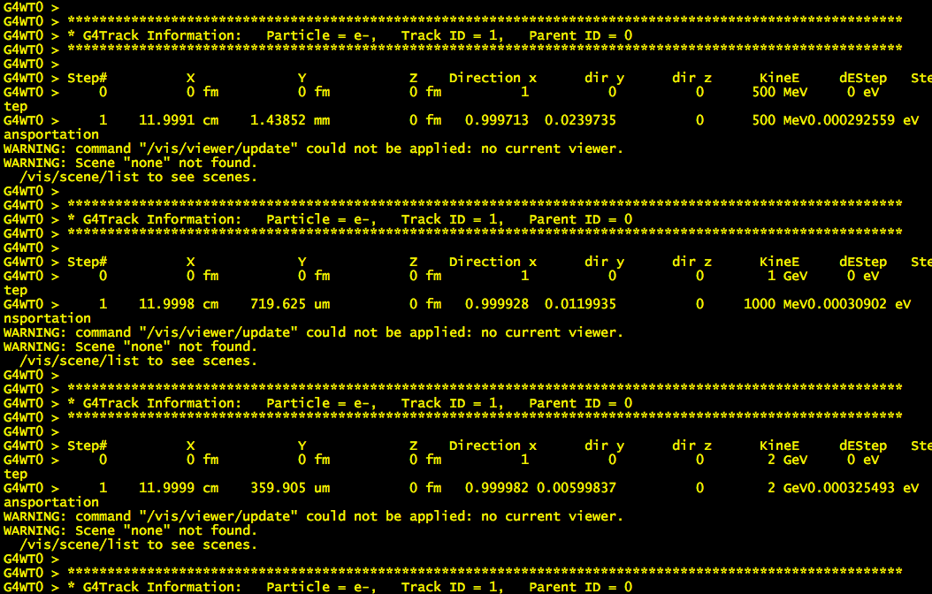

Slide 27
Spare slides

Slide 28
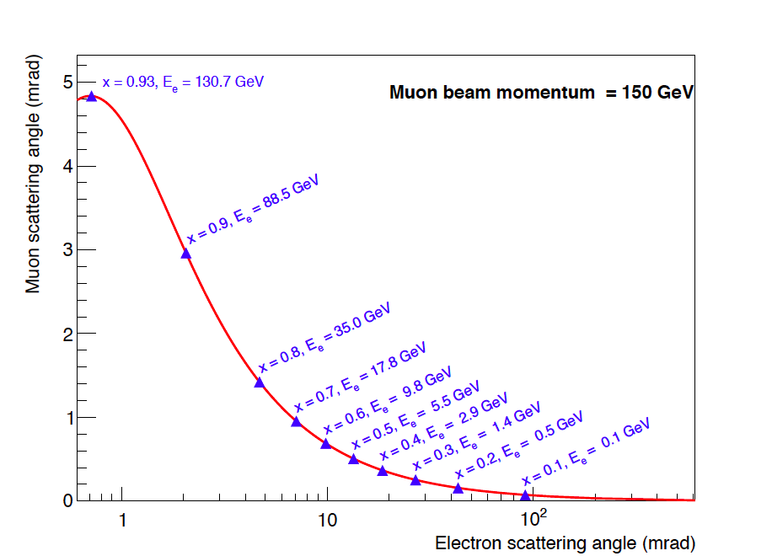
Signature: elastic scattering in the (θ_{e} , θ_{μ}) plane
e-out
θ_{e}
μ-in
θ_{μ}
μ-out
θ_{e} → E_{e} → t = q² = 2m_{e}² - 2m_{e}E_{e}

Slide 29
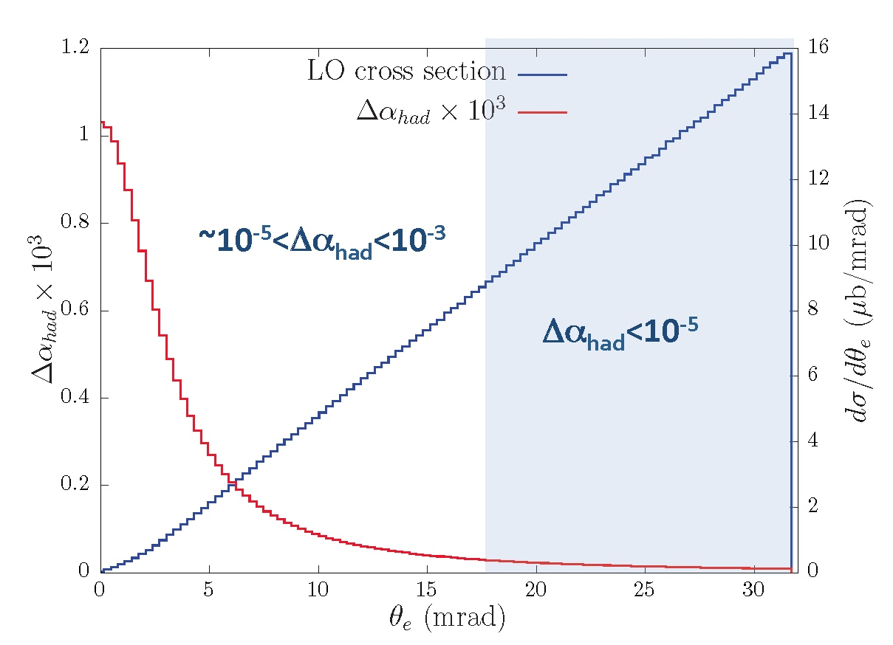
Cross section and the signal
To reach a precision on a_{μ}^{HLO} as with time-like data (4 × 10⁻¹⁰):
2 years of data taking, with a muon beam of intensity of 1.3 × 10⁷ s⁻¹
60 cm of low Z material segmented in thin layers, each of 10mm

Slide 30
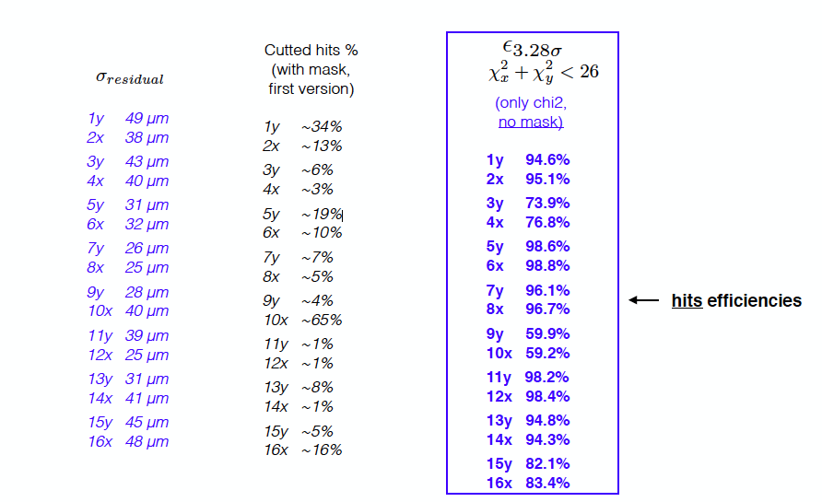
Tracking efficiency

Slide 31
