Slide 1
Task 6.1 Masterclasses on flavour physics
Ezio Torassa
INFN Padova
JENNIFER General Meeting
Paris 30th-31st October 2018

Slide 2
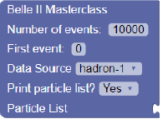
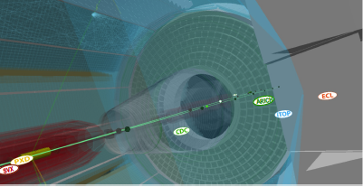
Belle II Masterclass 2018
Belle II masterclass
- Introductory lecutre / training courses
Exercise with results stored in spreadsheet
Belle II virtual reality
Belle II Masterclass 2018
INFN Padova – Univ. Padova
Syncronized with the International Masterclass activity in Padova but outside IMC organization
(36 students for the Belle II exercise)
J.S. Institute / Univ. Lubjana
Included in the Summer school program
(20 students for the Belle II exercise)

Slide 3
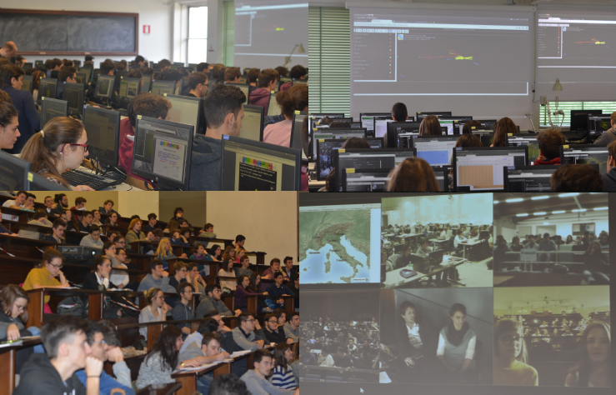
Belle II Masterclass 2019
Belle II Masterclass 2019
Common Mastereclass for Ljubljana, Padua, Prague, Rome, Strasbourg
one day between 20 – 22 March 2019 with videoconference connection
In Padua we will test the scalability of the exercise for a large number of students.
720 students will participate to the 2019 International Masterclass, 100 students will perform the Belle II exercise ( http://www2.pd.infn.it/masterclasses/ )

Slide 4
Belle II Exercise
Data sample
Root file with Belle data with 4.5 M events (to be replaced with Belle II data)
containing the list of N particles reconstructed for every event.
For every particle 7 information are stored:
px, py, pz, E, charge , particle ID
ID inside the root file is an integer number: 0 ÷ 5 {PHOTON, ELECTRON, PION, MUON, KAON, PROTON}
4

Slide 5
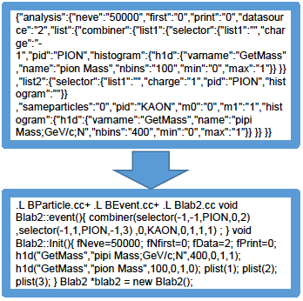
Belle II Exercise
Data analysis
Analysis code based on Belle educational B-lab exercises:
http://belle.kek.jp/b-lab/b-lab-english/
Root macro.c files replaced with a Web based interface:
http://belle2.ijs.si/public based on a Blockly graphic library
code histograms
Blockly Root Blockly
Developed by
Ryosuke Itoh in 2004
Developed by
Rok Pestotnik in 2017
1) CombineParticles
2) SelectParticles
❑ Blockly JavaScript generates JSON text strings
❑ The strings are sent to the server
❑ Converted into the computer code ROOT macro
❑ The code is executed on the server
❑ histograms are sent back to the client
❑ displayed using JSROOTJavaScript

Slide 6
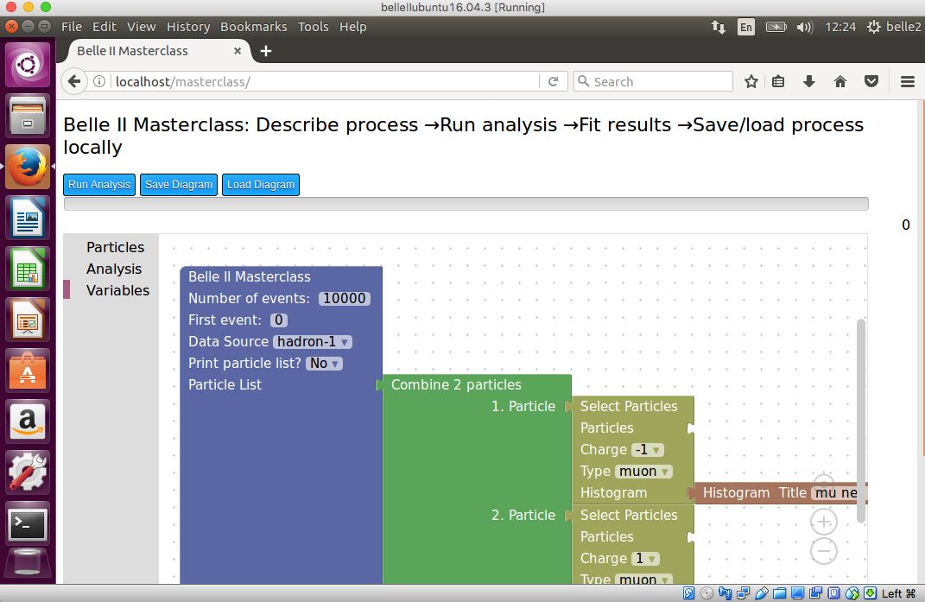
Belle II Exercise
To work in local download inside a single file: 1) Virtual Machine 2) full data 3) software
❑ 2018 version (Ubuntu 18.01) http://belle2.ijs.si/arich/data/belleIIubuntu18.01.ova
❑ 2017 version (Ubuntu 16.04) http://belle2.ijs.si/belleIIubuntu16.04.3.7z
❑ unpack with http://www.7-zip.org/
❑ run with https://www.virtualbox.org/

Slide 7
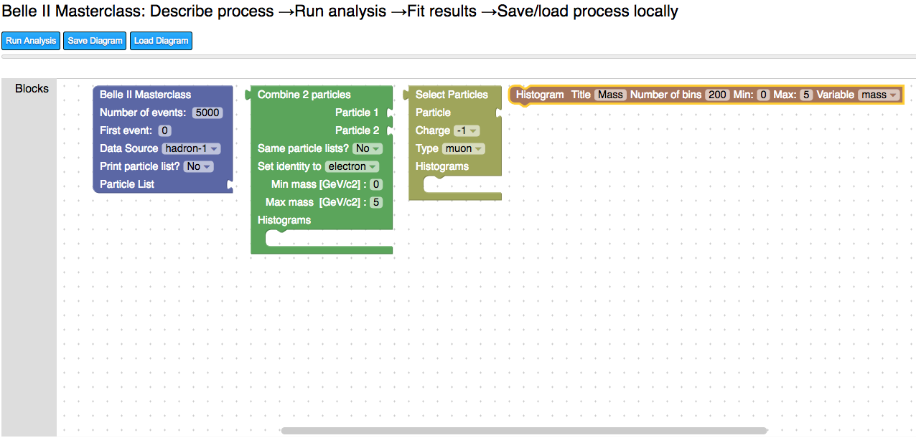
Belle II Exercise
Programming by selecting and connecting blocks inside a web browser whiteboard
- create histogram
- choose variable with min. and max.
- choose bins and title
- select data source
- number of events
- select particles to be combined
- charge and ID selection
- combine 2 particles
- min and max inv. mass

Slide 8
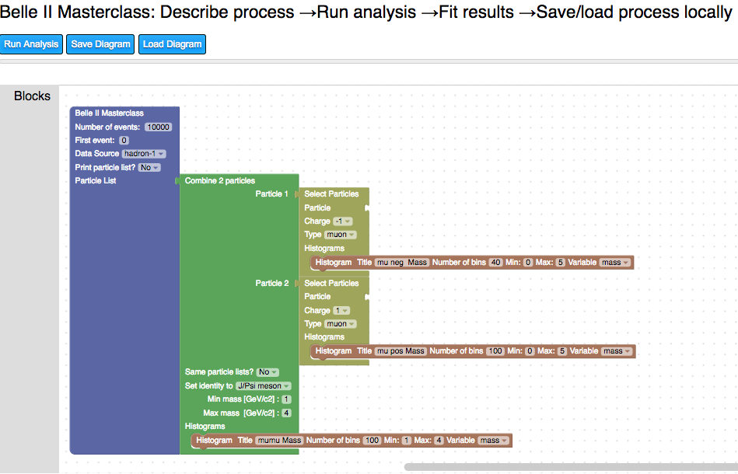
Belle II Exercise
When the analysis is ready with the appropriate combined blocks
click on “Run Analysis”

Slide 9
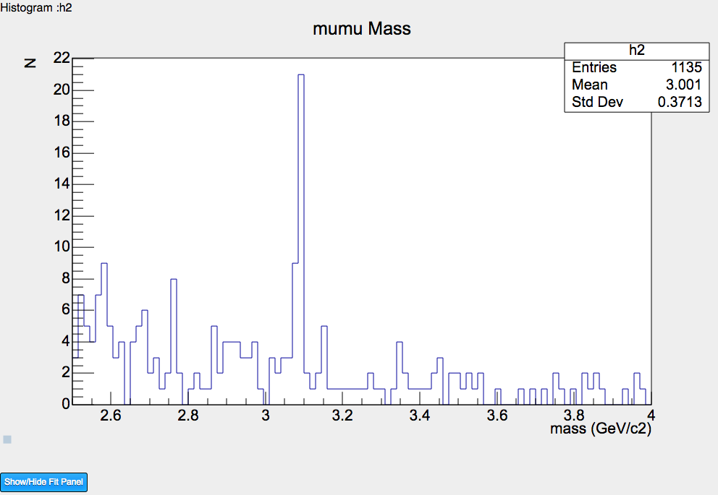
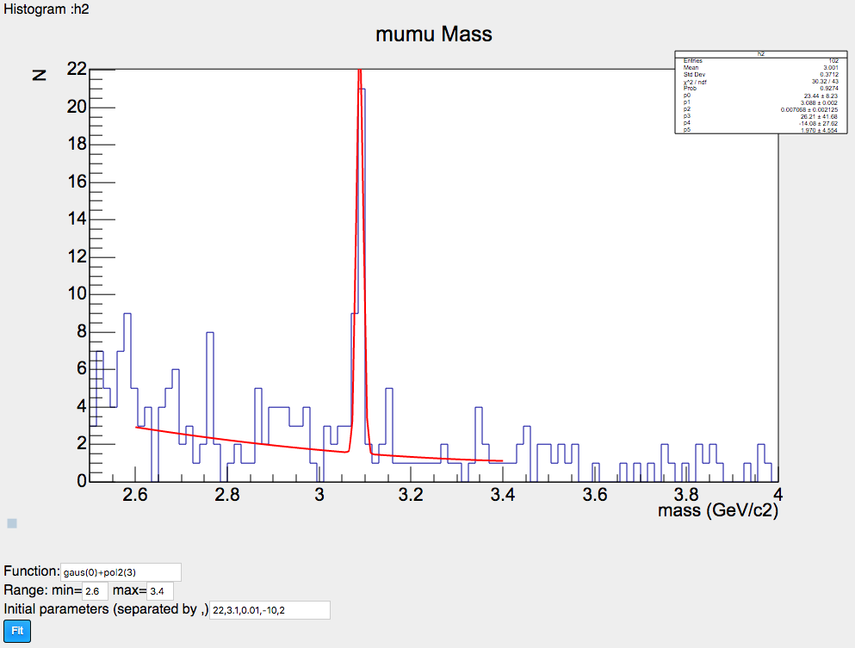
Belle II Exercise
p1 = 3.088 ± 0.002
Histograms are shown
under the whiteboard
Perform the fit

Slide 10
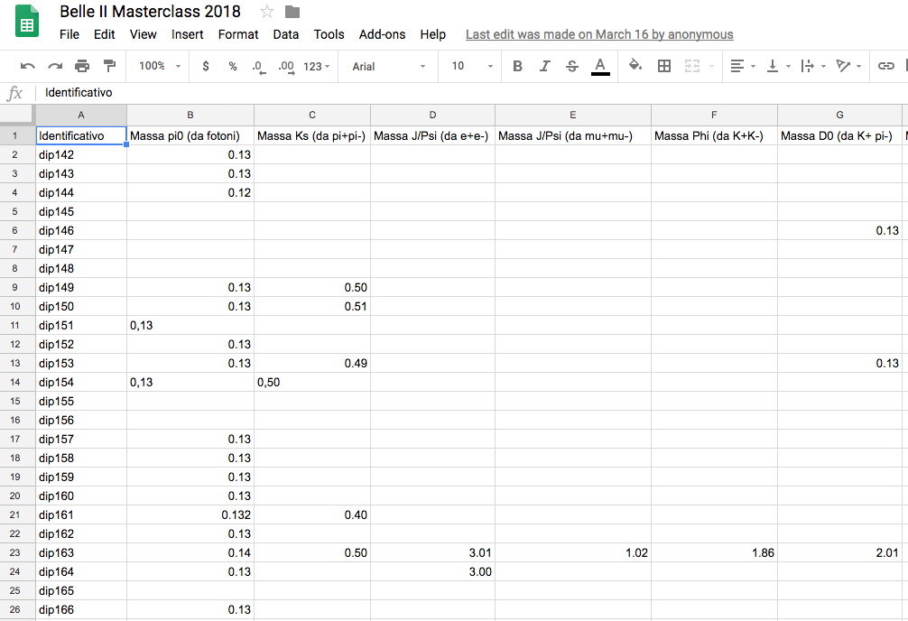
Belle II Exercise
Store the fitted masses in the spreadsheet

Slide 11
Belle II Masterclass summary and next steps
Belle II 2019 Masterclass
Several European institutes will perform the Belle II Masterclass in March 2019 the same day.
A videoconference connection will possible in the afternoon
(same time of the IMC: from 4 pm to 5 pm)
Coordination is needed:
to check the software/hardware video connection some days before;
to define a common set of exercise;
to choose moderators for the videoconference;
to define a common spreadsheet (e.g. different Tabs) to easily analyze the data.
Next developments
Replace the Belle root file with a similar Belle II root file, same structure, same variables but Belle II data (for 2019 Masterclass )
Add new variables (e.g. PID variable, impact parameter) and new methods/blocks
to extend the exercise (e.g. background reduction, lifetime measurements)
Test event display implementation.
Upload and study real events in Belle II VR (I asked to developers if can be implemented)

Slide 12
Belle II Masterclass summary and next steps
//////////////////////////////////////////////////////////
// This class has been automatically generated on
// Fri Oct 26 16:25:21 2018 by ROOT version 6.08/02
// from TTree T/Event Tree
// found on file: hadron-2.root
//////////////////////////////////////////////////////////
#ifndef T_h
#define T_h
#include <TROOT.h>
#include <TChain.h>
#include <TFile.h>
// Header file for the classes stored in the TTree if any.
#include "TObject.h"
class T {
public :
TTree *fChain; //!pointer to the analyzed TTree or TChain
Int_t fCurrent; //!current Tree number in a TChain
// Fixed size dimensions of array or collections stored in the TTree if any.
const Int_t kMaxm_particles = 112;
// Declaration of leaf types
//BEvent *BEvent;
UInt_t fUniqueID;
UInt_t fBits;
Int_t m_evno;
Int_t m_nprt;
Int_t m_particles_;
UInt_t m_particles_fUniqueID[kMaxm_particles]; //[m_particles_]
UInt_t m_particles_fBits[kMaxm_particles]; //[m_particles_]
Float_t m_particles_m_px[kMaxm_particles]; //[m_particles_]
Float_t m_particles_m_py[kMaxm_particles]; //[m_particles_]
Float_t m_particles_m_pz[kMaxm_particles]; //[m_particles_]
Float_t m_particles_m_e[kMaxm_particles]; //[m_particles_]
Float_t m_particles_m_charge[kMaxm_particles]; //[m_particles_]
Int_t m_particles_m_pid[kMaxm_particles]; //[m_particles_]
// List of branches
TBranch *b_BEvent_fUniqueID; //!
TBranch *b_BEvent_fBits; //!
TBranch *b_BEvent_m_evno; //!
TBranch *b_BEvent_m_nprt; //!
TBranch *b_BEvent_m_particles_; //!
TBranch *b_m_particles_fUniqueID; //!
TBranch *b_m_particles_fBits; //!
TBranch *b_m_particles_m_px; //!
TBranch *b_m_particles_m_py; //!
TBranch *b_m_particles_m_pz; //!
TBranch *b_m_particles_m_e; //!
TBranch *b_m_particles_m_charge; //!
TBranch *b_m_particles_m_pid; //!
T(TTree *tree=0);
virtual ~T();
virtual Int_t Cut(Long64_t entry);
virtual Int_t GetEntry(Long64_t entry);
virtual Long64_t LoadTree(Long64_t entry);
virtual void Init(TTree *tree);
virtual void Loop();
virtual Bool_t Notify();
virtual void Show(Long64_t entry = -1);
};
#endif

