Slide 1
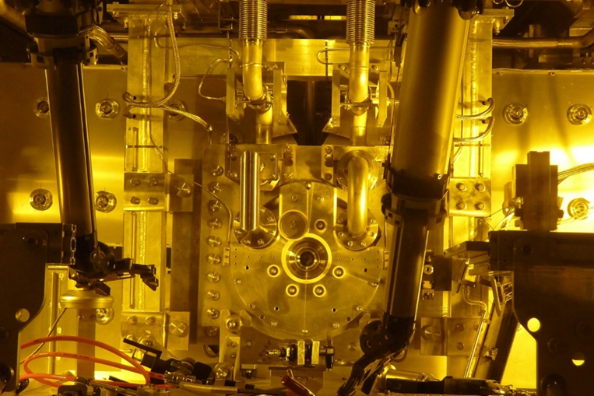


T2K Target and Beam Window Upgrades for 1.3 MW Operation
Chris Densham
(STFC Rutherford Appleton Laboratory)
On behalf of T2K Collaboration

Slide 2
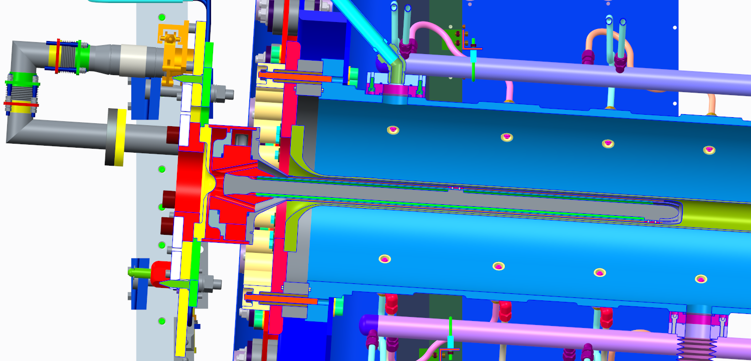
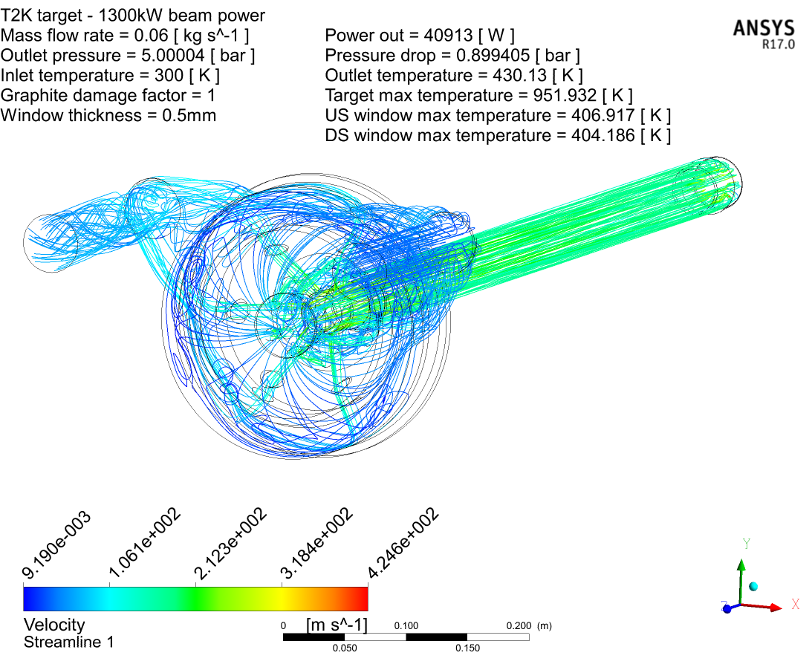
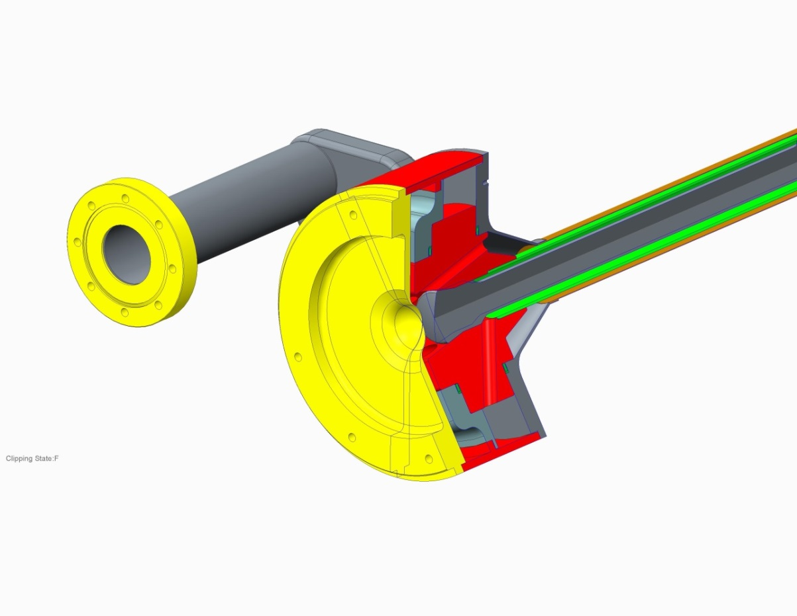
Target & horn
Next target under construction
Next target under construction at RAL
Helium cooling flow lines
p
425 m/s

Slide 3
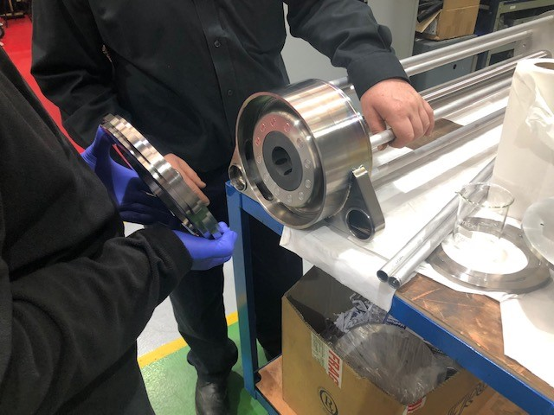
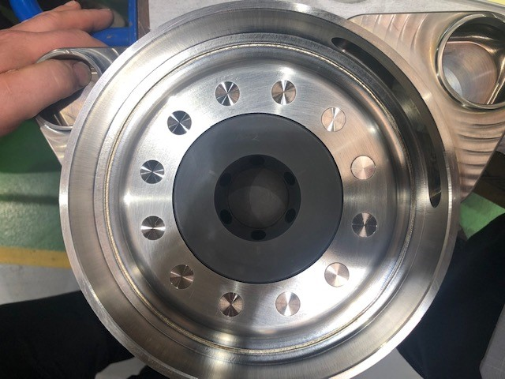
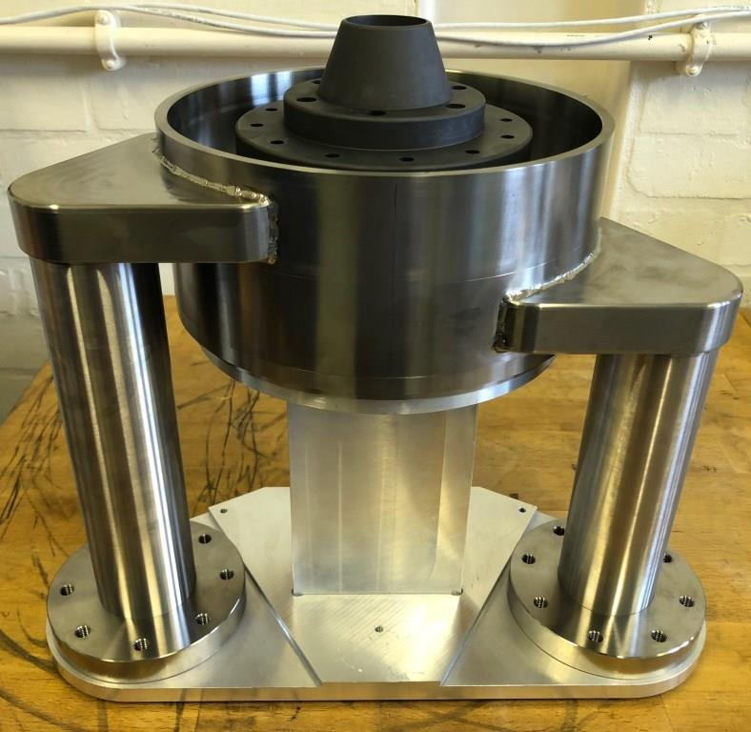
Next 750kW target manufacture underway now at RAL

Slide 4
Target upgrade requirements
The increase in design beam power from 0.75→1.3MW will increase the integrated heat load on the target (approx. 23kW → 41kW).
Need to increase helium mass flow rate to keep outlet temperatures within range
Necessary to increase operating pressure to keep velocities and pressure drops within range.
  Increasing the pressure will increase the helium density and therefore heat transfer coefficient.
  Higher operating pressure has the advantage of reduced pressure drop.
  Running at higher pressure reduces the pressure drop and max velocity
  Compressor will be cheaper to purchase and operate (less power consumed).

Slide 5
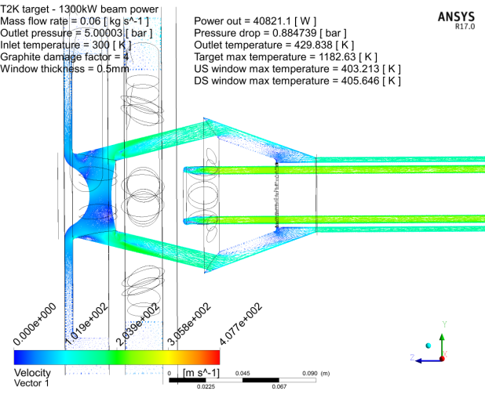
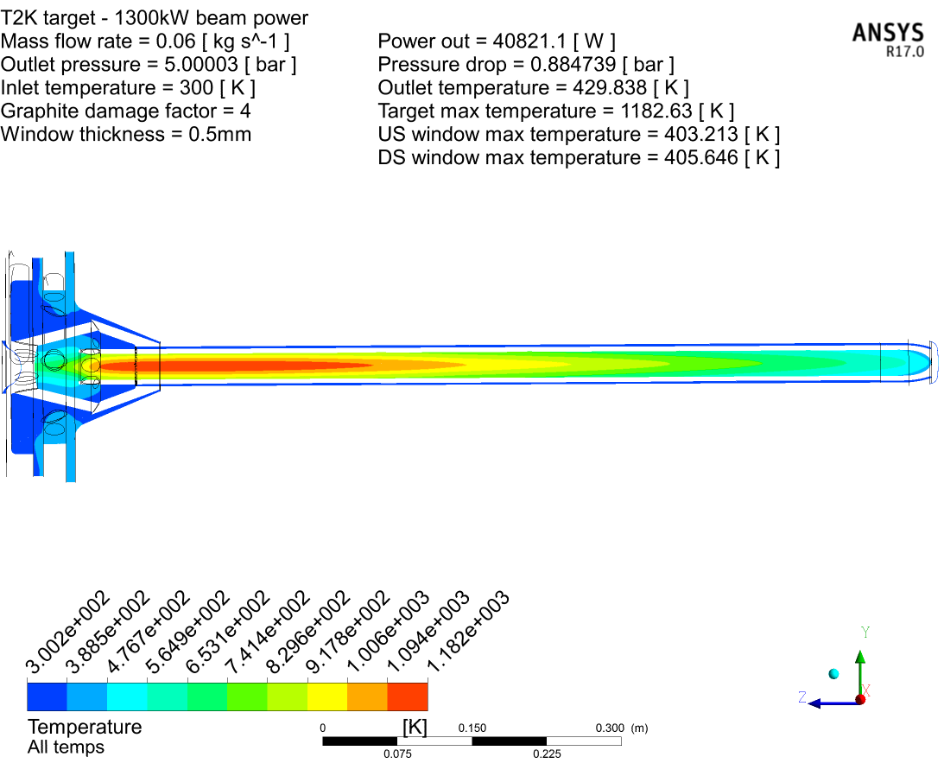
Simulations of target @ 1.3MW
Increased beam power, flow rate & pressure
60g/s @ 5.9bar (5barG outlet) – 1.3MW beam power
Helium flow lines
Damaged graphite
Thermal conductivity 1/4

Slide 6
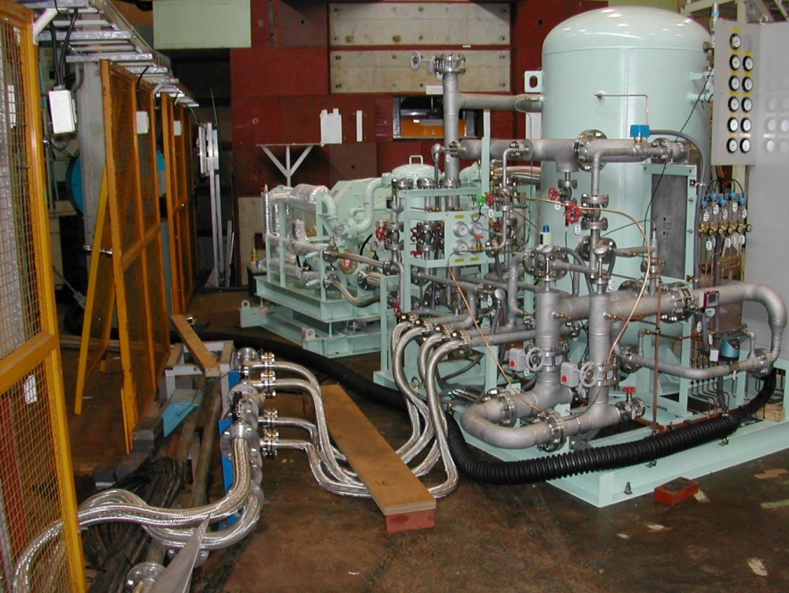
Summary of cooling simulations
Flow rate [g/s] | Outlet Pressure [bar] | Beam power [kW] | Pressure drop [bar] | Max velocity [m/s] | Target core temp (damaged) [K] | Target core temp (new) [K]
32 | 0.9 | 750 | 0.73 | 560 | 1025 | 894.1
60 | 0.9 | 1300 | 1.93 | 870 |  | 960.3
60 | 2 | 1300 | 1.39 | 639 |  | 952.3
60 | 3 | 1300 | 1.09 | 501 |  | 951.1
60 | 5 | 1300 | 0.88 | 425 | 1182.6 | 951.9
NOTE: speed of sound in He ~1000m/s
Existing plant can deliver cooling power for 900 kW operation.
For 1.3MW beam @ 5bar and 60g/s, the velocity and pressure drop are comparable to 750 kW design.
Need to upgrade plant to operate at higher pressure.
Some target modifications needed to operate at higher pressure (e.g. window geometry, weld design, target pipes – bellows & isolators)
Target will run slightly hotter. Need high helium purity to avoid oxidation. (New target will withstand vacuum load to enable helium back fill)

Slide 7
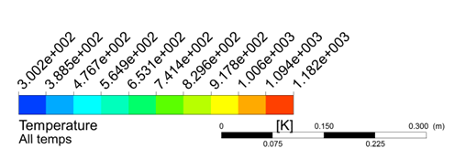
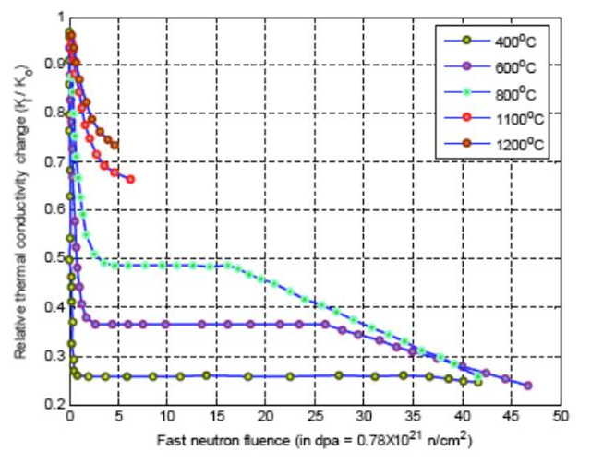
Graphite thermal conductivity degradation
Max core temperature ~900°C at 1.3 MW
(degraded graphite assumed)
Even a low radiation dose drastically reduces thermal conductivity
High temperatures reduce effect
Helium cooling lets target run hot
Also reduces swelling & changes to mechanical properties
As beam power increases, target failures are to be expected
800°C
600°C
400°C

Slide 8
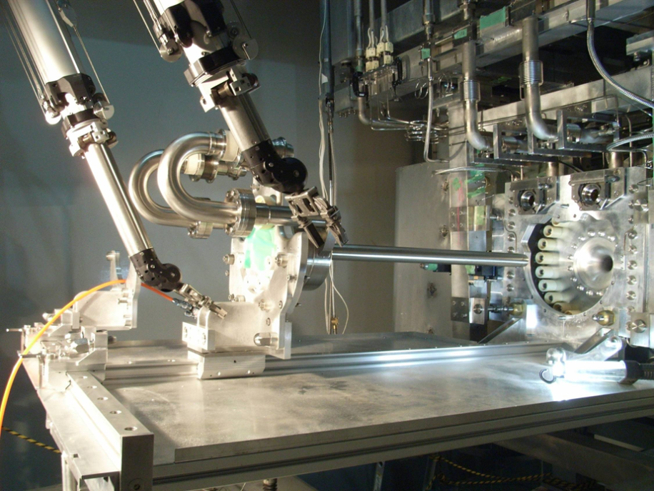
Remote Target Exchange System
Target exchanger and manipulator system. See pipe replacement at:
https://www.youtube.com/watch?v=VWGXz5QHFH4
Notes:
Target exchange procedure
Target exchanger platform on gimbal/spring system, positioned by dual jacks, X and Z rails allow carriage cross over for target removal installation.
View of operators through RMA lead glass window.

Slide 9
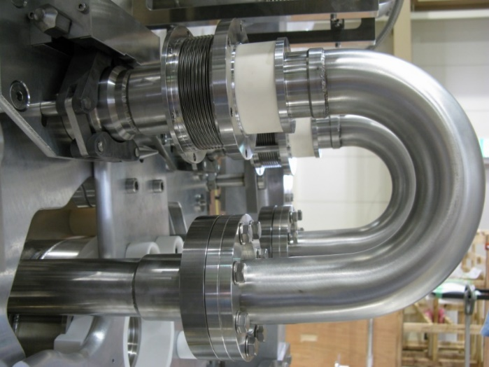
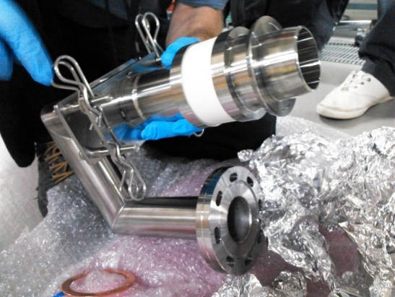
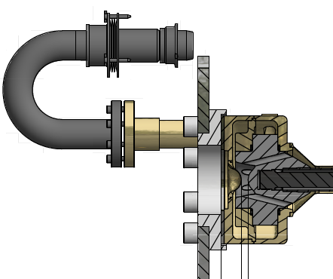

Leak at Helium Outlet Pipe & Remote Handling
Failure of joint/ceramic from movement of stainless pipes (stress relieving) at 450 kW operation
Thermal fatigue failure of the diffusion bonded joint/ceramic
Remote Exchange in 2015
No leak since then
Diffusion bond
(Aluminum)
316L Stainless
Bellows
304L
Stainless
Bent in cold process
Alumina ceramic

Slide 10
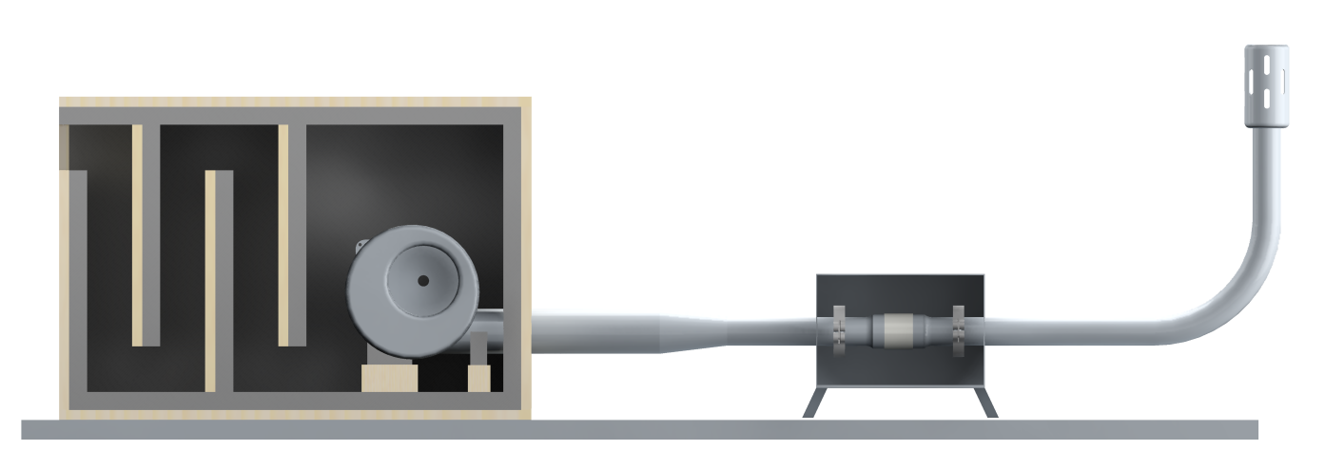
Ceramic Isolator Thermal Fatigue Test Rig
www.stfc.ac.uk
Thermal transients from beam trips at 475 kW operation
- Beam trips cause rapid cooling and repeated thermal cycling of ceramic isolators in helium cooling system
- Expected c.5000 beam trips / year
Beam Power [kW]
He in TS Vessel [℃]
He at Target inlet [℃]
He at Target outlet [℃]
Noise isolation box (rig suitable for 24h running)
Exhaust silencer/exhaust to external outlet
Test ceramic isolator (welded into removable KF flange section for leak testing)
Noise reducing inlet baffles
Forced convection cooling blower
Test section tape heated (low thermal mass), enclosed in stainless box

Slide 11
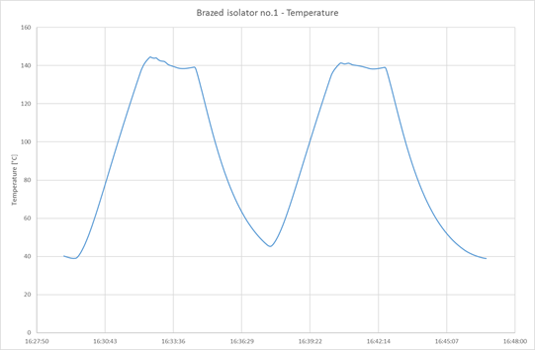
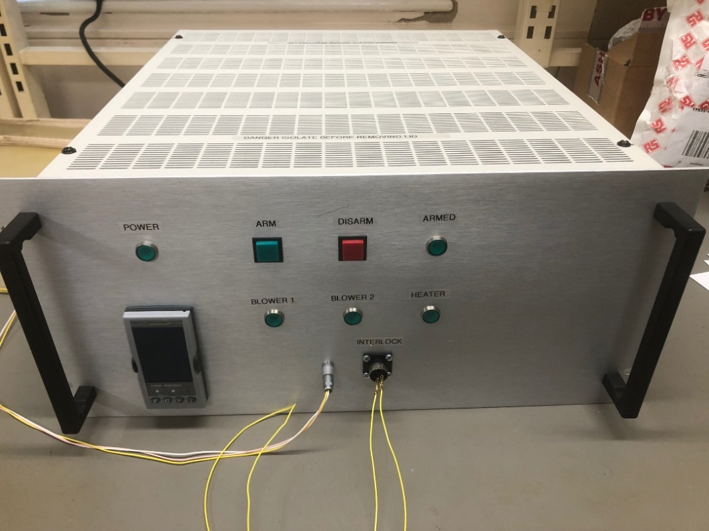
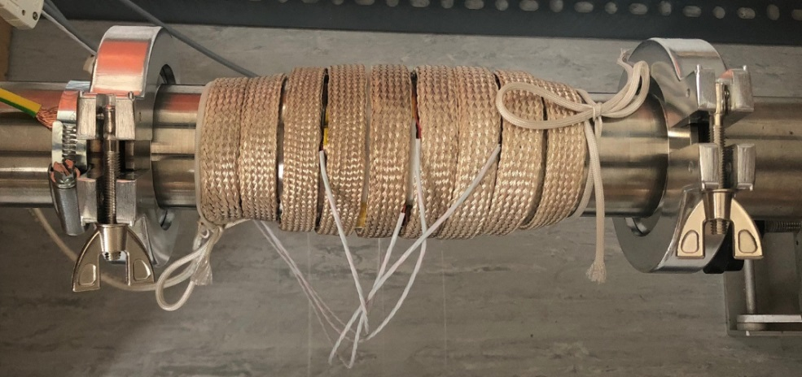
Ceramic Isolator Thermal Fatigue Test Rig
Thermal cycles reproduce effect of beam trips
Eurotherm 3508 controller
Tape heater
Interlock system
PT100
KF50 for quick disconnect/leak testing

Slide 12
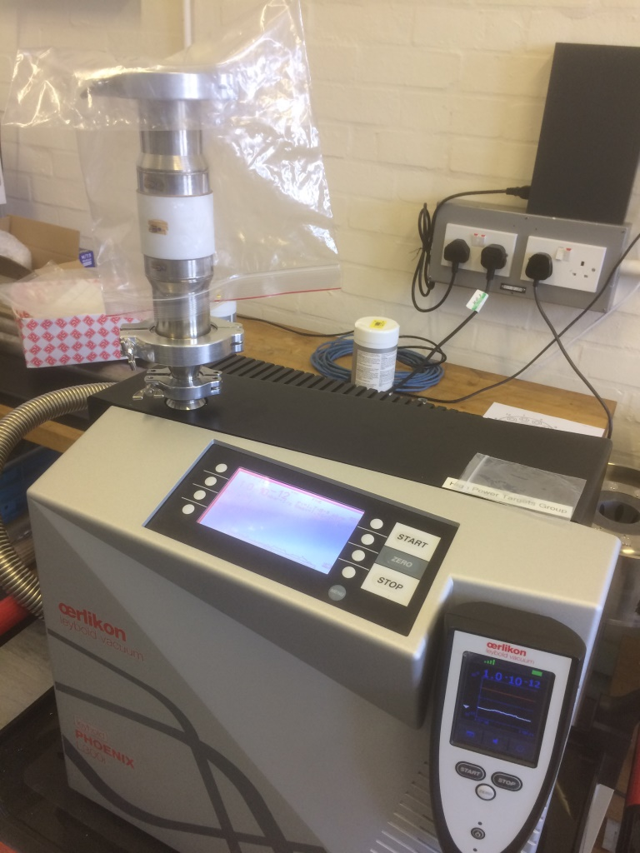
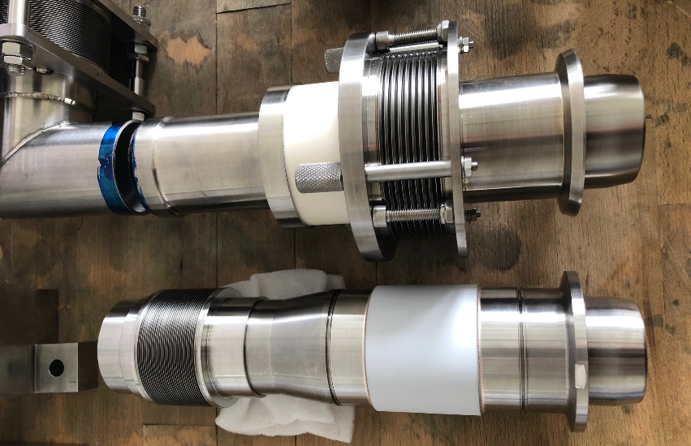
Target helium pipes
Brazed isolator completed 5120 thermal test cycles (140 <=> 40 °C with max heating rate of 40°C/min & a max cooling rate of 50°C/min)
This is measured at the outside surface of the ceramic and about double the rate we expect from current 500kW operation.
No change in leak rate measured which was 1e-12mbar/l.s when bagged and filled with helium.
All parts manufactured and just need welding.
We will use two new brazed ceramics for the next target pipes.
Replace diffusion bonded parts with brazed ceramics

Slide 13
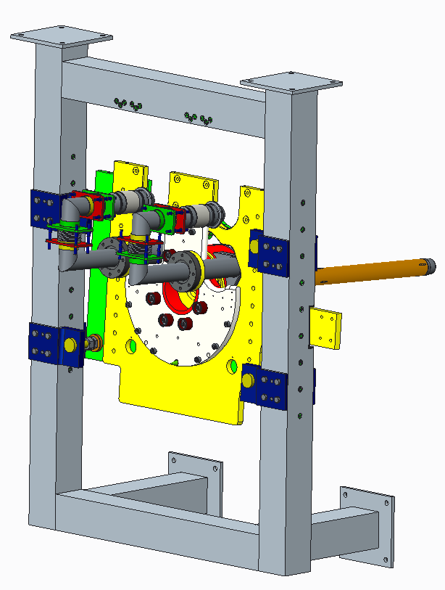
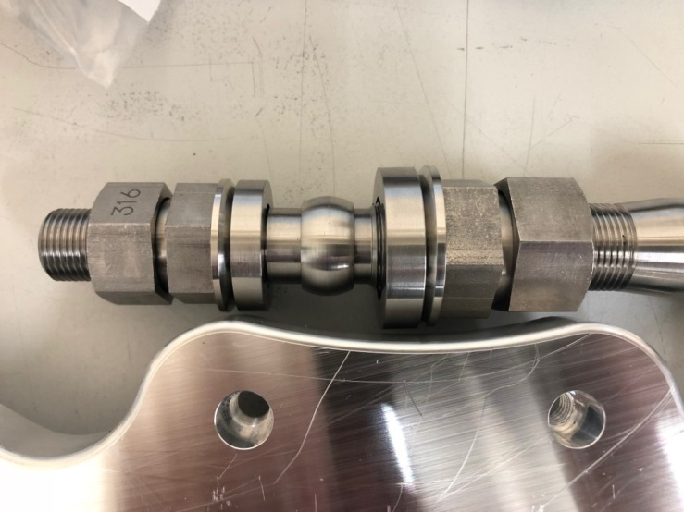
Target supports and horn integration
Increasing horn current from 250 kA to 320 kA will increase vibrations
Target supports redesigned to prevent any movement
E.g. new ‘kinematic’ design feature
Angular adjustment is enabled whilst constraining position using spherical bushes

Slide 14
Target Summary
Existing target cooling plant suitable for up to 900 kW beam power
Operation at 1.3 MW appears feasible with incremental design changes to target
  windows, weld joints
Thermal cycling test program underway for ceramic isolators
Need new helium plant to operate at higher pressure
Target lifetime at 1.3 MW is not known

Slide 15
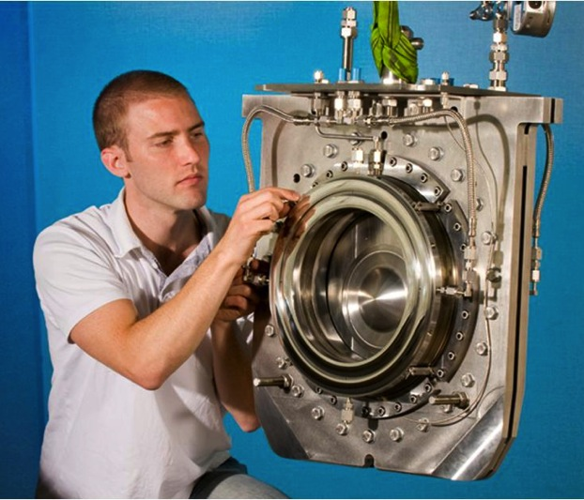
Ti-6Al-4V Beam Window
Periodic thermal stress wave caused by the intense proton beam energy deposition
1.3 MW operation will cause radiation damage of ~2 DPA/ops-year
Significant irradiation hardening and loss of ductility has been reported with 0.3DPA (no higher DPA data exists)
No known data exists on high cycle fatigue (>10³ cycles) of irradiated titanium alloys
Beam Power | PPP | Rep. cycle | POT / 100 days
470kW (achieved) | 2.4 x 10¹⁴ | 2.48 sec | （0.8 x 10²¹）
750kW (proposed) | 2.0 x 10¹⁴ | 1.3 sec | 1.3 x 10²¹
750kW [original plan] | 3.3 x 10¹⁴ | 2.1 sec | 1.3 x 10²¹
1.3 MW (proposed) | 3.2 x 10¹⁴ | 1.16 sec | 2.4 x 10²¹
Ti-6Al-4V
(0.3mm-t)
2mm gap
designed
~8M pulses/yr
～1DPA/yr (MARS)

Slide 16
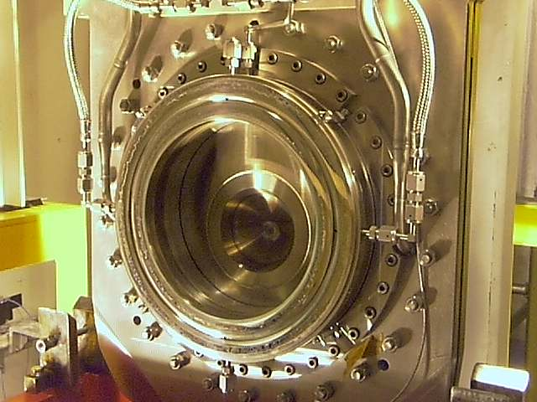
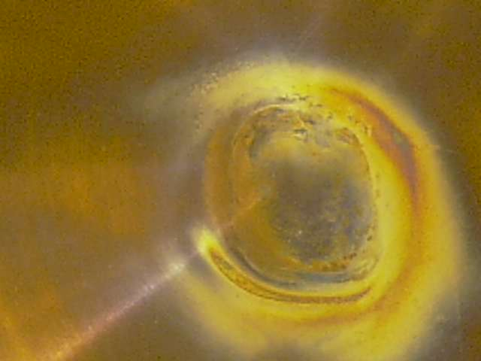
Beam window replacement 22 Aug 2017
Want to avoid failure of window during operation
-> Decided to replace with spare during 2017 scheduled shutdown
Inflatable pillow vacuum seal appears deformed after removal
Not possible to reuse the old beam window.
Centre of beam window appears to be damaged / discoloured
Need to conduct Post-Irradiation Examination -> talking to materials scientists

Slide 17
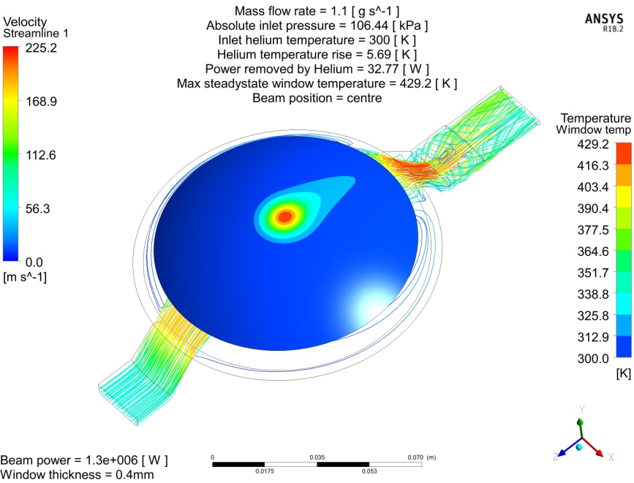
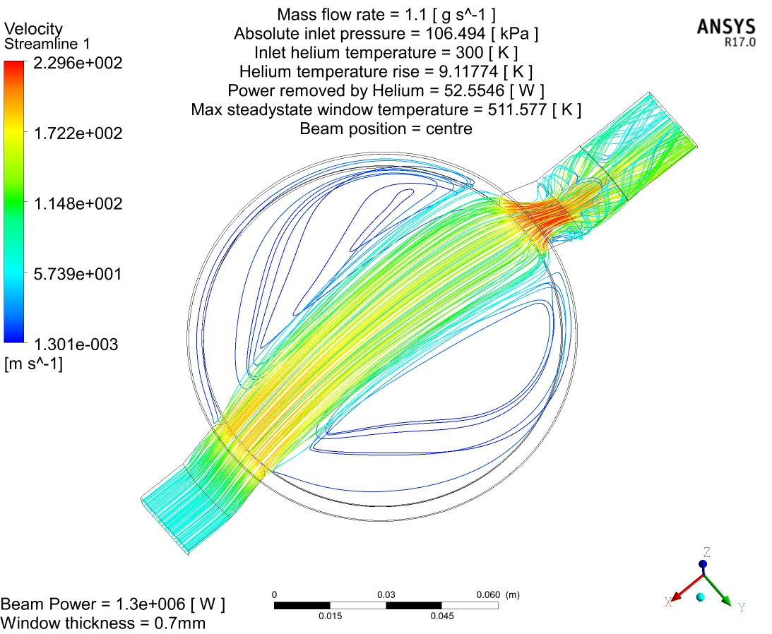
T2K beam window upgrade plans for - 1.3 MW
Strong recirculation zones driven by high speed jet
Helium flow lines
1.3 MW beam (steady state/CW simulation)
Pressure drop 0.06bar @ 1.1g/s
Max velocity 230 m/s

Slide 18
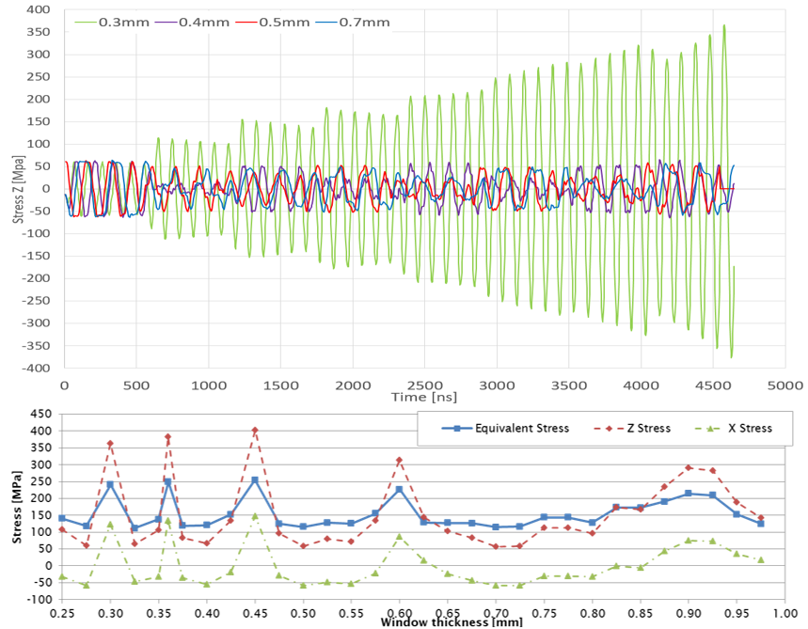
Window thickness upgrade – for beam upgrade
~4.2 µs
80 ns (3σ)
581-598 ns
0.30 mm
2.48 s → 1.16 s
Beam bunch structure can generate stress resonance within thickness of Ti alloy window material
Constructive interference at 0.36 mm (S.F.=1.5)
Destructive interference at 0.40 mm (S.F.=2.6)
0.40 mm selected for next beam window (just manufactured)

Slide 19

Existing data on radiation damage of beam window material (Grade 5 Ti6Al4V, α+β)
0.24 dpa
First window 22.4x10²⁰ pot → c.2 DPA (NRT)
Significant loss of ductility reported at 0.24 DPA
Existing window entirely brittle?
Does it matter? Low stress at moment
But need to consider reduction in High Cycle Fatigue lifetime at elevated temperature
N. Simos (BNL)
1.3 MW, 0.5 mm
0.75 MW, 0.3 mm
Electron Back Scatter Diffraction (EBSD) of new beam window material (approved by materials scientists for fatigue)
19

Slide 20
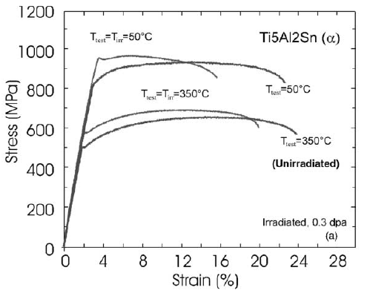
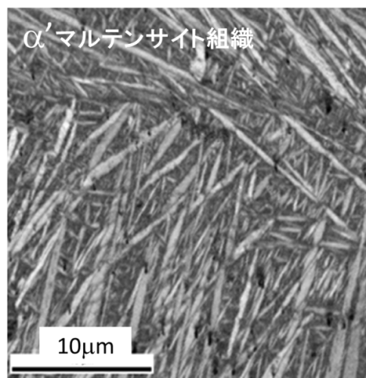
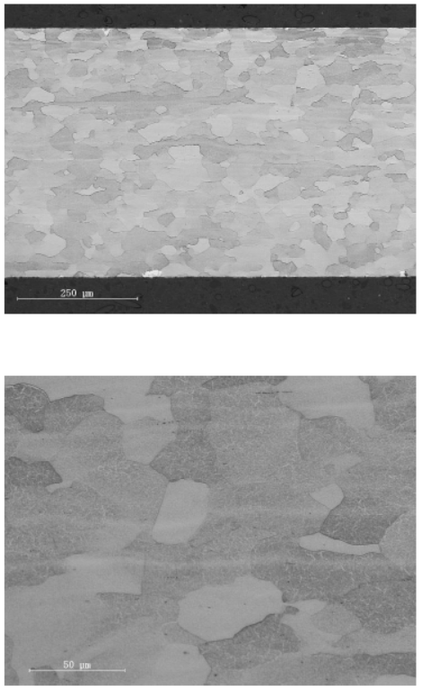
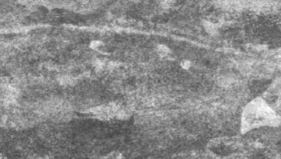
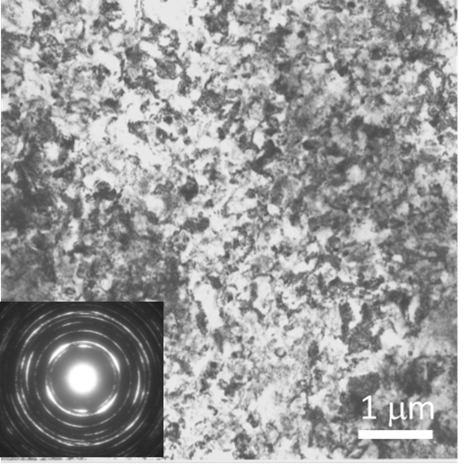
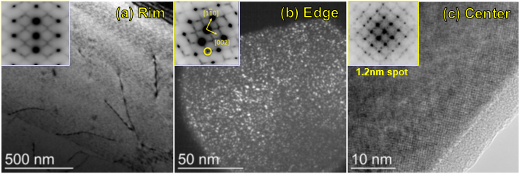

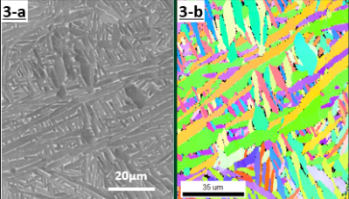
Alternatives to ‘industry standard’ α+β Ti alloy (Gr 5)
Damage-tolerant candidates in BLIP Irradiation (Ishida)
Neutron Irradiation (0.3DPA)
S.Tahtinen et al.
J. Nucl.Mat. 307-311 (2002) 416
HCP α alloy Gr6
Better ductility (n 0.3DPA)
64Ti α’-Ultra FineGrain
Rich grain boundaries
Metastable β 15-3Ti
Nanoscale precipitates
WQ (martensite α’)
Solution Treatment
50um
Aging
Gr6(HCP)
Rolling at
Proper High Temp.
S. Tähtinen et al., JNM 307-311 (2002) 416
3D printing (Direct Metal Laser Sintered) Gr-23
D=0.4um
Ultrafine-equiaxed
α’-single phase
Nano-scale α”/ω precipitates as
defect sinks
F.Pellemoine, NBI2017+RaDIATE
H.Matsumoto et al., Adv.Eng.Mat.13 (2011) 470
T.Ishida et al, NME (2018) in press

Slide 21
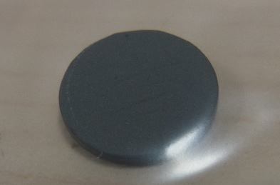
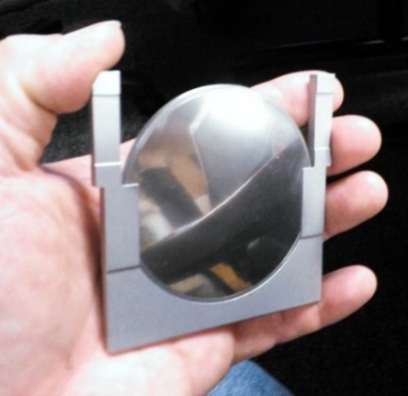
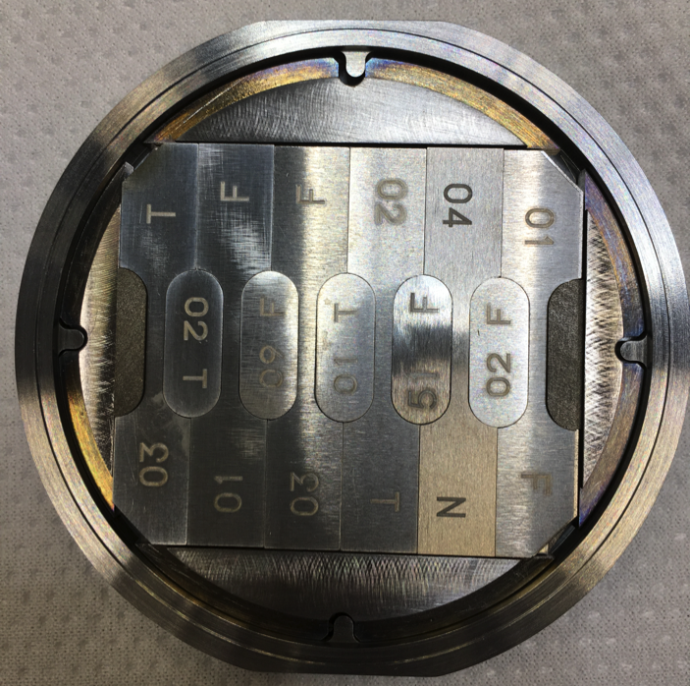
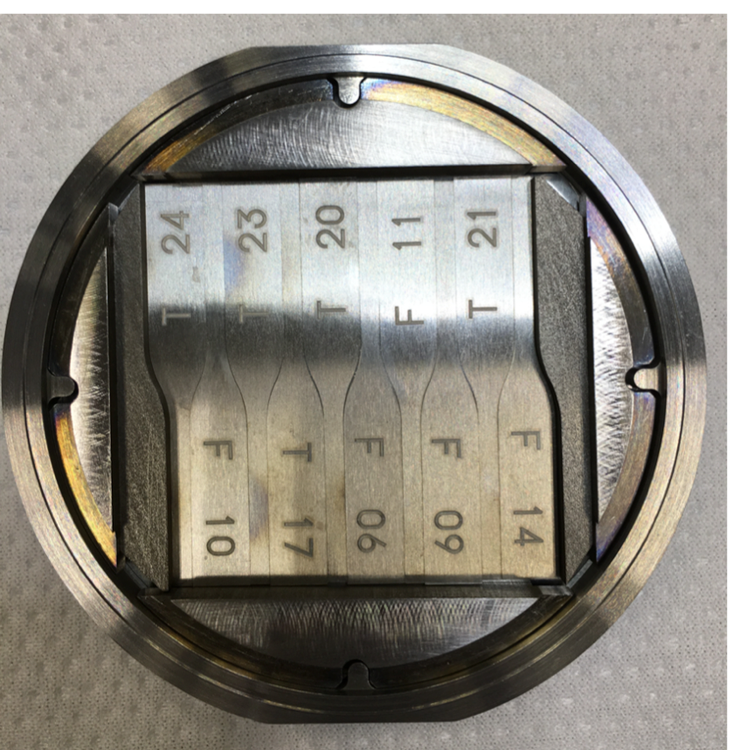
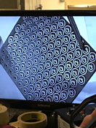



RaDIATE Irradiation Runs at BNL-BLIP Facility
SiC-coated graphite
1st phase irradiation (2017)
  Total POT: 1.76 x 10²¹ in 22 days @ 146µA average c. 0.25 DPA (NRT)
  Capsules shipped to PNNL
2nd phase irradiation (Jan-Mar 2018)
  2.81 x 10²¹ in 33 days @ 158uA av. c.1.5 DPA (NRT)
  Capsules to be shipped to PNNL soon.
10 mm
→ D.Senor
70mm
Accumulated Damage
Ti : 1.52 DPA peak (NRT)
0.93 DPA peak (Stoller)
Macro-Tensile & Microstr.
Macro-Fatigue
3.4mm
48mm

Slide 22
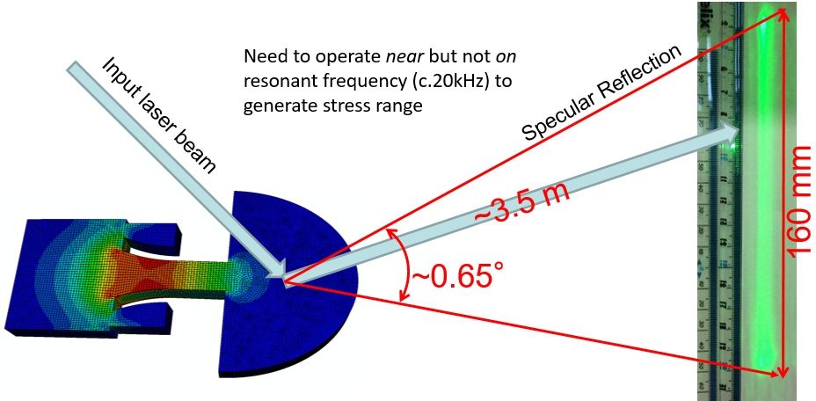
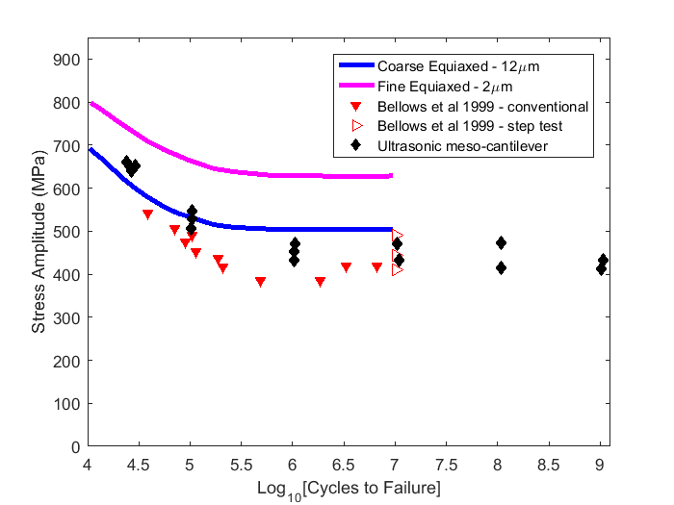
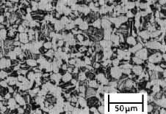
Meso-scale fatigue testing of irradiated Ti-6Al-4V titanium alloy
State-of-the-art ‘meso-scale’ technique c/o Oxford Uni
Can test many small samples of highly active foil material
High Cycle Fatigue data in short time
First ever rig for testing of activated samples being constructed at Culham Lab
Funding secured for 6 month post-doc to carry out test programme - early 2019?

Slide 23





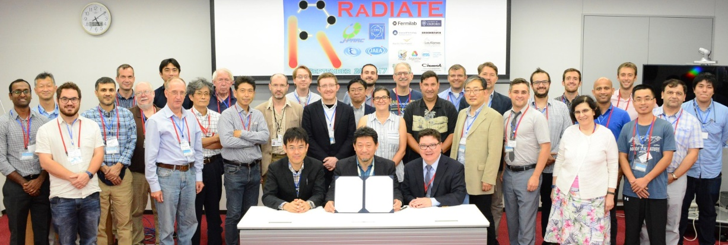
R a D I A T E
Radiation Damage In Accelerator Target Environments
International collaboration to bring together the accelerator target and materials science communities
J-PARC MoU signing & workshop in 2017

Slide 24
Summary
Plan to upgrade beam window thickness from 0.3 mm -> 0.4 mm to increase tolerance of beam window to thickness/bunch structure (and increase helium pressure)
Operation at 1.3 MW appears feasible for upgraded beam window
Radiation damage of materials is main question

