Slide 1
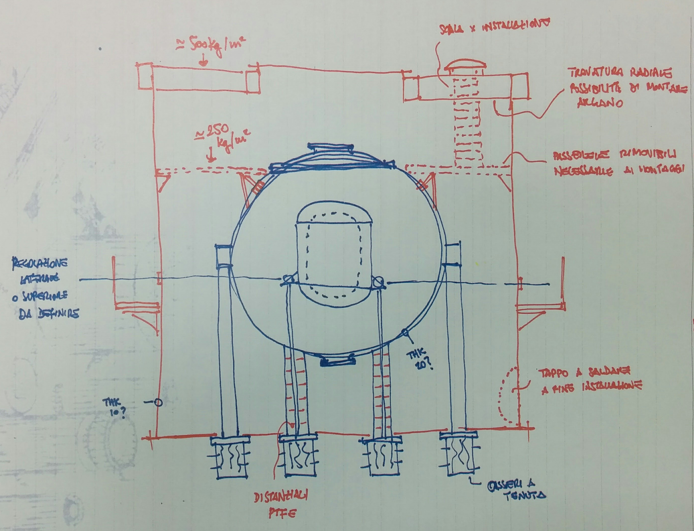
Commissioning
Seruci 0
Andrea Ianni
Carbosulcis, Aug. 7th, 2018

Slide 2
Outlines
Active Subjects
Standard Procedures adopted by Polaris
People involved

Slide 3
Active Subjects
Contractor/Producer: Polaris
Manufactures: Kaeser, Ventos, Stirling (LNGS), etc
Process responsible: DarkSide-20k Collaboration
Safety: Carbosulcis, INFN, Polaris

Slide 4
Standard Procedures
Installation check (as built P&IDs, global lay-out)
Instruments and signals check, alarms and interlocks check, loop check
Process definition (Seruci 0)
Documentation availability (manuals, certifications, etc)
Training
Utilities and gas availability
Equipment commissioning
Starting-up
Program of validation (Paul suggestion)

Slide 5
Standard Procedures
P&ID (As built) and lay-out for Seruci 0
Documentation availability
All the approved drawings should be available in advance to all the “actors” will be part of the commissioning. The plant should be well know before starting any operation
The global installation of the plant (lay-out) will involve not only the column, but also all the equipment and utilities

Slide 6
Standard Procedures
Instruments and signals check, alarms and interlocks, loop check
The instrumentation installation is part of the global installation done by Polaris
The cabling and connections, together with the check and setting of alarms, will be done internally (??)

Slide 7
Standard Procedures
Process definition
The Control System is done by DarkSide (P. Cavalcante) using LabView platform
Seruci 0 will not be used for isotopic separation, so proper process procedures should be written, and the choice of mixture decided soon, then the Process details reported accordingly

Slide 8
Standard Procedures
Utilities and Equipment commissioning
All the Utilities and Equipment needed for Seruci I, will be installed and will run in Seruci 0.
The commissioning will be very important and will be performed with Polaris and the various manufacturers
There are systems (as the global vacuum system and/or the Stirling system) that are part of the DarkSide Collaboration. They vacuum system will be partially installed, while the Stirling system will be installed and a proper procedure should be ready, together with the agreement to use the storage tank from SIAD as recovery tank.

Slide 9
Standard Procedures
Program Validation
Above the good suggestion done by Paul, a validation program should be considered in Seruci 0, after the vacuum and cold operations will be performed.
The program validation could be followed by an other campaign of leak test, as final and additional check before the dismounting of the plant.

Slide 10
People involved
Seruci 0 as test plant for the Installation, Commissioning and Training of personnel
Polaris personnel
ARIA personnel
DarkSide people
ITIM people
University of Cagliari
PoliMi
Carbosulcis personnel

Slide 11
Schedule
See other talks……
Commissiong estimation:
Starting November 2018
Completion within January 2019
Depending upon the kind of process to carry out in Seruci 0, the completion of Seruci 0 operation should happen within March 2019

