Slide 1
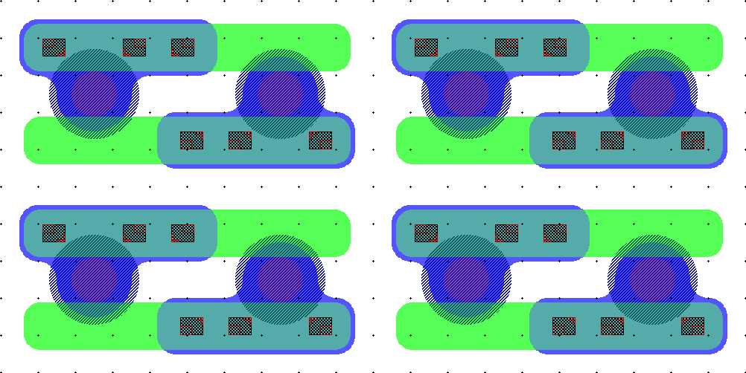
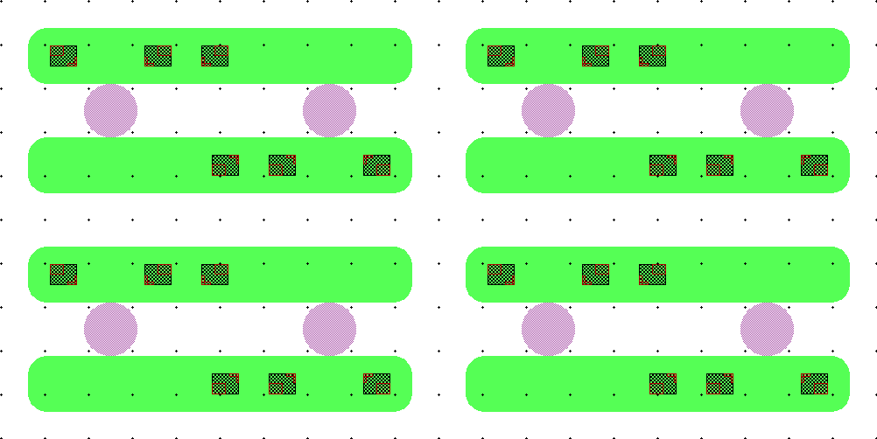
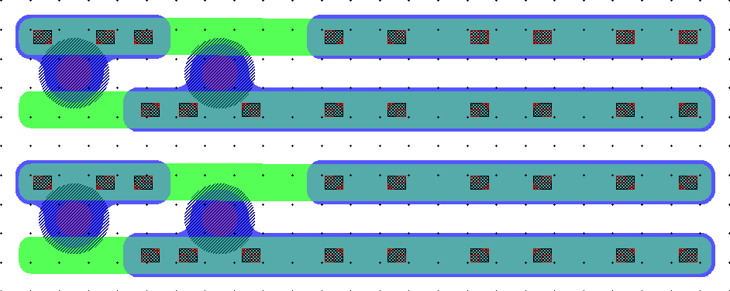
25x100_TM_V1
«STANDARD» DESIGN
N+: 12.5um
METAL: 4um wider than PASS opening
PIXEL
DEAD AREA DOUBLE

Slide 2
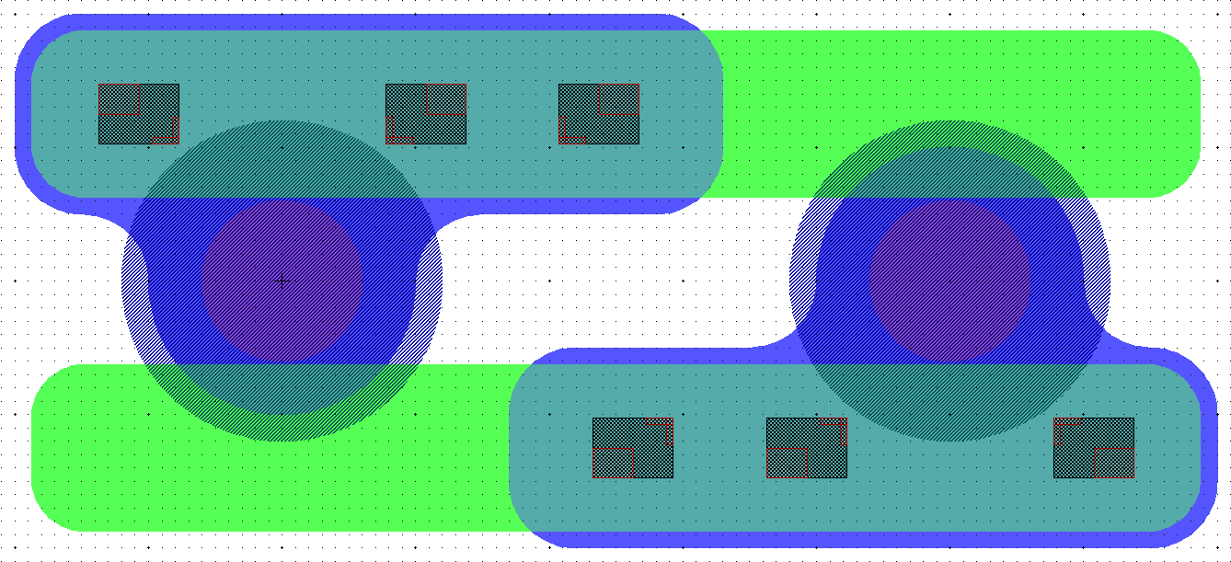

Slide 3
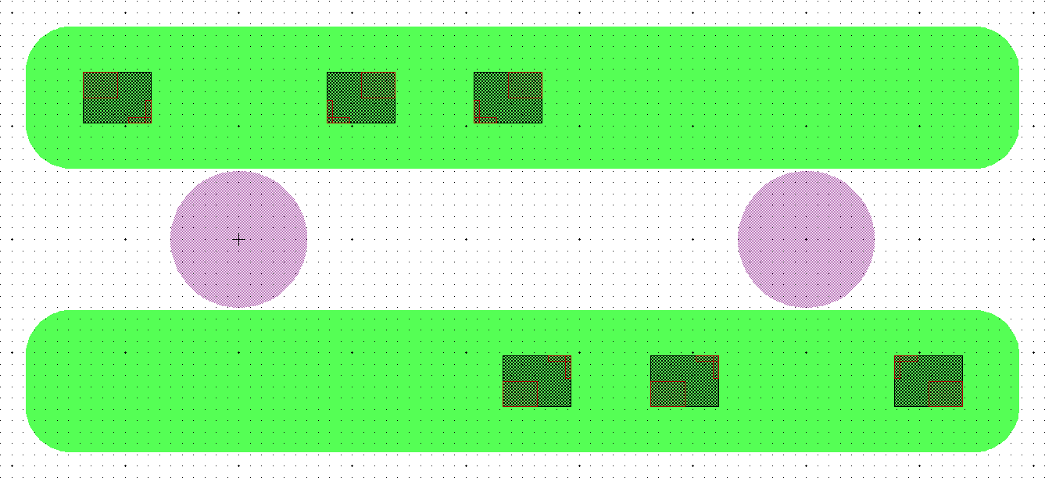

Slide 4
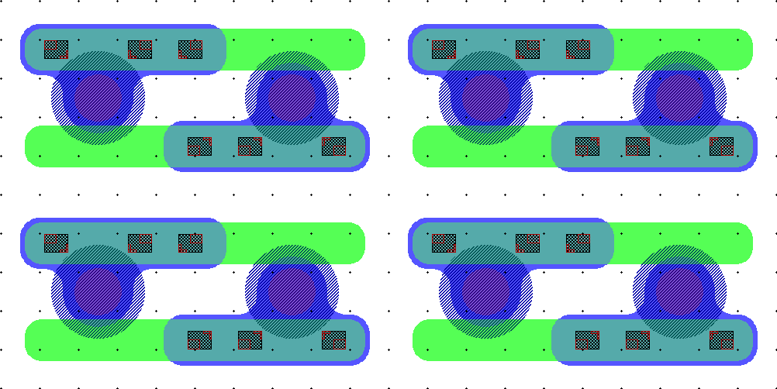
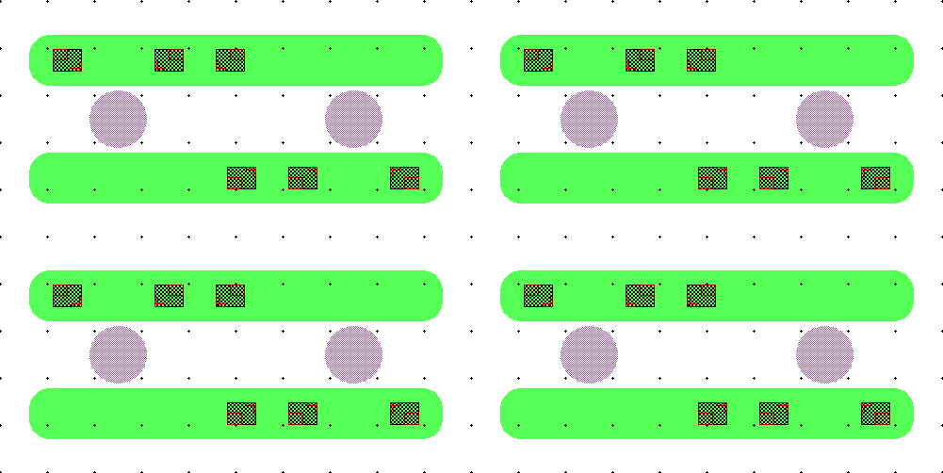
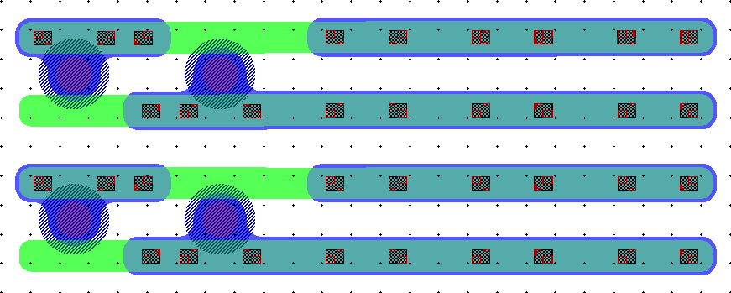
25x100_TM_V1r
REDUCED OVERLAP:
N+: 10.5um
METAL: 3um wider than PASS opening
PIXEL
DEAD AREA DOUBLE

Slide 5
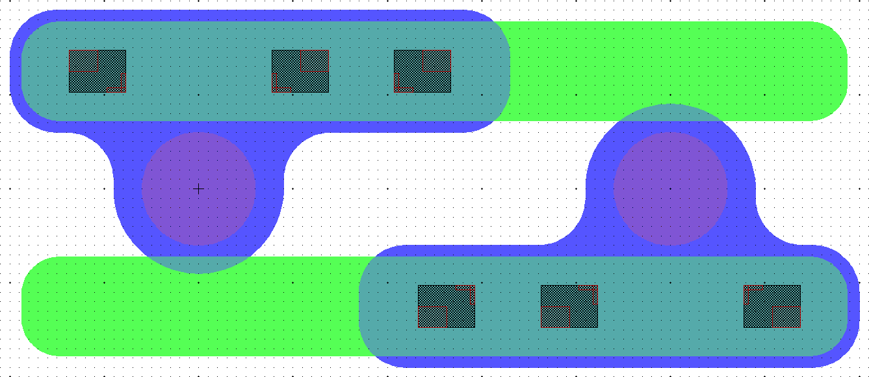

Slide 6
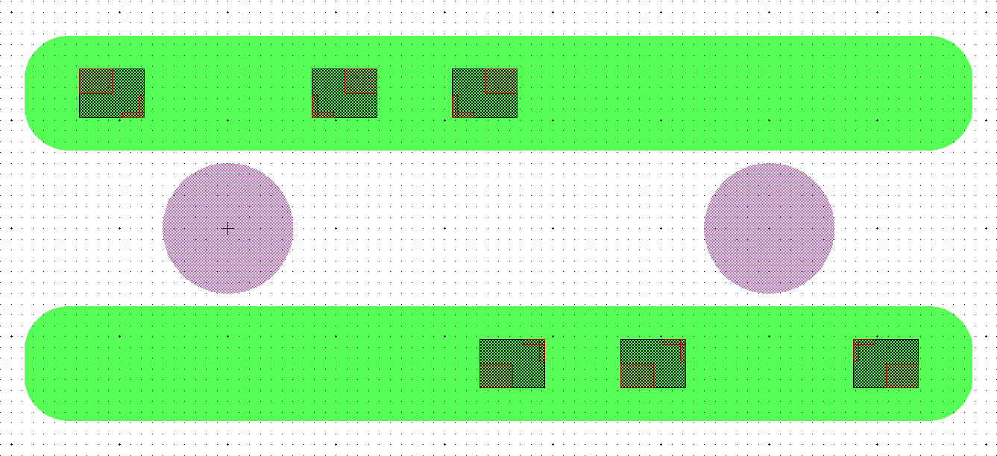

Slide 7
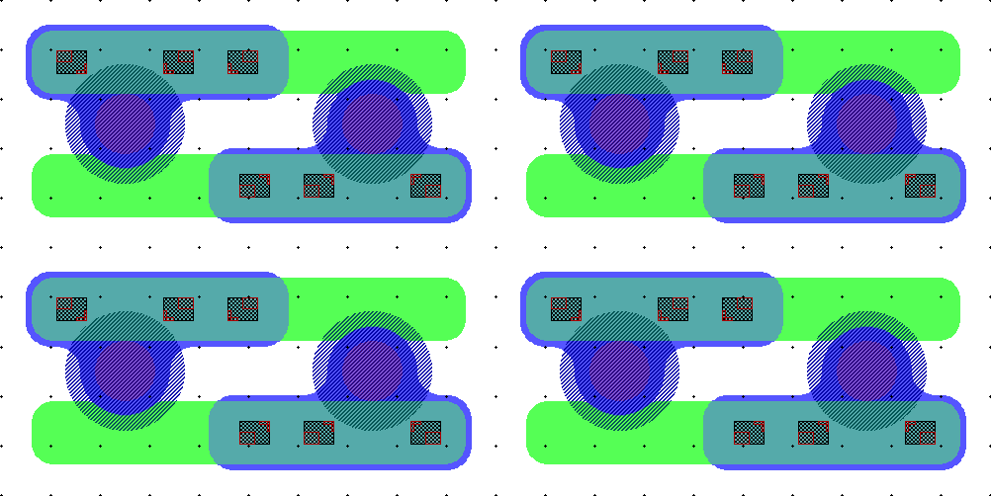
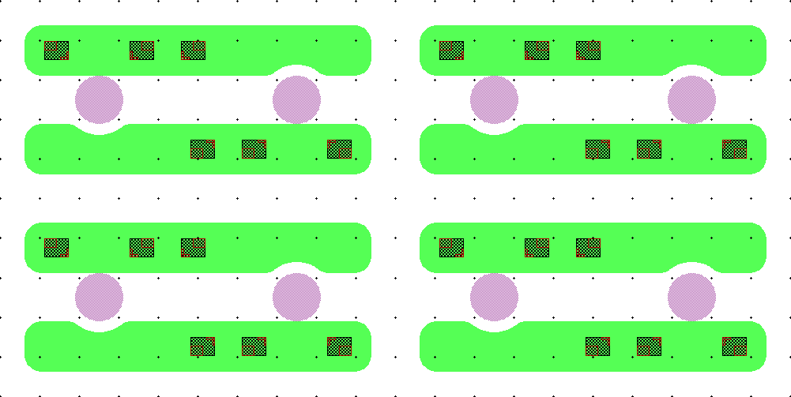
25x100_TM_V1b
«BITE» NO OVERLAP:
N+: 12.5um with BITE
METAL: 3um wider than PASS opening
PIXEL
DEAD AREA DOUBLE

Slide 8
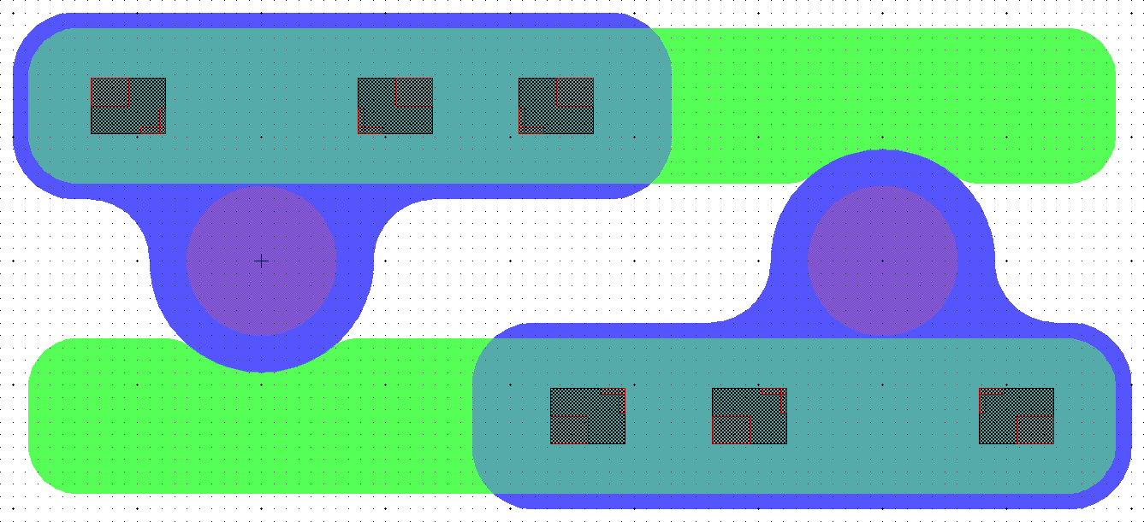

Slide 10
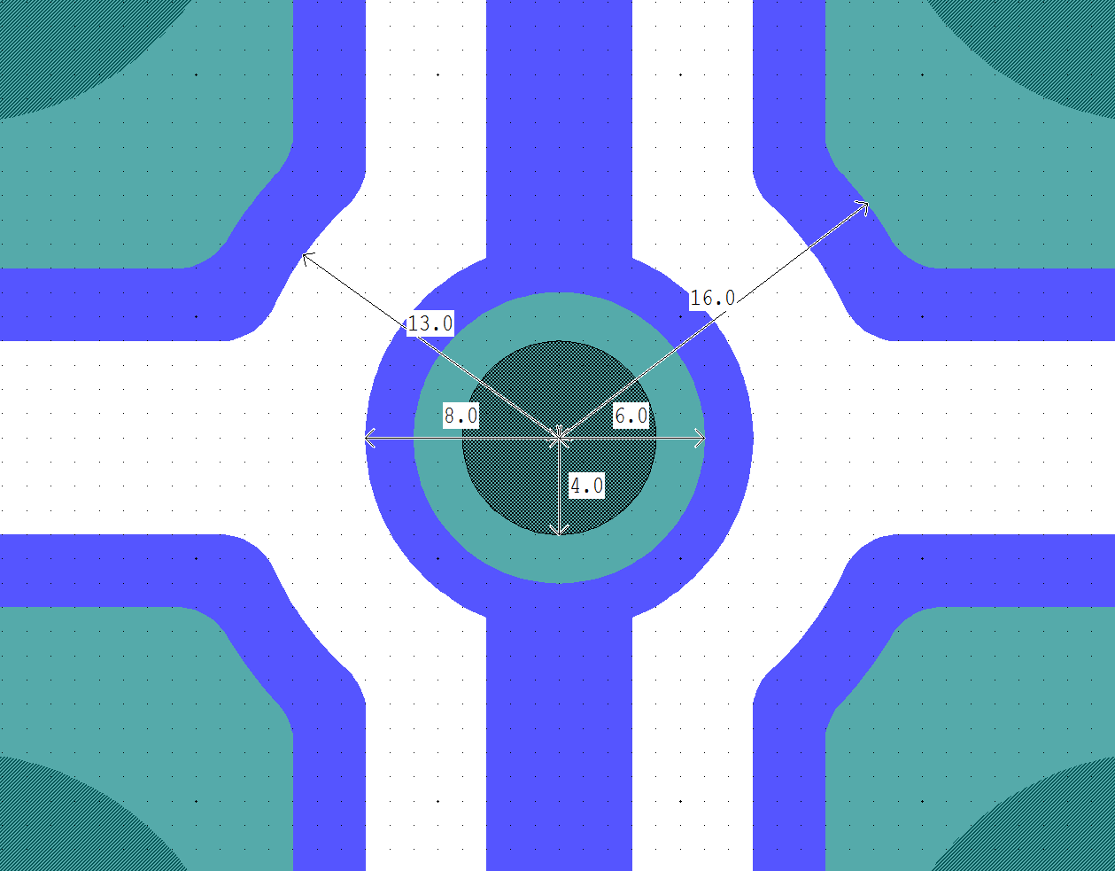
50x50 PT_V3 DETAIL
PT DOT:
CONTACT diameter: 4um
IMPLANT diameter: 6um
METAL diameter: 8um
PT/PIXEL IMPLANT GAP: 10um
PT/PIXEL METAL GAP: 5um

Slide 11
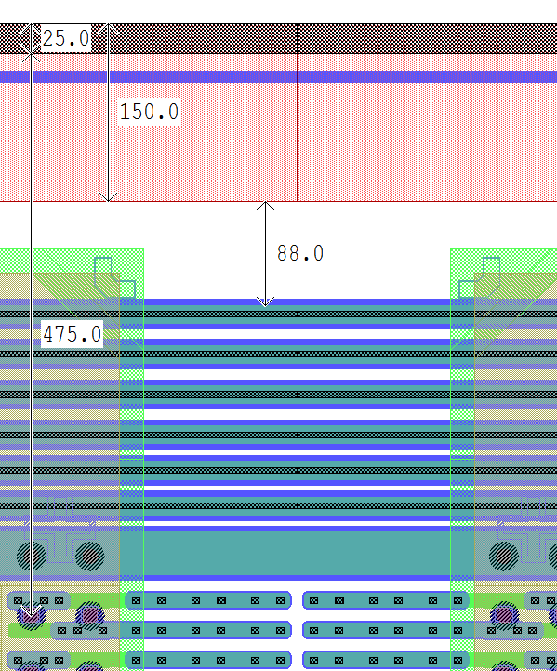
450um ATLAS Termination
PSTOP implant: 150um
HALF CUT-LINE: 25um
NO IMPLANT AREA (bulk): 88um
Clearance from bump center to CUT-LINE: 475um
1 BIAS RING (PT-LINE)
3 GR (30um pitch) + 3 GR (34um pitch)

Slide 12
450um CMS Termination
HALF CUT-LINE: 25um
OHMIC IMPLANT: 140um
FIELD PLATE: 10um
NO IMPLANT GAP: 150um (between FIELD PLATES)
GUARD RINGS:
1 BIAS RING (PT-LINE) + 2 GR
GR EXTENSION: 150um (from PIXEL EDGE to last FIELD PLATE)
TOTAL EXTENSION: 450um + 25um HALF CUT-LINE (if required)

Slide 13
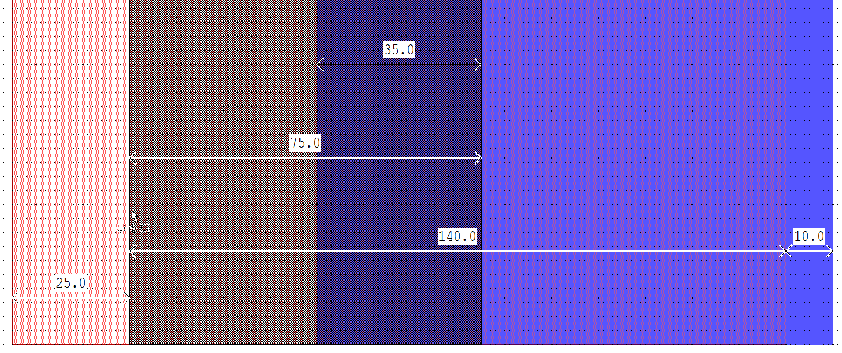
450um CMS Termination – Ohmic Implant detail
HALF CUT-LINE: 25um
OHMIC IMPLANT: 140um
FIELD PLATE: 10um
CONTACT OPENING: 75um
IMPLANT/METAL CONTACT: 35um

Slide 14
450um CMS Termination – GR detail
2x GR:
IMPLANT:15um
CONTACT: 5um
FIELD PLATE:5um
GR GAP: 10um (between FIELD PLATES)
BIAS RING:
IMPLANT:65um
CONTACT: 20um
FIELD PLATE:5um
PIXEL EDGE GAP: 5um

Slide 15
50x50 PT_V3 DOUBLE-CHIP
NOTES:
DIMENSIONS include HALF-CUTLINE (25um+25um)
2x RD53A FOOTPRINT over DOUBLE-CHIP are displayed

Slide 16
50x50 PT_V3 DOUBLE-CHIP – DETAIL 1
NOTES:
350um space between last/first pixels
PT lines interrupted at the center of the pixel matrix

Slide 17
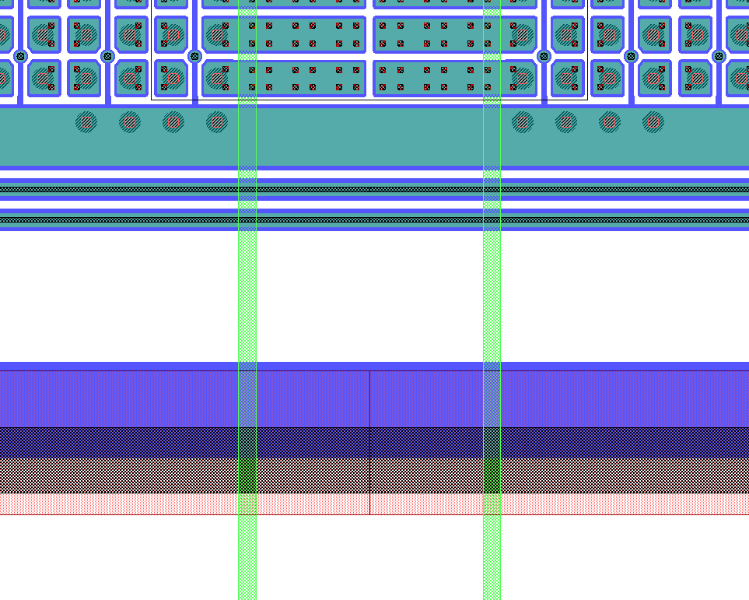
50x50 PT_V3 DOUBLE-CHIP – DETAIL 2
NOTES:
RD53A bumps for BIAS RING connection
RD53A edges

Slide 18
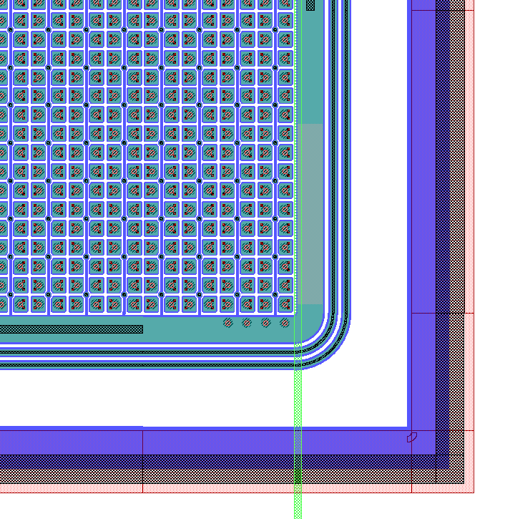
50x50 PT_V3 DOUBLE-CHIP – DETAIL 3
NOTES:
BIAS RING PASSIVATION OPENING
(on the 4 doublechip corners)
RD53A bumps for BIAS RING connection
RD53A edge

Slide 19
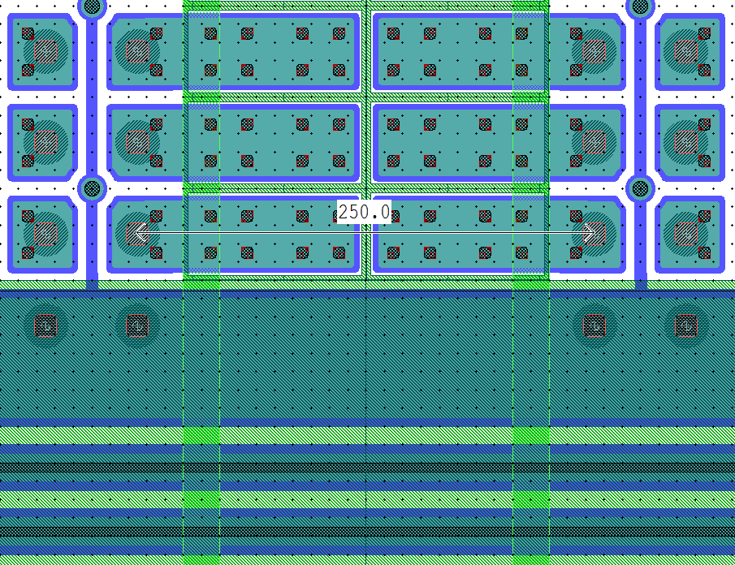
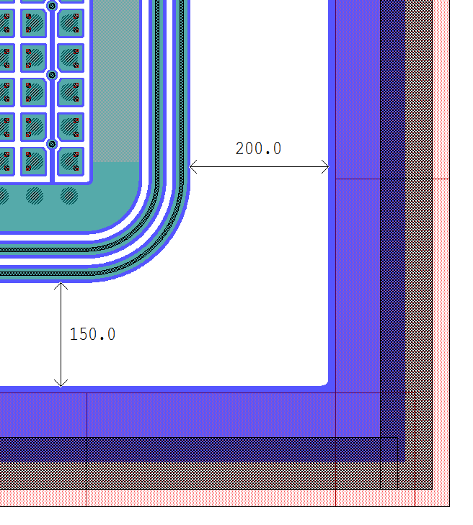
50x50 PT_V3s DOUBLE-CHIP – «SHORT» LONG PIXELS

Slide 20
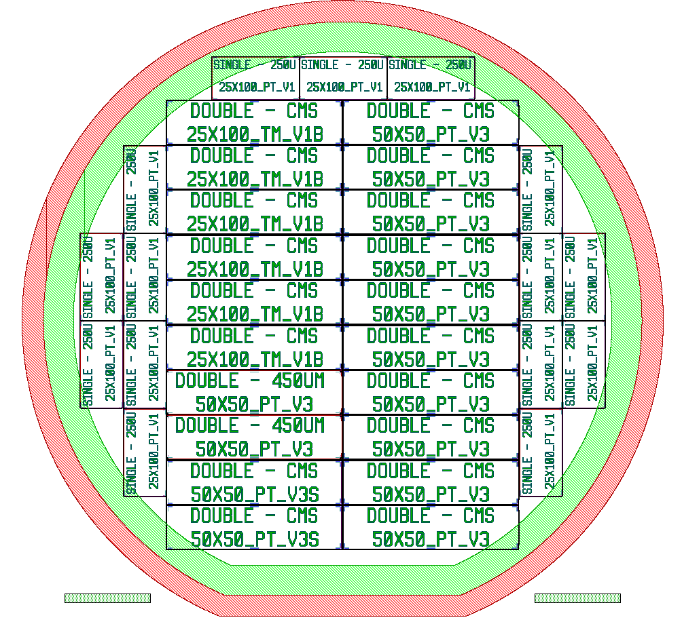
Wafer Assembly
6 DOUBLE CHIPs 25x100_TM_V1? (version TBD)
10 DOUBLE CHIPs 50x50_PT_V3
2 DOUBLE CHIPs 50x50_PT_V3 “ATLAS-like” Termination
2 DOUBLE CHIPs 50x50_PT_V3s (250um “SHORT”)
15 SINGLE chips (TBD)

