Slide 1
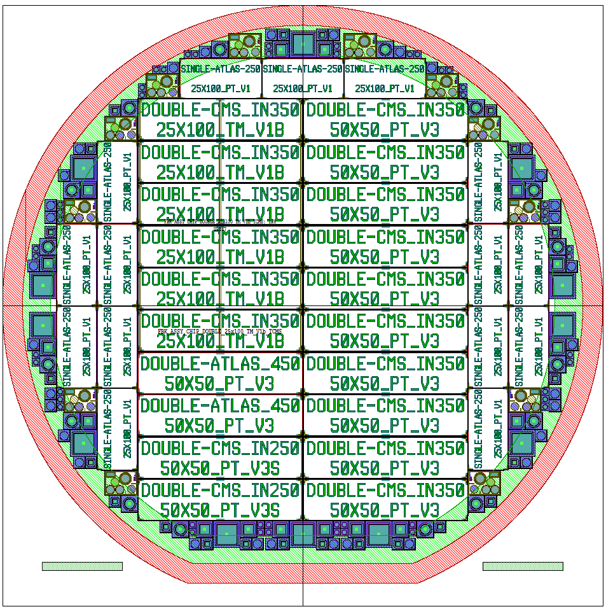
Proposed Layout
Border Clearance (RED): 5mm
- To be avoided due to equipment
Additional Test Structured proposed by Jörn
have been put in the border region (as FBK’s TS)
FBK Test Structures: 12 in a wafer

Slide 2
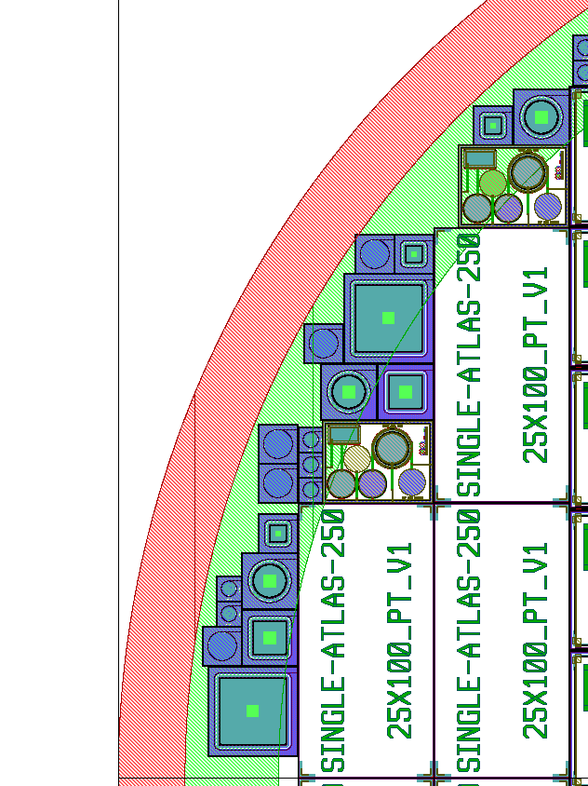
It seems that TS have been placed «randomly»,
while TS have been placed keep in mind DEVICE dicing:
test structures will not be damaged by dicing.
DEVICE dicing

Slide 3
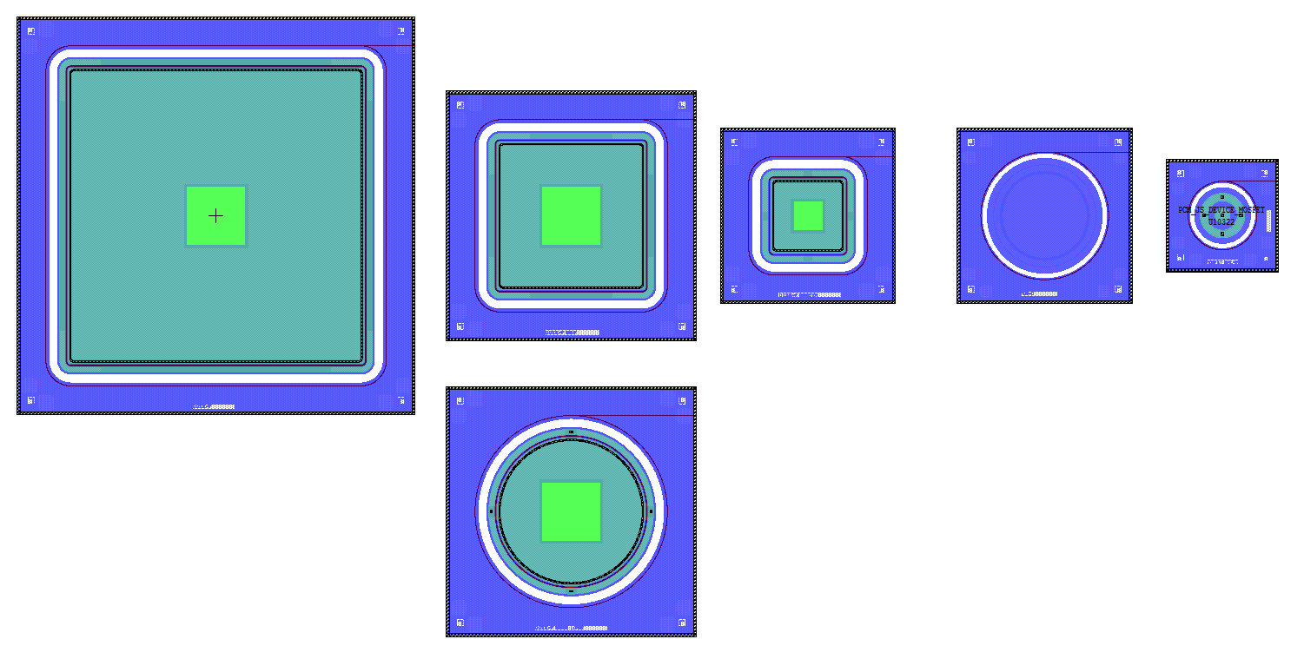
IT is very hard from FBK side to measure automatically
that TS structures due to different PAD position…
…but we can try on one diode layout: with the aim to correlate it’s measurements with FBK diode layout.

