Slide 1
Planning for Planar (Pseudo-)Quad Sensors Production at FBK
M. Backhaus, M. Meschini, A. Messineo, J. Schwandt

Slide 2
Quad Modules Baseline Options
Two most recent meetings on quad modules on June 20th and on July 17th :
3 quads with 25x100 pixels and no punch through bias. Temporary metal will be used for measurements at FBK premises
5 quads with 50x50 pixels with punch through bias
Clearances between chips
  Four of the 50x50 quads and all 25x100 quads with 350μm inter-chip bump center to bump center distance in x-direction (results in ~200μm clearance)
  One of the 50x50 quads with 250μm or 300 μm inter-chip bump center to bump center distance in x-direction (results in ~100μm clearance) to be decided when dicing precision will be known

Slide 3
More Options & Decisions
No dicing street in between quad (→ doublets cannot be separated)
Clearances between doublets in the quad
  900μm inter-chip bump center to bump center distance in Y-direction
Clearances outside doublets in the quad (for the three sides facing outside)
  500μm from bump center to sensor edge (dicing line)
  ~450um from active matrix edge to physical edge after dicing
long pixels (200 μm) in between chips in X-direction
  Do the same on the outer edges of the sensor? To be decided
PT sensors: design the Punch Through bias rails along Y instead of X as in the present layout

Slide 4
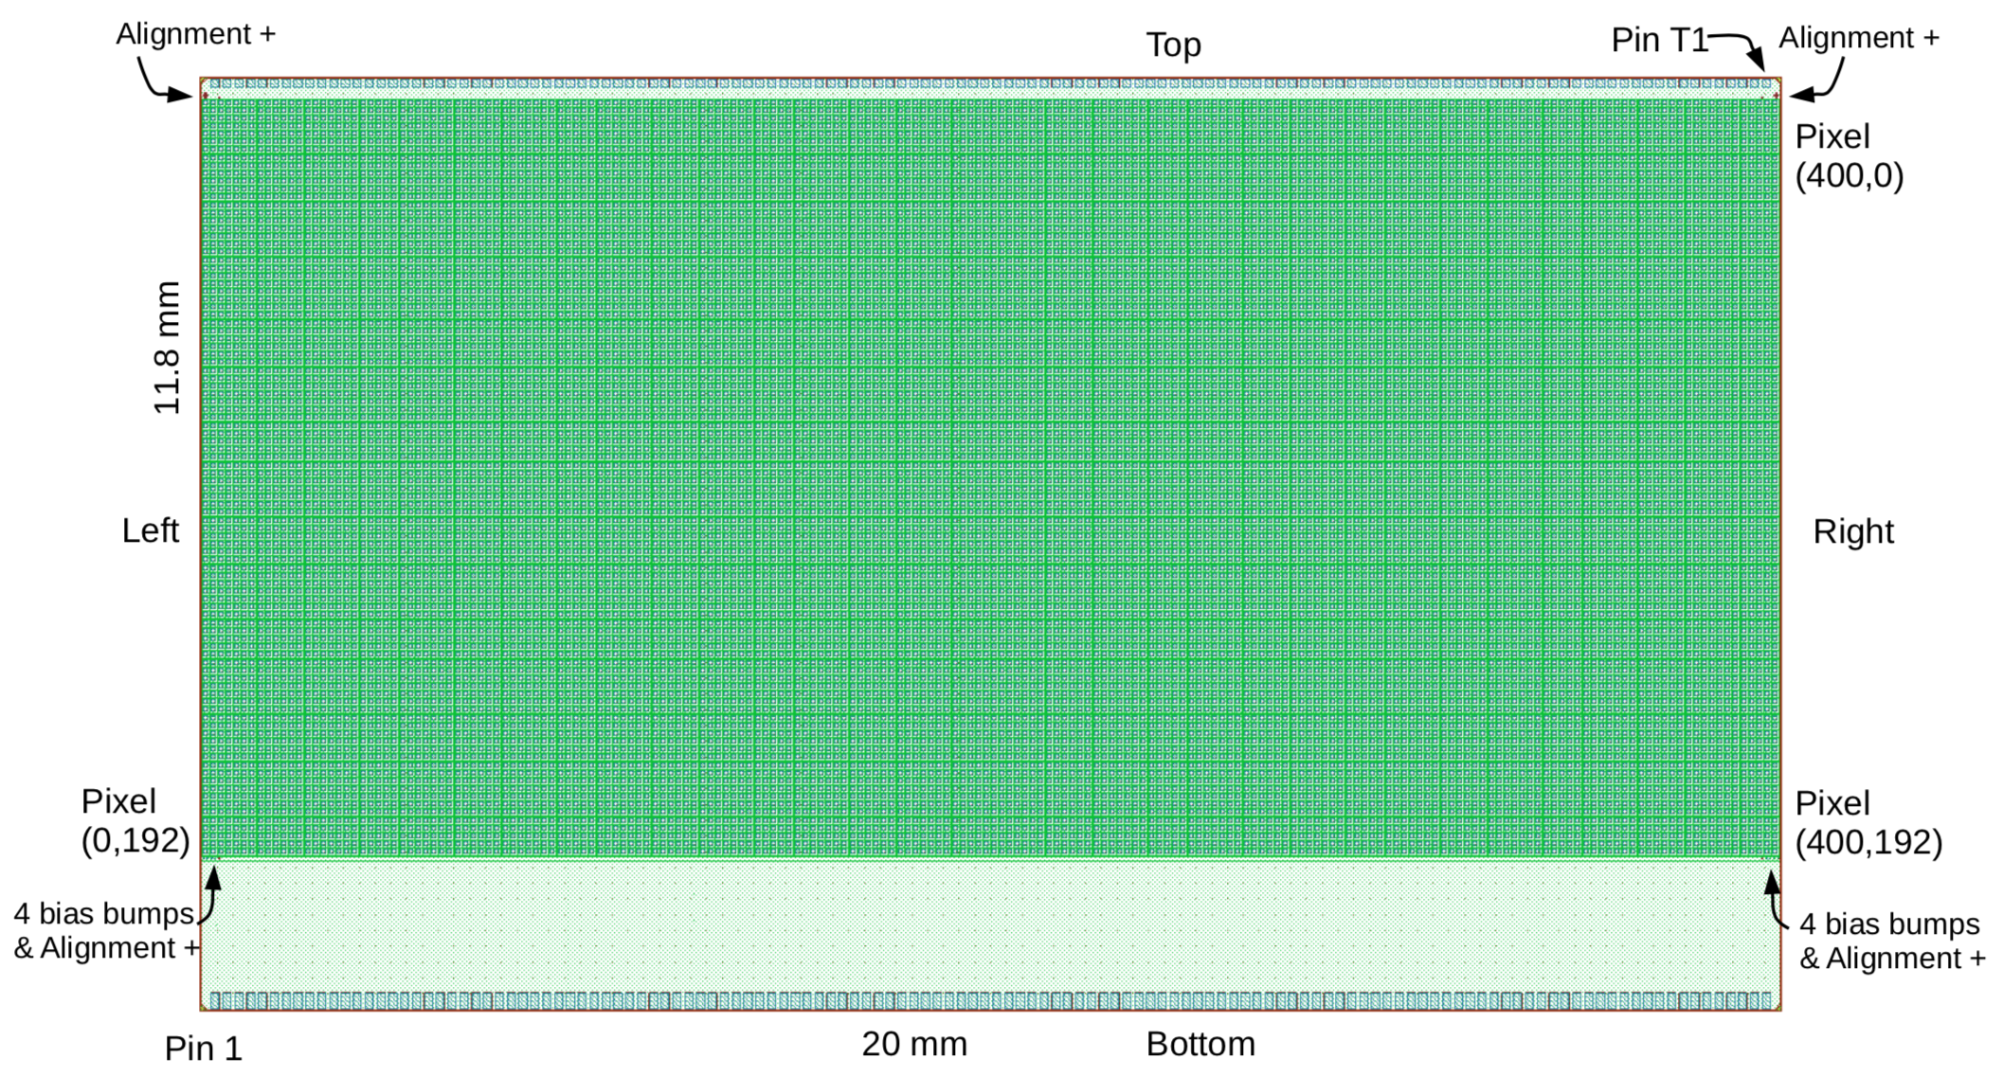
RD53A
Y
Physical dimension including dicing streets not accounted in this figure
Top row pads CANNOT be diced
X

Slide 5

A possible layout for pseudo-quads, doublets and single RD53A
Sketch, not yet a real design file
7 Doublets -> Yellow
8 Quads -> Cyan
8 Singles -> Grey
Based on ATLAS layout (A. Macchiolo)

Slide 6
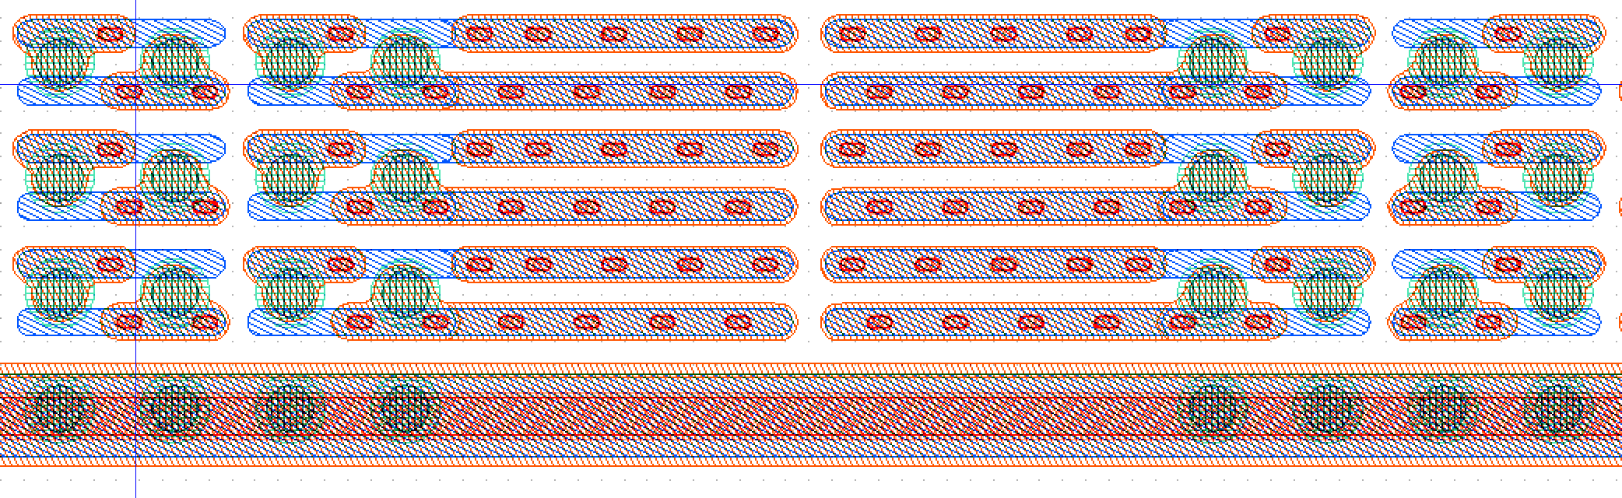
Central zone of a 25 μm * 100 μm pitch doublet without punch through bias
350 μm distance between centre of bumps
FBK is working on
better bump pad shape and symmetry
reducing opening size
reducing metal overlap on adjacent row pixels to minimize cross-talk between pixel rows

Slide 7
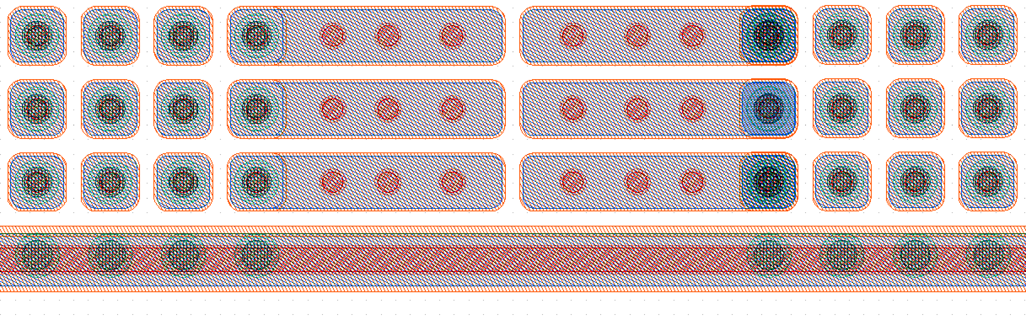
Central zone of a 50 μm * 50 μm pitch doublet without punch through bias
350 μm distance between centre of bumps
FBK is working on
Two versions, with 250 or 350 μm distance between centre of bumps

Slide 8
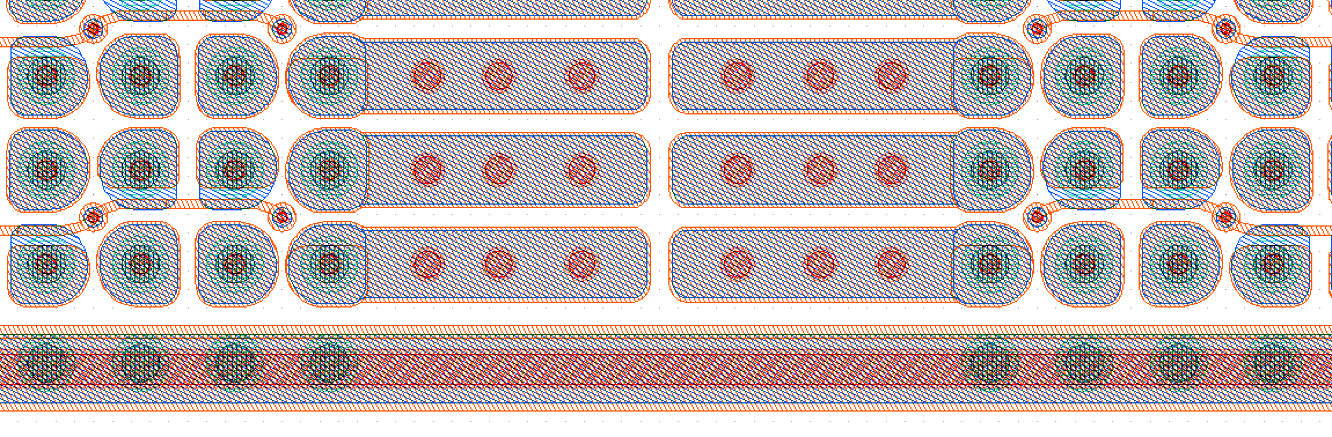
Central zone of a 50 μm * 50 μm pitch doublet with punch through bias
350 μm distance between centre of bumps

Slide 9
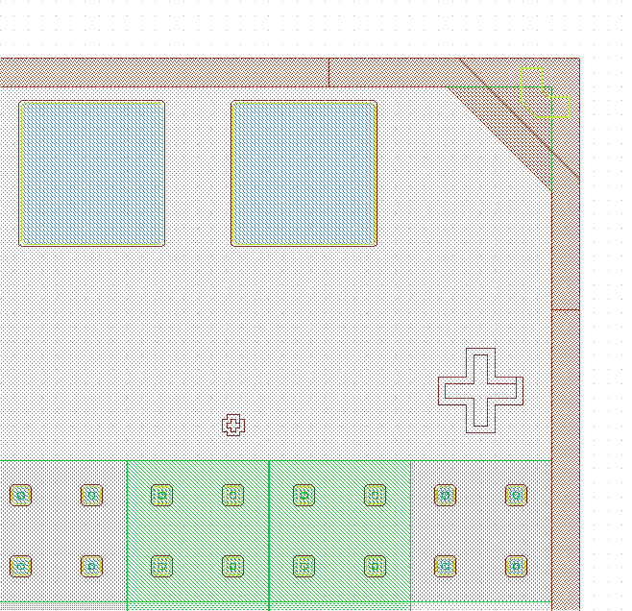
Layout Constraints coming from RD53a chip size
Dicing streets still to be accounted in this slide
We got a design file of the top layer, thanks Flavio Loddo
Distances are taken from center of the last bump to the nominal border In order to assembly two RD53 side-by-side in X or Y:
  Along module width (W or Y):
    310 X 2 + 200 (or 100) = 720-820 μm
  Along the module length (L or X):
    45 X 2 + 200 (or 100) = 190-290 μm
In the front side the center of last bump is 1749 μm far from wire bonding pad (along Y)
310 μm
45 μm

Slide 10
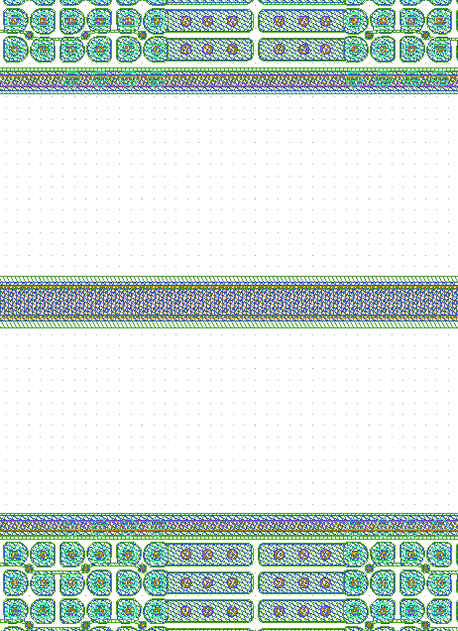
Center of a RD53a-Quad
Left-side sensor
Right-side sensor
Top row sensors
190-290 mm
Empty space to be populated by Bias ring (in case of PT) + guard rings
Dicing line in case it is planned to
separate Doublets from Quads
720-820 μm
No dicing street → We will not cut quads into doublets
Empty space to be populated
by Bias (in case of PT) + guard rings
Bottom row sensors

Slide 11
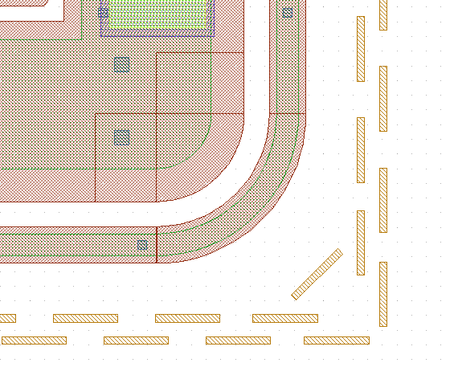
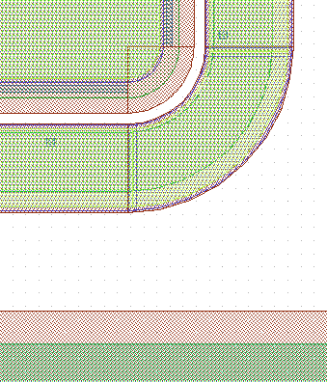
Proposal for Bias/Guard Rings
Profit from experience in FBK R&D planar productions
CMS-diodes : 1 Bias ring or 1 G.R.
Junction implant
+ overhang
Dicing region Ohmic (P⁺) implant
+ overhang

Slide 12
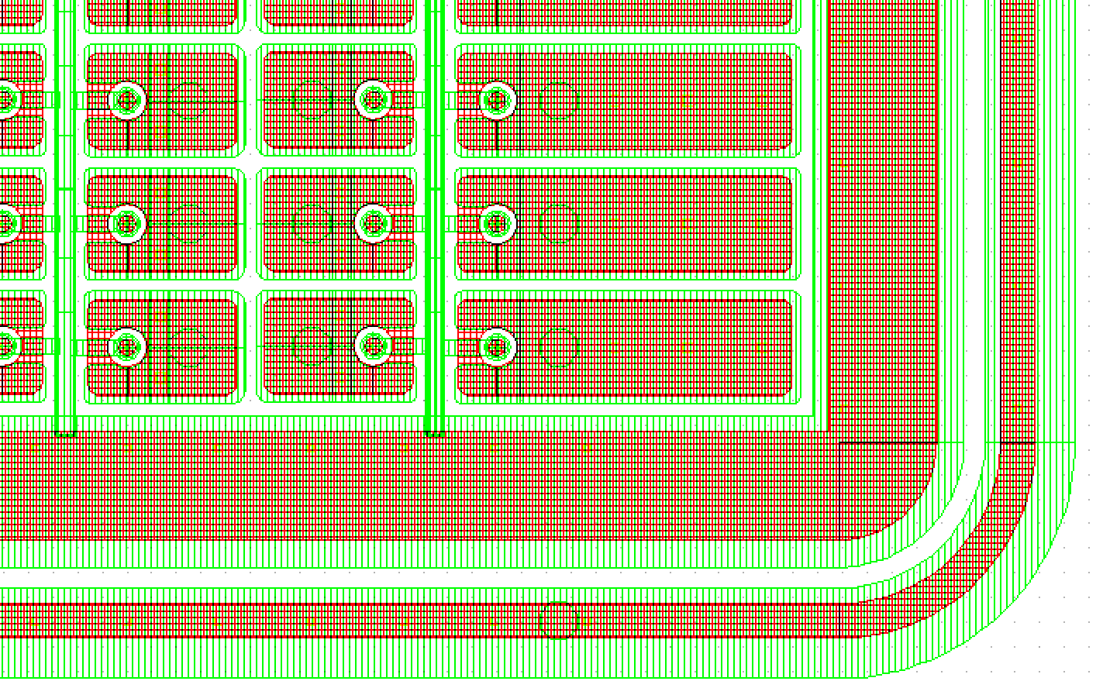
Example: 1 Bias ring plus 1 GR
One of the best terminations in the first FBK planar batch

Slide 13
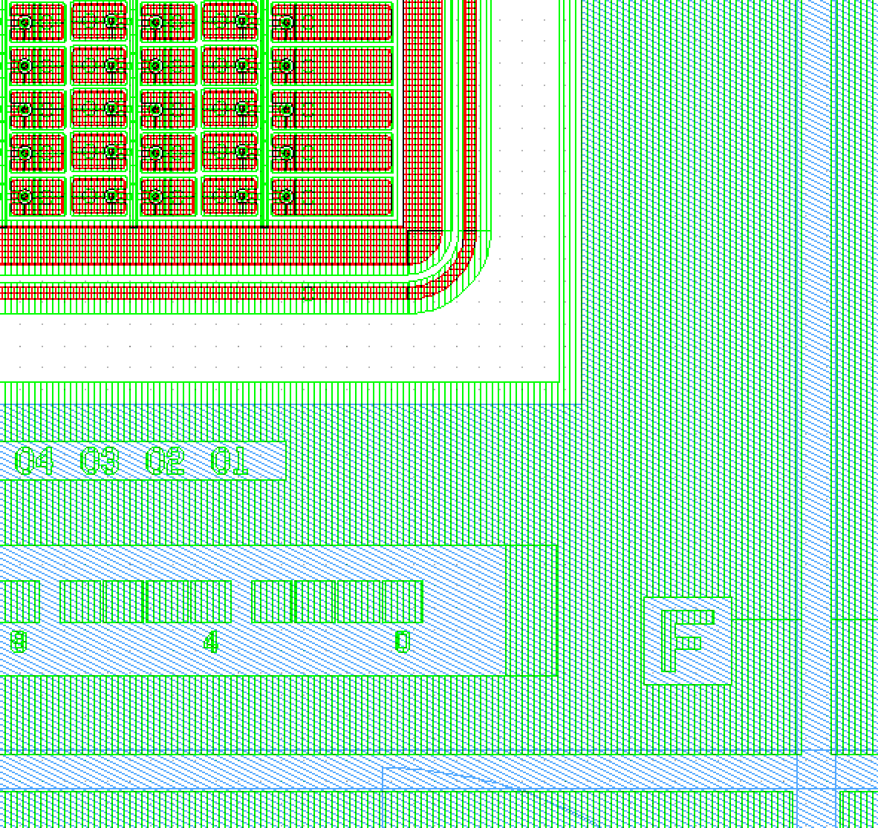
Dicing Street with P-stop and large metal overhang
This is the same sensor of the previous page including the area outside the GRs up to the dicing streets
Dicing streets with P+ and metal overlap “HPK Old Style” require a lot of space around sensor: how far con we go outside pixel matrix plus GR? 500um total

Slide 14
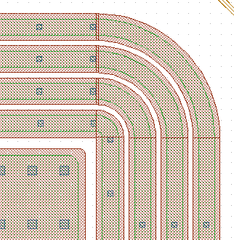
Multiple Guard Rings
Try to implement at least 3 or 4 Guard Rings with metal overhang and no p-stop between N⁺ implants. We will try to fit in the available space between sensors

Slide 15
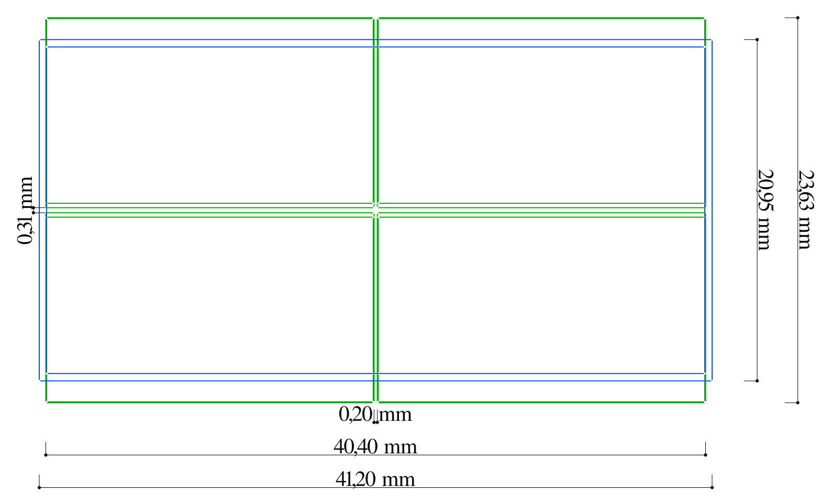
Up-to-date Quad Module dimension
Malte B. made the latest update this morning on module size
In blue: sensor
In green: RD53A

Slide 16
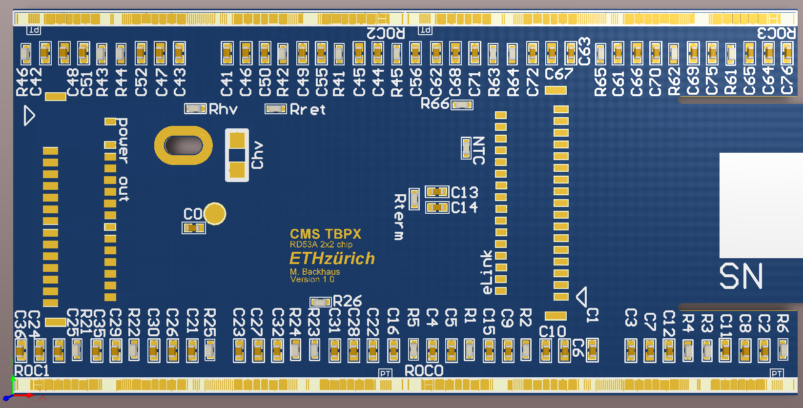
Layout of Quad HDI vs Quad sensor
L= 40100 μm
275 μm from
wire-bonding-pad
to border
W = 19765 μm
HDI design from Malte B., dimensions defined, production in progress
Proposal for quad sensor size: L = 41300 μm, W = 21100 μm

Slide 17
Planar Quad Sensor Production at FBK
ICEmos is once more delaying wafer delivery… ☹
  Rescheduled to ship week commencing 16th July 2018: difficult to believe… and indeed the mail from ICEmos today at 12:05 says “I have discussed your order with the production team this morning, we will need until 6th August to complete and ship your order.”
6” Float Zone Si-Si DBW (Direct Bonded Wafer) 150μm thick active device, on 500μm handle
  P type, FZ Sensor resistivity > 5kOhm cm
  Handle wafer: CZ 0.1-1 Ohm cm resistivity, 500μm thick
Layout design in underway, to be completed soon, once all distances and constraints are finalized
If you have comments or suggestions, please speak up, you are still in time!

