Slide 1

Coatings R&D
G. Cagnoli
for the VCR&D Collaboration

Slide 2
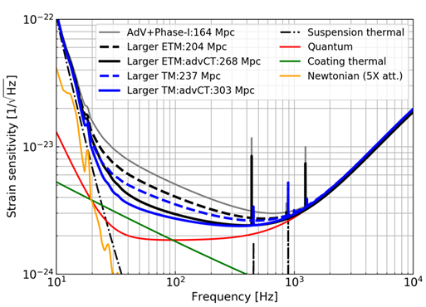
The AdV+ objectives

Slide 3
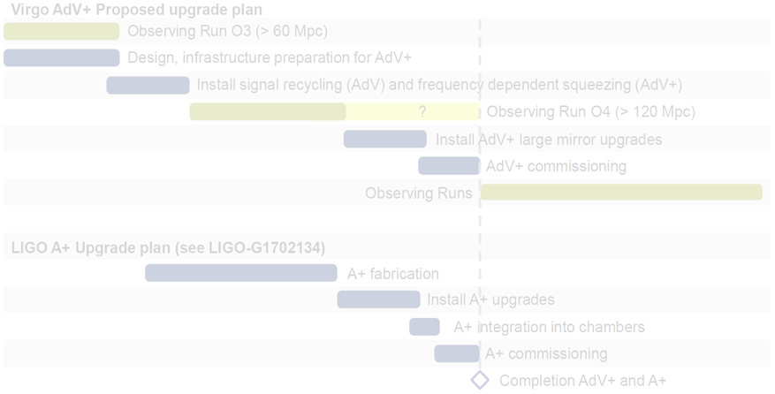

Timing and strategy of AdV+
Mirror
production
Post deposition
corrective coatings
and optical control
Uniformity
on selected
materials
Material selection
GC
mod.
Substrates purchasing
and polishing
Metrology and handling upgrades

Slide 4

The wide context of Coatings Development
Materials (VCR&D)
Coaters and metrology (LMA)
Pragmatic
Fundamental
Physics
Ongoing
Selection and
Optimization
Materials
Deposition
parameters
Metrology
Density of TLS
and structure
TLS distribution
and structure
Uniformity
In-situ optical metrology for real
time thickness control
Spectrophotometric bench for
large optics
Point like defects investigation
Planned
High T deposition
Post deposition coating correction

Slide 5
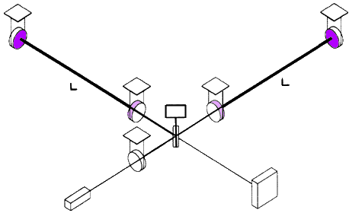
The ubiquitous thermal noise
Thermal noise in cavities
  Coating noise dominates between 30 Hz and 300 Hz

Slide 6
Thermal noise and relaxations
Thermal noise is not thermal agitation
  Random processes brake the coherence of modes and
  spread the thermal energy over all the frequencies
Thermal vibrations without noise
energy
kT
frequency
Thermal vibrations with noise
energy
frequency

Slide 7

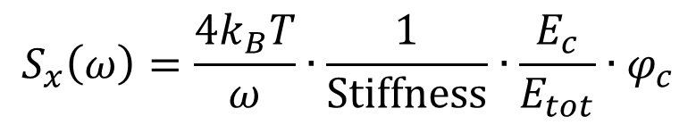

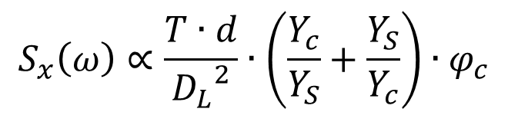
Coating thermal noise and its parameters
The Power Spectral Density $S_{x}$
  $T$: temperature
  $D_{L}$ : laser beam diameter
  $d$ : coating thickness
  $Y$ : Young’s modulus
  $φ$ : mechanical loss angle
$$S_{x}\left(ω\right)=\frac{4k_{B}T}{ω}∙\frac{1}{Stiffness}∙\frac{E_{c}}{E_{tot}}∙φ_{c}$$
$$S_{x}\left(ω\right)∝\frac{T∙d}{{D_{L}}_{}^{2}}∙\left(\frac{Y_{c}}{Y_{S}}+\frac{Y_{S}}{Y_{c}}\right)∙φ_{c}$$
Coating
development
(LMA)
Material
research
( )
Fluctuation-Dissipation
theorem

Slide 8
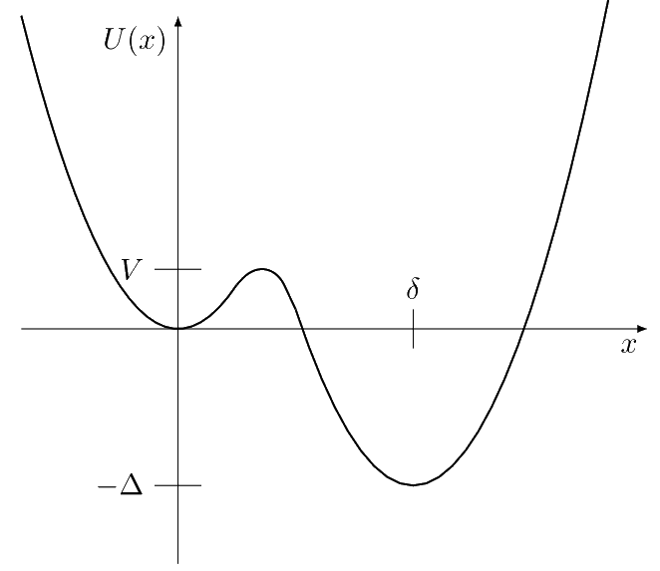
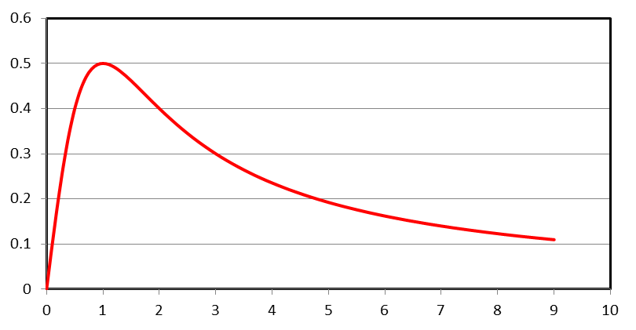
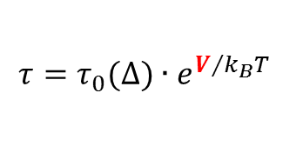

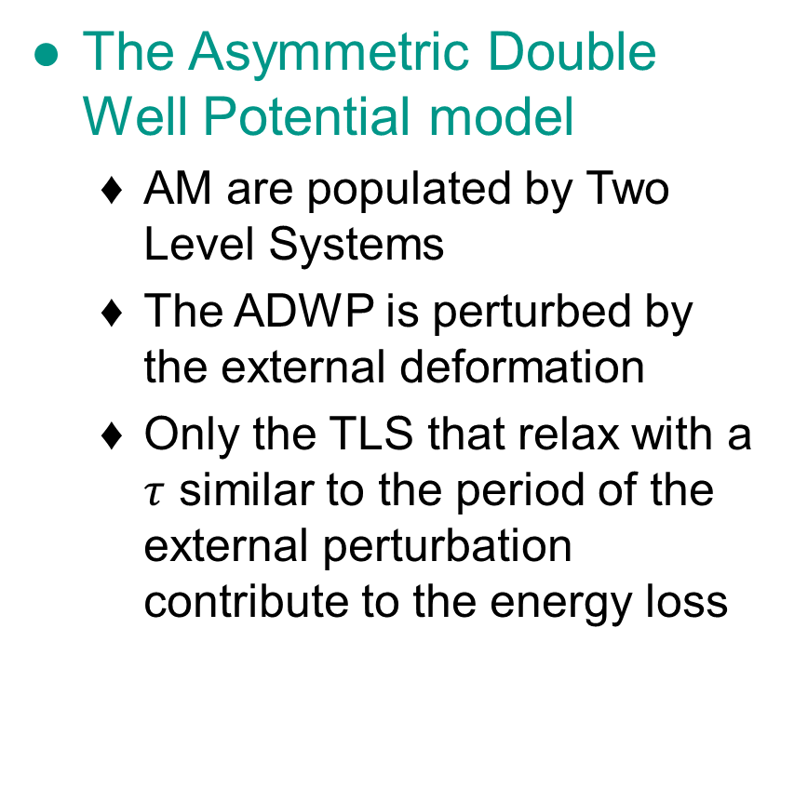
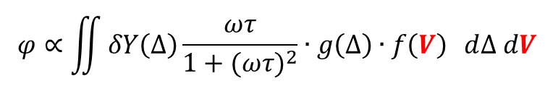
Energy loss in Amorphous Materials (AM) in the acoustic band
The Asymmetric Double Well Potential model
  AM are populated by Two Level Systems
  The ADWP is perturbed by the external deformation
  Only the TLS that relax with a $τ$ similar to the period of the external perturbation contribute to the energy loss
$$τ=τ_{0}(∆)∙e^{V/{k_{B}T}}$$
$$ωτ$$
$$φ∝\iint{δY\left(∆\right)\frac{ωτ}{1+(ωτ)^{2}}∙g\left(∆\right)∙f\left(V\right) }d∆ dV$$
Debye

Slide 9
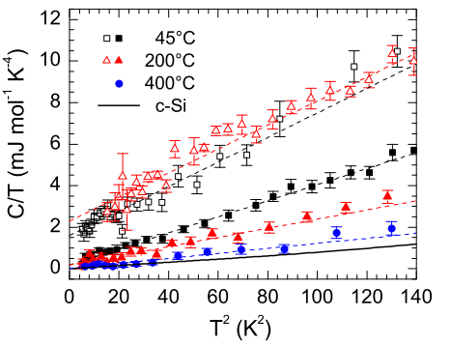
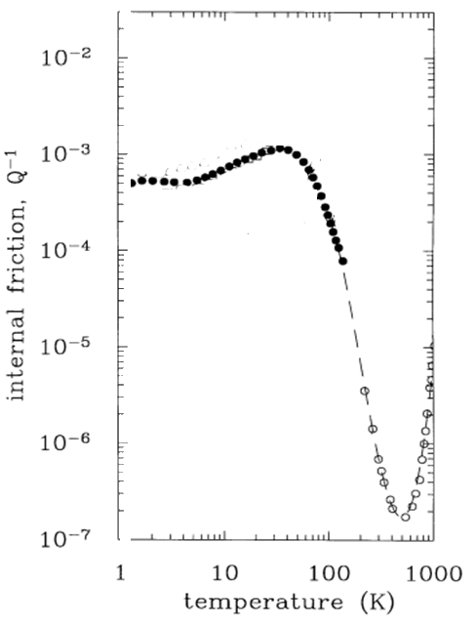
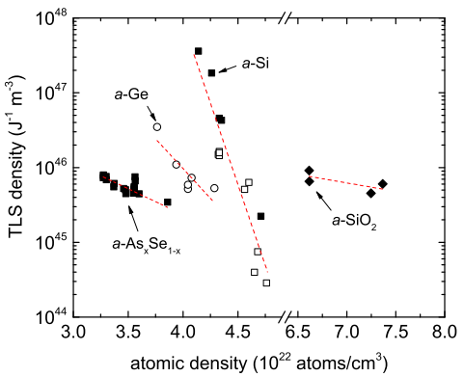
Two ways to reduce thermal noise in coatings
Reducing the density
of TLS
Shaping the TLS distribution
High-temperature deposited aSi
Fused silica

Slide 10
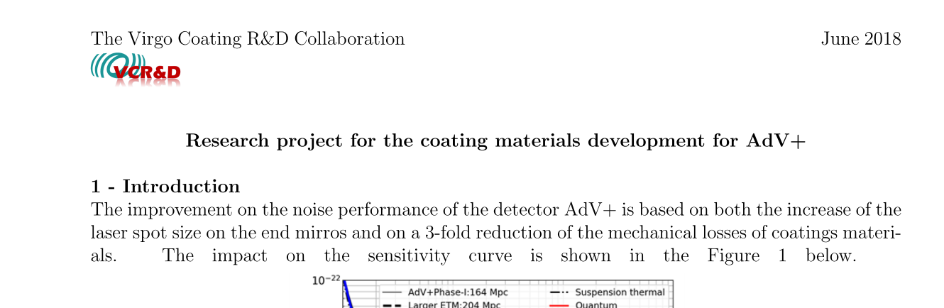
The VCR&D project for AdV+
Proposal made in 3 weeks between may and june
  It details the strategies we are pursuing to reduce the internal friction in coatings
  It gives a detailed list of samples production
  It describes all the characterizations needed
  The WBS is outlined

Slide 11
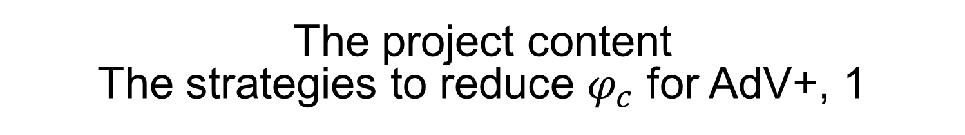
The project content
The strategies to reduce $φ_{c}$ for AdV+, 1
Post deposition annealing
  It shapes the TLS distribution
  Not known why in some materials the effect is larger than in others
Mixing of oxides
  To reduce internal friction (unexplained)
  To increase the crystallization temperature
High temperature deposition
  It reduces the TLS density
  Ultra-stable glasses
  Not all amorphous materials are « glasses »

Slide 12
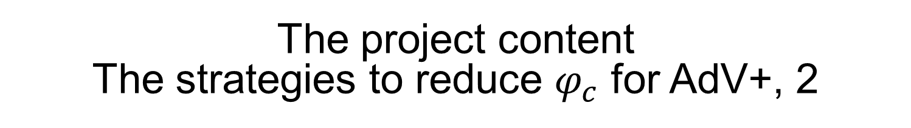
The project content
The strategies to reduce $φ_{c}$ for AdV+, 2
Deposition parameter optimization
  3 parameters: Vb, Ib, deposition rate Rd
  Indications that for Vb and Rd, the lower the better
  The physics of deposition is lacking
Nano-layering
  Nano layers inhibits crystallization during annealing
  They shape the TLS distribution for a not yet clear relation between relaxation-time to structure-dimension relation

Slide 13
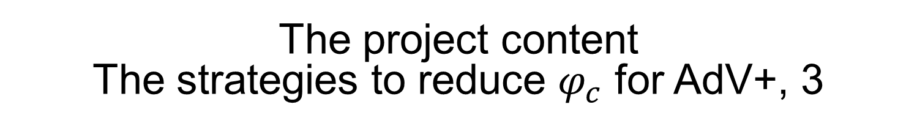
The project content
The strategies to reduce $φ_{c}$ for AdV+, 3
High coordination-number glasses
  Phillip’s conjecture: coordination number larger than 3 reduces the TLS concentration (example: aSi)
High index silica glasses
  To retain, if possible, the SiO2 TLS distribution
Nitrides
  Optimization of SiNx
  Possibly of GaN

Slide 14
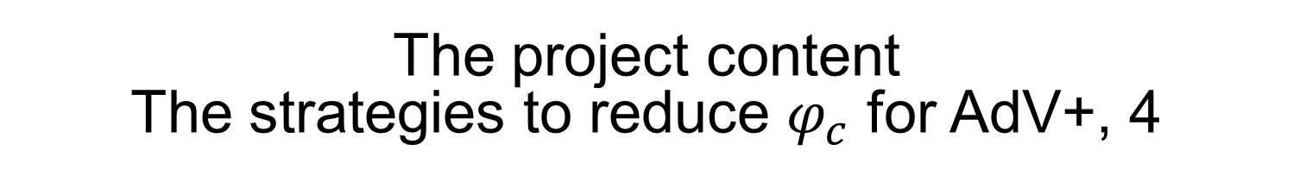
The project content
The strategies to reduce $φ_{c}$ for AdV+, 4
Missing activities
  Modelling, Molecular dynamics simulation of:
    Deposition
    Structural relaxations
    Mechanical properties
  Characterization:
    Calorimetry
    Dielectric
    Diffusion of Argon

Slide 15
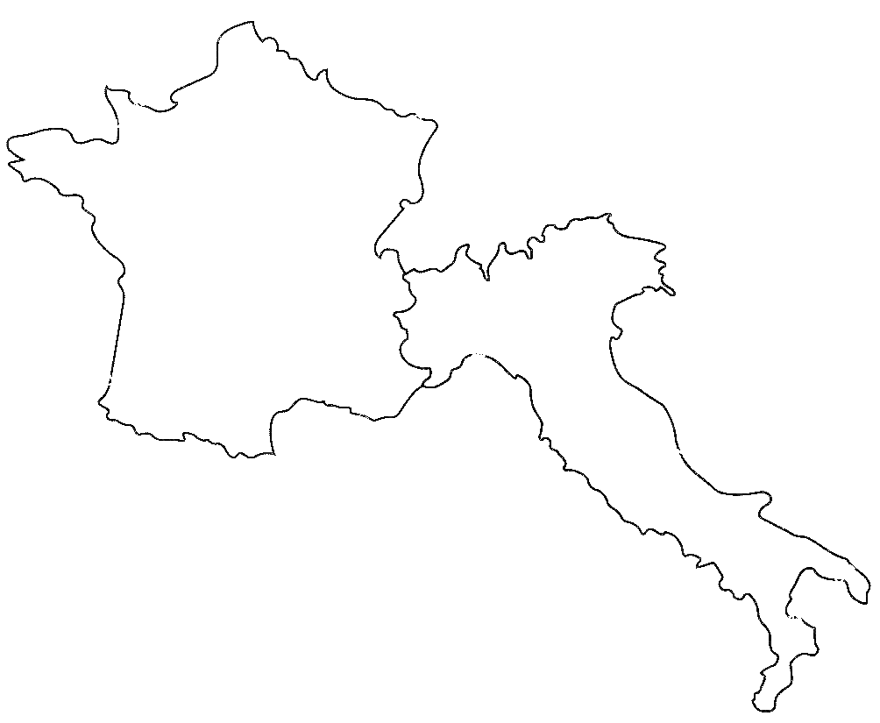


The Virgo Coatings R&D
Collaboration
LYON
  IBS HT, IAD
  GeNS 300K
  FEA
  Optical metrology
  Raman, Brillouin
  Physics of Glasses
  Molecular Dynamics
GENOVA
  Ellipsometry
  Optical properties
  AFM, XPS
  Raman
LYON
URBINO
  GeNS Cryo
  FEA
GENOVA
URBINO
PERUGIA
PERUGIA
  Cantilevers &
  GeNS Cryo
  Physics of Glasses
  Brillouin
VIRGO
ROMA 2
  Laser Polishing
  GeNS 300K 1’’
  FEA
ROMA 2
  Sample production
  Characterization
SALERNO
SANNIO
SALERNO/SANNIO
  IAD
  SEM,TEM,AFM and XRD
  nanolayered composites and Mie-metamaterials

Slide 16
Other groups expressing interest recently
LYON
GENOVA
URBINO
PISA
  Study of the crystallization processes
  Physics of deposition and ultrastable glasses
  Modelling
  Calorimetry and Dielectric response
PISA
VIRGO
PERUGIA
ROMA 2
ROMA 1
ROMA 1
  Structural
  characterization
  Thermobalance
  Physics of
  deposition
SALERNO
SANNIO

Slide 17
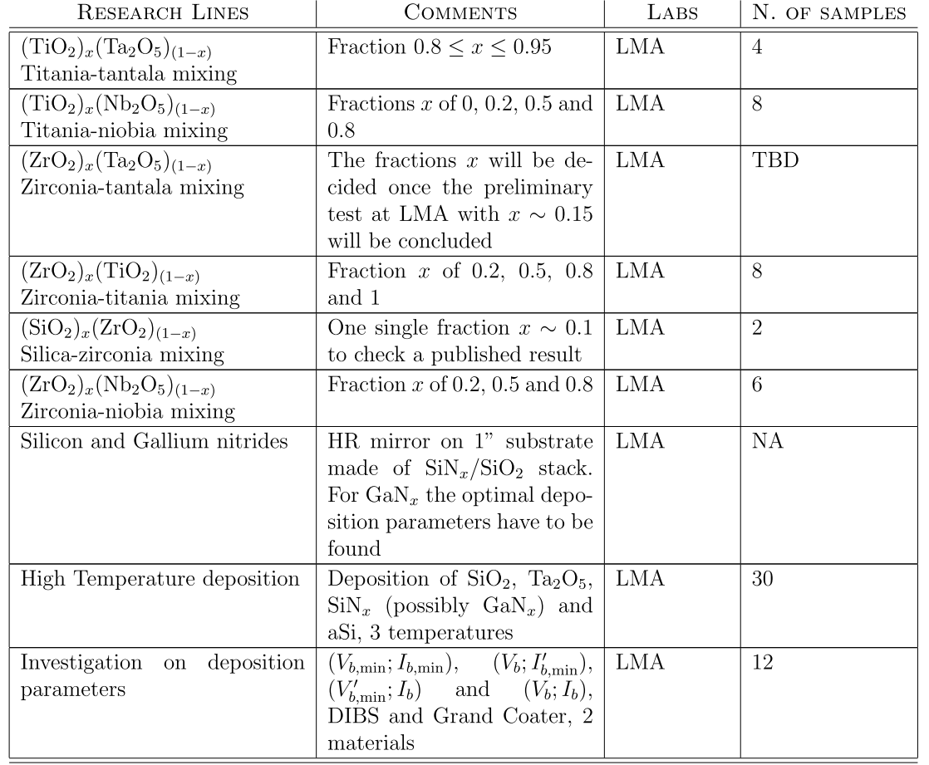
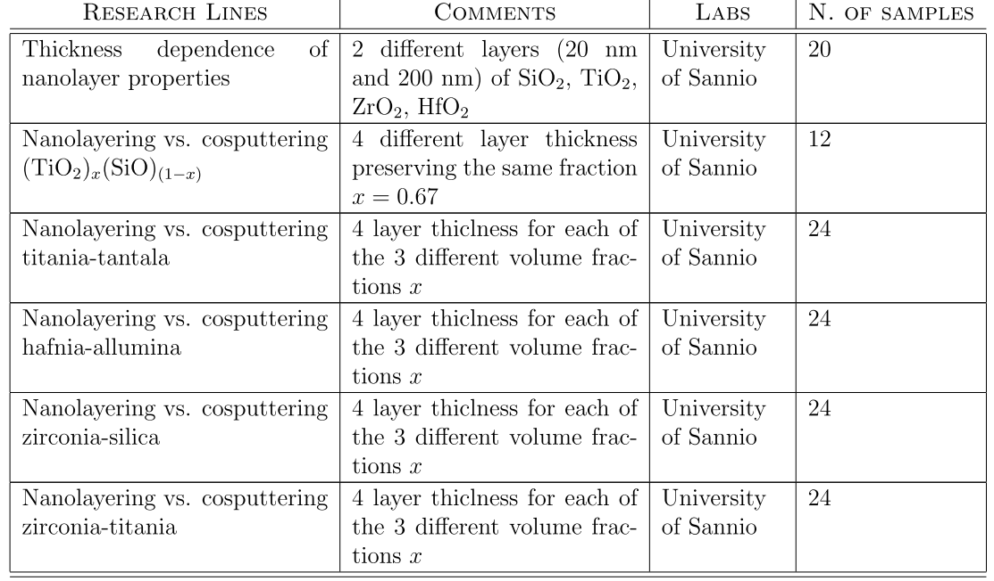


The project content
The sample production plan
LMA $\sim 70 ×3$ samples
Sannio $\sim 140 ×3$ samples

Slide 18
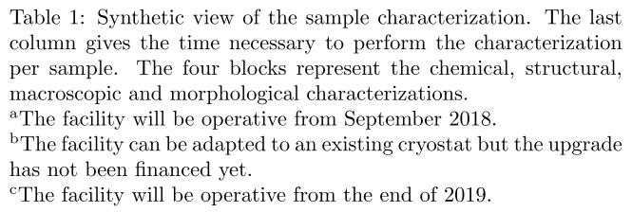
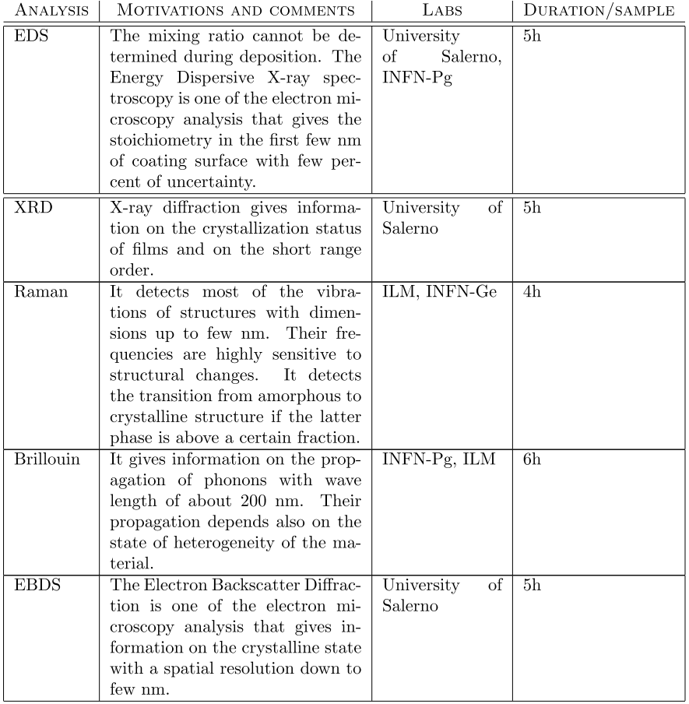
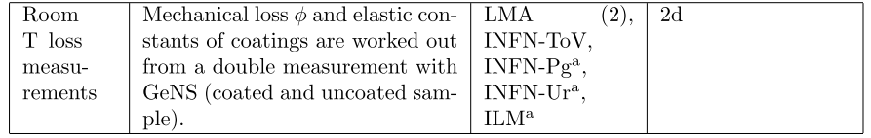
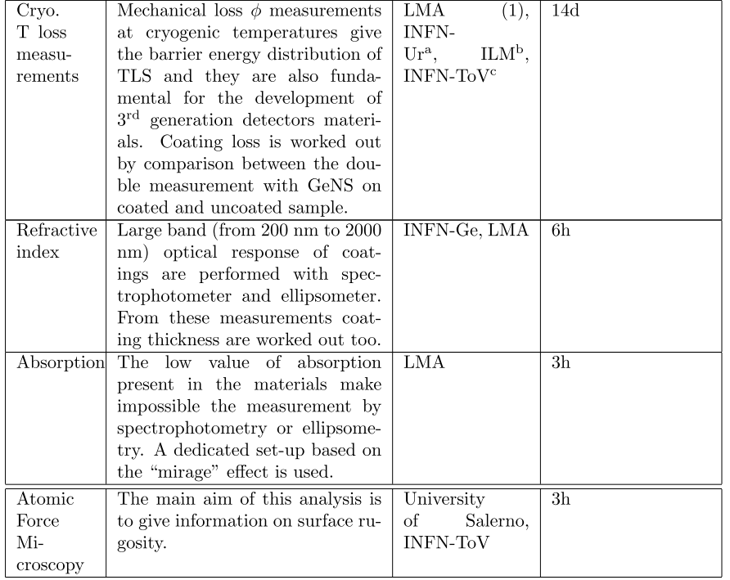
The project content
The characterization plan
The Pisa and Roma1
are not yet included

Slide 19
The WBS of the VCR&D collaboration
WP1 Sample production of co-sputtered coatings (LMA)
WP2 Sample production of nanolayered and co-sputtered coatings
(Sannio)
WP3 Chemical characterization (Perugia, Salerno, Genova, Roma1)
WP4 Structural analysis, Raman and Brillouin (ILM, Perugia, Genova,
Salerno, Pisa, Roma1)
WP5 Optical characterization (Genova, LMA, Roma ToV )
WP6 Room temperature loss measurements (Roma ToV, LMA, ILM,
Urbino, Perugia, Pisa)
WP7 Low temperature loss measurements (Urbino, LMA, ILM, Roma ToV)
WP8 Morphological characterization (Salerno, Perugia, Roma ToV)
WP9 Modelling and calorimetry (Pisa)

Slide 20
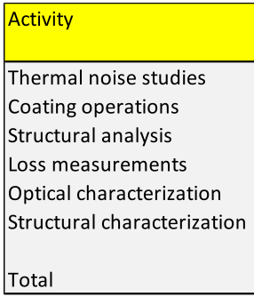
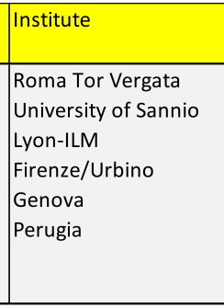
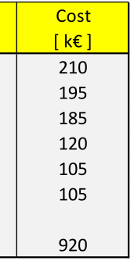
The total budget for coating material research
Materials (VCR&D)
  Keeping the existing competences
    Sannio: 3yr RTD-A
    Tor Vergata: 3yr RTD-A
  Foster new competences
    Fi/Ur: PhD
    Genova: PhD
    Lyon: PhD
    Perugia: 2 yr post doc
  Developing new tools
    Equipment and consumables

Slide 21
The international context
Advanced Virgo +
  ϕ laser spot
    Labs: 8, 3 coaters
    Funding: pending
LIGO Scientific Collaboration
  Centre of Coating
  Research
    Labs: 9, 3 coaters
    Funding: 3M$ (postdocs)
    Projects: aLIGO+
    Voyager
ϕ
ϕ
  Glasgow
    Labs: 2, 2 coaters
    Projects: aLIGO+
    Voyager
    ET
ϕ

Slide 22
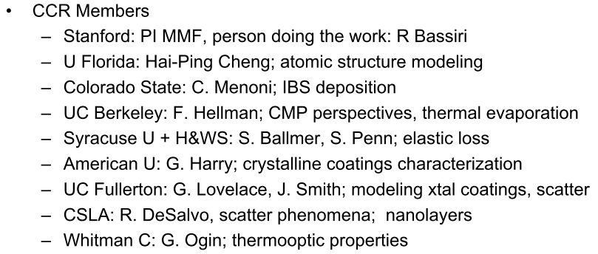
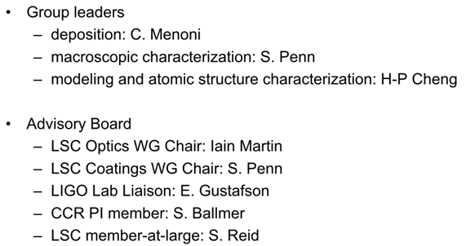
The Centre for Coating Research, 1

Slide 23
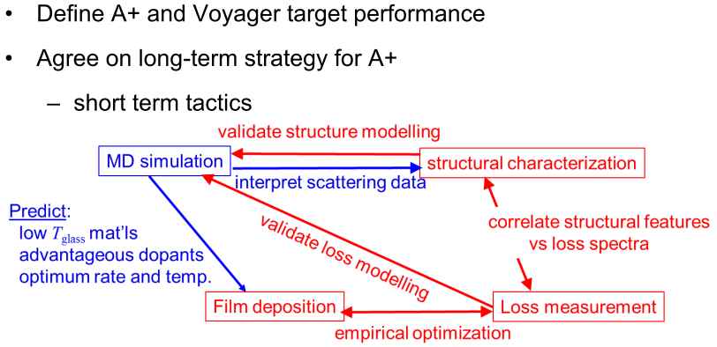
The Centre for Coating Research, 2

Slide 24

The current status of material research
Ti:Ta₂O₅ 500°C
SiN_{x} IBS 800°C
loss angle ϕ
aSi 400°C
UWS
Si₃N₄
LPCVD
AlGaAs
G. Cole
SiO2 500°C
SiO2 900°C
aSi 450°C
ATF
Thank you
for your attention
aSi
dep. 400°C
Berkeley

