Slide 1
IDEA: The vertical slice Test Beam
R. Santoro

Slide 2
IDEA Test Beam
Measurements:
Particle Identification with:
Drift Chamber Prototype (p, π, k) using dE/dx VS cluster counting
Preshower + Dual Readout Calorimeters (e, π, μ)
μRWell (e, μ)
Preshower optimization studies
Tracking qualification
Qualification of a RD52 calorimeter with staggered fibers
Qualification of a small calorimeter module readout with SiPM

Slide 3
Setup schema
Drift chamber
Preshower
Muon Chamber
RD52 Calorimeter
Scintillators
DWC
DWC
50 cm
50 cm
280 cm
140 cm
Trigger with 2 scintillators in coincidence + 1 veto (if needed)
2 DWC (Delayed Wire Chamber)
CEDAR (Differential Cherenkov detector)
Drift Chamber Prototype
Preshower with GEM: 2 layers GEM + absorber (0 – 2 X₀)
Different Dual Readout prototypes
RD52 calorimeter with PMT readout
RD52 calorimeter with staggered fibers
Small calorimeter module with SiPM readout
Muon chamber: 1 layer GEM + 2 layers μRWell
The large scintillator usually used in the RD52 test beam will be also readout

Slide 4
EHN1 – H8 – C (door 168, between ATLAS tile and Totem)
Control room: HNA – 468 (0887-1- Q70)
Gas systems
Space for the muon chamber
RD52 calorimeter (already installed in the area)
Some space for the preshower
Space for the drift chamber
Trigger + Delay Wire Chamber (DWC) already installed

Slide 5
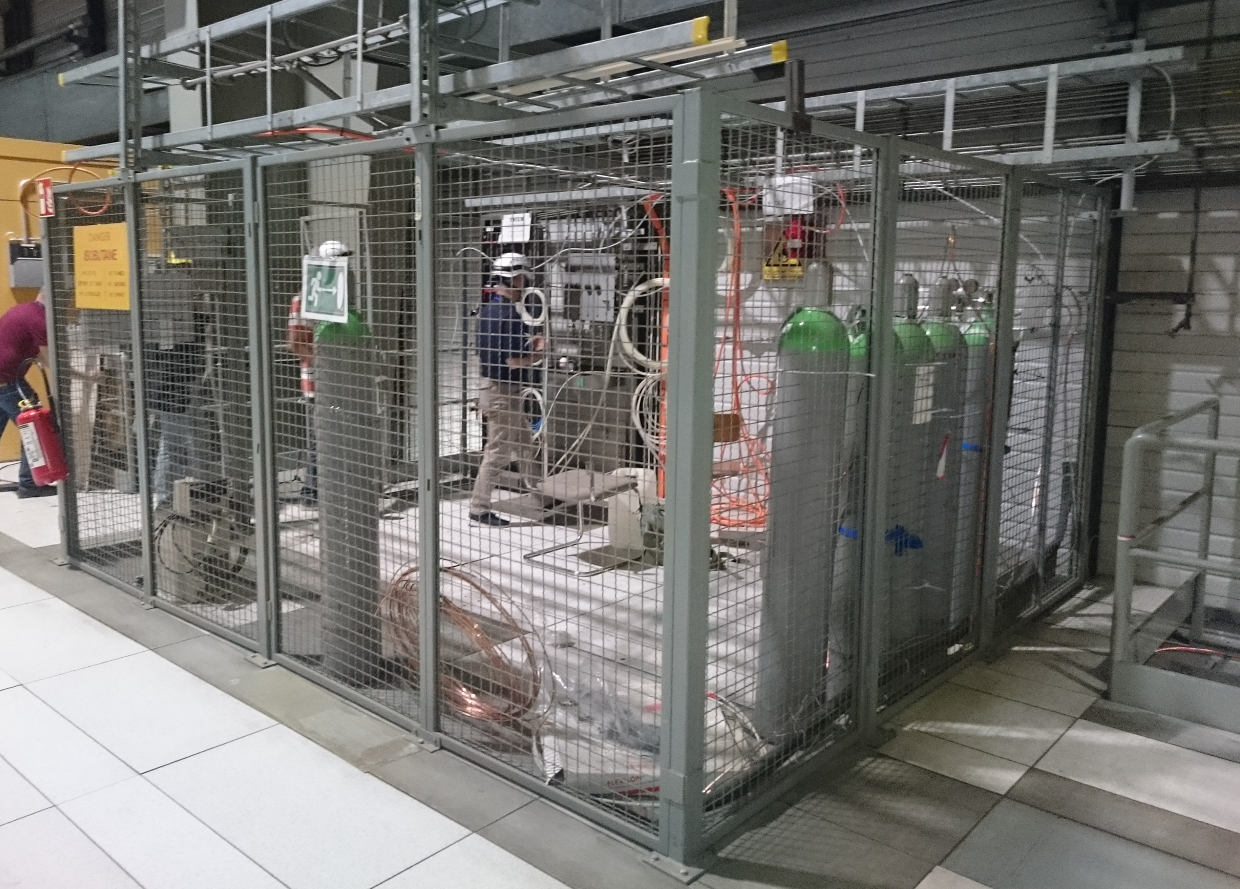
EHN1 – H8 – C (door 168, between ATLAS tile and Totem)
Control room: HNA – 468 (0887-1- Q70)
Place where to install the gas bottles (?? m from the detector)
ArCO₂CF₄: requested by preshower and muon chamber
He/Isobutene (90/10): requested by drift chamber

Slide 6
Trigger and DaQ
Trigger based on scintillators in coincidence. It will be prepared in counting room and it will be delivered to all subsystems (expected delay 200 ns)
All subsystems are able to sustain 1kHz trigger rate with the exception of the drift chamber ($≈$ ??)
Under investigation the possibility to record the number of the accepted trigger in the data header
3 different DaQ systems and Qas running in parallel
Central (trigger, calorimeters, CEDAR and ancillaries detectors used the measure the energy leakage in the RD52 calorimeter)
Preshower and muon chamber
Drift chamber
1 Quasi on-line system (Tom Coates)
Gets the data from each subsystem and displays the summary plots when the run is closed
The data merging will be also tried during the test beam period
Test beam simulation (see talk from Lorenzo Pezzotti)

Slide 7
Some general information
Access to the Area since August the 29th
Free access with beam dumped upstream (beam dump before PPE168)
Safety inspection: September the 5th at 12:00
Alignment service: September the 5th at 14:00
Beam on: September the 5th at 18:00
Beam stop: September the 12th at 8:00
No machine development between us and the next users

Slide 8
A preliminary plan (I)
Detector installation and qualification (from Aug - 29th to Sept. – 2nd)
System integration (from Sept – 3rd to Sept – 5th )
Beam on (Sept - 5th)
Calibration (1.5 days):
RD52 calorimeter: calibration runs (60 GeV electrons)
All modules calibrated with the absorber out
Few modules calibrated with $≈$1 X₀ (or more?) of absorber in
Drift Chamber: HV scan (60 GeV electrons)
Drift Chamber: angle scan (60 GeV electrons)
@ 2 – 3 angles (access to the area is needed to change the angle)
Drift Chamber: Gas mixture test? (60 GeV electrons)
It depends by the gas system (premixed or not), this is still something under discussion

Slide 9
A preliminary plan (II)
Measurements with all systems (2.5 days)
Energy Scan
Drift Chamber request
$π$/k separation at different energies in the 6 – 60 GeV range
10k $π$ and 10k kaons are requested at each energy
CEDAR information available off-line
Calorimeter request
Energy scan with electron beams (6 – 60 GeV)
$μ$ and $π$ contamination is expected
Energy scan with different absorbers (0 – 2 X₀) to study the energy resolution degradation (6 – 60 GeV electron beam?)
Energy scan with $π$ beam?
Test in a multi-particle environment (target): under discussion

Slide 10
A preliminary plan (III)
Tests with new calorimeters (2 days)
Module with staggered fibres
Calibration strategy (still under discussion)
Test with electrons and pions
Module with SiPM
Ph-e / Gev measurement
Cross-talk measurement

Slide 11
Summary
The space available is good enough to install all subsystems
Each subsystem will come at CERN with his own support structure and it will be placed onto the platform / concrete block
The installation will start in Aug-29, 1 week before the beam time. This will allow us to test the system integration.
Quasi on-line and simulation is progressing. I’m always more convinced that they will have a crucial role for a successful test beam
I’ll start collecting the list of participant and the expected period they will spend at CERN for the test beam.

Slide 12
Back up Slides

Slide 13
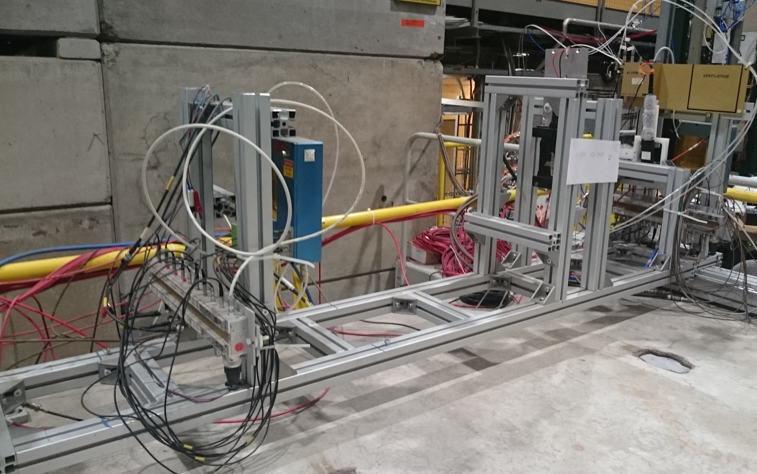
EHN1 – H8 – C (door 168, between ATLAS tile and Totem)
Control room: HNA – 468 (0887-1- Q70)
Trigger
DWC
Beam
46 cm
1 m
The space for the drift chamber

Slide 14
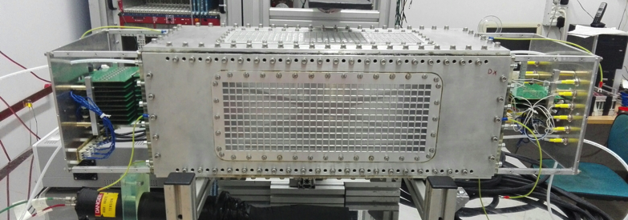
EHN1 – H8 – C (door 168, between ATLAS tile and Totem)
Control room: HNA – 468 (0887-1- Q70)
Beam
46 cm
1 m
Drift chamber prototype

Slide 15
EHN1 – H8 – C (door 168, between ATLAS tile and Totem)
Control room: HNA – 468 (0887-1- Q70)
1 RAC for the Drift chamber. Space available close to the detector is 50cm. It should be enough
1 Crate Camac
1 Crate VME
The HV module will be installed in the RAC used by the preshower + muon chamber
Drift chamber prototype

Slide 16
EHN1 – H8 – C (door 168, between ATLAS tile and Totem)
Control room: HNA – 468 (0887-1- Q70)
Beam
1.26 m
50 cm
Preshower:
downstream the Drift chamber and just in front to the calorimeter

Slide 17
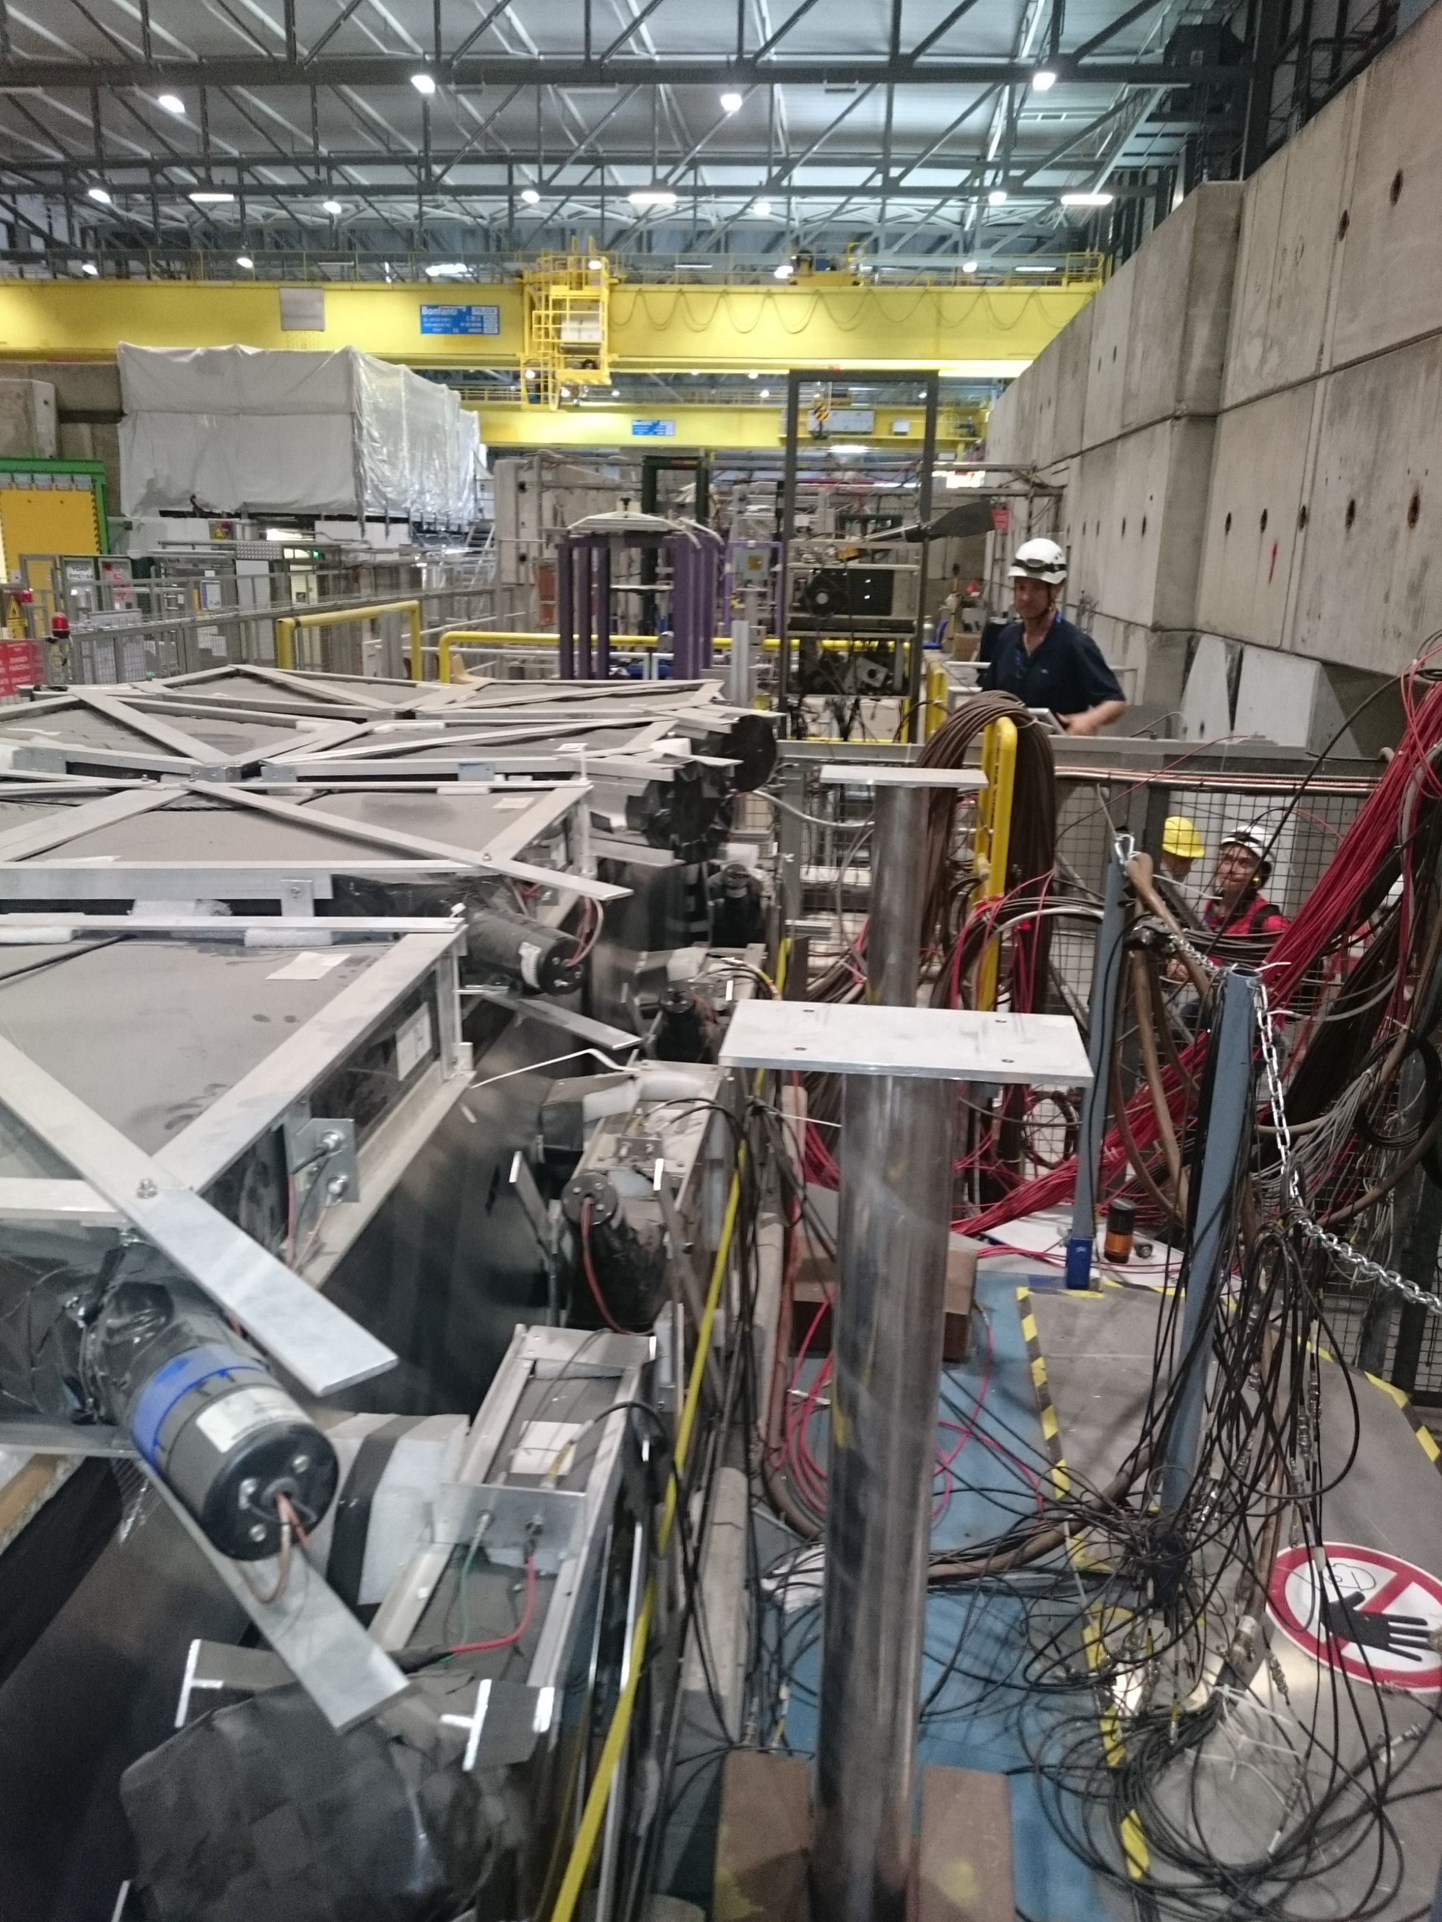
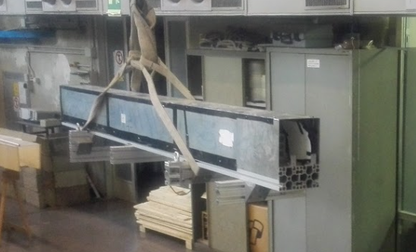
EHN1 – H8 – C (door 168, between ATLAS tile and Totem)
Control room: HNA – 468 (0887-1- Q70)
RD52 Calorimeter:
already installed
Possible places where to install the calorimetric module with staggered fibres

Slide 18
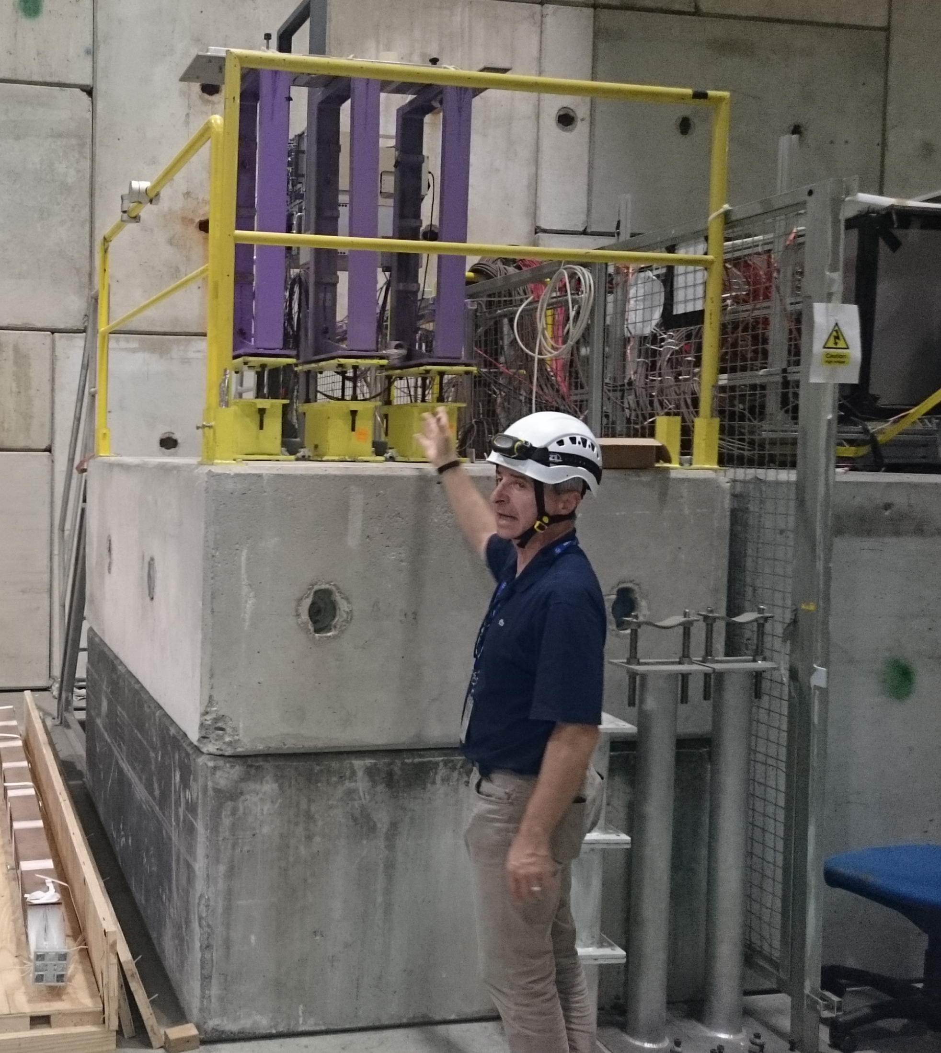
EHN1 – H8 – C (door 168, between ATLAS tile and Totem)
Control room: HNA – 468 (0887-1- Q70)
Space for the muon chamber downstream the calorimeter
Beam
1.26 m
2 m
1 RAC to install the electronics for the preshower and mu-chamber + HV power supply

