Slide 1
INFN-CERN X-band collaboration July 25 - 2018 INFN-LNF A. Gallo, status of the LNF X-band test stand
Status of the LNF X-band test stand
Alessandro Gallo
with
D. Alesini, P. Baldini, M. Bellaveglia, B. Buonomo, S. Cantarella, R. Clementi, F. Cardelli, C. Di Giulio, M. Diomede, G. Di Raddo, A. Esposito, L. Foggetta, O. Frasciello, A. Ghigo, S. Incremona, L. Piersanti, S. Quaglia, R. Ricci, U. Rotundo, M. Scampati
INFN-CERN X-band collaboration Meeting
April 18 - 2018 INFN-LNF

Slide 2
INFN-CERN X-band collaboration July 25 - 2018 INFN-LNF A. Gallo, status of the LNF X-band test stand
The INFN Frascati X-box
X- band technology allows achieving higher accelerating gradients with respect to other industrially available technologies (L, S, C bands).
However, the maturation of the X-band as a reliable baseline for high gradient accelerators required a huge technical effort to establish the proper machining, cleaning and vacuum procedures, and to design and develop all the required RF components. It is in general more critical respect to the well established lower frequency bands.
The INFN Frascati Labs have a long lasting experience on S-band acceleration, and a recent experience also on C-band (SPARC_LAB and ELI projects). Therefore in view of the EuSPARC project, the Frascati RF team need to gain experience and expertise in handling and operating X-band structures and power plants.
The duplication of one of the CERN X-boxes (X-box #2 is our reference) at the INFN Frascati Labs is a perfect opportunity to establish and consolidate this kind of expertise, and will provide a strategic infrastructure to the Labs for the development and optimization of the EuSPARC accelerating sections.
Finally, this activity allows activating a strong synergy and collaboration with the CERN.
2

Slide 3
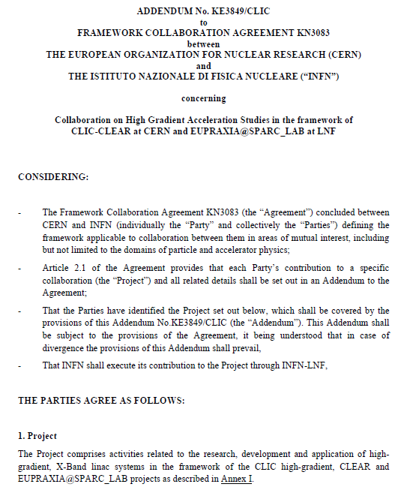
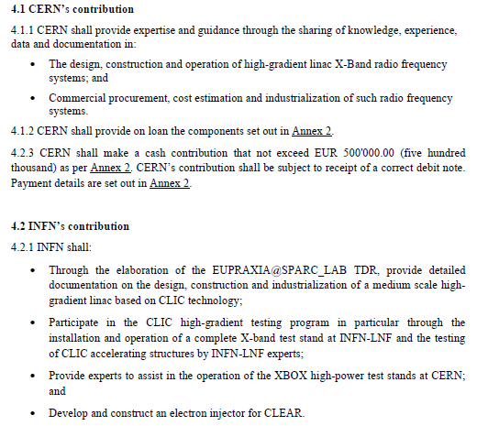
INFN-CERN X-band collaboration July 25 - 2018 INFN-LNF A. Gallo, status of the LNF X-band test stand
INFN – CERN official partnership on X-band RF development
officially approved by INFN Board of Directors on Dec. 22, 2017
3

Slide 4
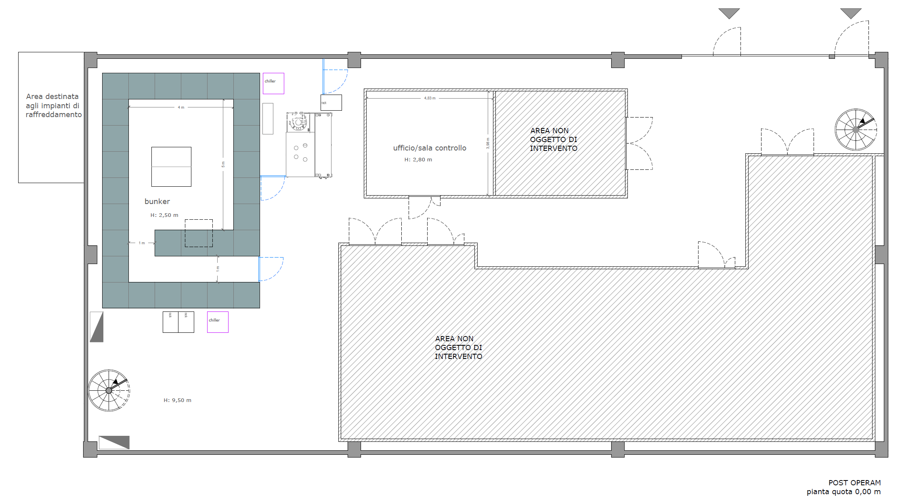
INFN-CERN X-band collaboration July 25 - 2018 INFN-LNF A. Gallo, status of the LNF X-band test stand
The INFN Frascati X-box
SPARC_LAB
Building #7
4.0 m
it will be located in LNF building #7, very close to the SPARC_LAB area, formerly used for testing and conditioning of the DAFNE RF power plants and cavities
5 m
4

Slide 5
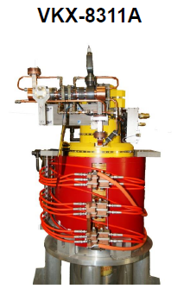
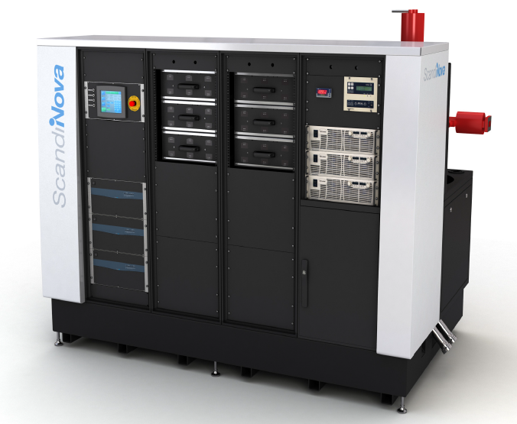
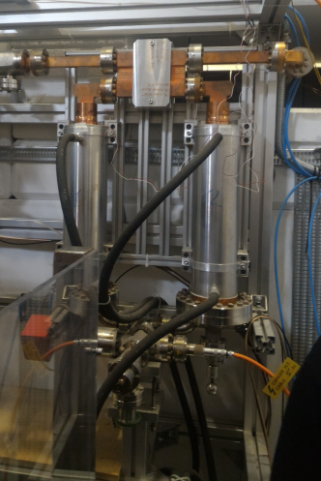
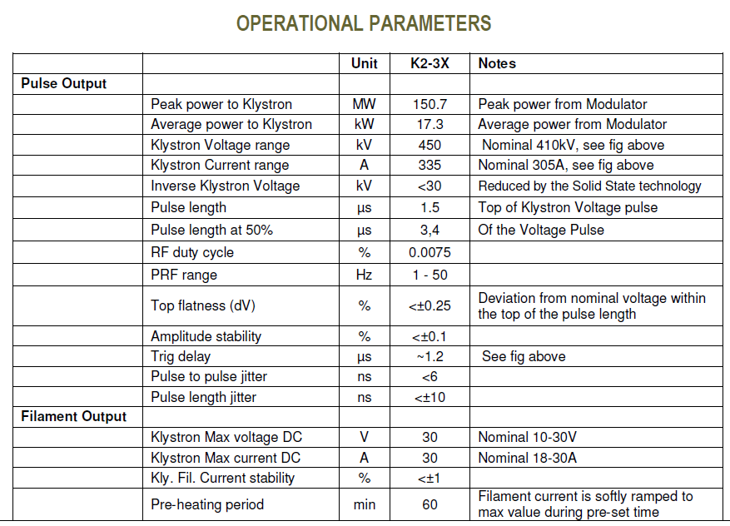
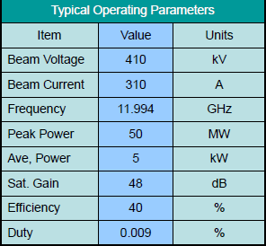
INFN-CERN X-band collaboration July 25 - 2018 INFN-LNF A. Gallo, status of the LNF X-band test stand
The INFN Frascati X-box
Pulse compressor:
provided by CERN
Pulsed Modulator: to be procured by INFN
Other components:
Low level RF and controls;
RF driver amplifier;
Rectangular waveguides;
Ceramic windows;
Vacuum pumps and power supplies;
…
All components will be either provided by CERN or procured by INFN in full conformity with the original CERN X-box parts.
X-band klystron: provided by CERN
5

Slide 6
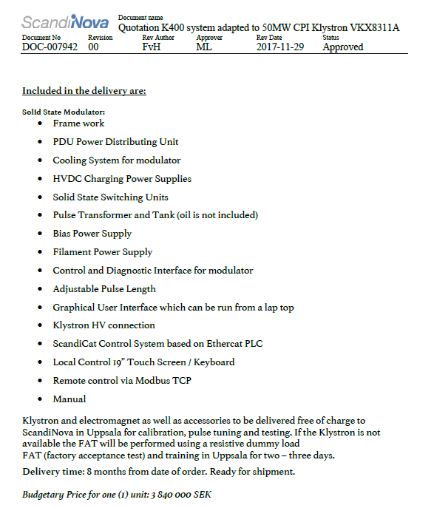
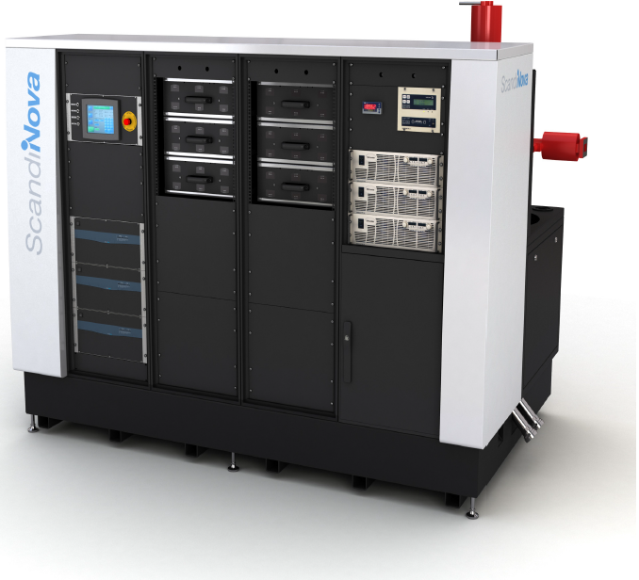
INFN-CERN X-band collaboration July 25 - 2018 INFN-LNF A. Gallo, status of the LNF X-band test stand
SEK 3.840.000 +
SEK 360.000 +
SEK 348.000 +
SEK 124.000 =
SEK 4.672.000
Accessories
100 Hz
Installation + Tests
EUR 450.000
6

Slide 7
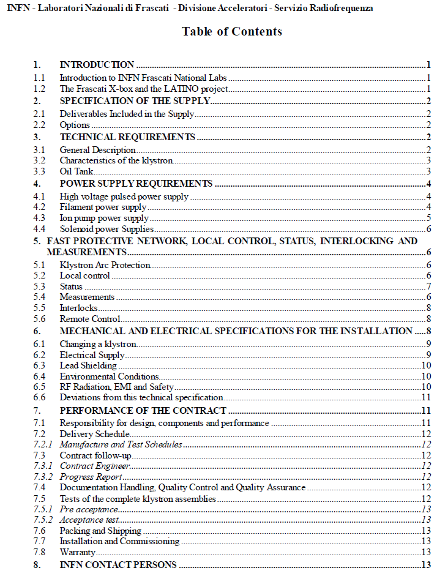
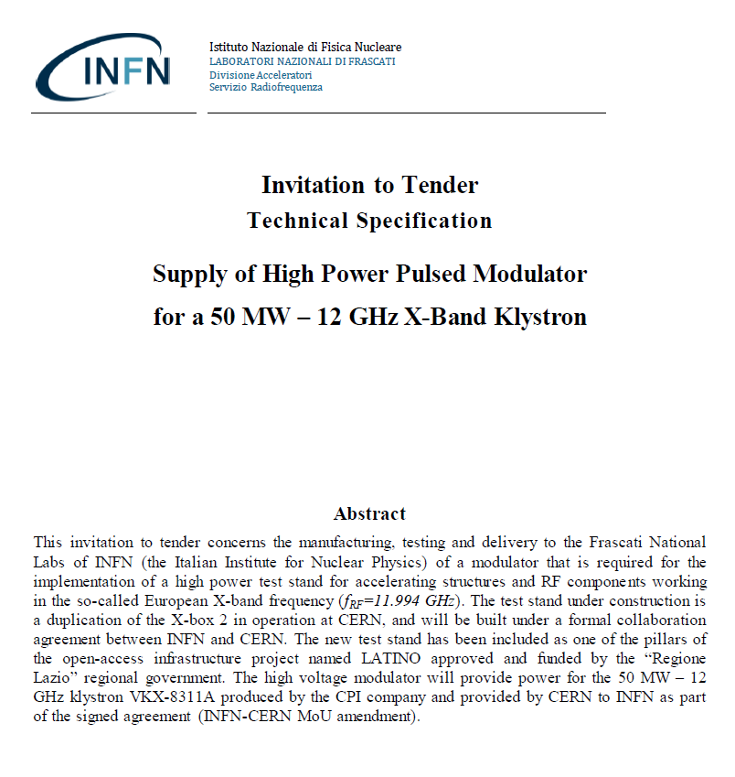
INFN-CERN X-band collaboration July 25 - 2018 INFN-LNF A. Gallo, status of the LNF X-band test stand
Modulator draft technical specifications sent to Scandinova
7

Slide 8
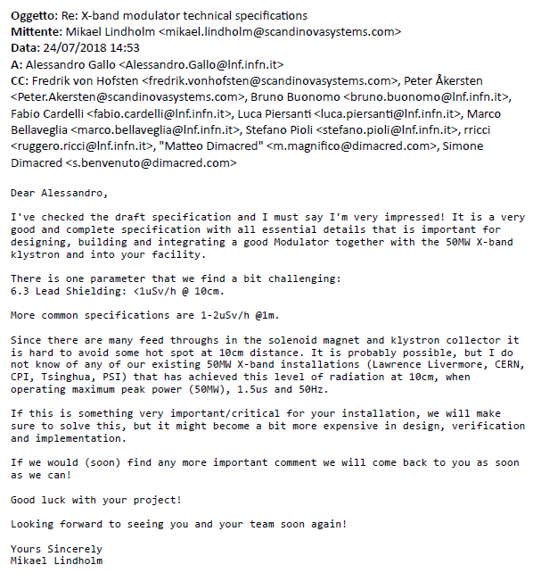
INFN-CERN X-band collaboration July 25 - 2018 INFN-LNF A. Gallo, status of the LNF X-band test stand
Scandinova
reaction
8

Slide 9
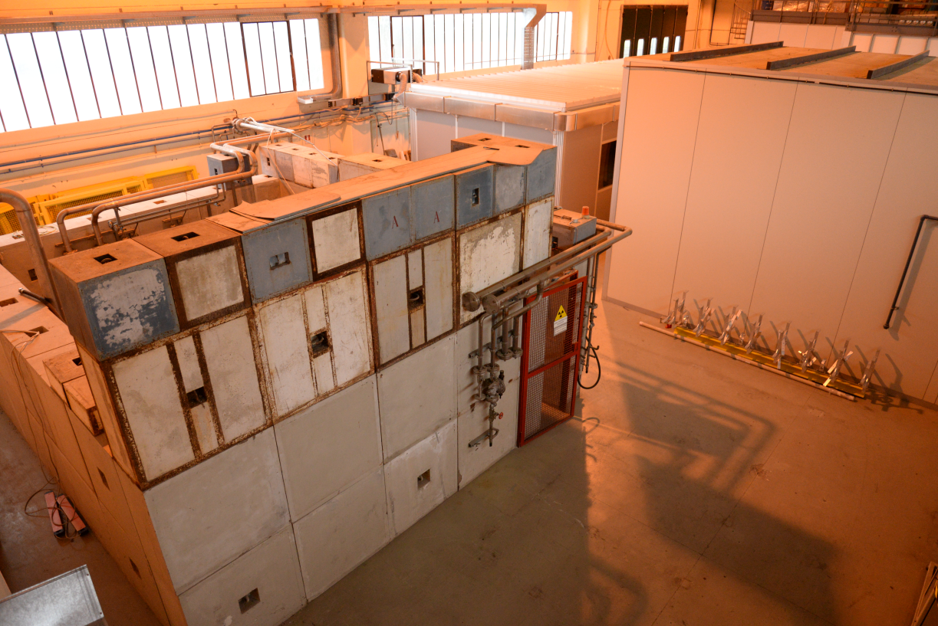
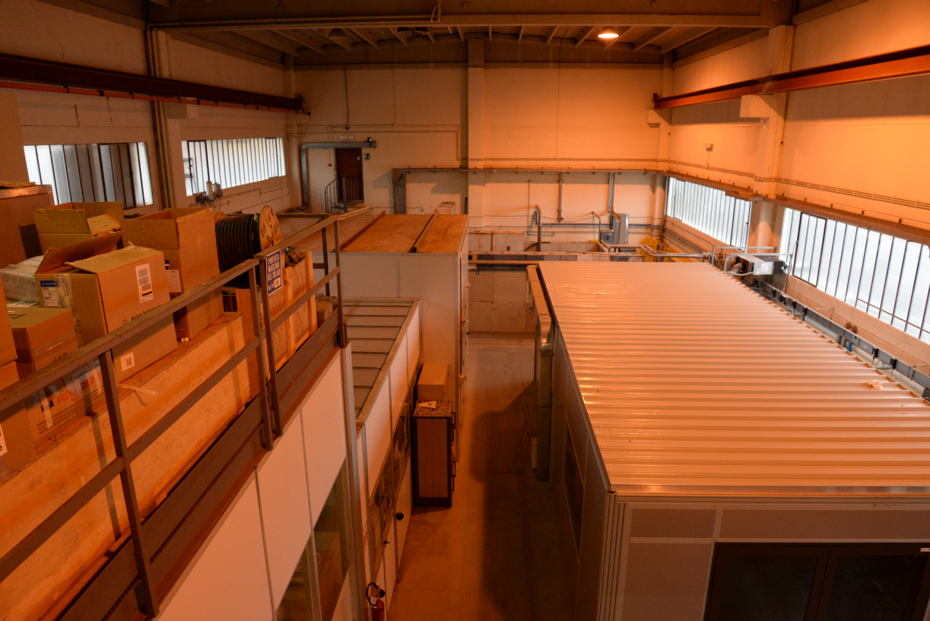
INFN-CERN X-band collaboration July 25 - 2018 INFN-LNF A. Gallo, status of the LNF X-band test stand
LNF building #7:
the old bunker
LNF building #7:
inside view
9

Slide 10
Dose rate as a function of dark current
INFN-CERN X-band collaboration July 25 - 2018 INFN-LNF A. Gallo, status of the LNF X-band test stand
CERN X-box data: courtesy of Nuria Catalan Lasheras
10

Slide 11
Time dependency (decrease with constant gradient…)
INFN-CERN X-band collaboration July 25 - 2018 INFN-LNF A. Gallo, status of the LNF X-band test stand
CERN X-box data: courtesy of Nuria Catalan Lasheras
11

Slide 12
FLUKA simulation
INFN-CERN X-band collaboration July 25 - 2018 INFN-LNF A. Gallo, status of the LNF X-band test stand
CERN X-box data: courtesy of Nuria Catalan Lasheras
Method: Simulation of the setup in CTF2 to and scaling of the number of e⁻ impinging on the cavity wall to measured dose rate
Simulation of the bunker with experimental electron emission rate (mono-energetic e⁻)
FLUKA geometry (plotted with SimpleGeo)
Cavity
Lead screens
12

Slide 13
Example dose rate in and around the bunker
INFN-CERN X-band collaboration July 25 - 2018 INFN-LNF A. Gallo, status of the LNF X-band test stand
CERN X-box data: courtesy of Nuria Catalan Lasheras
13

Slide 14
INFN-CERN X-band collaboration July 25 - 2018 INFN-LNF A. Gallo, status of the LNF X-band test stand
INFN – CERN contacts for radioprotection issues
14

Slide 15
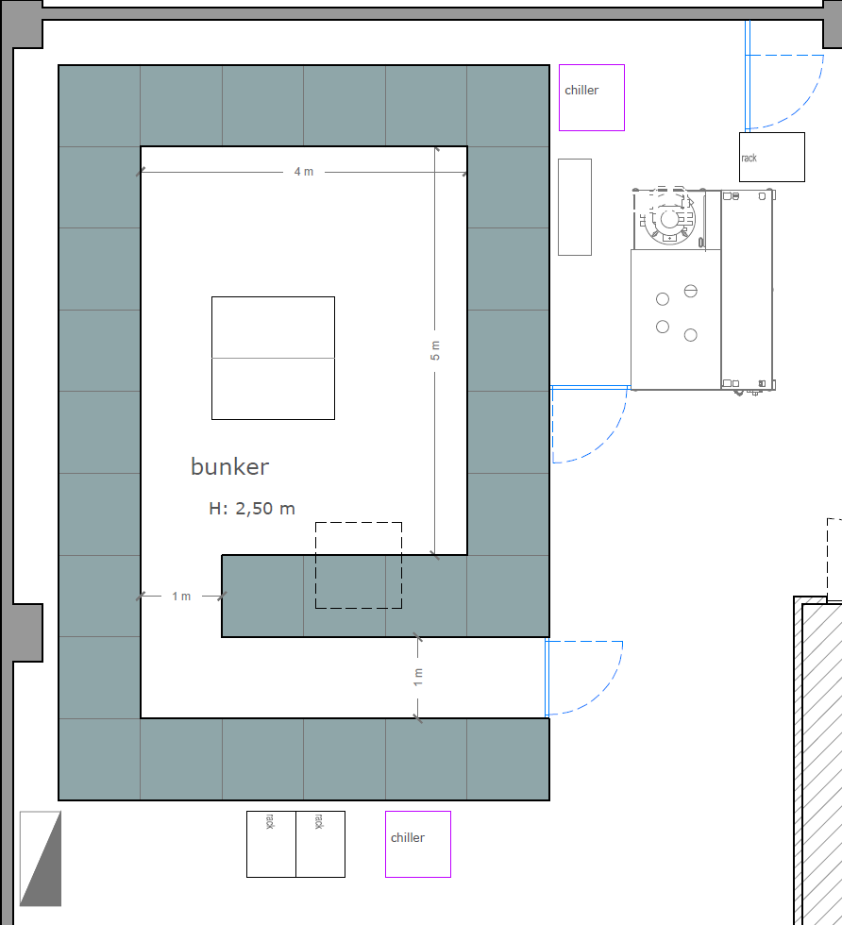
INFN-CERN X-band collaboration July 25 - 2018 INFN-LNF A. Gallo, status of the LNF X-band test stand
On the base of data provided by CERN it has been decided to base the bunker design on concrete walls of 1 m width.
The ceiling will be made by means of T-shaped concrete beams of 50 cm width.
On the base of measured doses the total ceiling concrete shield can be upgraded to 1 m width by stacking additional blocks of 50 cm width.
According to CERN experience a local lead shield around the accelerating section under test is also mandatory, placed on the TW forward direction side.
Courtesy of S. Incremona
15

Slide 16
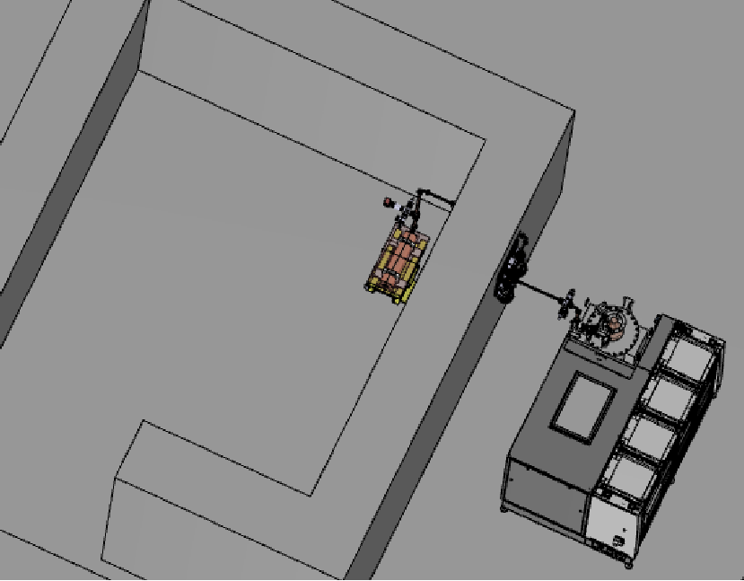
INFN-CERN X-band collaboration July 25 - 2018 INFN-LNF A. Gallo, status of the LNF X-band test stand
3-D model of the bunker including the RF power station, the RF power transport, the pulse compressor and the section under test on its girder
Courtesy of G. Di Raddo
16

Slide 17
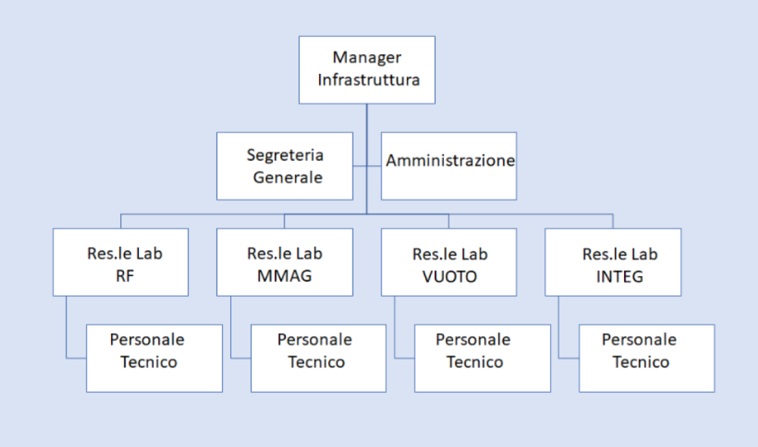
INFN-CERN X-band collaboration July 25 - 2018 INFN-LNF A. Gallo, status of the LNF X-band test stand
A Laboratory in Advanced Technologies for INnOvation
The LATINO project
submitted to Regione Lazio
From LATINO Businnes Plan Executive Summary
«LATINO è un'infrastruttura di ricerca aperta che mette a disposizione delle imprese tecnologie avanzate e sviluppate nell'ambito degli acceleratori per ricerca ed applicazioni mediche ed industriali, in 4 settori ad alto valore aggiunto: sistemi radiofrequenza di alta/bassa potenza, caratterizzazione di elementi magnetici, ultra-vuoto e trattamenti termici, progettazione meccanica. Tali tecnologie intercettano trasversalmente la KET di riferimento AMS e risultano rilevanti per diverse S3: aerospazio/aeronautica, biomedicale, beni culturali, ambiente, sicurezza.
Il tessuto industriale regionale e nazionale del settore presenta una serie di PMI ad alto contenuto tecnologico, alle quali l'R&D sviluppato nei Laboratori di LATINO potrebbe consentire lo sviluppo di nuovi prodotti per l'accesso a nuovi mercati. L'infrastruttura è un polo di riferimento anche per OdR che operano nel settore dello sviluppo delle tecnologie avanzate per gli acceleratori. Le numerose espressioni di interesse allegate sono testimonianza dell'unicità di livello europeo della struttura. «
17

Slide 18
INFN-CERN X-band collaboration July 25 - 2018 INFN-LNF A. Gallo, status of the LNF X-band test stand
Workplan for the Frascati X-box realization
1) | Choice of the area | First clean-up, relocation of the stored material to recover the needed surface | DONE
2) | MoU INFN-CERN | Agreement to share material and expertise on injector design and X-band RF technology | DONE
3) | Modulator procurement | Acquisition from industry of a pulsed power supply to feed a 50 MW, 1.5 µs, 50 Hz X-band klystron | Procedure has started, ≈ 12 months required
4) | Old bunker dismounting, new bunker design and construction | Concrete blocks of the existing bunker can be reused together with new ones that need to be ordered, especially those needed for coverage LNF Radioprotection service has to validate the bunker design! | Started ≈ 9 months required
5) | Services | Electric and cooling services are already available in building #7. Distribution need to be adapted to the requirements of the new facility | ≈ 6 months required
6) | Waveguide network design and construction | 3D CAD model of the facility is needed to precisely define the waveguide path. | CAD: 3 months required Fabrication: 6 months
7) | LLRF | Hardware and software to precisely shape and control the RF drive signal for pulse compression, and to run the facility need to be acquired and installed | 12 months required
… | … | … | …
18

Slide 19
INFN-CERN X-band collaboration July 25 - 2018 INFN-LNF A. Gallo, status of the LNF X-band test stand
CONCLUSIONS
EuSPARC project will consolidate and expand the scientific program presently ongoing at SPARC_LAB, and will be one of the candidate to host the plasma acceleration based European infrastructure EUPRAXIA.
To preserve the facility compactness, X-band RF technology has been chosen for the EuSPARC linac in view of the injection into the FEL undulators of a >1GeV beam accelerated only by RF.
The X-band RF expertise of the CLIC RF team is a resource for the EuSPARC project. A collaboration agreement has been set for technical and scientific information exchange.
The realization of a new test stand is one of the most relevant item of the agreement. The Frascati X-box construction has started, and will be completed in about 18 months.
19

