Slide 1
Artificial
Intelligence in
Medicine
INFN - CSN5 proposal
2019-2021
RN: A. Retico (INFN-PI)

Slide 2
AIM in short
geno
mics
a network of expertise in applied data analysis
focus on medical data & radiomics
INFN-wide collaboration
PI / GE / CA / BO / BA / (CT/ FI / RM / NA )
Seeks to grow and develop existing and new curriculum in applied data science
Developments are CNTT-oriented
(e.g. DORIAN [A. Chincarini], R4I 2018)
neuro oncology
breast RX
neuro
dege
nera
tion
radiomics

Slide 3
background
gather and builds on a tradition of applied physics @ INFN
1998-2001 CALMA
2002-2004 GP-CALMA
2005-2011 MAGIC V
2011-2012 SEVEN
2012-2013 M5L
2012-2014 MIND
2013-2014 TESLA
2015-2017 nextMR

Slide 4
Synergy with external funds
from nextMR final report to CSN5, April 2018

Slide 5
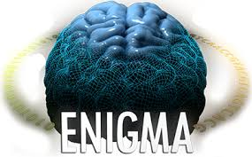
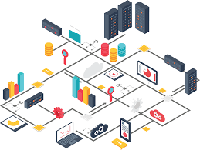
sharing the expertise
AIM role is grounded into expertise sharing:
workshops: 2/year (one internal, one open)
slots into INFN software schools
shared PhD training
generation of consortia for regional / EU / health-related applications
geared towards an INFN-Medicine infrastructure
following a CNTT proposal

Slide 6
AIM flowchart
Regional / EU calls
INFN experiments
/ IRCCS / CNTT
machine learning
clustering
association
segmentation
normalization
networks
advanced statistics
classification
regression
radiomics
quantification
local developments on a specific problem / data / technology
workshops / shared training /
knowledge exchange
ad-hoc consortia
new applications / services

Slide 7
partners & dataset
Clinical partners
IRCCS S. Martino (GE)
IRCCS Stella Maris (PI)
IRCCS Gaslini (GE)
IRCCS Centro S. G. di Dio (BS)
IRCCS G.Paolo II (BA)
IRCCS SDN (NA)
AOUP (PI)
Policlinico (BA)
Osp. Pediatrico Meyer (FI)
Dip. SBSC Radioterapia (FI)
EU / consortia
IMAGO7 (Fondazione di Ricerca)
EADC (EU)
ADNI (US)
ABIDE (EU/US)
ENIGMA (WW)

Slide 8
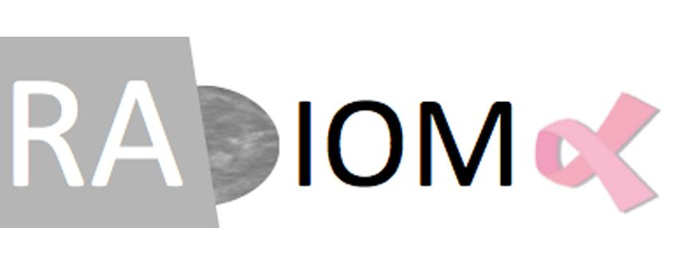
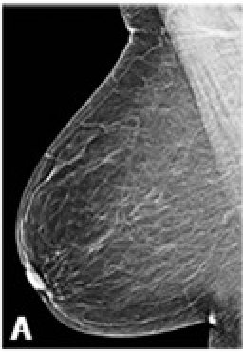
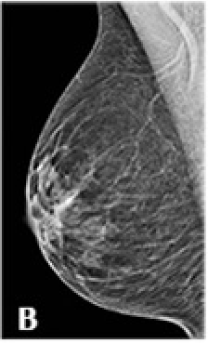
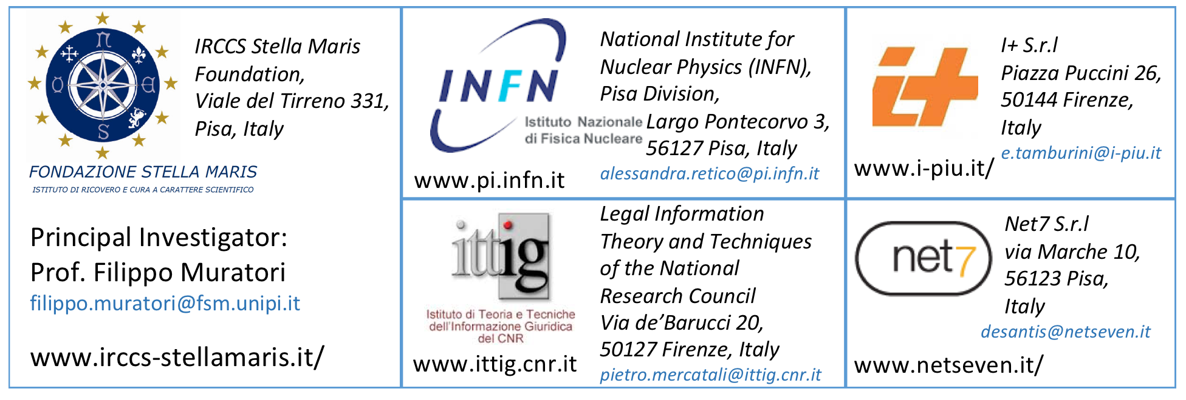
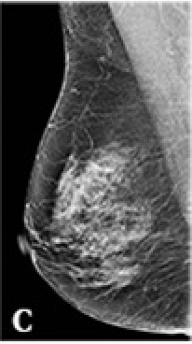
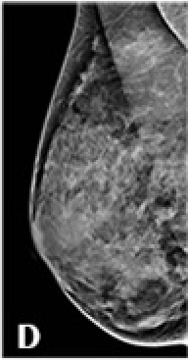
Synergy with ARIANNA and RADIOMA
Ambiente di Ricerca Interdisciplinare per l'Analisi di Neuroimmagini Nell’Autismo
2016-2018
Total budget: 880 kE
2017-2020
Total budget: 500 kE
Partners: Fondazione Pisa, Pisa University, AOUP, INFN
INFN role in RADIOMA:
Activity: Development of image processing algorithms to evaluate mammograms of breasts of different composition and thickness, acquired in different irradiation conditions.
Goal: Contribute to develop a new personalized dose index, significant for each patient and each mammographic exam.
INFN role in ARIANNA:
Development of an IT platform for multicenter data analysis
Set up of an on-demand analysis service of neuroimaging data
Development of new predictive models
http://arianna.pi.infn.it

Slide 9
AIM 1: multi-site data standardization
AIM1 is focused of data harmonization problems, and includes the development, optimization and implementation of algorithms (including ML- and DL-based ones) devoted to the management of the systematic errors introduced by different acquisition machine (e.g. MR scanner, RX tubes, etc.) in multicenter studies. Case studies include a large data samples of multicenter structural and functional MRI data, and and a multicenter data sample of breast mammographic screening images.
data gathered by different sites and/or acquisition systems carries local “fingerprint”, often to the detriment of the much more subtle information of interest.
this problem is akin to the management of systematic errors
typical application cases: MRI, RX, PET, NPSY tests
Autism Brain Imaging Data Exchange

Slide 10
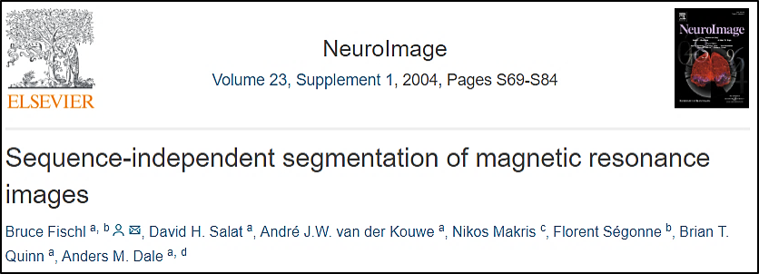
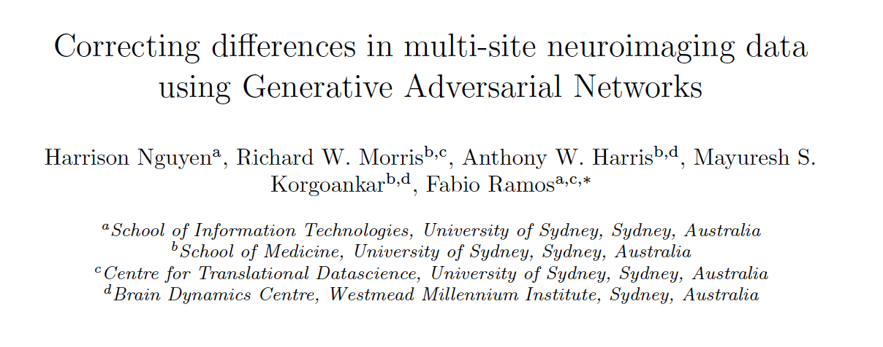
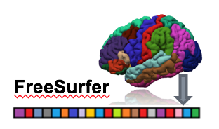
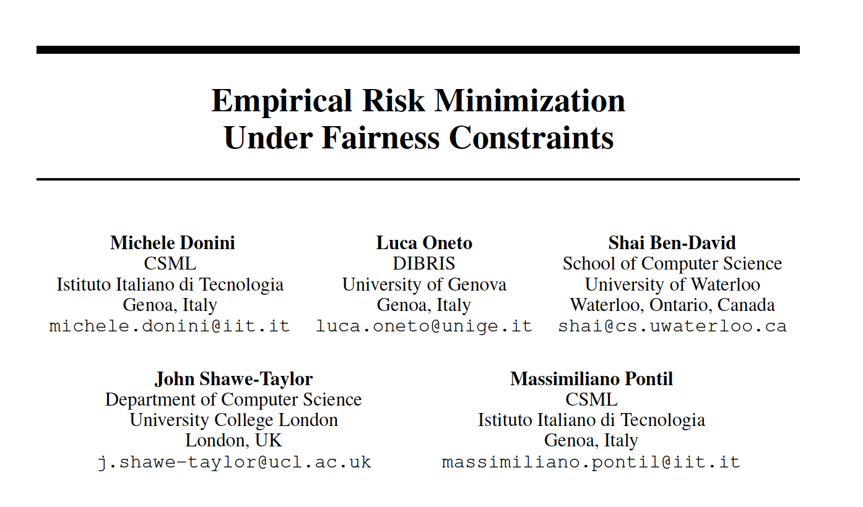
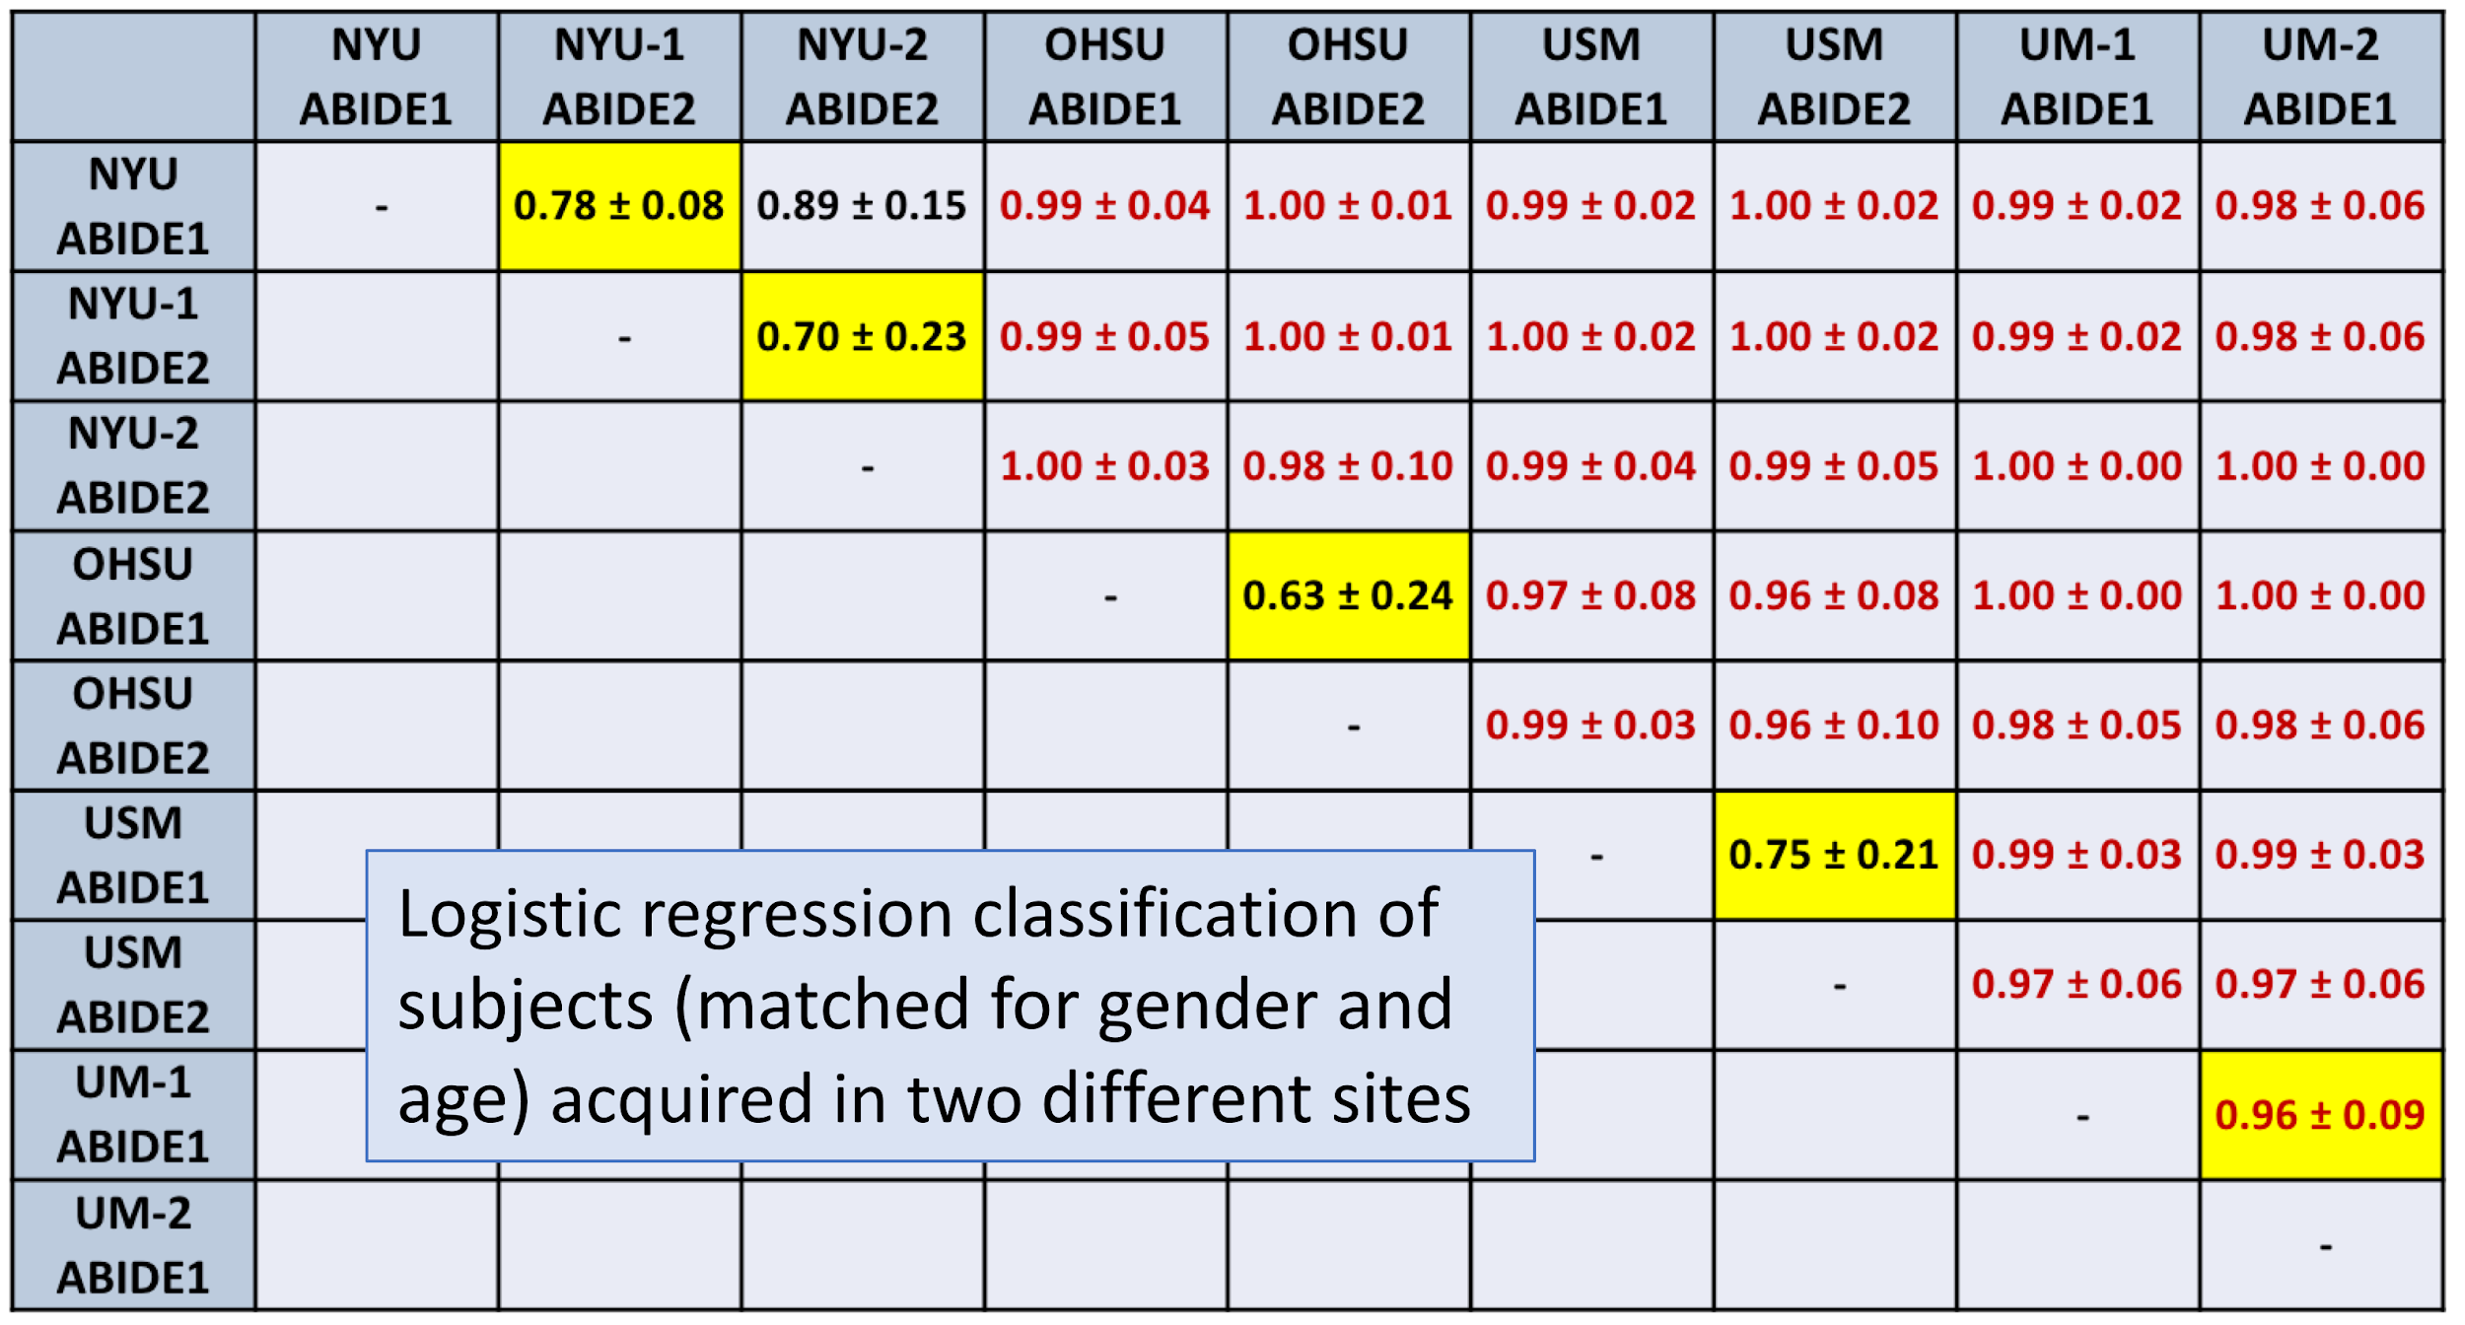
Specific task in AIM 1 (PI-GE-CA): MRI multisite analysis
Proposed approaches in AIM
arXiv:1803.09375v2
2226 subjects
1060 ASDs |  | 1166 TDCs
907 M | 153 F | 879 M | 287 F
Age at Scan 5 – 64 years
40 different acquisition sites
arXiv:1802.08626v2
Master Thesis of Elisa Ferrari, Univ. of Pisa, 2017
Notes:
http://fcon_1000.projects.nitrc.org/indi/abide

Slide 11
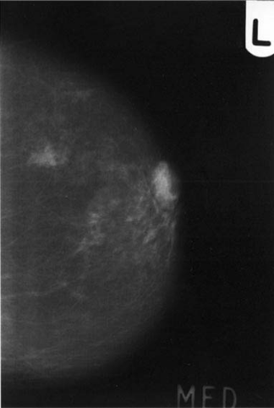
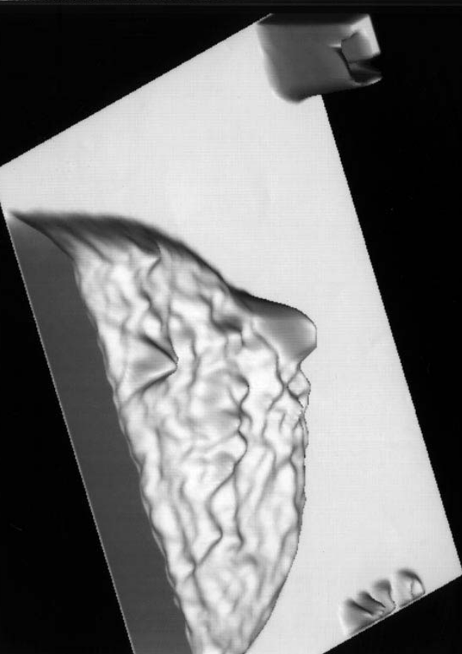
Specific task in AIM 1 (PI-CA): standardized mammography
Essential step is to uniform multi-centre databases
Analytic approach
Modeling the image formation process in mammography
Extraction of physical information about breast density
Image independent from the imaging system
Machine learning approach
training a deep learning network to reconstruct the standardized image from the original one and the acquisition parameters.
kVp
Anode/filter
Detector
Mammogram
Height of glandular tissue
Notes:
Once site dependence is removed, standardized images can be used in machine-learning classification systems
This means that also images obtained with systems for which only a number of cases is available, too small to train a classification system, may be analyzed by a classifier trained on standardized images from other sites

Slide 12
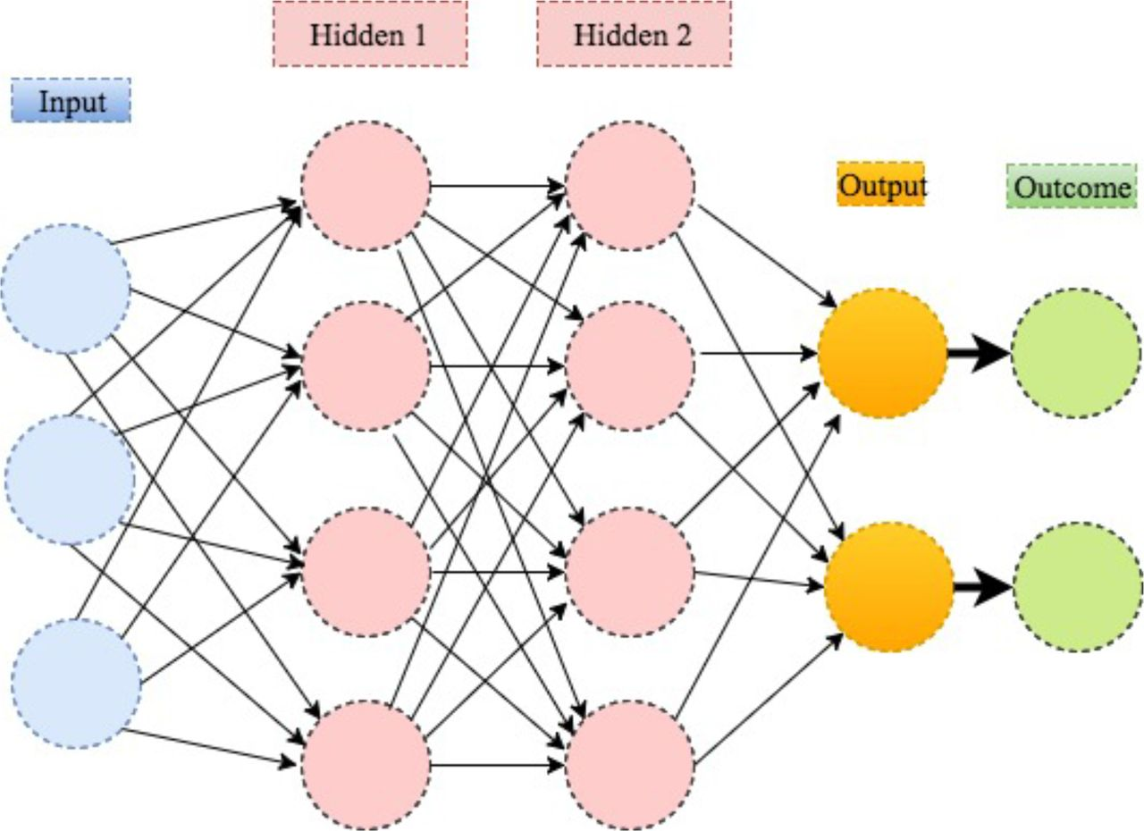
Specific task in AIM 1 (PI-CA): standardized mammography
At this moment are available from RADIOMA data sample:
~ 8000 clinical mammograms Gold Standard (4 BIRADS density classes) by an expert AOUP radiologist
RX acquired by 4 different RX devices.
To be extended to 10000 screening mammograms supplemented by genetic and epidemiological informations.
Machine Learning/Deep learning methods can also allow:
to search in the mammograms new markers related to breast density
to take into account other prognostic factors to calculate the individual risk of having a cancer in a short term.
→ see AIM 2

Slide 13
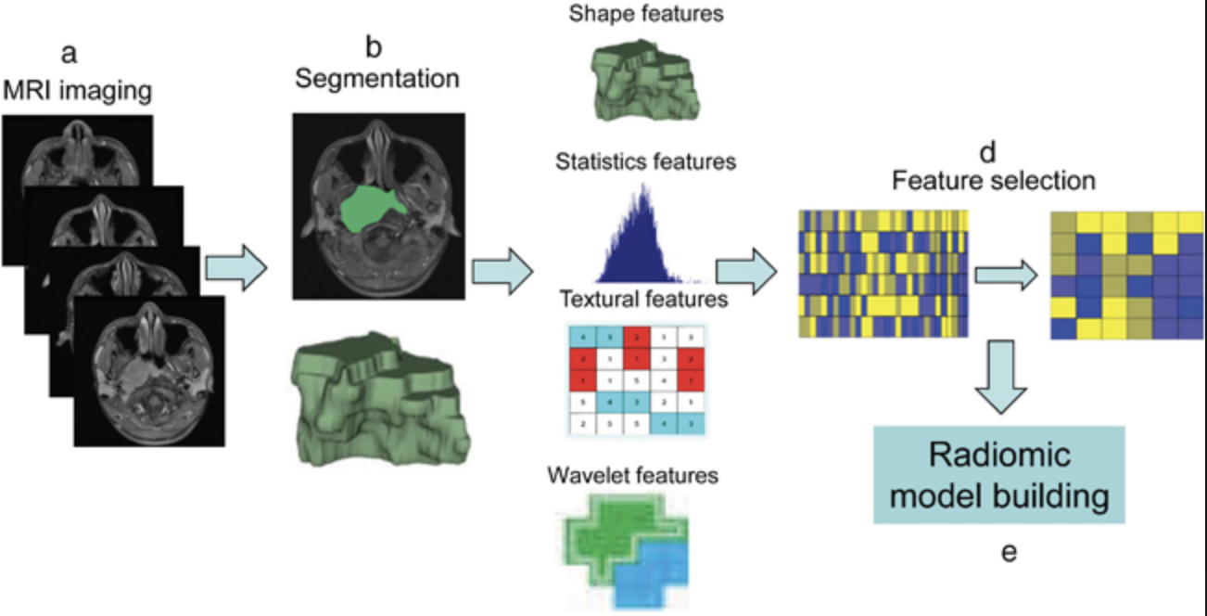
AIM 2: predictive diagnosis/outcome (PI-GE?-FI)
It has the objective of putting in place predictive medicine solutions, and it includes both the search of biomarker of pathology in multiparametric neuroimaging MRI data, and the prediction of treatment outcome in oncologic patients, relying on CT, MRI, clinical and dosimetric data of patients.
After image acquisition, image preprocessing, and defining regions of interest by structure segmentation, algorithms are applied to calculate shape, intensity, texture, and multiscale filter features. By combining multiple features and correlating them with dosimetric and clinical outcome, prognostic and predictive models can be created.
AIM2.T1 - Predictive models for RT treatments (FI, GE, PI)
AIM2.T2 - Predictive models for MR-guided UFUS (CT?)
AIM2.T3 - Predictive models for System Biology (BO?)
Radiomics, describes quantitative computerized algorithm-based feature extraction from imaging data including computer tomography (CT), magnetic resonance imaging (MRT), or positron-emission tomography (PET) images. For radiation oncology it offers the potential to significantly influence clinical decision-making and thus therapy planning and follow-up workflow.
Oncotarget, 2017, Vol. 8, (No. 42), pp: 72457-72465

Slide 14
AIM 2: predictive diagnosis/outcome (PI-FI)
Lo studio sarà focalizzato sui tumori del sistema nervoso centrale (SNC) . I centri coinvolti saranno l’Azienda Ospedaliero Universitaria Meyer e la Sezione di Radioterapia del Dip.Scienze Biomediche Sperimentali e Cliniche .
Studio retrospettivo su almeno 50 pazienti pediatrici (2015-2017) che sono stati sottoposti ad un trattamento radioterapico.
immagini CT ed RM di pazienti colpiti da tumore SNC. Si dispone di immagini di pretrattamento e di follow-up.
I dati clinici più importanti per lo studio saranno: sopravvivenza, tipo di tumore, grado di differenziazione, malignità, referto istologico, tipo di percorso terapeutico dose erogata, frazionamento, dati dosimetrici.
Notes:
In particolare gli esami saranno costituiti da immagini MRI di diffusione con mezzo di contrasto per la mappatura dell’ADC (apparent diffusion coefficient), immagini CT usate per la pianificazione del trattamento radioterapico, RTPLAN ovvero i dati sulle superfici di isodose per il trattamento radioterapico.

Slide 15
AIM 2: predictive diagnosis/outcome (PI-GE?-FI)
Recent studies analyze the opportunity to hippocampal avoidance during brain radiotherapy to reduce neurocognitive toxicity. Hippocampal dose constraint and dose response relation are still unclear.
Hippocampal damage during radiotherapy could correlate to neurocognitive dysfunction, the baseline characteristics of hippocampus in brain tumor patients is not well known.
In this study we will analyze pediatric tumors radiological characteristics of hippocampus prior radiotherapy and after radiotherapy and correlate any changes from the baseline to tumor characteristics and dose distribution within the organ of interest.

Slide 16
AIM 2: predictive diagnosis/outcome (PI-GE-FI)
Correlating imaging features with clinical/genomic information highlights the important conclusion that information obtained at the tissue/organ level (macroscopic level) is directly linked to underlying physiologic, cellular processes (microscopic level).
Moreover volumetric image features could confirm the correlation between tumor volume and higher risk of local failure and the identification of necrosis could identify a prognostic factor of progression free survival.
All the collected data could identify specific radiotherapy dose level and investigate if higher doses (or dose distribution) in higher risk area result in a better local control than in unfavorable dose distribution.

Slide 17
people & facilities
Nome | Ruolo | FTE (Tot 1)
C. Talamonti | PA unifi | 0.3
S. Pallotta S. Calusi S. Piffer | PA unifi Assegnista Specializzando | 0.3 0.2 0.2
per il CdS: richieste ai servizi NESSUNA

Slide 18
Budget (preliminary)
 | First year | Second year | Third year | Total
Travel | 15 | 15 | 15 | 45
HardWare | 20 |  |  | 20
Consumables | 10 | 10 | 10 | 30
SW licenses | 6 | 2 | 2 | 10
WorkShops | 5 | 5 | 5 | 15
 | 56 | 32 | 32 | 120

Slide 19
thank you

