Slide 1
PERO’: Development of medical dosimetric systems based on PEROvskite materials
INFN Firenze
Mara Bruzzi 60% Responsabile Loc/Naz
Cinzia Talamonti 20%
Anna Vinattieri 40%

Slide 2
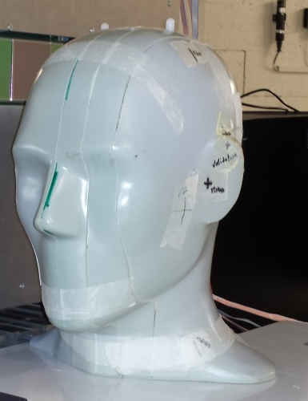
OBJECTIVE
Development of INORGANIC PEROVSKITES DOSIMETERS FOR ADVANCED CLINICAL RADIOTHERAPY
First results in terms of sensitivity, stability under beam are prominsing.
Active perovskite dots can be deposited almost on any contact flexible geometry to get a 3D real-time dose monitoring under modern radiotherapy beams
This projects aims at giving a first proof-of-principle toward:
  Perovskites dosimetry
  Application in anthropomorphic phantoms for in-vivo dosimetry during Total Body Irradiations
  Flexible perovskites dosimetric devices
  Perovskite dosimetric thin films for trasmission monitoring

Slide 3
Perovskite-based opto-electronic devices
→ Towards medical applications
Ever increasing international scientific interest for the exceptional opto-electronic properties and easy processing of perovskites for large-area and flexible optoelectronic device systems [Adv. Energy Mater. 6 (2016). Nat. Commun. 6 (2015), Adv. Mater. 27 (2015) 41–46].
Organo-metallic halide perovskites recently proposed for printable large area flexible X-ray detectors in medical imaging applications (Nature 2017 550(7674): 87-91; Physics in Medicine, Vol. 5, 2018 20-23.).
All-inorganic perovskites, CsPbX₃ (X=Cl, Br, and I) attracting alternatives due to their improved chemical stability [4], they can be produced in form of single crystals, nano-crystals and micro-crystalline thin films [5-6].
Univ. of Florence: ability to produce samples of CsPbBr₃ single crystal and microcrystalline films on custom PCBs with promising photoconduction properties under radiation.
First dosimetric characterization of perovskites samples at Careggi Hospital in Florence reveals a potential for dosimetry in clinical radiotherapy.

Slide 4
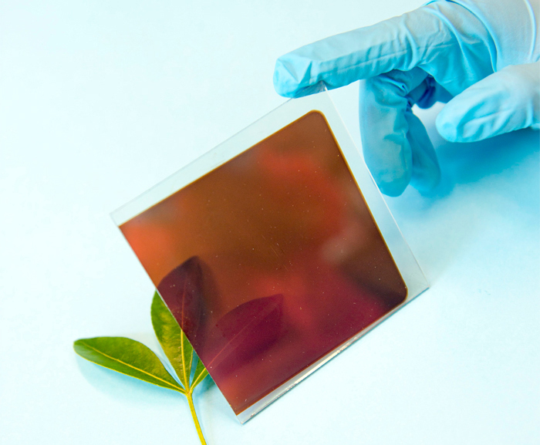
Introduction
Perovskite – based solar cells most promising emerging photovoltaic devices
High efficiency;
Facile low temperature solution-based fabrication method;
High absorption coefficient.
Higher stability in air.
High diffusion length, high charge-carrier mobilities.
very high values of open-circuit voltages (V_{OC}) typically obtained.
15% perovskite solar cell made in University of Oxford

Slide 5

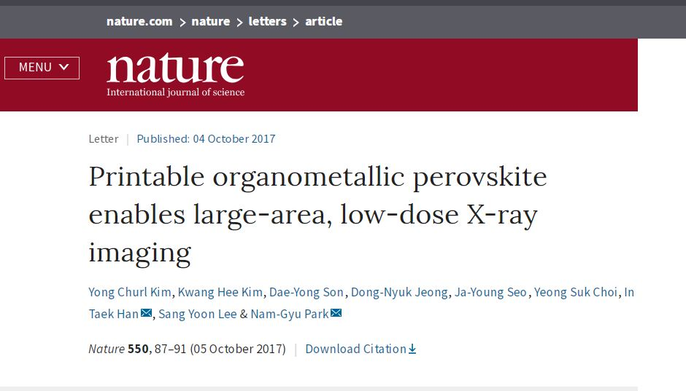
Organic-perovskites recently suggested for X-ray imaging and medical imaging applications

Slide 6
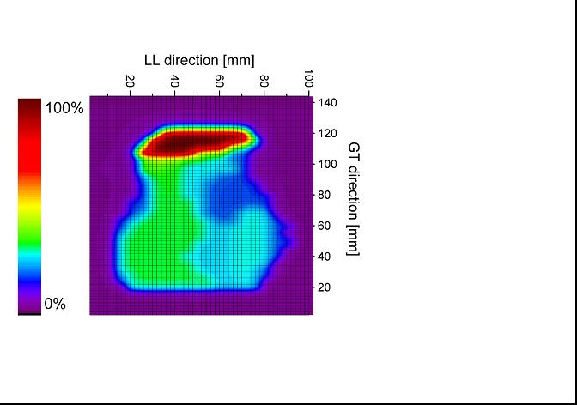
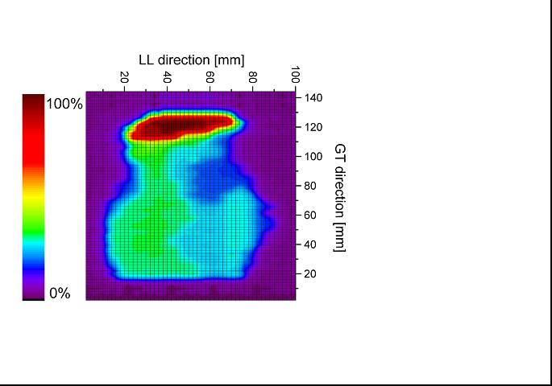
Our group has already experience on the development of perovskite optoelectronic devices
[1] F. Gabelloni , F. Biccari, G. Andreotti, D. Balestri, S. Checcucci, A. Milanesi, N. Calisi , S. Caporali, A. Vinattieri Recombination dynamics in CsPbBr3 nanocrystals: role of surface states, OPTICAL MATERIALS EXPRESS 7, 12, 4367-4373, 2017
[2] M. Bruzzi et al. Defective States in CsPbBr₃ and Their Role in Transport Properties, presented at the4th International Conference on Advanced Electromaterials(ICAE 2017), Date: ... 2017, Place: Ramada Plaza Jeju Hotel, Jeju Island, Korea.
.. and on the development of dosimetric devices for advanced radiotherapy
( diamond , Si, SiC, … Etc ) CSN5 EXPERIMENTS DIAPIX - RDH - IRPT MIUR WP8
2.5x2.5cm prototype IMRT
map 14x10cm² measured by shifting the diamond dosimeter
(GT = gantry target direction;
LL = lateral-lateral direction)
Grid spacing 3 mm.
IMRT breast cancer map as measured by the pCVD Diamond .
IMRT breast cancer map as calculated by the TPS (treatment planning system)

Slide 7
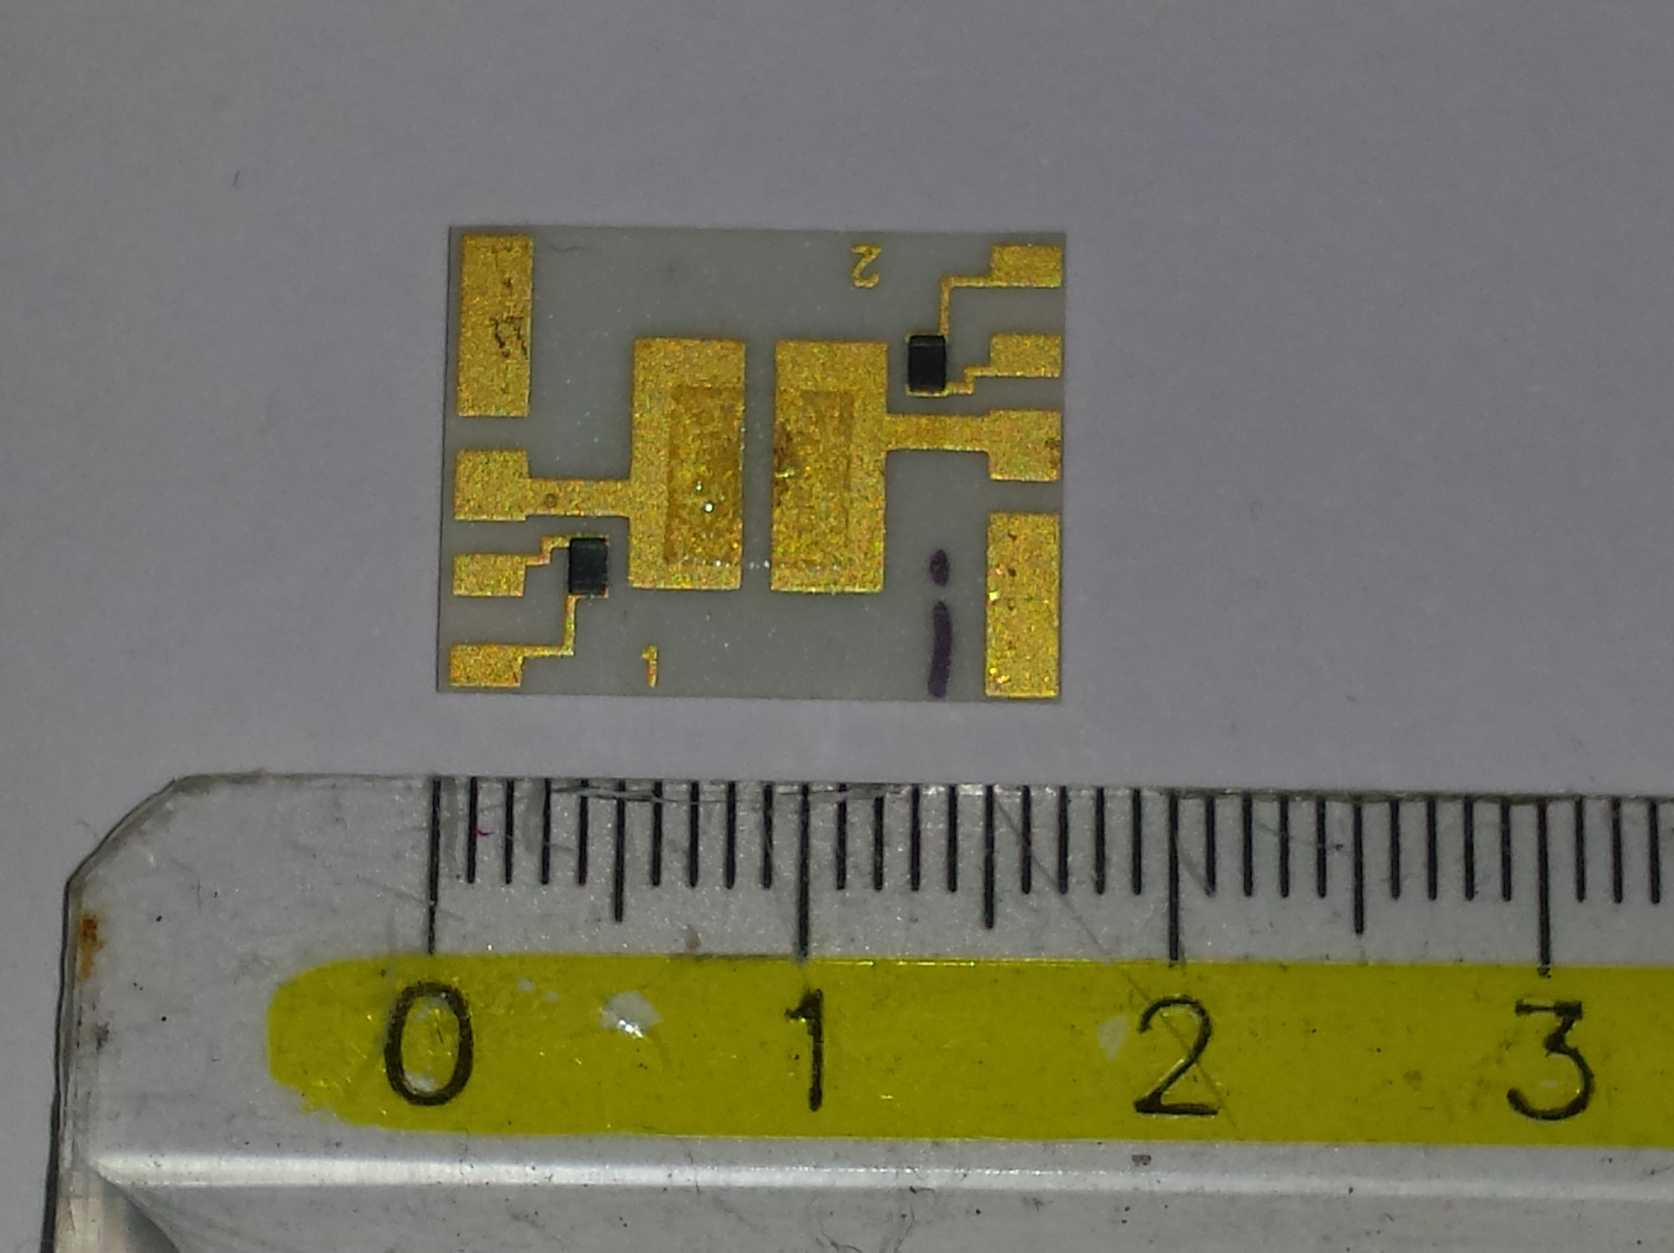
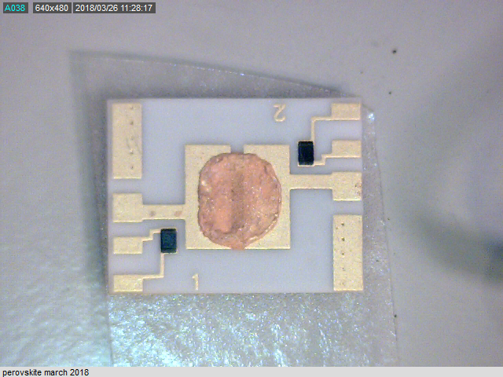
Devices preparation in Florence
Our research group in Florence* is able to produce CsPbBr₃ single crystals and microcrystalline perovskite films. A set of perovskite films about 100μm thick deposited by drop-cast on integrated circuits on thick alumina substrates developed by us having two parallel gold contacts 20μm thick, 7mm long and spaced 0.8mm, an integrated heater on the back and two symmetrical Pt sensors.
CsPbBr₃
sat. in DMSO
Heating treat.
150 °C
Our custom PCB
Deposition of the saturated solution
of CsBr and PbBr₂ in DMSO (1:1)
Evaporation of the solvent
and formation of perovskite
* Stefano Caporali, Nicola Calisi, Dipartimento di Ingegneria Industriale, Università di Firenze

Slide 8
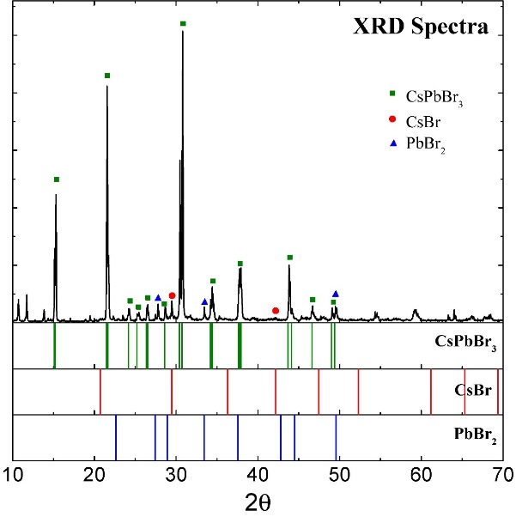
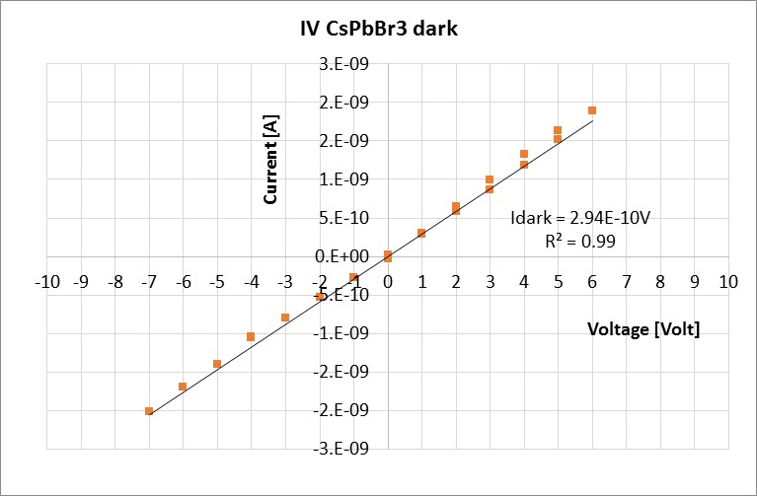
Florence Samples Characterization
XRD spectra of the deposited material show no residuals and contaminants after deposition.
AFM images of the perovskite film showing the microcrystalline morphology of the film.
Ohmic behavior of the film on PCB
650μm
(a)
(b)
(c)

Slide 9


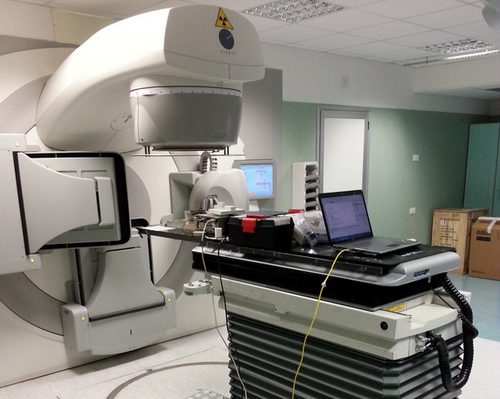
Irradiation Set-up
LINAC X 6MV @ Azienda Ospedaliera Careggi Firenze
Dosimetric systems can be tested at Careggi Hospital radiotherapy unit with modern therapeuthic X-rays beams :
- Uniform dose distribution for calibration
- Intensity Modulated RadioTherapy (IMRT-VMAT)
- In vivo Total Body Irradiation (TBI)

Slide 10
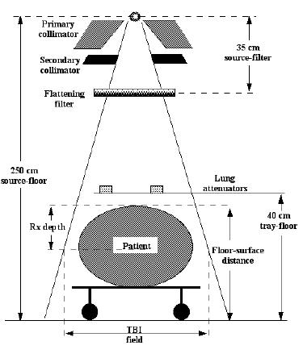
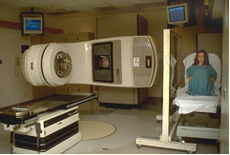
Total Body Irradiation in – vivo dosimetry
TBI in-vivo dosimetry answers to Article 56 COUNCIL-DIRECTIVE-2013/59/EURATOM since it verifies the consistency of the treatment delivery with the treatment prescribed by the Radiation Oncologist, in real-time, for every patient, during every fraction, for every treatment technique.
CALIBRATION
IONIZATION CHAMBER
beam in
d 100
d 100
beam out
in and out “in vivo” dosimeters to determine half thickness dose
Kin
Kout

Slide 11
First tests under uniform dose distribution are promising
Current measured with one of our perovskite samples under a X - 6MV beam at Careggi Hospital
Photoconductive Response
Fast rise/decay times,
Good stability during irradiation

Slide 12
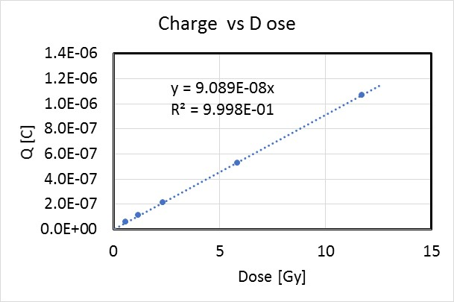
Charge Signal vs Dose measured with one of our perovskite samples under a X - 6MV beam at Careggi Hospital
HIGH SENSITIVITY
S_{CsPbBr3} ~ 300 nC / (Gymm³)
S_{Si} = 637 nC / (Gymm³)
S_{air} = 35 pC / (Gymm³)
S_{diam} ~ 4 nC/(Gymm³)
Linear dependence of the charge collected as a function of the dose measured with a X-rays 6MV in the range from 0.5Gy to 12Gy ( bias V = 5Volt, room Temperature) .
Measured sensitivity much higher than that of diamond and air chambers, favourably compares with silicon [M.Bruzzi, NIMA 2016].

Slide 13
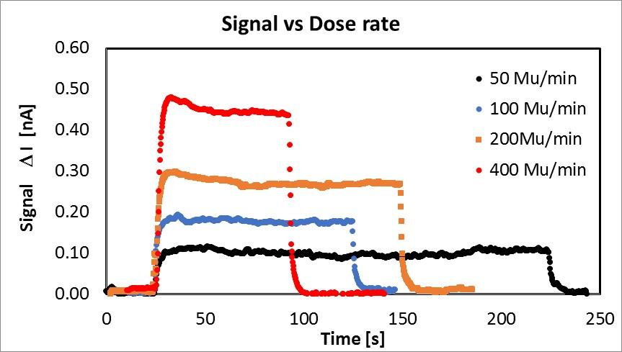
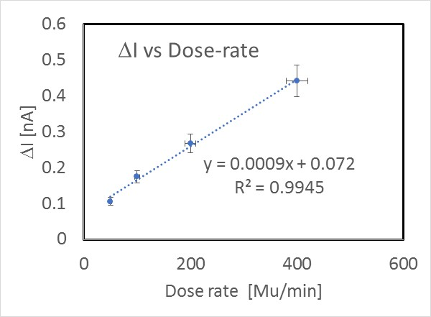
Current vs Dose rate
The entire dose rates range 50 – 400 Mu/min can be measured
Fair linear dependence of the current vs dose rate .

Slide 14
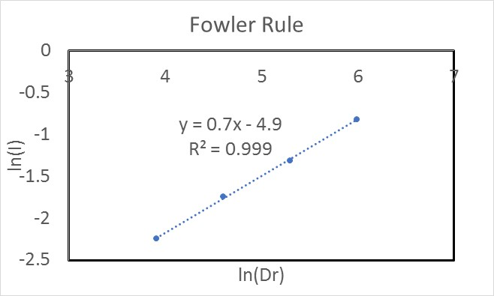
Current Signal dependence on dose rate
Fowler model: I = I_{DARK} + RD_{r}^{Δ}
Δ = 0.7 – 0.8
→ device optimization needed to get to get closer to a linear dependence Δ ~ 1

Slide 15
Proposal : 3-year Project
First year
Optimization of the structural composition of the perovskite material;
Preparation of a first set of point- dosimetric samples with different contact geometries and materials in view to optimize the dosimetric response;
Design of flexible 2D/3D contact geometries toward realistic therapeutic beams applications (IMRT, TBI….);
Test with laser beams for fast monitoring;
Studies of native defects with photoluminescence and TSC and possible correlation with dosimetric perfomance;
Characterisation of the photoconductive response under different photon/electron beams.

Slide 16
Second / Third Year
Second year
Preparation of a set of 2D dosimetric samples;
Characterisation under different photon/electron beams with conformal dose distribution.
Radiation induced defect studies with photoluminescence / TSC
and correlation with performance after accumulated doses.
Third year
Preparation of a set of 3D dosimetric devices;
Characterisation under different photon/electron beams with 3D conformal dose distributions.
Radiation induced defect studies with photoluminescence / TSC
and correlation with performance after accumulated doses.

Slide 17
Financial Request 1° year
Consumable ( certified materials for phantoms, chemical materials for devices, development of custom PCBs) | 15 kEur
International and national conferences – workshop | 2kEur
Instruments
Automated xyz system, read-out electronic system, spin coating accessories | 17kEur

Slide 18
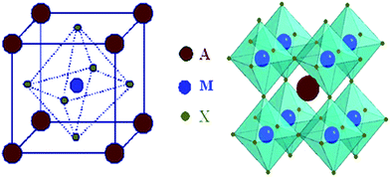
Perovskite Crystal Structure
Usually have stoichiometry of AMX₃
X is an oxide or halide anion such as Cl, Br and I.
M refers to a metal cation with a coordination number of 6.
The MX₆ octahedra share corners and A is usually a large cation that fills the cuboctahedral holes with coordination number of 12.
A can be Ca, K, Na, Pb, Sr, other rare metals.
CrystEngComm, 2010, 12, 2646-2662

Slide 19
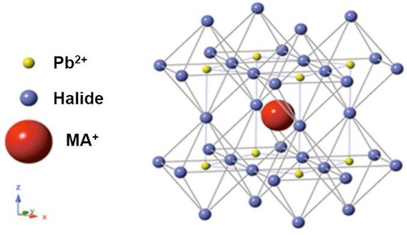
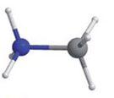

Organic–inorganic Hybrid Perovskites
First three-dimensional organic–inorganic hybrid perovskite, discovered by replacing caesium in CsPbX₃ (X = Cl, Br or I) with methylammonium cations (MA = CH₃NH₃⁺) by Dieter Weber, in 1978.
CH₃NH₃PbI₃ is most common used materials for making high efficiency perovskite solar cells.
CH₃NH₃PbI₃ is a semiconducting pigment with a direct bandgap of 1.55 eV with absorption coefficient as high as 10⁴–10⁵ cm⁻¹
Methylammonium (MA)
JACS, 136, 622, 2014

Slide 20
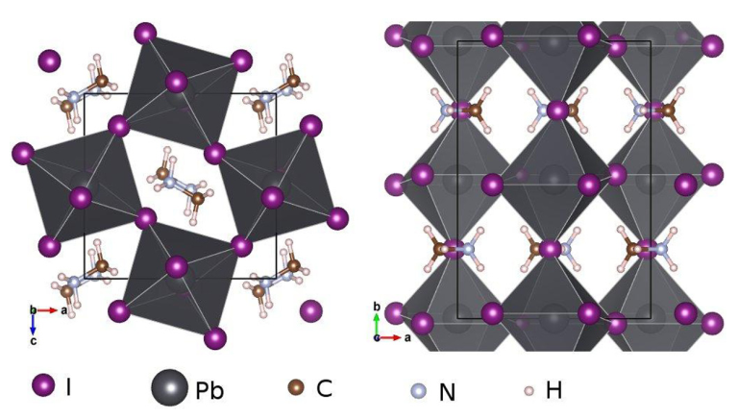

Organic–inorganic Hybrid Perovskites cont.
The unit cell parameter $a$ increases from 5.68 to 5.92 and to 6.27 Å as the size of halide increases from X = Cl to Br and to I, respectively.
The large size and aspherical shape of MA cause distortion in network and drives several phase transitions by decreasing T.
For T <160 K orthorhombic, 162.2 K<T< 327.4 K tetragonal and T > 327.4 K cubic.
Phys. Rev. B 90, 045207

Slide 21
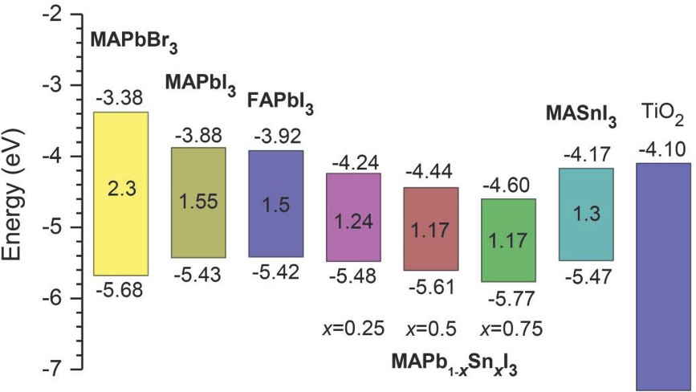
Band Gap Tuning
Bandgap tuning is required to extend the absorption to longer wavelengths without sacrificing the absorption coefficient.
Changing in any of A, M and X in AMX₃ changes the bandgap
The bandgap also can be tuned in between 1.55 eV and 1.17 eV by varying the ratio of lead to tin
FA: formamidinium HC(NH₂)₂⁺
Small
Volume 11, Issue 1, pages 10-25, 30 OCT 2014 DOI: 10.1002/smll.201402767
http://onlinelibrary.wiley.com/doi/10.1002/smll.201402767/full#smll201402767-fig-0002

Slide 22
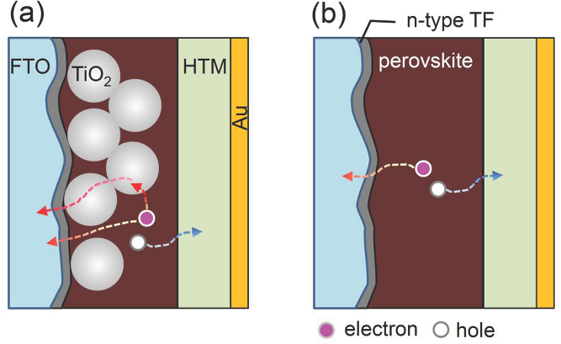
Device structure
The device structure, related materials, and interfacial modification are key factors in performance of solar cells.
Two typical structures can be constructed: a) mesoscopic nanostructure and b) planar structure.
Mesoporous TiO₂ layer usually is used to collect the electrons
Organic Hole transporting material (HTM) collects the holes
Planar structure has simpler structure and higher efficiency
Small
Volume 11, Issue 1, pages 10-25, 30 OCT 2014 DOI: 10.1002/smll.201402767
http://onlinelibrary.wiley.com/doi/10.1002/smll.201402767/full#smll201402767-fig-0004

Slide 23
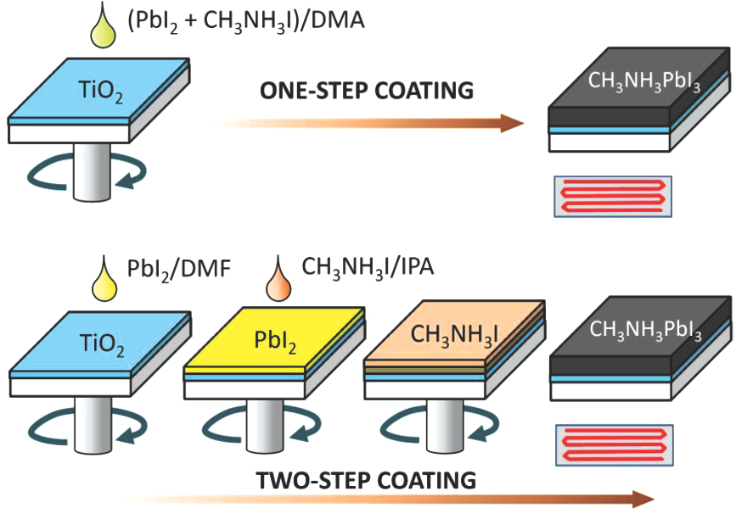
Preparation Method
There are two common methods:
  one step coating: spin-coating a mixed CH₃NH₃I and PbI₂solution
  two-step coating: spin-coating CH₃NH₃I after coating with PbI₂
Small
Volume 11, Issue 1, pages 10-25, 30 OCT 2014 DOI: 10.1002/smll.201402767
http://onlinelibrary.wiley.com/doi/10.1002/smll.201402767/full#smll201402767-fig-0005
Video instruction of fabricating perovskite solar cells:
  https://www.youtube.com/watch?v=RqW9HrasNPA

Slide 24
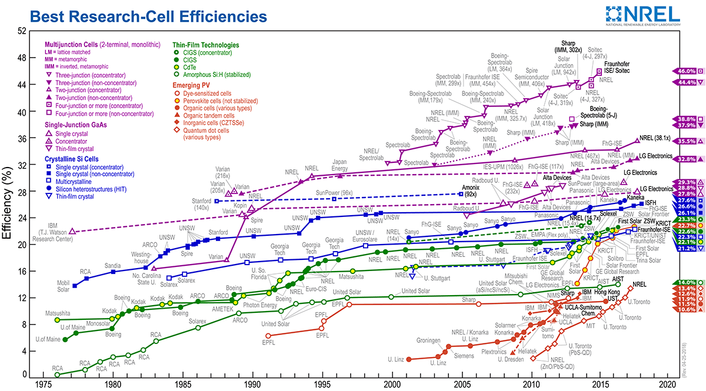
PEROVSKITE SOLAR CELLS : MOST PROMISING EMERGING PV

