Slide 1




Attività e richieste
2019
Alexis Pompili
(in rappresentanza del Gruppo CMS-Bari )
11 luglio 2018 – Consiglio di Sezione INFN-Bari - Aula multimediale

Slide 2
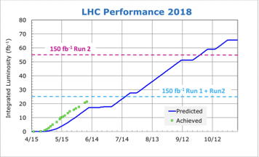
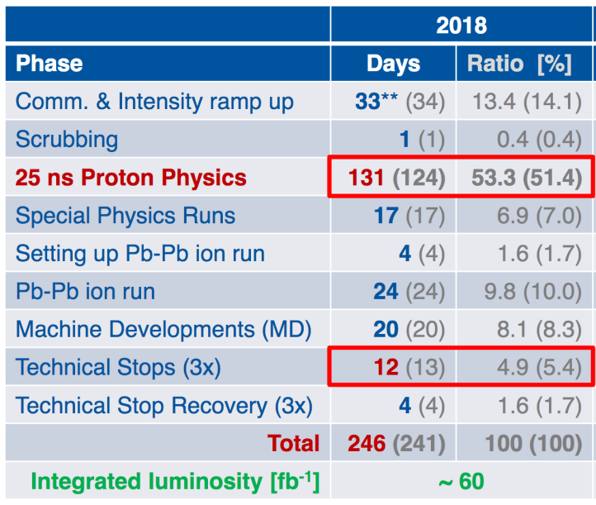
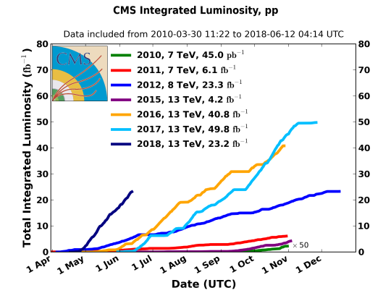
LHC operations & status in 2018
PLAN
23.2 fb⁻¹ NOW
Almost 2 weeks ahead what initially expected
As of June 12nd LHC delivered 23.2fb⁻¹
[0.5fb⁻¹ per 12hours fill ]
July2018 - C.d.S. @INFN-Bari
1/47

Slide 3
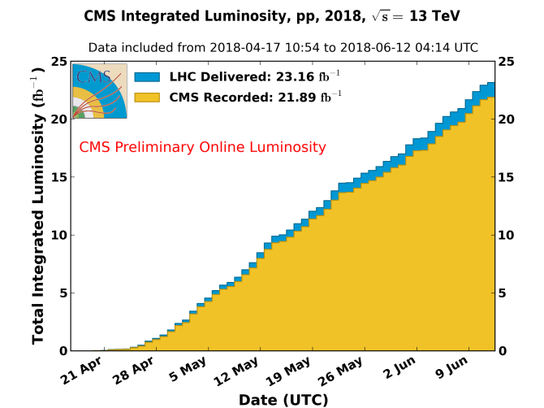
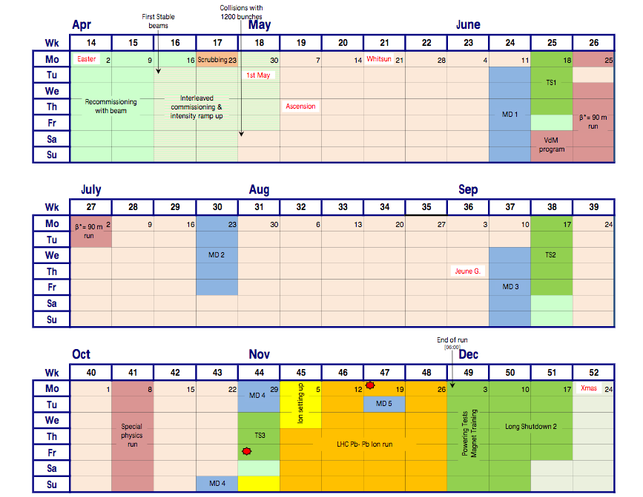
CMS data taking in 2018
The machine start was incredible but
also CMS is performing data taking
with high recording efficiency :
Integrated recording efficiency : 94.8%
by collecting 21.9fb⁻¹ out of 23.2fb⁻¹
[ Deadtime ~3.1% / Downtimes ~2.1% ]
(distributed)
L. Silvestris – Run Coordinator
Now ending the MD1 & TS1 & special run (*) period & restarting :
[PbPb ion run foreseen in December]
…..
(*) QCD studies, glueballs (with TOTEM)
July2018 - C.d.S. @INFN-Bari
2/47

Slide 4
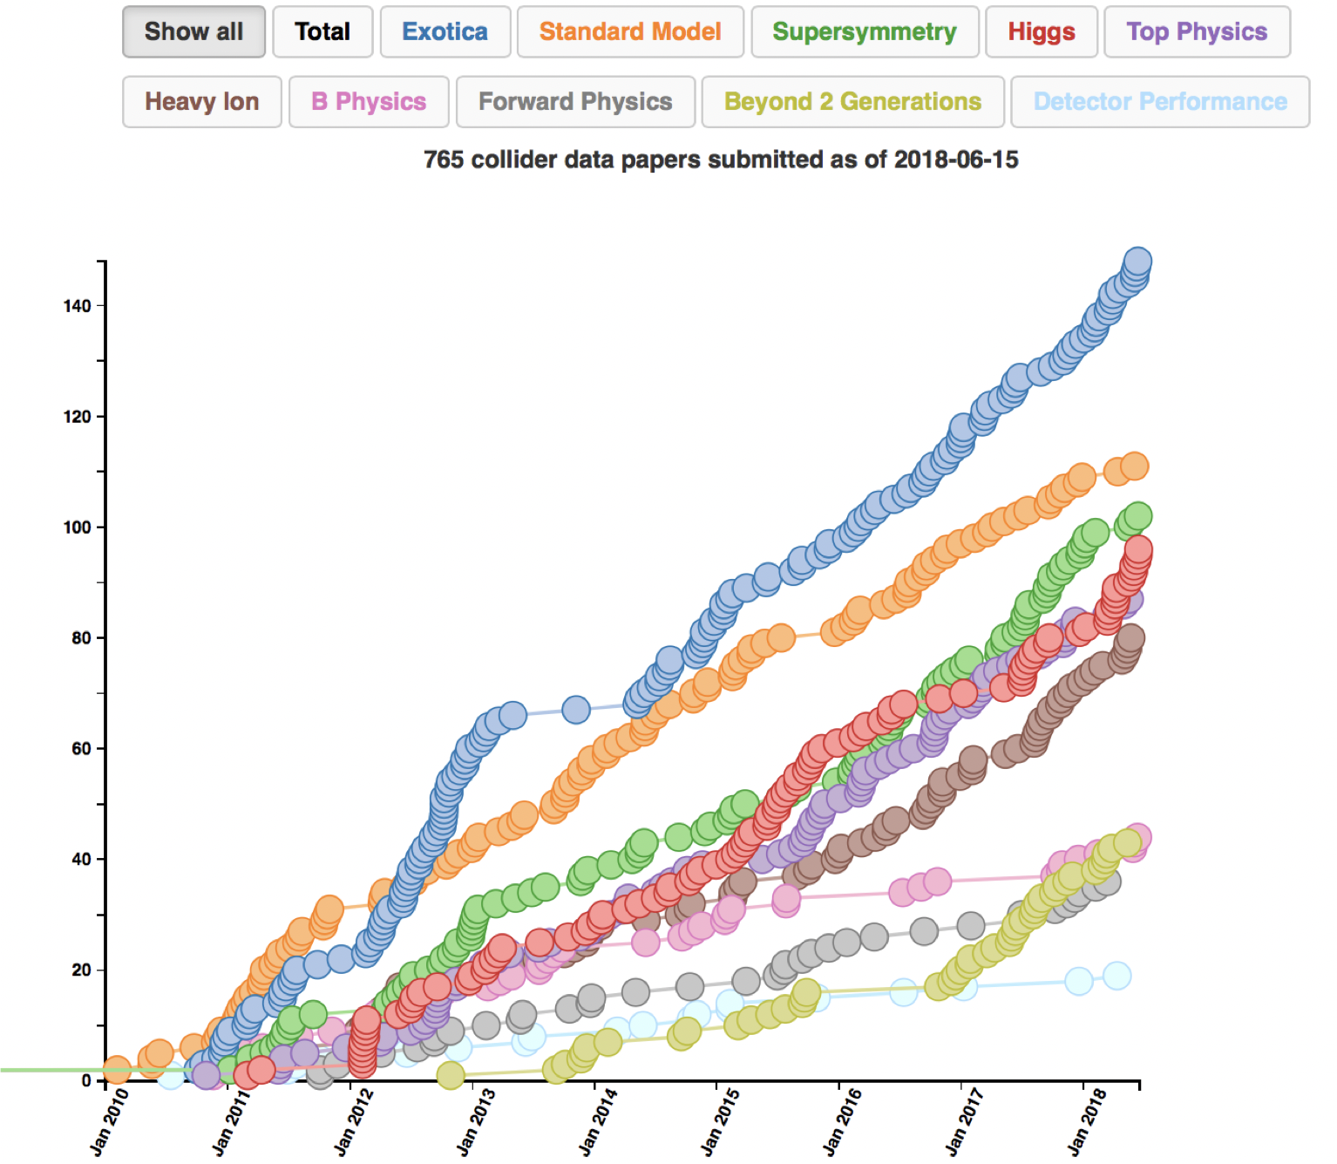
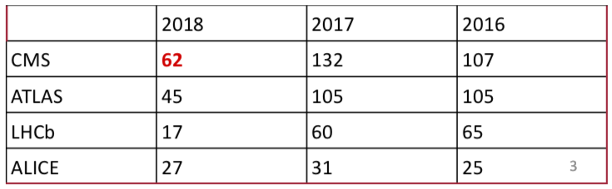
CMS publications trend
765 physics papers submitted in total
- very good trend in the last year
Submitted papers (from inspirehep.net) :
CMS-Bari Collaboration Wide Reviews:
- SMP-17-012 (20/6/18)
- HIG-16-040 (21/12/17)
- TOP-17-014 (25/5/18)
- SUS-17-006 (21/11/17)
- SMP-17-005 (10/4/18)
- B2G-17-009 (12/10/17)
- HIG-17-024 (17/3/18)
- BPH-15-008 (22/7/17)
- HIG-16-018 (7/2/18)
- SMP-16-017 (5/6/17)
July2018 - C.d.S. @INFN-Bari
3/47

Slide 5
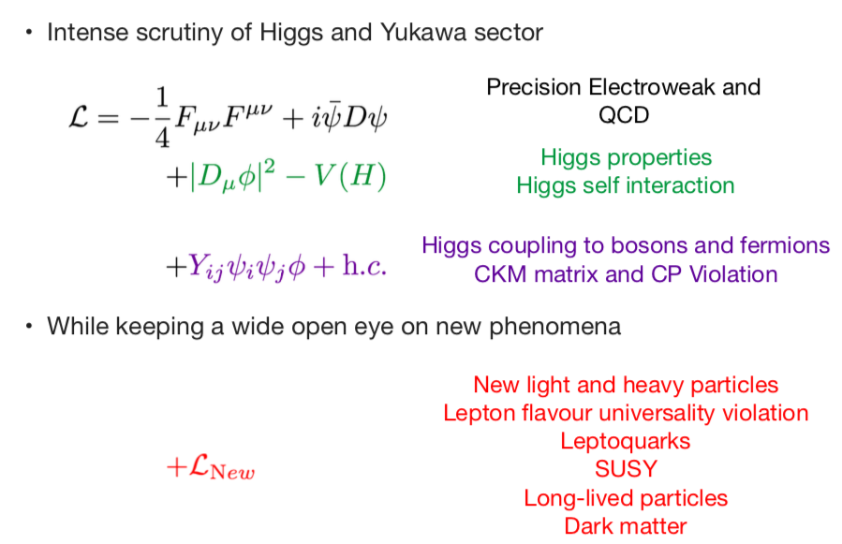
LHC physics after Higgs discovery
From S. Rahatlou @ ICHEP18
July2018 - C.d.S. @INFN-Bari
4/47

Slide 6
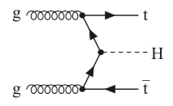
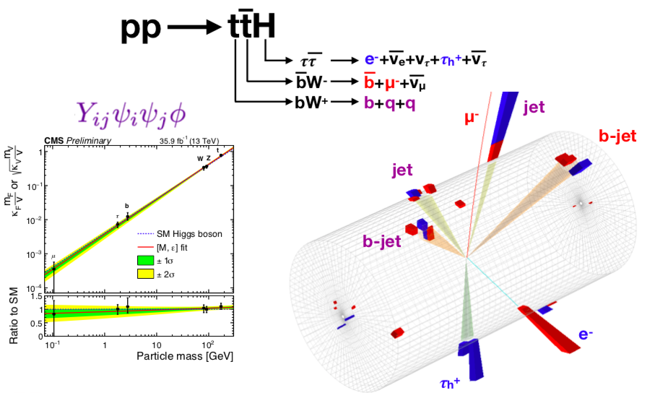
Observation of ttH production
CMS paper on “observation of ttH production” published on the 4th of June [Phys.Rev.Lett. 120, 231801]
Observation of direct coupling of Higgs to quark top
From S. Rahatlou @ ICHEP18
July2018 - C.d.S. @INFN-Bari
5/47

Slide 7
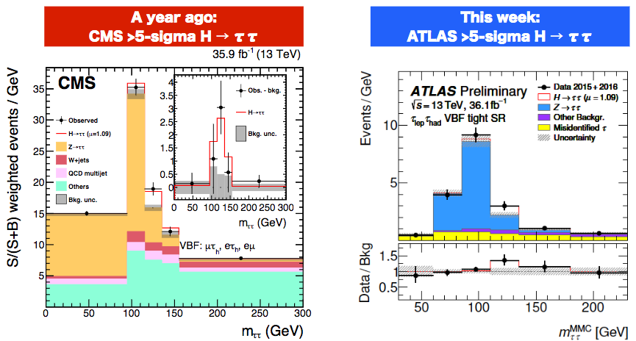
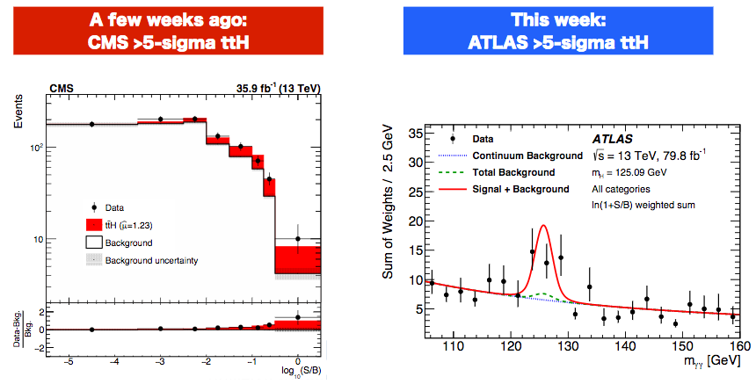

Physics Highlights – what happened in the last 12 months
From the talk given by Gavin Salam
@ closing plenary session of LHCP :
The >5σ observations of ttH and $H→ττ,$ independently by CMS & ATLAS, firmly establish the existence of a new kind of fundamental interaction, Yukawa interactions!
They have never before been directly observed! This is as important as the discovery of the Higgs boson itself because fundamental interac-tions are as important as fundamental particles.
Within SM conjecture, Yukawa couplings are what give masses to all quarks (so protons are lighter than neutrons and thus are stable, which gives us the hydrogen atom & chemistry and biology as we know it).
Within SM conjecture, Yukawa couplings are what give masses to all leptons (electron mass determines size of all atoms & sets energy levels of all chemical reactions).
July2018 - C.d.S. @INFN-Bari
5a/47

Slide 8
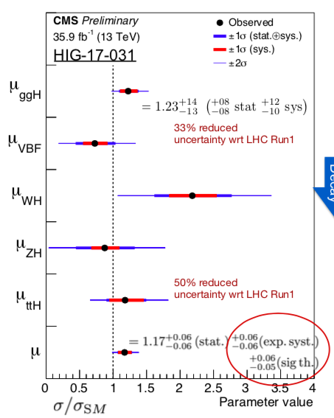
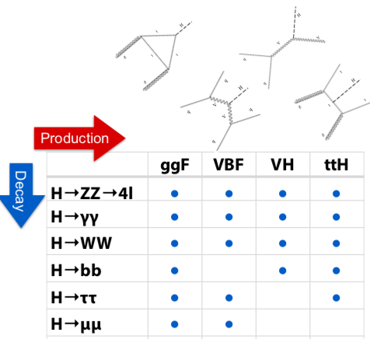



Higgs properties
Close to theory-limited territory with just 2016 data
From S. Rahatlou @ ICHEP18
Next steps : &
(evidence for it: )
H$→μμ$
H$→bb$
July2018 - C.d.S. @INFN-Bari
6/47

Slide 9
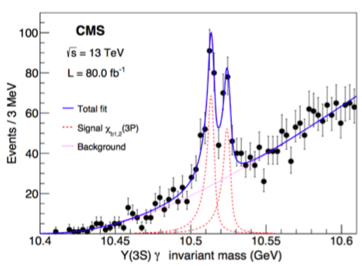
Other Physics Highlights (from LHCP 2018)
BPH-17-008
Results with 2017 data included!
First time that the J=1,2
states are well resolved
(J=0: negligible radiative decay BF )
[submitted to PRL]
July2018 - C.d.S. @INFN-Bari
7/47

Slide 10
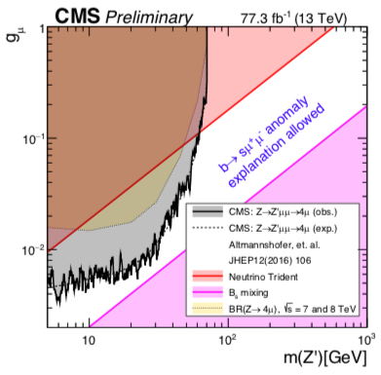
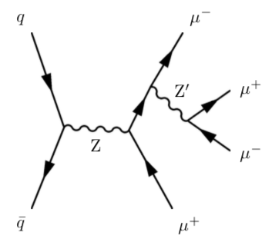

Other Physics Highlights (from LHCP 2018)
BPH-17-008
Results with 2017 data included!
Gauge coupling strength (LIMITS)
EXO-18-008
First time that the J=1,2
states are well resolved
(J=0: negligible radiative decay BF )
[submitted to PRL]
Search for a narrow Z’ gauge boson in
resulting from Lμ-Lτ U(1)’ gauge symmetry that could explain 1) lack of DM signals in direct detection,
2) eventual LFV in B decays (anomalies by LHCb),
$$Z→Z′μμ→μμμμ$$
3) tension in anomalous μ magnetic moments measurements
First dedicated limits on this SM model extension @ LHC
July2018 - C.d.S. @INFN-Bari
7/47

Slide 11
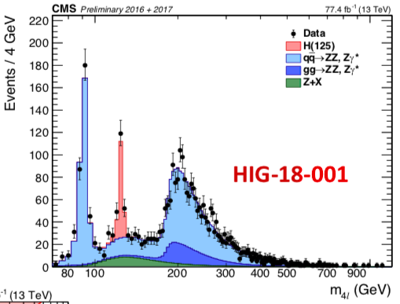

Other Physics Highlights (from LHCP 2018)
BPH-17-008
Results with 2017 data included!
Gauge coupling strength (LIMITS)
Improvements introduced in the new measurement of the properties of the H in the decay channel
EXO-18-008
H$→ZZ^{∗}→4ℓ$
Observed distribution agrees with SM expectations within uncertanties [stacked histograms represent expected distributions of signal & bkg in the SM]
First time that the J=1,2
states are well resolved
(J=0: negligible radiative decay BF )
[submitted to PRL]
Search for a narrow Z’ gauge boson in
resulting from Lμ-Lτ U(1)’ gauge symmetry that could explain 1) lack of DM signals in direct detection,
2) eventual LFV in B decays (anomalies by LHCb),
$$Z→Z′μμ→μμμμ$$
HIG-18-001
3) tension in anomalous μ magnetic moments measurements
Contribution by N.De Filippis
First dedicated limits on this SM model extension @ LHC
July2018 - C.d.S. @INFN-Bari
7/47

Slide 12
Current analysis activities with CMS-Bari involvement
Gr.I / July-C.d.S. @INFN-Bari

Slide 13
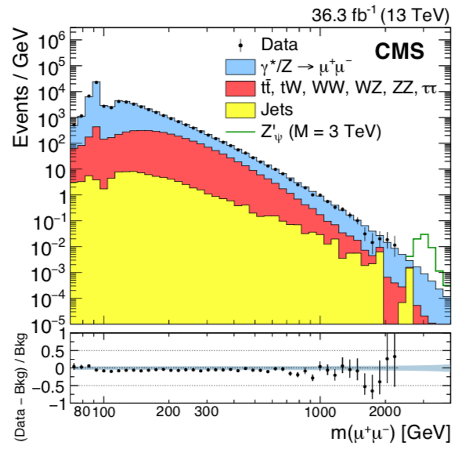

High-mass dimuon resonances
Search for high-mass resonances into two muons (contribution to dilepton final states) [ ]
Z’$→μμ$
F. Errico + R. Radogna + A. Colaleo (contributing within Z’ task force)
In the last years relevant effort in this search
- with 2015 data combined with Run-1 (8TeV)
[EXO-16-047 ; Phys. Lett. B 768 (2017) 57]
- with 2016 data (Run-2) submitted to JHEP
[EXO-16-047 ; submitted to JHEP] (R. Radogna co-editor)
Observation in agreement with SM expectations. UL on the product of a new resonance production xsection times unknown branching fraction to dileptons calculated in model-independent way, thus allowing the interpretation of the limits in models predicting
dilepton heavy narrow resonances (SSM, GUT & Warped Extra-dim.)
Observed yields on stacked histograms repre-
senting the expectations from SM processes
Currently working on Run-2 Legacy analysis (full Run-2 dataset)
- for its preparation the 2018 performances are compared to previous datasets
with F. Errico one of main analysers
R. Radogna μ-POG/EXO contact & ARC member for EXO-17-003 and EXO-17-009
July2018 - C.d.S. @INFN-Bari
8/47

Slide 14
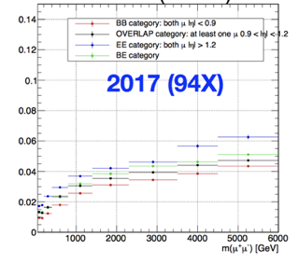
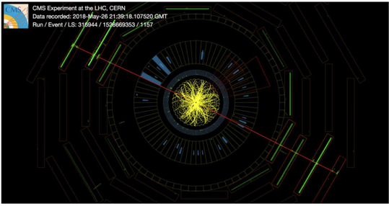
… connected to high-p_{T} muon reconstruction
Previous searches are closely connected with high-p_{T} muon reconstruction performance.
For this reason a new dedicated muon-POG sub-group was created to study high energy muons !
- R. Radogna co-coordinator of this high-energy muons performance sub-group [MUO-17-001 (AN-18-008)];
also in charge for the estimation of the muon momentum scale with 2017 data
- F. Errico in charge for the high-pT muon assignment
using dedicated TuneP (for the estimation of muon
resolution)
Mass resolution (%)
The heaviest dimuon found so far at CMS (3.142TeV) [into 2018 Run]
July2018 - C.d.S. @INFN-Bari
9/47

Slide 15

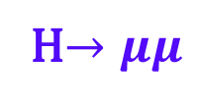
Current effort
H$→μμ$
Further involvement in a cross-check analysis dedicated to search
H$→μμ$
Search of SM Higgs - decaying into 2 muons using 2016 (and 2017) data – produced via VBF & ggF
F. Errico + R. Radogna + R. Venditti (+ CMS-Pisa)
- 2017 data analysis in preparation
- contribution to the implementation of a multivariate analysis to use in the limit extraction process
- F. Errico in charge of the systematic uncertainties estimation
(in particular that related to the b-jets tagging)
July2018 - C.d.S. @INFN-Bari
10/47

Slide 16
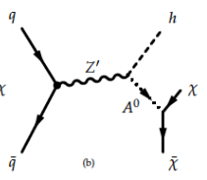
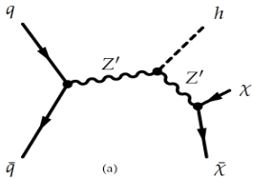
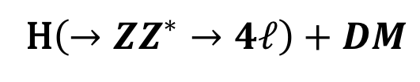

Mono-Higgs search :
H$\left(→ZZ^{∗}→4ℓ\right)+DM$
The search for a final signature of the kind (SM-Hggs + MET), particularly with the tag ,
constitutes one of the workstreams in the Dark Matter quest.
H$→ZZ^{∗}→4ℓ$
G. Miniello + N. De Filippis + R. Aly (contributing within the MET+X EXO-WG) [EXO-18-009, AN-2016/328]
Two simplified benchmark models are used as a reference to interpreting the data;
in both a new massive particle mediates the interaction H-DM :
1) Z’-2HDM ( on-shell Z’ decays into Higgs + A₀ pseudoscalar, with )
  2) Z’-baryonic (a Z’_{B} vector boson decays into after «irradiating» an Higgs)
(1)
(2)
Crucial aspects : fake leptons & fake-MET rejection, backgrounds estimation (by MC or Data-driven)
[mainly reducible], systematic uncertainties reduction
Preliminary result: no excess of events over the expected SM background is found & 95% CL exclusion limits on the xsection are derived for both models
Status : pre-approved / using full2016 dataset
Target : paper after combination with other Higgs-tag channels
July2018 - C.d.S. @INFN-Bari
11/47

Slide 17

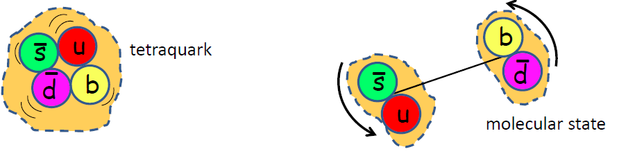

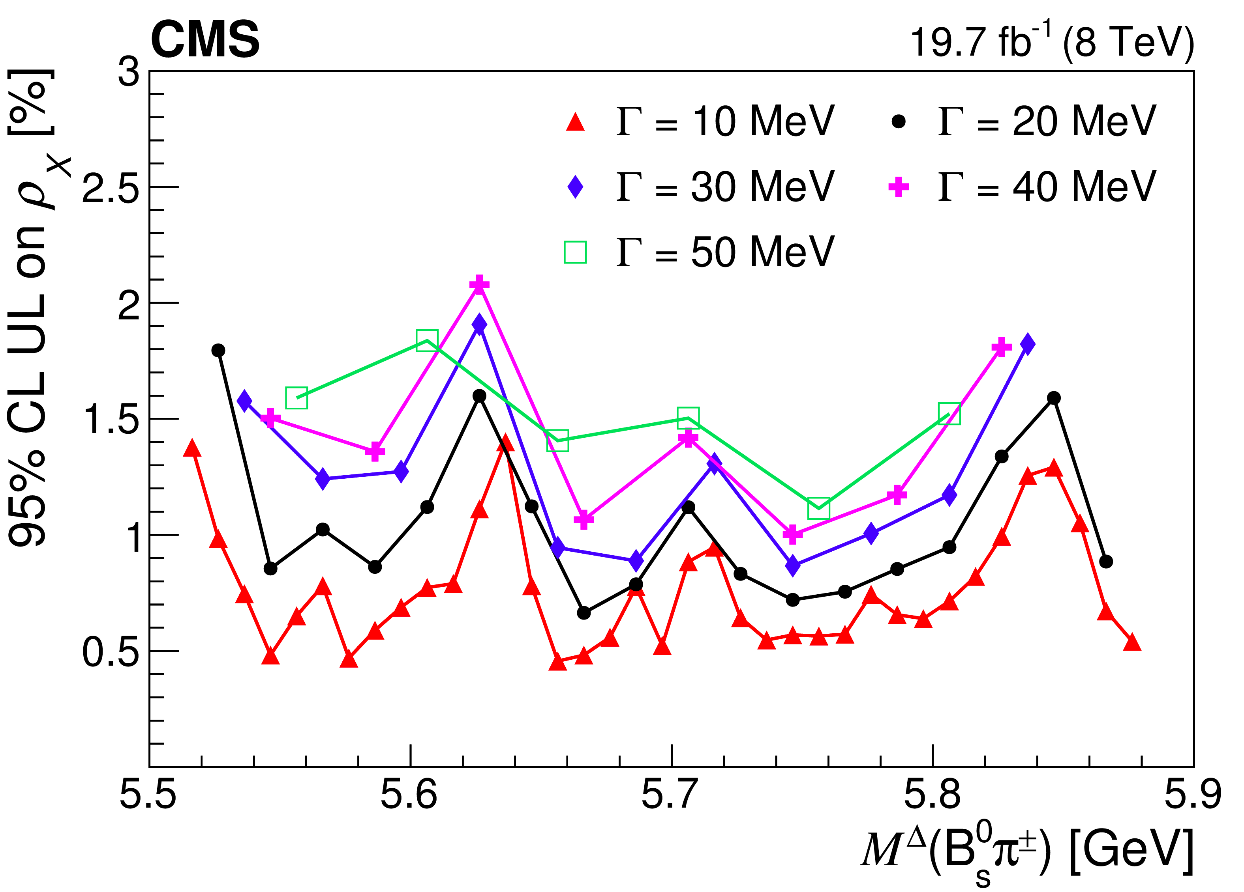
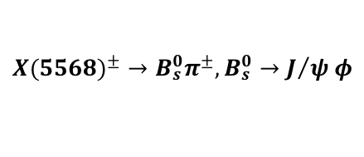



B-Physics & Quarkonia - I
A. Pompili
$${X(5568)}^{±}→B_{s}^{0}π^{±},B_{s}^{0}→J/{ψ φ}$$
- B-Physics PAG sub-convener / Spectroscopy & Properties co-convener:
long-term appointment (2014-2017) ended with 2017
$Γ_{X}^{D0}≈22MeV$
- CMS representative in HFLAV since 2018 [https://hflav.web.cern.ch/ ]
- as convener/internal reviewer followed and helped a few analyses
in the last year, among which:
X(5568) most stringent & extended UL :
BPH-14-008, BPH-17-002,
BPH-16-003 [to EPJC] (${ B}_{s}^{∗∗}$ spectroscopy),
BPH-16-002 [PRL 120 (2018) 202005]
L. Cristella
- μ-POG/BPAG contact (generalize muon-ID from studies )
- as T&P expert contributed to PLB 771 (2017) 435 (B⁺ prod. xSec. @13TeV)
- coordination of performance plots for B-Physics PAG for 2017 Run (see one @ next slide)
${ B}_{s,d}^{0}→μμ$
July2018 - C.d.S. @INFN-Bari
12/47

Slide 18
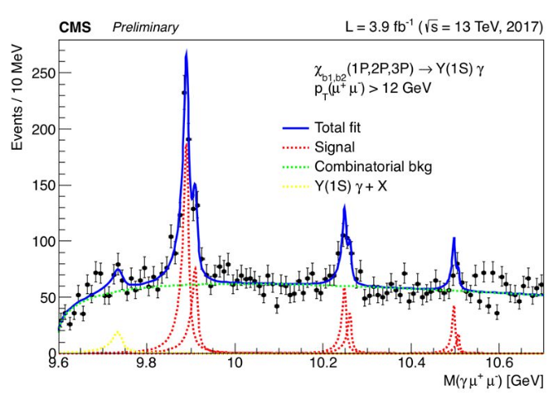




B-Physics & Quarkonia - II
L. Cristella + A. Pompili + A. Di Florio + V. Mastrapasqua + N. Sur (TIFR)
- charged exotic Z spectroscopy with the 3-body decay
${ B}_{d}^{0}→J/ψKπ$
(full amplitude fit on GPUs) [BPH-14-003]
- enough statistics with 2012 data
A. Di Florio + A. Pompili + L. Cristella
- inclusive search for exotic X(4140) state & partners in the final state
- use later 2017-2018 data (dedicated triggers)
J/ψ $ϕ$
S. Lezki + A. Pompili + L. Cristella + CMS CINVESTAV(Mexico City) [Progetto MAECI Italia-Messico 2018-2020]
$χ_{b1}(1P)ππ$
Y$(1S)ππ$
- inclusive search for exotic X_{b} state [beauty partner of X(3872)] in the final states &
- use 2017-2018 data
CMS-DP- 2017-029
[reflection]
July2018 - C.d.S. @INFN-Bari
13/47

Slide 19
Computing T2 infrastructure & activities
July2018 - C.d.S. @INFN-Bari

Slide 20
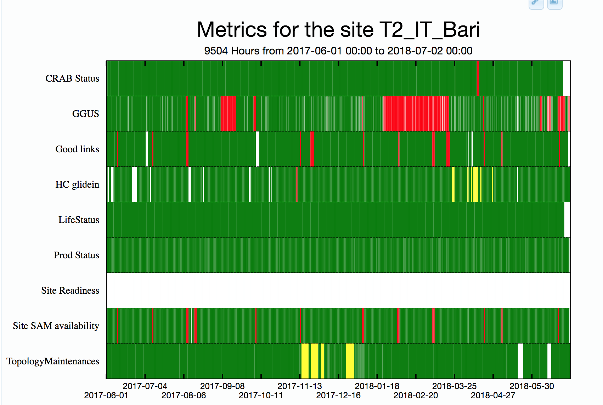
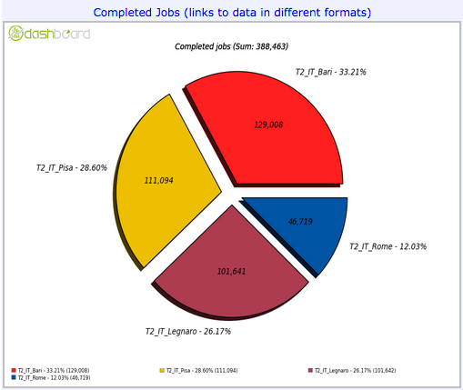
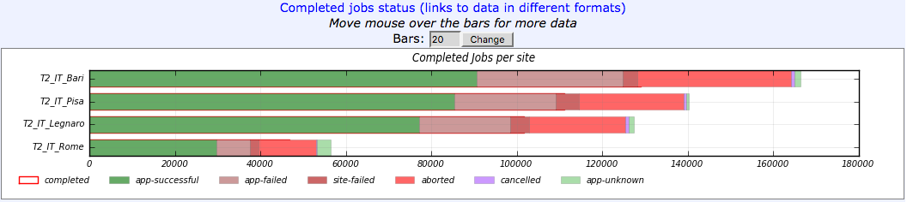
CMS T2 status
T2 maintenance in production
optimal efficiency & reliability
Support to extra activities (CMS-tagged as well)
CMS not only uses the production farm but also the HPC cluster (GPU usage, see slides later)
Support to R&D computing activities of INFN-scolarships
For instance: last month’s performances (CMS analysis jobs) :
July2018 - C.d.S. @INFN-Bari
14/47

Slide 21
CMS-T2 : perspectives & requests for 2019
G.Donvito, G.Maggi, A.Pompili, C.Calabria, L.Cristella, G.Selvaggi (CMS side),
but - regardless the official affiliations/tags – all IT group (staff & TD) collaborates,
at different levels of involvement, to the maintenance of infrastructure and computing resources !
Very wide projects/proposals activity (PRIN, PON, infrastructural projects, EU projects) centered on the ReCas Data center [see G.Donvito’s presentation yesterday]. Just an extremely significative example:
IPCEI (Important Projects of Common European Interest) useful to strengthen the ReCas data center
[IBISCO is an infrastructural proposal within the INFN framework to an IPCEI call]
- a consistent part of computing resources could be used by LHC experiments (CMS, ALICE) in next years
- expected funding of about 6M€ (between UNIBA & INFN-Bari)
CMS-T2 requests – summary :
Total request | 294.9k€
CPU | 179.6k€ [*]
Storage | 97.8k€
Overhead Networking | 7.8k€
Overhead Servers | 9.7k€
[*] : For the 2019 we are asking either those for 2019 and those due for 2018
Troubles with the 2017 storage tender : 900TB are missing w.r.t. the pledged storage
July2018 - C.d.S. @INFN-Bari
15/47

Slide 22
Scientific Computing activities in CMS
[more in backup slides]
C. Calabria [INFN “fellowship” about R&D on scientific computing for innovative solutions for the LHC experiments]
contribution to development of CMS tracking code in parallel programming on a hybrid CPU-GPU platform (*)
contribution to development of a monitoring tool based on ML techniques for the DT Local Trigger (anomalies)
L. Cristella [CMS Remote Analysis Builder (CRAB) user support & development]
contribution to development in 2018: automatic job splitting (to enhance CPU efficiency @ GRID sites)
development plans for 2019: activation of so called job overflow from a site to a geographically adjacent one
(to reduce waiting time of jobs in queues)
A. Di Florio
contribution to application of ML-based techniques to speed up tracking @HLT (*);
specific studies of the use of Convolutional Neural Networks (typical use case: pattern recognition within images) to select pixel seeds on the basis of the cluster shape of the pixel hit.
(*) activity within CMS Future Tracking WG
July2018 - C.d.S. @INFN-Bari
16/47
22

Slide 23
HEP Computing & Statistics
Sviluppo dell’uso di GooFit (interfaccia di RooFit a CUDA)
(A. Di Florio, A. Pompili, L. Cristella)
There are 2 main separate lines of research (carried out with the GPUs hosted by the ReCas HPC) :
With respect to new physical signals (for instance in exotic QCD) techniques of p-value (statistical significance) estimation on GPUs have been developed by means of the pseudo-experiments method (CMS AN-2015/334).
Statistical analysis studies :
Wilks theorem application limits & Asymptotic formulae by Cowan et al.
[ ACAT2016, ICHEP2016, XII Quark Confinement: statistics session]
Clustering technique to include LEE in the global significance estimation (ACAT2017)
Currently under study : check of Trial factors method for LEE (Gross-Vitells approx.)
[ will be presented to XIII Quark Confinement: statistics session ]
Highly complex Fitting tasks :
Amplitude analyses (related to BPH-14-003 and similar analyses within CMS-BPAG)
Development started also for other BPAG analyses, for instance flavor anomalies ( )
[ CMS-PD & CMS-MiB ]
July2018 - C.d.S. @INFN-Bari
17/47

Slide 24
See the dedicated presentation given on the last 25th of june in INFN-Bari:
[you can find there details related to the CMS document for the INFN-CTS]
https://indico.cern.ch/event/739423/
CMS Phase-2 Upgrade & related activities
Scientific program :
- precision measurements of Higgs boson properties (couplings to fermions & vector bosons)
- studies of vector boson scattering
- searches of new heavy or exotic particles (BSM phenomena)
- measurements of rare decays & rare production modes of standard particles (precise SM)
July2018 - C.d.S. @INFN-Bari

Slide 25
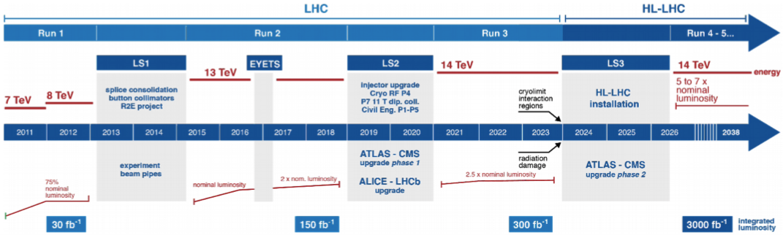


High-luminosity LHC
The CERN Council approved (06/2016) the High Luminosity upgrade of the LHC (HL-LHC) [by year 2026]
During the 3rd Long Shutdown (LS3) [2024-26] the accelerator will be upgraded to enable:
Instantaneous Peak Luminosity: ( or even )
$$ℒ_{inst}\sim 5×{10}^{34}{cm}^{−2}s^{−1}$$
$$ℒ_{inst}\sim 7.5×{10}^{34}{cm}^{−2}s^{−1}$$
[stable]
[ultimate]
July2018 - C.d.S. @INFN-Bari
18/47

Slide 26


High-luminosity LHC
The CERN Council approved (06/2016) the High Luminosity upgrade of the LHC (HL-LHC) [by year 2026]
During the 3rd Long Shutdown (LS3) [2024-26] the accelerator will be upgraded to enable:
Instantaneous Peak Luminosity: ( or even )
$$ℒ_{inst}\sim 5×{10}^{34}{cm}^{−2}s^{−1}$$
$$ℒ_{inst}\sim 7.5×{10}^{34}{cm}^{−2}s^{−1}$$
[stable]
[ultimate]
HL-LHC expected to run @ with a bunch spacing (close to current values) but with :
$$\sqrt{s}=14TeV$$
$$25ns$$
- an event pile-up (PU) rate 5 times higher than current PU [stable: 140; ultimate: 200 (#collisions/bunch crossing)]
- an integrated radiation dose (after 10 years of operation) 1 order of magnitude higher than foreseen for the
… current LHC detectors
July2018 - C.d.S. @INFN-Bari
18/47

Slide 27
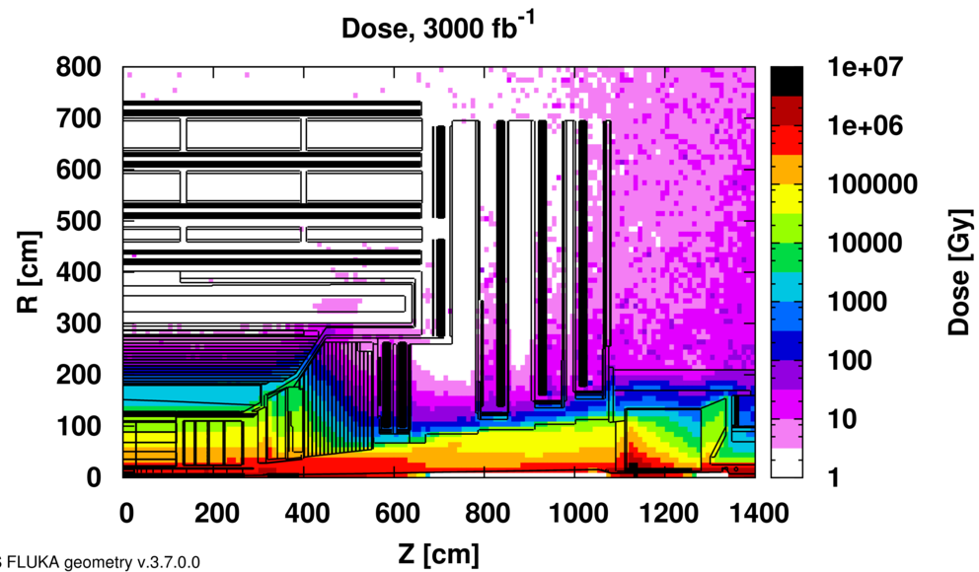
CMS Phase-2 Upgrade - I
An upgrade programme of CMS (Phase-2) is accompanying the HL-LHC upgrade
... in order to …
maintain excellent detector performance while
fully profiting from the HL-LHC capabilities
Absorbed (in CMS cavern)
... in spite of …
the challenging radiation levels & operating conditions
Radiation level increase
improved detector radiation hardness
Higher PU rate
- higher detector granularity (to reduce occupancy)
- increased bandwidth (750kHZ to accomodate higher data rates)
- improved trigger capability (track info @L1 with extended trigger latency @ 12μs)
July2018 - C.d.S. @INFN-Bari
19/47

Slide 28
CMS Phase-2 Upgrade - I
An upgrade programme of CMS (Phase-2) is accompanying the HL-LHC upgrade
... in order to …
maintain excellent detector performance while
fully profiting from the HL-LHC capabilities
Absorbed (in CMS cavern)
... in spite of …
the challenging radiation levels & operating conditions
Radiation level increase
improved detector radiation hardness
Higher PU rate
- higher detector granularity (to reduce occupancy)
- increased bandwidth (750kHZ to accomodate higher data rates)
- improved trigger capability (track info @L1 with extended trigger latency @ 12μs)
Several kinds of constructions, installations & commissioning to be done from LS2 through LS3 :
July2018 - C.d.S. @INFN-Bari
19/47

Slide 29
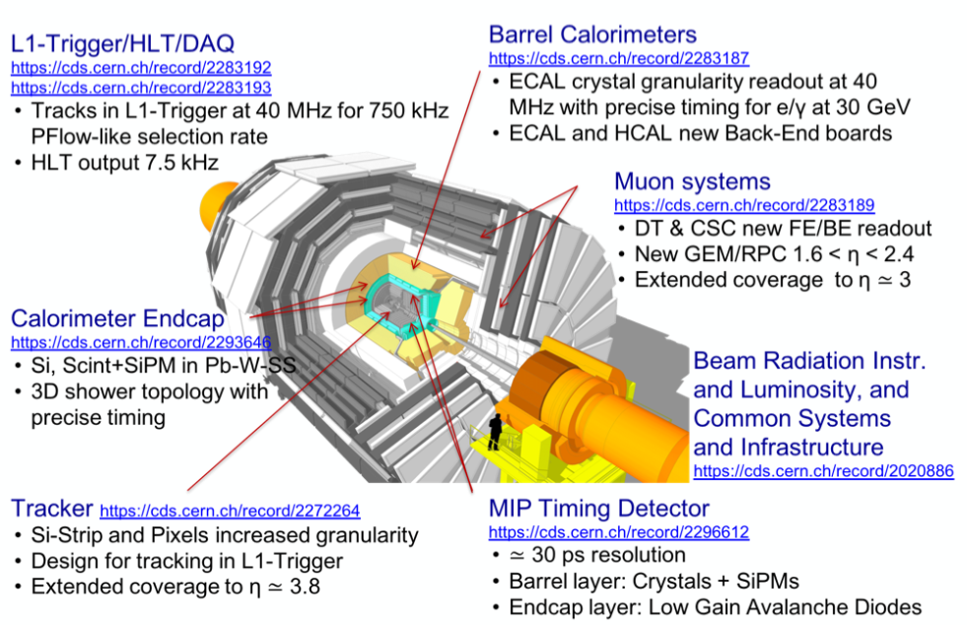
CMS Phase-2 Upgrade - II
CMS is entering a new phase of engineering, prototyping & construction
Tracker, Barrel Calo, Endcap Calo, Muons Technical Design Reports already approved by CERN Research Board
L1 trigger, HLT & DAQ TDRs will follow (expected in 2020) [ LHCC reviews just ended ]
For the expected performances and features and the physics impact you can refer to the TDRs and TPs.
July2018 - C.d.S. @INFN-Bari
20/47

Slide 30
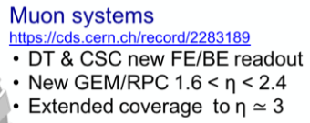
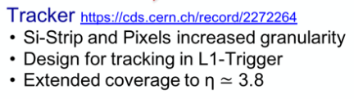
CMS Phase-2 Upgrade - II
CMS is entering a new phase of engineering, prototyping & construction
INFN participation
Tracker, Barrel Calo, Endcap Calo, Muons Technical Design Reports already approved by CERN Research Board
L1 trigger, HLT & DAQ TDRs will follow (expected in 2020) [ LHCC reviews just ended ]
For the expected performances and features and the physics impact you can refer to the TDRs and TPs.
July2018 - C.d.S. @INFN-Bari
20/47

Slide 31
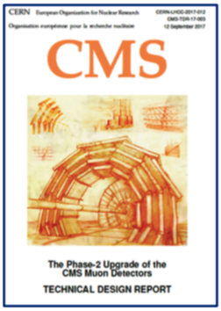
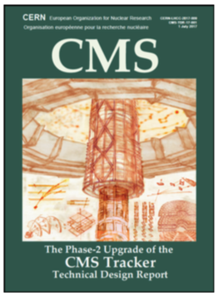
CMS Phase-2 Upgrade - II
CMS is entering a new phase of engineering, prototyping & construction
INFN participation
CMS-Bari participation
Tracker, Barrel Calo, Endcap Calo, Muons Technical Design Reports already approved by CERN Research Board
L1 trigger, HLT & DAQ TDRs will follow (expected in 2020) [ LHCC reviews just ended ]
For the expected performances and features and the physics impact you can refer to the TDRs and TPs.
July2018 - C.d.S. @INFN-Bari
20/47

Slide 32
Bari contributions to CMS Upgrade TDRs
Lot of efforts has been devoted to analyses & studies with simulations
for the upgraded CMS performances also in Bari.
Contributions to MUON TDR :
Contributions to TRACKER upgrade :
Official editors :
N. De Filippis (plots for TRACKER TDR)
C. Calabria (Cap.6: New GEM detectors)
A. Colaleo (Cap.9: Organization, schedule, cost)
A. Di Florio (studies in ML group / workshops)
(Deep Learning for Pixel doublets filtering @ HL-LHC)
Contributions (plots, …)
G. Pugliese, A. Gelmi
(Cap.4: RPC upgrades and new RPC detectors)
C. Calabria, A. Sharma, F. Errico
(Cap.7: Muon trigger and reconstruction )
N. De Filippis, R. Venditti
(Cap.7: Muon trigger and reconstruction )
July2018 - C.d.S. @INFN-Bari
21/47

Slide 33
New Tracker for Phase-2 CMS
July2018 - C.d.S. @INFN-Bari

Slide 34


The new Tracker – requirements/features
The entire Silicon Tracking System will be replaced !
The new Tracker ( Inner Tracker (IT) based on silicon pixel modules
+ Outer Tracker (OT) made from silicon modules with strips and macro-pixel sensors) … will feature :
increased radiation tolerance
[fully efficiency up to ]
$$ℒ_{int}\sim 4500{fb}^{−1}$$
higher granularity
[channel occupancy kept below the %(% ) level in the IT(OT); improved 2-track separation]
extended tracking acceptance
[efficient tracking up to $\left|η\right|\sim 3.8]$
robust pattern recognition
[optimized design for track finding @high PU]
July2018 - C.d.S. @INFN-Bari
22/47

Slide 35
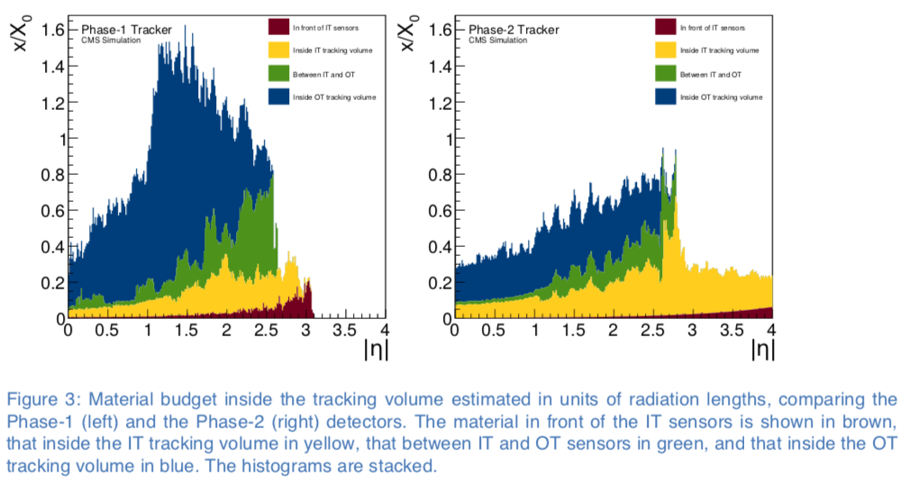
The new Tracker – requirements/features
The entire Silicon Tracking System will be replaced !
The new Tracker ( Inner Tracker (IT) based on silicon pixel modules
+ Outer Tracker (OT) made from silicon modules with strips and macro-pixel sensors) … will feature :
increased radiation tolerance
[fully efficiency up to ]
$$ℒ_{int}\sim 4500{fb}^{−1}$$
higher granularity
[channel occupancy kept below the %(% ) level in the IT(OT); improved 2-track separation]
extended tracking acceptance
[efficient tracking up to $\left|η\right|\sim 3.8]$
robust pattern recognition
[optimized design for track finding @high PU]
reduced material in the tracking volume
[lighter than current Tracker]
July2018 - C.d.S. @INFN-Bari
22/47

Slide 36
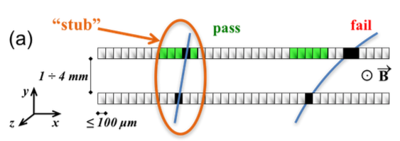
The new Tracker – requirements/features
The entire Silicon Tracking System will be replaced !
The new Tracker ( Inner Tracker (IT) based on silicon pixel modules
+ Outer Tracker (OT) made from silicon modules with strips and macro-pixel sensors) … will feature :
increased radiation tolerance
[fully efficiency up to ]
$$ℒ_{int}\sim 4500{fb}^{−1}$$
higher granularity
[channel occupancy kept below the %(% ) level in the IT(OT); improved 2-track separation]
extended tracking acceptance
[efficient tracking up to $\left|η\right|\sim 3.8]$
robust pattern recognition
[optimized design for track finding @high PU]
reduced material in the tracking volume
[lighter than current Tracker]
compatibility with higher data rates & longer trigger latency
tracking information to the L1 trigger (now available only at HLT)
[keeping trigger rates at sustainable level]
concept used to provide L1 trigger primitives,
based on correlation of signals in closely-spaced
sensors in order to enable rejection of low-p_{T} tracks :
accepted “stub”
July2018 - C.d.S. @INFN-Bari
22/47

Slide 37
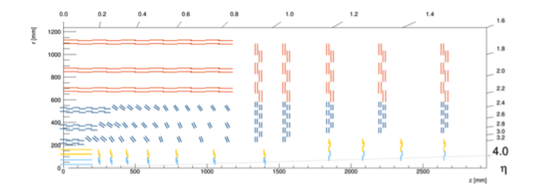
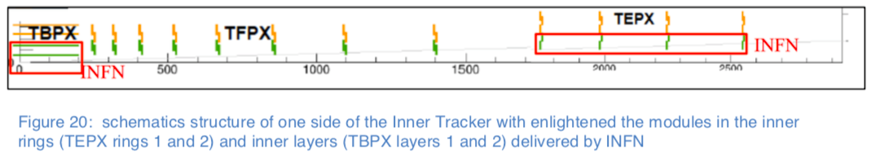
INFN commitments in Tracker construction
INFN will deliver for the IT :
rz layout
1128 Pixel modules assembled, integrated & tested in :
– inner layers (TBPX L1 & L2)
IT
– inner rings (TEPX R1 & R2 in Disks 1-4)
July2018 - C.d.S. @INFN-Bari
23/47

Slide 38
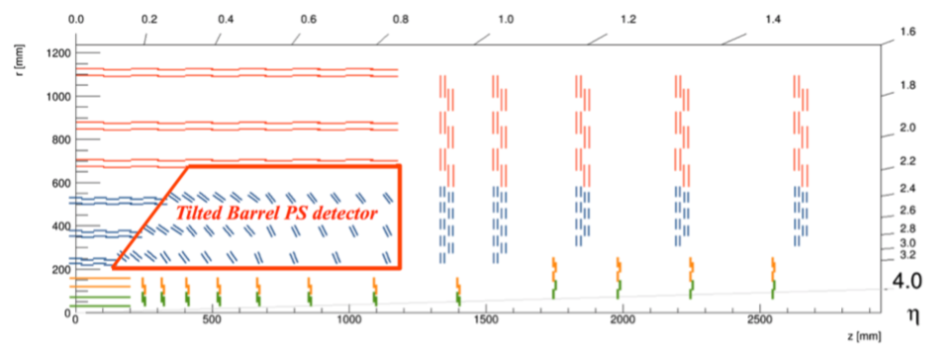
INFN commitments in Tracker construction
INFN will deliver for the IT :
OT
rz layout
1128 Pixel modules assembled, integrated & tested in :
– inner layers (TBPX L1 & L2)
IT
– inner rings (TEPX R1 & R2 in Disks 1-4)
OT
INFN will deliver for the OT :
1920 PS modules assembled,
integrated & tested in :
– 72 rings of the Tilted Barrel
(TBPS)
July2018 - C.d.S. @INFN-Bari
23/47

Slide 39
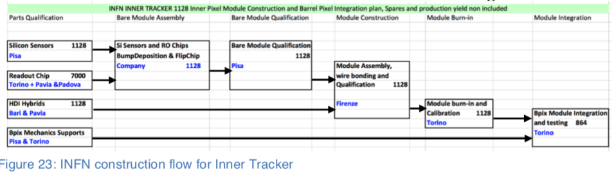
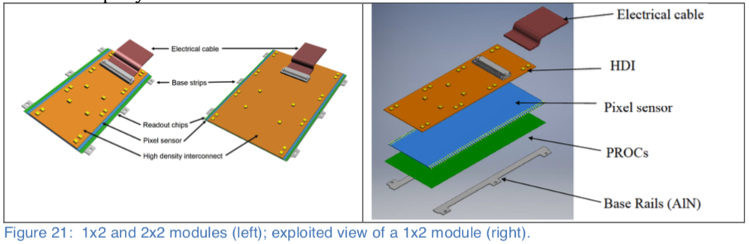
CMS-BARI commitments in IT construction : HDI Hybrids
CMS-Bari will take care of the Front End Hybrids testing/quality control task :
High Density Interconnect (HDI) Hybrids – produced by a supplier company –
will be qualified in Bari & Pavia using a dedicated setup.
Qualified good HDIs will be delivered to Firenze for module assembly.
July2018 - C.d.S. @INFN-Bari
24/47

Slide 40
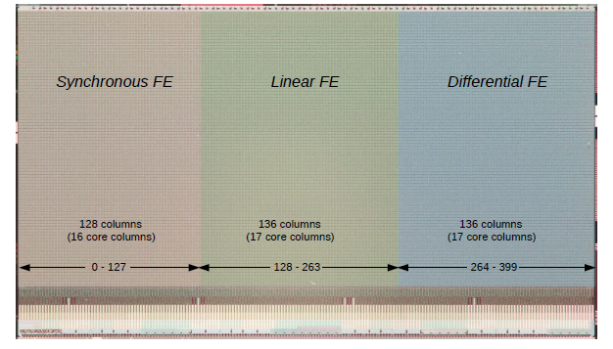
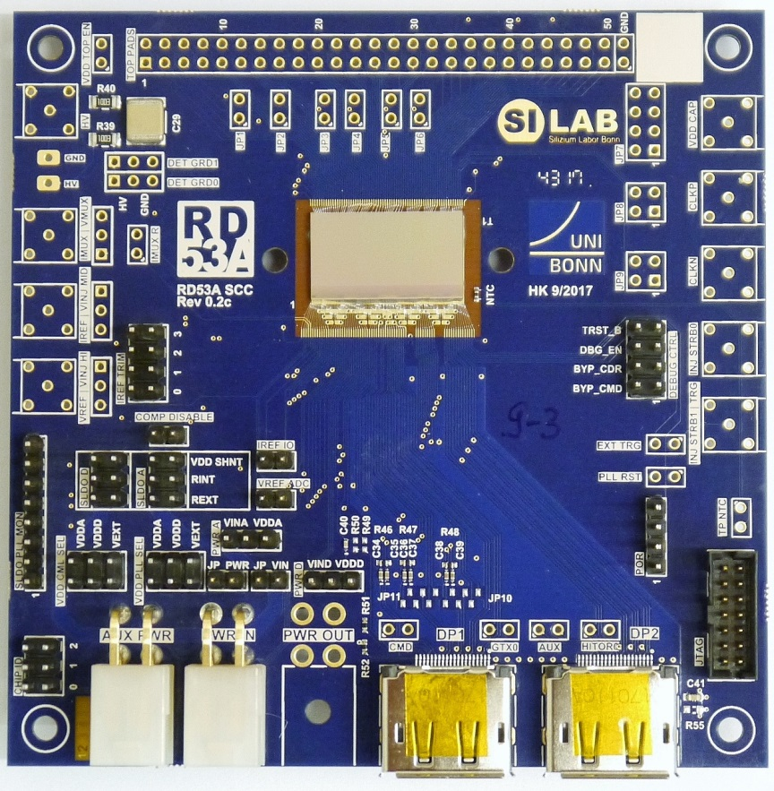
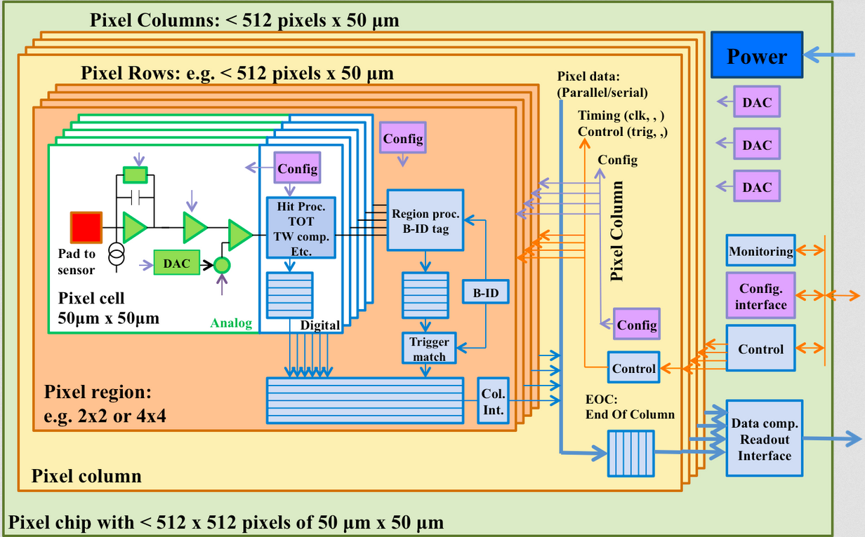
CMS-BARI commitments in IT construction : Pixel readout chip
INFN is also participating to the development, integration and commissioning
of the IT common system (power backend, DAQ & safety systems).
The IT DAQ system is under development having as a starting point the test-setup of RD53A chip.
Design/development activity started in Bari since 2013 within RD53 Collaboration & CHIPIX65 (Gr.V)
- Design, production of a large scale demonstrator “RD53A” was in 2017
2018 activity
Chip size: 20.066 x 11.538 mm²
400x192 pixel array
- Design of the production pixel readout chip for CMS & Atlas
on the basis of the “RD53A” successfull measurements/tests
of 2018 and the final specifications of the two experiments
2019 activity plans
- continuation of the pixel readout chip design & submission to foundry in Q4 2019
- preparation of the Front End Hybrids test (tests foreseen in 2020-2023)
Involved engineers (RD53 group): F. Loddo, G. De Robertis, C. Marzocca, G. Matarrese
F. Loddo is RD53A Project Engineer since 6/2016; recently appointed in this role for the
development of final chip with additional coordination responsibility within RD53 Collab.
Since 5/2018 also responsible for the development of the pixel ASIC within IT coordination
for CMS Phase-2 upgrade.
RD53 digital pixel chip architecture
July2018 - C.d.S. @INFN-Bari
25/47

Slide 41



CMS-BARI commitments in OT construction : PS modules
CMS-Bari will carry out the production of 50% of 1920 TBPS modules
macro-pixel sensor (PS-p)
short-strip sensor (PS-s)
Pixel Sensor module assembly :
- PS-s sensor,
- Macro-Pixel Sub Assembly (MaPSA) [1 PS-p sensor bump bonded with 16 Macro Pixel Asics],
- Front-End Hybrid to readout short strips (HL & HR are the 2 types of FEH),
- Power Hybrid (PH) [equipped with Power DCDC regulator],
- Optohybrid (OH) [equipped with optical link drivers & opto-fiber connector]
… will be assembled and glued to mechanical parts in 5 steps, using different jigs, to finally form a module!
A full qualification test will be performed to assess quality & identify issues.
Encapsulation of wire bonding will be made after testing. Qualified modules will be delivered to Pisa.
July2018 - C.d.S. @INFN-Bari
26/47

Slide 42





Preparation activity for the TBPS modules’ production
INFN-Bari will be one of the two assembly centers : 960 modules to produce and qualify (2020-2023)
- the construction & wire-bonding of a PS module are based on the use of 6(at least)-7 manual jigs
- an automated machine will be used only in the phases of glue distribution & encapsulation
Involved physicists: D. Creanza, M. de Palma, L. Fiore, S. My, M. Ince
2018 activity
- design (Serv. Progett. Mecc. - M. Mongelli), realization & validation of jigs’ prototypes
- glueing trials of the several components of a PS module with glue EP 601-LV (candidate to final use)
- realization of mechanical mockups of (pseudo-) sensors & hybrids
- realization of the first mechanical modules for bonding tests (P. Cariola)
Within the end of 2018 :
  - production of more realistic dummy modules (as soon as components will be available)
  - fine tuning of the test/certification station
2019 activity plans
- finalization of assembly jigs
- tests of glue dispenser robot with volumetric control [to be bought in 2019 (CTS)]
- production & qualification of 5 functional modules
July2018 - C.d.S. @INFN-Bari
27/47

Slide 43
Tracker requests for INFN-Bari services in 2019
Requests (*) evaluated in “Mesi Persona” (m.p.)
SERVICE | TRACKER | Task
Progett. Meccanica | 7 | jigs (prototypes) design (¹)
Officina meccanica | 7 | Fabrication of jigs (for PS module assembly) (²)
Camera Pulita | 9 | Modules construction/assembly (³)
Servizio Elettronico | 2 | Debug of eventual troubles during the setup of the test station
(*) Note: requests based on the experience matured in 2018 :
(¹) design of jigs (prototypes) : 0.5m.p. x 7jigs x 2 iterations (1 modification foreseen in average)
(²) production of jigs : 0.5m.p. x 7jigs x 2 iterations (1 modification foreseen in average)
(³) 9 = 3m.p. for mechanical mockups to use jigs in full assembly trials (glueing included)
+ 3m.p. for 5 dummy modules
+ 3m.p. for 5 functional modules
July2018 - C.d.S. @INFN-Bari
28/47

Slide 44





Lab space of INFN-Bari for Outer Tracker commitments
Currently used Clean Rooms (CP1, CP2) will be confirmed till 2023 and
will be intensively used in the construction period 2020-2023
GEM clean room
CP3
Cl.10000 / ISO7
CP2
Cl.10000 / ISO7
servizi
CP3
CP2
CP1
CP1
Cl.1000 / ISO6
July2018 - C.d.S. @INFN-Bari
29/47

Slide 45
CMS Muon system upgrade
July2018 - C.d.S. @INFN-Bari

Slide 46









Current Muon chambers System & upgrade
Robust trigger, efficient muon reconstruction & excellent identification performances
The CMS Muon system consists of 3 distinct detector systems :
Resistive Plate Chamber (RPC)
0 < |η| < 1.8
480 (barrel) + 576 (endcap) chambers
Spatial resolution 0.8-1.3 cm, time resolution 1.5 ns
Drift Tube (DT):
0 < |η| < 1.2
250 chambers
Spatial resolution 100 µm time resolution 2 ns
Cathode Strip Chamber (CSC)
0.9 < |η| < 2.4
540 chambers
Spatial resolution 50-140 µm, time resolution 3 ns
Upgrade goal: maintain excellent triggering, μ measurement & ID under harsher HL-LHC conditions up to
$$\left|η\right|=2.8$$
all currently installed Muon detectors will be kept operational @ HL-LHC
July2018 - C.d.S. @INFN-Bari
30/47

Slide 47
Main Muon system upgrade features - I
High radiation, PU, longer trigger latency require : - the upgrade of several components (electronics)
- the addition of new ones (in forward region)
[in particular new Gas Electron Multiplier Detectors]
A longevity validation campaign took place (with Bari contribution) in the past years.
As a result : the components requiring upgrade & the actions to be undertaken were identified
- DT, CSC & RPC detectors currently installed will survive the radiation doses
- new GEM & iRPC detectors will be able to deal with the expected radiation doses
July2018 - C.d.S. @INFN-Bari
31/47

Slide 48



Upgraded Muon system overview - I
High radiation, PU, longer trigger latency require : - the upgrade of several components (electronics)
- the addition of new ones (in forward region)
[in particular new Gas Electron Multiplier Detectors]
A longevity validation campaign took place (with Bari contribution) in the past years.
As a result : the components requiring upgrade & the actions to be undertaken were identified
- DT, CSC & RPC detectors currently installed will survive the radiation doses
- new GEM & iRPC detectors will be able to deal with the expected radiation doses
Key issues :
(100 $→750kHz )$
(3.2 $→12μs )$
- detector electronics (DT & CSC) must be upgraded to handle higher L1 trigger rates & to longer latency
- longevity : aging electronic parts need to be replaced
while detector life expectancy (related to radiation damage) is more than acceptable
- event reconstruction capabilities (@trigger & offline) particularly in forward region that will be
completed with the missing RPC chambers & complemented by new GEM chambers to enhance redundancy, to
increase # of measurements, spatial & time resolution, to solve - @ trigger level - track reconstruction ambiguities
- extended acceptance ( coverage) to partially complement the wider tracking coverage
$$\left|η\right|$$
July2018 - C.d.S. @INFN-Bari
31/47

Slide 49

Upgraded Muon system overview - II
Upgrade goal : maintain excellent triggering, μ measurement & ID under harsher HL-LHC conditions
1. New forward μ detectors:
July2018 - C.d.S. @INFN-Bari
32/47

Slide 50



Upgraded Muon system overview - II
Upgrade goal : maintain excellent triggering, μ measurement & ID under harsher HL-LHC conditions
1. New forward μ detectors:
- Triple GEM technology [in GE1/1, GE2/1 & ME0] to enhance trigger & μ-reco
stack of 2 Triple-GEMs
stack of 2 Triple-GEMs
stack of 6 Triple-GEMs
July2018 - C.d.S. @INFN-Bari
32/47

Slide 51



Upgraded Muon system overview - II
Upgrade goal : maintain excellent triggering, μ measurement & ID under harsher HL-LHC conditions
1. New forward μ detectors:
- Triple GEM technology [in GE1/1, GE2/1 & ME0] to enhance trigger & μ-reco
- Improved RPC (iRPC) [ in RE3/1 & RE4/1 ] ( rates up to ,
increased lever arm for μ-reco )
2$kHz$/${cm}^{2}$
Front End Boards
July2018 - C.d.S. @INFN-Bari
32/47

Slide 52




Upgraded Muon system overview - III
Upgrade goal : maintain excellent triggering, μ measurement & ID under harsher HL-LHC conditions
New forward μ detectors:
- Triple GEM technology [in GE1/1, GE2/1 & ME0] to enhance trigger & μ-reco
- Improved RPC (iRPC) [ in RE3/1 & RE4/1 ] (rates up to )
2$kHz$/${cm}^{2}$
- to handle (aiding CSCs) the most difficult region with high backgrounds,
high readout & trigger rates and limited μ-bending (@ higher )
$$\left|η\right|$$
- to extend the μ coverage by introduction of ME0 (a stack of 6 Triple-GEMs) up to
[complementary to tracker extension up to ]; useful for μ-tagging & reduction of the lost-μ bkg
$$\left|η\right|=2.8$$
$$\left|η\right|=3.8$$
July2018 - C.d.S. @INFN-Bari
33/47

Slide 53

Muon system upgrade – schedule overview – I
The schedule for the Muon system upgrade foresees a time-staggered installation !
Indeed - during LS3 - the Muon upgrade activities cannot be integrated due to the overloaded schedule
[ involving the installation of the new Tracker & High Granularity Calorimeter (HGCAL) ]
Some Muon upgrade activities & installation can be anticipated to LS2 (before Run-3):
- the upgrade of the Endcap (CSC) chambers is @ LS2 [refurbish MEx/1 (x=1,…,4) with new FE boards]
- GEM stations (GE1/1) will be installed in LS2 (including pipes & cable services)[*] [partly constructed in Bari]
LS2
More detailed time schedule in a backup slide
- other activities in LS2 :
- installation of services for GE2/1, RE3/1, RE4/1 [*]
- RPC leak repairs [*]
[*] activities requiring INFN-Bari technicians @ CERN
July2018 - C.d.S. @INFN-Bari
34/47

Slide 54
Muon system upgrade – schedule overview – II
Some Muon upgrade activities & installation can be anticipated to YETS 2022 & 2023 (during Run-3):
- GEM stations (GE2/1) will be installed in YETS/22 & /23 [*]
- iRPC chambers (RE3/1, RE4/1) will be installed in YETS/22 & /23 [*]
More detailed time schedule in a backup slide
YETS/22
YETS/23
- other activities in 2021-2022 : ME0 construction in Bari (see slide later)
[*] activities requiring INFN-Bari technicians @ CERN
July2018 - C.d.S. @INFN-Bari
34/47

Slide 55
Muon system upgrade – schedule overview – III
Last Muon upgrade activities concern LS3 :
- ME0 GEM stations will be installed in 2024-2025 [LS3] [*]
More detailed time schedule in a backup slide
LS3
The ME0 installation will be done in surface while the assembly of the Calorimeter endcaps (HGCAL) will be carried out, during LS3, as CMS moves into a closed barrel configuration.
The installation of the HGCAL will require the extraction of the ME1 (CSC, RPC, GEM) chambers and subsequent
re-installation & re-commissioning [*].
[*] activities requiring INFN-Bari technicians @ CERN
July2018 - C.d.S. @INFN-Bari
34/47

Slide 56
GEM system for Phase-2 CMS
July2018 - C.d.S. @INFN-Bari

Slide 57



INFN(-Bari) commitments in GEM construction
INFN will deliver for the upgraded Muon system
a part of the designed Triple-GEM detector (see backup) :
72/288 GE2/1 detectors (36 chambers @ Bari; 36@ LNF)
@ Bari
- to be installed/commissioned/analyzed in YETS 2022/23
54/216 ME0 detectors (27 chambers @ Bari; 27@ LNF)
- to be installed/commissioned/analyzed in LS3
2019
2021
Schedule GE2/1
Schedule ME0
2024
This will be in addition to the current (2017/8) production activity of 18 GE1/1 chambers @ Bari :
13 chambers already constructed & tested (5 to be done) [next slide]; installation+commissioning in LS2
July2018 - C.d.S. @INFN-Bari
35/47

Slide 58









Current Production @ Bari of GE1/1 chambers
[R. Venditti, P. Verwilligen, A. Colaleo, A. Sharma, A. Ranieri, E. Soldani]
1.
Arrival of materials
6. Transport to CERN
2. Check Materials
Pre-Assembly
4. Transport
5. Quality Control
3.
Assembly in Clean Room
Assistance by technicians:
- officina mecc.
- design CAD
- serv. elettronico
July2018 - C.d.S. @INFN-Bari
36/47

Slide 59
GEM activities @Bari – RECAP
Past activities in 2018:
Build & Test 18 GE1/1 chambers (spring-summer 2018) + Build GE2/1 prototypes (fall 2018)
VFAT3 design, bench-tests & tests with full GE1/1 chambers @ CERN
Analysis of Slice Test data, Run Coordination (M. Maggi)
Activities in 2019-2020 (LS2):
Install & commissiong GE1/1 chambers + Detector Performance Analysis
Build & Test 72 GE2/1 chambers (2019-2020) together with LNF
VFAT3 Packaging & Test
Activities 2021-2025 (EYTS + LS3):
Build & Test 54 ME0 chambers (2021-2022) together with LNF
Install GE2/1 in YETS 2022 & 2023 + Commissioning & Detector Performance
Install ME0 in 2024-2025 (LS3) + Commissioning & Detector Performance
July2018 - C.d.S. @INFN-Bari
37/47

Slide 60
GEM requests for INFN-Bari services in 2019
Requests evaluated in “Mesi Persona”
SERVICE | GEM | Task
Progett. Meccanica | -
Officina meccanica | 4.5 @ CERN 3 | GEM SuperChambers assembly (2) GE1/1 installation [chambers + services (HV/LV)] (2.5) Modules construction [2 prototipi GE2/1 + 22 GE2/1]
Camera Pulita | 3 | Mitutoyo expert (precision measurements)
Servizio Elettronico | 2 1.5 @ CERN | GE2/1 modules : test setup GE2/1 services (HV/LV) installation (1.5)
July2018 - C.d.S. @INFN-Bari
38/47

Slide 61




Lab space of INFN-Bari for GEM commitments
Currently used laboratory space (Clean Room + 2 Labs) confirmed & saturated for the period 2019/23
Clean Room (CP3)
2 Laboratories (*):
S-01 (ex-BC2S) :
- Material inspection
- GEM Chamber
Pre-Assembly
- Gas leak test (QC3)
- HV-test (QC4)
- “Hospital”
S-06-08 (ex BC2S) :
- GEM Gain Measurement
- GEM Gain Uniformity
(*) equipped/instrumented thanks to funds by Dotazioni-Gr.I
July2018 - C.d.S. @INFN-Bari
39/47

Slide 62
RPC system for Phase-2 CMS
July2018 - C.d.S. @INFN-Bari

Slide 63

CMS-Bari commitments into RPC upgrade
Activities for the RPC upgrade are foreseen to be carried out @CERN :
ongoing longevity tests @ GIF++, to be continued & completed by 2020/21
RPC leak repairs & installation of services for RE3/1, RE4/1
in LS2 (2019-20) :
in YETS/22 & /23 : installation of iRPC chambers (RE3/1, RE4/1) [36 & 36]
& commissioning
in LS3 (2024-25) : re-installation & re-commissioning
of ME1 RPC chambers
18 & 18
(x2 endcaps)
Front-End board electronics
Front End Boards
double-gap RPC
wedge-shaped with
- HPL electrodes,
- pick-up strips in the middle,
- improved FE electronics
July2018 - C.d.S. @INFN-Bari
40/47

Slide 64
CMS-Bari commitments into RPC upgrade
Activities for the RPC upgrade are foreseen to be carried out @CERN :
ongoing longevity tests @ GIF++, to be continued & completed by 2020/21
RPC leak repairs & installation of services for RE3/1, RE4/1
in LS2 (2019-20) :
in YETS/22 & /23 : installation of iRPC chambers (RE3/1, RE4/1) [36 & 36]
& commissioning
in LS3 (2024-25) : re-installation & re-commissioning
of ME1 RPC chambers
18 & 18
(x2 endcaps)
Front-End board electronics
Front End Boards
The new iRPC chambers will need to be instrumented with a new a Front-End (FE) board electronics.
double-gap RPC
wedge-shaped with
- HPL electrodes,
- pick-up strips in the middle,
- improved FE electronics
The baseline for the FE electronics is developed in Lyon (PETIROC).
A back-up choice is represented by a - currently under study - ASIC chip developed @ Roma-TorVergata (synergy with ATLAS);
a 16-channel version has been successfully tested on a double-gap RPC @GIF++ during summer 2017.
Final decision on the electronics will be taken after suitable test-beams
and within 2018.
July2018 - C.d.S. @INFN-Bari
40/47

Slide 65

RPC activities @Bari – RECAP
Past activities in 2018:
Longevity tests RPC in GIF++ Operation & Analysis: RPC system ok up to
Activities in 2019-2020 (LS2):
Longevity tests RPC in GIF++ to be continued
Gas Leak Repairs + services iRPC
FE electronics tests
(ATLAS chip as backup for PETIROC)
Activities 2021-2025:
iRPC chamber validation @ CERN + installation in YETS 2022-2023
+ Commissioning & Detector Performance
0.6$kHz$/${cm}^{2}$
July2018 - C.d.S. @INFN-Bari
41/47

Slide 66




RPC system Longevity test @ GIF++(Cern)
To certify the RPC system at HL-LHC conditions a new LONGEVITY
STUDY started @ Gamma Irradiation Facility (GIF++) in 2016
40 %
Expected integrated charge @ HL-LHC
840 mC/cm²
Setup @ GIF++:
2 RE2 chambers (Irrad & Ref)
2 RE4 chambers (Irrad & Ref)
Detectors performance are stable so far.
Plan to complete the irradiation test on these chambers & with standard gas mixture by 2021
(A. Gelmi, G. Pugliese)
July2018 - C.d.S. @INFN-Bari
42/47

Slide 67
RPC requests for INFN-Bari services in 2019
Requests evaluated in “Mesi Persona”
SERVICE | RPC | Task
Progett. Meccanica | -
Officina meccanica | 4.5 @ CERN | Fixing Gas Leak for current Barrel RPC (4) GIF++ operations support (0.5)
Camera Pulita | -
Servizio Elettronico | 1.5@CERN | iRPC (Phase-2) services installation
July2018 - C.d.S. @INFN-Bari
43/47

Slide 68
WRAP-UP/ Tables
July2018 - C.d.S. @INFN-Bari

Slide 69
Current Contributions/Responsibilities within CMS
2018 2019
Group | Name | Responsibility task | Level
RUN | Lucia Silvestris | Run coordinator | L1
MUON | Anna Colaleo | Muon System manager | L1
RPC | Gabriella Pugliese | RPC project manager | L2
TRK | Flavio Loddo | RD53 project engeneer + IT coordinator | L2
GEM | Rosamaria Venditti | Upgrade Physics coordinator | L2
GEM | Marcello Maggi | Bari-T2 coordinator | L2
COMP | Giorgio Maggi | GEM Operations & Online coordinator | L3
MUON | Raffaella Radogna | Muon-POG subconvener | L3
GEM | Piet Verwilligen | GEM simulation convener | L3
Muon/Phys | Leonardo Cristella | Muon-POG / BPH contact | L3
Muon/Phys | Raffaella Radogna | Muon-POG / EXO contact | L3
Phys | Alexis Pompili | CMS representative @ HFLAV | -
Phys | Nicola De Filippis | DAS & PhD Thesis Award committees | -
TRK | Mauro De Palma | Carreer committee | -
AP (TL / CB representative / Safety resp.)
Team responsibilities :
Salvatore My (deputy TL / Tracker IB representative)
Piet Verwilligen (deputy TL / Muon IB representative)
July2018 - C.d.S. @INFN-Bari
44/47

Slide 70
Total requests for INFN-Bari services in 2019 - Recap
Requests evaluated in “Mesi Persona” (in parenthesis @CERN) :
SERVICE | TRACKER | GEM | RPC | TOTAL
Progettazione Meccanica | 7 |  |  | 7
Officina meccanica | 7 | 3+ (4.5) | (4.5) | 10+(9)
Camera Pulita | 9 | 3 |  | 12
Servizio Elettronico | 2 | 2+(1.5) | (1.5) | 4+(3)
We gratefully acknowledge the enduring support & effort provided by INFN-Bari technicians
in their excellent contribution to design, construction, installation, maintenance & repair activities provided to the CMS experiment !
July2018 - C.d.S. @INFN-Bari
45/47

Slide 71

Anagrafica for CMS-Bari 2019 - I
CMS 2019 :
July2018 - C.d.S. @INFN-Bari
46/47

Slide 72

Anagrafica for CMS-Bari 2019 - II
FASE2_CMS 2019 :
July2018 - C.d.S. @INFN-Bari
47/47

Slide 73
BACKUP
July2018 - C.d.S. @INFN-Bari

Slide 74

Physics Highlights (from LHCP 2018)
CMS paper on “observation of ttH production” published on the 4th of June [Phys.Rev.Lett. 120, 231801]
July2018 - C.d.S. @INFN-Bari
74

Slide 75

rz cross section of the upgraded CMS detector (quadrant)
July2018 - C.d.S. @INFN-Bari

Slide 76
Summary on Phase-2 Upgrade
The HL-LHC & CMS Phase-2 are widespread & complex projects that will allow to perform Physics research (@CERN) for other 15 years, going from the Energy Frontier to the Intensity Frontier
(by increasing luminosity rather than energy scale) and looking for New Physics signs while performing precision measurements.
CMS-Bari has been, is and will be heavily involved in activities for the CMS Phase-2 upgrade.
In particular into:
- new Tracker construction & commissioning
- new GEM detectors construction, test & commissioning
- new iRPC test & commissioning
Construction activities imply intense efforts from physicists & technicians highly committed
in INFN-Bari properly equipped laboratories, till LS3 (2024-26).
Limited amount of temporary but fully dedicated experts need to be hired on specific tasks.
Further efforts, also from technicians, will be requested in test & commissioning activities @CERN.
July2018 - C.d.S. @INFN-Bari

Slide 77

Concept of Trigger latency
Credits: F. Pastore
July2018 - C.d.S. @INFN-Bari

Slide 78



CMS Triple-GEM detector - I
CMS Triple-GEM
GE2/1
ME0
GE1/1
Stack of 2 triple GEMs
Stack of 6 triple GEMs
July2018 - C.d.S. @INFN-Bari

Slide 79


CMS Triple-GEM detector - II
Diagram of the GEM electronics readout system for CMS
VFAT3 block diagram
July2018 - C.d.S. @INFN-Bari

Slide 80

Activities within INFN LHC computing fellowships
(C. Calabria)
In the context of my INFN “fellowship” regarding the R&D on scientific computing for innovative solutions for the LHC experiments, my activity until now have been twofold:
  Parallel programming on GPU: I collaborated with the “Future tracking” group
    The group takes care in CMS of developing a hybrid CPU-GPU application that takes RAW data coming from the pixel detector and gives tracks as result
    I contributed to the implementation on GPU and to the optimization of the first step of the chain, i.e. the unpacking of the raw data (Raw2Digi) coming from the pixel detector. In particular:
      unpacking of the errors from the FEDS on GPU
      optimization of the memory allocations and transfers
      check of the results towards the serial implementation
  Machine learning application: I am collaborating with the “ML Muon” group
    The groups take care inside the CMS Muon community (DT, RPC, CSC, GEM) of developing innovative tools for monitoring the performance of the CMS Muon System and the detection of its anomalies
    Currently I am working on the development of a monitoring tool based on Machine Learning techniques for the DT Local Trigger System.
      The algorithm must correlate trigger rates and instantaneous luminosities coming from CMS database and identify chamber(s) with rate problem(s)
      Best results with (semi-)supervised approaches like AutoEncoders and KMeans clustering
    On long term this R&D work is meant to lead to a tool that can be run at different stages of the L1 Muon Barrel Trigger correlating different sources of information to make a diagnosis of the issue
      Another student (M.Ince) has started to work on the monitoring of the RPC Local Trigger (only barrel)
July2018 - C.d.S. @INFN-Bari
80

Slide 81

Improving efficiency of analysis jobs in CMS
(L. Cristella)
CMS experiment has a workload management system that schedules and executes production & user tasks in a distributed Grid infrastructure. Submission is performed via the CMS Remote Analysis Builder (CRAB).
Recent focus on efficiency & optimization : turnaround time, CPU efficiency, system scalability.
There are 3 lines of work :
Encouraging results. Generally high user satisfaction. Few issues showed up & got solved.
July2018 - C.d.S. @INFN-Bari

Slide 82





Deep Learning for tracking (with GPUs usage)
Tracks RECONSTRUCTION @ CMS
(A. Di Florio)
Seed generation: bottleneck due to huge combinatorial background. For a single (simulated) pp collision event: ${O(10}^{5})$ seeds produced with fake ratio $\sim O(100)$ corresponding to $O(1000)$ true seeds.
Pixel Hits
Seeding
Tracks Building
Track fitting
Each seed is build from a couple of hits on the silicon pixel tracker detector. Each hit is not simply a point on the detector but it is a collection of pixels (2D ) on or off. Each hit is then a 2D pixel image centered on the center of charge. (15x15)
Pattern recognition problem (true/fake classification): suitable for a Convolutional Neural Network approach
π⁺
π⁺
ML/DL techniques for mitigating combinatorial explosion look very promising :
Val – 0.966
Test – 0.968
Train – 0.969
Whole Dataset Training |  |  | @ Max Acc |  | Rej@ Eff |  | Eff @ Rej
 | AUC | ACC | Efficiency | Rejection | 0.99 | 0.999 | 0.99 | 0.5
Test | 0.968 | 0.90 | 0.96 | 0.91 | 0.81 | 0.65 | 0.54 | 0.99
Val | 0.966 | 0.90 | 0.95 | 0.91 | 0.81 | 0.66 | 0.54 | 0.99
Train | 0.969 | 0.91 | 0.96 | 0.91 | 0.81 | 0.65 | 0.55 | 0.99
July2018 - C.d.S. @INFN-Bari

Slide 83

Infrastructures for Outer Tracker commitments
Infrastructures @ INFN-Bari for the CMS (Outer) Tracker upgrade :
July2018 - C.d.S. @INFN-Bari

Slide 84




Upgraded Muon system performances
Few examples of foreseen performances (with full MC simulation):
Illustration of the additional
info provided by the new GEM
Enhanced μ triggering & identification in the forward region :
- The Phase-2 upgraded forward muon system has new detectors (GE1/1, GE2/1, RE3/1, RE4/1) that provide 1) further high-resolution measurement points & 2) an increased lever arm for μ reconstruction, in the current range
$$\left|η\right|<2.4$$
$$\left|η\right|=2.8$$
- The ME0 chambers extend the acceptance to , providing additional hits for triggering and offline μ reconstruction
Axial (transverse) point-of-view
- GEM chambers, in tandem with CSC ones, provide accurate measurement of μ
“local bending” angles, thus improving the muon momentum measurement
Standalone μ trigger capabilities are important, for instance for the reconstruction of long-lived particle decaying into muons outside the IT.
L1 Standalone Trigger :
- sizable reduction of the rate (bkg )
- relevant increase of the efficiency
(in forward region)
July2018 - C.d.S. @INFN-Bari

