Slide 1

SR3T: High energy phase-shift triggered nanoparticles for dosimetry
PCDA Phase Change Perfluorocarbon Nanodroplets
Yosra Toumia, Fabio Domenici, Gaio Paradossi

Slide 2
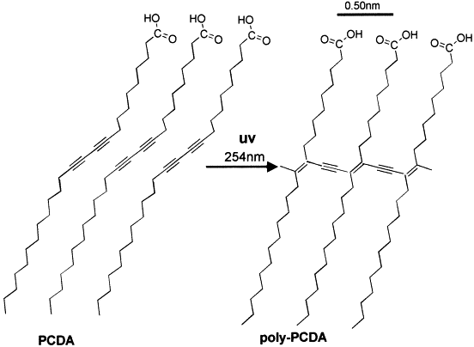
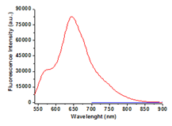
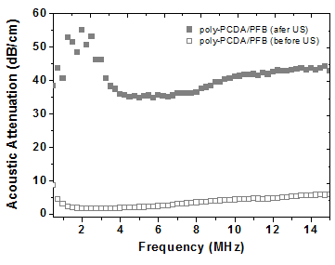
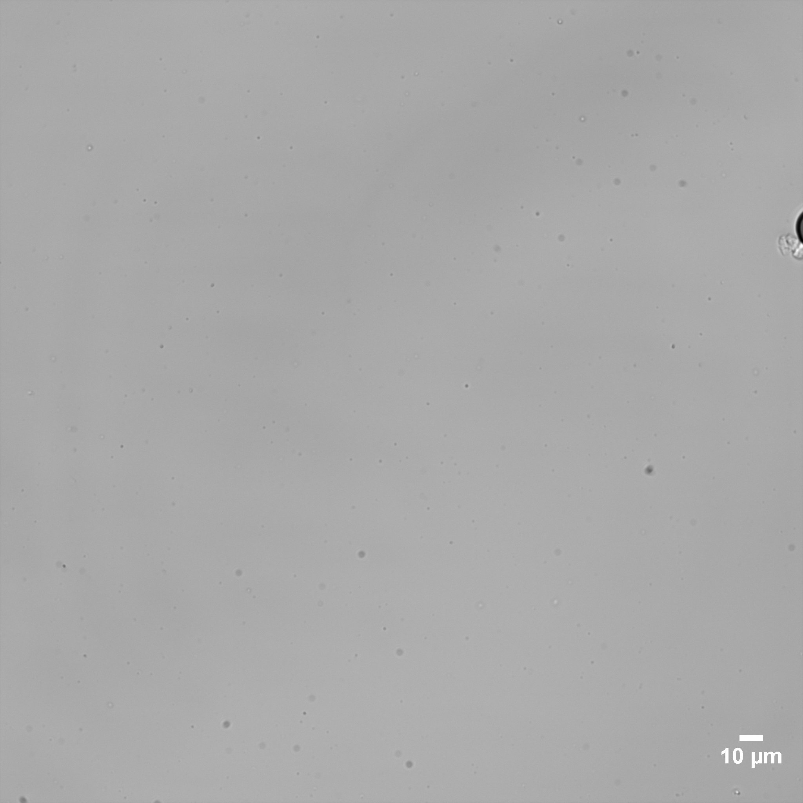
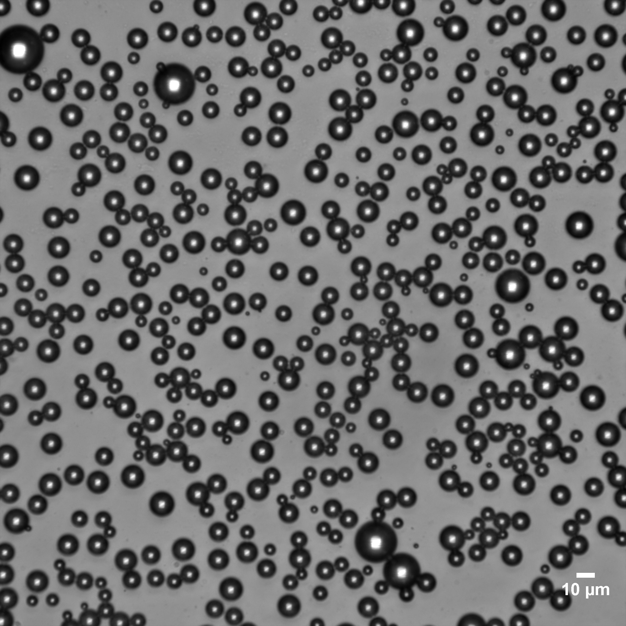
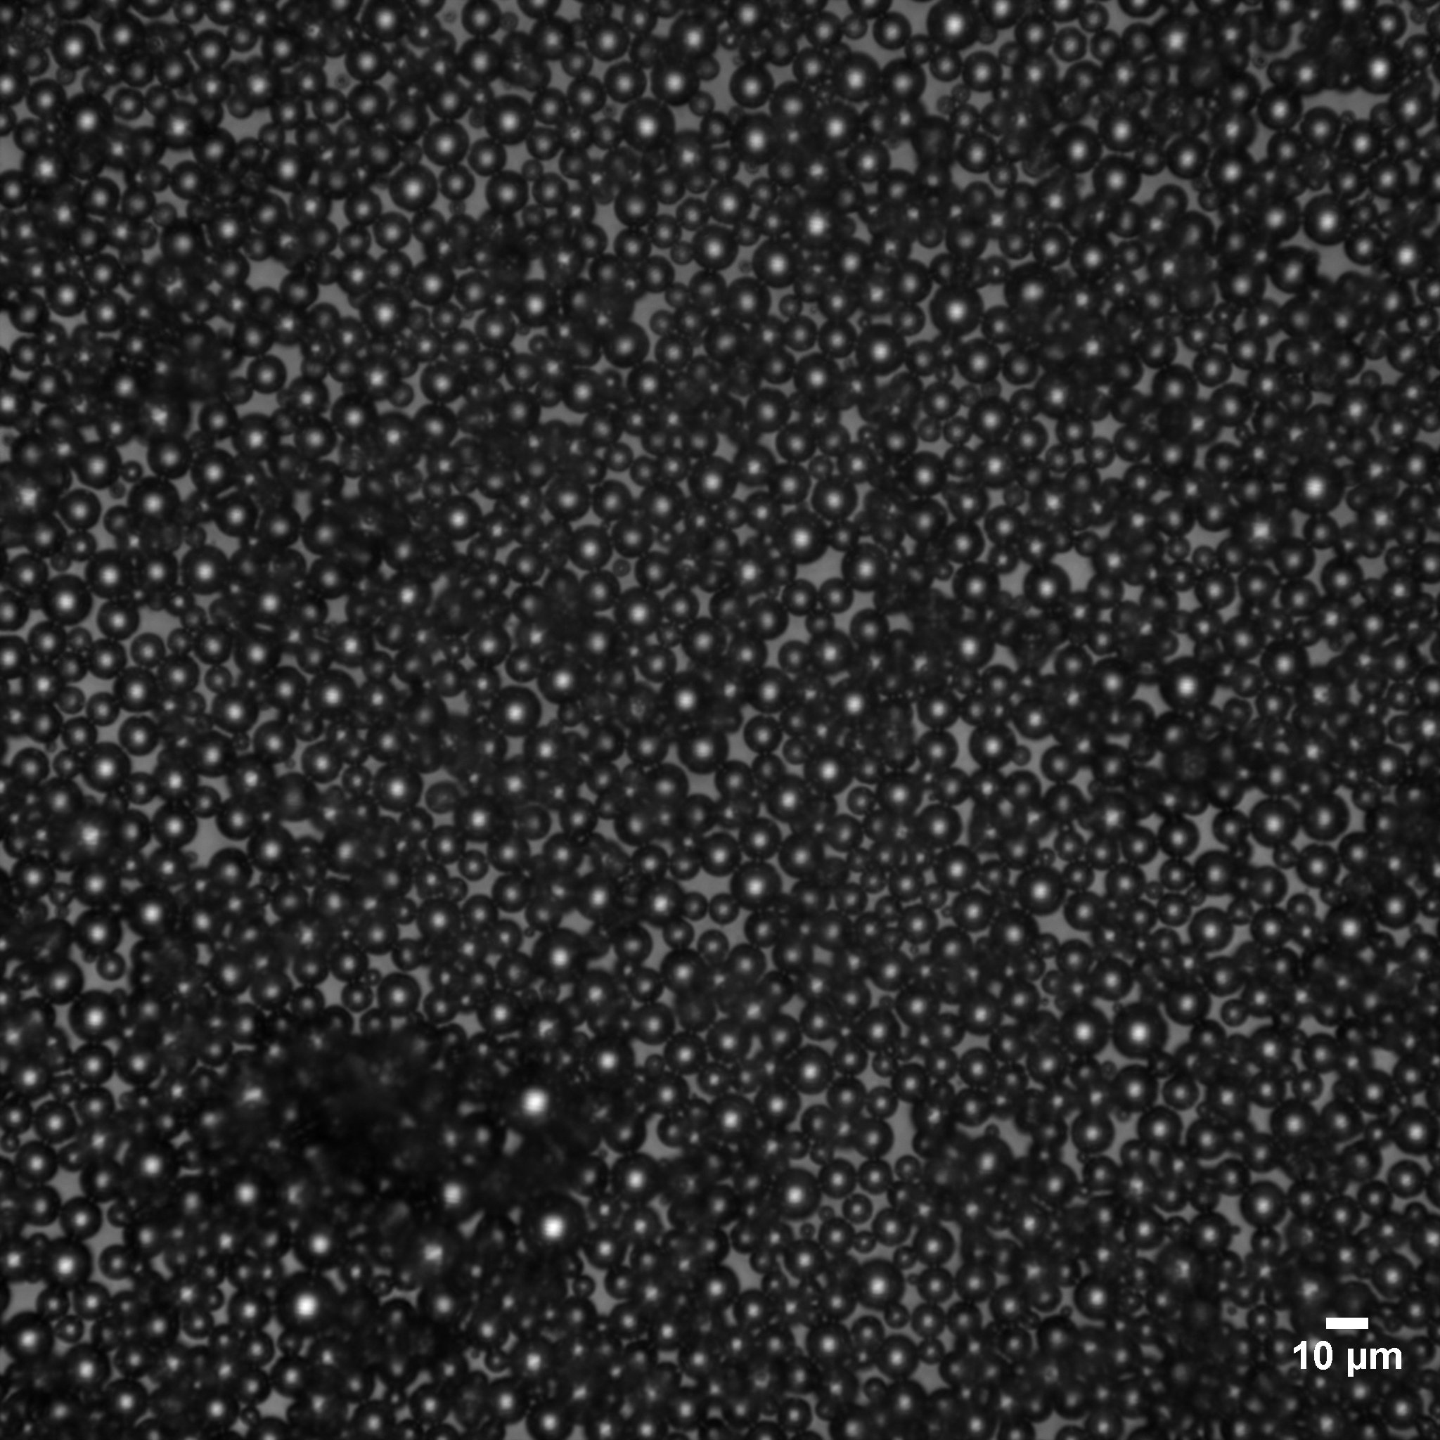
1
Poly-PCDA Droplets: Concept Reminder
γ, X rays
Poly-PCDA/PFC blue
Poly-PCDA/PFC red
Before US
After ADV_0.1 W/cm²
DC 100- 30s
After ADV_0.5 W/cm²
DC 100, 30s
250 ± 10 nm
7.5 ± 2.7 µm

Slide 3
GPC Characterisation of the polymer chains (Dr. Heiko Lange, Dept Chemistry, UniTOV)
GPC analyses
pcda-polymers re-dissolved in DMSO.
conditions: Plgel mix column, DMSO, 0.25 ml/min, PDA-detector.
data evaluation: Excel-based, calibration using polystyrenesulfonic acid standards
(MW range 4.3 – 2600 kDa).
results: Mn (5 min sample) = 5400 Da (DP 14) Mn (15 min sample) = 6200 Da (DP 17)
Mp (5 min sample) =16000 Da (DP 46) Mp (15 min sample) = 15500 Da (DP 45)
=> Increasing polymerization upon prolonged mixing prior to curing.
3

Slide 4
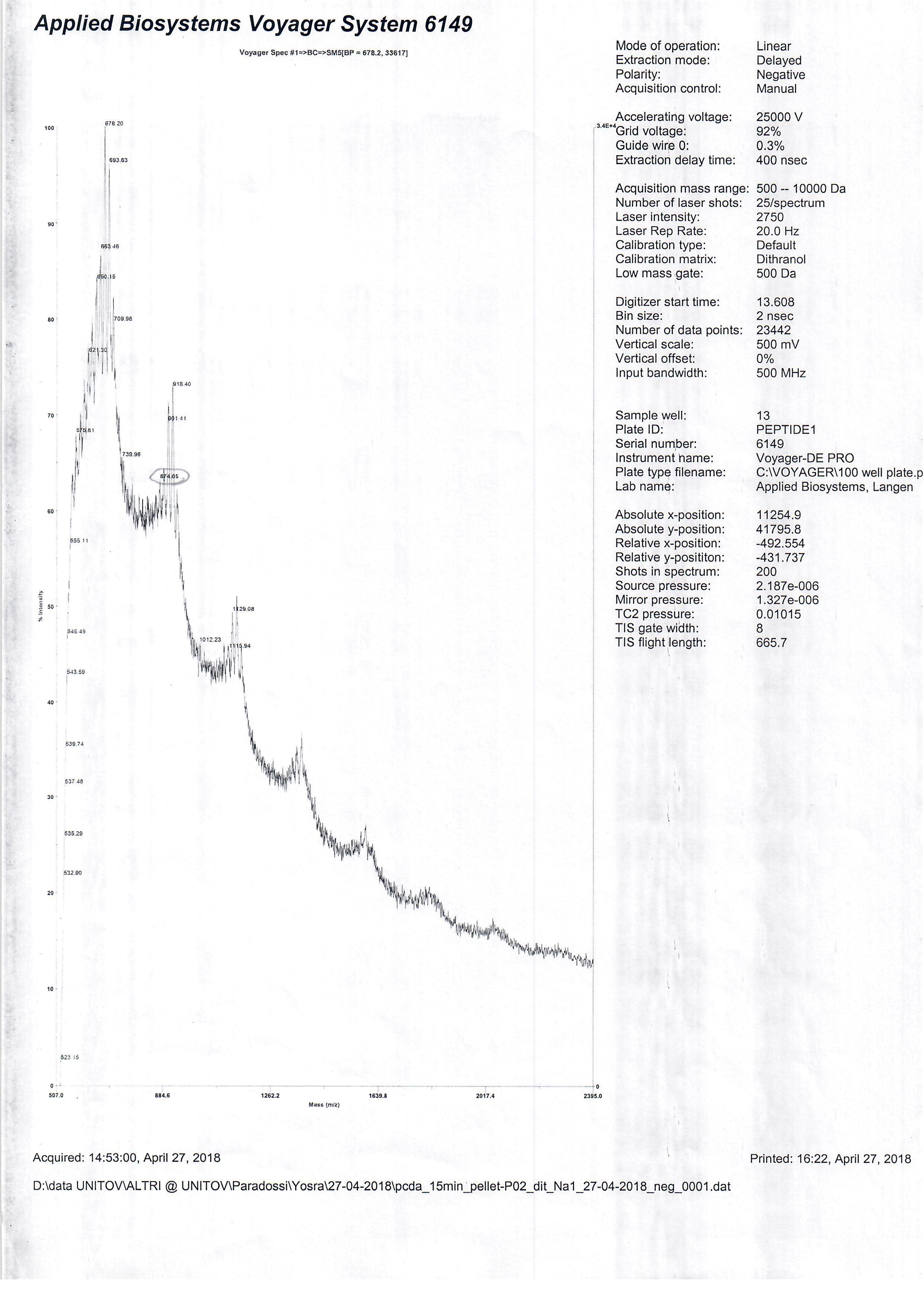
2
MALDI-TOF characterization
(Dr. Heiko Lange)

Slide 5
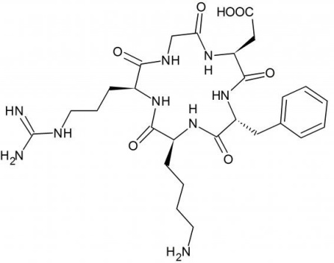

3
Previous Experiment
Main issues
Non specific cell adhesion
Protein corona in serum medium
PFC
PFC
EDC/NHS
MES (pH 6.5)
RT
Proposed solution:
Incorporating a PEG spacer branch
MW: 3000 Da

Slide 6
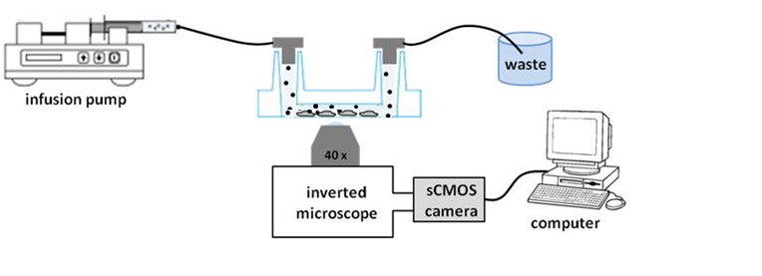
3
cRGD-lys PCDA-PFC Nanodroplets Active Targeting: integrins α_{v}β₃
HUVEC cells
Conditions:
Medium: PBS (40%), FBS (50%), DMEM (10%) v/v
Temperature: 37°C
Time: 10 min
Flow: 1.12 ml/min
Shear Stress: 1 dyn/cm²
Medium: PBS (40%), FBS (50%), DMEM (10%) v/v
5 min upside down + 10 min washing with PBS

Slide 7
3
HUVEC Cells in vitro targeting
Control: poly-PCDA/PFC-PEG3000
poly-PCDA/PFC-PEG3000-cRGD
Bright field microscopy (×40)
Sample | Droplets count/Cell (%)
Control | 25 ± 6
c-RGD | 60 ± 15
Fluorescence microscopy (×40)

Slide 8
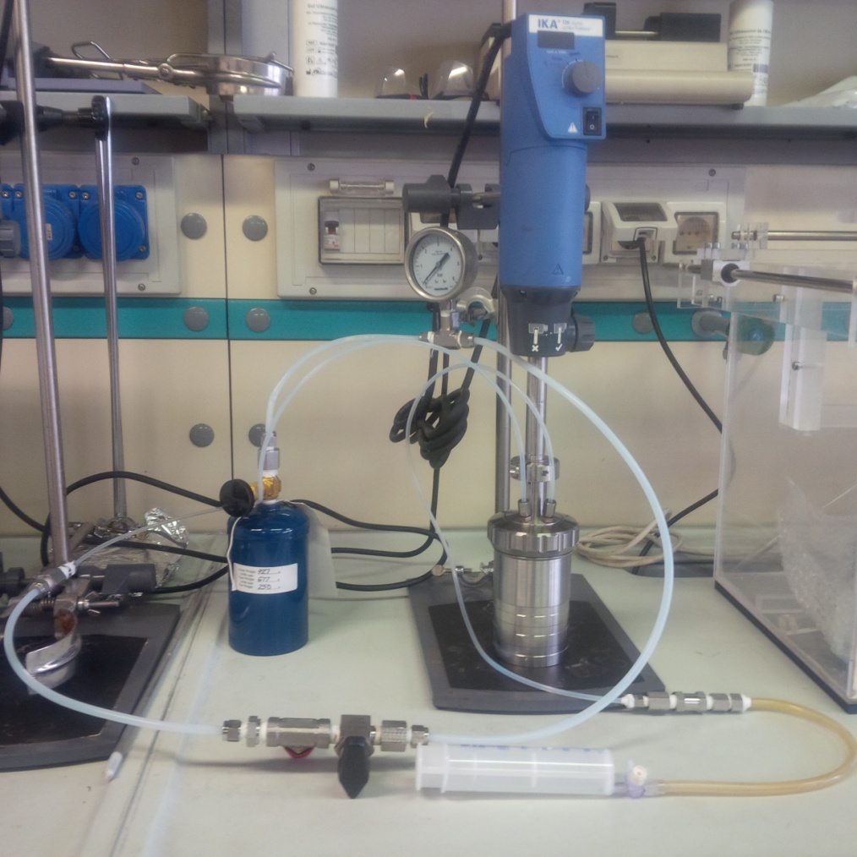


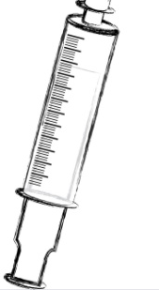
4
Building Set-Up for Very Low bp Perfluorocarbon Candidates
PFC | Boiling point (°C)
2H-Heptafluoropropane | (-15°C)
1,1,1,2-Tetrafluoroethane | (-27°C)
Perfluoropropane | (-39°C)
manometer
Ultraturrax motor
Ultraturrax
Manometer
homogenizer
valve
PFC
PCDA input
Gas inlet
syringe valve
PFC gas
Reactor
reactor
Syringe Valve
Syringe (PCDA)
PCDA filled syringe
Valve

Slide 9
5
Update on Radiation Dosimetry Experiments (Policlinico Tor Vergata)
Discussed points: set up for irradiation; next week starting experiments
Experimental conditions suggested:
- Photon beam: Linac 6MV
- Field of irradiation: 10x10 cm²
Irradiation in water phantom (water tank approx 40x40x30 cm³)
with sample placed at the radiation isocenter
dose rate: from 2 Gy/min to 10 Gy/min.
Dose at the isocenter: 2Gy (according to microbubbles sensitivity)
Planned experiments: PCDA/gel suspensions
Synchrotron radiation for high doses

Slide 10

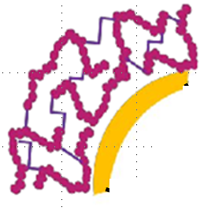
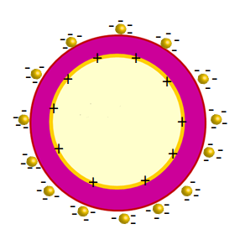
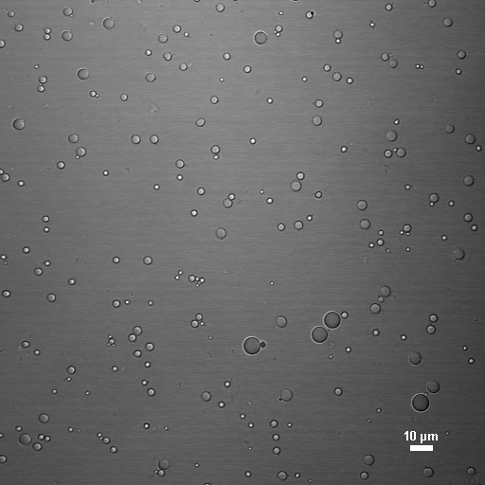
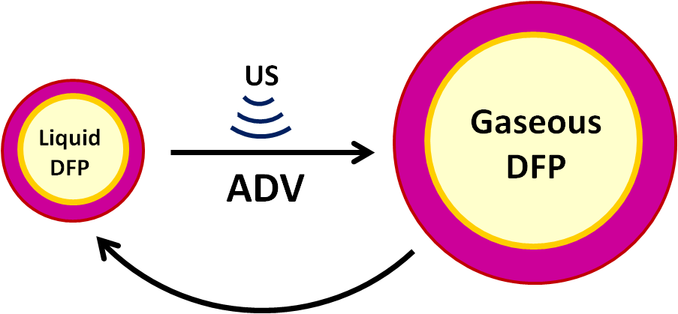
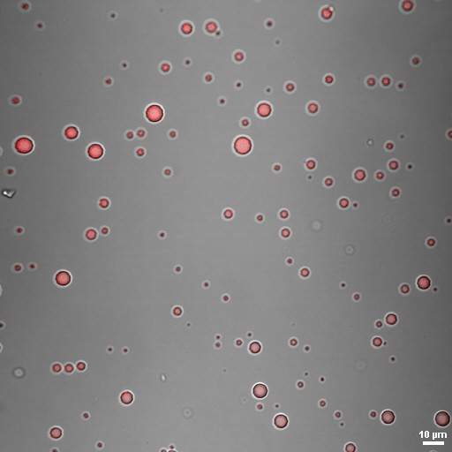
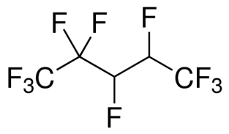
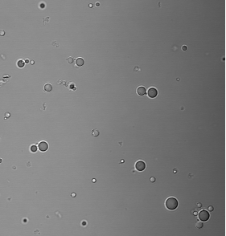
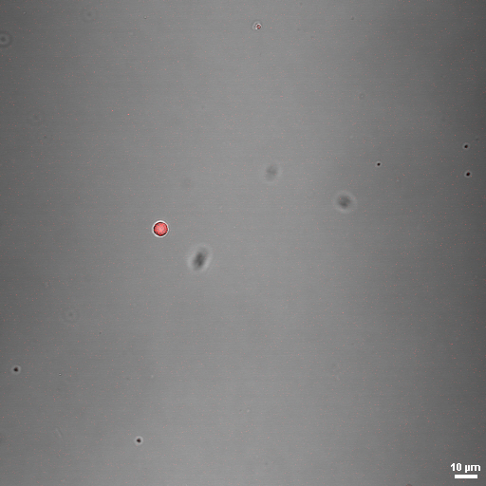
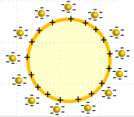

High energy triggered phase-change contrast agents with polymer/surfactant hybrid shells
F. Domenici, Yosra Toumia, G. Paradossi
General idea: we aim to develop a novel class of hybrid Phase-Change Contrast Agents with double optical and ultrasound responsivness for theranostic purposes
Polymer-lipid Echogenic Microdroplets
Gold NPs-Droplets for opto-acoustic MDs to MBs transition
DexMA Cross-linked polymer shell
Surfactant
droplets diameters
1.1 ± 0.1 μm
Ultrasound
10 μm
DFP
Gas
DFP
Liquid
Ionizing
radiation
Acoustic
Droplet
Vaporization
Localized phototermal vaporizzation
10μm
bubbles diameters
5.1 ± 2.0 μm
Lases inducd
NPs release

Slide 11
Finanziamento richiesto Unità TV_Paradossi
2000 € : missioni per l’interazione con l’unità di Napoli.
7000€ : materiale di consumo. Il dettaglio di spesa per la fabbricazione del dosimetro a transizionecdi fase (nanodroplet) comprende l’acquisto di
— gas PFC a differente temperature critiche; —il polimero e i reagenti necessari per la formazione del guscio della nanodroplet;
— celle in quarzo per il contenimento del dosimetro in geometria controllata e per la misura della risposta dosimetrica.
—nanoparticelle d’oro di differente taglia da accoppiare con le nanodroplet come mezzo di amplificatore locale della dose assorbita.
1000€: accessori meccanici necessari all’implementazione della cella Turrax criostatata, già presistente nell’unità di TV, per la generazione delle droplet ottimizzate per la risposta dosimetrica in condizioni sottocritiche usando PFC a bassa Tc (in azoto liquido).
Totale 10000 €

