Slide 1
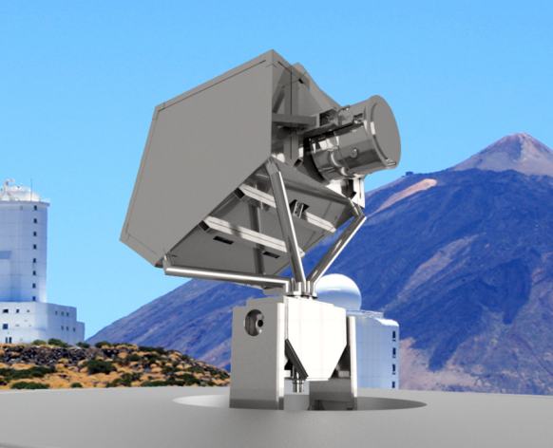



Milano, 10 July 2018 – Consiglio di Sezione INFN/Milano
LSPE/STRIP
Marco Bersanelli
and the LSPE/STRIP Team

Slide 2




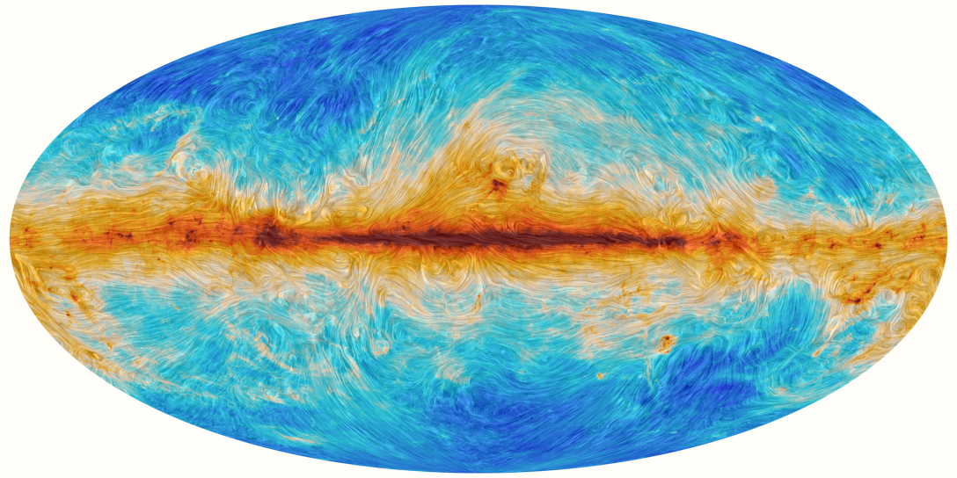
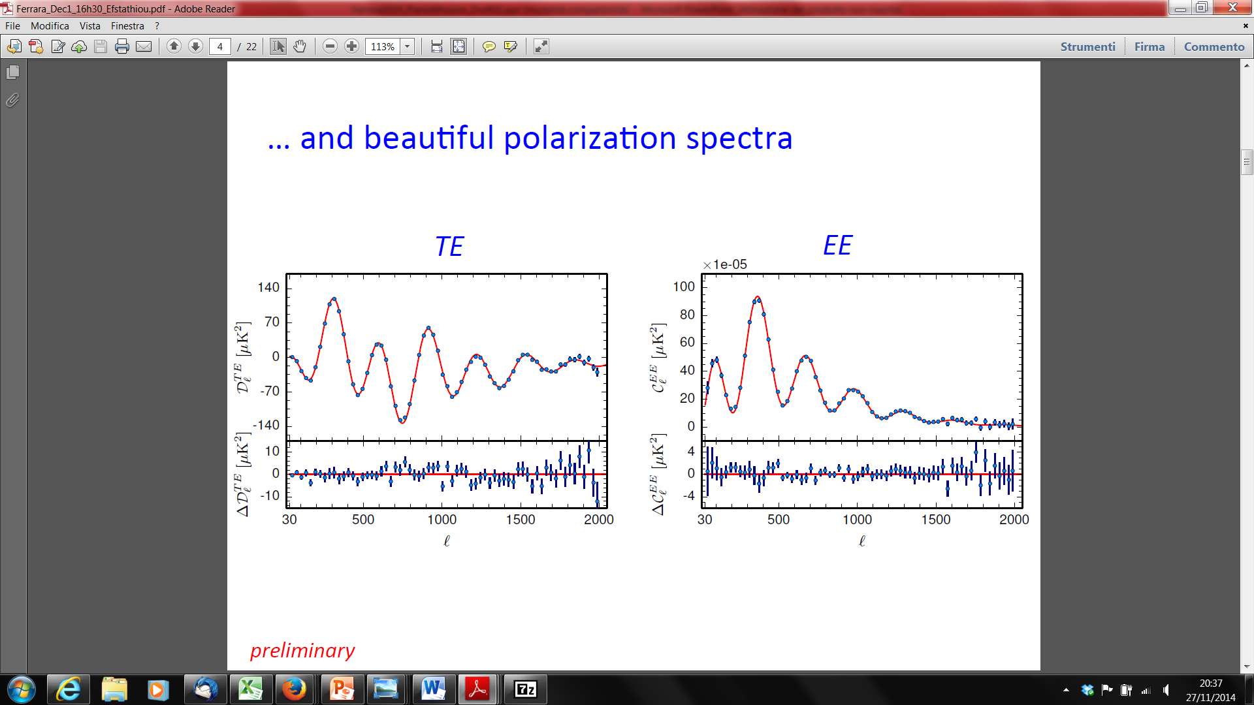
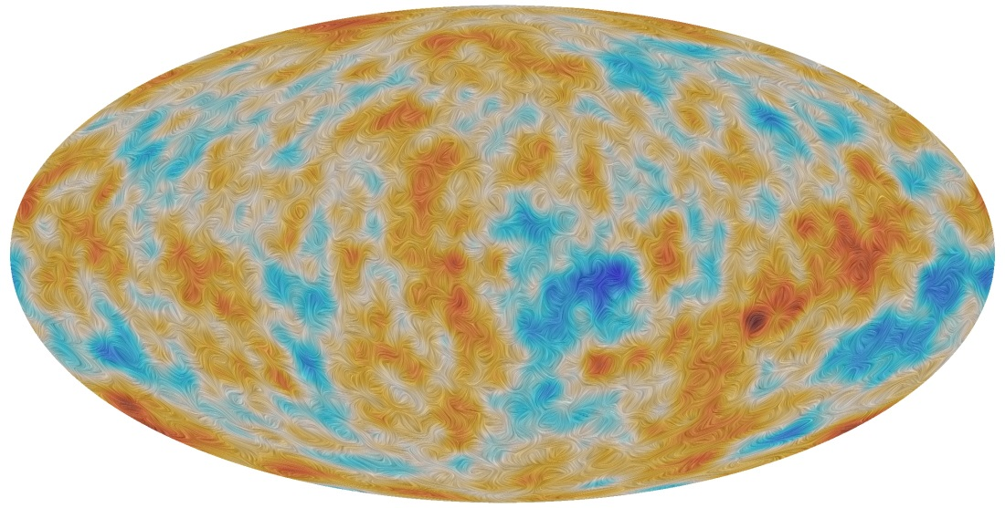
Planck sky in polarization
Planck 2016
TE
TT best fit
EE
TT best fit
Planck Collaboration 2016

Slide 3
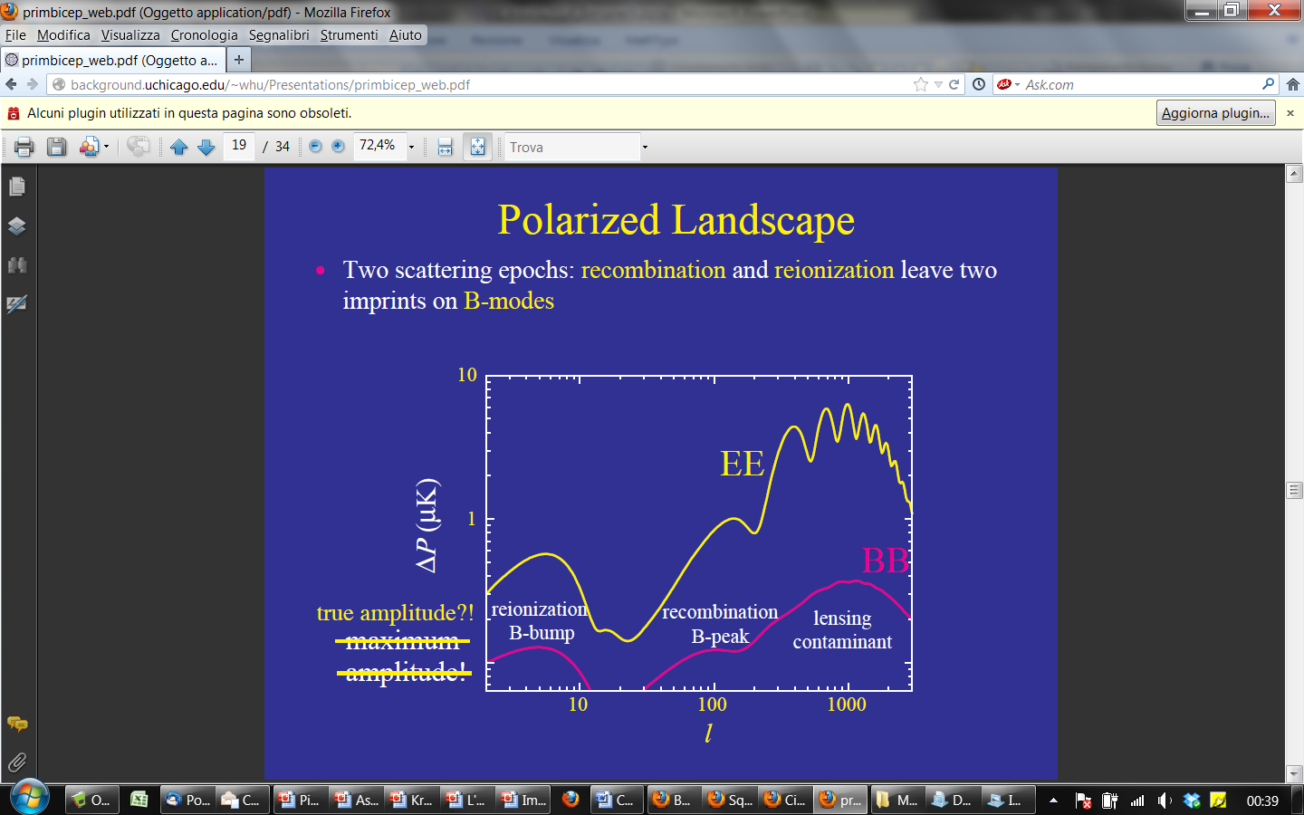
CMB Polarization Power Spectrum
by Wayne Hu
Density Waves (EE)
E<0
E>0
Possible signature
of inflation
Gravitational Waves (BB)
B<0
B>0

Slide 4























Notes:
Check Pisa

Slide 5
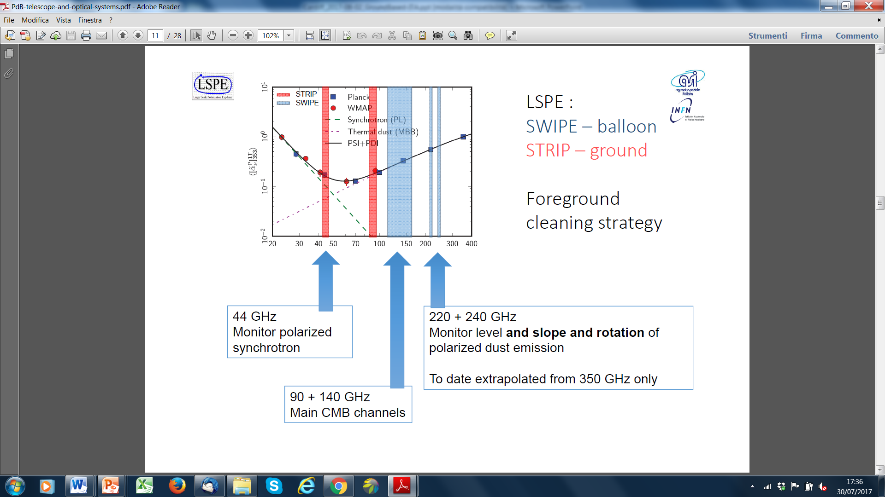
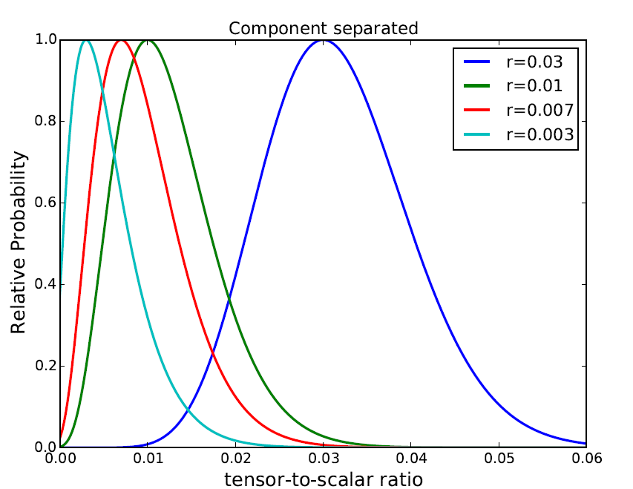
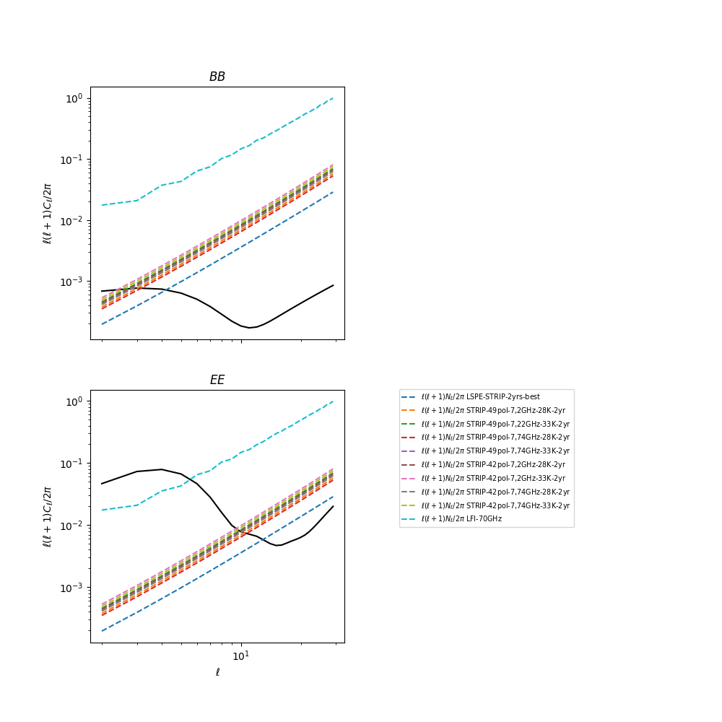


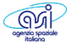
LSPE objectives
Ground
(Tenerife)
Balloon
(Svalbard’s)
r∼ 0.01
STRIP vs Planck-LFI
Planck 70GHz
Planck 70GHz
STRIP realistic
STRIP Goal
STRIP realistic
τ = 0.05
r = 0.03
STRIP Goal
Milano, 10/07/2018 –– Consiglio di Sezione INFN/Milano –– M. Bersanelli

Slide 6

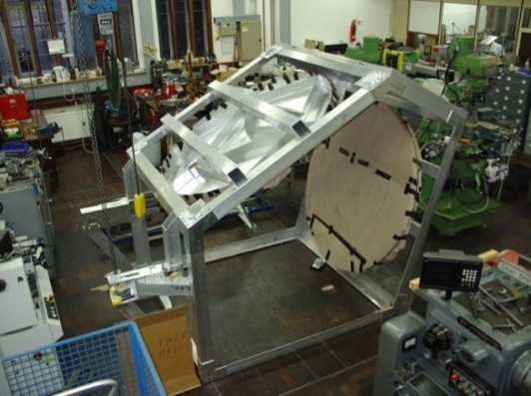
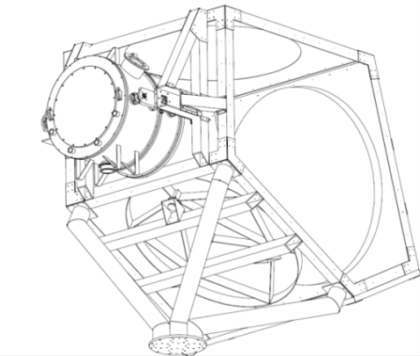
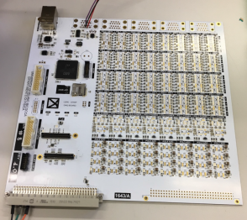
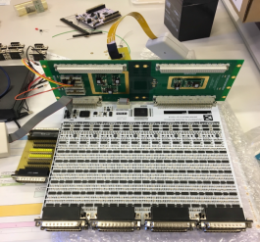
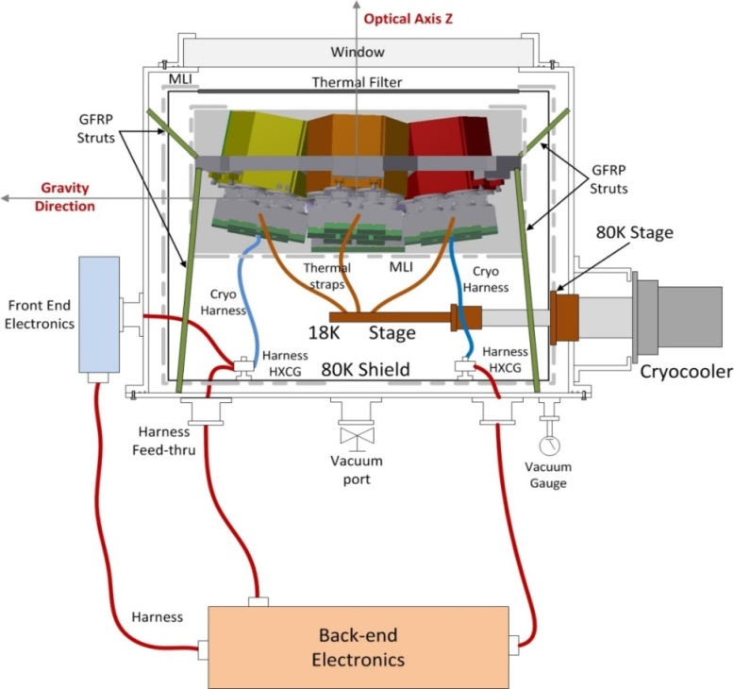
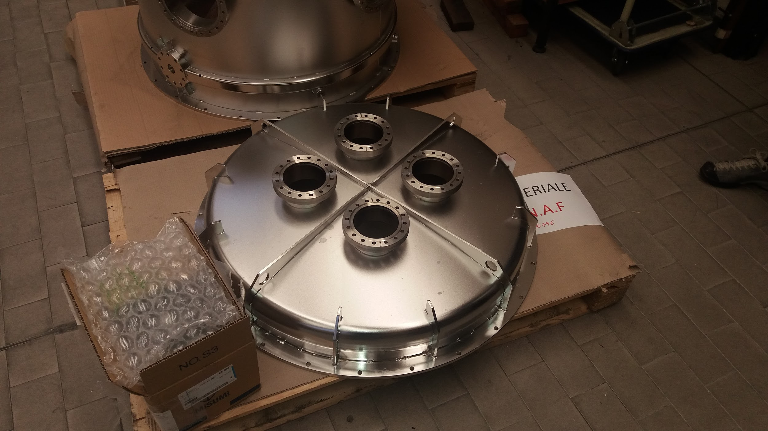
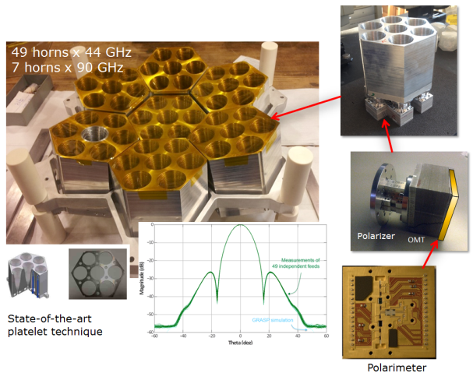
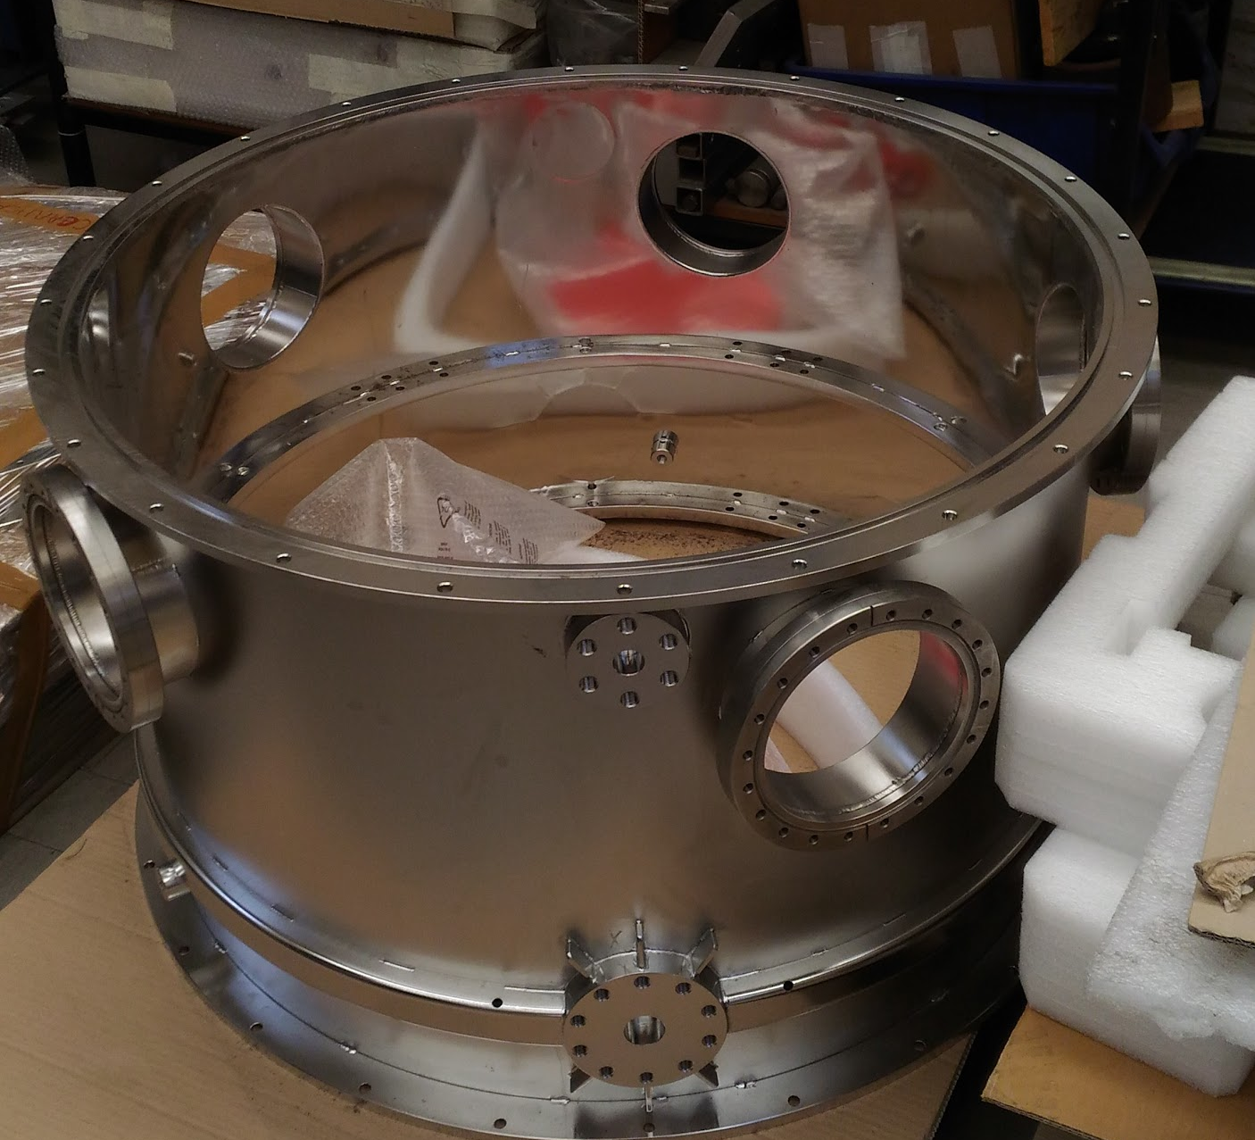
LSPE/STRIP
Instrument subsystems
Deployment at Teide Observatory
1.5m cross-Dragone telescope (Oxford University)
STRIP Electronics
High efficiency 2-stage 18-20K cooler
Intermediate 80-100K shield
STRIP focal plane
Milano, 10/07/2018 –– Consiglio di Sezione INFN/Milano –– M. Bersanelli

Slide 7
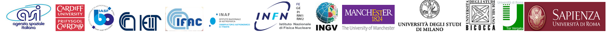




LSPE
Scanning strategy concept
North Pole
25% of sky
85% overlap STRIP/SWIPE
~1min
~1min
24h
~15d
SWIPE
Svalbard Is.
STRIP
Tenerife
Avoid Sun in beam
~1 yr observations

Slide 8
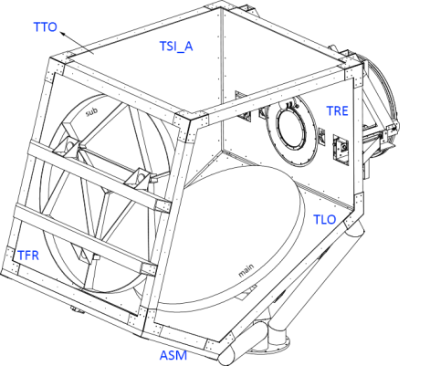

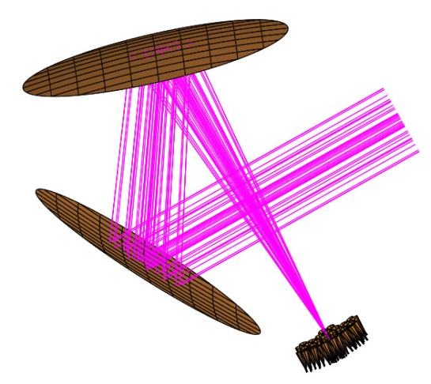
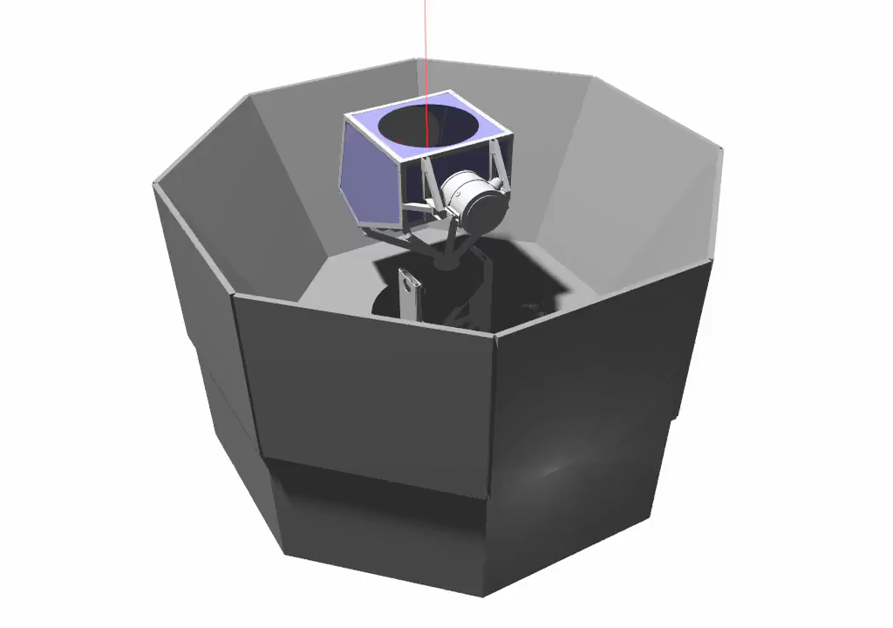
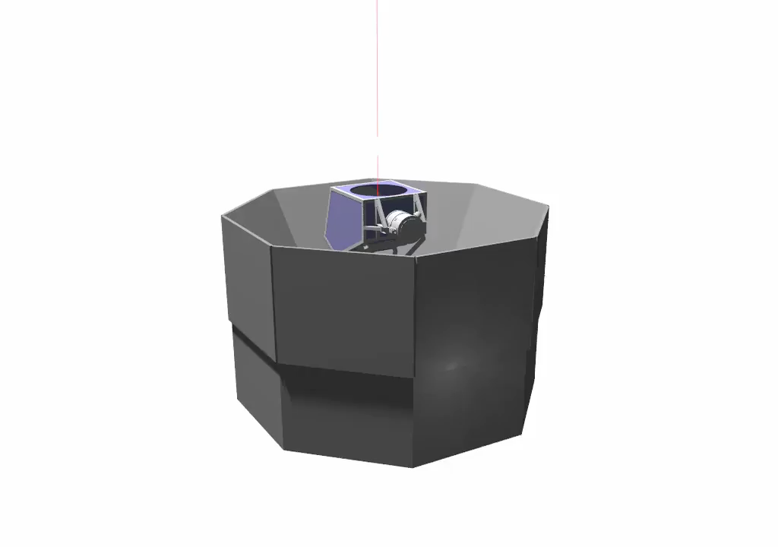
STRIP telescope and mount
M. Jones et al (Oxford University)
Oxford-provided H/W requires significant modifications
1) Instrument interfaces to optical enclosure to be adapted to STRIP instrument
Full CAD model of STRIP mount and interfaces (INFN Rome)
Telescope at Oxford
1.5m Cross-Dragone optics
Trieste, 20/04/2018 – ASI/COSMOS Foregrounds – M. Bersanelli & The LSPE/STRIP Team

Slide 9
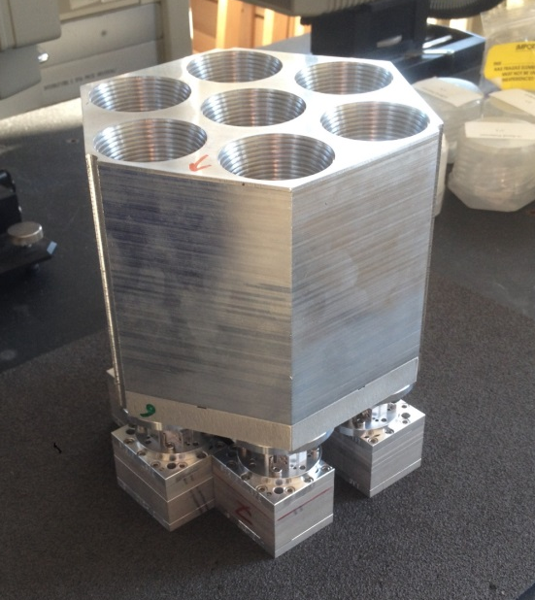
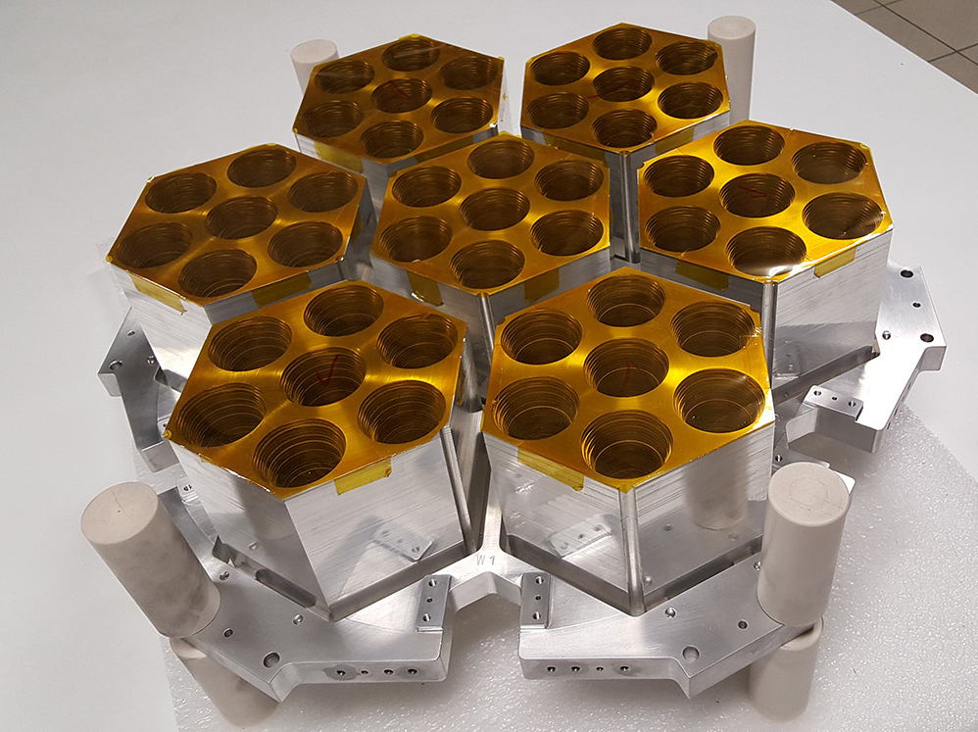
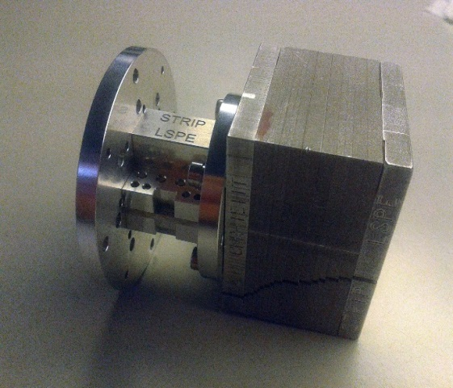
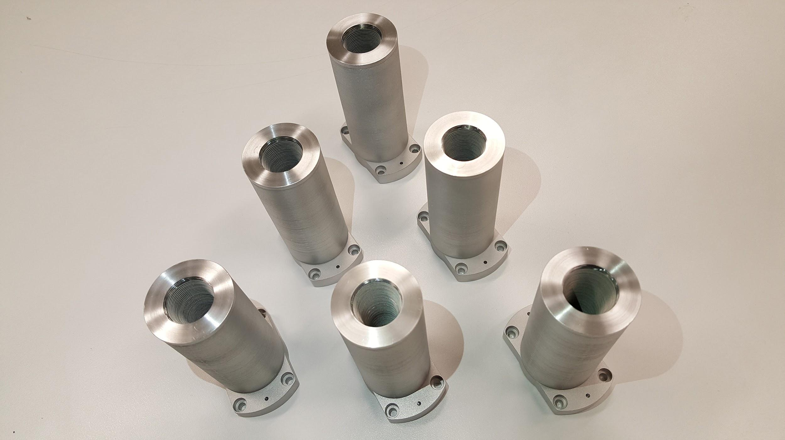
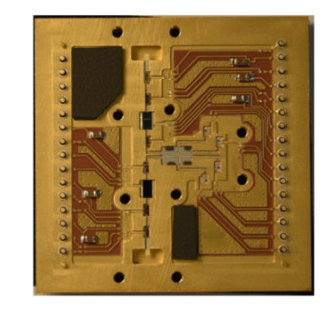
LSPE/STRIP
Q and W band array
Q-band array
7-element module
Polarizer
OMT
7-elements array
W-band array
Polarimeter
Università di Milano-Bicocca, 04/05/2018 – STRIP Polarimeters TRB – M. Bersanelli

Slide 10
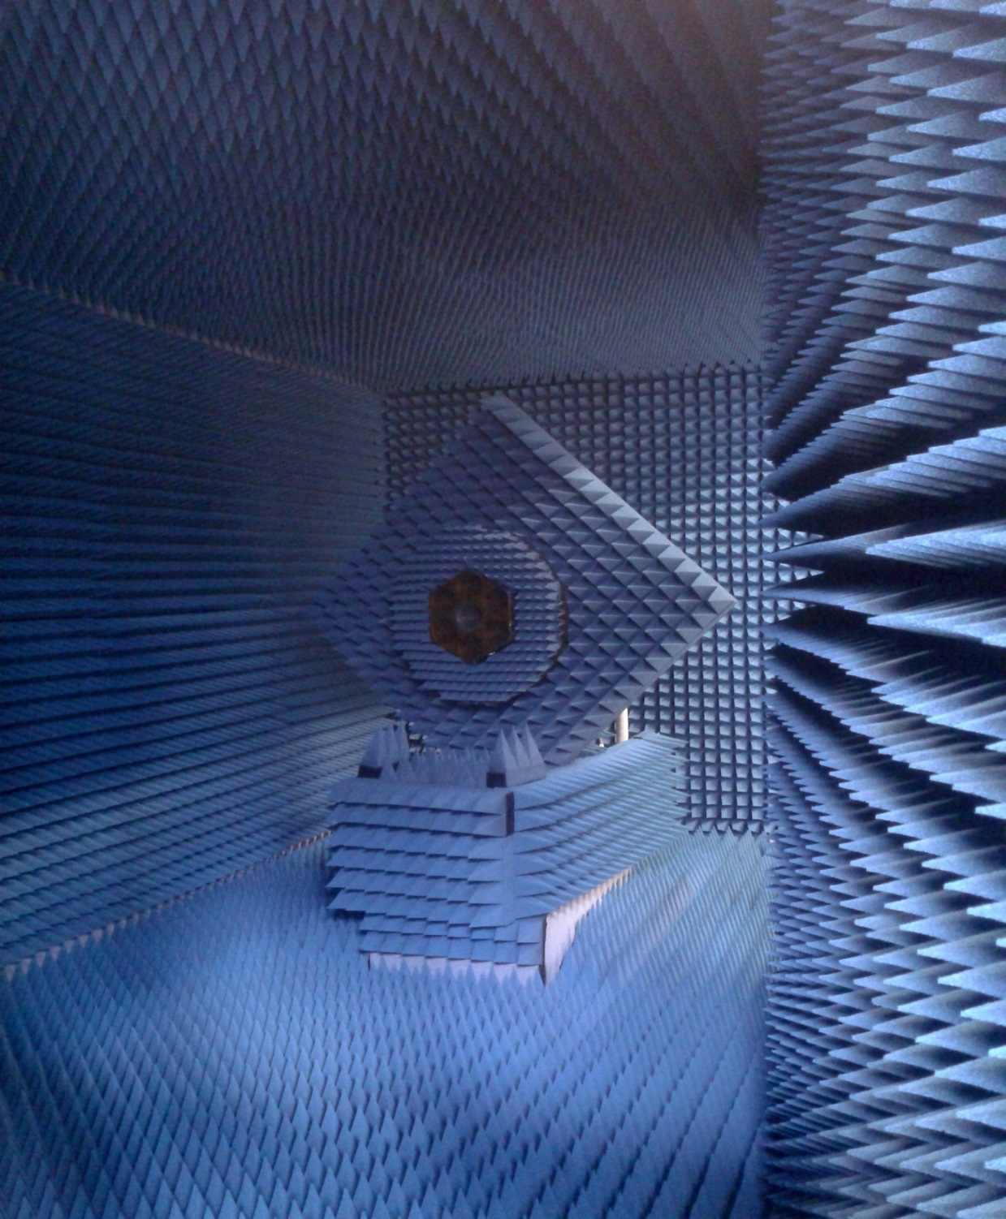
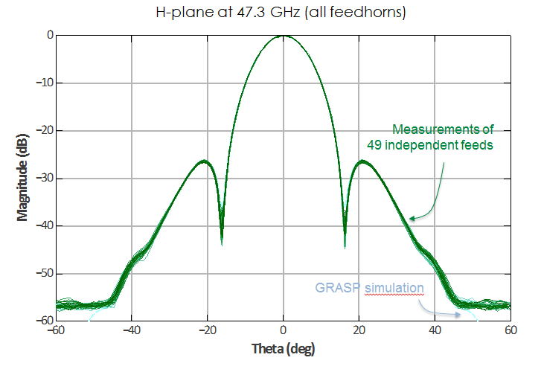
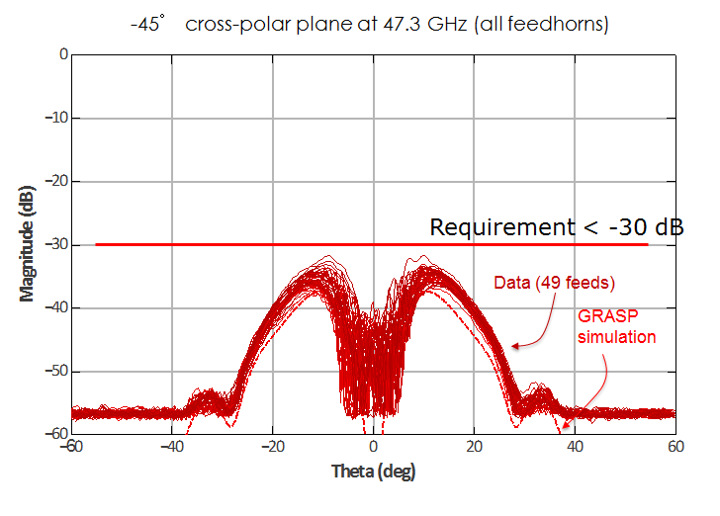
Verification of Q-band Feedhorns Performance
(C. Franceschet et al, UniMI, INFN-MI)

Slide 11
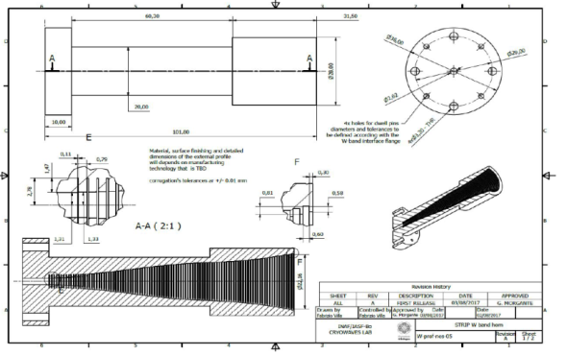
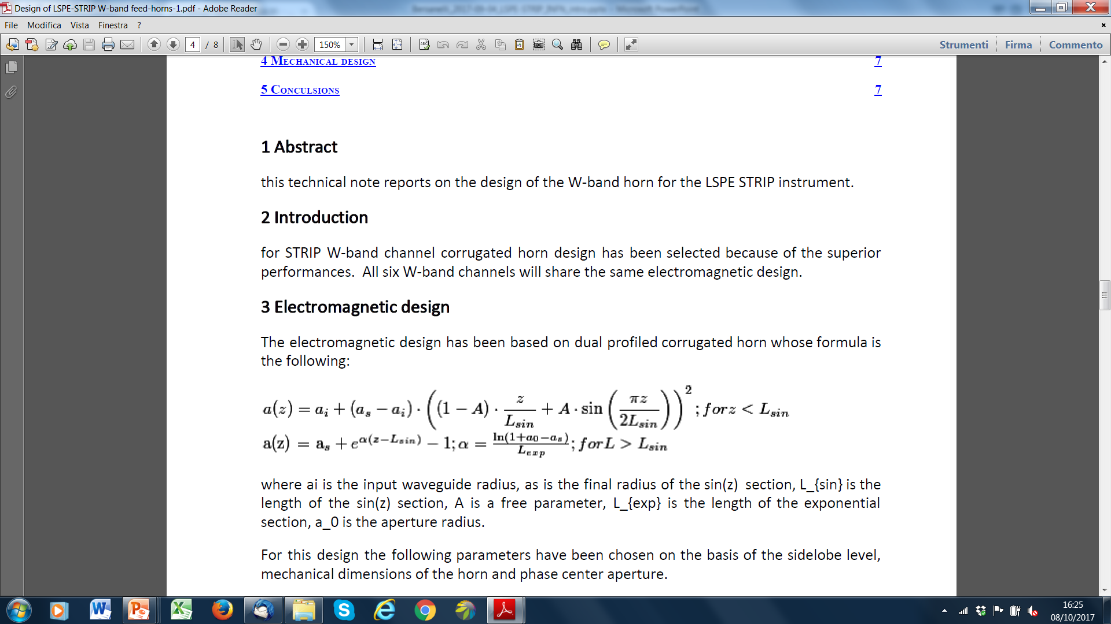
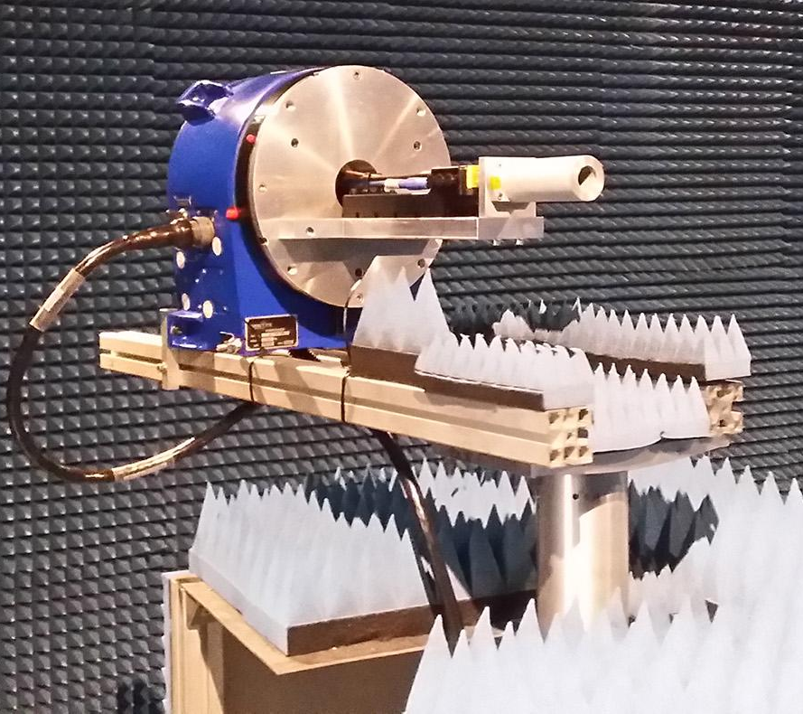
W-band feedhorns
(F. Cavaliere, F. Villa, C. Francerchet, R. Bongiolatti – UniMI, IASF/BO)
Horn design: dual corrugated profile
Entire set of W-band horns
W-band horn under test
Milano, 10/07/2018 –– Consiglio di Sezione INFN/Milano –– M. Bersanelli

Slide 12
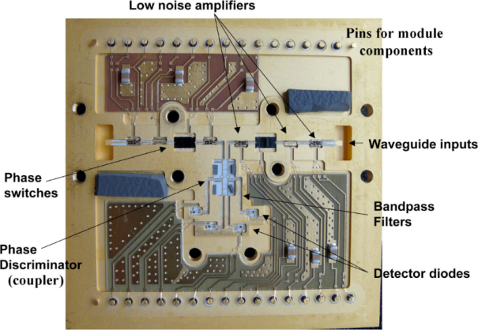
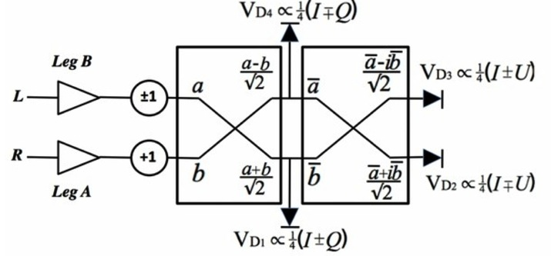
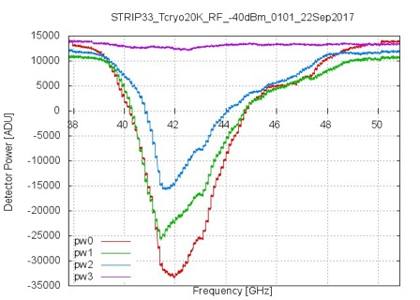
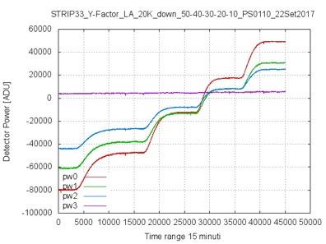
Polarimeters cryo testing
Polarimeters cryo testing
Polerimeter design: Continuous correlation design
  QUIET, heritage from PLANCK-LFI
  4 diodes, direct Q and U detection
Polarimeter module
Polarimeter level testing completed
Tuning, Tsys, Isolation
Unites tested: 70 Q band, 12 W band
Testing rate: 3-4 per week
Rework at JPL for 14 Q units completed
Milano, 10/07/2018 –– Consiglio di Sezione INFN/Milano –– M. Bersanelli

Slide 13
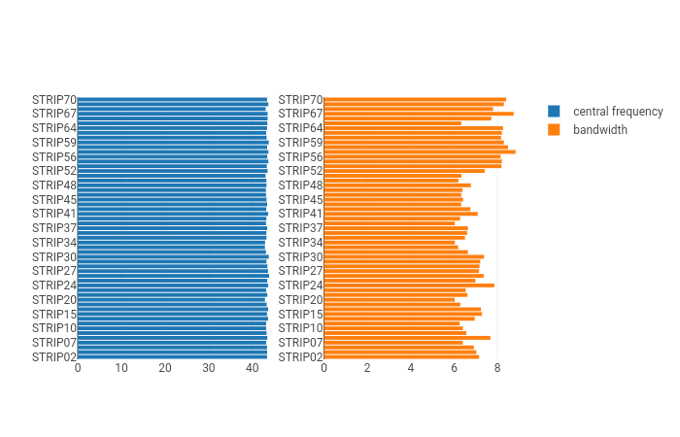
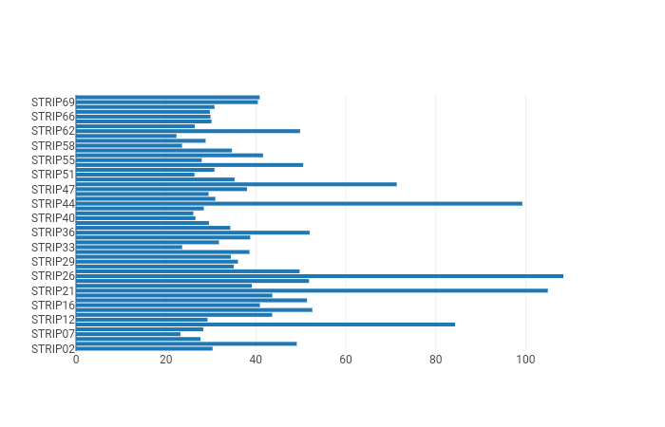
Polarimeters cryo testing
Data analysis: M. Tomasi et al.
Preliminary – Before tuning optimization (to be performed at system level)
Center frequency
Bandpass
Noise temperature. Typical: ~ 30 K
Selection for instrument integration completed
Milano, 10/07/2018 –– Consiglio di Sezione INFN/Milano –– M. Bersanelli

Slide 14
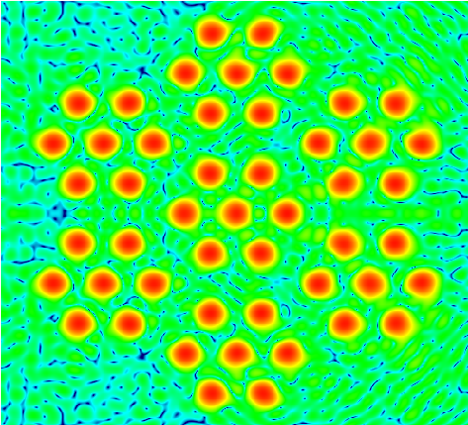
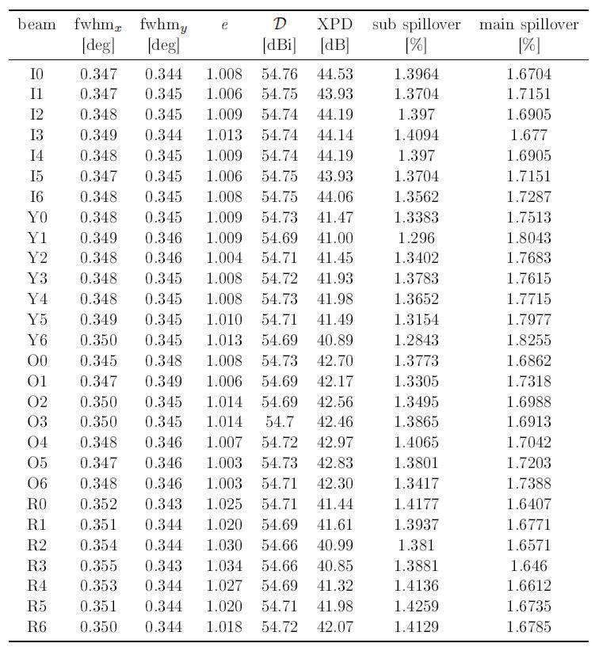
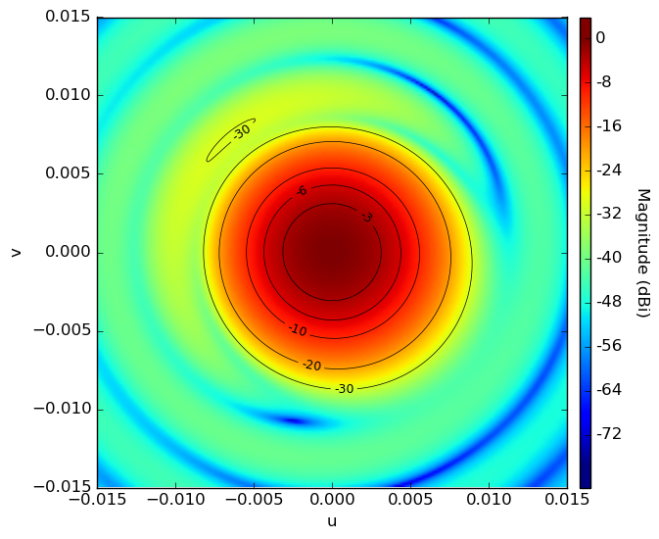
LSPE/STRIP optical characterisation
New ground-based optimized configuration
S.Realini et al (UniMI, INFN/MI)
Milano, 10/07/2018 –– Consiglio di Sezione INFN/Milano –– M. Bersanelli

Slide 15
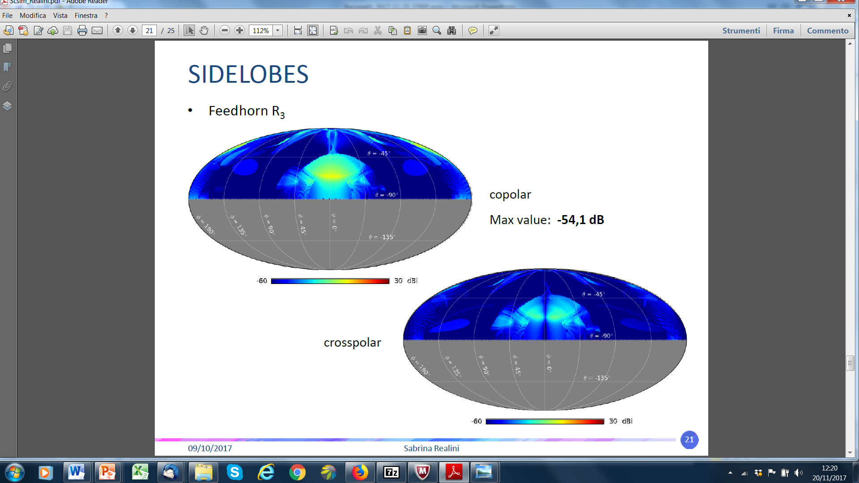
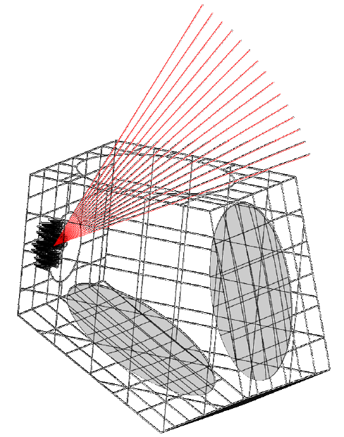
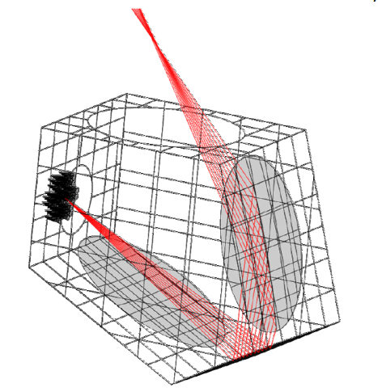
IMPACT OF THE OPTICS ON STRIP MEASUREMENTS
Computation of the STRIP far sidelobes
Pysical Optics compuation with GRASP®
MAIN CONTRIBUTIONS
Realini, Franceschet (UmiMI, INFN-MI)
Co-polar
Direct :
-57dB to -63 dB
ASMrSr:
-53 dB to -57 dB
Cross-polar
Milano, 10/07/2018 –– Consiglio di Sezione INFN/Milano –– M. Bersanelli

Slide 16
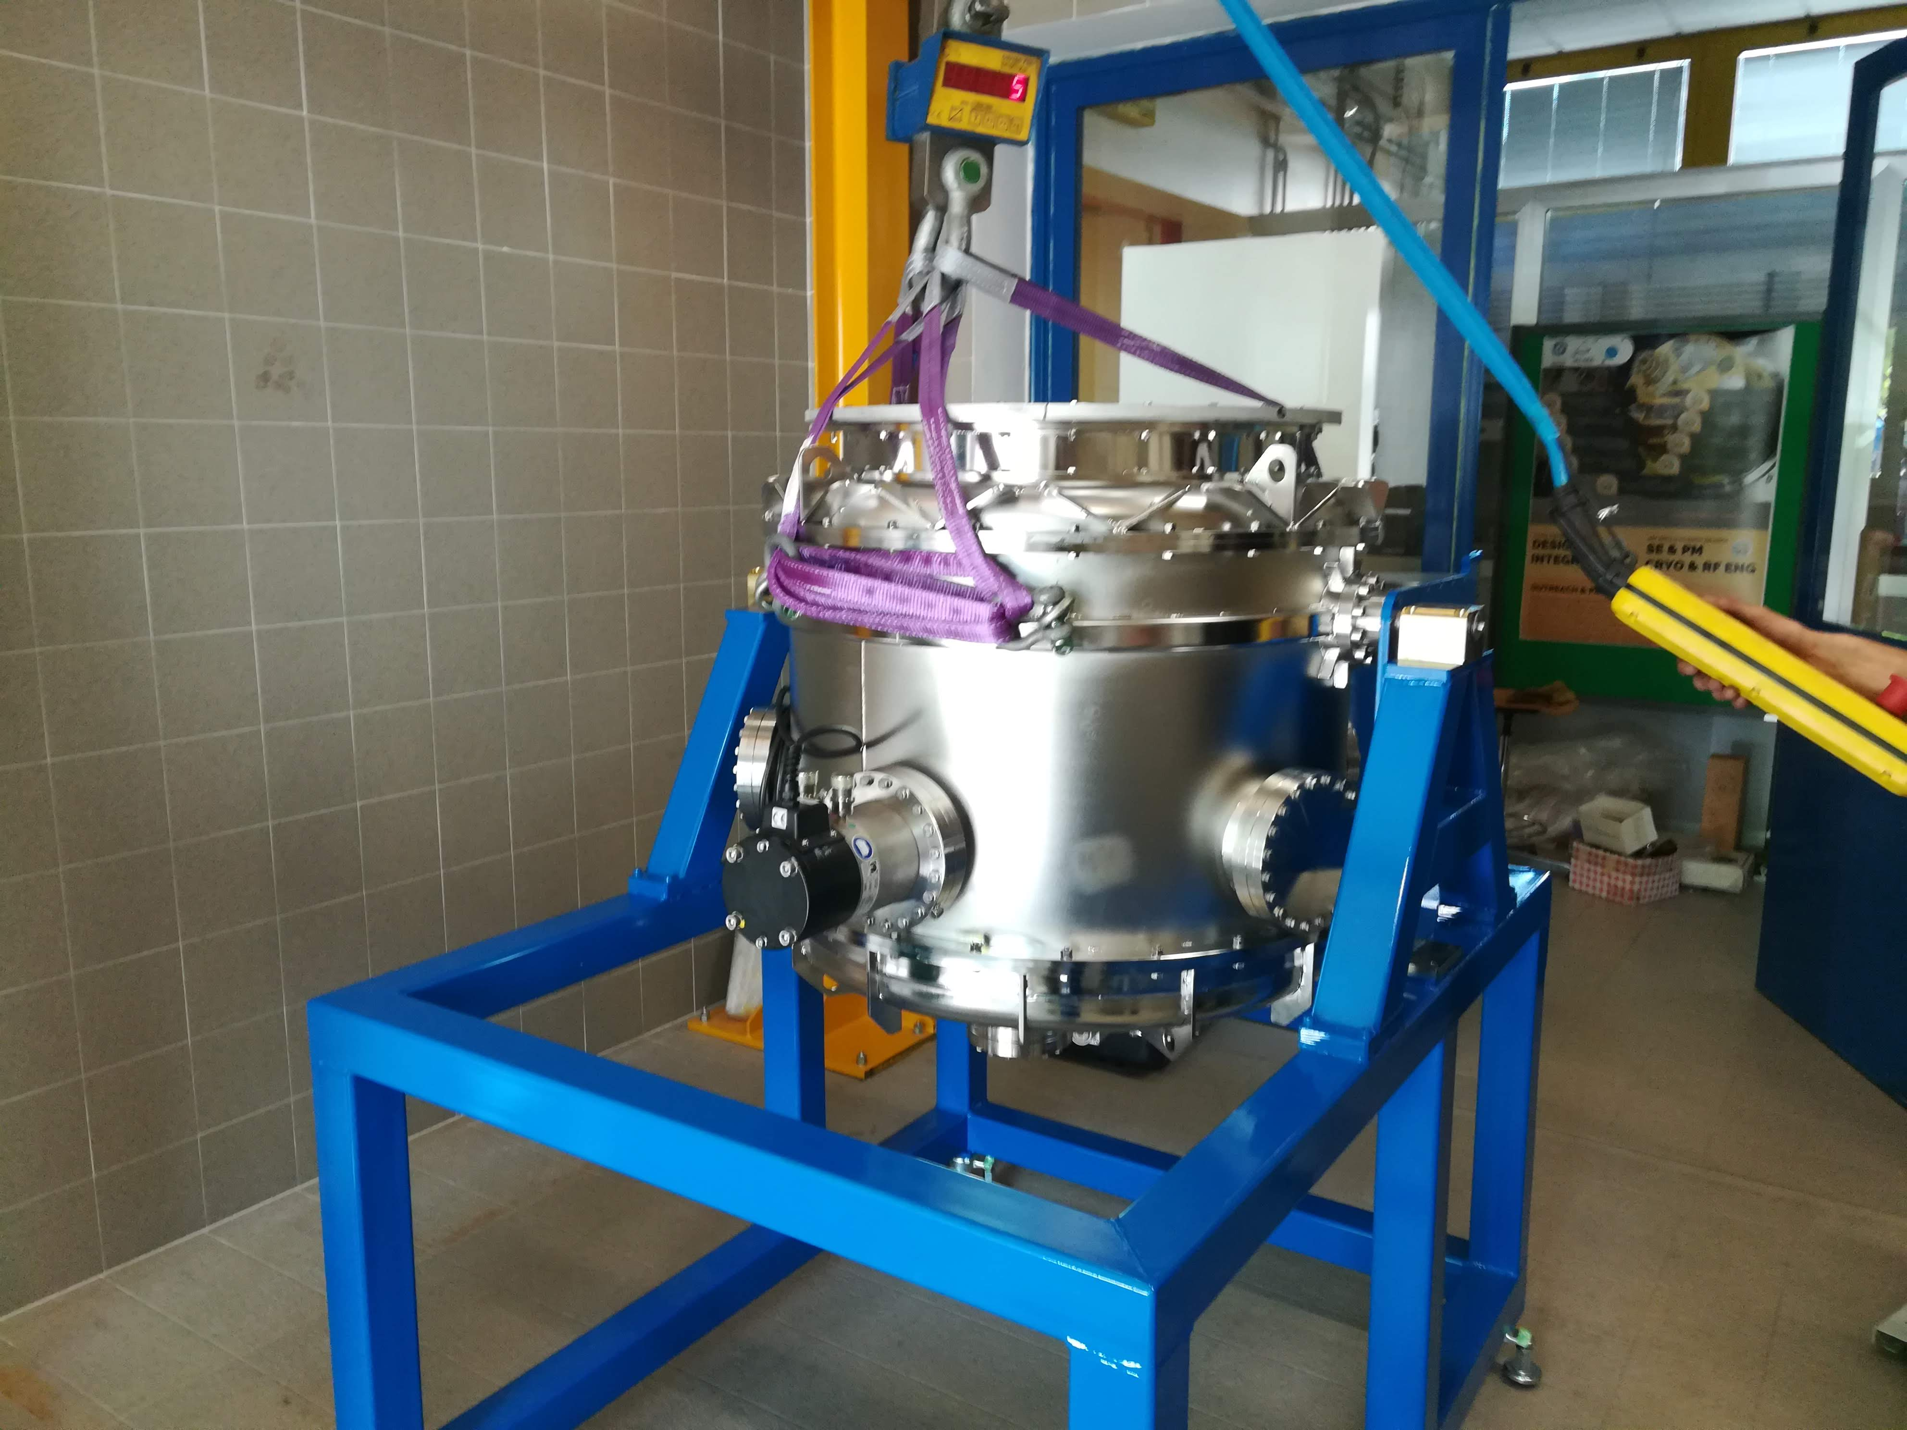
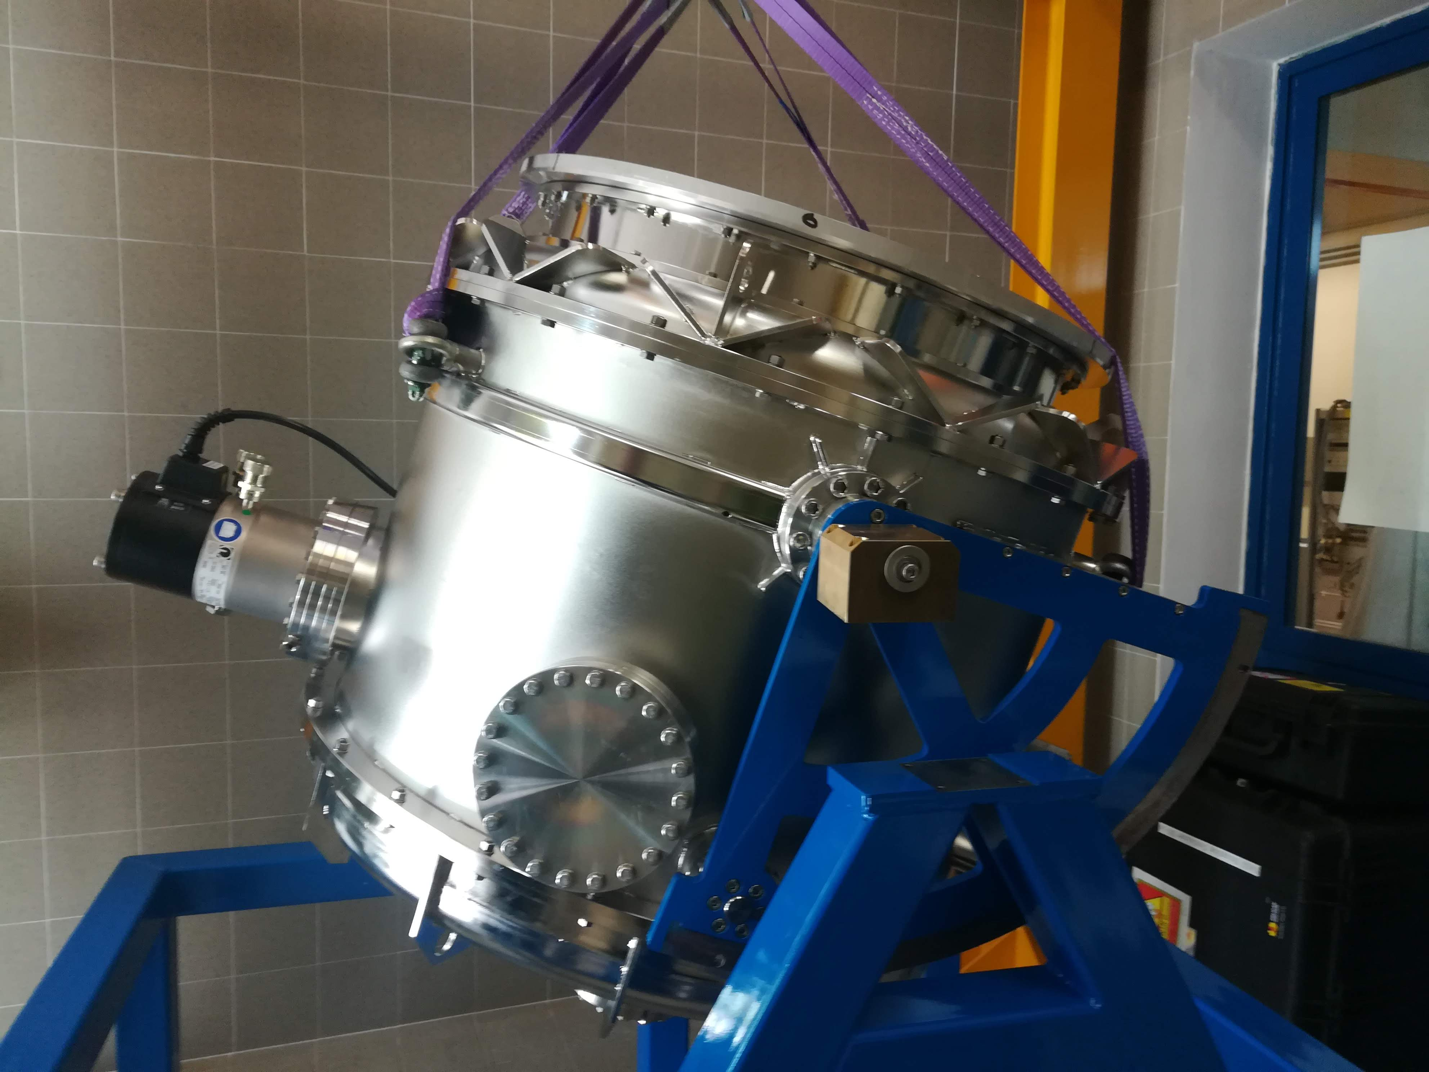
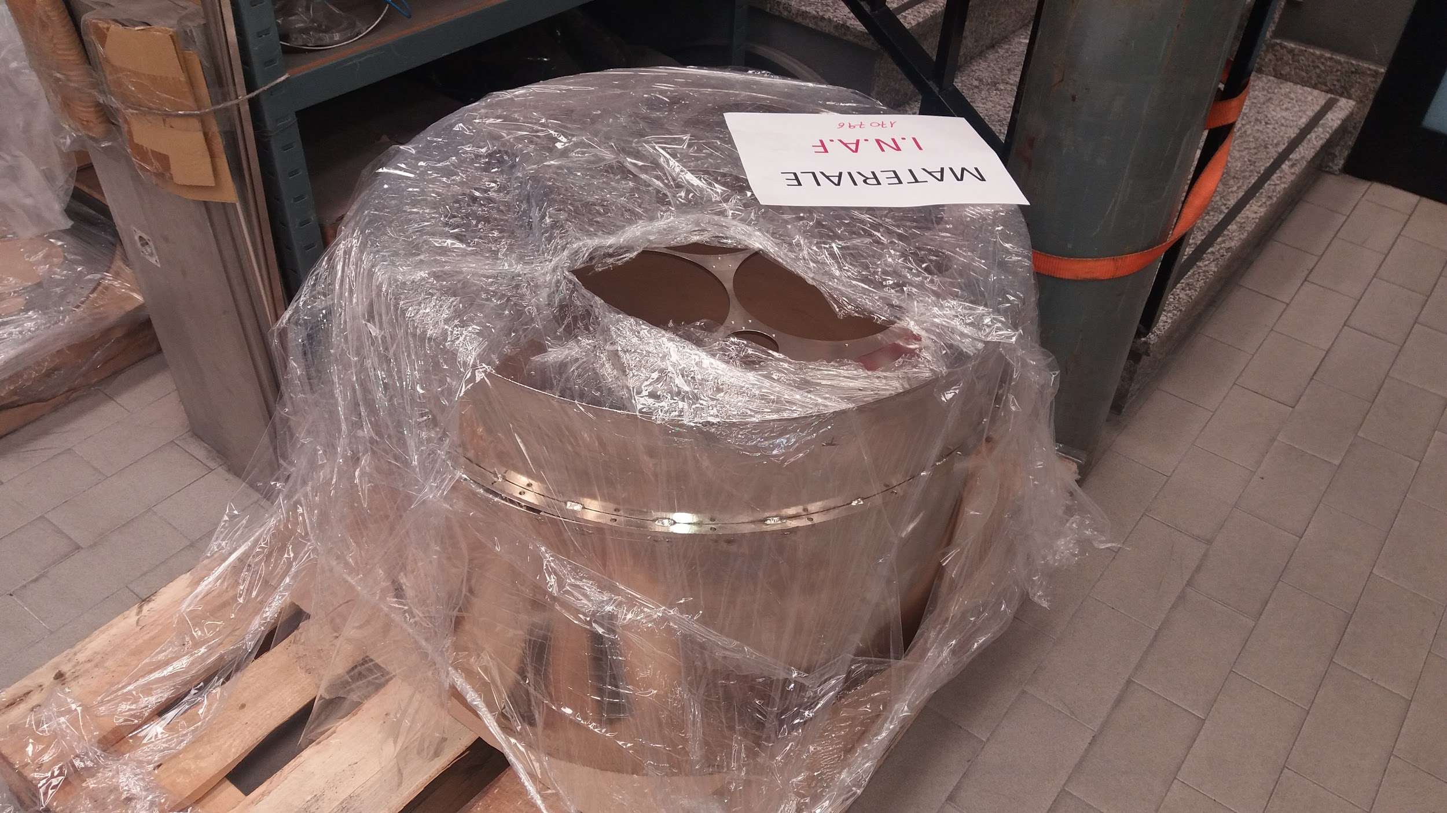
Cryostat design & fabrication
Ready to house Focal Plane assembly
Inner shell
Bottom flange
External shield
Milano, 10/07/2018 –– Consiglio di Sezione INFN/Milano –– M. Bersanelli

Slide 17
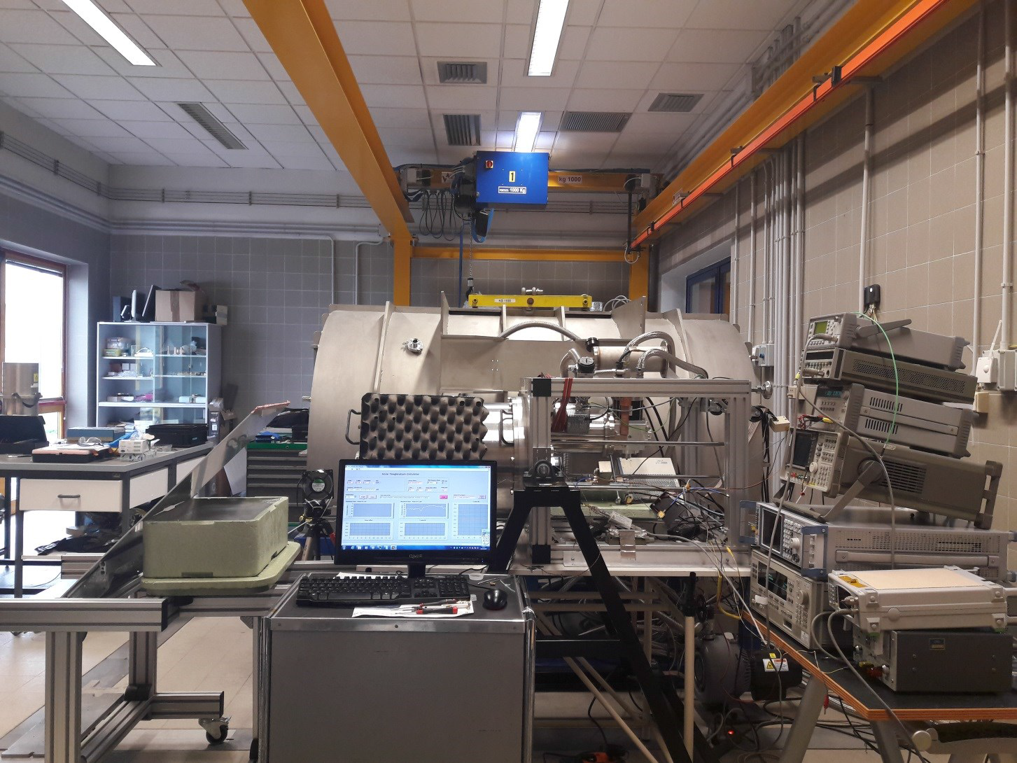
STRIP Instrument-level Integration and Verification (AIV)
Lab and facility at IASF INAF Bologna
Cuttaia, Villa, Morgante, Terenzi et al.
ILT campaign will be performed at IASF-Bologna in the ‘’Cryowaveves’’ Laboratory, equipped with:
Crane Bridge
Areas for assembly
Shelfs for storage
He gas / LN2
RF Instruments
Thermal control & monitoring
Clean Room Cl 100.000
Storage room
Interface with STRIP control SW being developed (INAF/TS, Zacchei, Sartor)
Milano, 10/07/2018 –– Consiglio di Sezione INFN/Milano –– M. Bersanelli

Slide 18
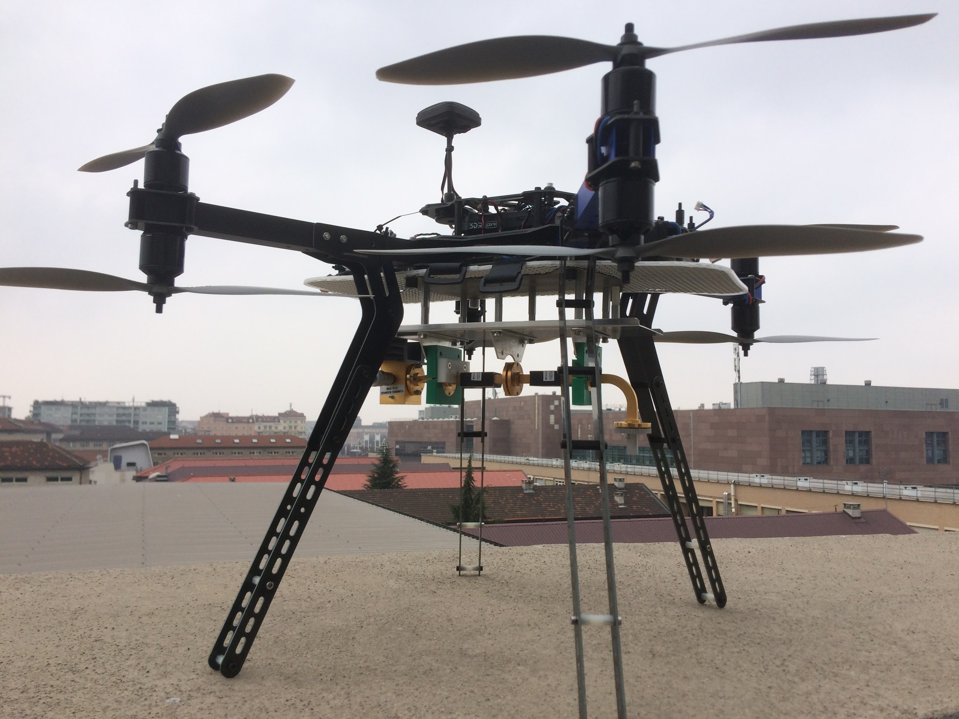
Far-field calibration system development
Peverini et al (CNR, Torino)
System assembled and ready for testing
Milano, 10/07/2018 –– Consiglio di Sezione INFN/Milano –– M. Bersanelli

Slide 19








QUIJOTE (10-40GHz)
LSPE (40-220GHz)
Same sky area (>20% sky, North Hemisphere)
10 frequencies from 10 to 240 GHz
Redundancy, cross-correlation
GroundBIRD
145-220 GHz
LSPE/SWIPE
140-220-240GHz
QUIJOTE
6 frequencies in 10-40 GHz range
Large scale surveys, deep fields
LSPE/STRIP
43 + 90 GHz channels
Large scale surveys, deep fields

Slide 20
STRIP current status
Schedule consolidation ongoing
To be presented to ASI/INFN by end-July
FPU integration: ongoing (started July 1st)
Cryostat test: ongoing (started end-June)
System level test: start early-September
Telescope mechanical tests*: next fall-winter 2018
Dome fabrication: Spring 2019
STRIP commissioning: Summer 2019
*Critical path

Slide 21


Slide 22


Slide 23


Slide 25
QUBIC
Q and U interferometer for cosmology
Funds and activities at INFN/University Milan
Aniello Mennella
Univ. di Milano, Dipartimento di Fisica
INFN - Milano

Slide 26

QUBIC
Q and U interferometer for cosmology

Slide 27

The QUBIC antenna array
Plane with 400 circular apertures
Each aperture interfaced with corrugated feed-horn antenna. A second twin antenna “illuminates” an “optical combiner” that creates the interference pattern.
A shutter between antennas allows us to control the interference pattern during calibration

Slide 28

The QUBIC antenna array
Plane with 400 circular apertures
Each aperture interfaced with corrugated feed-horn antenna. A second twin antenna “illuminates” an “optical combiner” that creates the interference pattern.
A shutter between antennas allows us to control the interference pattern during calibration

Slide 29
Activity during 2018
Mechanical testing of the platelets antenna holes (A. Mennella, S. Iovenitti)
Integrated first block of 400 antennas (F. Cavaliere, F. Pezzotta). Completion of integration pending until switches block is completed (WP under responsibility of Milano – Bicocca)
System scientist (A. Mennella) / collaboration board activities (contribution to the Technological Demonstrator (TD) calibration plan, chair of QUBIC mount development review)
Development of calibration tests database (M. Tomasi)
QUBIC Technological Demonstrator testing will be carried out during Autumn 2018. Then the TD will be shipped to Argentina for installation at the site of Alto Chorrillo

Slide 30


The 400+400 antenna array
Dual band (150 and 220 GHz) antenna array produced by platelet technique with chemical etching of aluminum plates

Slide 31

2017 money
Money for antenna array that was paid on PNRA money. Currently moved to Uni-Bicocca to support the switches production for the final instrument
Currently negotiating with referees and INFN on how to transfer this money to PNRA (this was part of the agreement that moved QUBIC from PNRA to INFN funding)

Slide 32
2017 money
Shipment of final instrument antenna array to Paris.
Will have to be moved to 2019 because we need to wait for the completion of the switches array, the system integration and final measurements

Slide 33
2017 money
Money spent in travels to Rome (mount consolidation meeting), Paris (simulation pipeline) and Crete (participation to ICNFP conference)

Slide 34
2017 money
Residual travel money will be spent presumably on one travel in Argentina in preparation for the QUBIC TS shipment and installation

Slide 35

Requests for 2019 and FTEs
FTEs
Aniello Mennella: 0.7
Federico Incardona (PhD student): 1.0
Maurizio Tomasi (RTD-A): 0.4
M. Bersanelli: 0.3
C. Franceschet (RTD-B): 0.2
Total: 2,6

