Slide 1
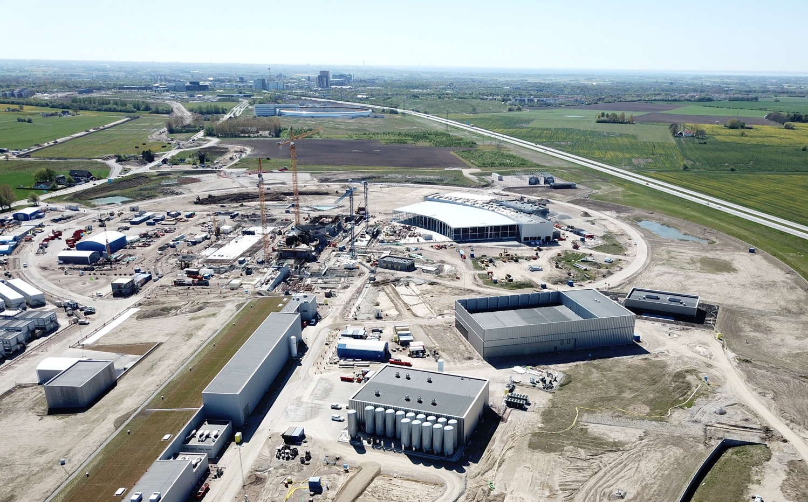
Status of the ESS project
D. Sertore
for ESS Group at LASA

Slide 2
Evolution of neutron sources
10²⁰
Reactor Sources
Spallation Sources
J-PARC
ESS
HFIR
ILL
LANSCE
ISIS
CSNS
10¹⁵
MTR
HIFAR
MARIA
ORPHEE
IPNS
SALAM
HANARO
SNS
NRX
HFBR
NIST
ZING-P’
Dhruva
CARR
PIK
NRU
SAFARI-1
JRR-3
ETERR-2
FRM-II
OPAL
LVR
RSG
SINQ
IBR-II
HOR
JEEP II
KENS
X-10
WNR
Effective thermal neutron flux n/cm²-s
ZING-P
10¹⁰
CP-2
CP-1
10⁵
Berkeley 37-inch cyclotron
Particle driven pulsed
350 mCi Ra-Be source
Particle driven steady state
Pulsed reactor
Fission reactors
1
Chadwick
1930
1940
1950
1960
1970
1980
1990
2000
2010
2020
2030
Year
(Updated from Neutron Scattering, K. Skold and D. L. Price, eds., Academic Press, 1986)

Slide 3
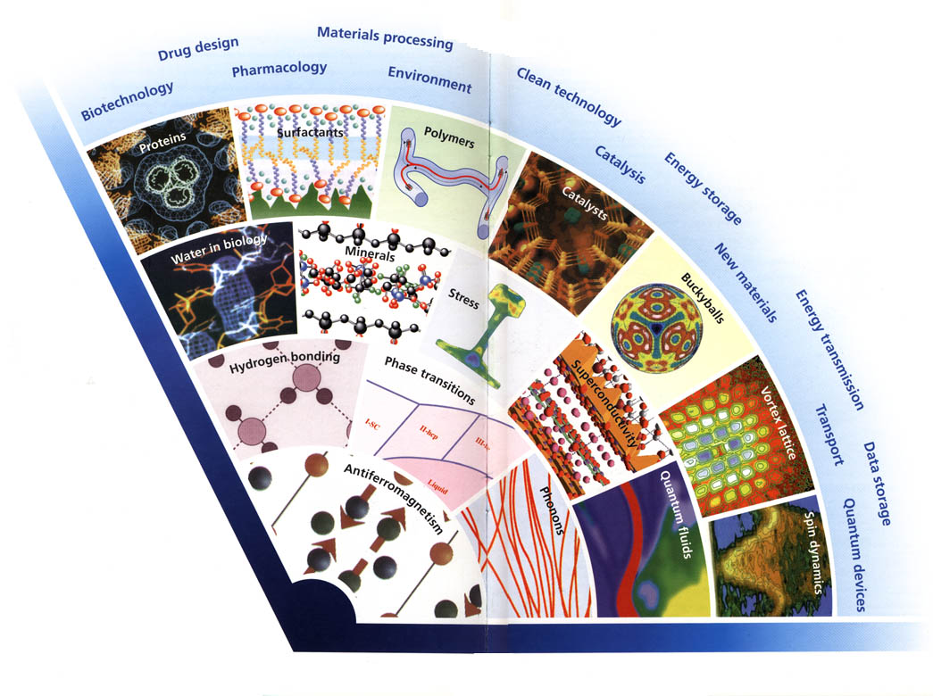
Intensity opens new possibilities
Complexity/
Count-rate
ESS intensity allows
studies of
complex materials
weak signals
important details
time dependent phenomena
Details/Resolution
Notes:
The development of neutron scattering over the past 40 years has been from the initial studies of basic solid state physics in model systems, to detailed studies of complex systems with applications. Similar development can be xepceted in the next 40 years.

Slide 4
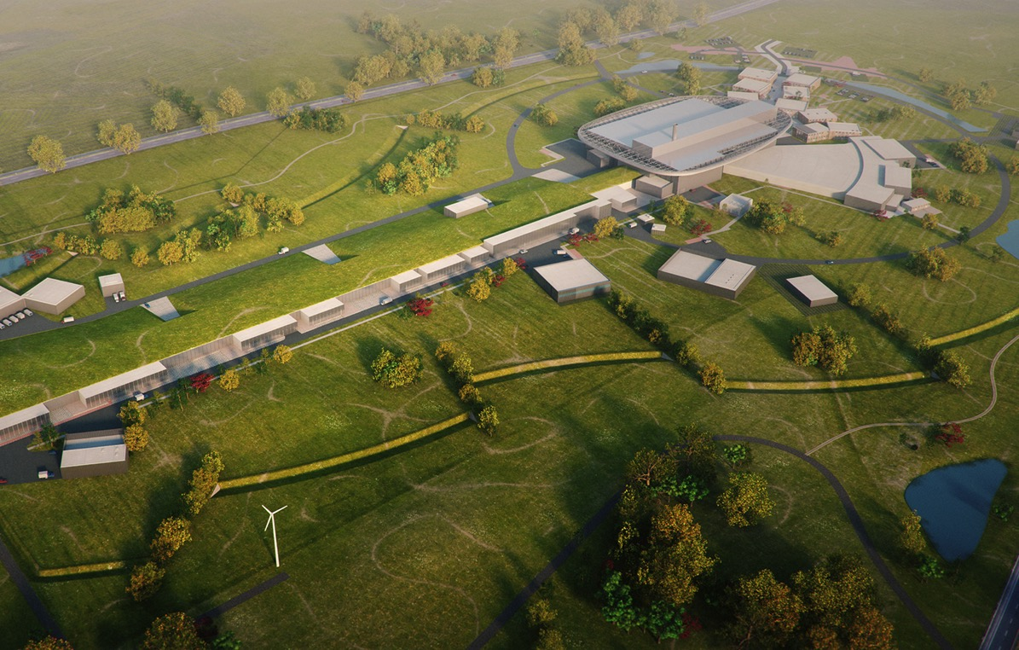

The world’s leading facility for research using neutrons
2025
ESS construction complete
2014
Construction work starts on the site
2023
ESS starts
user program
2009
Decision: ESS will be built in Lund
2019
First beam on
Target
2012
ESS Design Update phase complete
2003
First European design effort of ESS completed

Slide 5
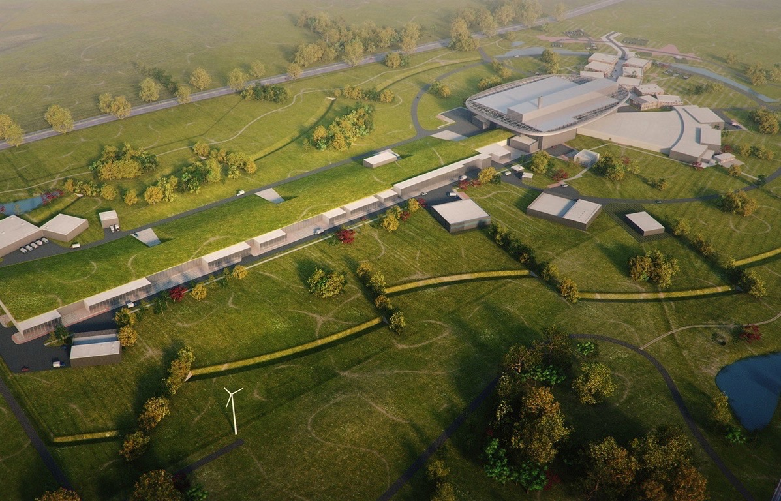
ESS design
High Power
Linear Accelerator:
Energy: 2 GeV
Rep. Rate: 14 Hz
Current: 62.5 mA
Target Station:
He-gas cooled rotating
W-target (5MW average
power)
42 beam ports
16 Instruments in Construction budget
Committed to deliver 22 instruments by 2028
Peak flux ~30-100 brighter than the
Institute Laue-Langevin
Ion Source
Total cost: 1843 MEuros ₂₀₁₃

Slide 6
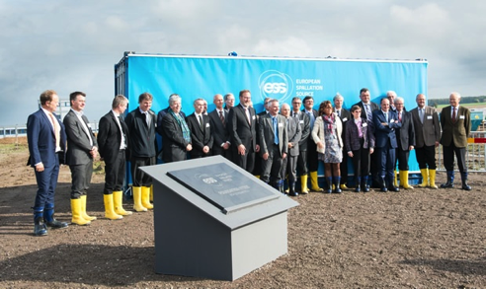
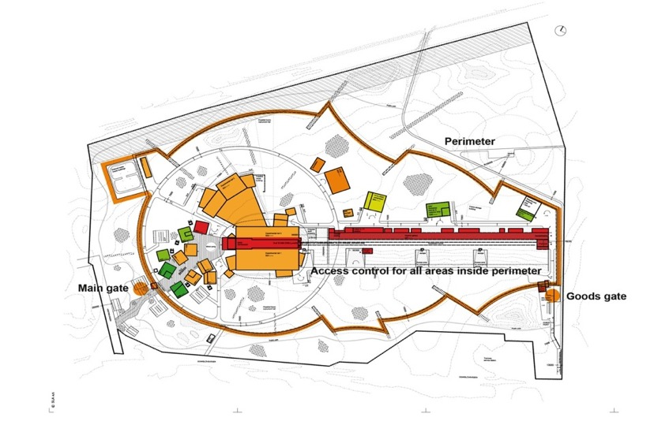
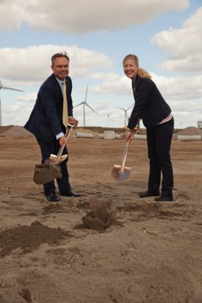
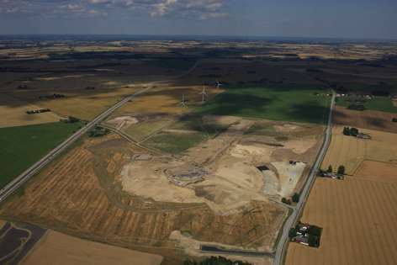
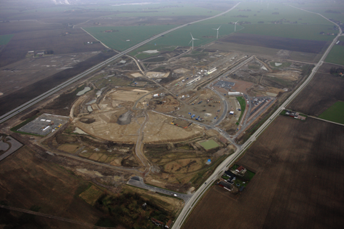
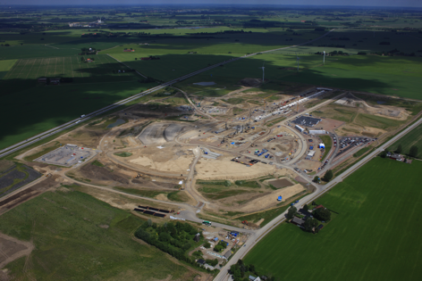
Construction phase
Ground breaking ceremony
September 2, 2014
July 2014
Dec 2014
July 2015

Slide 7
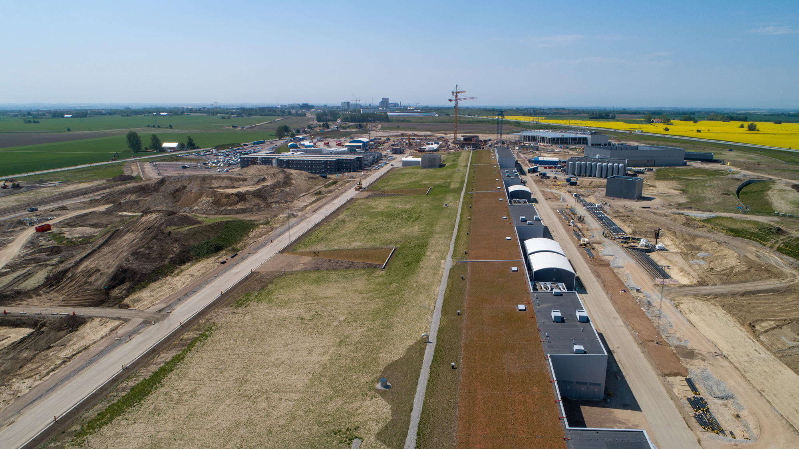
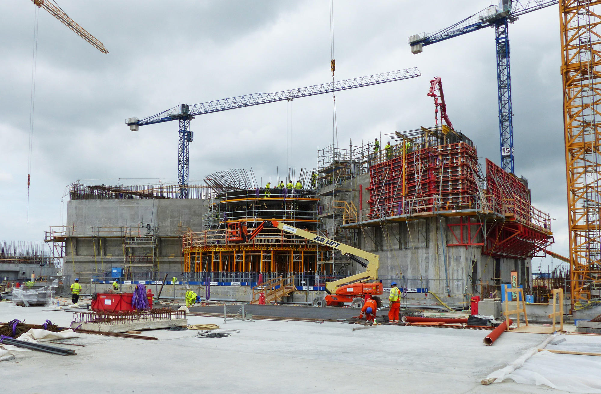
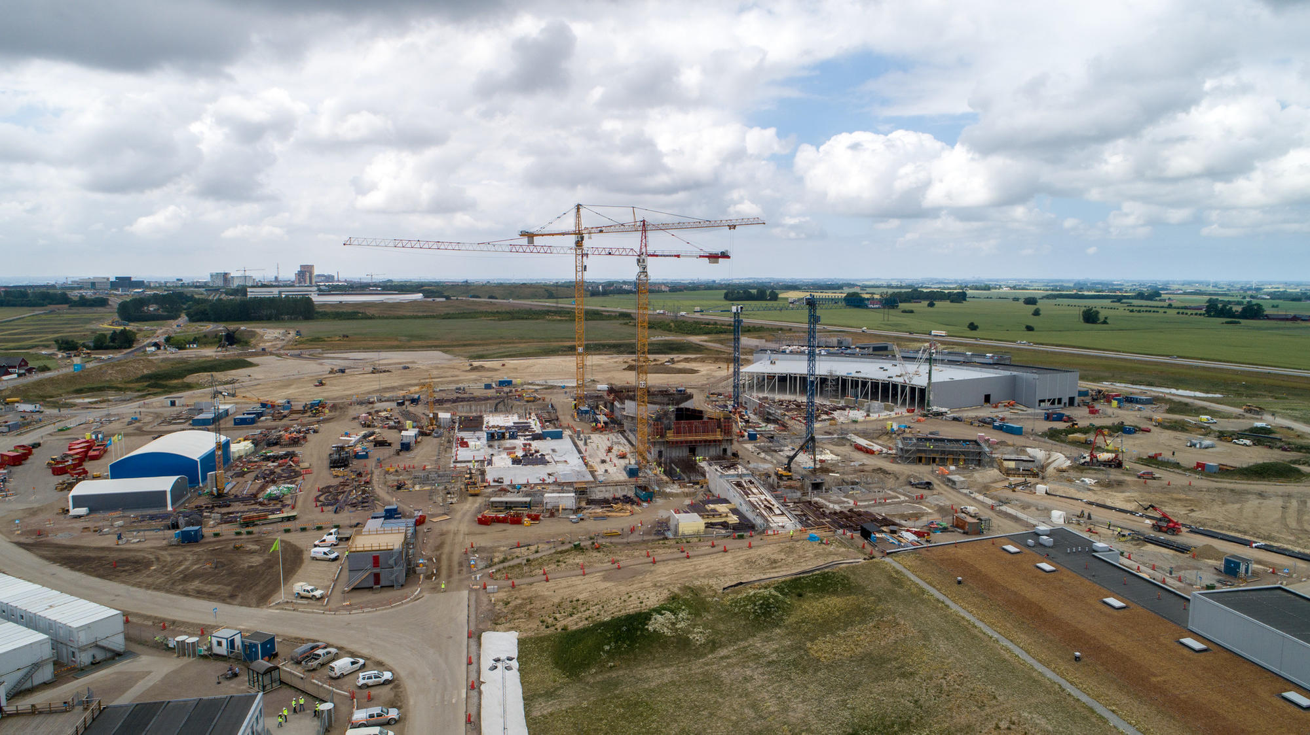
ESS construction
June 2018
Linac Bunker
Target Core
Target Area

Slide 8





Accelerator Technical performances
Key parameters:
    - 2.86 ms pulses
    - 2 GeV
    - 62.5 mA peak
    - 14 Hz
    - Protons (H+)
    - Low losses
    - Minimize energy use
    - Flexible design for mitigation and future upgrades
Design Drivers:
High Average Beam Power
5 MW
High Peak Beam Power
125 MW
High Availability
352.21 MHz
704.42 MHz
2.4 m
4.6 m
3.8 m
39 m
56 m
77 m
179 m
Target
Source
LEBT
RFQ
MEBT
DTL
Spokes
Medium β
High β
HEBT & Contingency
75 keV
3.6 MeV
90 MeV
216 MeV
571 MeV
2000 MeV

Slide 9
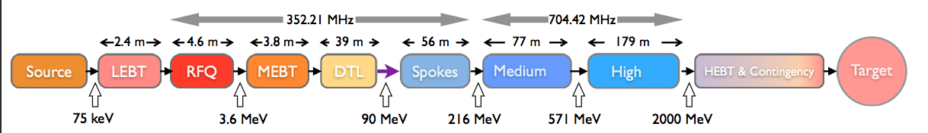
ESS Linac & INFN Contribution
INFN – LNL&TO
INFN - LNS
INFN - MI
INFN is in charge of:
Ion Source & LEBT (LNS, minor contribution of INFN-Bologna) 5.2 M€
Drift Tube Linac (Laboratori Nazionali di Legnaro and INFN-Torino) 16.5 M€
Medium Beta Superconducting elliptical cavities (LASA-Milano) 11.3 M€
Each activities during the years involved contribution of other teams
The 3 main TAs of INFN have been approved by INFN Board and signed in 2016 (DTL in April, Ion Source&LEBT in June, Medium beta cavities in November)

Slide 10
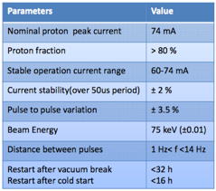
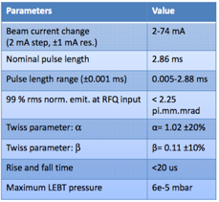
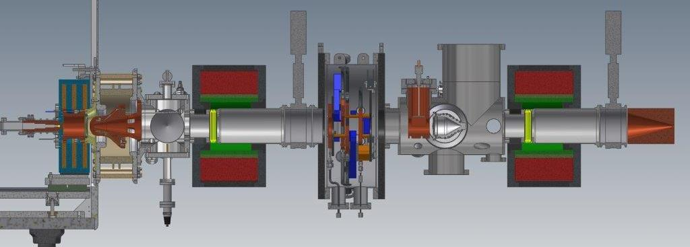
Source & LEBT
Extraction
Solenoid
Iris
Gate valve
Collimator
Chopper
Source
Solenoid
Diagnostics
Gate valve

Slide 11
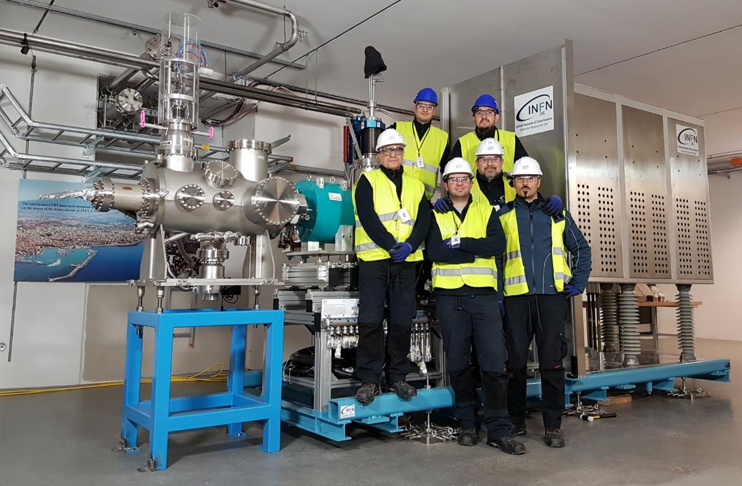
Source & LEBT
Installed in Lund
2018-02-01 Source fully assembled in Lund by INFN-LNS team

Slide 12
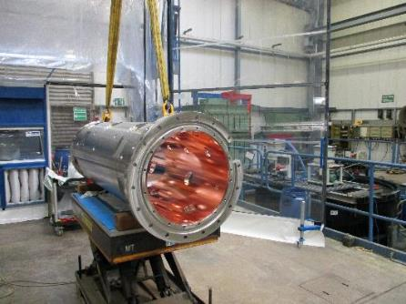
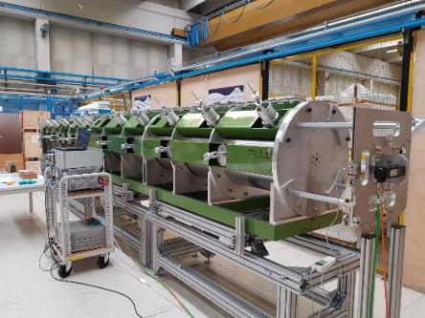
Drift Tube Linac after 2013 design update
Requirement | Target value | Comment
Particle type | H+
Input energy | 3.62 MeV | +- 50 keV
Output energy | 90 MeV
Input current | 62.5 mA | Peak, (2.86 ms long with a repetition rate of 14 Hz)
Input emittance | 0.28 mm mrad | Transverse RMS normalized
 | 0.15 deg MeV | Longitudinal RMS
Emittance increase in the DTL | <10% | Design
Beam losses | <1 W/m | Above 30 MeV
RF frequency | 352.21 MHz
Duty cycle | <6%
Peak surface field | <29 MV/m | 1.6 E_{kp}
RF power per tank | <2.2 MW | Peak, dissipated+beam load, including
Module length | <2 m | Design constraint
Focusing structure | FODO | Empty tubes for Electro Magnetic Dipoles (EMDs) and Beam Position Monitors (BPMs) to implement beam corrective schemes
Permanent Magnet Quadrupole (PMQ) field | <62 T/m
Mock-up of tank, for bead-pull tests etc.
Copper plated tank section #4-1 at GSI

Slide 13
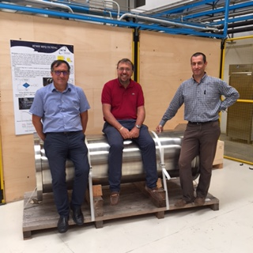
Drift Tube Linac
Santo Gammino, Andrea Pisent and Paolo Mereu sitting on the first ESS DTL tank
The DTL construction is proceeding through
    The procurement of many components in industry (all main contracts in place)
    Internal INFN work for the most critical components (drift tubes, brazing, integration of beam components).
    Preparation for the various integration steps in Italy and at Lund
  The main points for the management of all the process are to ensure the best quality and to maintain the dates for installation (RFI).
  The task is very hard but we do not see major show stop
  Acknowledgements: CERN for making available the details of Linac4 DTL and for constant support (Technological transfer agreement renewed June 2017), ESS contact persons (Frank Hellström, Edgar Sargsyan, Janet Schmidt) for managing the constant flux of information (very critical in this phase)
Tank # | Present RFI
4 | 2018-09-18
1 | 2018-11-16
3 | 2019-03-08
2 | 2019-04-30
5 | 2019-09-30

Slide 14
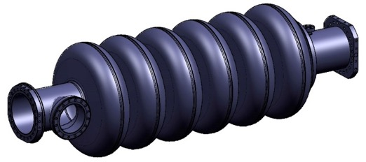
Medium beta cavities at INFN-LASA
R&D on prototypes:
    Built 3 prototypes of medium beta cavities.
    INFN design, using Large and Fine Grain Nb, plug compatible with ESS cryomodule.
    Full treatment at the industry.
    Final handling and test done in the qualified infrastructure at LASA.
INFN In-Kind contribution:
    Niobium procurement for the fabrication of 36 medium beta cavities.
    Cavity fabrication of 36 medium beta cavities in the industry, including treatments, tuning, Helium tank integration. Full treatment at the vendor.
    Ancillaries, certification activities, documentation.
    Cold test at DESY. Test can be done also LASA, but not with the occurrence needed for the series.
    Transportation in special boxes and delivery at CEA cryomodule assembling facility.
MB cavity technical requirements
Frequency (MHz) | 704.42
Number of cells | 6
Geometric beta | 0.67
Nominal Acc. Gradient (MV/m) | 16.7
E_{peak} (MV/m) | < 45
RF peak power (kW) | 1100
Q external | 5.9-8 10⁵
Q₀ at nominal gradient | > 5 10⁹

Slide 15
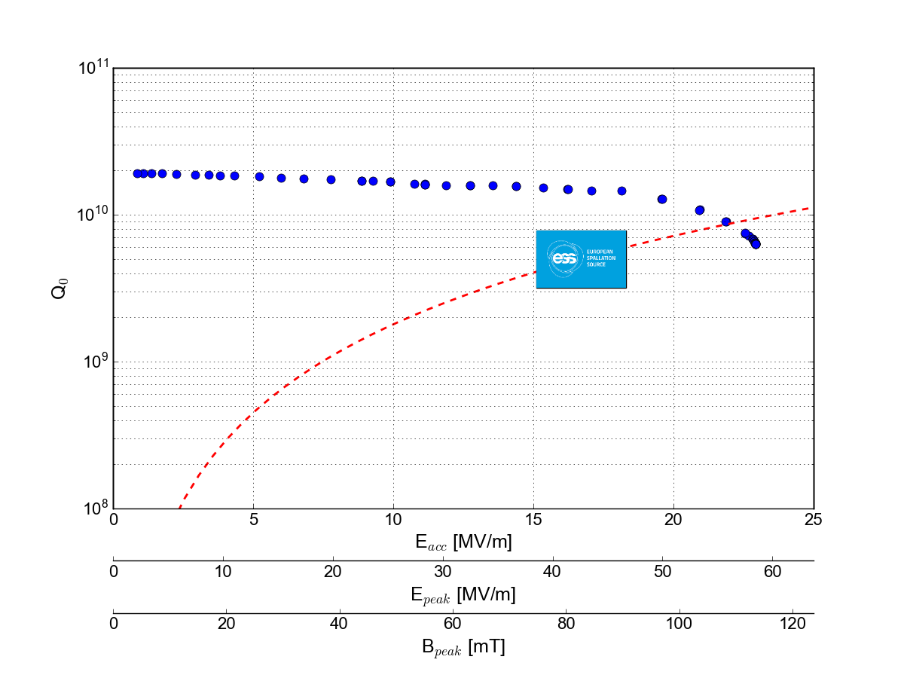
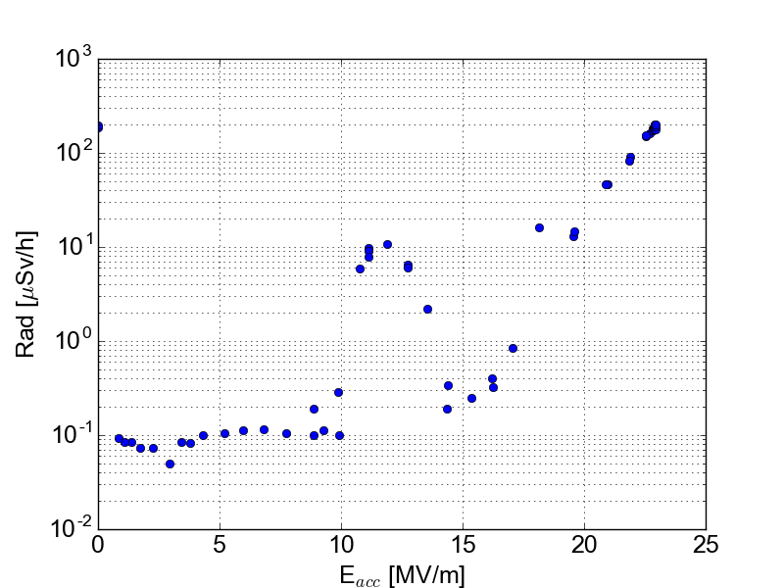
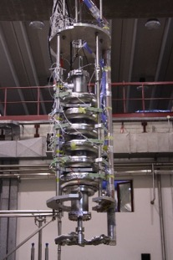
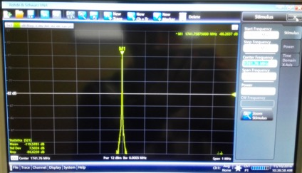
INFN LASA
MB Prototype Cavity Test
The INFN LASA designed cavity was successfully tested @ 2 K, exceeding the ESS specifications.
Soft Multipacting barrier
Power Rise @ 2 K
A soft MP barrier was easily conditioned.
This barrier matches with simulations.
HOM near 5th machine line
100 W CW cryo power,
i.e. 16.7 MV/m @ Q₀ 5 10⁹
f = 1741.8 MHz (> 19 MHz from machine line)
Δf < 1 MHz from simulations (f =1742.4 MHz).

Slide 16
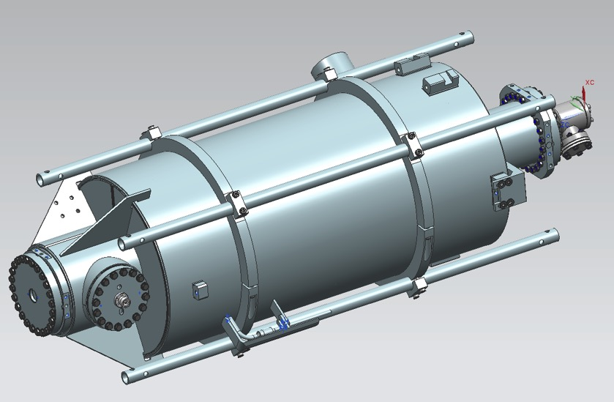
Industrial production of the INFN medium beta cavities for ESS

Slide 17
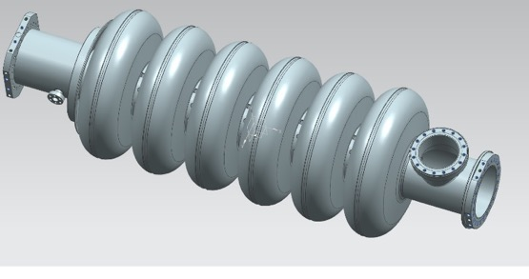
Medium Beta Cavity
Preliminary Design Report
The PDR was held in
Milano on May 19, 2016
to review the INFN cavity design.
The PDR committee reported:
  INFN – LASA has completed a very detailed optimization of the medium beta cavity design. The committee was impressed by both the level of detail of the work and the application of LASA’s previous experience in SRF cavity design and production
  No technical showstoppers are seen for the medium beta design
Few recommendations were issued mainly on:
  Conduct Multipacting Studies
  Conduct study of HOMs due to cavity fabrication shape variation
Green light for series production

Slide 18
Medium Beta Cavity
Production Strategy
ESS cavities production strategy similar to XFEL
One company: 36 cavities.
Company already “experienced” by previous activities as E-XFEL.
  Prototypes developed at the company, both for mechanical construction and treatments.
INFN expert for QA/QC set up, reviewing of operative instructions, vacuum, RF measurements, chemical treatments etc
Niobium vendor selected by public tender in 2017 (2.6 M€) NINGXIA OTIC
Cavity vendor selected by public tender in 2017 (3.7 M€)
Ettore Zanon

Slide 19



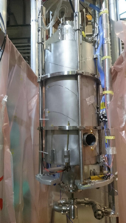

Medium Beta Cavity
Production cycle
Ettore Zanon
NOK
RRR 300
Nb Sheets
Eddy current
Scanning (DESY)
INFN LASA
OK
Alt. line
more diagn.
Rs/t, etc
pref. line
Semifinished parts
Cavity TEST at DESY
Cavity TEST at LASA
Cryomodule testing at ESS (LUND)
CEA
Assembly of cavities in the cryomodules
NOK
OK

Slide 20
Medium Beta Cavities
Major Procurements
Medium beta series cavities
  Niobium procurement for the fabrication of 36 medium beta cavities.
  Cavity fabrication of 36 (*) medium beta cavities in the industry, including treatments, tuning, Helium tank integration, etc., accomplishing the ESS requirements in terms of performances, functional interfaces.
  Certification, documentation
  Ancillaries
    vacuum valves
    Antennas
    frames
  Cold test in a qualified infrastructure.
  Transportation in special boxes and delivery at the cryomodule assembling facility.
  Man power for the above activities.
  (*) INFN Design, plug compatible with CEA boundary condition

Slide 21
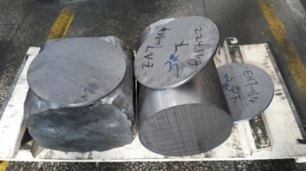
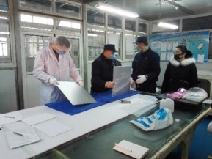
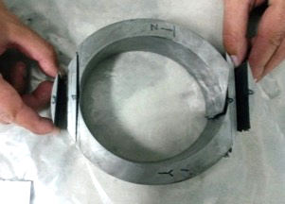
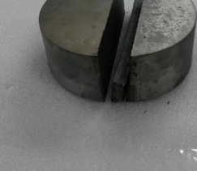
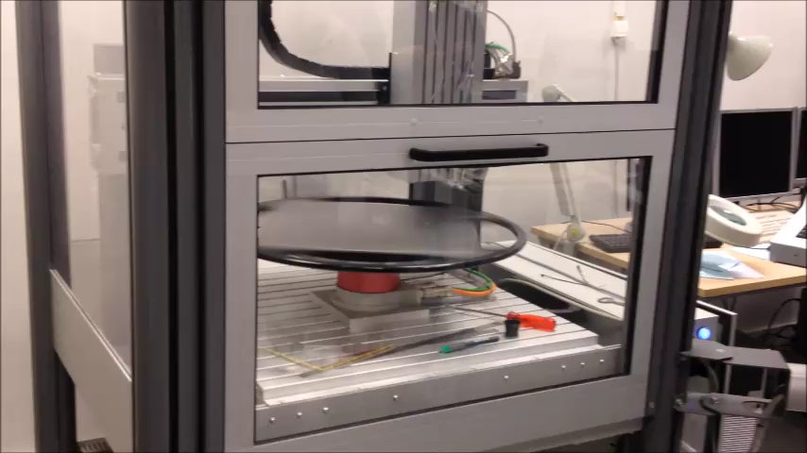
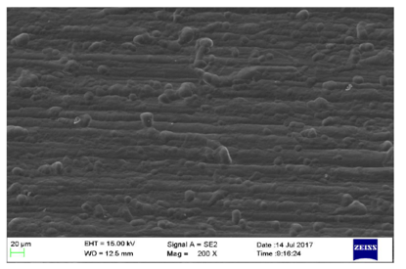
Medium Beta Cavity
Nb Procurament
Ca. 4000 kg of Nb sheets delivered in 3 batches
Eddy current scanning of sheets at DESY (check for surface defects)
  1st and 2° batches scanned, 330 sheets. 15 forwarded for further analysis
  Next and last batch arrived last Friday at LASA (144 sheets)
All semi finished products (tubes, MC, PU, etc.) at Zanon
Niobium ingot and forged piece at Ningxia OTIC
Sheet inspection at Ningxia OTIC
Nb grain size, RRR and mechanical properties measurement
EDDY scanning results
Eddy current scanning at DESY
SEM after final polishing

Slide 22






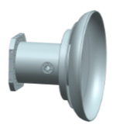

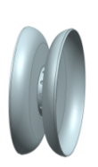

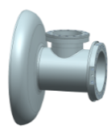
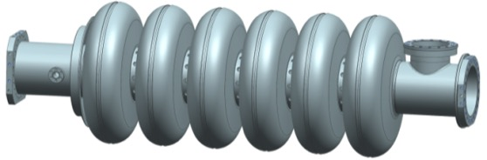
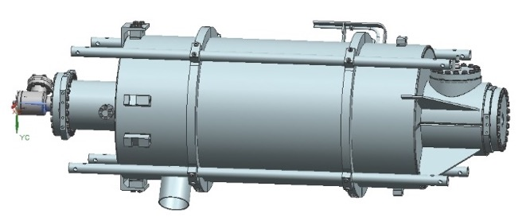
Medium Beta Cavity Fabrication Cycle
Nb sheets are deep drawn to form three kind of half cell (Inner, Penultimate and End Cell)
IC and PC half cells are EB welded to form the Dumb Bell and the EC form the End Group (PickUp and Main Coupler)
All the parts are EB welded together to form the cavity. This is then treated to prepare the inner surface, tuned to right frequency and to required field flatness.
The He-Tank is the welded to the cavity and the final preparation is done to have the cavity ready for test at DESY.
EC
PC
IC
PC
EC
EGP
PD
ID
CD
EGC

Slide 23

Medium Beta Cavity
QA/QC and document flow
Industry
NCR
INFN Experts Check
INFN
Managing System
Quality Control
Cavity production data
Database
(parameter analysis)
INFN Managing system
Documents for full equipped cavity acceptance (for string assembly)
NCR
CAVITY with TANK
Documents for cold RF test acceptance
NCR
ESS
(approval)
NCR
DESY
(Cold RF test)
CEA
CAVITY with TANK
STRING ASSEMBLY
MODULE
Q₀ vs. Eacc
ESS
Document and data management developed in the framework of collaboration

Slide 24
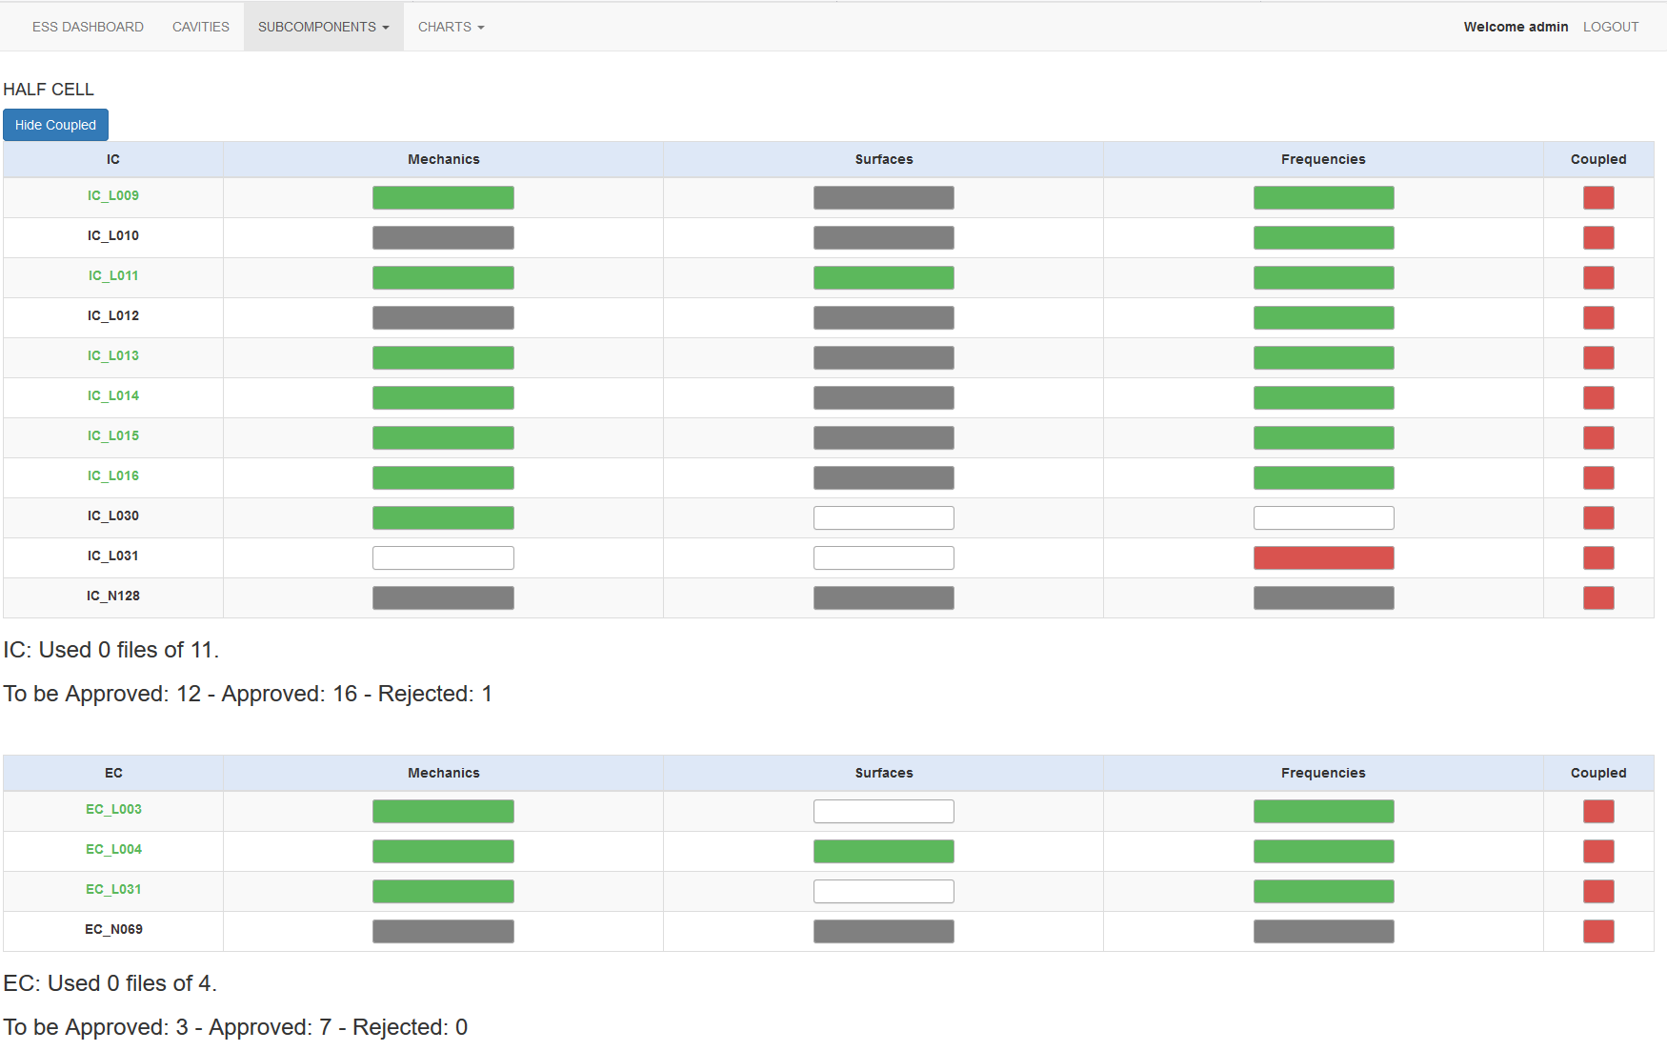
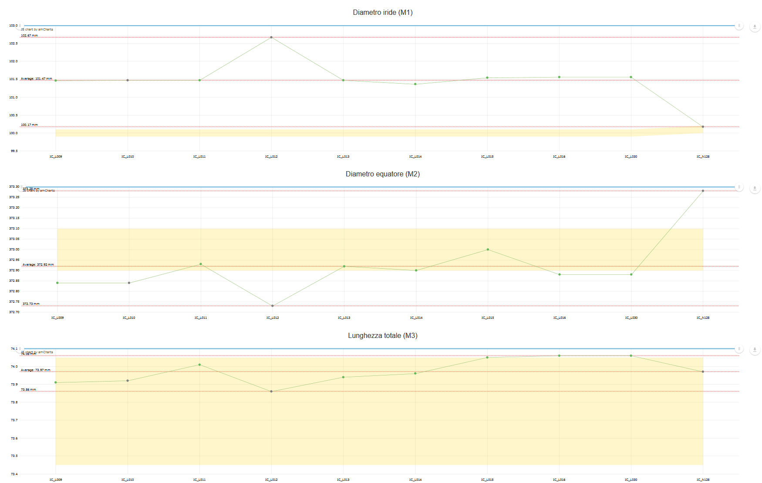
Medium Beta Cavity
QA/QC and document flow
Document and data management developed in the framework of collaboration

Slide 25
Medium Beta cavity
Status at Zanon
Work in progress with Ettore Zanon
  Final definition of production drawings and interfaces (CEA) for tank.
  Cavity production cycle finalization from subcomponents to tanked cavity
  Final set up of QA/QC system
  Half cell deep drawing started.
  RF measurement machines (for HC and DB ready , cavity tuning finalization).
Expected deliveries (from Zanon)
  First two cavities: 8 August 2018
  First six cavities (needed for M-ECCTD demonstator assembly): October 2018
  Last cavity: extimated by October 2019
  Production rate: 2 cavities every 3 weeks.

Slide 26
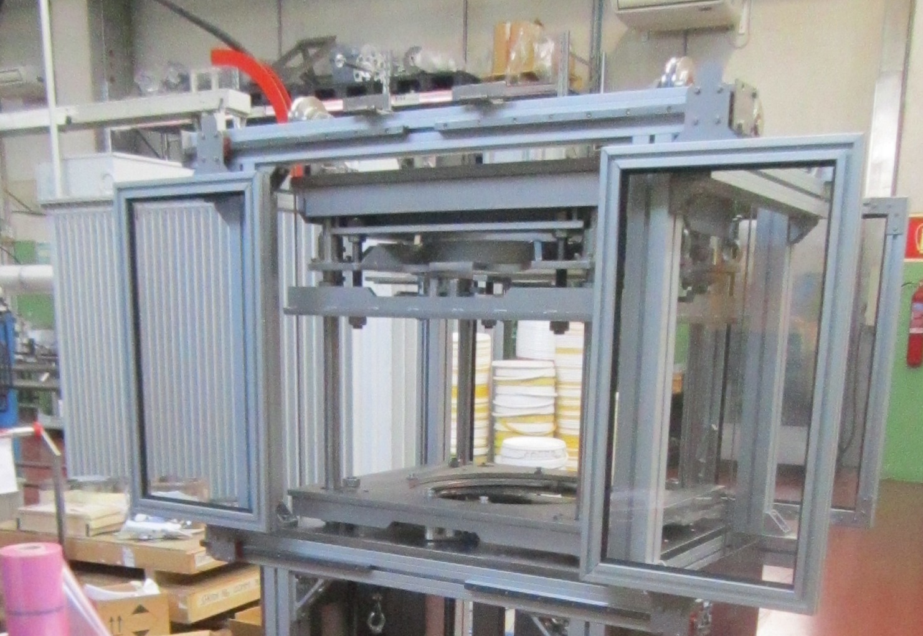
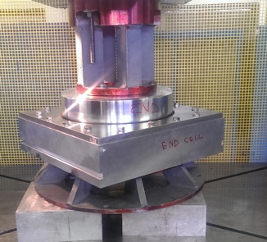
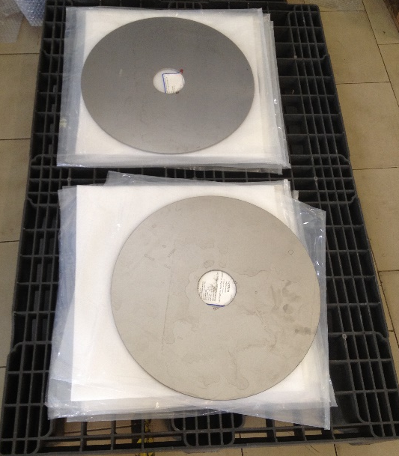
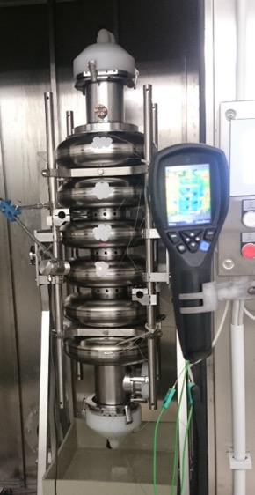
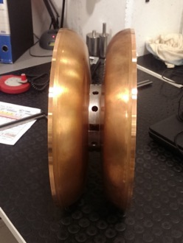
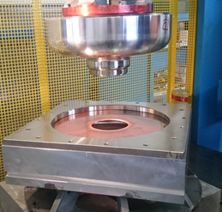
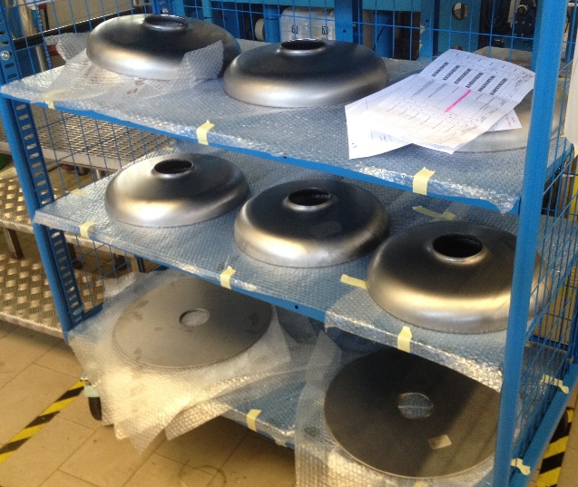
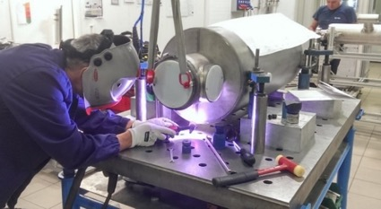



Activity at Zanon
Co.Co.De for
HC and DB RF measurements
Half cell deep drawing
Nb sheets water cut
Bulk BCP
Test of deep drawing dies
Cu DumbBell
Nb sheets deep drawn
Cavity integration in He tank
Deep drawing dies
Nb tubes for end group
Cavity tuning machine

Slide 27



Medium Beta Cavity
Vertical Test @ DESY
Agreement INFN / DESY: signed
Cold test specifications: ready
DESY infrastructure status:
  DESY will test the cavities in their adapted Vertical Test Infrastructure.
  Modification to the cold insert done.
  First test in May with the LG INFN naked cavity and a
  dummy cavity from CEA.
  Procurement of components (RF amplifier, cables,
  hardware for cavity handling) done.
  Cold test of LG cavity this week at 2 K.
  Expected test rate: 2 cavities/week, cycle time: 3 weeks
    First two cavities tested by end of September 2018
    First 6 cavities tested by the end of October.

Slide 28





Medium Beta Cavity
Cavity cold test at LASA
The qualified infrastructure at LASA could test ESS cavities, as it was done for prototype testing, but not with the occurrence needed for the series (personnel and cryo system limitations).
LASA infrastructure will be useful for a few tests on cavities that needs dedicated diagnostic not available at DESY (X ray spectroscopy, cryo X ray detection, second sound, fast thermometry).
Cold test can be done at LASA at different temperature (down to 1.5 K).

Slide 29




Medium Beta Cavity
Box and Transportation
Two prototype boxes built
Four soft rubber dampers in
place of foam supports
7 shipments made so far: OK
  4 EZ to LASA, 1 LASA to CEA,
  2 LASA to DESY
Data analyses on prototypes:
  Test done at a qualified and specialized company on a vibrating table
  g-shock reducing factor > 8
  Residual oscillations < 7 Hz
  Damping τ₀ about 0.25 s
Series box design finalized and tender issued
Each transportation will be equipped with shockloggers
Cavity spectral response
Cavity response to 6 g shock event

Slide 30

Medium Beta Cavity
ESS accelerator (cryo)
Project scheduling
Medium beta

Slide 31


Medium beta cavity
ESS Project scheduling
First two cavities
available
First six cavities
(for the M-ECCTD)
2018
2019
2020
Cavities manufacturing at the company
First two cavities
test at DESY
Last cavity delivered

Slide 32

Medium Beta Cavity
ESS Linac tunnel today …

Slide 33
Grazie per l’attenzione

Slide 35




















Financing includes cash and deliverables
Host Countries of Sweden and Denmark
Construction 47.5%
Operations 15%
Non Host Member Countries
Construction 52.5%
Operations 85%
In-kind Deliverables ~ 3%
Cash Investment ~ 97%
In-kind Deliverables ~ 70%
Cash Investment ~ 30%
~ 100
Collaborating Institutions
42 In-kind Partners
60 Collaboration, MoU and Grant Partners
47 Nationalities
368 Employees
6%

Slide 36
ESS In-kind goals
Construction cost: € 1.84 Billion
In-kind: € 747.5 Million
40.5%
€ 510 M
€ 350 M
€ 155 M
€ 73 M

Slide 37
ITALY
I.N.F.N. (33 M€)
LNS-Catania: Ion Source and Low-Energy Beam Transport;
LNL-Legnaro: Drift Tube LINAC;
LASA-Milano: Medium Beta Cavities;
Elettra Sincrotrone Linac Magnets;
(30 M€) Wire scanner Acquisition;
Spoke RF Power Stations;
Linac Magnets Power Converters;
CNR (20 M€) T-Rex
VESPA
Total Planned Commitment (2013 prices): 110,186 M€ ( 6,0% )
CASH: 20,8 M€ (19,0%)
IN KIND: 89,39 M€ (81%), 6.16 M€ for pre-construction phase
Total IKC to the accelerator (ELETTRA+INFN): 62.51 M€
WP2 Regional Hubs

