Slide 1

Progetto HiLumi
I magneti correttori di alto ordine
INFN Milano - consiglio di sezione – 10 Luglio 2018
Marco Statera
on behalf of the LASA team
INFN Milano - LASA

Slide 2
OUTLINE
scope: the High Order correctors magnets
coils studies
octupole MCOXF and decapole MCDXF : cold test results
baseline changes
dodecapole MCTXF and quadrupole MQSXF
Round Coil Superconducting Magnet
Integration
new cryostat for series and long prototypes
next steps

Slide 3
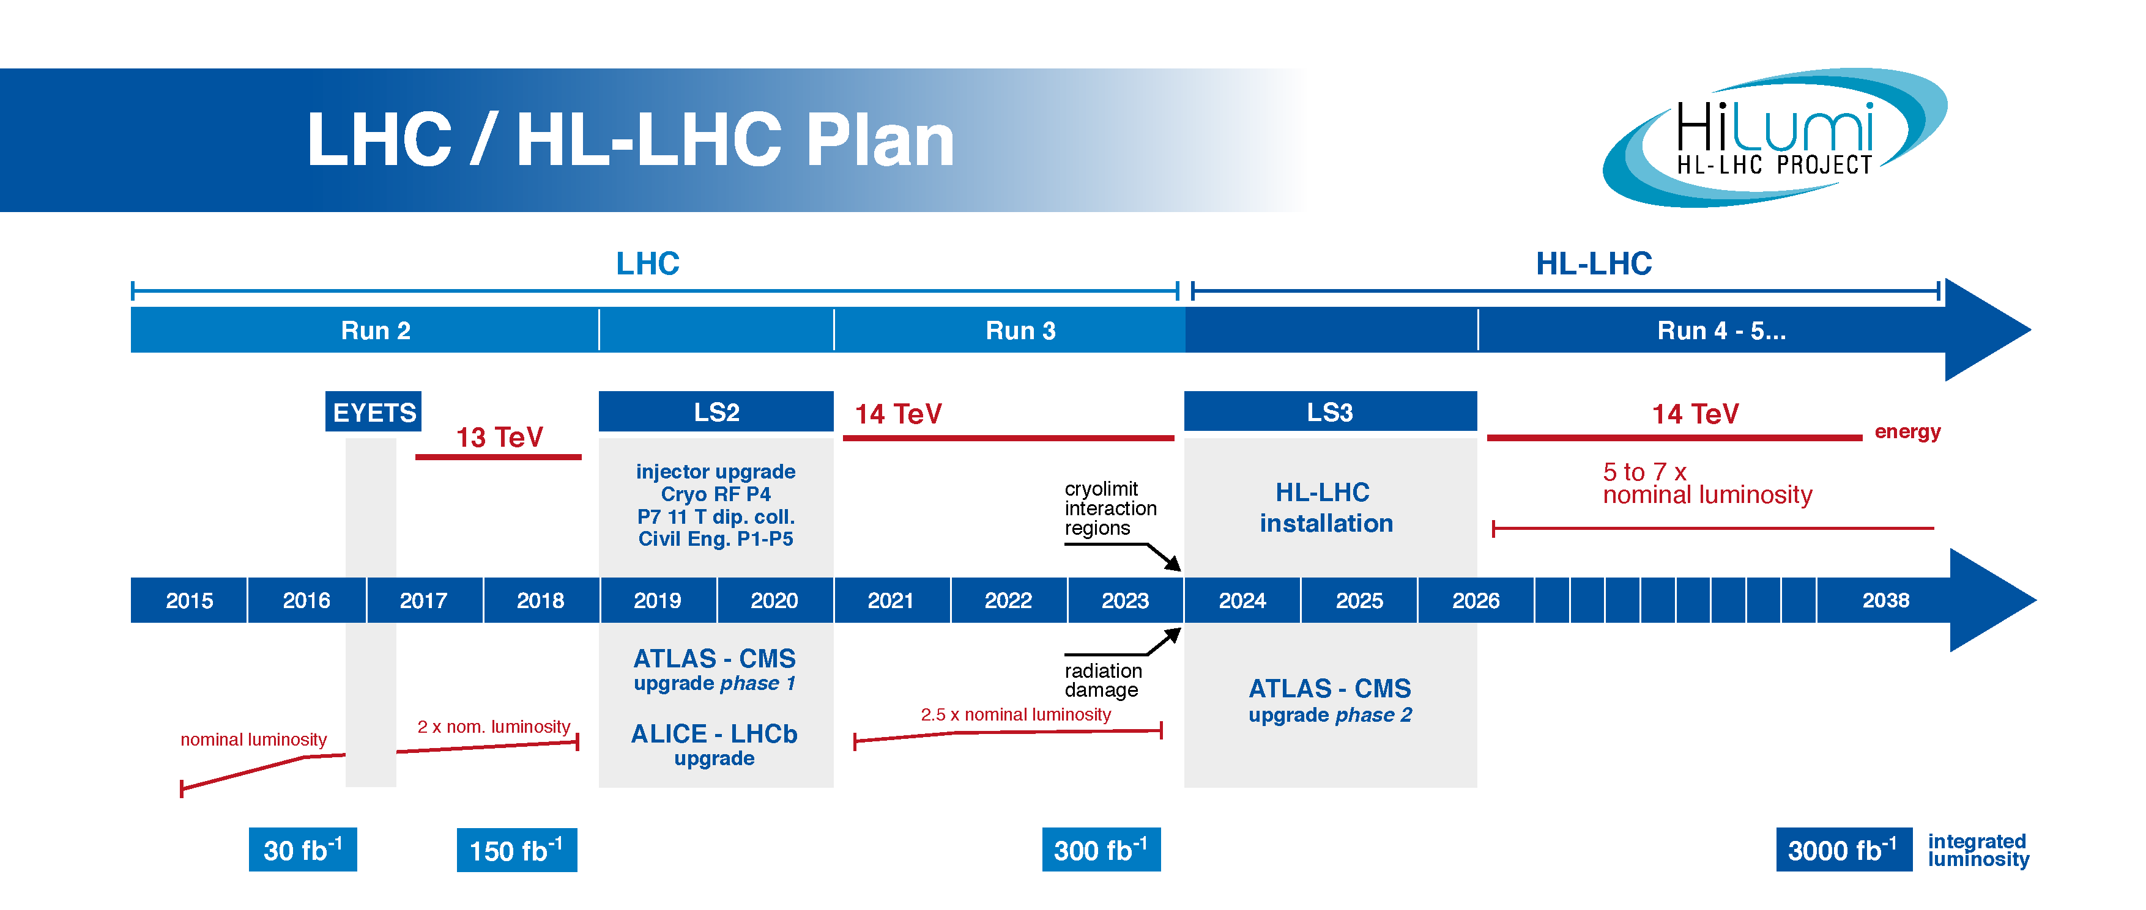
HiLumi LHC
The main objective of HiLumi LHC Design Study is to determine a hardware configuration and a set of beam parameters that will allow the LHC to reach the following targets:
A peak luminosity of L_{peak} = 5×10³⁴ cm⁻²s⁻¹ with levelling, allowing:
An integrated luminosity of 250 fb⁻¹ per year, enabling the goal of L_{int} = 3000 fb⁻¹ twelve years after the upgrade.
This luminosity is more than ten times the luminosity reach of the first 10 years of the LHC lifetime.
Courtesy of L. Rossi

Slide 4
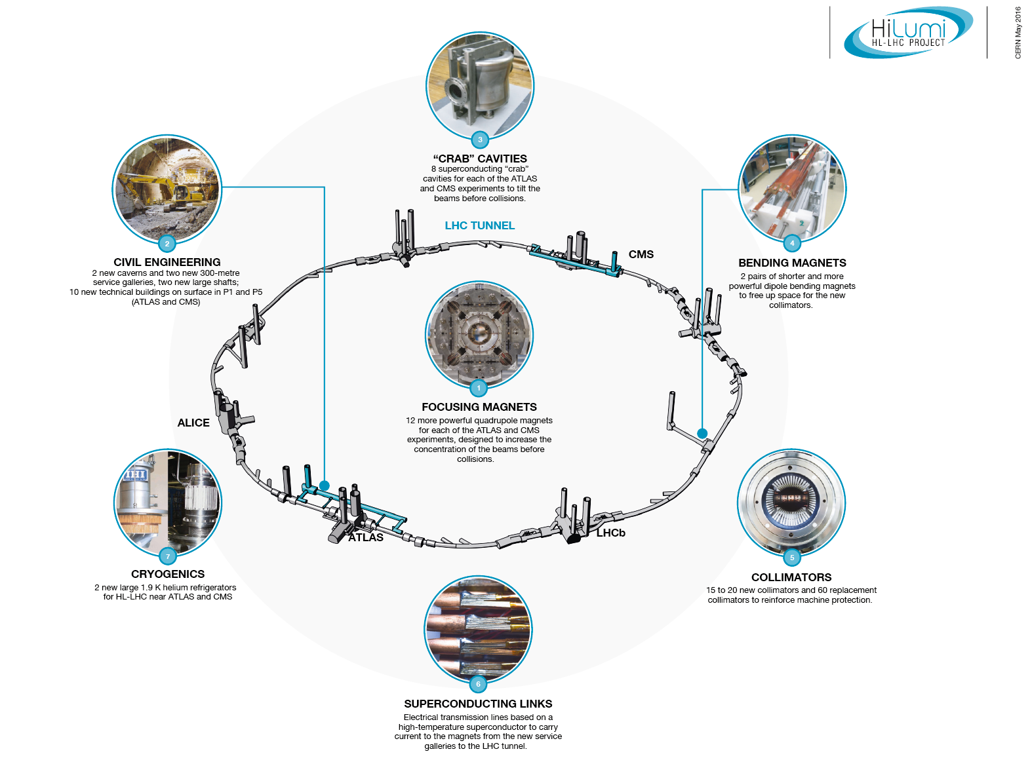
HiLumi LHC landmarks
Hilumi LHC a project for Physics and Technology jump
Courtesy of L. Rossi

Slide 5
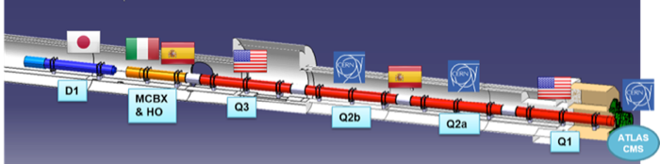
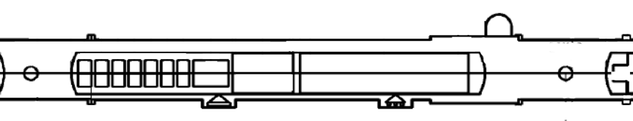
SCOPE
The INFN-LASA follows the design, construction and test of the 5 prototypes of the high order (HO) corrector magnets for the HL interaction regions of HiLUMI (KE2291/TE/HL-LHC)
This activity is founded by INFN (Magix “activity”), and with an agreement CERN contributes for about 50%
The INFN-LASA follows the series production (KE3085/TE/HL-LHC)
~70 m
b3
b4
b5
b6
a3
a4
a5
a6
a2
by P. Fessia

Slide 6
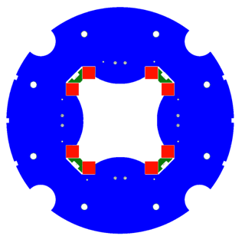
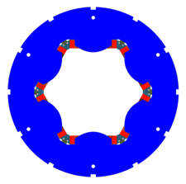
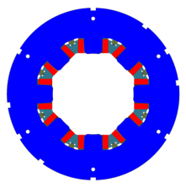
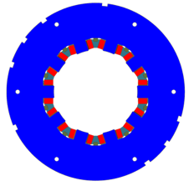
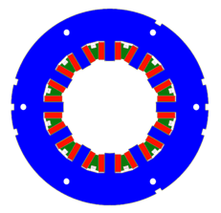
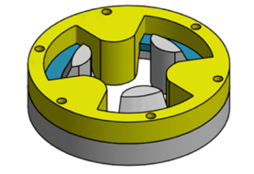
HO CORRECTOR MAGNETS ZOO
OD460
MCSXF
MCOXF
OD320
a3
b3
✔
a4
b4
✔
a2
MQSXF
✔
a5
b5
a6
b6
NbTi superconducting coils
superferric design
60% margin @ 1.9 K
existing power supplies
no energy extraction (but 4P)
MgB₂
round coil
MCDXF
MCTXF

Slide 7
OUTLINE
scope: the High Order correctors magnets
coils studies
octupole MCOXF and decapole MCDXF : cold test results
baseline changes
dodecapole MCTXF and quadrupole MQSXF
Round Coil Superconducting Magnet
Integration
new cryostat for series and long prototypes
next steps

Slide 8
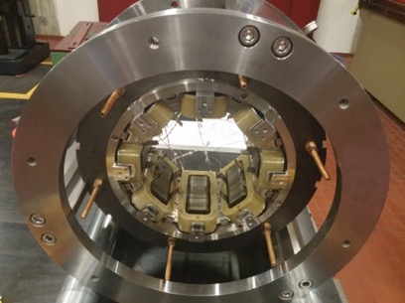
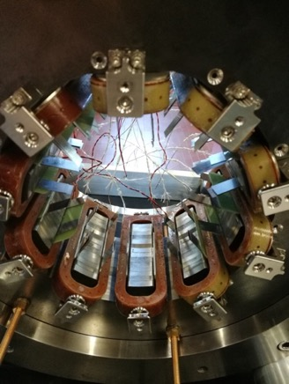
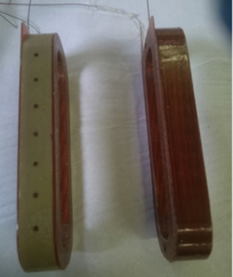
COILS STUDIES
8 coils duratron
ISSUE: radiation
15 MGy recalculated
(35 MGy the previous estimate)
Validated Materials (for coils)
  Duratron
  BTS2 by Arisawa
  Hybrid BTS2/Duratron
5 coils BTS2
5 coils hybrid

Slide 9
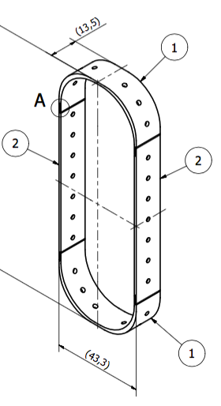
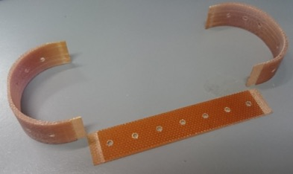
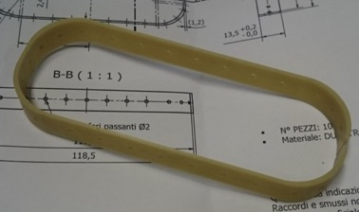
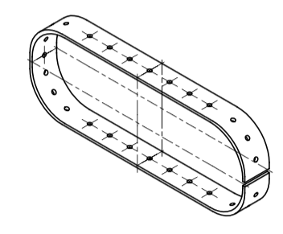
COILS
machined from bulk
4 parts
>1 mm BTS2 – new design
0.15 mm BTS2
1.05 mm BTS2
1.3÷1.5 mm DURATRON
machined from bulk

Slide 10
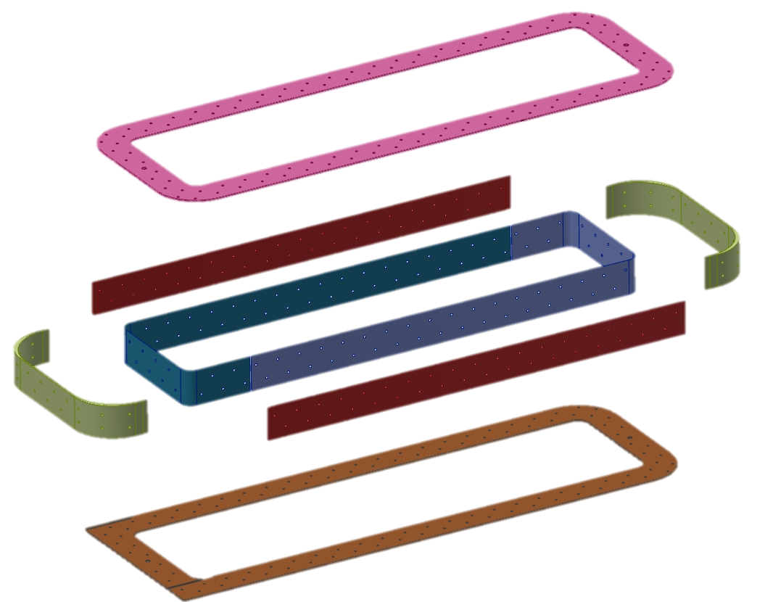
FINAL DESIGN
One technology for all HO correctors coils
7-8 parts BTS2 (up to 12 in the previous version)
Machined from bulk
0.15 mm
sheet
1.0 mm
sheet
In & out

Slide 11
OUTLINE
scope: the High Order correctors magnets
coils studies
octupole MCOXF and decapole MCDXF : cold test results
baseline changes
dodecapole MCTXF and quadrupole MQSXF
Round Coil Superconducting Magnet
Integration
new cryostat for series and long prototypes
next steps

Slide 12
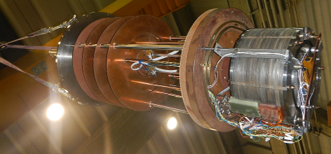
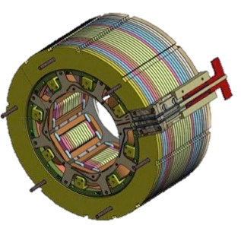
MCOXFP1
 | nominal | design
length | 160 mm | 183 mm
integrated field @ Iop @ r50 mm | 46 Tmm | 46 Tmm
magnetic length | 87 mm | 99 mm
energy @Iop | 1.4 kJ | 1.07 kJ
harmonics |  | B12=11.6 B20=-3.0
DURATRON
PEI U2300 coils
electrical connections redesigned
183 mm
OD 320 mm

Slide 13
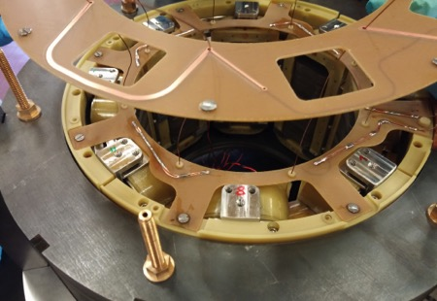
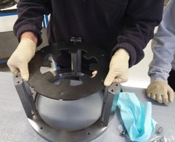
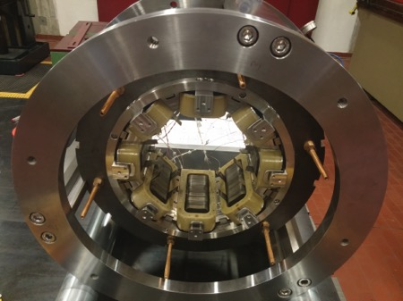
MCOXFP1 ASSEMBLY 1
assembly procedure
same as 6pole
new electrical connections
lamination
Copper 2 mm wide
0.035 mm thick
two printed circuit boards
coils’ connections
signals
alignment frame
spacers
fixed longitudinally
wedges in position
the wedges are fixed
CuBe rods

Slide 14
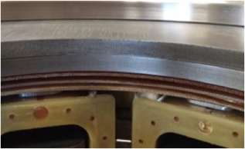
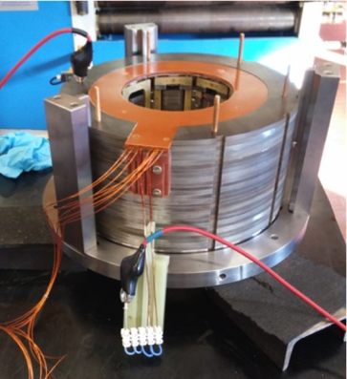
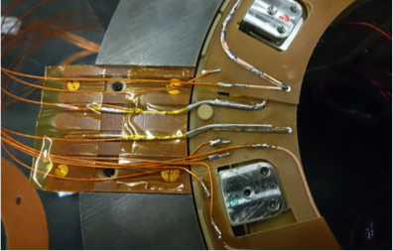
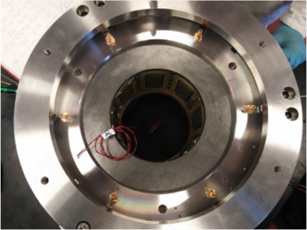
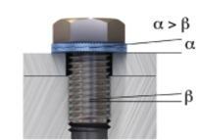
MCOXFP1 ASSEMBLY 2

Slide 15
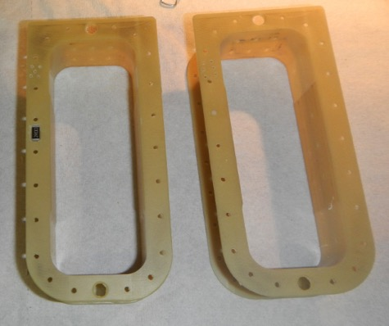
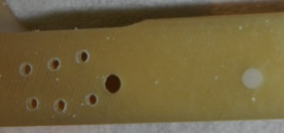
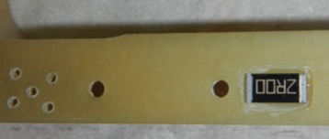
HEATERS
Two heaters are installed
DURATRON thickness reduced by hand in coil B5
A Φ 2 mm Aluminum nitride (AlN) ceramic insert in one hole of coil B6
quench induced at 4.2 K, I= 73 A
10.1 J
4.4 J
AlN
1 mm thick
By INTELLION S.a.r.l.

Slide 16
8POLE TEST
qualification @ 4.2 K
qualification 1h @ 108% @2.17 K
training @4.2 K
working condition test
w/o energy extraction
thermal cycle
qualification @ 4.2 K

Slide 17
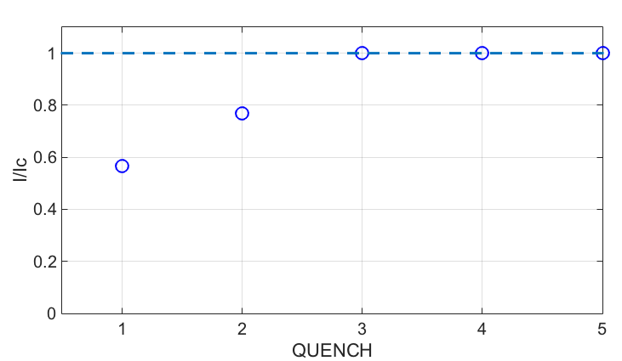
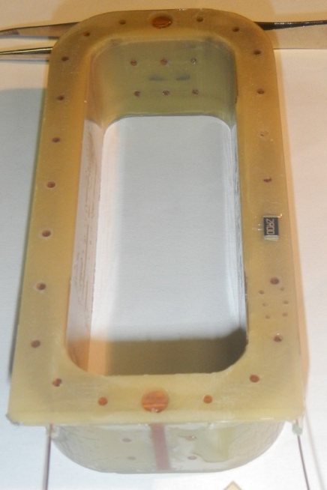
MCOXFP1 COILS
s.s.l.
12 coils produced
HCMCOXFC01-I1000001
nominal current
heigth
single coil’s cold test:
2 training quenches
reached short sample sample 247 A
inner long
B1 | M08-01
B2 | M08-08
B3 | M08-07
B4 | M08-06
B5 | M08-09
B6 | M08-10
B7 | M08-11
B8 | M08-12
inner short
coils’ assessment
Geometry
6pole average σ 0.09 mm
8pole average σ 0.13 mm
Resistance
number of turns
HV insulation
all coils above 1.8 TΩ at 5 kV
outer long
outer long

Slide 18
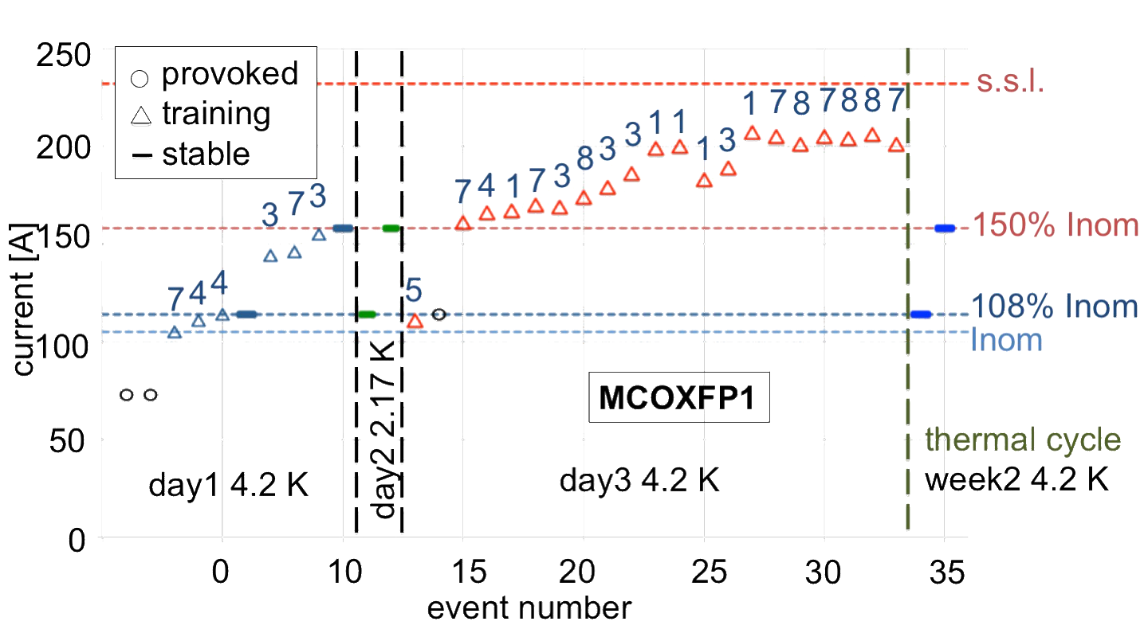
8POLE COLD TEST RESULTS
stable at ultimate current (108% Inom) and at 150% Inom
26 quenches – I_{max}= 207 A (89.2 % s.s.l.)

Slide 19
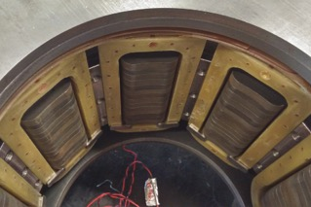
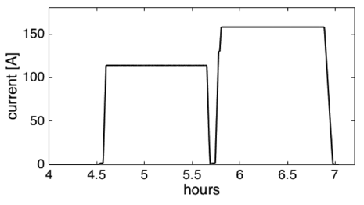
8POLE COLD TEST RESULTS - 2
He II test: 2.17 K
1h @ 108% Inom (114 A)
1h @ 150% Inom (158 A)
no quenches occurred
1h@ 150% In
qualification
1h@ 108% In
tests @ 4.2 K
full training: Imax 89% of s.s.l.
working condition test
qualification @4.2 K after a thermal cycle

Slide 20
QUENCH PROTECTION IN LHC
Protection in LHC
  Existing power supplies
  Measuring current
  Time range 60-180 ms
  Max current: ultimate current (114 A)
Protection at LASA
  Total voltage and differential voltage (half magnet)
  Quench induced by heater (and AlN insert)

Slide 21
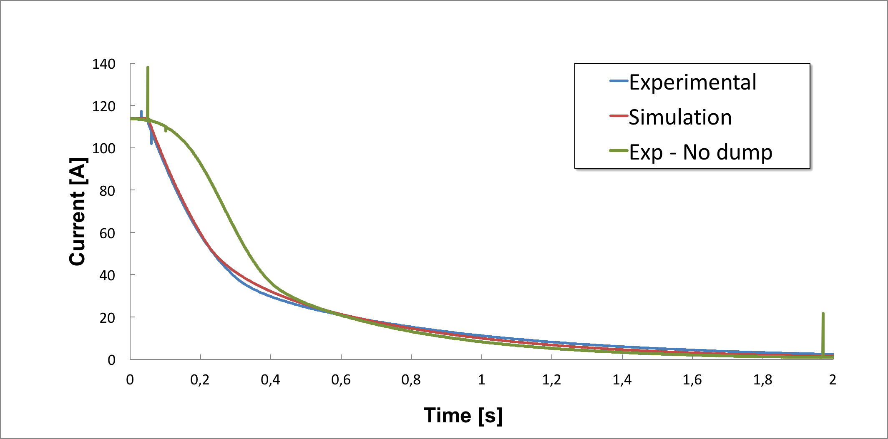
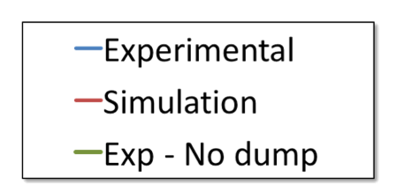
QUENCH PROTECTION (no ENERGY EXTRACTION)
  Quech induced by heater (and AlN insert)
  threshold up to 5.0 V
  total time before relay opening: 145 ms
  ΔI = 8 A @ 145 ms PS dependent
tuning of the simulation by QLASA
  inductance
  current decay
  voltages
no dump
training
200 ms
time

Slide 22
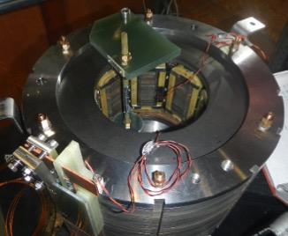
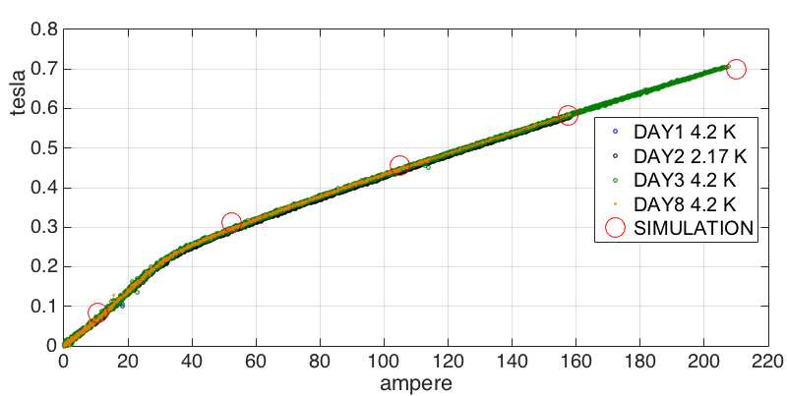
PRELIMINARY FIELD MEASUREMENT
preliminary measurement of the field
single point
in front of a pole
radius of 50±1 mm (correction applied)
reproducible
5 mT
saturation 30 A
complete measurement at CERN (2018)

Slide 23
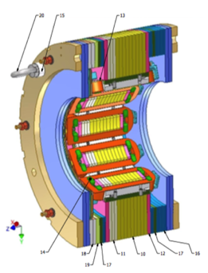
MCDXFP1 10-POLE
length | 183 mm
integrated field @ Iop @ r50 mm | 26 Tmm
magnetic length | 97 mm
harmonics | <15 U
5 coils BTS2
5 coils hybrid
Tested in Sept 2017
COILS
  Updated BTS2 Arisawa design
  Hybrid BTS2/DURATRON
Improved electrical connection design, pcbs supporting and integration with connection box

Slide 24
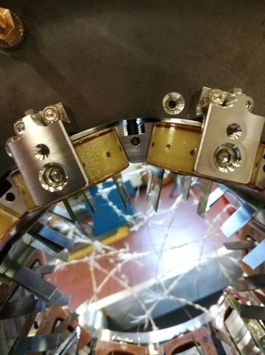
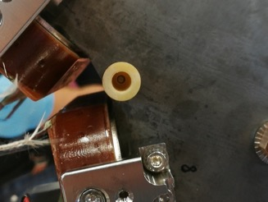
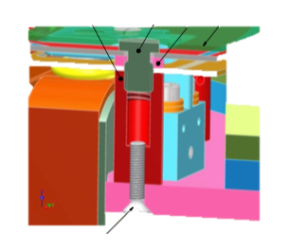
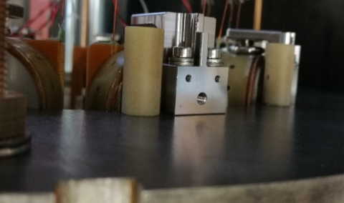
ASSEMBLY
New supports for connection PCBs
Updated design
wedge

Slide 25
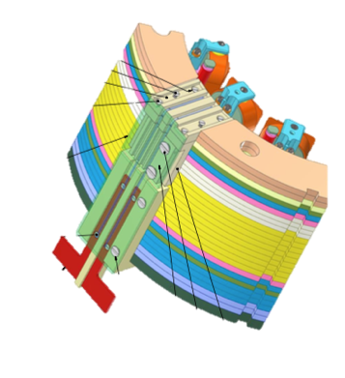
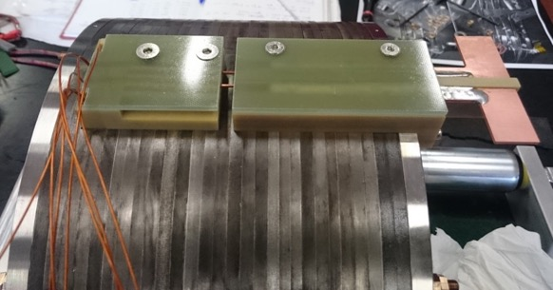
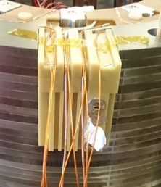
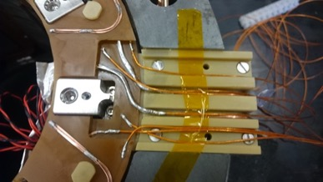
ELECTRICAL CONNECTIONS
CERN
connection box
LASA
connection box
copper for
bus bar connection
Diagnostic
(prototypes)
upper PCB
bridge
lower PCB
CERN connection box
PCBs fixing

Slide 26
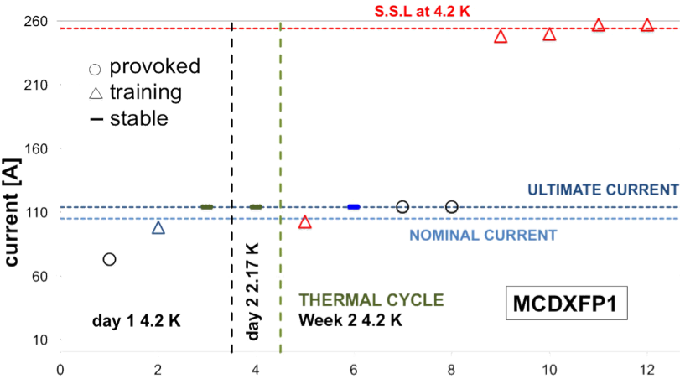
10-POLE COLD TEST RESULTS
B3-B4
B3-B4
B7-B8
B9-B10
B3-B4
B3-B4
event number
Ultimate 114 A -1 h test
Reached 100% S.S.L at 4.2 K
Quench protection w/o energy extraction

Slide 27

GROUND INSULATION
max voltage to ground in operation <150 V
hot spot temperature in operation <200 K
10 μA limit
IEEE Standard 95-177
V_{RT}= (2 x V_{max}+500) x 2

Slide 28
OUTLINE
scope: the High Order correctors magnets
coils studies
octupole MCOXF and decapole MCDXF : cold test results
baseline changes
dodecapole MCTXF and quadrupole MQSXF
Round Coil Superconducting Magnet
Integration
new cryostat for series and long prototypes
next steps

Slide 29
BASELINE CHANGES
CERN requirements for magnet performances changed
HL – LHC Engineering Change Request CHANGE OF QUADRUPOLE, SEXTUPOLE, OCTUPOLE AND DECAPOLE CORRECTORS INTEGRATED FIELD AND LENGTH EDMS 1865591
6-pole, 8-pole and 10-pole are requested to have 50% of more integrated field
increasing length or 50-60 mm (magnetic design, protection scheme, integration)
4-pole 30% decrease of integrated field
Length reduction 276 mm (magnetic design, protection scheme, integration)
Ongoing integration work between CERN and to manage the increased length of the cold mass (+320 mm -276 mm)
Small cost revisions may be necessary (probably ~5%), and they can be discussed after the consolidation of the final design

Slide 30
LENGTHS
 | MQXF 4P S | MCSXF 6P N/S | MCOXF 8P N/S | MCDXF 10P N/S | MCTSXF 12P S | MCTXF 12P N
integrated field variation | -30% | +50% | +50% | +50%
Length prototype | 814.0 | 194.0 | 183.0 | 183.0 |  | 575.0
Updated length prototype | 538.0
Updated length series | 540.4 | 251.4 | 234.6 | 234.6 | 205.6 | 576.8
Engineering ✓ Protection ✓ Integration ✓

Slide 31
OUTLINE
scope: the High Order correctors magnets
coils studies
the decapole MCDXF : cold test results
baseline changes
dodecapole MCTXF and quadrupole MQSXF
Round Coil Superconducting Magnet
Integration
new cryostat for series and long prototypes
next steps

Slide 32



DODECAPOLE MCTXFP1 and
SKEW QUADRUPOLE MCQSXFP1
Electromagnetic and mechanical design finalized
I_{op}=105 A
NO energy extraction in operation
432 windings - Φ 0.5 mm NbTi
Connection box
PCB
OD320
575 mm
I_{op}=182 A
Energy extraction in operation
754 windings - Φ 0.7 mm NbTi
Coils’ length 457 mm
538 mm
SC coil
pole
wedge
OD 460 mm

Slide 33
PRODUCTION IN INDUSTRY
Long prototypes produced in industry
New winding machine
New custom vacuum oven

Slide 34
PRODUCTION IN INDUSTRY 2
2 test coils produced
First coil produced in industry
Long prototypes’ test
MCTXFP1 in September
MCQSXFP1 in November

Slide 35
OUTLINE
scope: the High Order correctors magnets
coils studies
the decapole MCDXF : cold test results
baseline changes
dodecapole MCTXF and quadrupole MQSXF
Round Coil Superconducting Magnet
Integration
new cryostat for series and long prototypes
next steps

Slide 36


ROUND COIL MAGNET
Fe
φ 380
SCHEDULE
Winding MgB₂ wire 2017
Impregnation 2017
Cold test of the coil 2018
Magnet assembly 2018
coil
demonstrator
100 mm
Fe
G. Volpini et al. Eletromagnetic Study of a Round Coil Superferric Magnet,IEEE Tr. App. Sup, 26, 4 (2016)
multipolar MgB₂ magnet
inner bore φ 150 mm
single MgB₂ coil
  bare diameter 1 mm
electromagnetic design
  working point 133 A @4.2 K
  margin 48 % on the load line
  adiabatic hot spot temperature < 90 K
winding @ LASA

Slide 37




RCSM Single Coil Test
Conical springs
BUS BAR
Strain gages
Hall probe
MgB₂ winding
BTS2
PCB
soldering
No quench training
The Coil is stable at the Ultimate Current (108% I_{op})
73% of the Short Sample Limit
M. Sorbi, M Statera and E. Todesco
March 2018

Slide 38
OUTLINE
scope: the High Order correctors magnets
coils studies
the decapole MCDXF : cold test results
baseline changes
dodecapole MCTXF and quadrupole MQSXF
Round Coil Superconducting Magnet
Integration
new cryostat for series and long prototypes
next steps

Slide 39
INTEGRATION
integration in the cold mass ongoing
  position in cold mass
  no magnetic coupling
  alignment
  cabling
  fix threads and nuts by resin (CTD 101K) and anti vibration washers
  position and diameter for the Heat Exchanger (MCQSXFP)
integration in the power grid and electrical tests
  all magnets but quadrupole no energy extraction (simulation and test)
  defining quench protection parameters (thresholds, Δt, resistance and protection circuit)
  defining voltage tests (focus on series production)

Slide 40
Integration
DOCUMENTATION
All produced prototypes are in MTF/EDMS
Test reports and test summaries
Acceptance procedures
Workflow
MIPs
NC

Slide 41
OUTLINE
scope: the High Order correctors magnets
coils studies
the decapole MCDXF : cold test results
baseline changes
dodecapole MCTXF and quadrupole MQSXF
Round Coil Superconducting Magnet
Integration
new cryostat for series and long prototypes
next steps

Slide 42

HiLumi CRYOSTAT
Mag.meas.
Safety
Valve and disk
He inlet
Cryostat for testing MCTXFP1 (12P), MCQSXFP1 (4P) and series magnets
4 K operation
515 mm inner diameter
Hosted within DISCORAP cryostat
(which acts as a support)
About 3 m high
Up to 4 magnets (3 possible configurations)
Flange modification, thermal insulation, magnet support, room temperature connections.
Mechanical interface with dicorap cryostat
CL
2+4

Slide 43




SC magnet test area
Small Magnets test cryostat
  HO correctors protoypes
    6P MCSXFP (MCSXF/MCSSXF)
    8P MCOXFP (MCOXF/MCOSXF)
    10P MCDXFP (MCDXF/MCDSXF)
High Current Test Station
  DISCORAP and HTS magnets
  HO correctors
    12P MCTXFP
    4P MQSXFP
  HiLumi HO correctors series
MAGIX
D 480 mm
h 1200 mm
4.2 K and 2.17 K
500 A
DISCORAP
D 695 mm
h 7200 mm
4.2 K
10 kA
HiLumi
D 515 mm
H 2950 mm
4.2 K
500 A

Slide 44

TEST STATION
Mechanics delivered
Commissioning ongoing
Prototypes
Single magnet test
Series production
3 batches
  18 magnets
  2X12P 2X4P
  5 cooldowns
600 mm
2350 mm
Designed to host a field quality system by CERN
4P
12P

Slide 45


COMMISSIONING 1
SOFTWARE
Quench protection
Fast DAQ
Slow control
CABLING
MECHANICS
BUS BARS
Each HO corrector
1 common CL + bus bar
1 dedicated CL + bus bar
3 voltage taps

Slide 46



COMMISSIONING 2
AAA
HiLumi cryostat
10 kA line
pumping station
Discorap cryostat
Nitrogen
heat exchanger

Slide 47
OUTLINE
scope: the High Order correctors magnets
coils studies
the decapole MCDXF : cold test results
baseline changes
dodecapole MCTXF and quadrupole MQSXF
Round Coil Superconducting Magnet
Integration
new cryostat for series and long prototypes
next steps

Slide 48
NEXT STEPS
Sept 2018 test MCTXFP1
Nov 2018 test MCQSXFP1
  Magnetic measurement @LASA?
2019 start series production
(54 magnets)

Slide 49


Construction of the series
The engineering design of the series completed as scheduled in July 2018 (M1.1)
Technical and Contractual documents for the tender completed
Approval by INFN Executive Board in mid July 2018
Launch the tender within Sept. 2018
Signature of contract. Jan. 2019 (D1.1)
6 cold masses (9 mangnets each)
Last delivery to CERN in Sept. 2021

Slide 50
Hold point for series construction
An Hold Point has been set after the delivery to LASA of the first set of 9 magnets (a entire cold mass)
We want to test at least the modified magnets (6-pole, 8-pole, 10-pole) to verify the requested modification respect to prototypes.
The production has to be stopped for 2 months
This allows to have a first set of 9 magnets on time or earlier (at CERN in Jan. 2020)
Last delivery to CERN in Sept. 2021

Slide 51
CONCLUSIONS
Status of the HO correctors prototypes production and test
Baseline changes
Integration
New test stand for long prototypes and series
Next steps

Slide 52


THANK YOU
CERN: A. Musso
LASA: F. Alessandria, G. Bellomo, F. Broggi, S. Mariotto, A. Paccalini, A. Pasini, D. Pedrini, A. Leone, M. Quadrio, M. Sorbi, M. Statera, M. Todero, R. Valente, C. Uva

