Slide 1
RD_FA^{(*)} Collab. Meeting
Franco Bedeschi
RD_FA Collaboration Meeting,
Milano, July 2018
Outline
Status and progress
Major deadlines
Conclusions
^{(*)}RD_FA == R&D on Future Accelerators

Slide 2
Status and progress: WG4
EIC (USA)
  INFN EB/presidents CSN1-3 decision to move activity in CSN3 as of Jan. 1, 2019
  RD_FA will continue support until end of 2018

Slide 3
Status and progress: WG8
Muon Collider:
  Enormous progress during this year!
    Simulation, test beams, organization/international cooperation
  Major workshop in Padova July 1-3 (ARIES)
    Palmer, Rubbia, Schulte, Zimmermann, ….
    Important to keep up international collaboration and interest
  CSN5 call presented
    If successful will shift many FTE to CSN5
  Contributions to ESU
    Document from MC community
    Part of CSN1 and/or INFN document

Slide 4
Status and progress: FCC/CepC
Consolidated leadership on EW physics
Consolidated IDEA detector proposal
  Container for Italian supported technologies
Important contributions to CDRs of FCC and CepC
  FCC: complete evaluation of readout channels
  CepC: update contributions by end of July
    More space available than FCC
Consolidation of international collaborations:
  Organization and active participation to Int. workshops:
    Beijing Nov. 2017, Amsterdam Apr. 2018, Roma May 2018
Major IDEA vert. slice TB planned for Sept. 2018

Slide 5
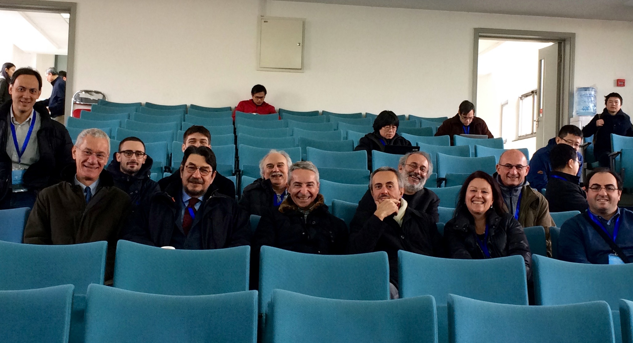
Workshop CepC
Beijing, Nov. 2017
  First international workshop on CepC
  Institutional board open to non-Chinese for first time
  Large Italian participation in both organization and attendance

Slide 6
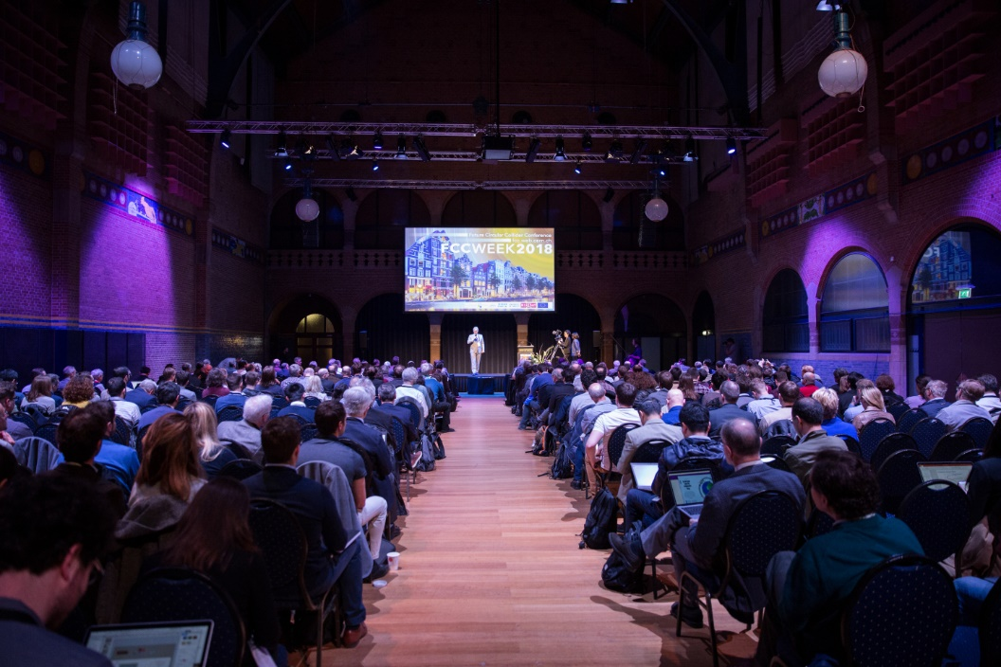
FCC week
Amsterdam, April 2018
  Many talks/conveners from the RD_FA community

Slide 7
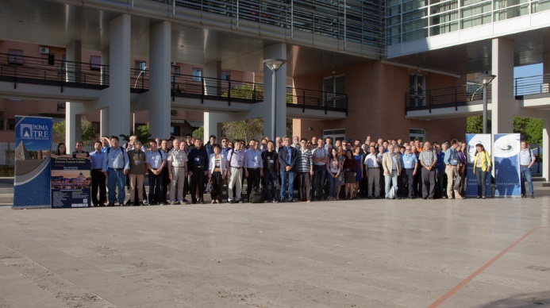
Workshop CepC
Roma3, Maggio 2018
  First CepC workshop outside of China
    Next will be in Oxford, UK – April 15-17
  Over 100 participants: 45% Chinese, 25% Italians, 30% other EU
  Very interesting round table → Document from Biagio & C.

Slide 8
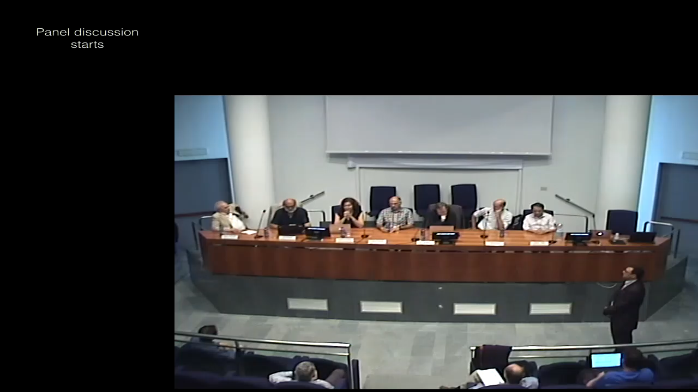
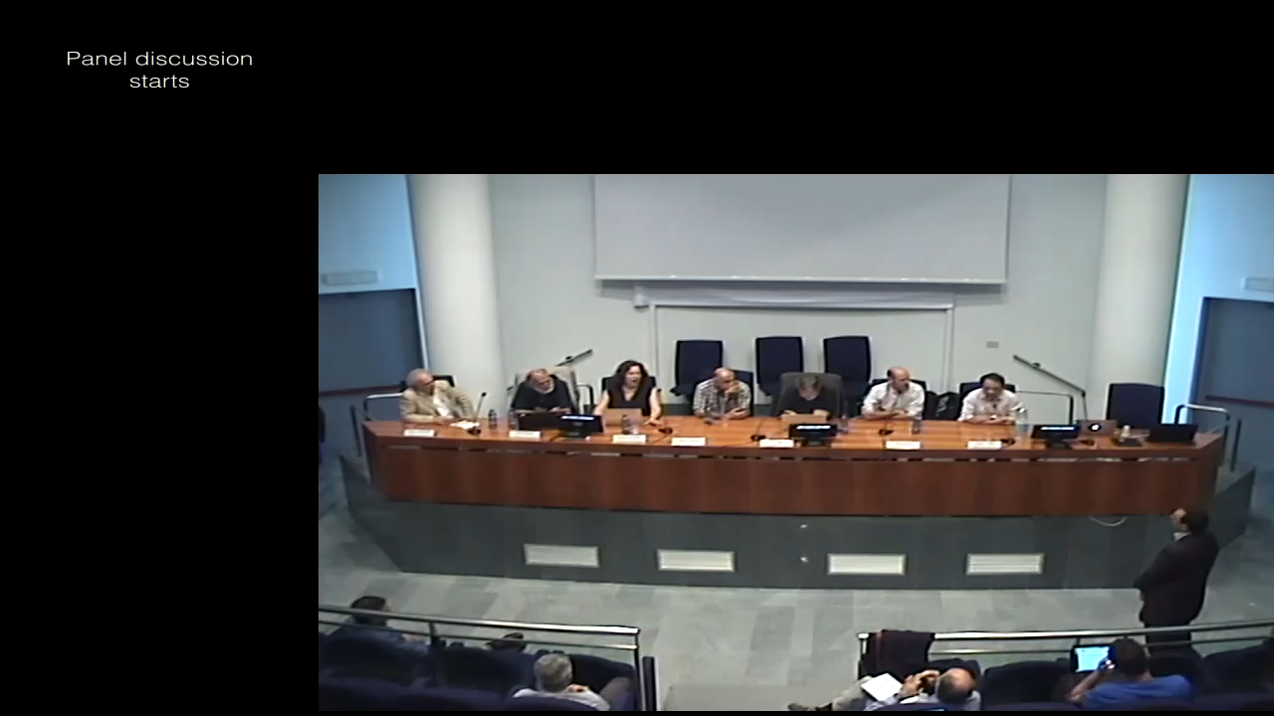
Rome3 workshop
Alain Blondel
  CERN is taking the FCC-ee very seriously
Yifang Wang
  Willing to collaborate

Slide 9
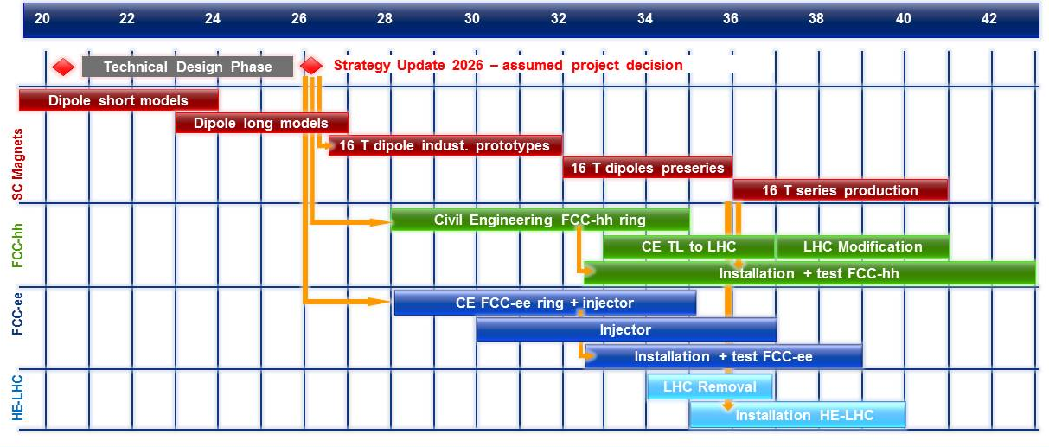
Circular collider schedules (EU)
CERN-FCC schedule unchanged in Amsterdam 2018
  Technically driven schedule
M. Benedict, FCC week,
Amsterdam, 2018
Could start sooner with e+e-

Slide 10
Circular collider schedules (China)
China-CepC/SppC ideal schedule
Jie Gao, CepC workshop,
Rome 2018

Slide 11
CepC evolution
Timing:
  During the IHEP-INFN meeting clear understanding that IHEP does not have human resources to work on CepC until 2025
    Interference with construction of High Energy Photon source
    Some civil engineering could start earlier
CDR:
  Internal review in August → need editors/list of authors
  Suggested names for International review → starts September
Vertical slide test:
  Invited Chinese. IHEP can’t, maybe universities. Not optimistic.
Plan to create International detector working group by November ‘18 – To be started during the workshop

Slide 12
FCC evolution
R&D activity for FCC-ee detector:
  Proposal being put together by Patrick/Alain
  We are in the loop
  It’s called a proto-proto-collaboration ….
  Assumes a total funding of 25 M€ and 200 participants
    Major simulation effort to justify the detector in addition to hardware R&D
Simulation work has to start seriously!
  Cannot afford to keep going at current pace

Slide 13
ESU
RD_FA contributions:
  Document from MC community
  Document from CSN1/INFN
ESU town meeting in Rome 6-7 September
  Unique opportunity to make strong pitch for ee/μμ collider
    A. Wultzer: Prospettive alla frontiera dell’energia
    F. Bedeschi: La fisica oltre High-Luminosity LHC
    ????: Futuri acceleratori e+e-
    ????: Verso un muon collider?

Slide 14
RD_FA structure
Work packages and coordinators:
    Physics & simulation (R. Tenchini/PI, P. Azzi/PD)
    MDI (M. Boscolo/LNF, N. Bacchetta/PD)
    Silicon/Vertex detectors (M. Caccia/MI, A. Andreazza/MI)
    MPGD for RICH/TPC (EIC) (S. Dalla Torre/TS) ➔ CSN3 in 2019
    Drift chamber (F. Grancagnolo/LE)
    MPGD for muon/preshower (P. Giacomelli/BO)
    Dual readout calorimetry (R. Ferrari/PV)
    Muon collider R&D (M. Antonelli/LNF) ➔ Call in CSN5

Slide 15
Admin. deadlines 2018
Financial requests 2018 – by July 20
  People (w/ formal responsibilities)
  Activities (Travel funds strongly correlated)
    R&D, Test beams
  Expect plan from coordinators during this meeting
CSN1 – Presidenza INFN - July 16-17
  Discussion on ESU document (again ….) on the 17th

Slide 16

Conclusions
Much progress since last year (July)
  Our proposals now well into international collaborations/ CDR’s
Our work has an impact on the ESU
Need to make solid financial request to CSN1
  No Test beams? …. Or Fermilab/DESY?
Formalization of future R&D in an international context is of paramount importance to maintain the momentum
  Work in progress with CERN and China
  International collaborations are still weak and need extension and consolidation.
We need more young people → Pisa is trying to help
15 High class peakers! Keith Ellis, Riegler, Janot, Mangano…
Already 71 registered students

Slide 17
Additional slides

Slide 18
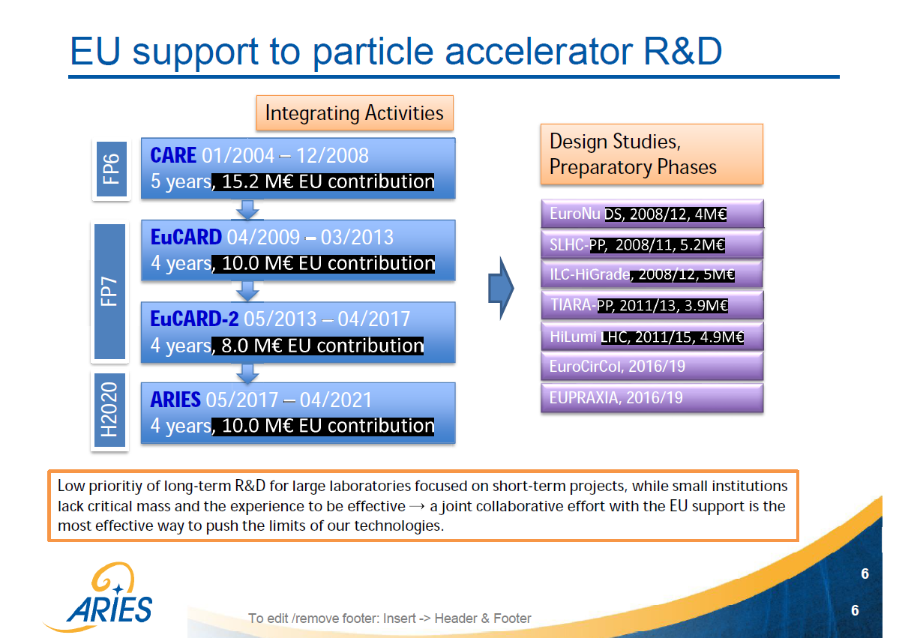
back

Slide 19
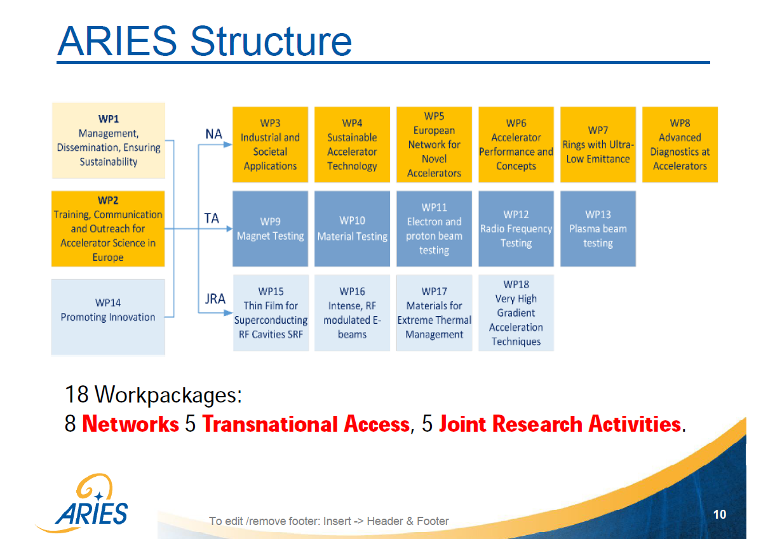
back

Slide 20
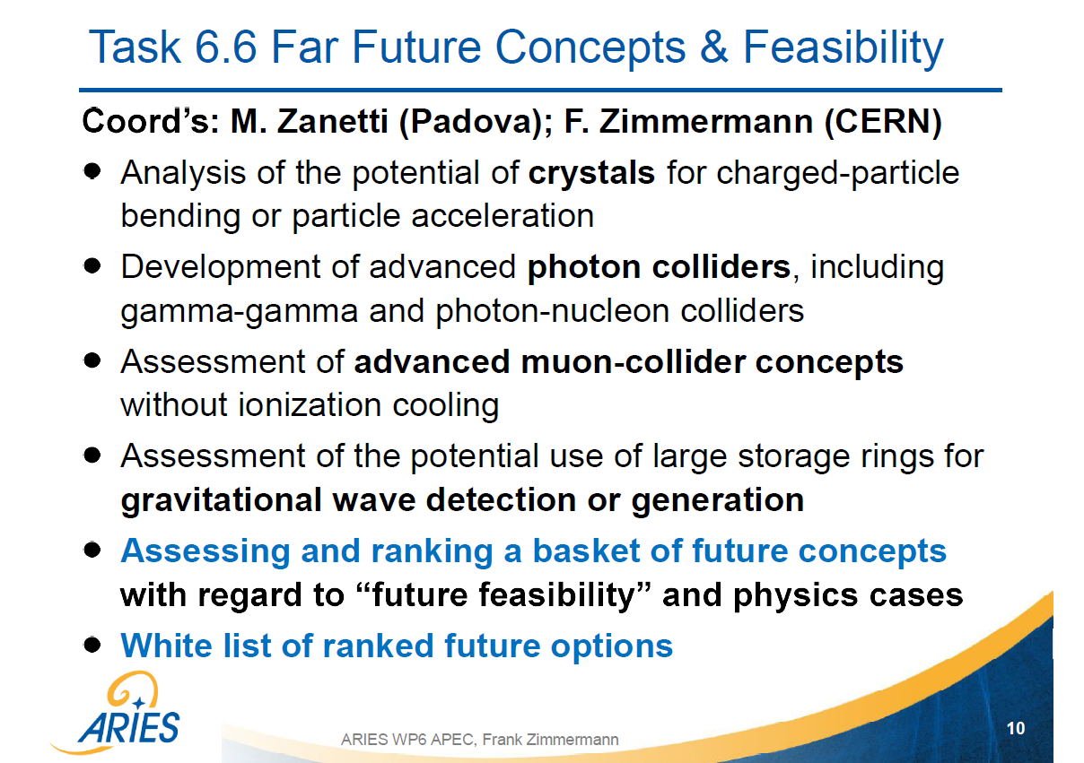
back

