Slide 1
Connecting to local wi-fi network RD_FA Collaboration Meeting

Slide 2
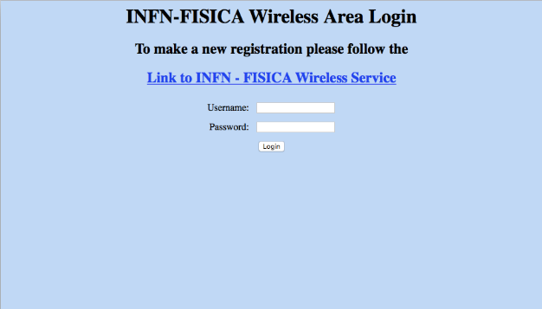
SSID Calcolo
The local network has SSID “Calcolo”: it is not broadcasted, therefore you are required to access is manually (example from the Join other network... menu item on mac’s)
In the network settings disable cryptography (Security: None)
When connected to the network open a brower (a popup window appear on mac’s)
Accept the certificate from the authentication page
You will get the login window:

Slide 3
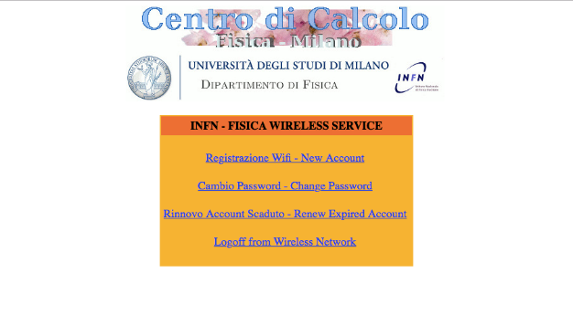
SSID Calcolo
If you have already registered:
put your username and password: you have now full network access
If you have not already registered:
Click on Link to INFN – FISICA Wireless Service
The following window will appear
Select Registrazione Wifi – New Account

Slide 4
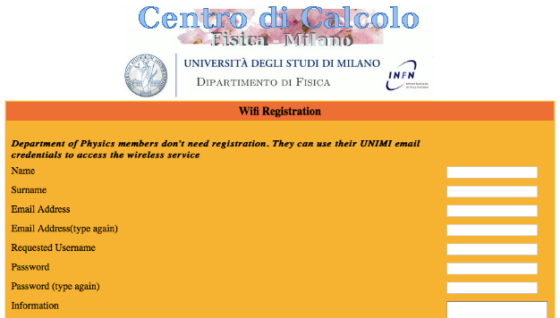
SSID Calcolo
Fill in the form that will open
Provide XXX XXX, xxx.xxx@mi.infn.it in the Reference fields
The account will be active after:
The computing centre create your account (probably few minutes)
Massimo Caccia approves it (depend on how interesting the talks are)

