Slide 1
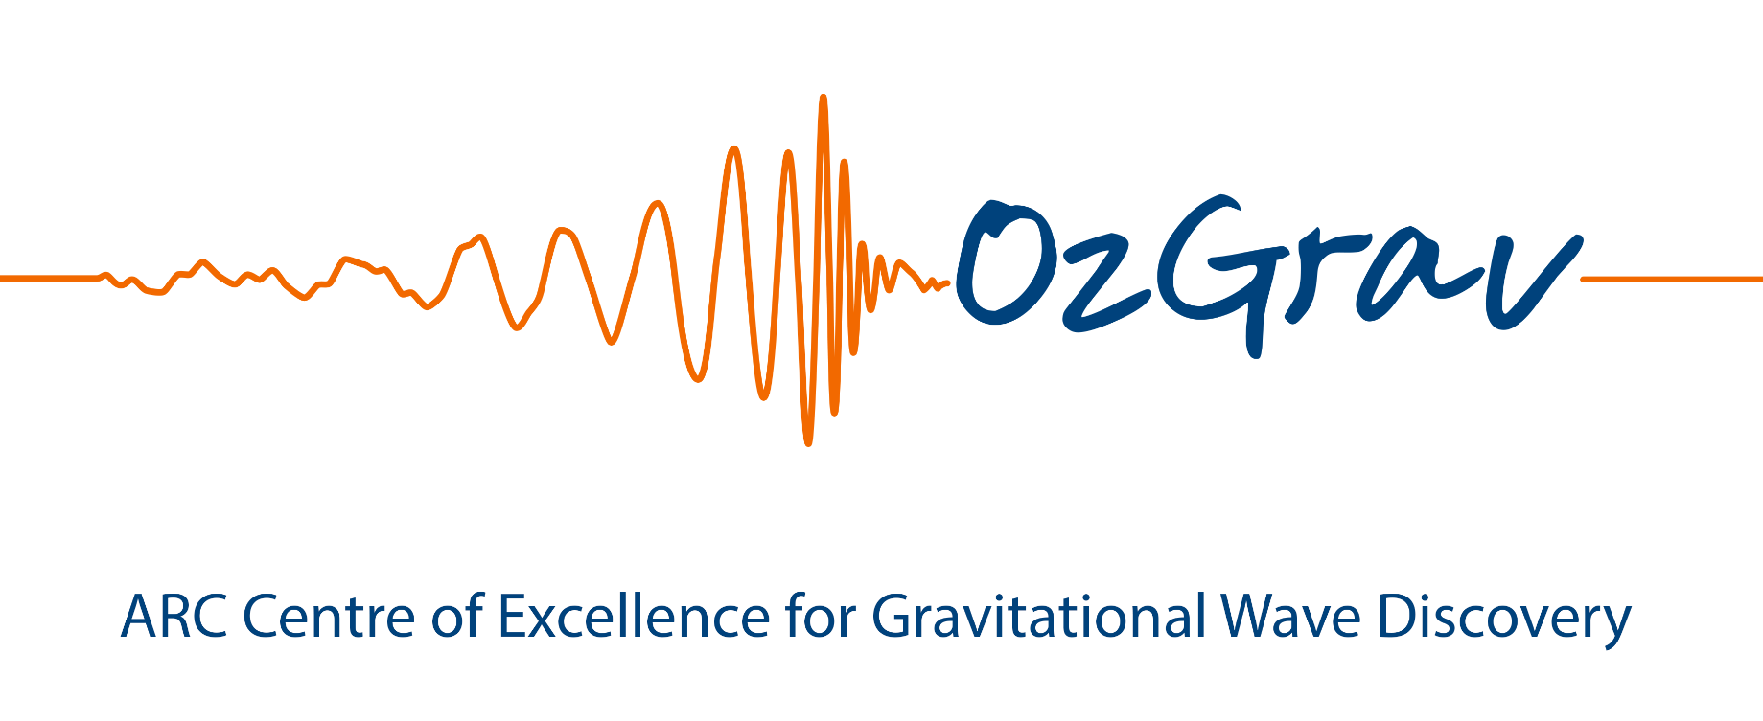








Gingin High Power Silicon Cavity
&Mechanical resonators for white light cavity
Chunnong Zhao
The University of Western Australia

Slide 2
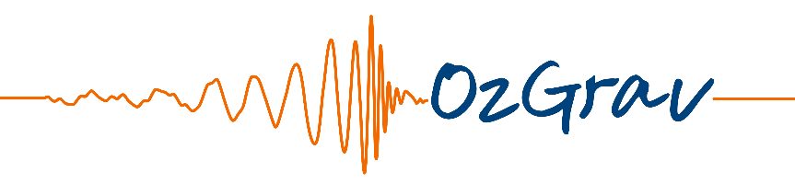
Motivation
Michael Coughlin’s talk on Monday
& Talks on this evening
To study BNS post-merger physics
Requires sensitivity,
~10⁻²⁴/√Hz @ 1-4 kHz
S. Usman, T. Li, A. Weinstein,
https://dcc.ligo.org/LIGO-P1500105/public

Slide 3
The sensitivity of GW detectors
The current detector sensitivity is limited by shot noise at kHz band.
To improve the kHz sensitivity:
  Reduce the noise
  Increase the signal
  Both 1) and 2)

Slide 4
Ways to improve kHz sensitivity
    Squeezing- reduce the noise
    High optical power- increase SNR
    Detuned signal recycling – enhance the signal but reduce the detection bandwidth
    Strong-coupled signal recycling – expand bandwidth
    White light signal recycling cavity/unstable filter – broadband amplification of signal
    ...

Slide 5
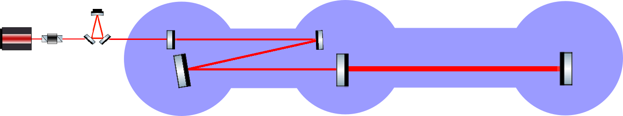
Gingin high power silicon cavity
100 mm in diameter silicon test masses
AlGaAs/GaAs coatings
Room temperature at the 1st stage
Low temperature (123k) in the future
Silicon arm cavity
5W, 2μm laser
Folded fused silica recycling cavity
7 m
72 m

Slide 6
Gingin high power silicon cavity
Build up high circulating power in silicon cavity
Study AlGaAs/GaAs coating uniformity and potential nonuniform absorption
Parametric instability and control using AMD with silicon test masses
Angular instability and control
Coupled cavity mode matching sensing and control

Slide 7
Mechanical resonators for white light cavity

Slide 8
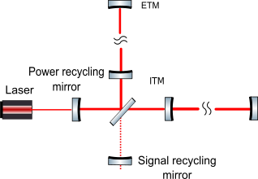


Signal recycling interferometer detector
The differential mode signal experience coupled cavity

Slide 9
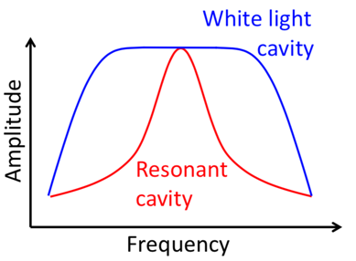
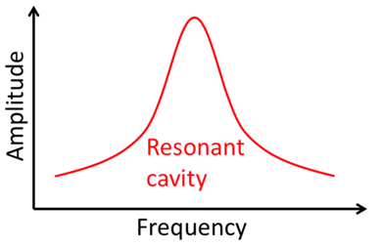
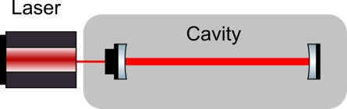
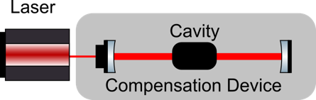
White Light Cavity Resonance
Optical cavities are resonant over a narrow frequency band
Negative dispersion medium compensates the cavity round-trip phase to achieve broadband resonance

Slide 10
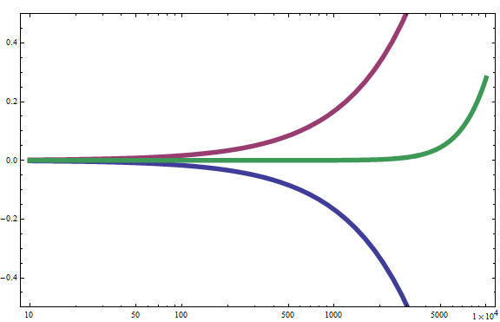
Cavity round-trip phase cancelation
Φarm
Phase
Φsum
Φfilter
Frequency (Hz)

Slide 11

Negative dispersion in optomechanical cavity
H. Miao, Y. Ma, C. Zhao, Y. Chen, PRL 115, 211104 (2015)

Slide 12
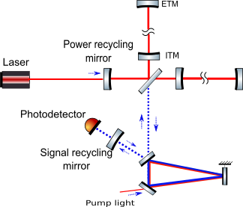
White light signal recycling

Slide 13
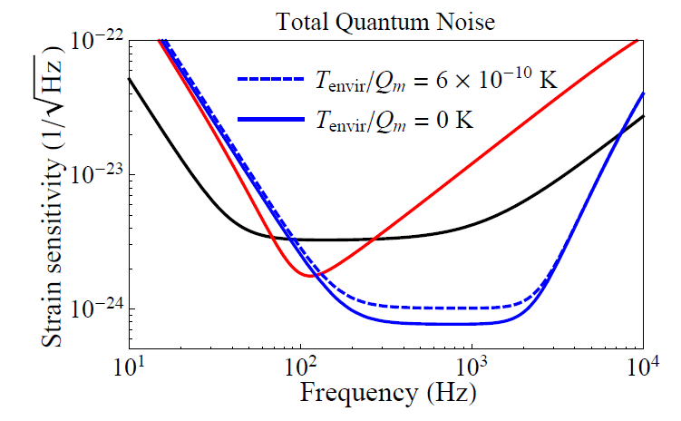
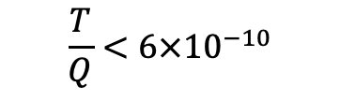
The sensitivity of white-light signal recycling
Red: Narrow tuned
Black: Broadband tuned
Blue: With optomechanical filter
Thermal noise requirement:
$$\frac{T}{Q}<6×{10}^{−10}$$
H. Miao, Y. Ma, C. Zhao, Y. Chen, PRL 115, 211104 (2015)

Slide 14
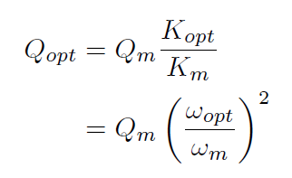
Optical dilution
Quality factor of optical spring resonator rises as square of the frequency ratio
Need low starting frequency
High optical spring frequency

Slide 15
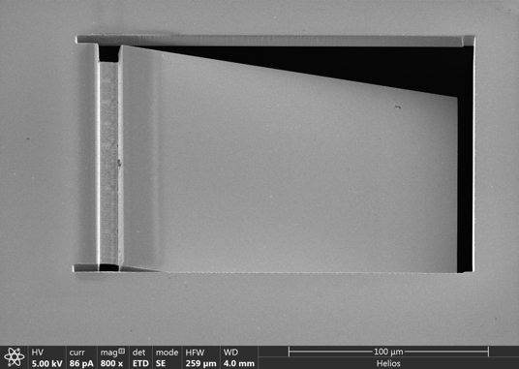
Cat-Flap resonator
Thin hinge
20 to 150 nm
Thin hinge - low resonant frequency
Optical dilution to enhance the mechanical frequency and quality
AlGaAs/GaAs
180 um x 6um

Slide 16
Progress: AlGaAs cat-flap Q measurement
Low Q

Slide 17
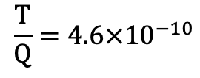


Bulk Acoustic Wave Quartz resonator
$$\frac{ω}{2π}=204.3 MHz @3.75K$$
$$Q=8×{10}^{9}$$
$$\frac{T}{Q}=4.6×{10}^{−10}$$
The dominate loss mechanism in acoustic cavities at low temperatures and relatively high frequencies is due to phonon-phonon scattering over crystal lattice anharmonicity

Slide 18
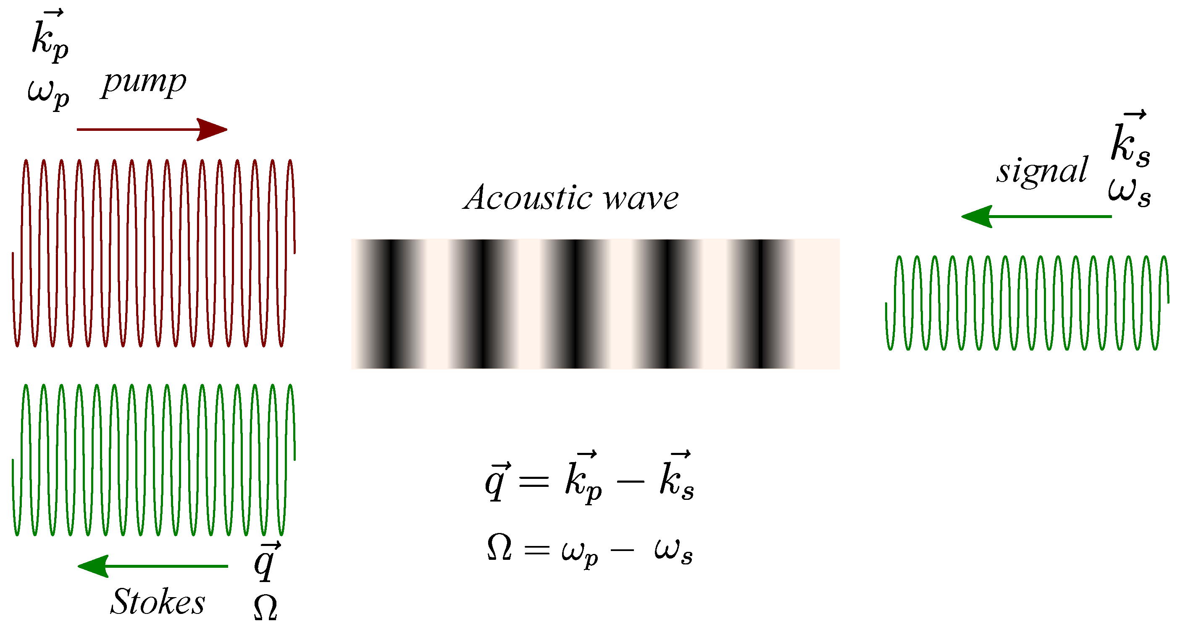
Bulk mode optomechanics
Brillouin scattering
phase-matching
energy conservation
https://doi.org/10.3390/app8122572
Photoelastic effect: stress -> modulate the reflection index
Electrostrictive effect: optical intensity -> modulate the stress

Slide 19
Bulk mode optomechanics
The Optomechanically Induced Amplification (OMIA) and Transmission (OMIT) have been demonstrated
OMIA
OMIT

Slide 20
Bulk mode optomechanics
Cooling, heating, and Phonon lasing shows unstable filter can be realized.

Slide 21
Quantum noise limited sensitivity
Preliminary sensitivity curves with BAW quartz resonator inside aLIGO signal recycling cavity
Issues like control of unstable optomechanical cavity, etc. is not considered yet.

Slide 22
Soft clamping SiNi membrane
Experimental results at 10K:
Ω_{m}/2π = 1.135 MHz and quality factor Q = 1.03 × 10⁹
D. Mason, J. Chen, M. Rossi, Y. Tsaturyan & A. Schliesser, arXiv:1809.10629

Slide 23
Summary
We are building a high optical power cavity using silicon test masses and 2µm laser to study high optical power effects
The BAW resonator has potential to be used to realize white light cavity in GW detectors
The Q-factor of 8 billion has been measured in a Bulk Acoustic Wave (BAW) quartz resonator at cryogenic temperature.
The optomechanics with BAW resonator has been demonstrated.
The size of BAW resonator (~30mm in diameter) has less problem in terms of optical mode matching to the larger scale interferometer
Soft clamping silicon nitride membrane has also been demonstrated Q-factor of ~1 billion. It is a potential candidate.
The mechanical resonator with optical dilution may potentially meet the requirement at room temperature.

