Slide 1
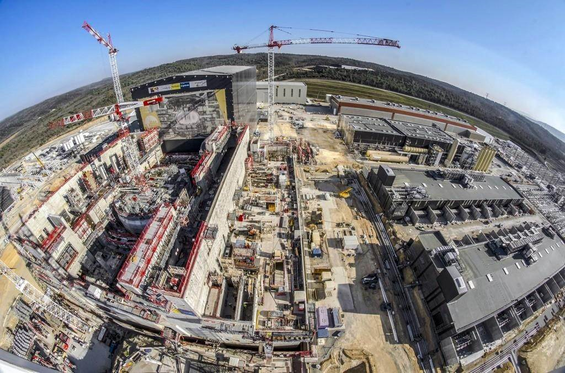
Sense and sensitivity
Real-time control for stability & performance of NF plasmas

Slide 2
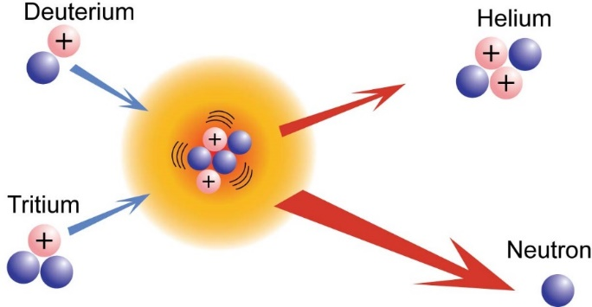
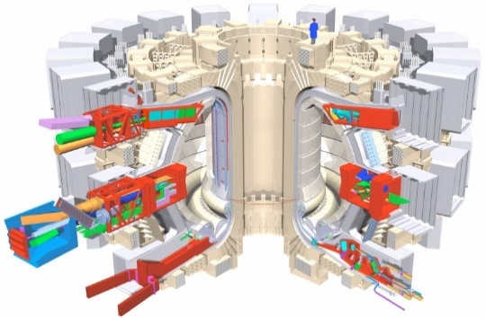
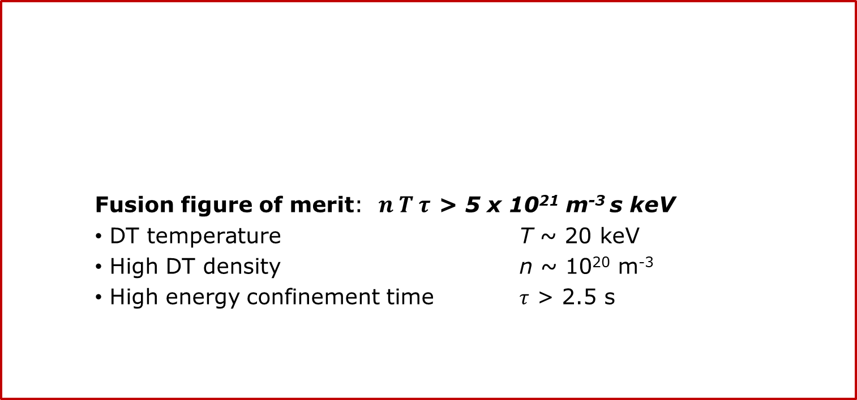
Top level requirements of nuclear fusion reactor
Fusion figure of merit: $n T τ$ > 5 x 10²¹ m⁻³ s keV
    DT temperature T ~ 20 keV
    High DT density n ~ 10²⁰ m⁻³
    High energy confinement time $τ$ > 2.5 s

Slide 3
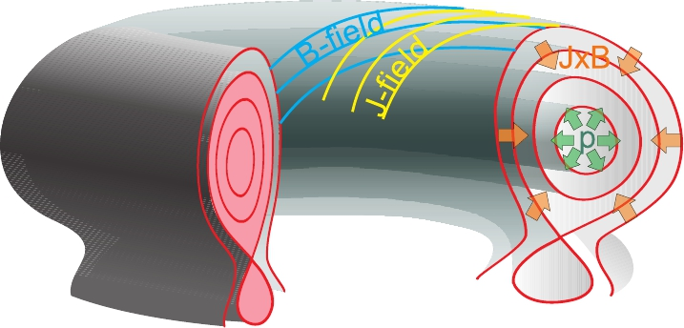
Tokamak Equilibrium

Slide 4
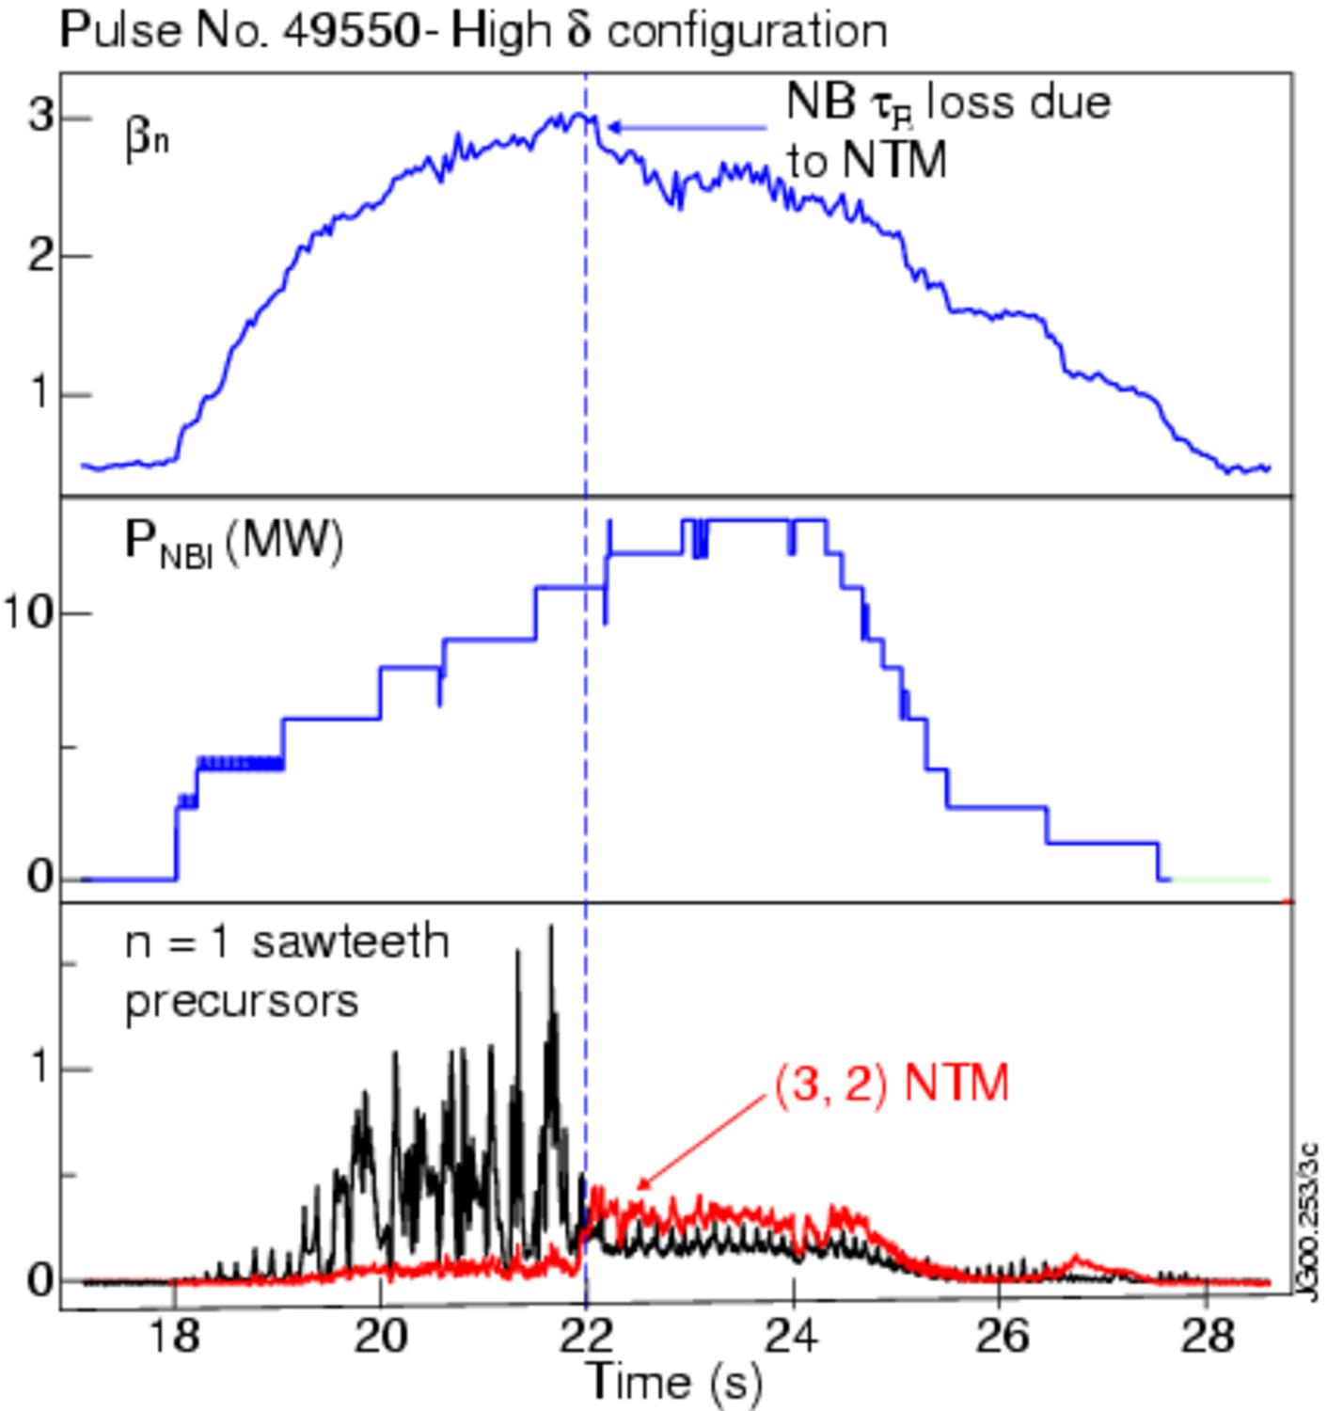
What happens if we go to high nT ?
W (a.u)

Slide 5
Pressure limit set by resistive MHD
W (a.u)

Slide 6
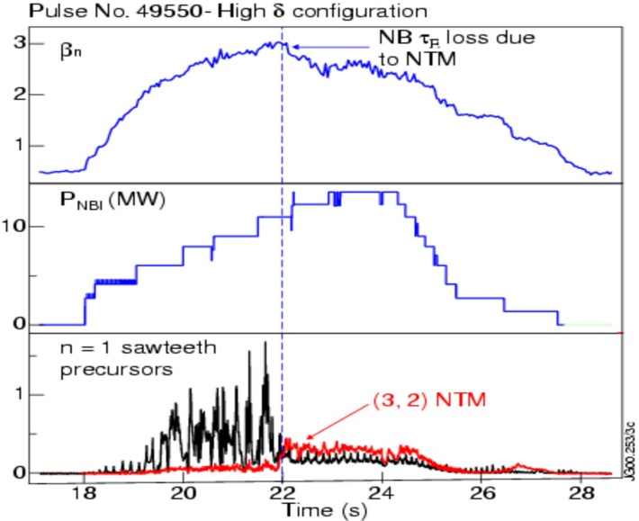
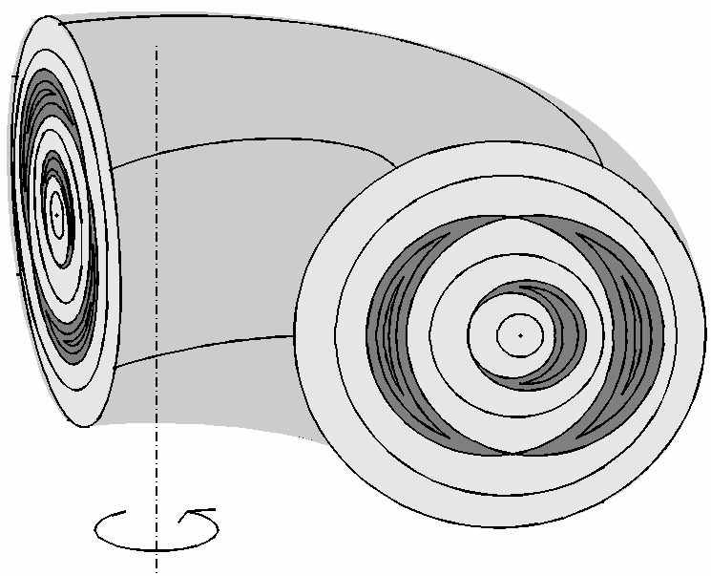
Magnetic islands
W (a.u)
Magnetic islands forms
Plasma performance deteriorates
Deficiency in current density in O-point
O
w
X

Slide 7
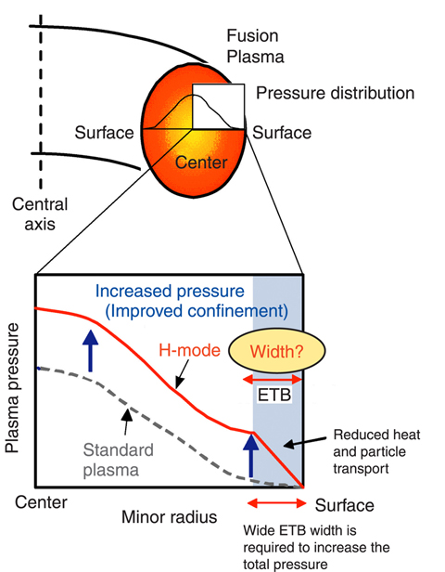
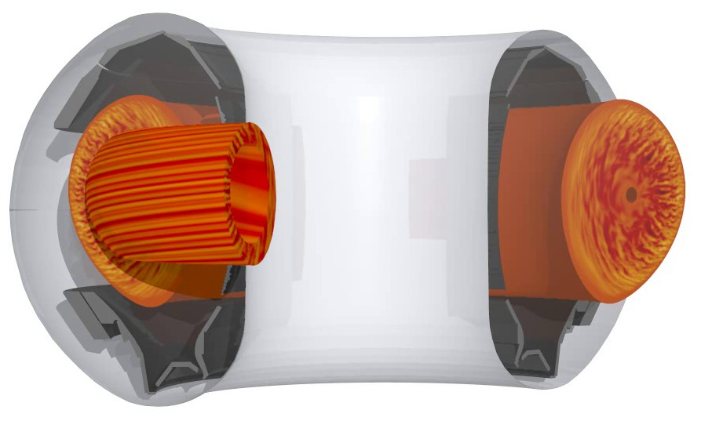
Turbulent losses limit τ
GENE (MPG, IPP Garching)

Slide 8
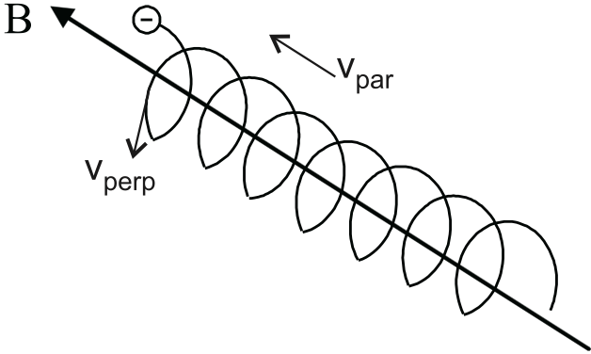
Electrons bound by magnetic field:
Cyclotron frequency for electrons:
e: electron charge
m_{e}: electron rest mass.
f_{c} ~ n.28 GHz / Tesla
Microwaves

Slide 9
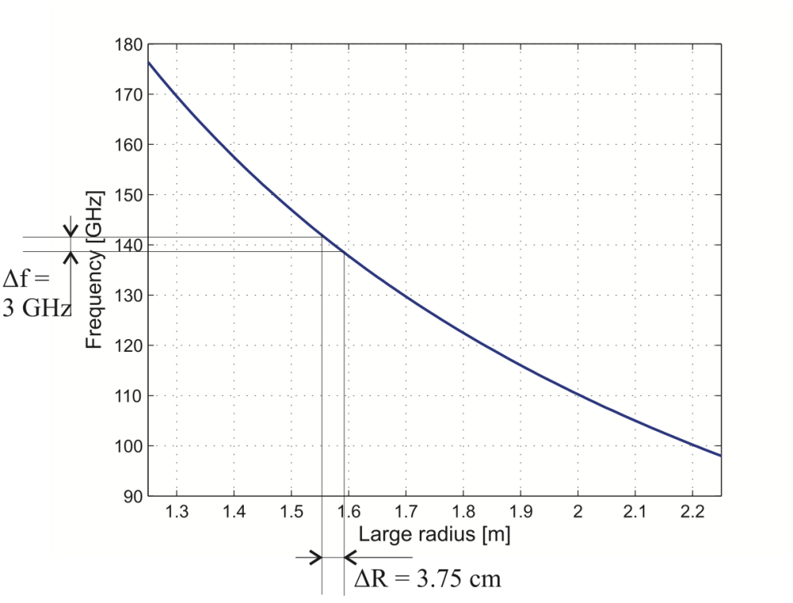

Sensor: EC Emission
R_{o}
Radiometer: I_{ECE} in receiving antenna
B
B_{o}
R_{o}
R
T= P_{ec} / k_{b}B_{w}

Slide 10
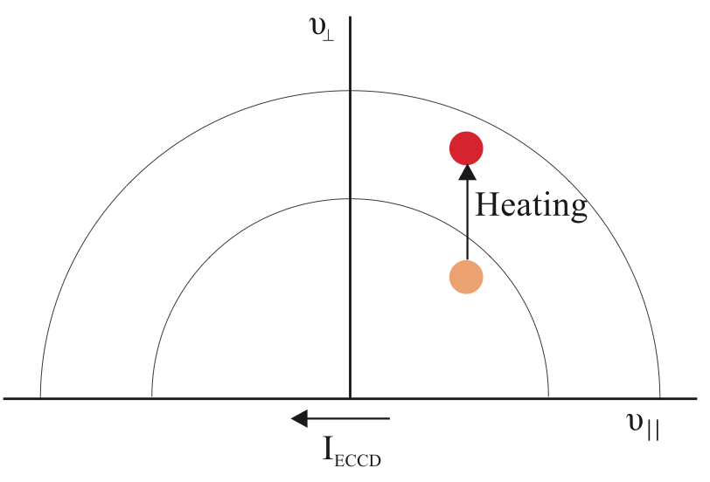
Actuator: Electron Cyclotron Current Drive
ECCD: Injection of high power microwaves at the cyclotron frequency under a toroidal angle.
Direct local current drive
Heating of selected v_{par}
Absorbed energy mainly to v_{per}
Reduces collisionality population
Increased current

Slide 11
Control Problem formulation
How can we design a real time control system to
-optimize the distribution of the current and plasma performance, while
-ensuring MHD stability and
-taking plasma limits and the actuator availability into account?

Slide 12
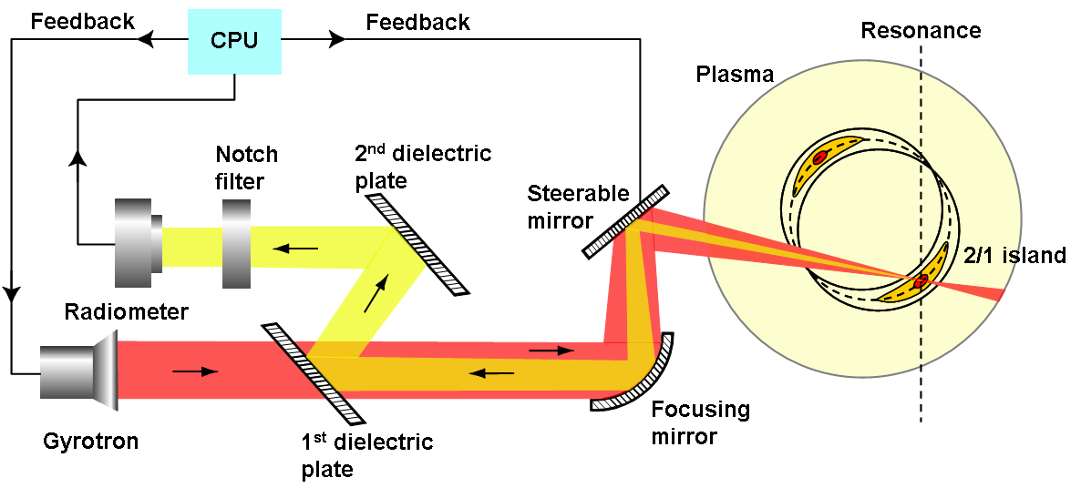
Control of MHD using CO-LOCATED actuator-sensor
A line-of-sight electron cyclotron emission receiver for electron cyclotron resonance heating feedback control of tearing modes, JW Oosterbeek et al., Review of Scientific Instruments 79 (9), 093503 (2009)

Slide 13
Sensor model: Radial location tearing mode
Rational
surface r_{s}
180°

Slide 14
Closed loop control of MHD in TEXTOR
Real-time control of tearing modes using a line-of-sight electron cyclotron emission diagnostic, BA Hennen, et al., Plasma Physics and Controlled Fusion 52 (10), 104006 26 (2010)

Slide 15
TEXTOR: PLL for O-point heating
PLLs have a limitted bandwith.
Requirements for Tokamaks with large bandwidth in mode rotation frequency?

Slide 16
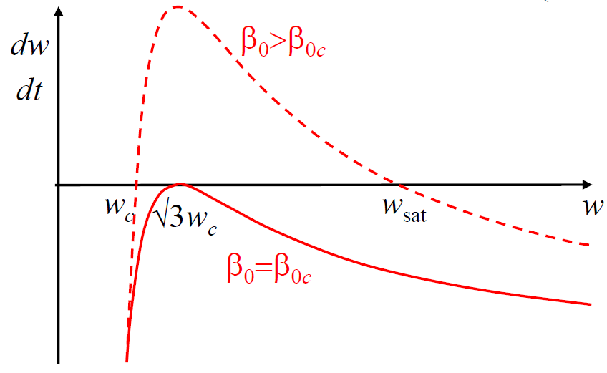
Generalized Rutherford equation
High β:
Island saturates
Grow
Shrink
Low β
Island “self heals”

Slide 17
Rutherford equation
Modified, Generalized Rutherford eq.
Nonlinear 1st order Ordinary Differential Equation
Local linearization of the (non-linear) ODE
Reformulate in state-space description for one operating point
Compute transfer functions for different operating points
Conceive Control structure
Ensure performance and stability
Carry-out closed loop simulations
des

Slide 18
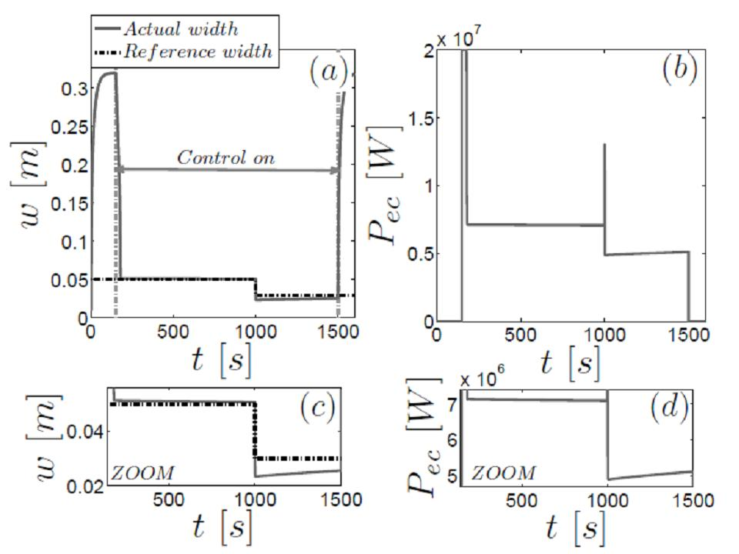
Simulation NTM control

Slide 19

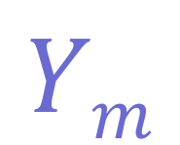

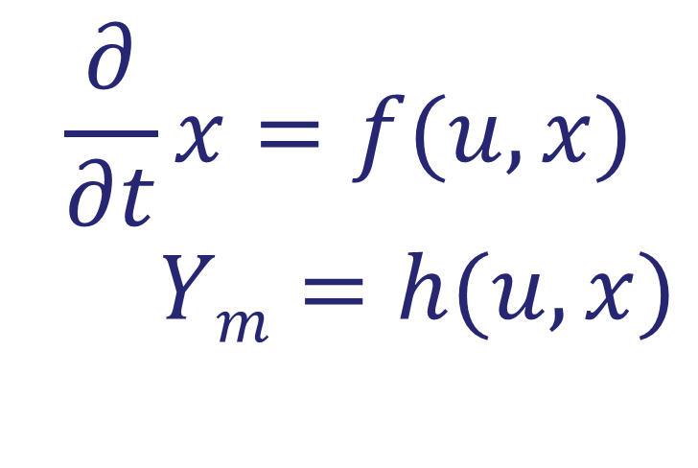
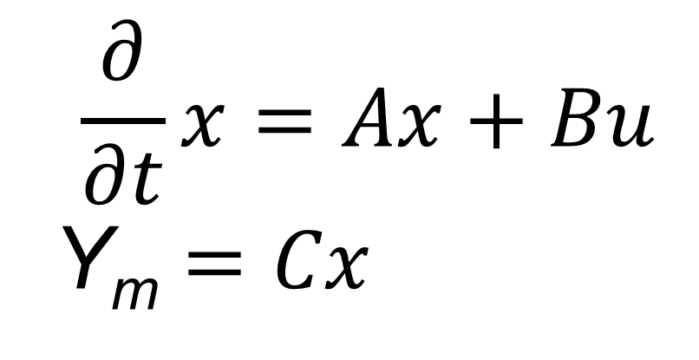
Detailed knowledge of state is key in modern methods
P

Slide 20

How can we estimate the state? Kalman observers
Plant
u
y_{me}
Model
y_{mo}
Kalman update of x

Slide 21
Unsented Kalman filter for mode frequency and phase
Kalman filters for real-time magnetic island phase tracking, DP Borgers, et al.,
Fusion Engineering and Design 88 (11), 2922-2932 (2013)

Slide 22
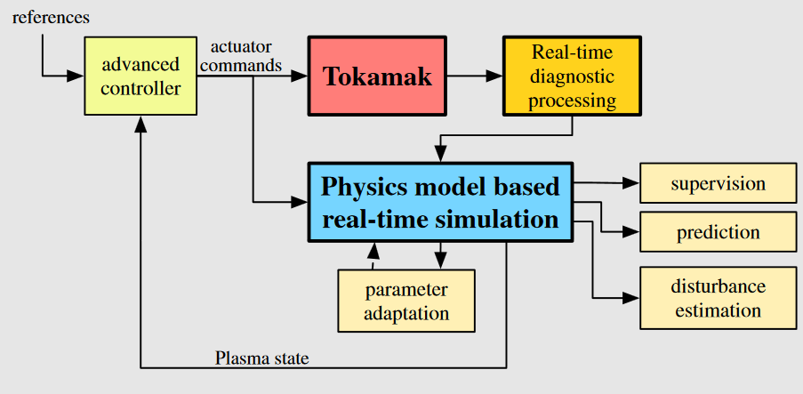
Observer for distribution of j and Te control
Discretized coupled nonlinear diffusion PDEs
Nonlinear state observation: Extended Kalman filter
Felici, F. et al. J.I. (2011). Real-time physics-model-based simulation of the current density profile in tokamak plasmas. Nuclear Fusion, 51(8):083052
Notes:
Rest van slides gaan in samenhang met mijn slide 10 in strategie verhaal en de tekst: Tractable and accurate models for plasma scenario prediction, optimization and control; dus zo nauwkeurig als nodig is voor control

Slide 23
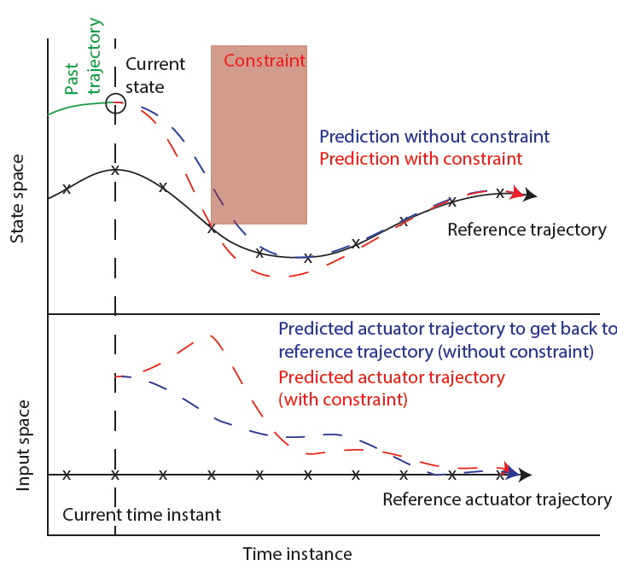
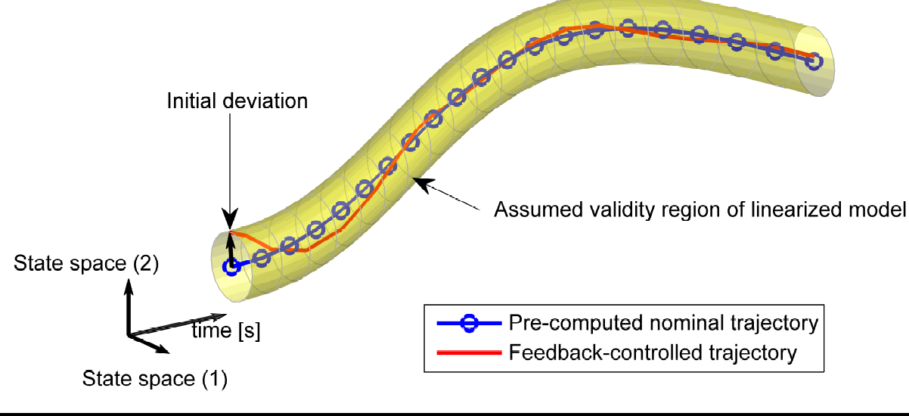
MPC for profile control in tokamaks
Control of the tokamak safety factor profile with time-varying constraints using MPC,
E Maljaars, et al. Nuclear Fusion 55 (2), 023001 19

Slide 24
MPC for j-distribution and plasma β @TCV
Profile control simulations and experiments on TCV: a controller test environment and results using a model-based predictive controller, E Maljaars et al.,Nuclear Fusion 57 (12), 126063 (2017)

Slide 25
Event driven actuator sharing for multiple control tasks
How to determine when to allocate the actuators to specific control tasks?
E. Maljaars et al., 42nd European Physical Society Conference on Plasma Physics, EPS 2015 (Europhysics Conference Abstracts, No. 39E).

Slide 26
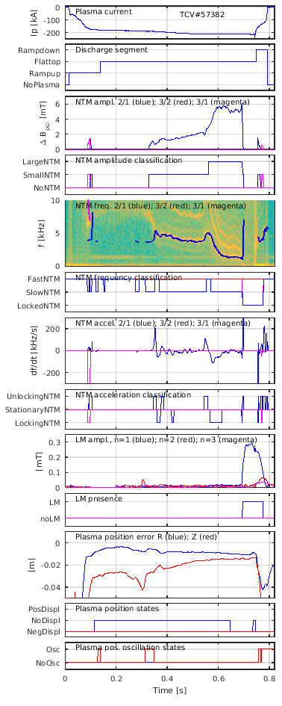
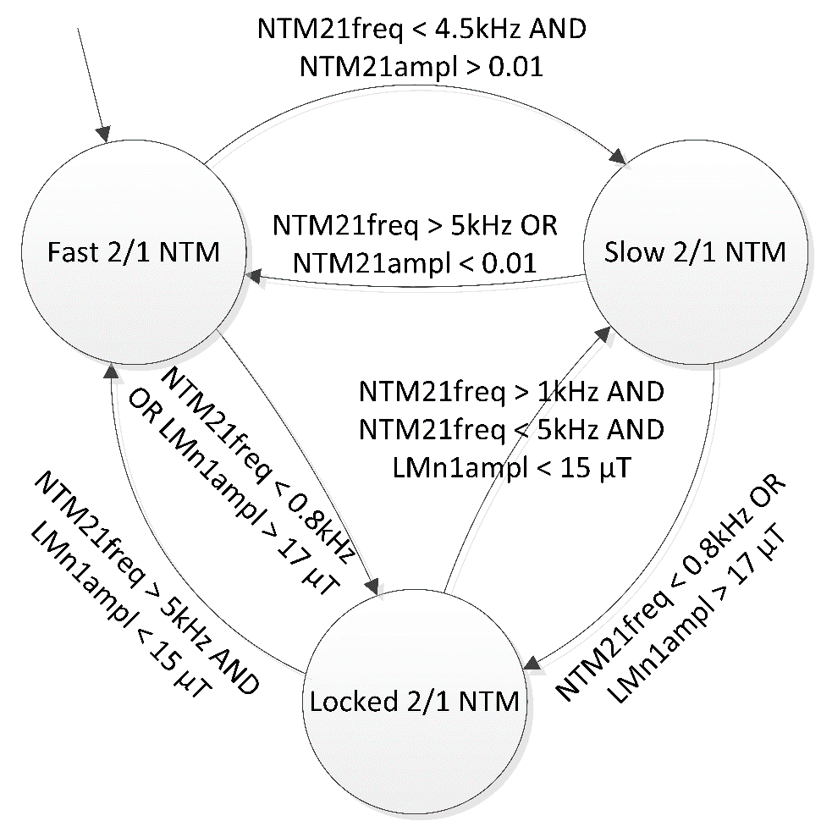

Finite state modeling of plasma
FSMs implemented in MATLAB Stateflow

Slide 27
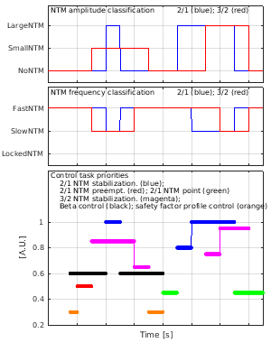
Modelled supervisory controller
Plasma states
Control task priorities
Only two control tasks may be simultaneously executed due to actuator constraints

Slide 28
Discrete State supervisory controller experiment
Tasks: Central heating, NTM stabilization and beta control
Decision chain: NTM presence → Control task priorities → EC launcher allocation

Slide 29
Evolution Systems and Control Theory
1940-1960 Classical control engineering (SISO)
1960-1980 State space formulation,
Large scale systems,
Kalman observation
1980-1990 Robust control,
System identification
1990-2000 Model predictive control
2000-2010 Hybrid (event-driven) system theory
2010-2018 Network control,
Distributed control,
Iterative Learning Control

Slide 30
Today → Examples of application in plasma control
1940-1960 Classical control engineering (SISO)
1960-1980 State space formulation,
Large scale systems,
Kalman observation
1980-1990 Robust control,
System identification
1990-2000 Model predictive control
2000-2010 Hybrid (event-driven) system theory
2010-2018 Network control,
Distributed control,
Iterative Learning Control

Slide 31
Conclusions
A successful Nuclear Fusion Reactor willmoperate with high confinement at high pressure.
Control of the distributions of current and temperature as well as the suppression of neoclassical tearing modes
Model-based controllers for these control tasks have been developed and implemented as well as a supervisory controller that determines in real-time the priority of the control tasks and the actuator allocation
Systematic design and optimization of control systems for fusion reactors requires model based optimization
Modern system and control theory essential

Slide 32
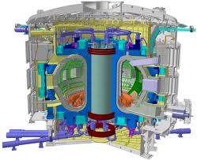
Tokamak reactor ITER

Slide 33
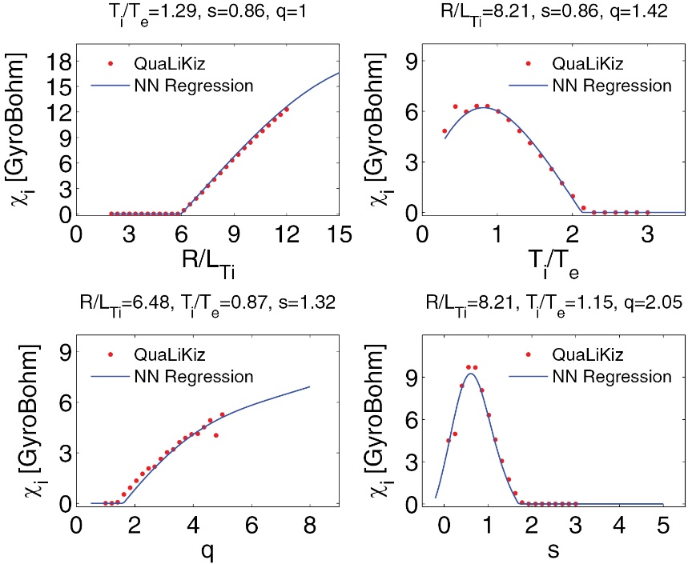
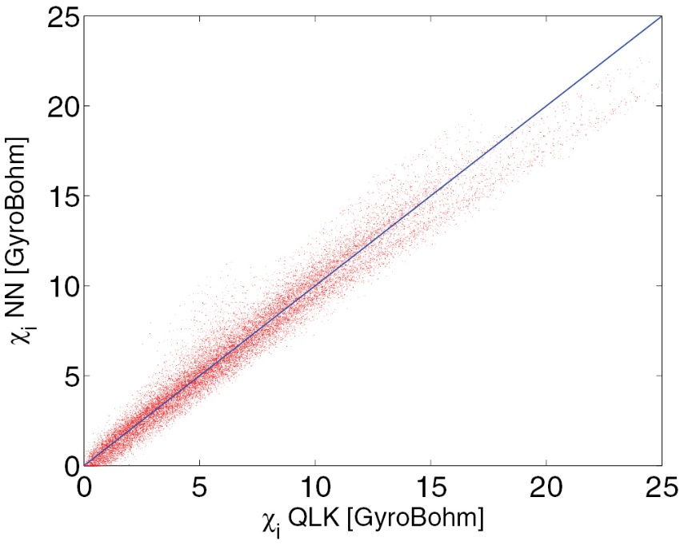
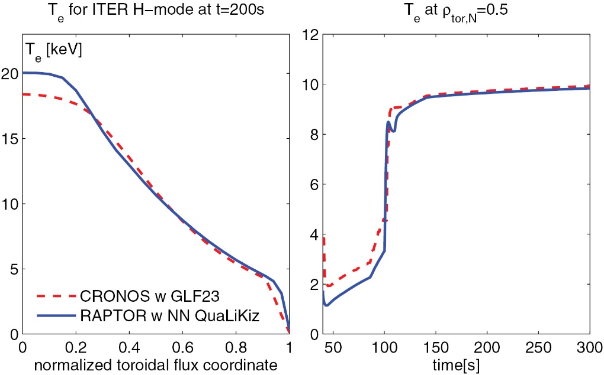
1st Principle physics to control oriented model
J. Citrin et al., Nuclear Fusion, 55(9):092001 (2015)

Slide 34
Design of supervisory controller
Task-based supervisory control
Each controller may (simultaneously) handle one or more tasks
Boolean logic expressions for activating control tasks
NTM controller
Kinetic profile controller
Notes:
Task-based supervisory control
Each controller may (simultaneously) handle one or more tasks
User-defined decision logic, based on:
Discrete plasma states
Time
Output:
Priority of control tasks
Activation of (feedback) controllers

Slide 35
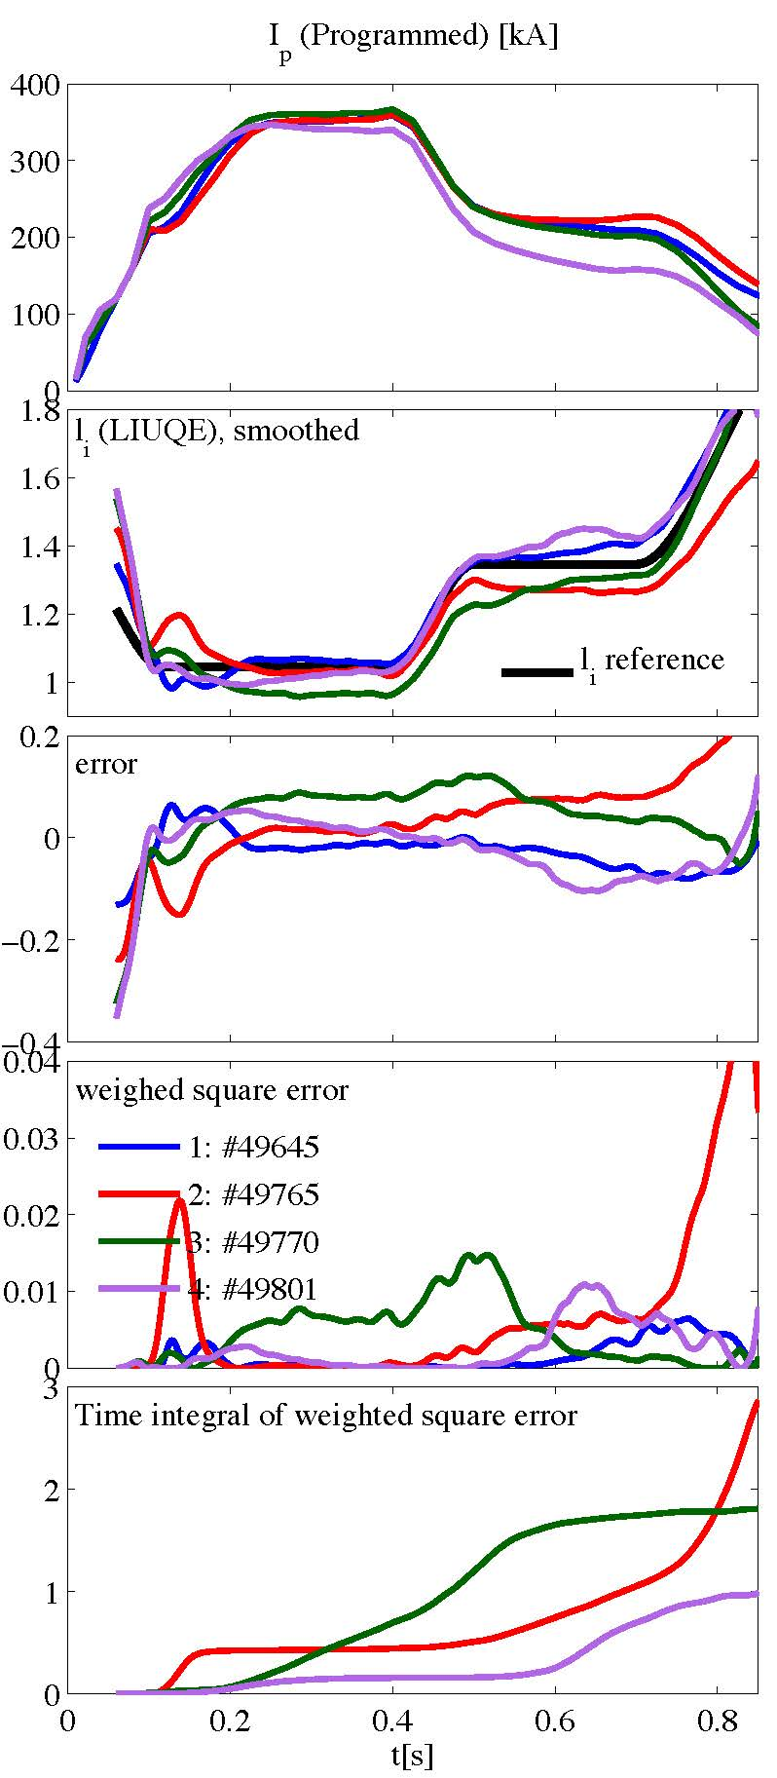
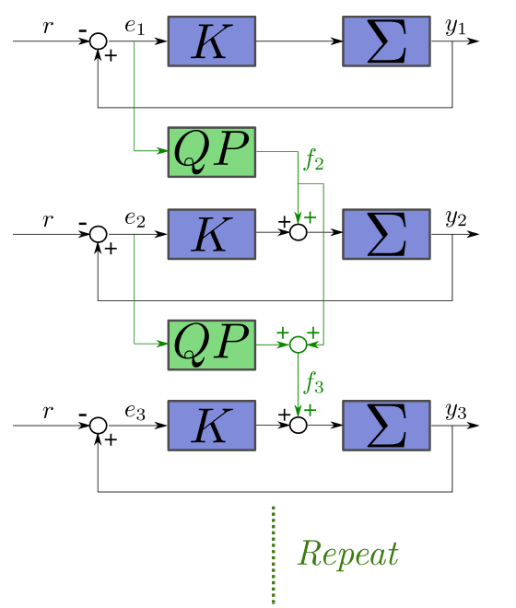
Model based feed-forward →Iterative Learning Control
F. Felici et al., 54th IEEE Conference on Decision and Control, 2015, Osaka, Japan

