Slide 1
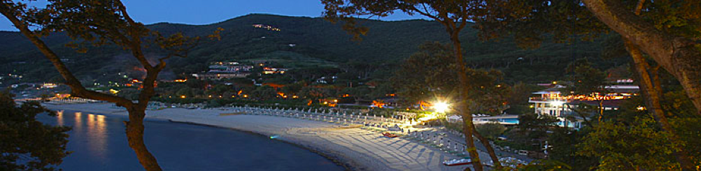

Squeezing status from LIGO & VIRGO
Fiodor Sorrentino – INFN Genova
Haocun Yu – MIT-LIGO

Slide 2
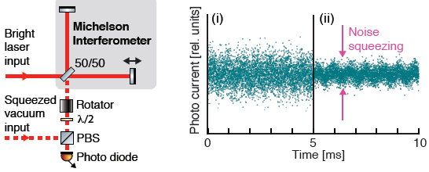
Squeezing injection
Interferometric GW detectors operate at dark fringe
Vacuum fluctuations enter the dark port of the ITF
  Carlton M Caves. Quantum-mechanical noise in an interferometer. Physical Review D, 23(8):1693, 1981.
  classical (coherent) states of light: no photon correlations
  equal phase and amplitude fluctuations
Quantum noise can be reduced by changing the statistical properties of vacuum optical field entering dark port
  squeezed states of light: photon correlations
  reduced phase fluctuations, increased amplitude fluctuations (or vice versa)

Slide 3
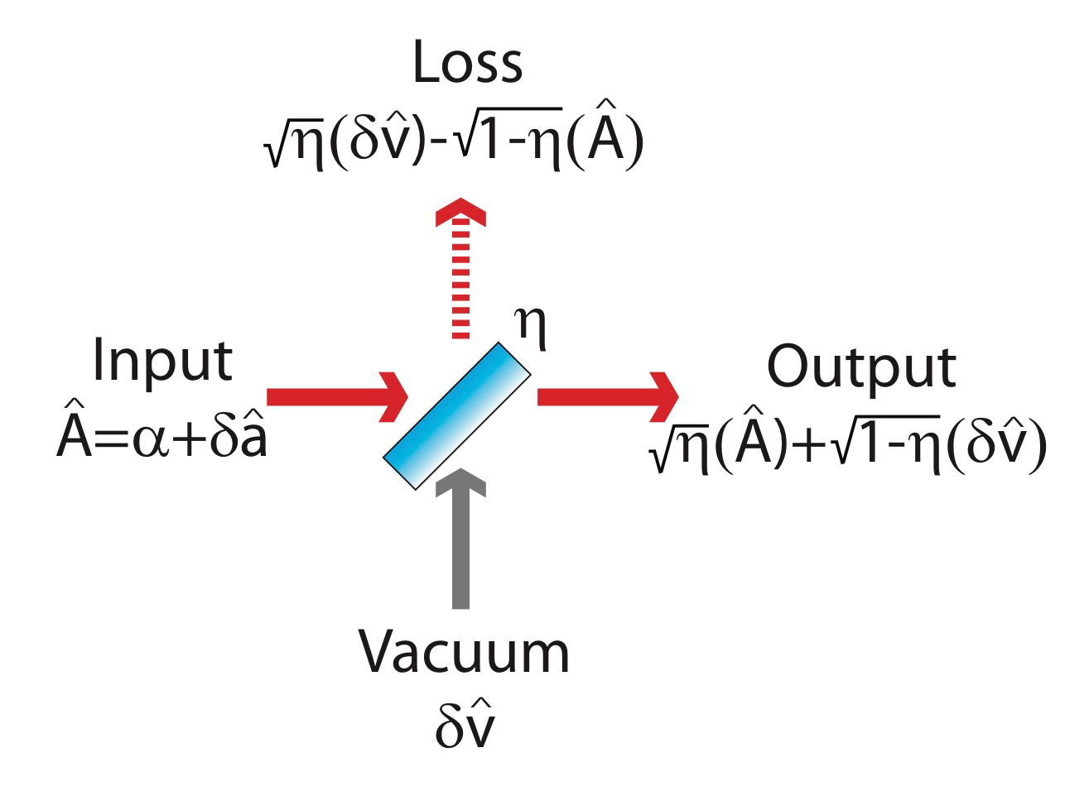
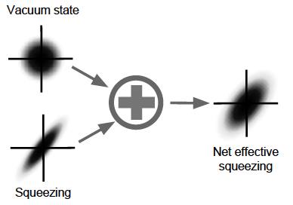
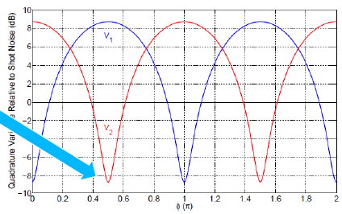
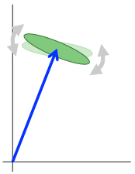
Limitations to QN reduction
Optical losses are equivalent to mixing with classical vacuum field
Technical noise (dark noise, scattered light) give similar effect
Angle fluctuations of squeezed quadrature

Slide 4
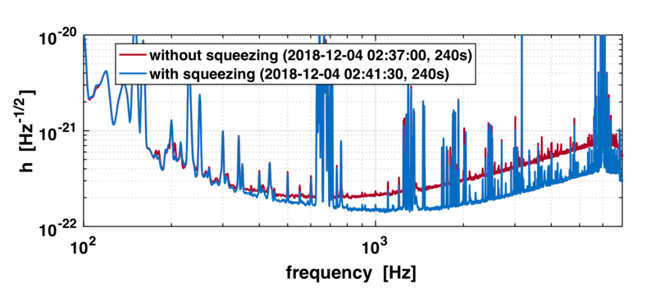
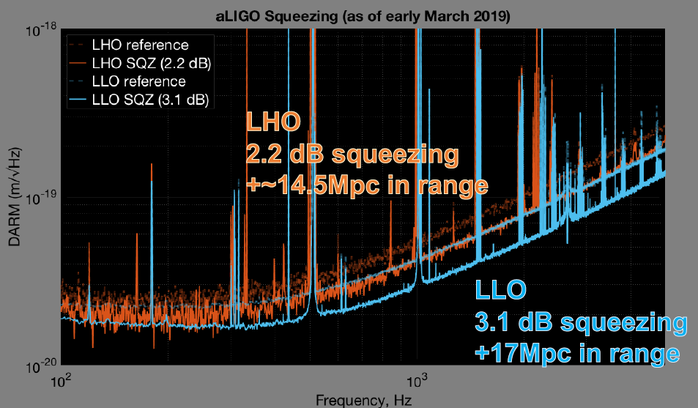
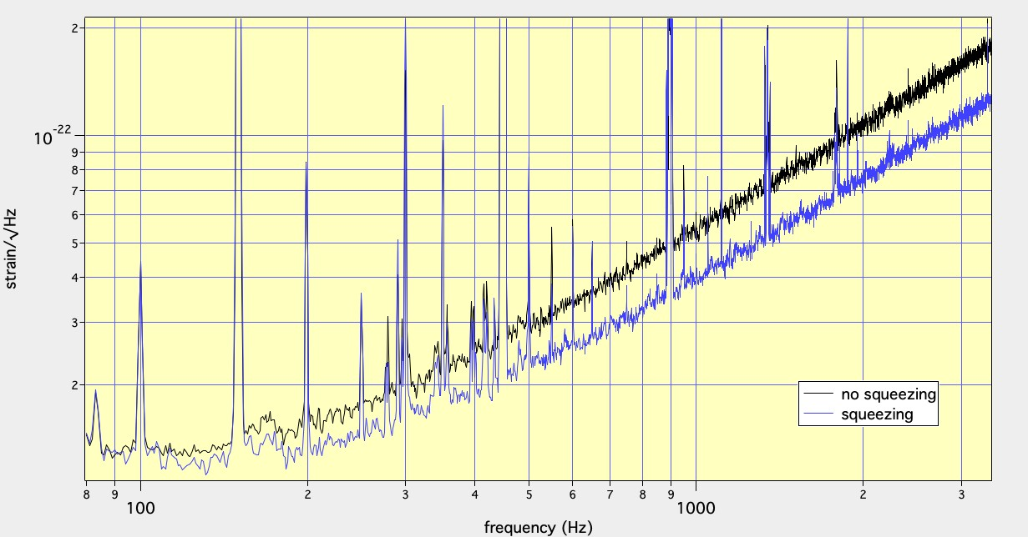
SQZ & GW detectors
Current performances
GEO600: 6 dB
aLIGO: 3.1 dB
AdV: 3.25 dB

Slide 5
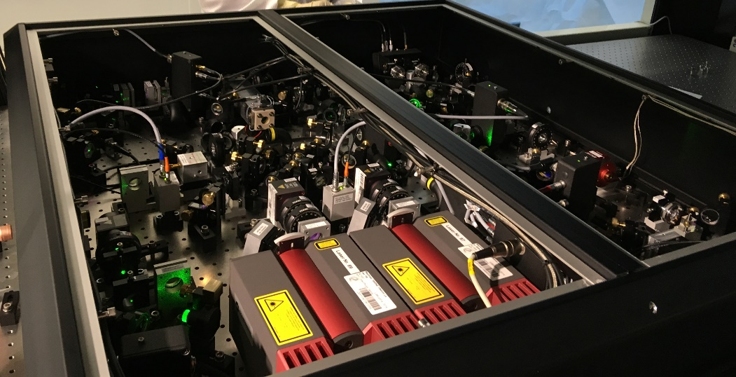
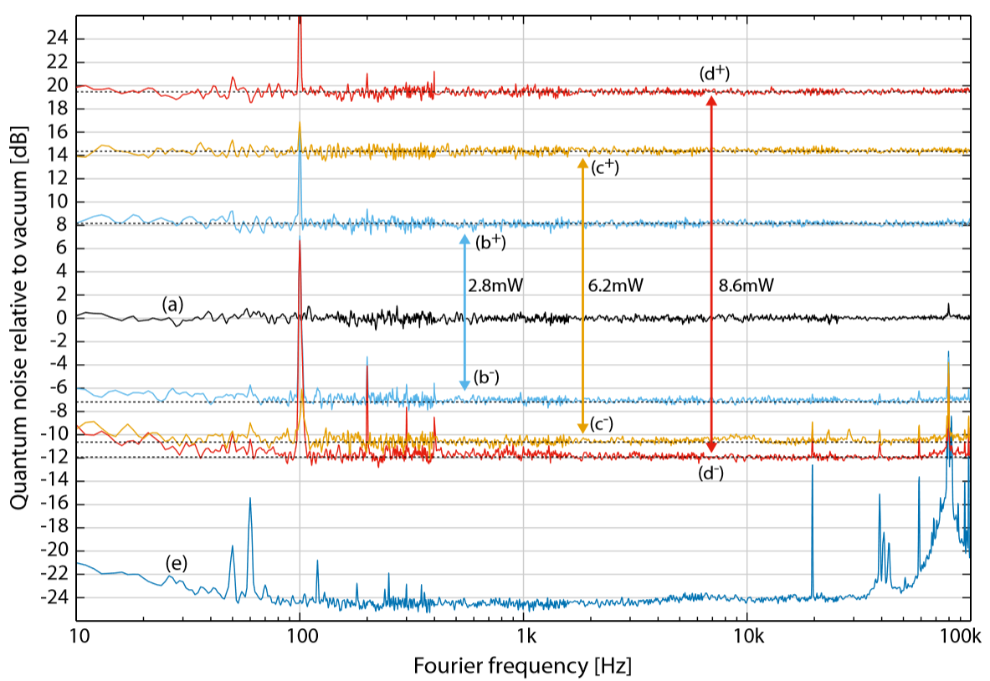
Squeezed vacuum source for AdV
2013÷2017: following GEO600 and LIGO, the Virgo collaboration has developed its own squeezer
  6 dB of squeezing, 15 dB anti-squeezing
  http://paduaresearch.cab.unipd.it/10854
In 2017 MoU between Virgo and AEI to install a compact SQZ source developed in Hannover
  Up to 14 dB of squeezing
  size 1m², duty cycle around 100%
  M. Mehmet and H. Vahlbruch, CQG 36, 015014 (2019)
  Source installed at EGO in January 2018

Slide 6
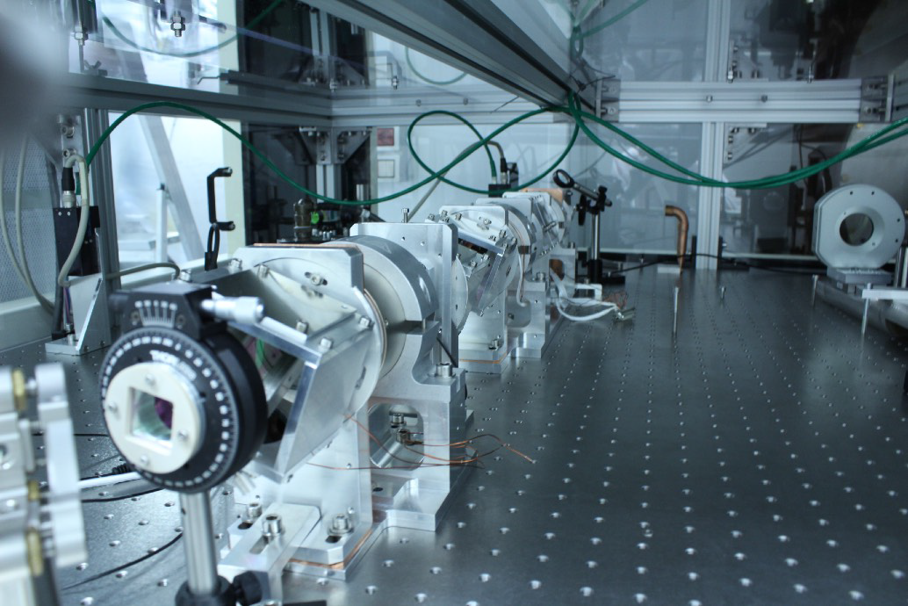
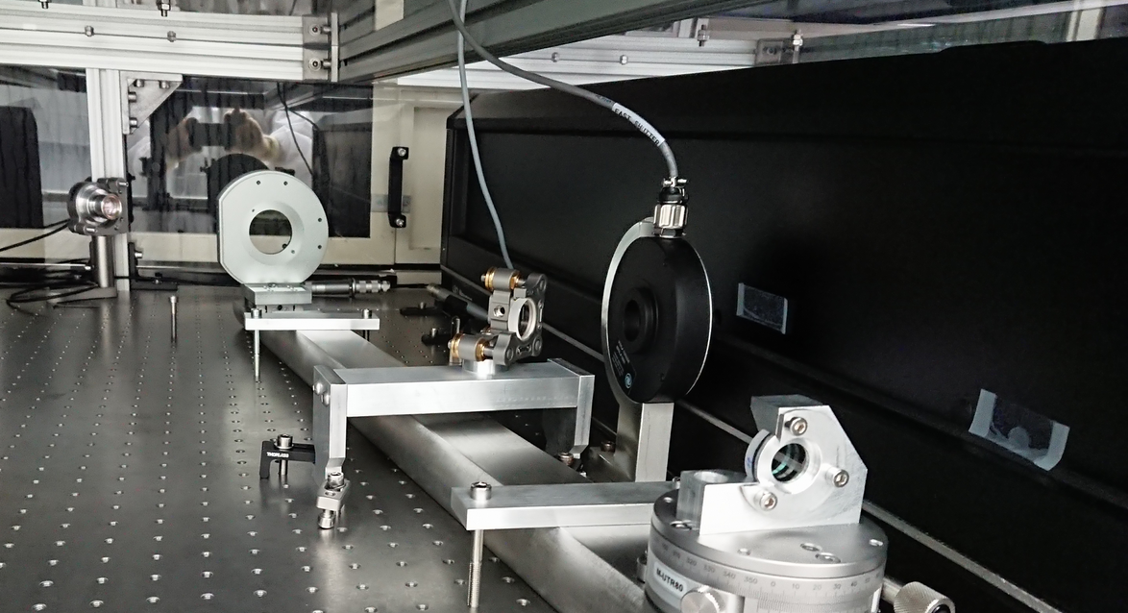
Squeezing injection in AdV
All critical optics in AdV are hosted on suspended benches under vacuum for noise mitigation
  seismic motion
  acoustics
  air turbulences
  stray light couplings
On the contrary, the AEI squeezer operates in air
External SQZ bench without seismic isolation
Need mitigation of scattered light
  Triple stage Faraday isolator to decouple OPO from interferometer
Optical losses
  Reflective telescope for mode-matching to ITF
  Minimal # of optical components
  Lossless optical components (FI)
  Accurate automatic alignment on ITF
Each stage: throughput >99%, isolation>40 dB
E. Genin et al. Applied Optics 57, 9705 (2018)

Slide 7
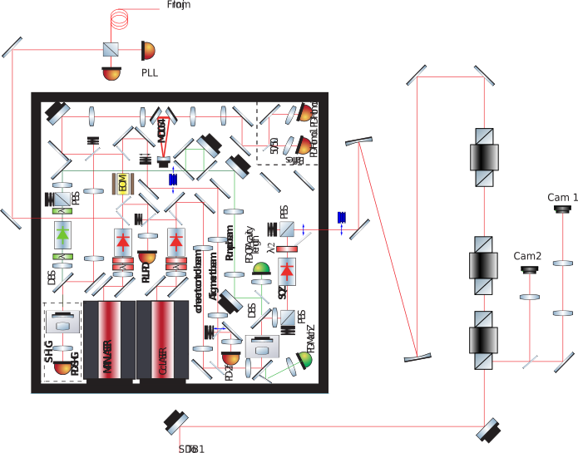
External squeezing bench in AdV

Slide 8
External squeezing bench in AdV
OPLL
Mode matching telescope
FI
AA sensors
Automatic alignment actuators

Slide 9
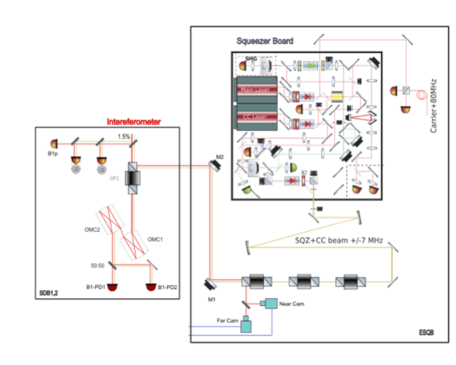
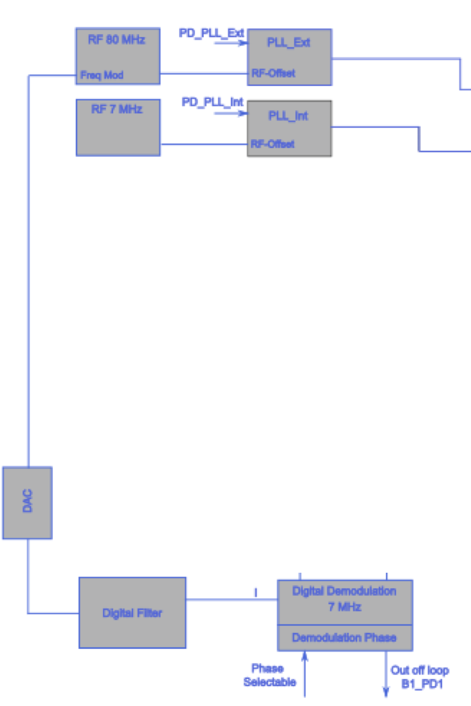
AA & CC
M1x
M1y
M2x
M2y
Digital filter
Dithering lines

Slide 10
AA & CC
Automatic pre-alignment
  Most alignment jitter and drifts is from SDB1 residual motion
    ITF mode-matching telescope magnification ~20
    bench jitter ~1 µrad, suspension modes 0.1÷0.5 Hz
    drifts >10 µrad
  Need alignment sensing when SQZ is not injected
    Use residual reflectivity from SDB1 FI to SQZ bench
Automatic alignment
  Baseline AA design was to use B1p quadrants for alignment sensing
    however signals are badly affected by HOMs on ITF carrier
    did not have commissioning time to test demodulation with ITF RF sidebands
  We rather add angular dither lines to steering mirrors
  Demodulate 7 MHz beat note (CC vs ITF carrier) at dark fringe photodiode
Coherent control
  Demodulate 7 MHz beat note (CC vs ITF carrier) at dark fringe photodiode
  Act on frequency tunable oscillator driving external PLL (sqz main laser vs Virgo laser)
  UGF>7 kHz
  Measured residual phase noise: 20 mrad

Slide 11
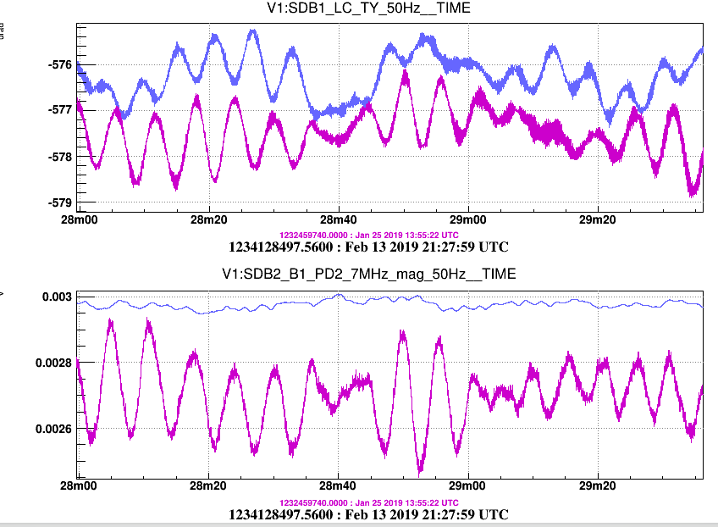
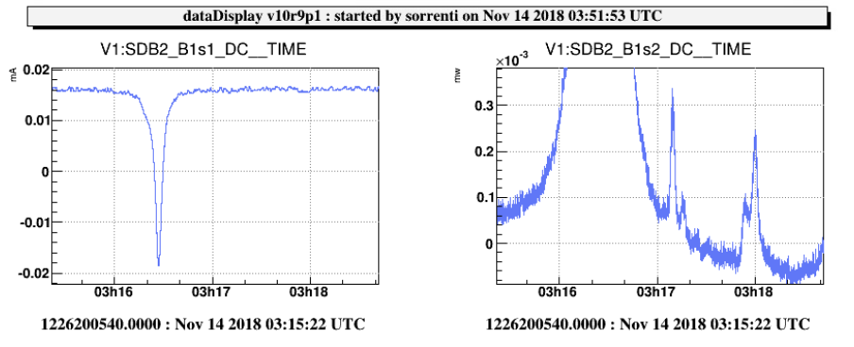
Alignment and mode matching
Magnitude of 7 MHz beat on B1 PD
AA with angular dither lines on steering mirrors
amplitude 100 nrad, frequencies 8÷17 Hz
no impact on ITF noise
no errors from driving matrix
accurate sensing of misalignment on OMC
Loop UGF < 0.1 Hz
  Does not correct for SDB1 angular jitter
  However residual alignment jitter contributes < 1% average losses
Mode matching measured to 97% with BAB
Pre tuning using beam profiler
MM tested with cold ITF
No further optimization so far
Telescope tuning in dark fringe might improve losses by several %
bad alignment
Angular motion of det bench
good alignment

Slide 12
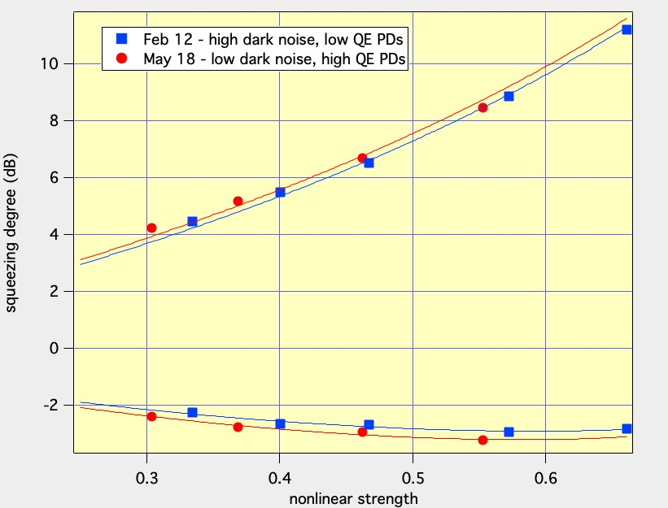
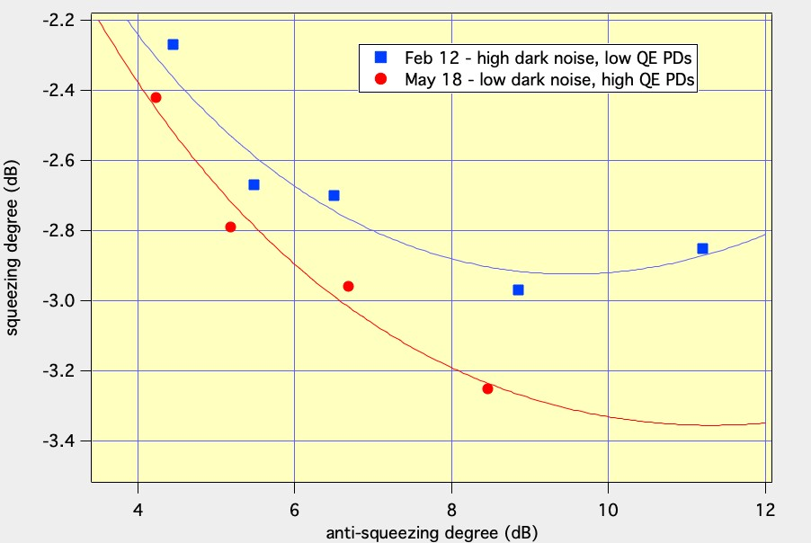
AdV: SQZ vs parametric gain
Losses 44%
Phase noise 50÷70 mrad
Losses 41%
Phase noise <90 mrad
Slight improvement after replacing B1 photodiodes
  Expected reduction of optical losses about 15%
Maximun squeezed produced: 12 dB
Maximun HF sensitivity improvement: 3.25 dB
Still large uncertainty
  overall losses: 30÷40% (dark noise included):
    our loss budget accounts for only 30%
  squeezing ellipse angular jitter: 20÷120 mrad
    Measured CC phase noise up to 100 kHz: 20 mrad

Slide 13
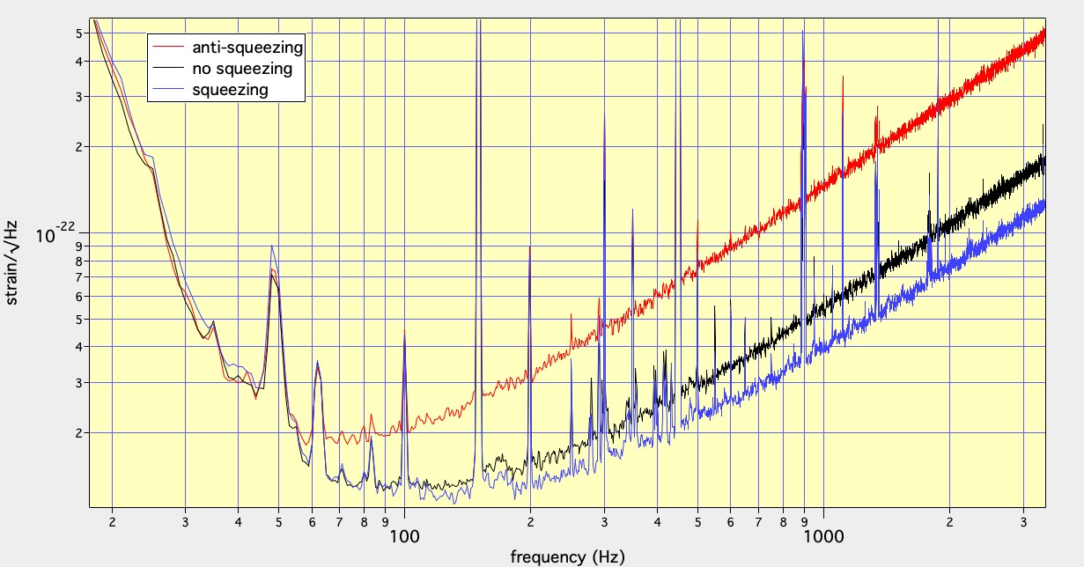
SQZ and radiation pressure noise

Slide 14
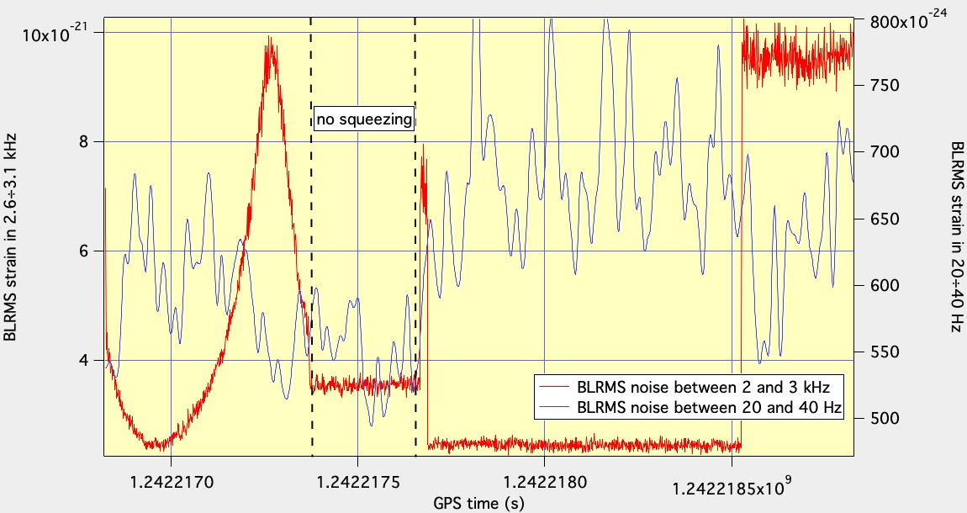
SQZ and radiation pressure noise
Red trace: BLRMS strain noise in 2.6÷3.1 kHz: 3.25 dB squeezing, 8.5 dB anti-squeezing
Blue trace: BLRMS strain noise in 20÷30 Hz: evidence of RPN?
Need to keep injected squeezing at moderate level in O3

Slide 15
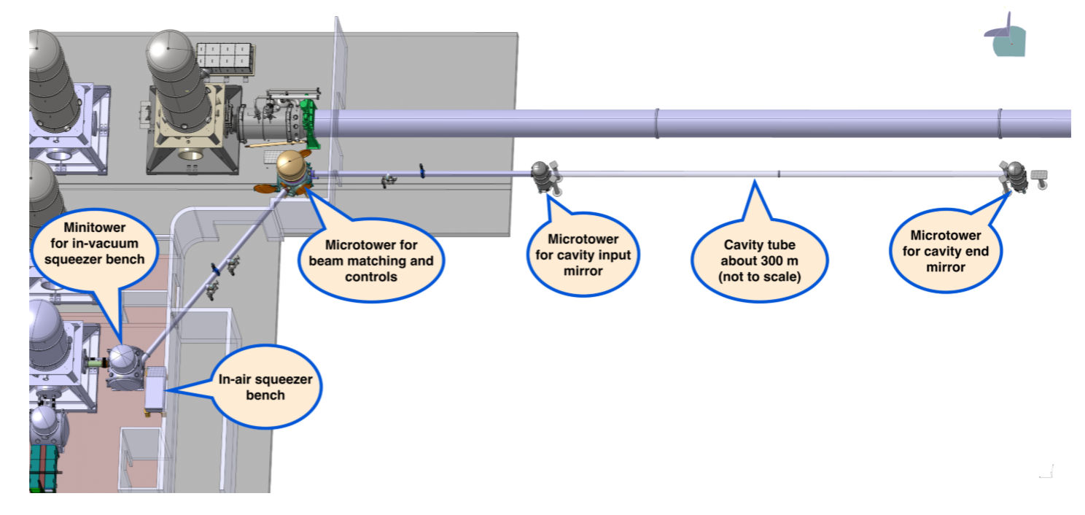
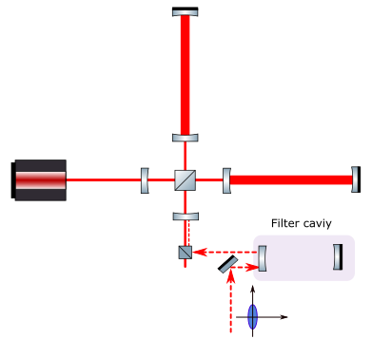
FDS in AdV+
Quantum noise in AdV+ dominates at both high frequency and low frequency
Already in O3, RPN is limiting the amount of injected FIS
Target for O4: inject FDS
  using filter cavity
  7÷9 dB of HF improvement without affecting low frequency sensitivity
Conceptual design: October 2018
TDR will be delivered on June
Assembly of FC already started at Nickef

Slide 16
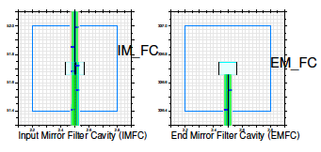
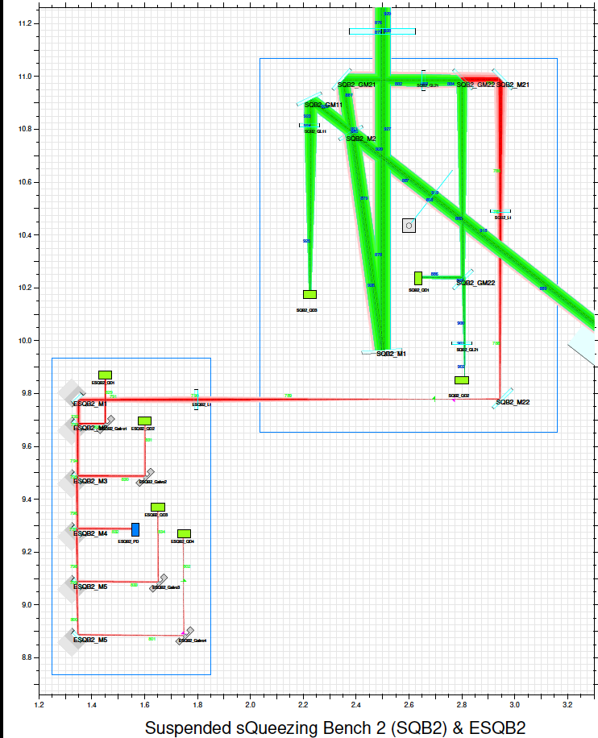
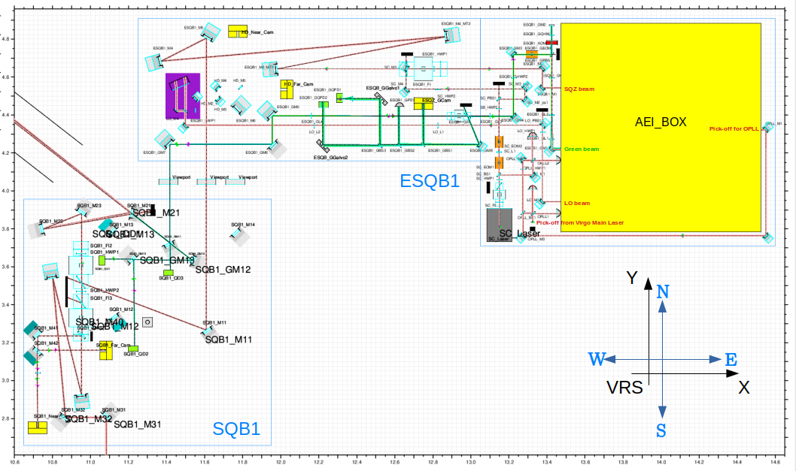
FDS in AdV+

Slide 17
FDS in AdV+
FC parameters
  Pole ~20 Hz
  L=285 m
  Finesse: 10k
  RTL: 20 ppm
  Mode matching > 98%
  Length fluctuations < 1 pm
SQZ source:
  phase I: AEI squeezer on in-air bench
  in-vacuum OPO to be developed for possible future upgrades
Optical system to connect SQZ source, FC, and ITF
  two suspended benches in vacuum
In parallel we have an R&D for FDS via EPR entanglement (see poster by C. Nguyen)
  benchtop demonstrator @ EGO
  technical design for possible implementation in Virgo

Slide 18
aLIGO O3 Squeezer Status Summary
Squeezer Duty cycle
Current situation of O3 squeezing
Things learned and challenges

Slide 19
aLIGO O3 Squeezer Duty Cycle
Up till May 17th, during 47 days since O3 start
 | H1 | L1
Observation with SQZ in | 98.7% | 97.7%
SQZ Level Detected (around 1kHz) | > 1.5 dB (2.2dB max) | > 2.3 dB (2.6dB max)
 | 54.1% | 32.2%
BNS Range | > 110Mpc | > 140Mpc
 | 16.5% | 15.1%

Slide 20
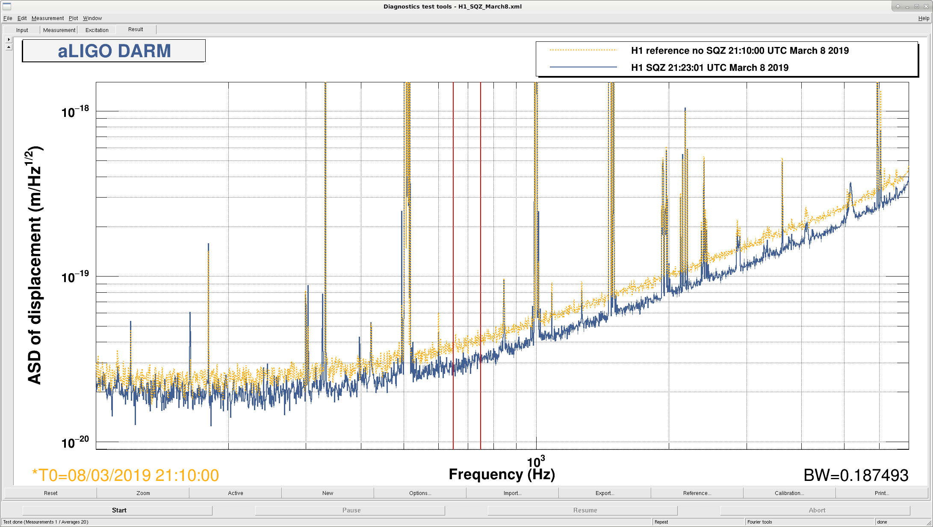
  LHO Squeezing During O3 Configuration
2.2dB

Slide 21
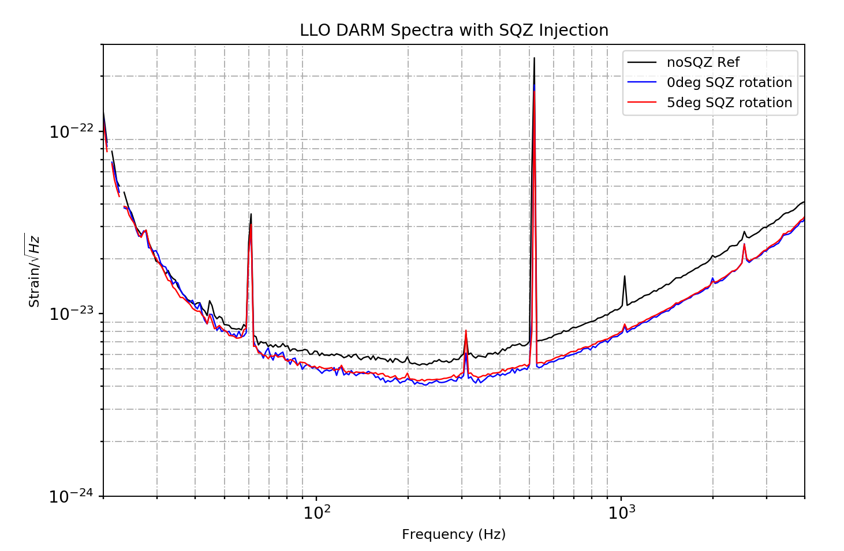
  LLO Squeezing During O3 Configuration
137MPc
140MPc
2.7dB
2.9dB
@1.3kHz
1.2dB
1.0dB
@80Hz
2.55dB
2.85dB
@700Hz
1.8dB
2.2dB
@200Hz

Slide 22
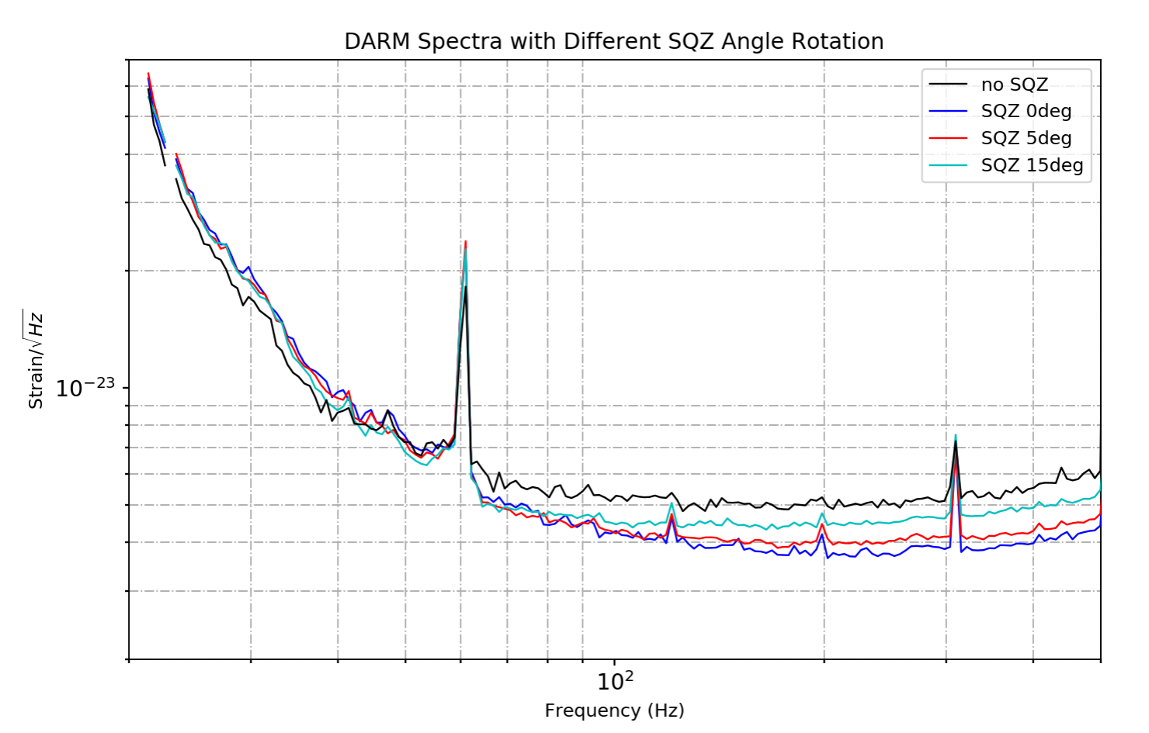
  Quanutm Backaction Evasion
Study on Range vs. OPO Pump Power & SQZ Angle Rotation: LLO alog 44376, 44706

Slide 23
aLIGO O3 Squeezer Facts
 |  | H1 | L1
OPO Threshold (mW) |  | 18 | 35 - 50
Green Input Power (mW) |  | 20 | 17.6
OPO Pump Power (mW) |  | 2.6 | 8.3
NLG |  | 2.25 | 2.65
Squeezing Generated (dB) |  | -- | 7
Homodyne | SQZ (dB) | 4 | 4.3
 | ASQZ (dB) | 6 | 6.6
IFO | SQZ (dB) | 2.2 | 2.9
 | ASQZ (dB) | 4.4 | 5.5
 | Loss | 40% (22% known) | 37-42% (21% known)
 | Phase noise (mrad) | 140 | 20-80 (18 from budget)
 | Range (MPc) (nosqz/sqz) | +10 | 127/140
ASC Loop BW |  | ~ 0.1Hz
Notes:
In general/principle, two sites are the same
H1 optical fiber limits the input power and NLG
Mystry loss and phase noise due to degeneration

Slide 24
Challenges & Things learned
Mode-matching study:
  Squeezing beam with OMC:
  Mistmatch 4 +/- 2% from single bounce test [alog 42311]
  IFO with OMC
    Mismatch <10%, study on-going
CLF power reduction helps squeezing level [alog 43399]
Optical loss and mode matching study
BNS range maximize with SRC length tuning and squeezing angle optimization [alog 44660]
ASC loop improvements
Hardware issues eg. Fibers, OPO crystal [alog 43750]

Slide 25
Conclusions and Future
Squeezing around 3 dB in AdV and aLIGO
Virgo O3
  AEI squeezer provides up to 14 dB (used at ~6 dB in O3)
  Measured squeezing 3 dB, anti-squeezing 5.5 dB
  Duty cycle > 90%
aLIGO O3
  LLO: 140MPc with 5 degree quadrature angle rotation, detected maximum 3.1 dB
  LHO: 125MPc with 2.2dB squeezing
Amplitude squeezing at low-frequency indication
Optical loss and phase noise hunting and reduction
Frequency-dependent squeezing with filter cavity

Slide 26
Spare slides

Slide 27


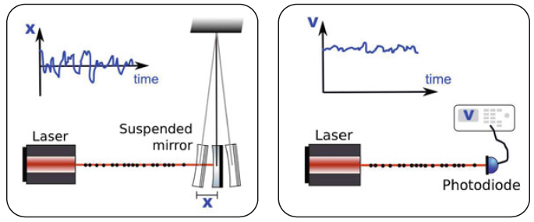
Quantum noise in GW detectors
Photon Shot Noise
Radiation Pressure Noise

Slide 28
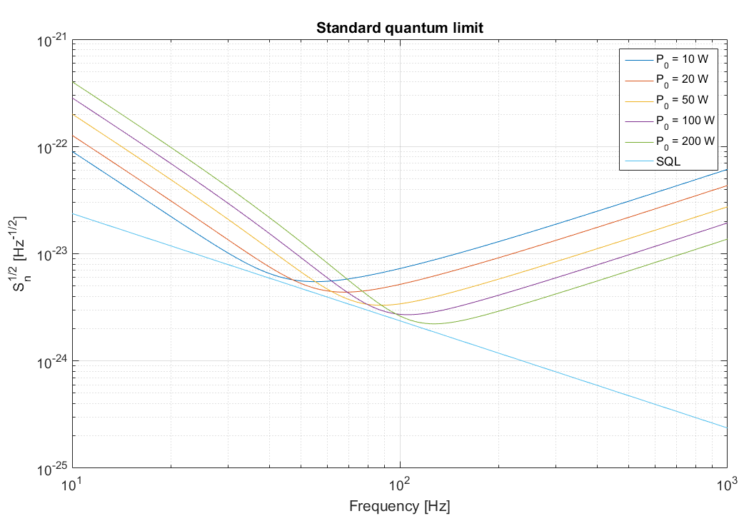
Quantum noise in GW detectors
RPN
increases with P
decreases with f
Shot noise
decreases with P
increases with f

Slide 29

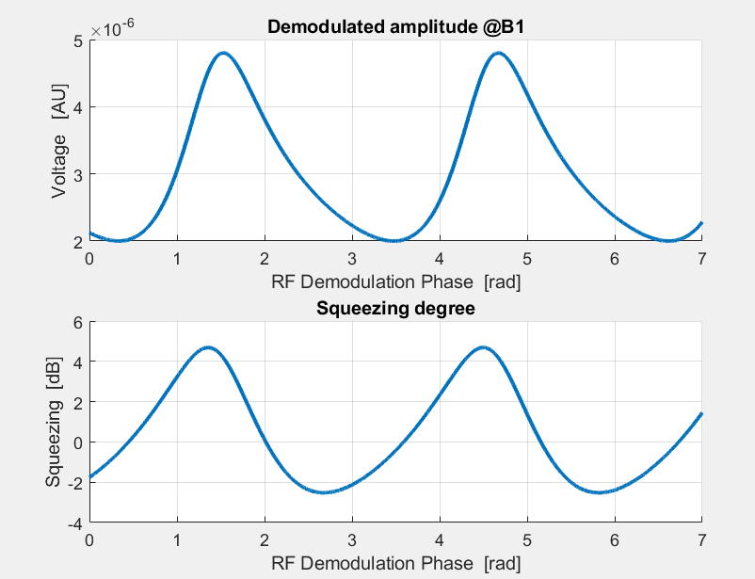

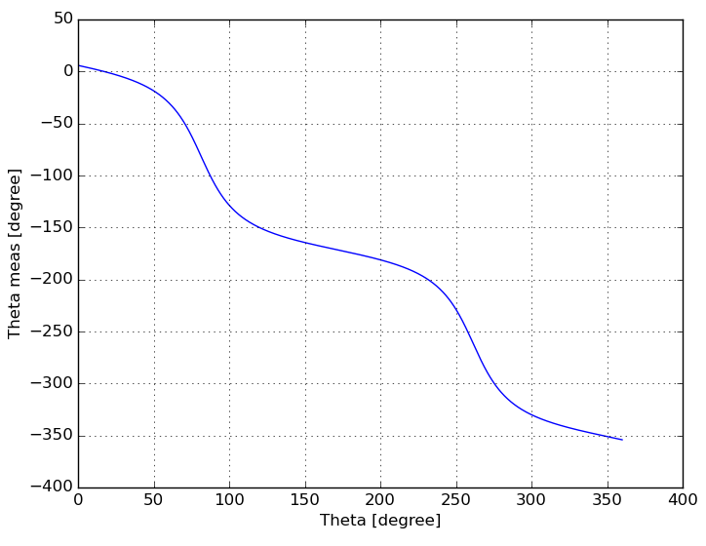
Coherent control of squeezing angle
CC loop error signal is derived from the 7 MHz beat note of ITF carrier with CC field
  Weird shape of measured squeezing vs CC phase
  B1 7 MHz magnitude depends on cc phase
    We exploit this by using the demodulated amplitude to control the slow drift of the CC loop
Can be explained by noting that the output of the squeezer contains two sidebands at +/-7MHz from the carrier with unequal amplitudes
B1 7 MHz beat note
Nonlinear relation between CC phase and squeezing angle

Slide 30
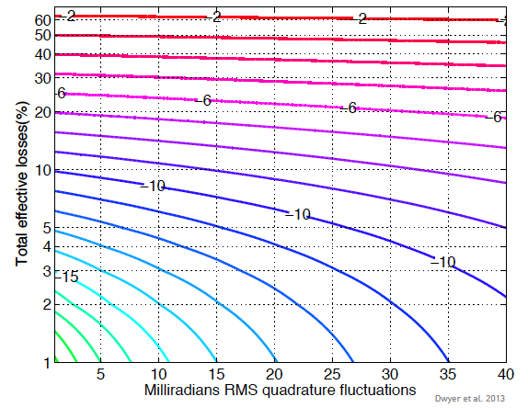
Limitations to QN reduction

Slide 31
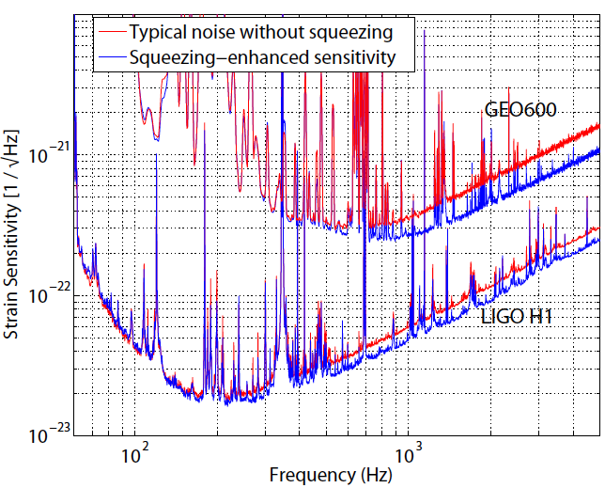
SQZ & GW detectors
Best published results
  GEO600: 3.7 dB
  Class. Quantum Grav. 33, 075009 (2016)
  LIGO: 2.15 dB
  Nat. Photon. 8, 613 (2013)

Slide 32
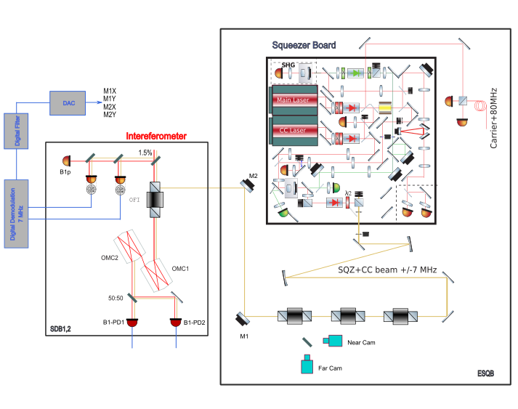
AA with B1p quadrants

Slide 33
Optical losses
Additional unmodeled losses play a role of the order of 10%
 | Loss value | Note1
1.Imperfect OPO escape efficiency | 1% | CQG 36, 015014 (2019)
2.Pick-off on the detection bench | 1.5% | Virgo TDR
3.In vacuum detection Faraday | 2×1.0 % | Appl. Opt. 57, 9705 (2018)
4.Injection Faradays | 5% | 4 FI (3 EGO+1 AEI)
5.OMC throughput | 4% | VIR-0059A-19
I6 IFT to OMC alignment and mode match. | 3% | VIR-0059A-19
7.Mode matching squeezer to OMC | 3% | Entry#43566 with cold ITF
8.Sensing Photodiodes QE | 10% | High QE PDs not yet installed
9.Arm cavity losses | 4% | Round trip losses times finesse
10.Alignment jitter | 1% | Entry#44966
11.Dark noise contribution | 6% | Electronic contribution
Total | 34%
The overall phase noise (60 mrad) comes from high frequency because in the range 0-100kHz is about 20 mrad. Due to 56 MHz sideband TEM 01 OMC1 leaking (entry#43660)?

Slide 34
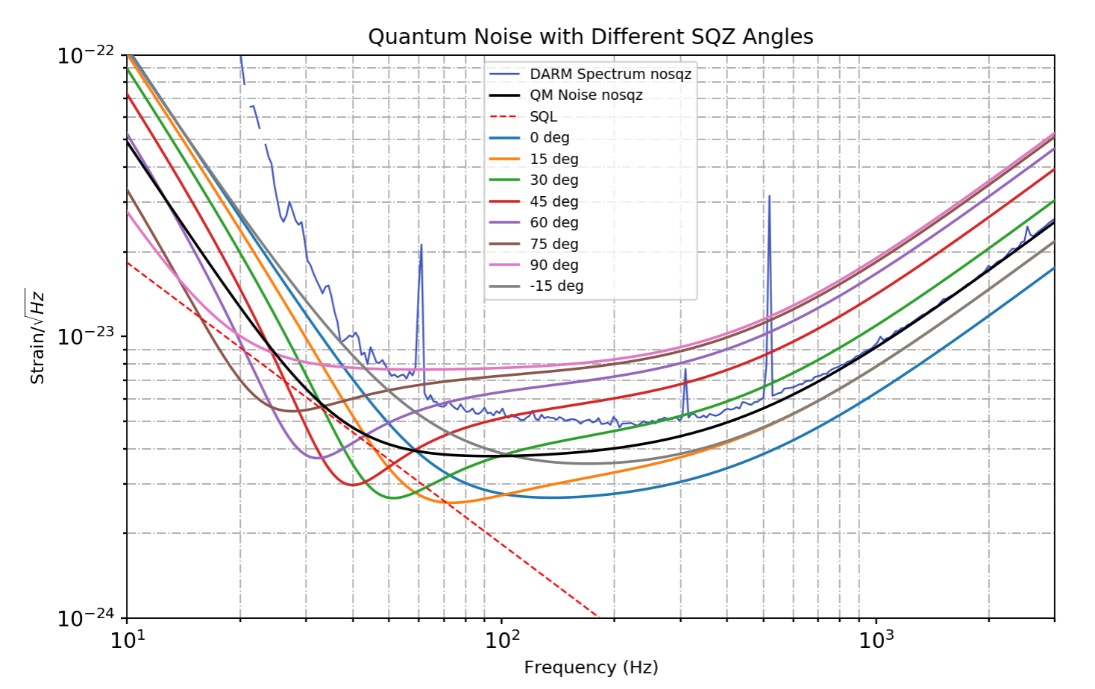
Notes:
If the effect is due to RPN dominated, we should be able to see these dips
QRPN interact with IFO reaction

Slide 35
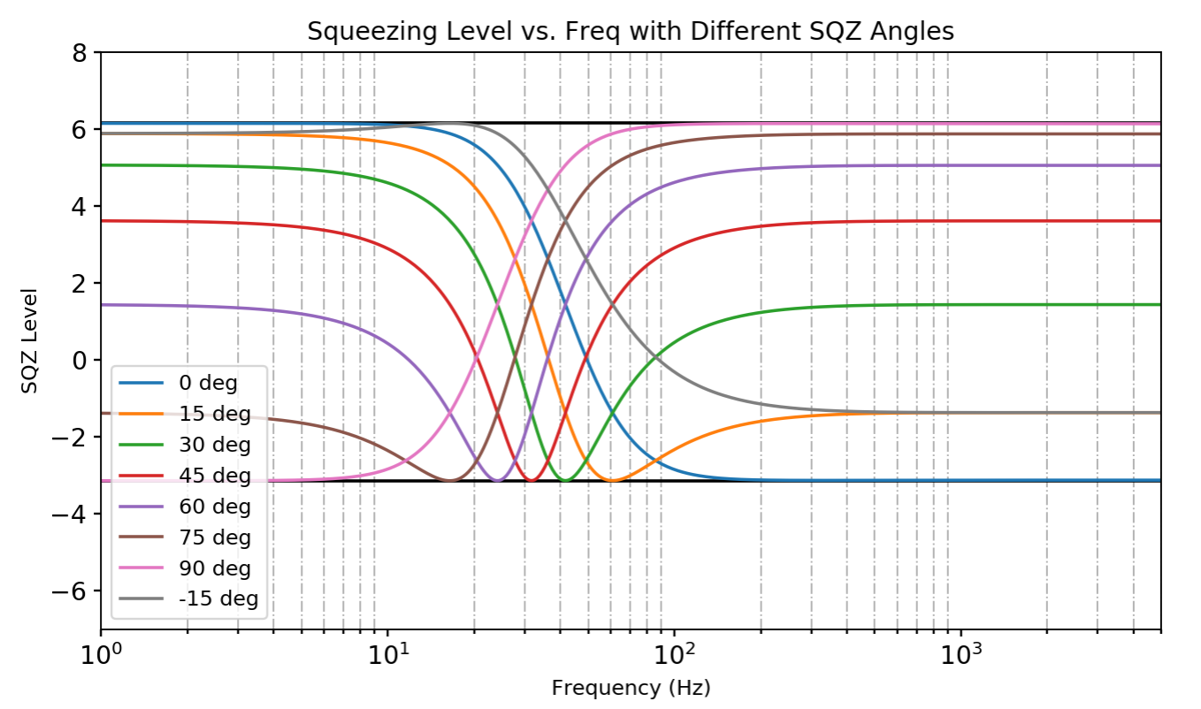
Notes:
If the effect is due to RPN dominated, we should be able to see these dips
QRPN interact with IFO reaction

Slide 36
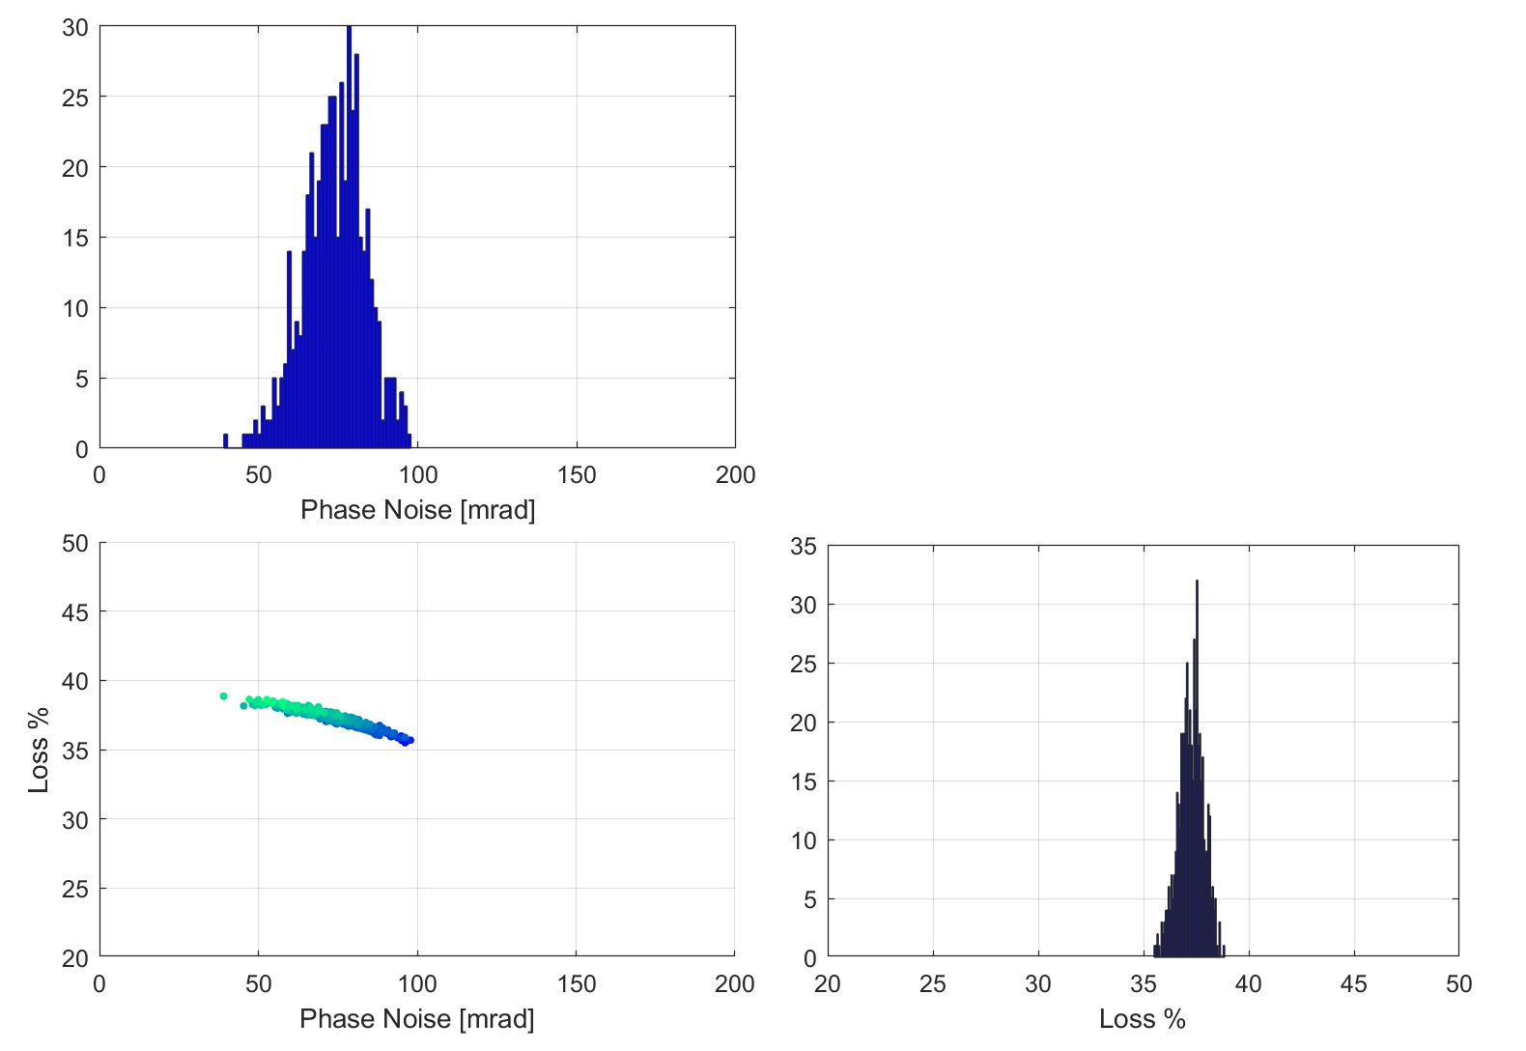
Loss & Phase Noise @LLO
  IFO Measurements:
      SQZ = 2.9dB
      ASQZ = 5.5dB
      NLG = 2.65
      22% known loss
  NLG = 2.65
plotSQZnlg(2.9, 5.5, 2.65, 0.01, 0.01)

Slide 37
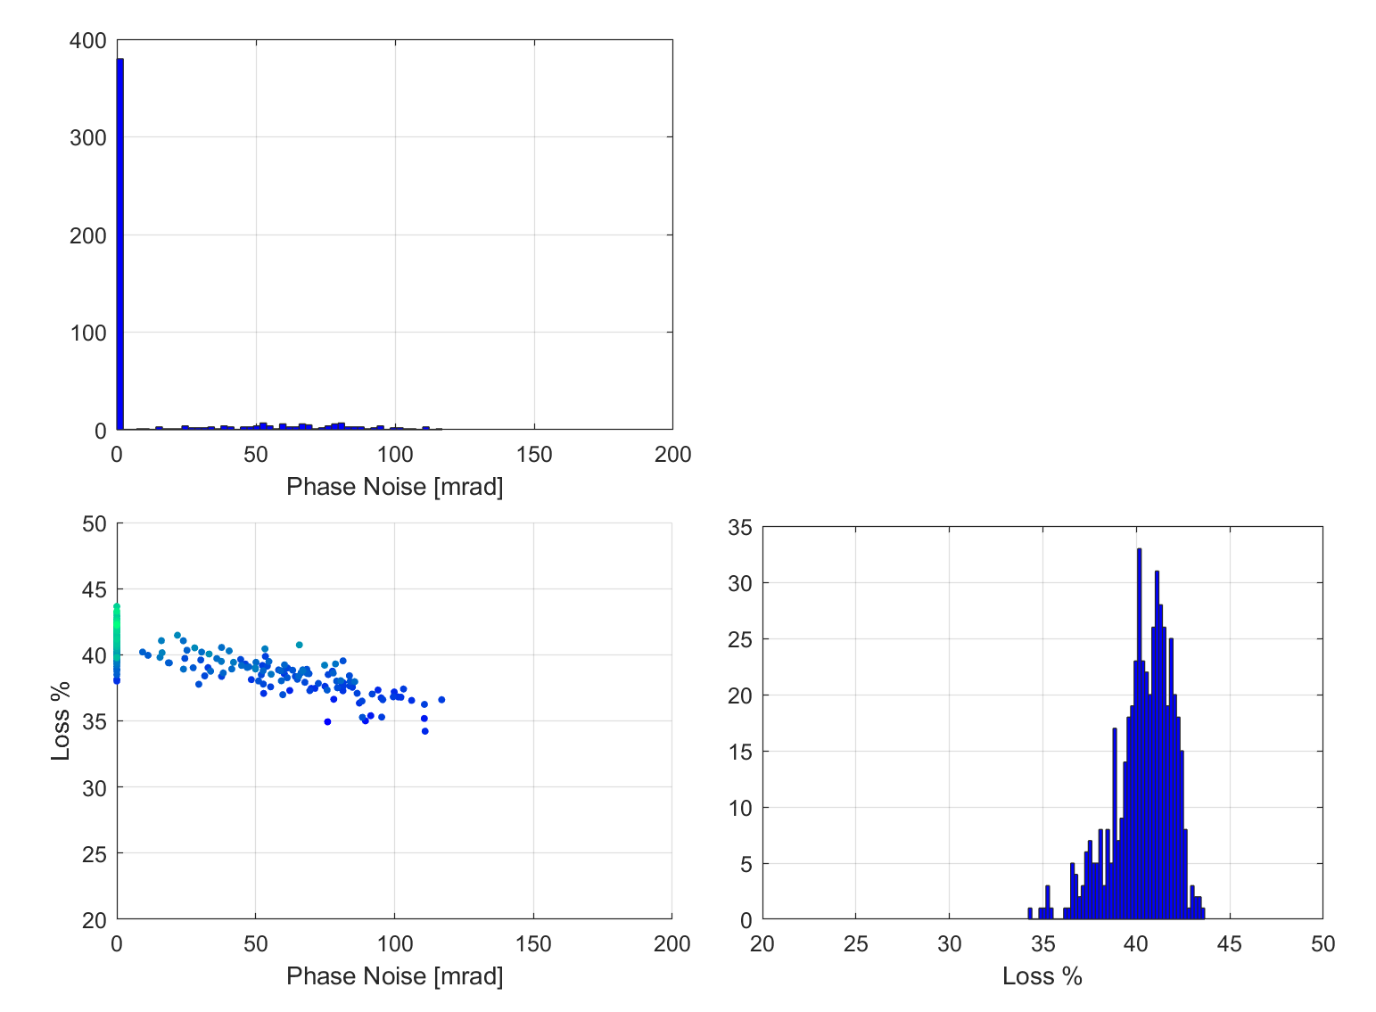
Loss & Phase Noise @LLO
  IFO Measurements:
      SQZ = 2.9dB
      ASQZ = 5.5dB
      22% known loss
      phase noise 10-20 mrad from noise budget
  NLG = 2.75
plotSQZnlg(2.9, 5.5, 2.75, 0.05, 0.05)

