Slide 1
CHIR2 CMOS R&D
INFN Sezione di Roma
DAQ Status and Future Development
JUN 06, 2018 | INFN (Rome), ITALY

Slide 2
Index
Background
HW Development status
Cypress CX-3 core
Off-line frame analysis
On-line frame analysis
Conclusions
Future^2 developments

Slide 3
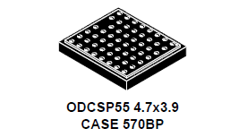
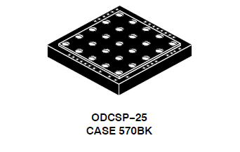
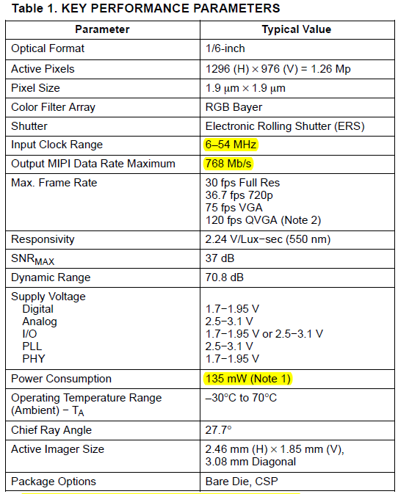
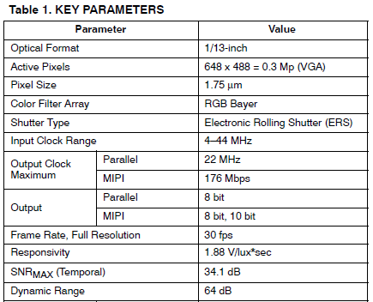
Background (from Sept 17)
We assume to use a sensor from ON Semiconductor (ex Aptina, ex Micron) probably from series MT9M/V_xyz in ODCSPxy package
This package should have a small protective film (we talked with ON Semi. Italia application engineer) in fact both the -114 and the -115 have the same thickness :
At the moment the candidate is the MT9M114 it has a greater optical format (1/6-inch) and the same pixel size of the -115 (same pix-to-pix cross talking expected)
It has 1.26Mp resolution (higher data bandwidth on MIPI)
ON Semi. app. ing. suggest to migrate to a new series, the AR0261 but we are stuck with NDA documents...

Slide 4
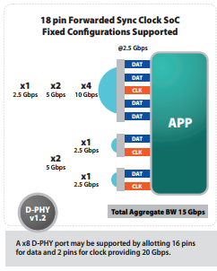
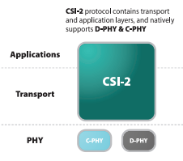
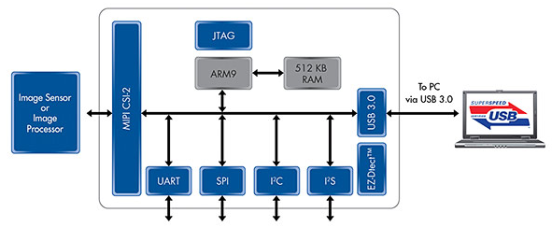
Background (from Sept 17)
DSP
USB
MIPI
CMOS
+ I2C-Bus
Running back-end SW
(and the GUI)
The MIPI of the MT9 is the CSI-2 version:
proprietary protocol
D-PHY based on Sub-LVDS
The CX3 has also the I2C-Bus to control the sensor.
WE NEED A MEDIA SUPPORT...
It can be based either on uC or SoC (uC+FPGA)
it is meant to execute the algorithm of “hit” detection as fast as possible
it must also interface the MIPI with USB
it must also configure the CMOS sensor via I2C-Bus
*ARM926 (SAM9G) inside
200MIPS 32-bit RISC

Slide 5
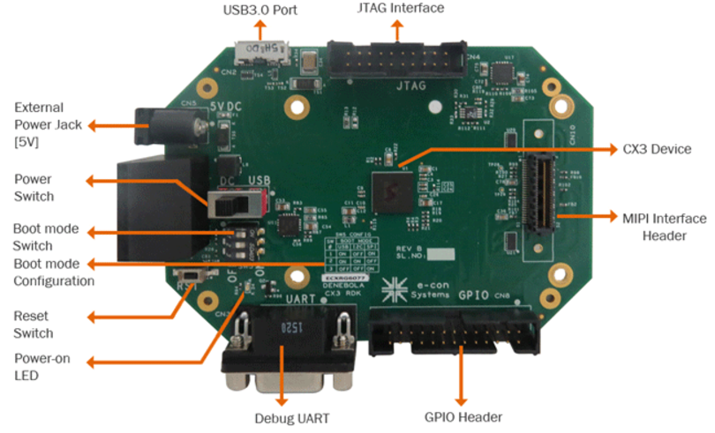
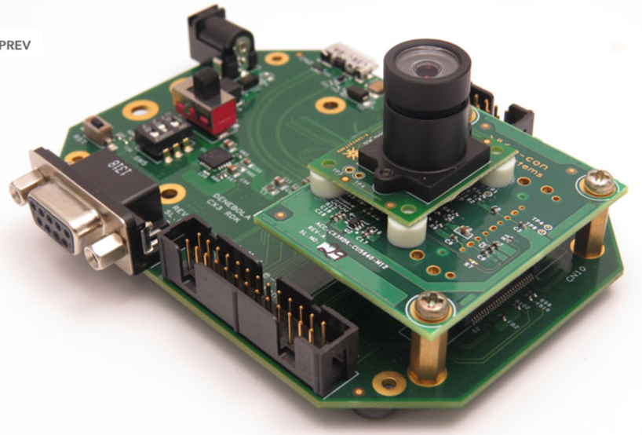
Background (from Sept 17)
Cypress® offers an EVB designed by Denbola® which host the CX3:
But it is meant to be connected with a sensor board using a MIPI connector (not standard, it use a SAMTEC QFS) :
PRO:
commercially available DSP (~250$)
a lot of code examples
ARM A9 fully available
maybe it’s fast enough for our algorithm
CX3 is in a 9x9mm package...
The idea is to develop:
a sensor holder and a small dummy adapter between HDMI and the SAMTEC QFS (HW)
the backend SW and the ARM A9 firmware (SW)

Slide 6
HW Development Status

Slide 7
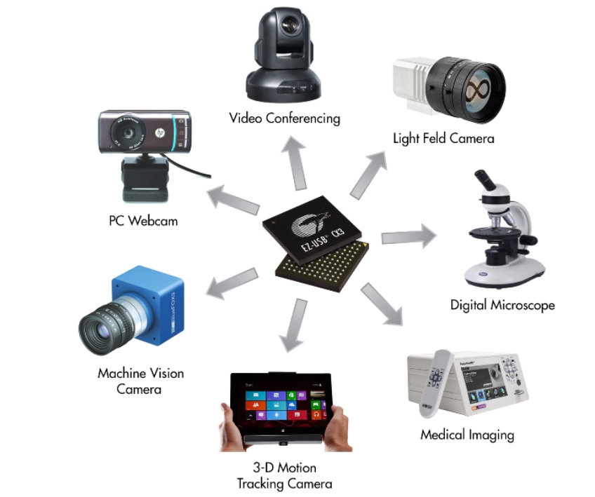
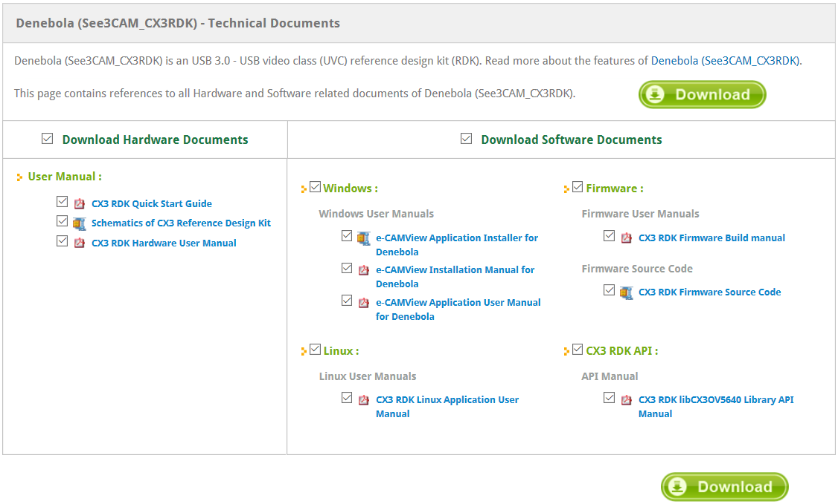
Cypress CX-3 Core
Internal ARM9 200Mips CPU
Full API support (C++) FX3/CX3
Full Denebola RDK support

Slide 8
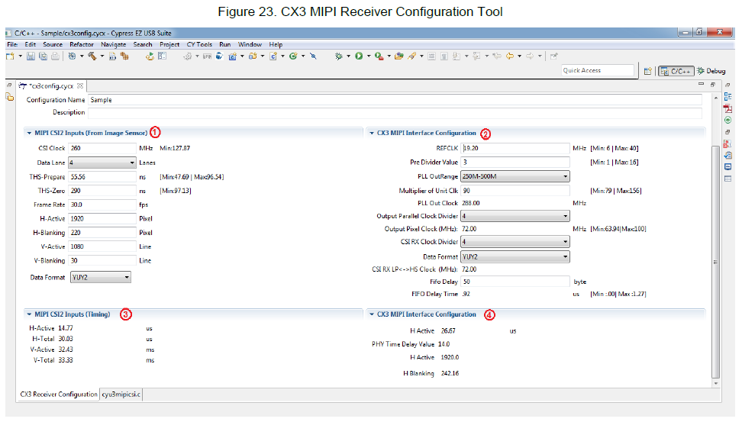
Off-line frame analysis
Basic Sensor control interface/derived from Cypress GUI
Configure the CX-3 for image streaming to PC via USB 3.0
Use the off-line scripts already developed

Slide 9
On-line frame analysis
Basic Sensor control interface/derived from Cypress GUI
Configure the CX-3 for image processing via ARM9 (512MB RAM!!!)
Use the PC to visualize the “hits/counts”

Slide 10
Thank you for you attention!
Coffee Break?

