Slide 1
progetto a.s.l. a scuola di astroparticelle

Slide 2
X-ray imaging and dosimetry: the research at the base of the applications
We collected radiographic images of a mobile phone using a prototype of computed tomography scanner.
We acquired the images setting different object-to-detector distances (R₂=25cm, R₂= 37cm) and changing the irradiation angle ( 0°, 45°, 90°).
We elaborated the acquired images for reducing detector defects.

Slide 3
The Process
To obtain the perfect radiography we acquired
three differents images
Dark: it’s the image we obtained with x-ray tube off and without the object (we need the dark image because the detector could be defective and affect the final image)
Flat: it’s the image obtained with x-ray tube on and without the object (we need it to calculate the distribution of the x-ray on the detector)
Image of the object: obtained with the

Slide 4
The Results…
We notice that it’s possible to obtain different radiographies of the same object by moving the detector
In the first image the object seems to be smaller then the second one beacause we changed the object-to-detector

Slide 5
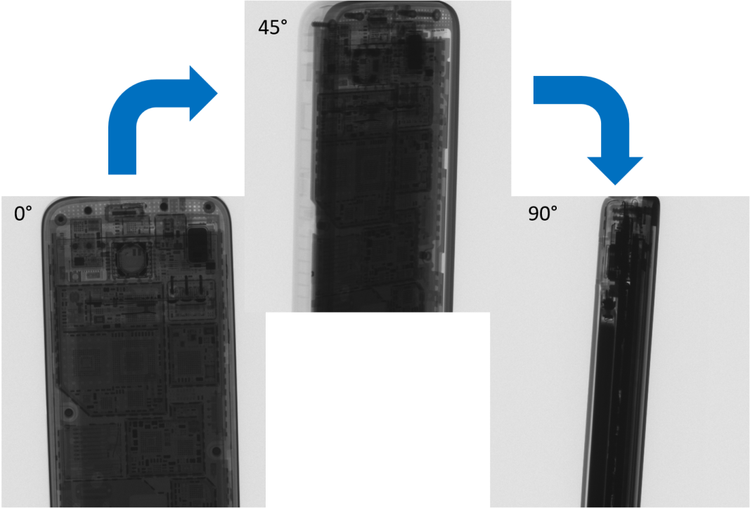
A single image of the object can’t be enough for a complete diagnosis because some particulars could be hidden by the structure of the object
So we collected different images changing the irradation angle (0°, 45°, 90°).
Doctors use the same method to do a CT scan for a patient

Slide 6
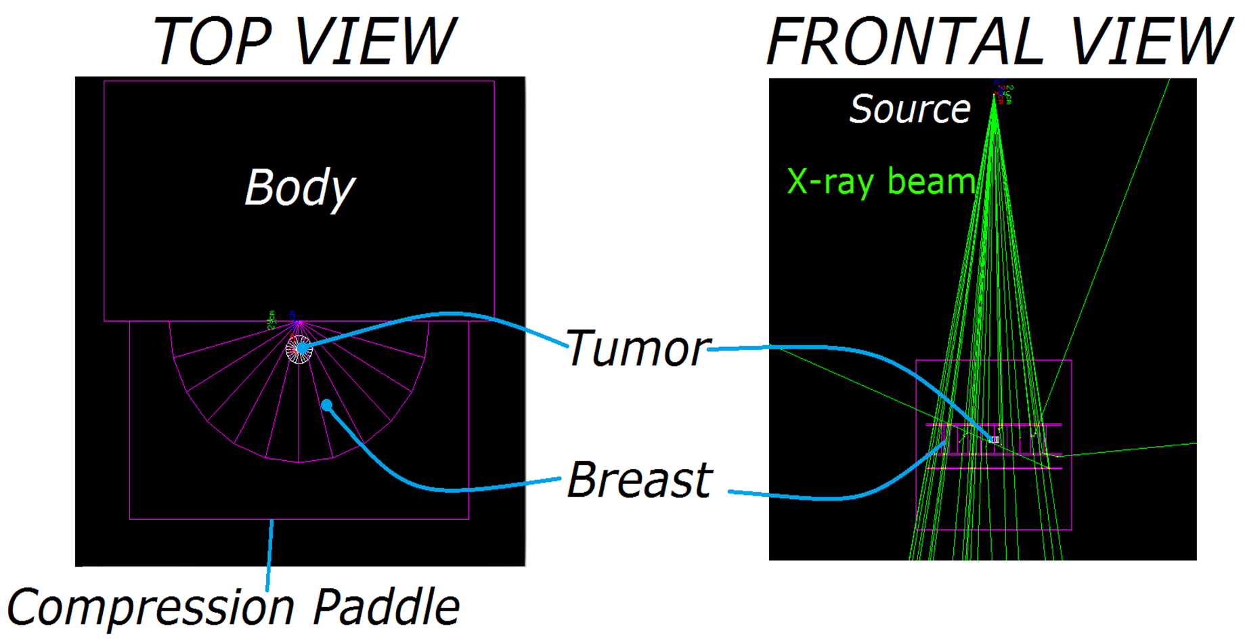
Monte Carlo Simulation
We used a Monte Carlo software to simulate a mammography exam. It was written in C++ programming language and it was based on GEANT4 toolkit.

Slide 7
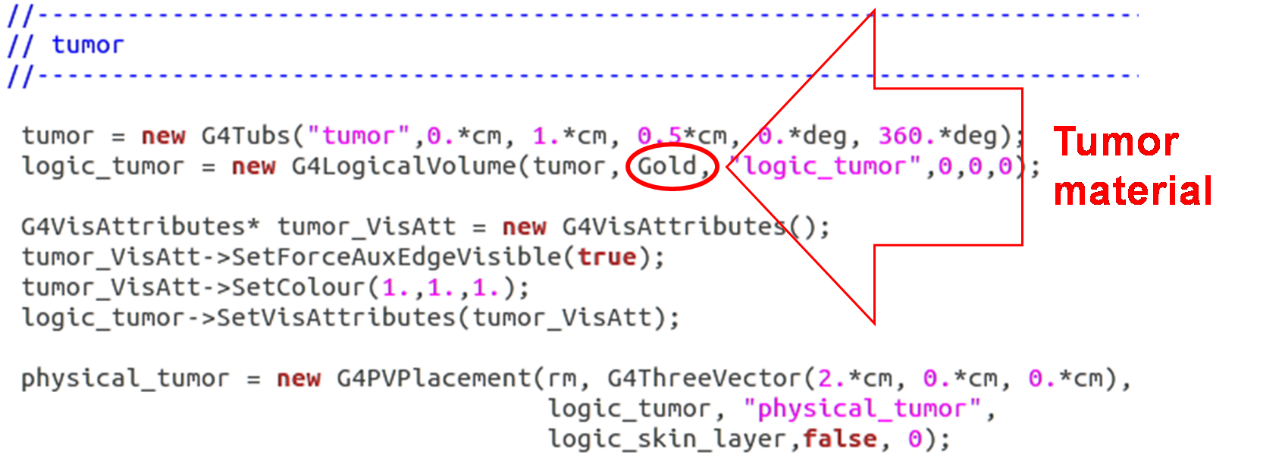
The breast was modelled as a cylinder with a semi-circular section made of a homogeneous mixture of 20% glandular/80% adipose tissue.
We added a cylindrical tumor lesion (radius=height=1 cm) whose material was changed in order to evaluate its impact on the final image. In addition we studied the relation between image quality and dose.

Slide 8
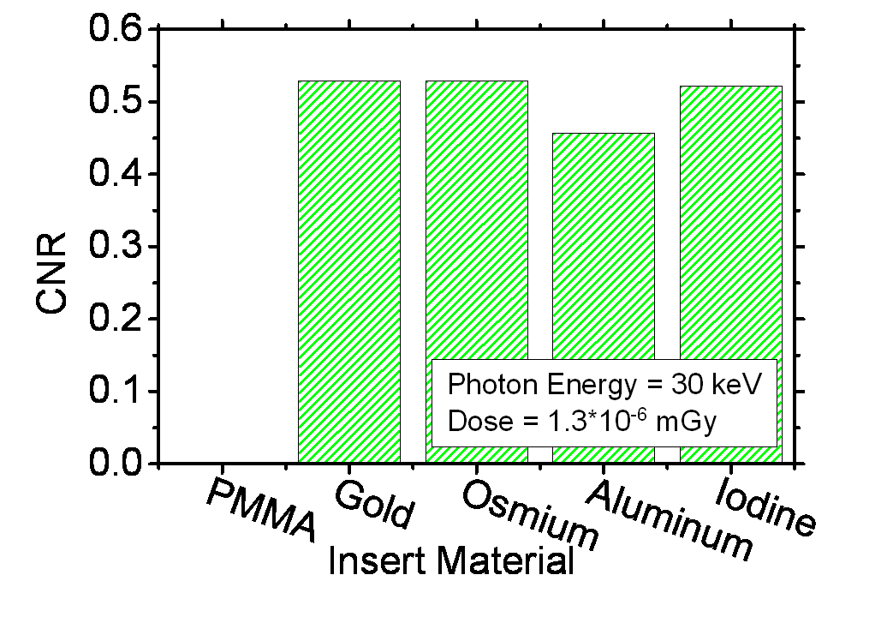
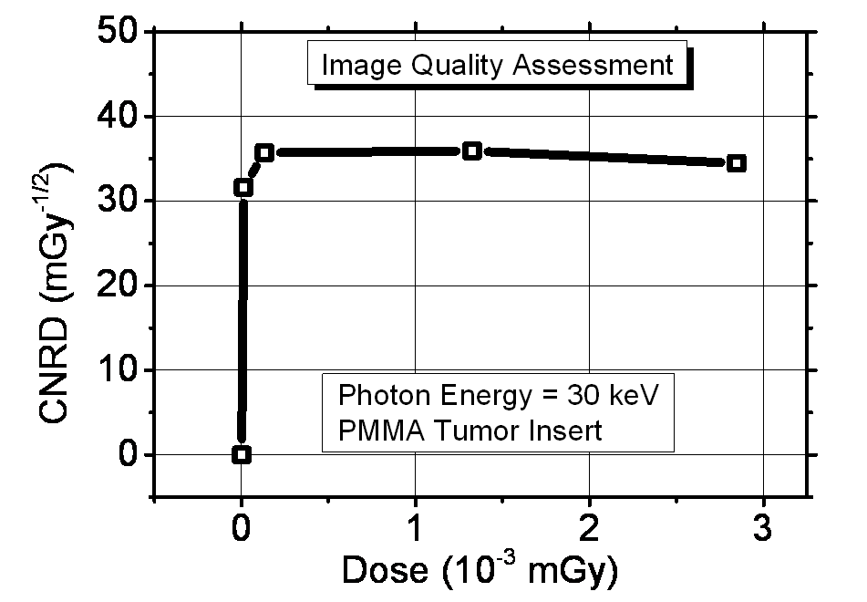
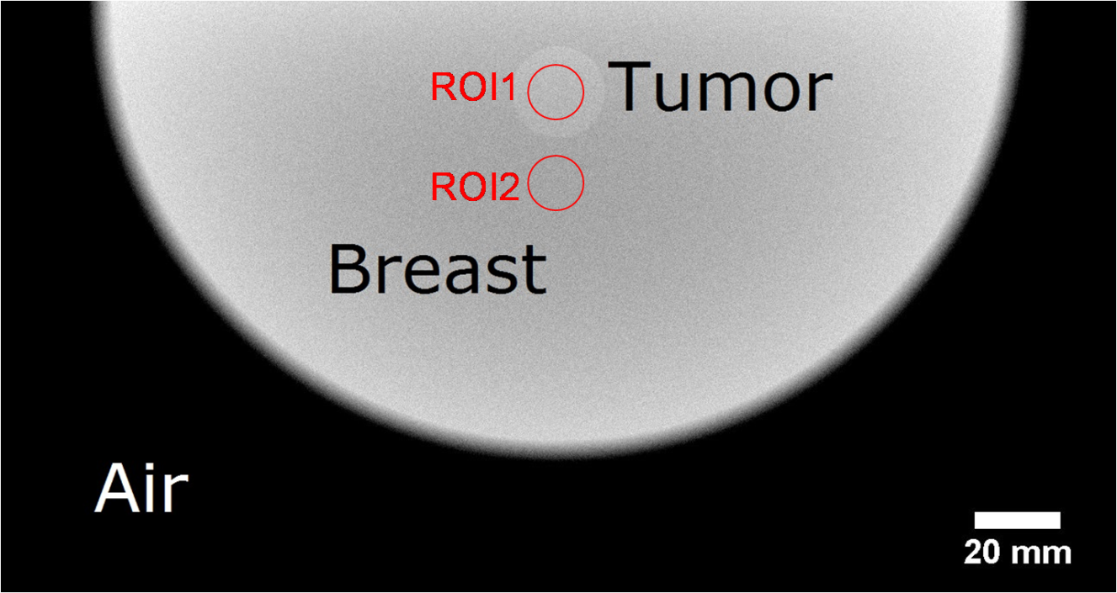
Simulated radiography of the modelled breast with a tumor inclusion. Photon energy = 30 keV; Breast thickness = 5 cm; Breast diameter = 10 cm; Dose = 1.3*10⁻³ mGy. The red circles contain the regions of interest (ROI) for image quality indexes calculation.

Slide 9
…Results
Via Monte Carlo simulations we produced model breast images including tumor lesions made of different materials.
For each used material we calculated a image quality index: the Contrast to Noise Ratio (CNR).
In the case of PMMA insert, we evaluated the quality image to dose relation. We introduced CNRD, which takes into account also for the dose contribution.
For low dose levels, this index presented a strong dose dependence, while for doses higher than 1.3*10⁻⁴ mGy its value remains constant.

Slide 10
Risk of low-dose radiation and the BEIR VII report:
a critical review of what it does and doesn’t say
BEIR VII (Biological Effects of Ionizing Radiations)
Japanese A-bomb survivors studies *
Medical Radiation studies
Environmental studies
Occupational radiation studies
* (Base study)

Slide 11
CANCER RISK MODELS
Excess Relative Risk
Excess Absolute Risk
Lifetime Attributable Risk
(LAR)
(EAR)
(ERR)
Rate of disease in exposed population
ERR + X
or
EAR + X
Rate of disease in exposed population
Rate of disease in unexposed population
- 1
-
Rate of disease in unexposed population
X= each year after exposure out to an expected lifespan of more or less 80 years
-Baseline cancer incidence does not influence the rate of additional cancers induced by ionizing radiations
-Useful only with ethnicities such as Japanese population in war time conditions

Slide 12
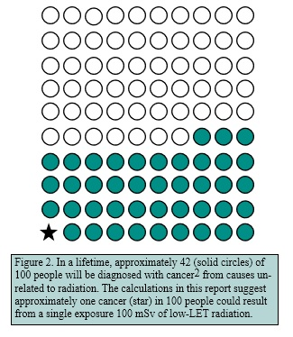
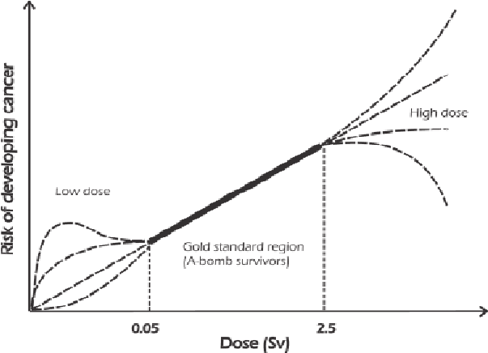
At high doses we are sure of the results:
Increase of risks of developing cancer and other fatal diseases and, eventually, death.
1Sv temporary hemoglobine alteration
2-3Sv Hair loss and hemorrhage
4Sv death in 50% of cases
6Sv Unlikely survival
But at low doses there is no sure evidence of what the effects could be. We can only assume one of these cases:
-The lower the dose is, the lower the chance of fatal effects (also linearely) will be
-There could be a threshold under which the risks will not lower further
-At lower doses there could be even some benefits

Slide 13
CONCLUSION
Despite over 50 years of intensive study, the data available is still inconclusive on any effects of ionizing radiation at doses below 100 mSv
The BEIR VII report:
But at the same time it doesn’t assure us that a low dose exposure could cause biological effects on population
Help us to understand the effects of IR on population
For these reasons, do not quote cancer estimates from BEIR VII as if they were a proven scientific fact !!!

