Slide 1






ISOLPHARM_AG - Task1
Nuclide production simulation with FLUKA and GEANT4
status report: May 2018
TASK 1: Michele Ballan

Slide 2
Overview
⚛ FLUKA & GEANT4: simulations parameters
⚛ Standard input definition: parameters for FLUKA
⚛ FLUKA input automatic generation
⚛ ISOLPHARM website: template selection
⚛ ISOLPHARM website: structure draft
⚛ News & plans
TASK 1: Michele Ballan

Slide 3
Simulation parameters
TASK 1: Michele Ballan

Slide 4
Simulation parameters: FLUKA
TASK 1: Michele Ballan

Slide 5
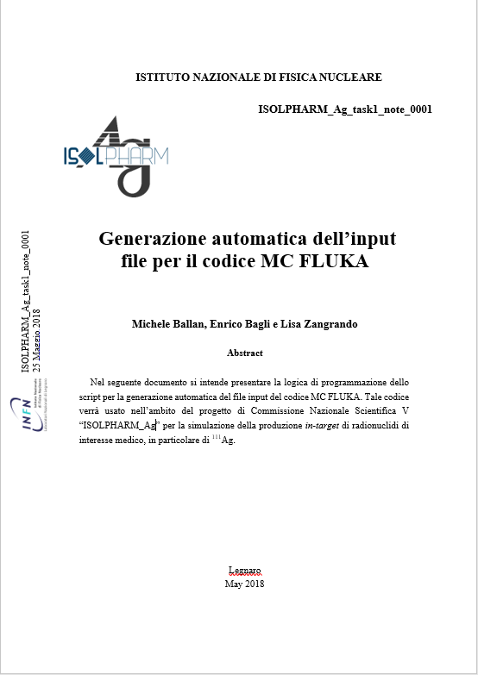
Automatic FLUKA input generation
TASK 1: Michele Ballan

Slide 6
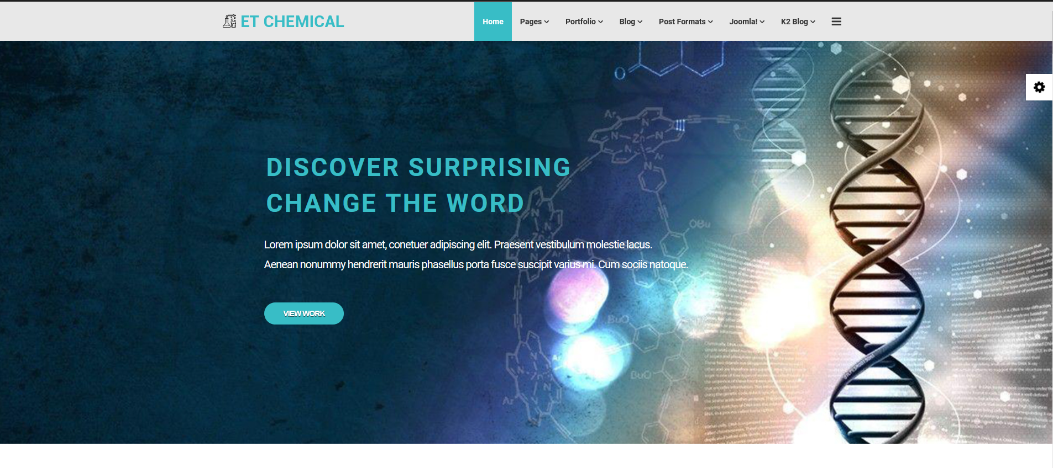
ISOLPHARM website: template
TASK 1: Michele Ballan

Slide 7
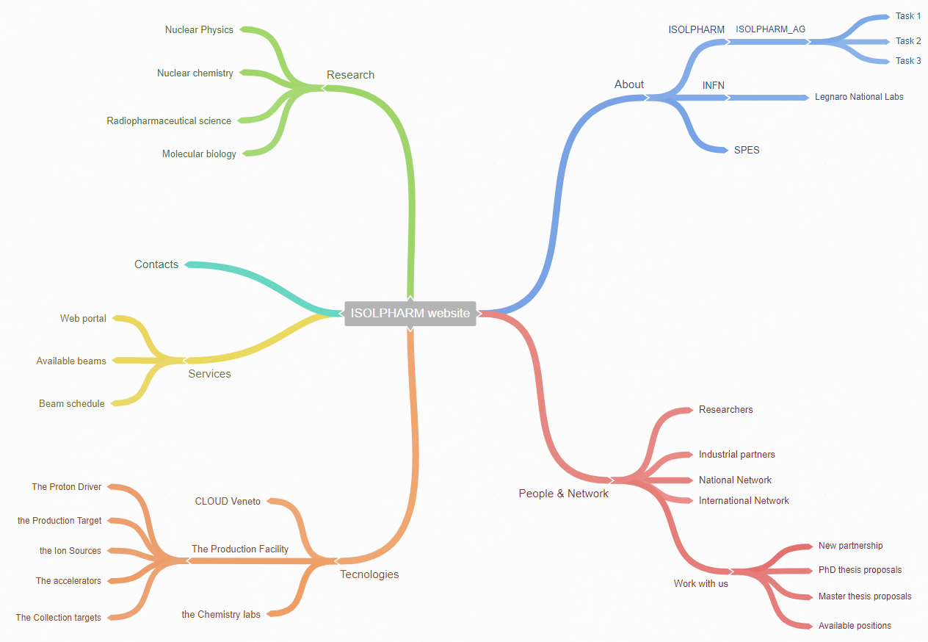

ISOLPHARM website: structure
TASK 1: Michele Ballan

Slide 8
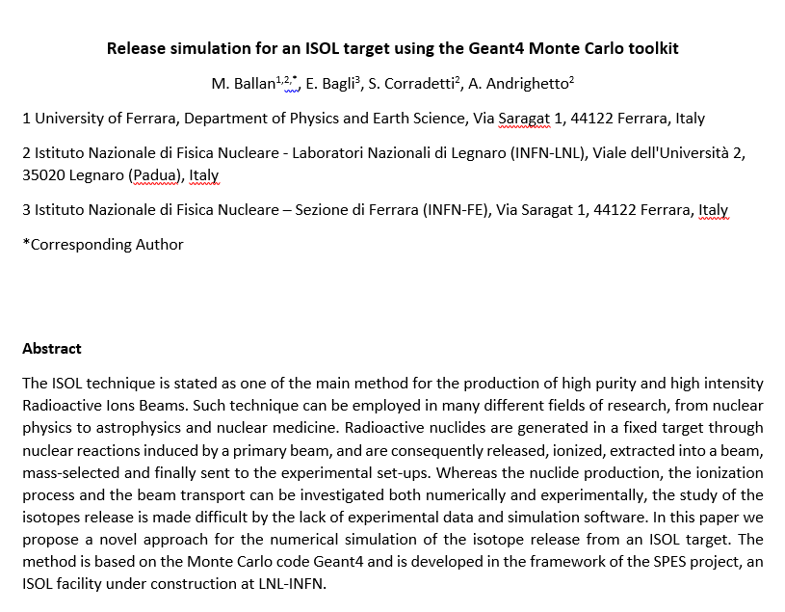

News & plans
Paper submitted on EPJA
PhD thesis writing: started
ISOLPHARM _Ag task 1 activities may be part of it.
TASK 1: Michele Ballan

