Slide 2
Ar-Nb ion energy distribution and thin film properties in HiPIMS with a positive voltage pulse
Fabio AVINO¹, A. Sublet¹, S. Calatroni², P. Costa Pinto¹, T. Richard¹, G. Rosaz¹, M. Taborelli¹, W. Vollenberg¹, A. Grudiev³, A. Lunt⁴.
¹ CERN, TE/VSC-SCC
² CERN, TE/VSC-VSM
³ CERN, BE/RF-LRF ⁴ CERN, EN/MME

Slide 3
Outline
Framework
R&D simulations
R&D experiments
Next steps
Conclusions

Slide 4
Outline
Framework
R&D simulations
R&D experiments
Next steps
Conclusions

Slide 5
The CRAB cavity: what for?
HL-LHC upgrade (by 2025) aim at increasing luminosity by a factor of 5.
16 CRAB cavities will be mounted around the two main experiments (CMS-ATLAS).
Why CRAB?

Slide 6
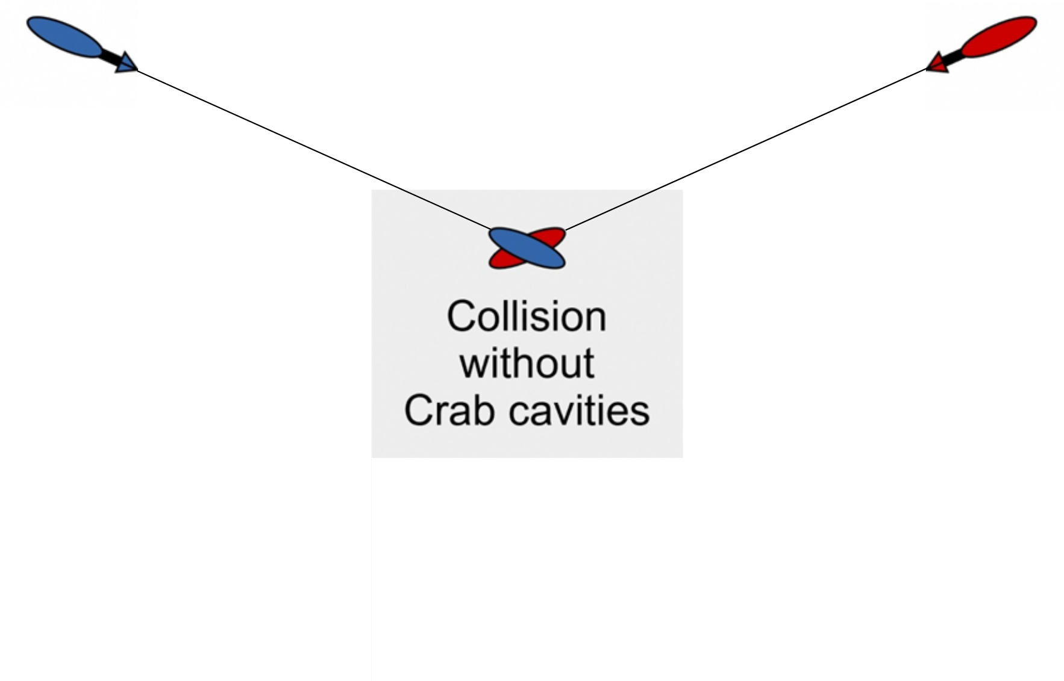
The CRAB cavity: what for?
HL-LHC upgrade (by 2025) aim at increasing luminosity by a factor of 5.
16 CRAB cavities will be mounted around the two main experiments (CMS-ATLAS).
Why CRAB?

Slide 7
The CRAB cavity: what for?
HL-LHC upgrade (by 2025) aim at increasing luminosity by a factor of 5.
16 CRAB cavities will be mounted around the two main experiments (CMS-ATLAS).
Why CRAB?

Slide 8
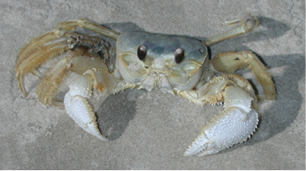
The CRAB cavity: what for?
HL-LHC upgrade (by 2025) aim at increasing luminosity by a factor of 5.
16 CRAB cavities will be mounted around the two main experiments (CMS-ATLAS).
Why CRAB?

Slide 9
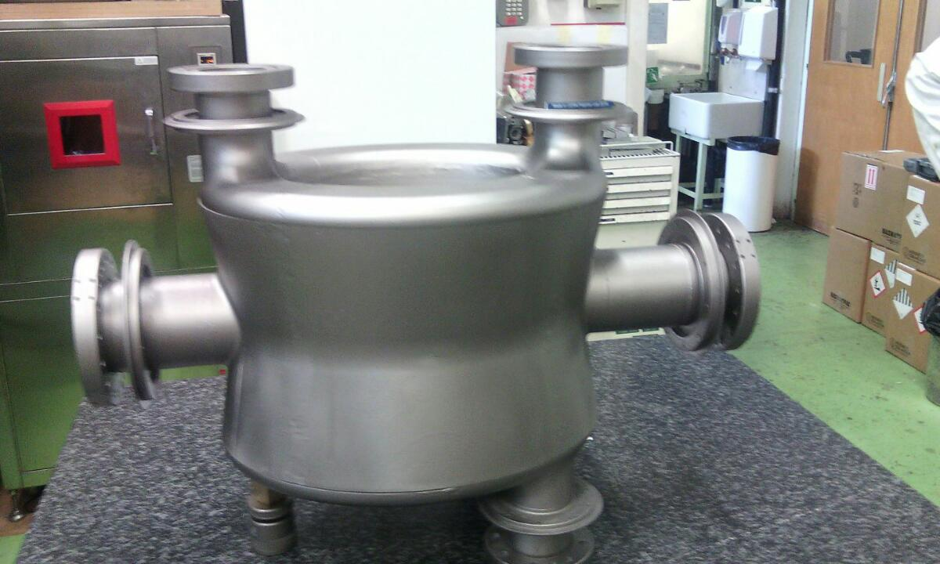
The CRAB cavity R&D
1st bulk Nb CRAB cavity for HL-LHC completed and under test in SPS
0.66 m

Slide 10
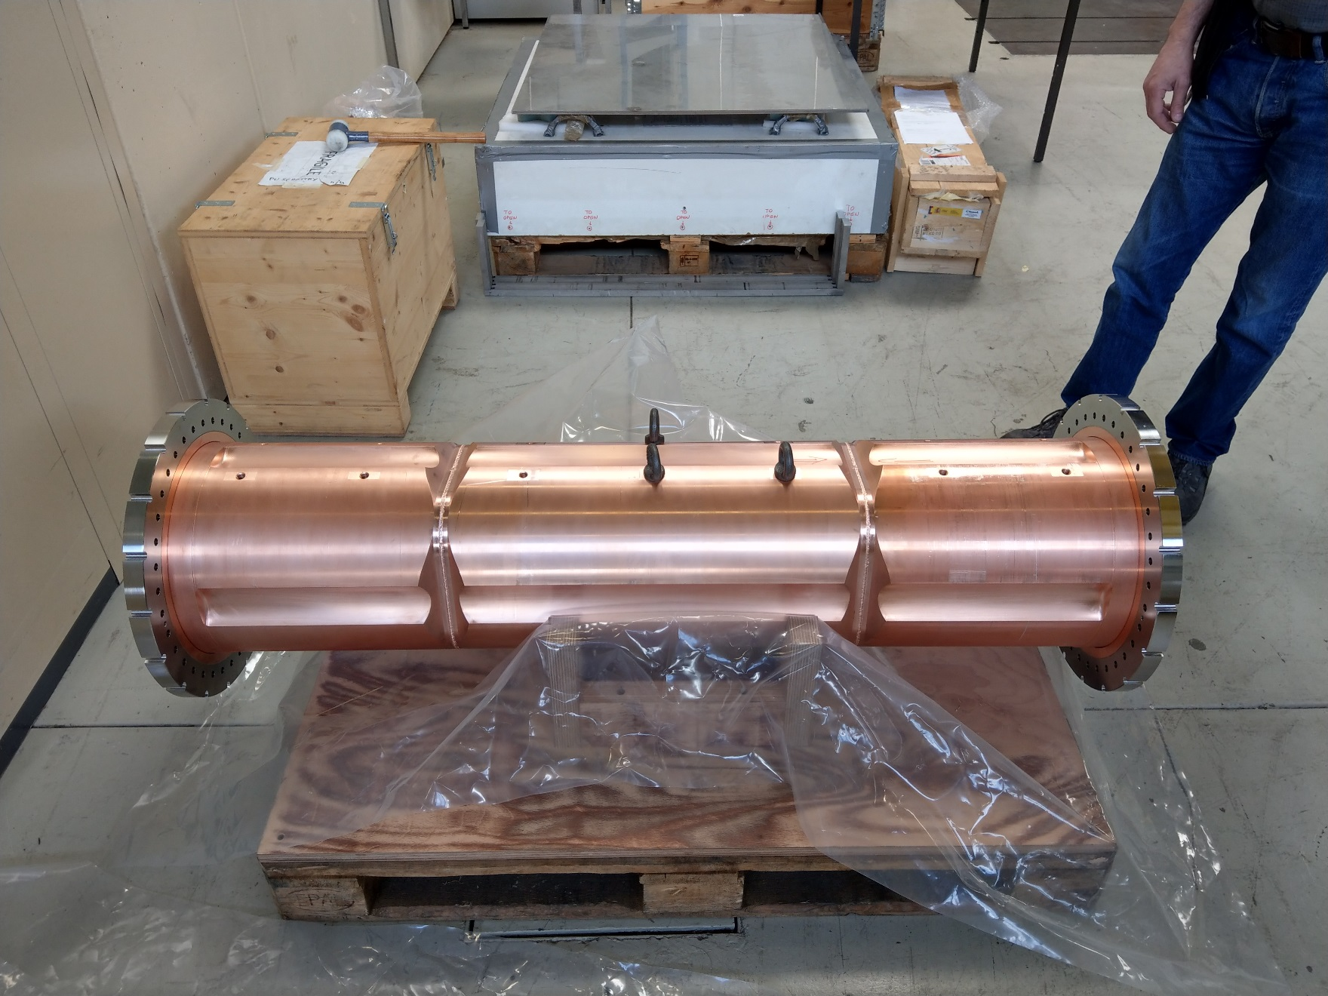
The CRAB cavity R&D
1st bulk Nb CRAB cavity for HL-LHC completed and under test in SPS
R&D in the FCC framework for alternative Nb/Cu WOW CRAB cavities
1st Cu WOW CRAB cavity prototype to be Nb coated
1.4 m
290 kg

Slide 11
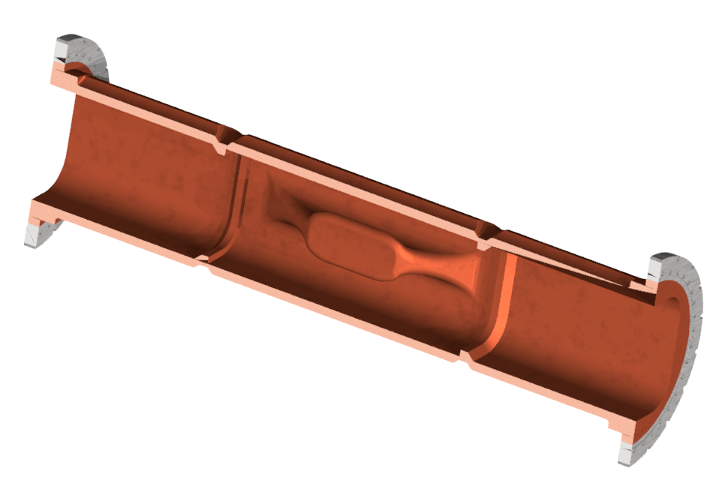
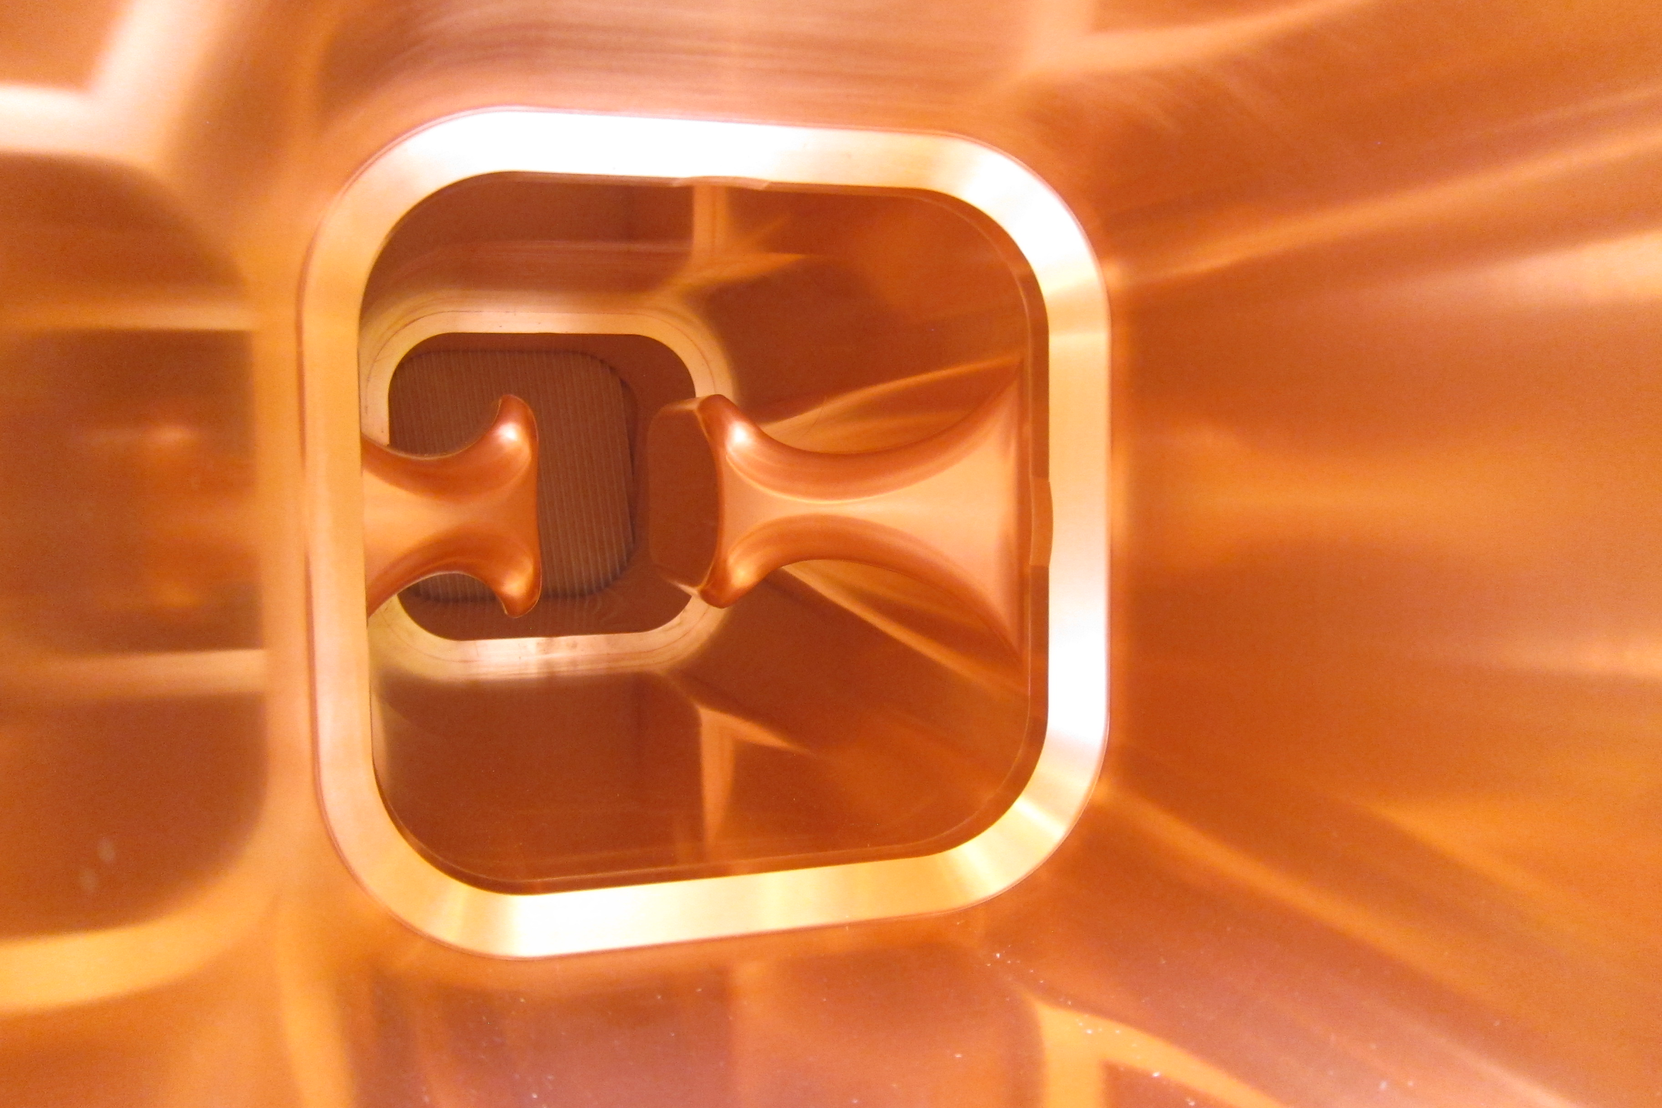
The CRAB Cu cavity
CHALLENGES:
Superconducting cavities require high purity and defect-free coatings
Complex shape: avoid shadowing / uniform growth

Slide 12
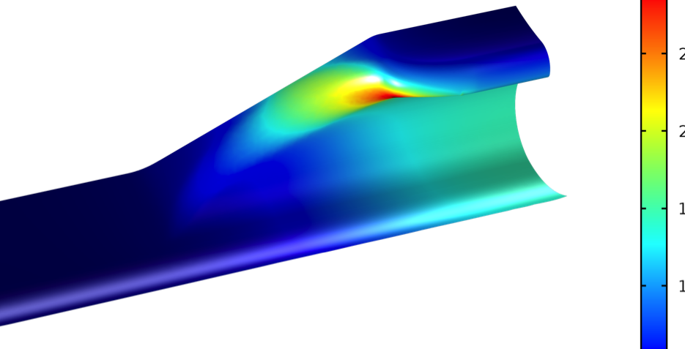
The CRAB Cu cavity
CHALLENGES:
Superconducting cavities require high purity and defect-free coatings
Complex shape: avoid shadowing / uniform growth
Dissipated P_{surf} [W/m²]
Total power loss ~ 60W
@ Q₀ = 4x10⁸ / 3 MV deflection

Slide 13
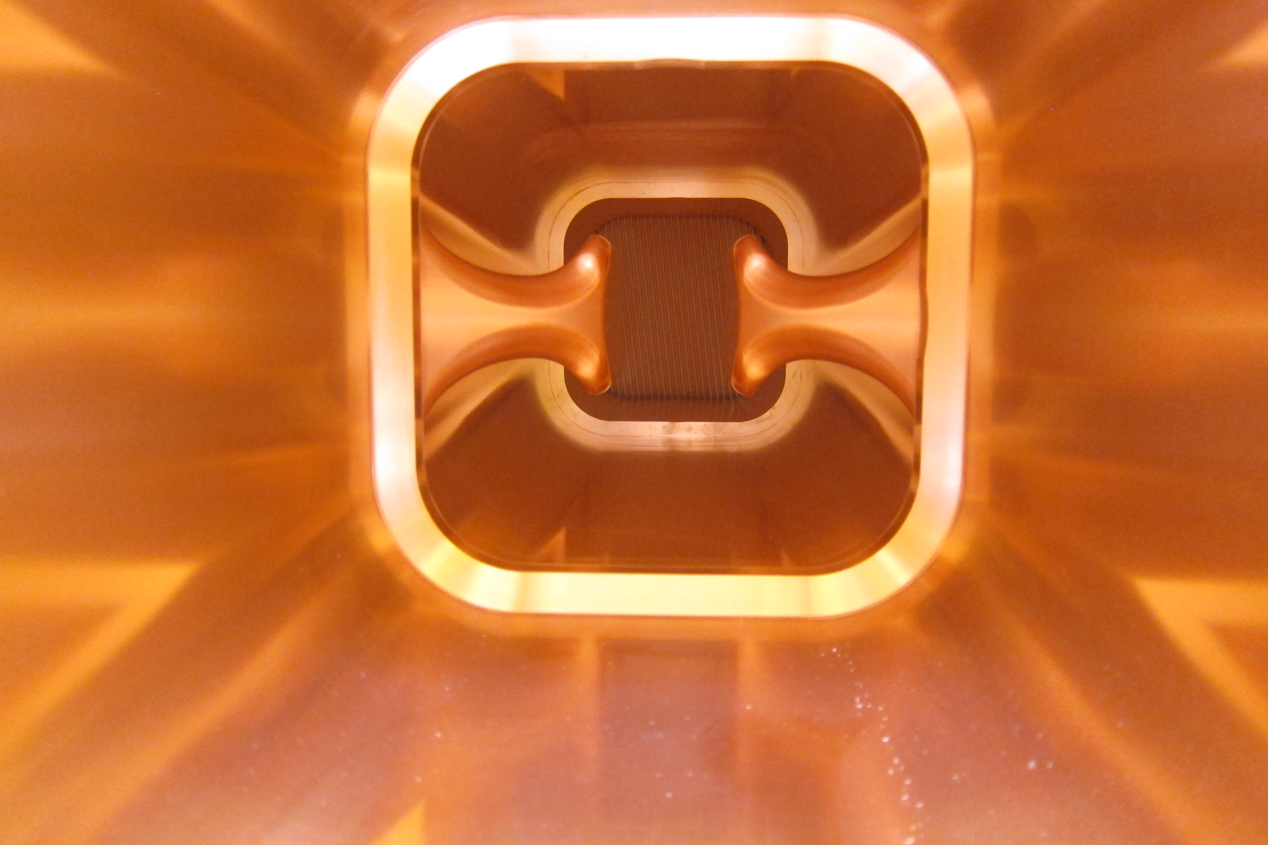
CRAB cavity coating challenge

Slide 14
CRAB cavity coating challenge
Cylindrical sputtering source

Slide 15
CRAB cavity coating challenge
Cylindrical sputtering source
Coating surfaces at different:
distances (50 – 150 mm)

Slide 16
CRAB cavity coating challenge
Cylindrical sputtering source
Coating surfaces at different:
distances (50 – 150 mm)
incident angles (0 – 90 °)

Slide 17
CRAB cavity coating challenge
Cylindrical sputtering source
Coating surfaces at different:
distances (50 – 150 mm)
incident angles (0 – 90 °)

Slide 18
CRAB cavity coating challenge
Cylindrical sputtering source
Coating surfaces at different:
distances (50 – 150 mm)
incident angles (0 – 90 °)

Slide 19
From R&D to scale-1 cavity
Basic tests in a R&D experimental setup:
Basic plasma physics in HiPIMS
Optimization of HiPIMS parameters

Slide 20
From R&D to scale-1 cavity
Basic tests in a R&D experimental setup:
Basic plasma physics in HiPIMS
Optimization of HiPIMS parameters
Coating of samples reproducing cavity shape
Coating of copper strips with the CRAB cavity shape
Parallel implementation of plasma diagnostics
New sputtering source development

Slide 21
From R&D to scale-1 cavity
Basic tests in a R&D experimental setup:
Basic plasma physics in HiPIMS
Optimization of HiPIMS parameters
Coating of samples reproducing cavity shape
Coating of the first scale-1 cavity prototype
Coating of copper strips with the CRAB cavity shape
Parallel implementation of plasma diagnostics
New sputtering source development

Slide 22
From R&D to scale-1 cavity
Basic tests in a R&D experimental setup:
Basic plasma physics in HiPIMS
Optimization of HiPIMS parameters
Coating of samples reproducing cavity shape
Coating of the first scale-1 cavity prototype
Coating of copper strips with the CRAB cavity shape
Parallel implementation of plasma diagnostics
New sputtering source development

Slide 23
Outline
Framework
R&D simulations
R&D experiments
Next steps
Conclusions

Slide 24
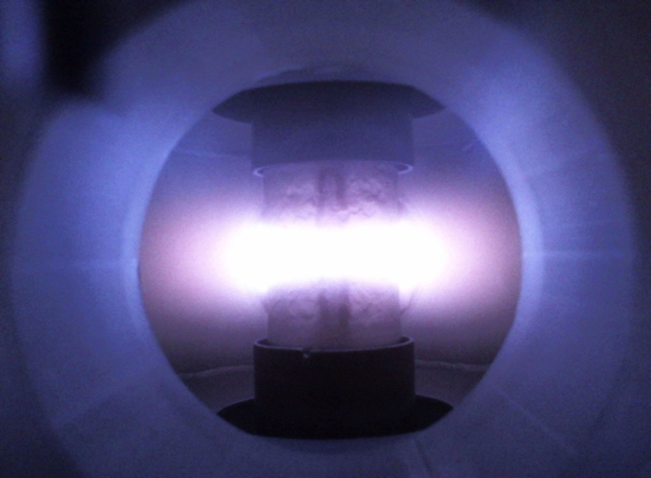
Plasma simulation of 60 mm long cylindrical cathode
Experiment
P = 5.10⁻³ mbar / Ar / 1kW / DCMS
60 mm
cathode
Side view of the cylndrical cathode (permanent magnet inside)

Slide 25
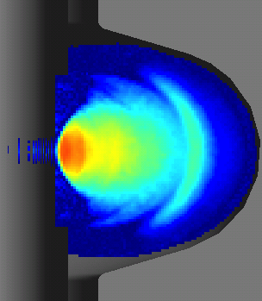
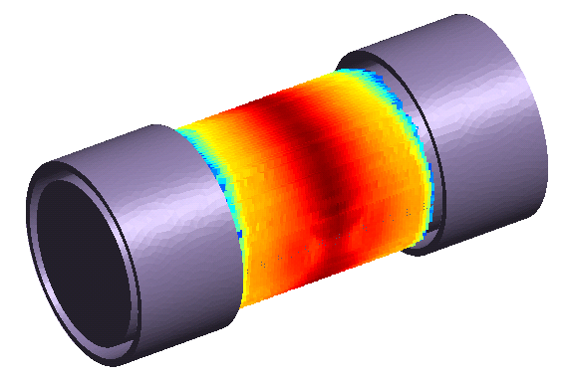
Plasma simulation of 60 mm long cylindrical cathode
Experiment
P = 5.10⁻³ mbar / Ar / 1kW / DCMS
Plasma simulation
P = 5.10⁻³ mbar / Ar / 10W / DCMS
Output: Nb sputtering profile
60 mm
cathode
N
S
Side view of the cylndrical cathode (permanent magnet inside)

Slide 26
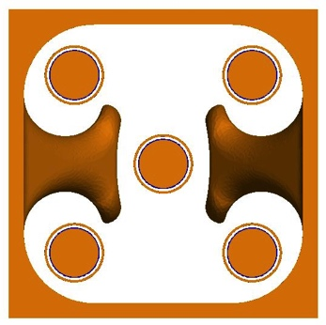
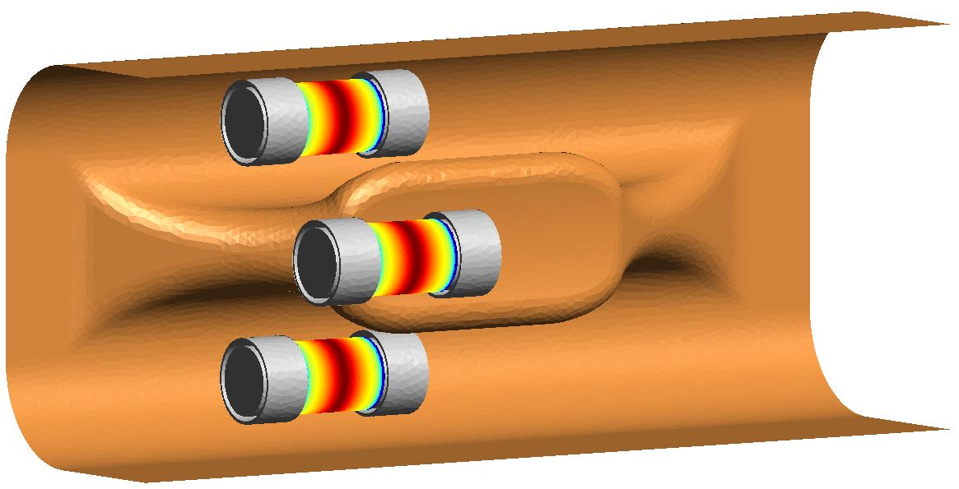
Plasma simulation of 60 mm long cylindrical cathode
Experiment
P = 5.10⁻³ mbar / Ar / 1kW / DCMS
Plasma simulation
P = 5.10⁻³ mbar / Ar / 10W / DCMS
Output: Nb sputtering profile
x5 cathodes in WOW
60 mm
cathode
N
S
Side view of the cylndrical cathode (permanent magnet inside)

Slide 27
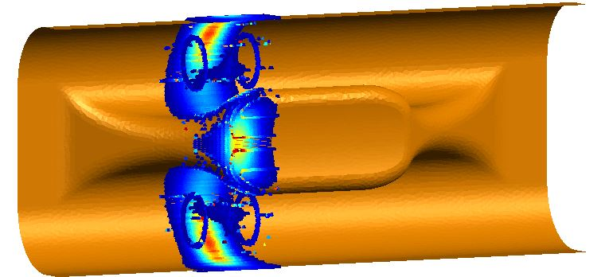
Transport simulation and thickness profile
Nb thickness profile, scaled to an equivalent 15’ coating at 1kW/cathode

Slide 28
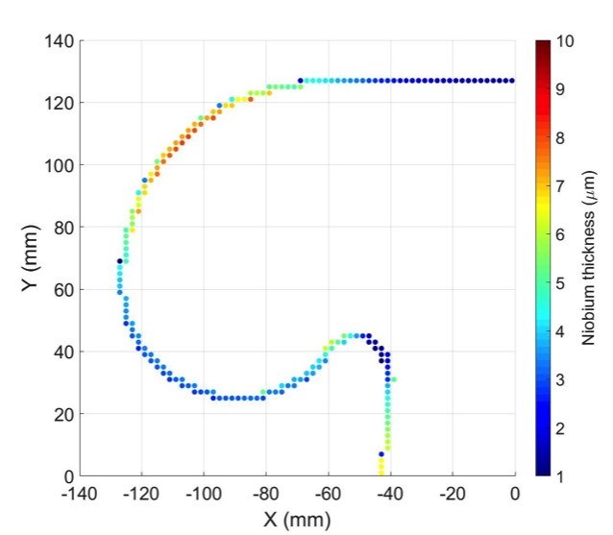
Transport simulation and thickness profile
Nb thickness profile, scaled to an equivalent 15’ coating at 1kW/cathode

Slide 29
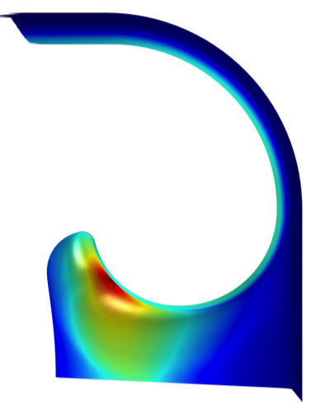
Transport simulation and thickness profile
Dissipated P_{surf} [W/m²]
Nb thickness profile, scaled to an equivalent 15’ coating at 1kW/cathode
Uniformity copes with peak power density position → layer morphology?
Could HiPIMS ?

Slide 30
Outline
Framework
R&D simulations
R&D experiments
Next steps
Conclusions

Slide 31
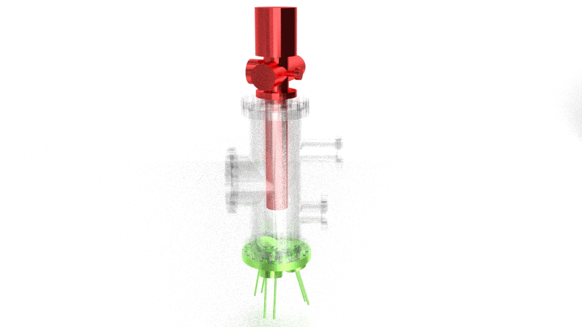
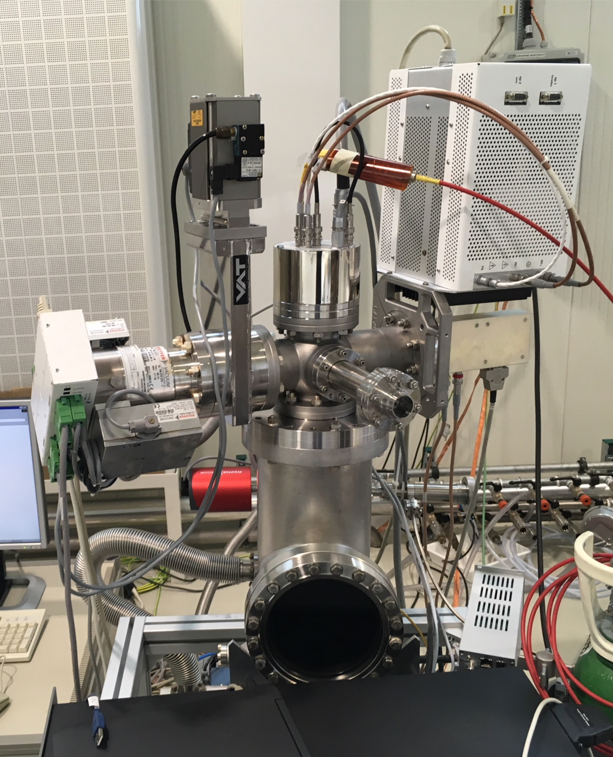
R&D experimental setup
43 cm high DN150 vacuum chamber

Slide 32
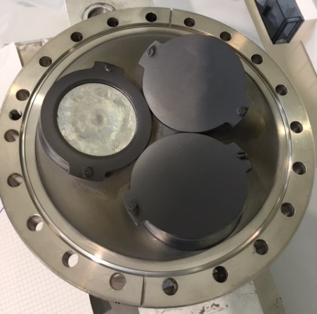
R&D experimental setup
43 cm high DN150 vacuum chamber
2’’ magnetron source, 15° tilted

Slide 33
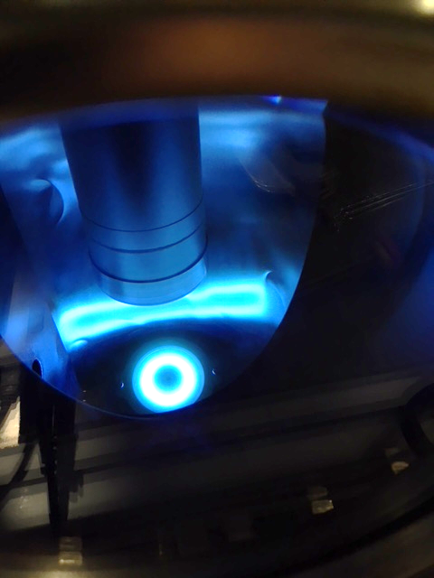
R&D experimental setup
43 cm high DN150 vacuum chamber
2’’ magnetron source, 15° tilted
Mass and energy analyser (MEA):
time integrated + time resolved measurements of ion fluxes

Slide 34
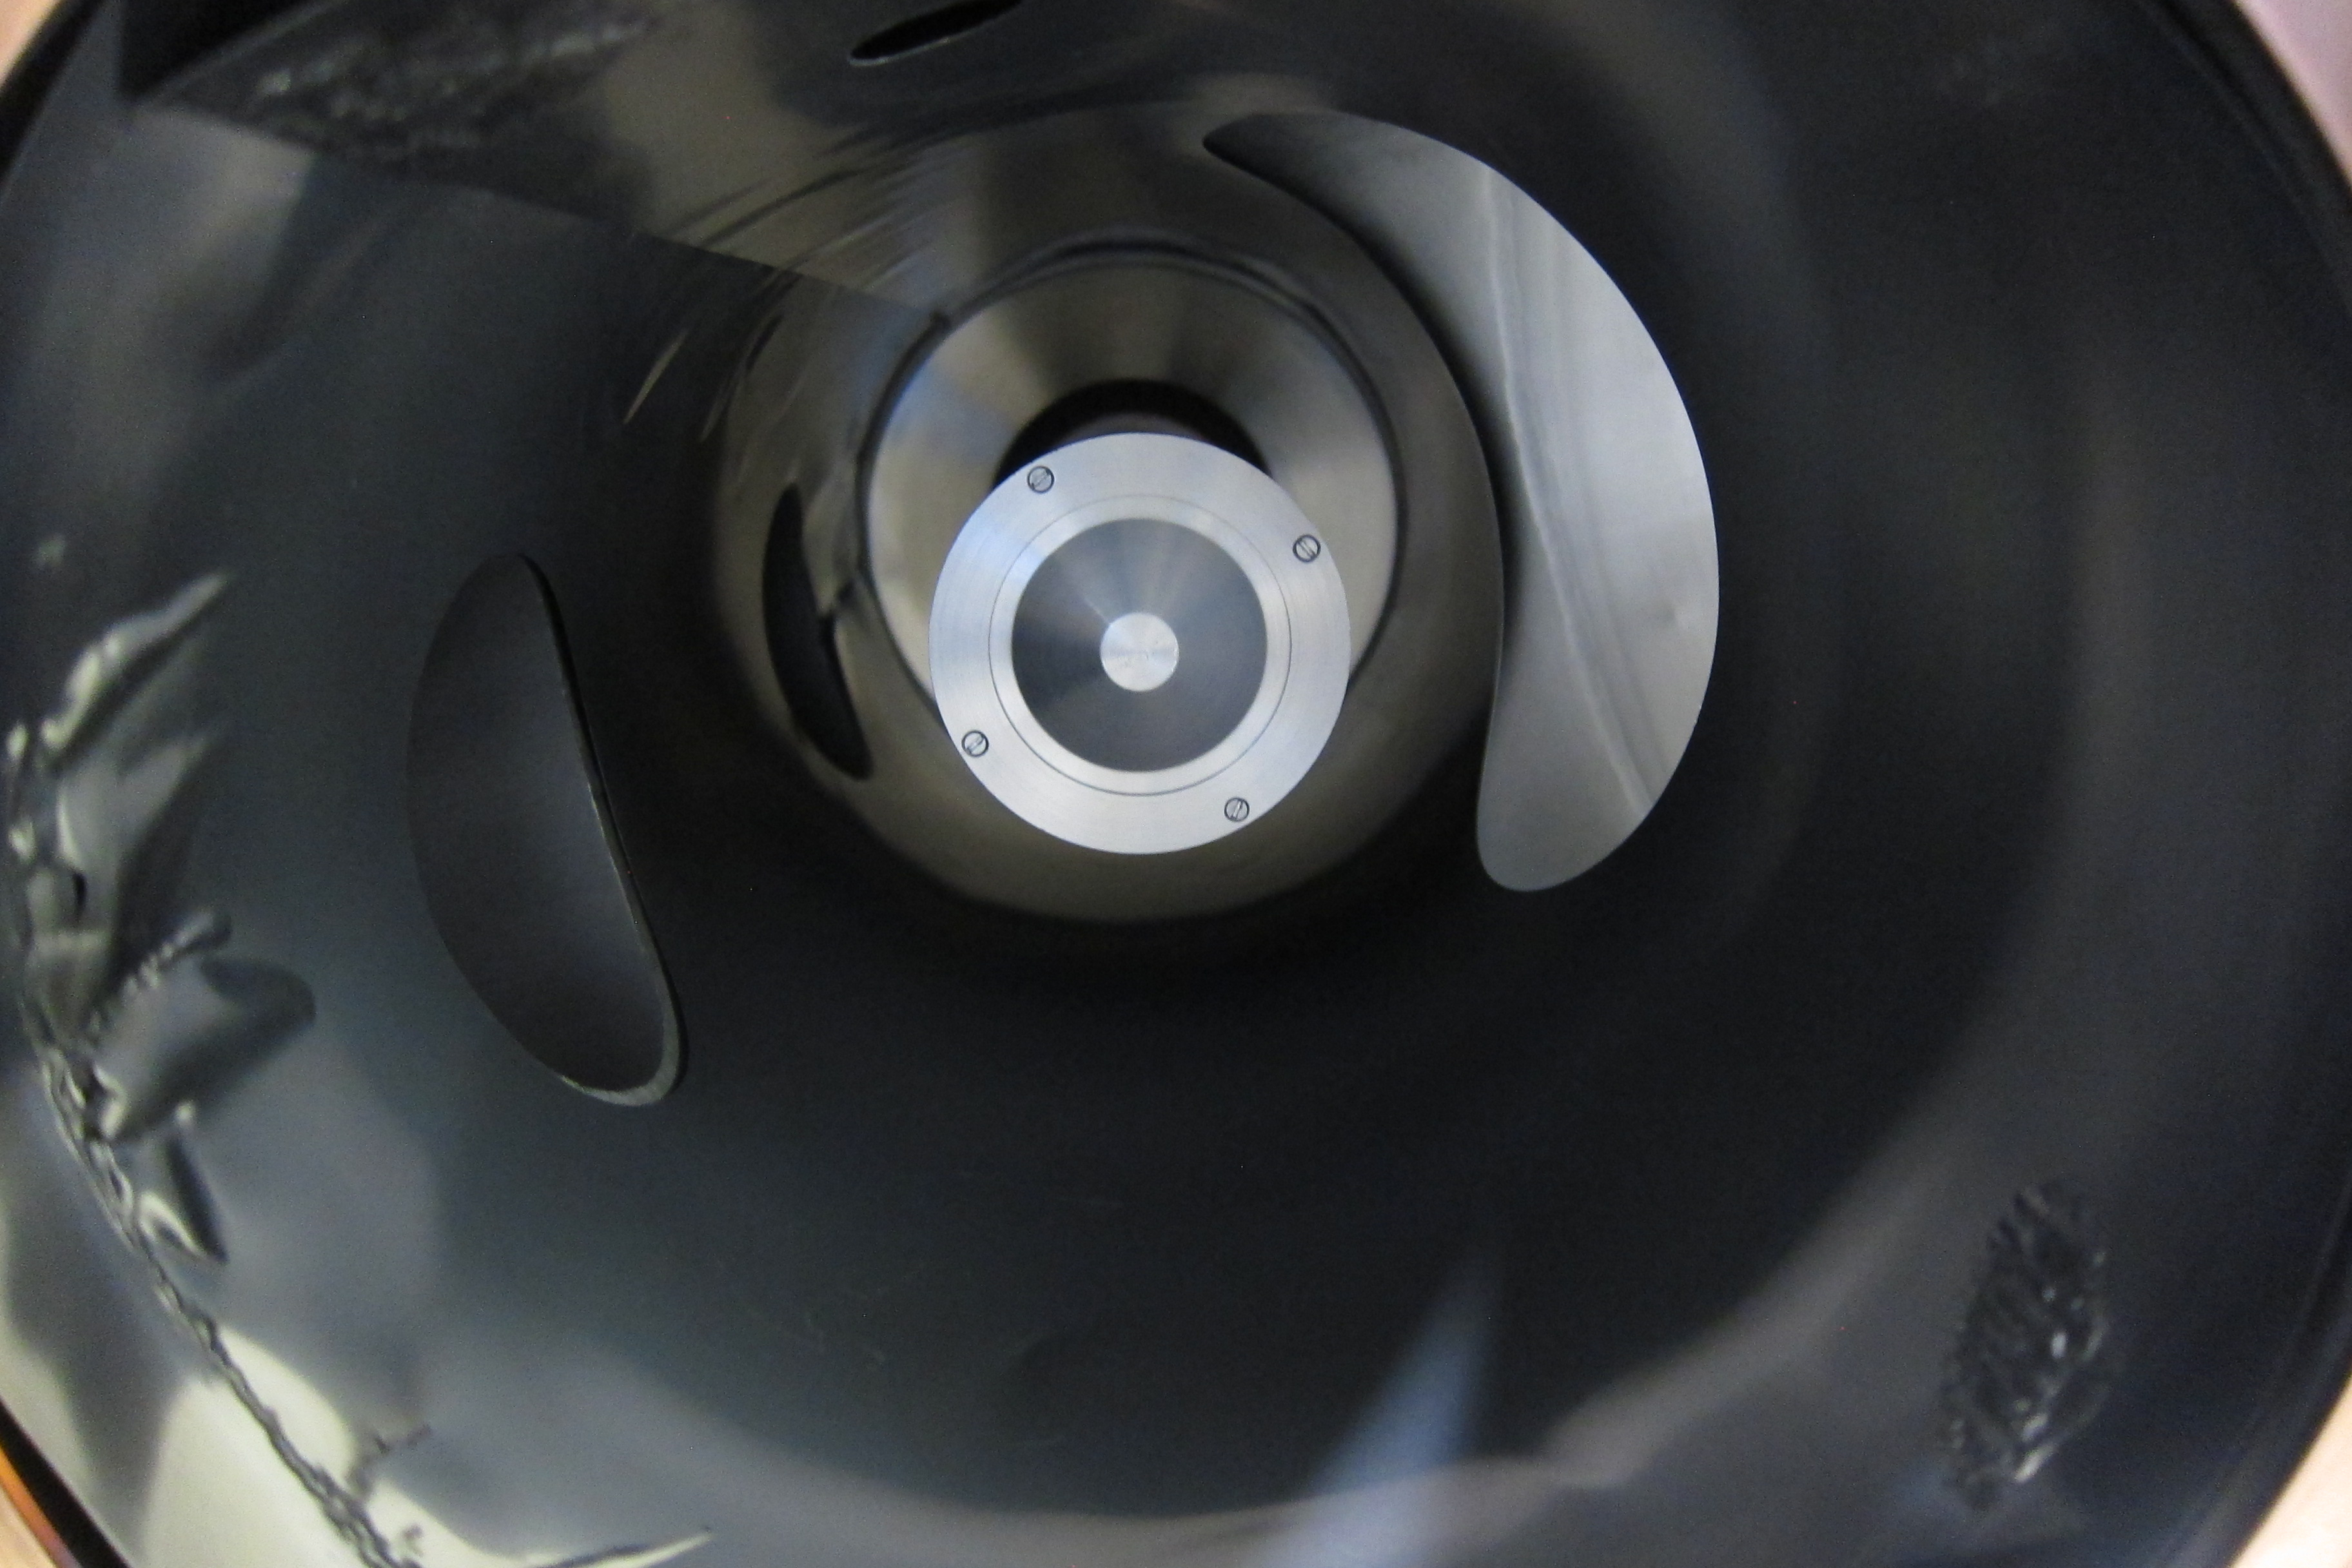
Samples and holder
View from bottom of the MEA entrance orifice

Slide 35
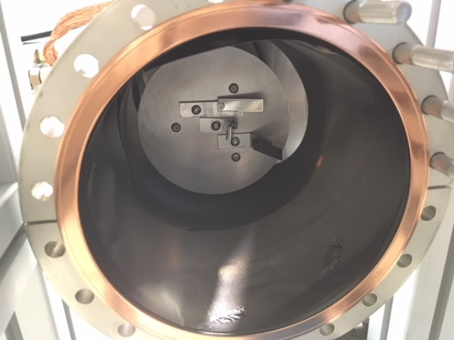
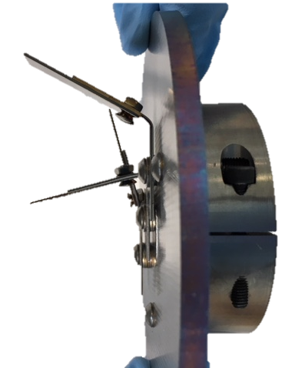
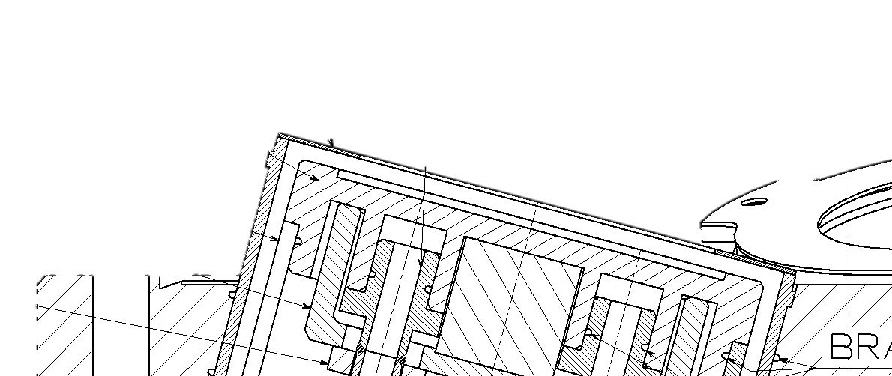
Samples and holder
View from bottom with sample holder
0°
sample
90°
sample
~ 14.5 cm
2’’ Nb target

Slide 36
Samples and holder
View from bottom with sample holder
0°
sample
90°
sample
~ 14.5 cm
FIB cut
15 mm
10 mm
5 mm
20 mm
2’’ Nb target

Slide 37
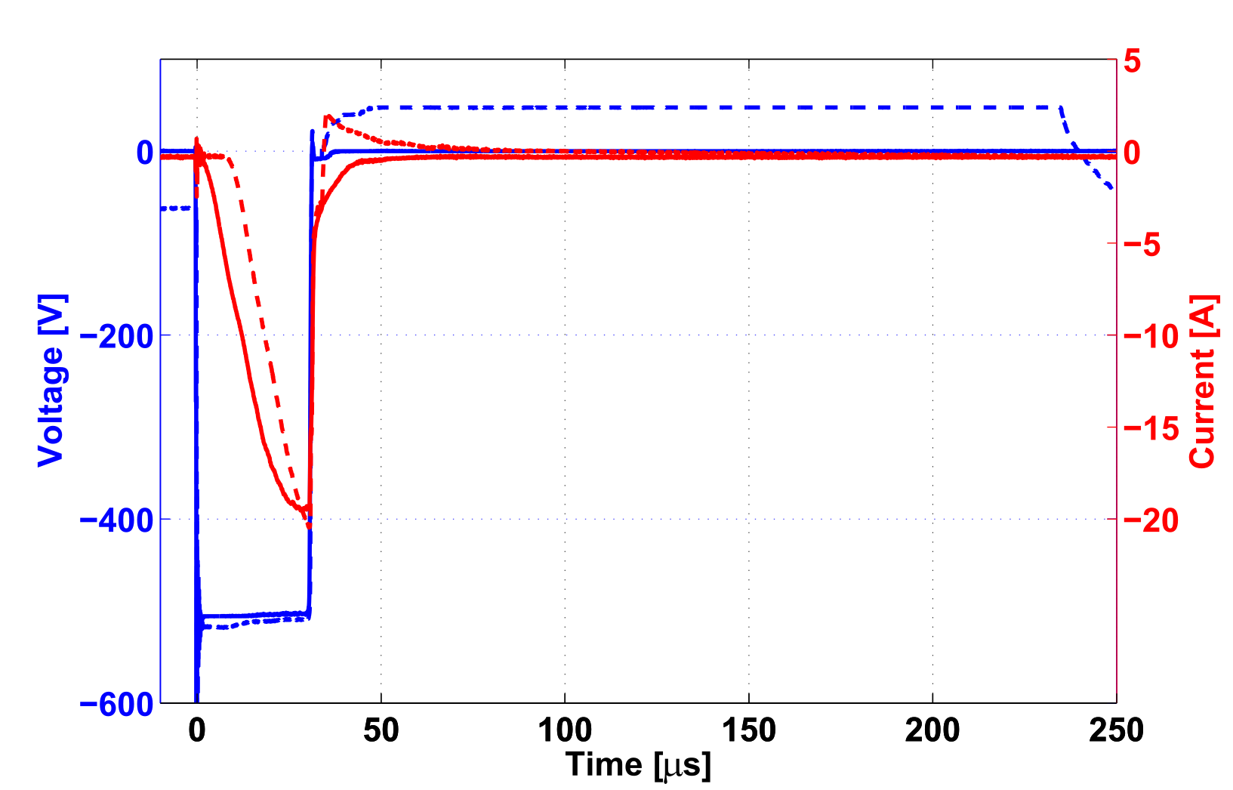
HiPIMS configurations
Duty cycle : 1 kHz
Main pulse (MP) : 30 μs
+50V PP
0V PP
MP
+50 V
~20 A
-550 V

Slide 38
HiPIMS configurations
Duty cycle : 1 kHz
Main pulse (MP) : 30 μs
Delay (D) : 4 μs
+50V PP
0V PP
MP
D
+50 V
~20 A
-550 V

Slide 39
HiPIMS configurations
Duty cycle : 1 kHz
Main pulse (MP) : 30 μs
Delay (D) : 4 μs
PP duration (PP) : 20 – 250 μs
+50V PP
no PP
MP
D
PP
+50 V
~20 A
-550 V

Slide 40
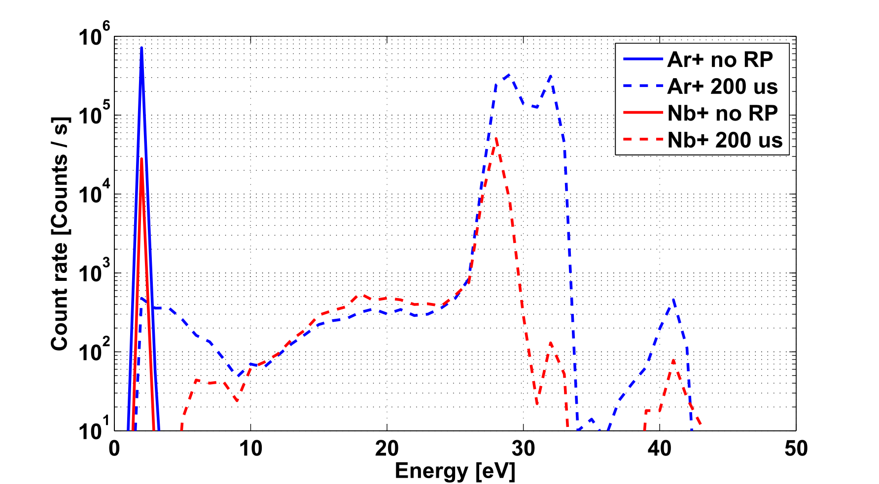
Time-integrated IEDF
By using the MEA
PP
PP

Slide 41
Time-integrated IEDF
By using the MEA
PP
PP
Evidence of a dominant high energy ion population!

Slide 42
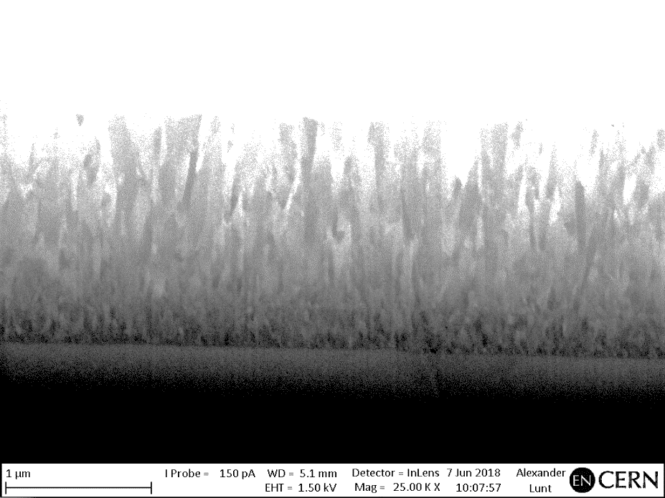
FIB on DCMS coatings
Experimental parameters:
Argon pressure : 8x10⁻³ mbar
Niobium target
Power : 250 W (1.5 hours)
DCMS with grounded substrate
DCMS with -50V bias on substrate
0°
90°

Slide 43
FIB on HiPIMS coatings
HiPIMS, no PP, grounded substrate
0°
90°

Slide 44
FIB on HiPIMS coatings
HiPIMS, no PP, grounded substrate
b) HiPIMS, no PP,
-50 V bias on substrate
0°
90°

Slide 45
FIB on HiPIMS coatings
HiPIMS, no PP, grounded substrate
b) HiPIMS, no PP,
-50 V bias on substrate
c) HiPIMS, +50 V PP,
grounded substrate
0°
90°
Biased-like effect with a positive pulse! 90° sample gets densified with 200 μs positive pulse at +50V

Slide 46
Outline
Framework
R&D simulations
R&D experiments
Next steps
Conclusions

Slide 47
From R&D to scale-1 cavity
Basic tests in a R&D experimental setup:
Basic plasma physics in HiPIMS
Optimization of HiPIMS parameters
Coating of samples reproducing cavity shape
Coating of the first scale-1 cavity prototype
Coating of copper strips with the CRAB cavity shape
Parallel implementation of plasma diagnostics
New sputtering source development

Slide 48
From R&D to scale-1 cavity
Basic tests in a R&D experimental setup:
Basic plasma physics in HiPIMS
Optimization of HiPIMS parameters
Coating of samples reproducing cavity shape
Coating of the first scale-1 cavity prototype
Coating of copper strips with the CRAB cavity shape
Parallel implementation of plasma diagnostics
New sputtering source development

Slide 49
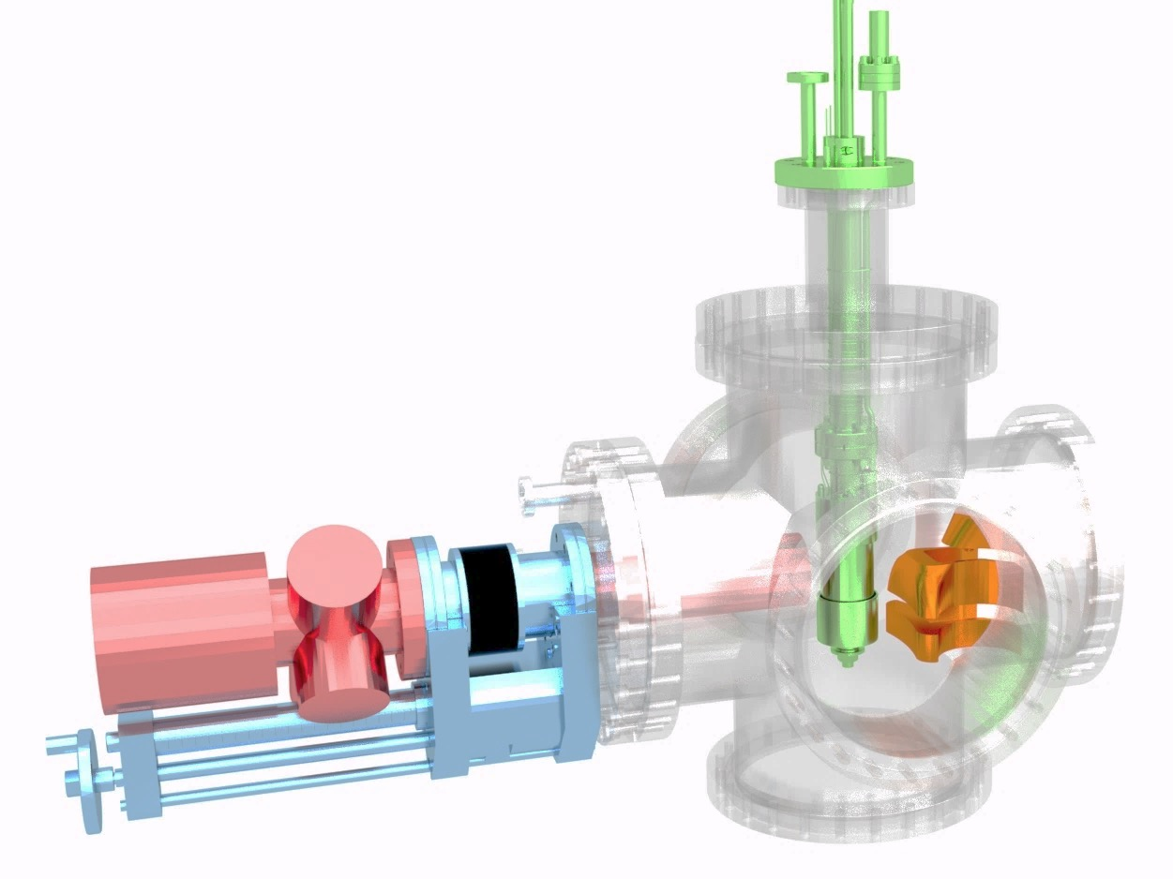
Validation of coating setup with mockup samples
Sputtering
source
Mass & Energy Analyser
200 mm stroke
bellow
Time- and spatially-resolved (substrate-cathode distance) IEDF measurements
Deposition on samples reproducing the CRAB cavity shape
Assess layer uniformity and SC properties with different coating configurations

Slide 50
Validation of coating setup with mockup samples
Sputtering
source
Mass & Energy Analyser
WOW-mockup
samples
200 mm stroke
bellow
Time- and spatially-resolved (substrate-cathode distance) IEDF measurements
Deposition on samples reproducing the CRAB cavity shape
Assess layer uniformity and SC properties with different coating configurations

Slide 51
Conclusions
First indication of coating uniformity with simulations in DCMS
Measured mass-, energy-resolved ion fluxes (Ar⁺, Nb⁺) Evidence of a dominant high energy ion population with positive pulse

Slide 52
Conclusions
First indication of coating uniformity with simulations in DCMS
Measured mass-, energy-resolved ion fluxes (Ar⁺, Nb⁺) Evidence of a dominant high energy ion population with positive pulse
Performed sample coatings in different HiPIMS configurations:
FIB analysis indicates a biased-like effect with a positive pulse! 90° sample gets densified with 200 μs, +50V positive pulse

Slide 53
Backup Slides

Slide 54
Process | Sample | XRF [μm] | FIB [μm] | Dr [nm/min]
DCMS (1.5 h / 250W) | 0° | 1.5 | 1.6 | 17.8
 | 90° | 0.5 | 1 | 11.1
DCMS and -50V bias on samples (1.5h / 250W) | 0° | 1.9 | 1.93 | 21.4
 | 90° | 0.6 | 1.3 | 5.4
HiPIMS 30 μs pulse (4h / 250W) | 0° | 2.1 | 2.1 | 8.8
 | 90° | 0.7 | 1.3 | 5.4
HiPIMS 30 μs pulse and -50 V bias on samples (4h / 250W) | 0° | 2 | 2 | 8.3
 | 90° | 0.7 | 0.8 | 3.3
HiPIMS 38 μs pulse and +50V / 200 μs reverse kick (4h / 250W) | 0° | 2 | 2.2 | 9.2
 | 90° | 0.67 | 0.8 | 3.3

Slide 55
FIB on HiPIMS coatings
HiPIMS (grounded substrate)
b) HiPIMS with -50 V bias on substrate
c) HiPIMS with +100 V positive pulse
(grounded substrate)
0°
90°

Slide 56
FIB on HiPIMS coatings
HiPIMS (grounded substrate)
b) HiPIMS with -50 V bias on substrate
c) HiPIMS with +100 V positive pulse
(grounded substrate)
0°
90°

Slide 57
FIB on HiPIMS coatings
HiPIMS (grounded substrate)
b) HiPIMS with -50 V bias on substrate
c) HiPIMS with +100 V positive pulse
(grounded substrate)
0°
90°
Biased-like effect with a positive pulse! 90° sample gets densified with 200 μs, +100V positive pulse

Slide 58
30us MP – 4us D – 200us RK 100V

Slide 59
How to measure time-resolved ion fluxes
CP400
Ion counter
ECL-TTL
converter
Multi-channel
Scaler MCS4
Time-resolved
Measurements:
50ns dwell time
PPM422
acquisition
Time-Integrated
Measurements

Slide 60
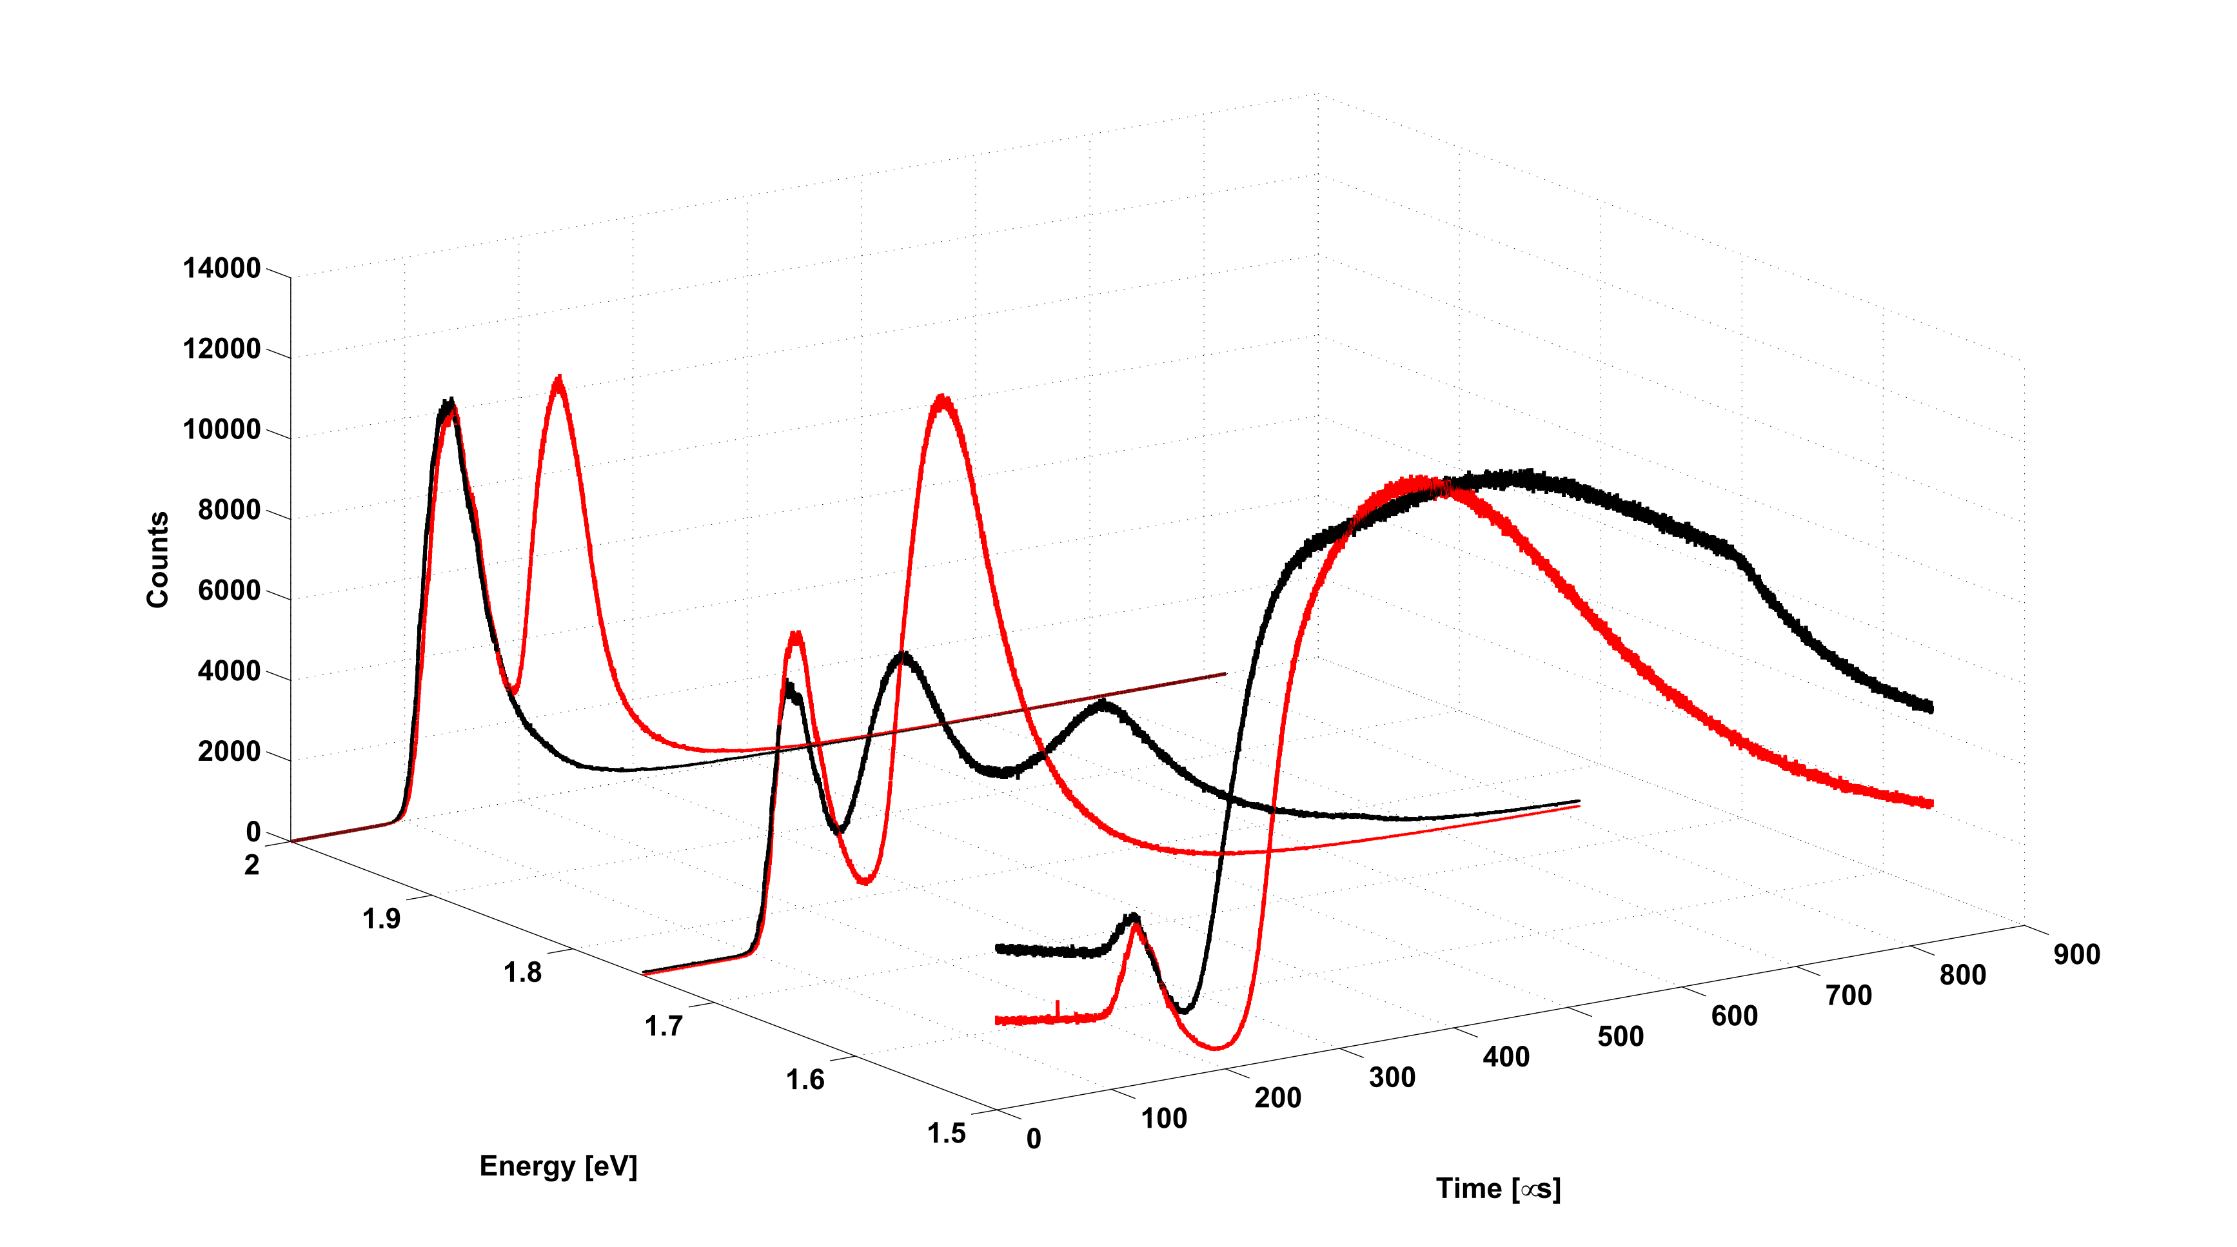
Time-resolved Ar⁺ fluxes
30 μs MP
30 μs MP – 25 μs D – 35 μs RK

