Slide 1
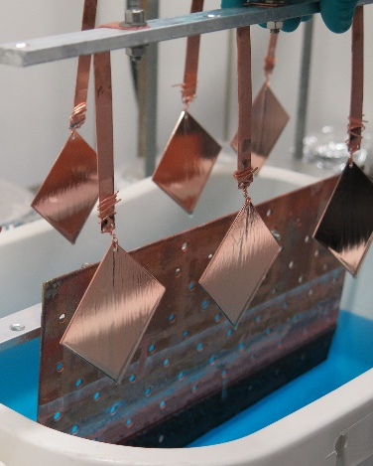




Evaluation of the
Copper Polishing procedures in the framework of ARIES H2020 Collaboration
This project has received funding from the European Union’s Horizon 2020 Research and Innovation programme under Grant Agreement No 730871.
C. Pira, C. Antoine, E. Chyhyrynets, A. Katashev, O. Kugeler, O. Malyshev, A. Medvids, V. Palmieri, E. Seiler, F. Stivanello, A. Sublet, R. Valizadeh, M. Vogel

Slide 2
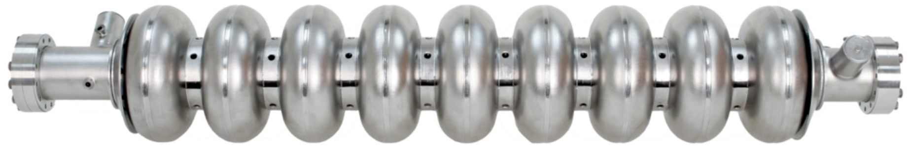
Importance of Surface Treatments in SRF
Used to remove the surface damaged layer, due to cavity fabrication methods
To get high gradient E_{acc} > 30 MV/m → surface roughness < 2 µm
Saito K., Proceedings of the 2003 Workshop on RF Superconductivity, Paris, France

Slide 3
Importance of Surface Treatments in SRF
On Nb-Cu cavities the thin film is not chemical treated
Different polishing treatments of Cu are used
Morphology of Cu surface is replicated by the Nb film
Direct correlation between Cu surface preparation and Nb films SC performances

Slide 4
Cu Treatments in Accelerator Cavities
LEP → Chemical Polishing (SUBU5)
Benvenuti et al., Proceedings of the 1987 Workshop on RF Superconductivity, Argonne National Laboratories, Illinois, USA
ALPI → Tumbling + ElectroPolishing + SUBU5
Palmieri et al., Proceedings of the 1997 Workshop on RF Superconductivity, Abano Terme (Padova), Italy
LHC → ElectroPolishing + SUBU5
Calatroni et al., Proceedings of the 1999 Workshop on RF Superconductivity, La Fonda Hotel, Santa Fe, New Mexico, USA
HIE Isolde → SUBU5
Venturini et al., Proceedings of the 2003 Workshop on RF Superconductivity, Paris, France

Slide 5
ARIES Surface polishing treatments

Slide 6

Workflow of the experiment
OFE COPPER SHEET
CUTTING

Slide 7


Workflow of the experiment
SUBU
SUBU
OFE COPPER SHEET
EP
EP + SUBU
TUMBLING
LASER
Cutting
Cu Polishing

Slide 8
Workflow of the experiment
SUBU
SUBU
OFE COPPER SHEET
EP
EP + SUBU
TUMBLING
Talk of Prof. Medvids
today at 15:55
LASER
Cutting
Cu Polishing

Slide 9



Workflow of the experiment
SUBU
SUBU
OFE COPPER SHEET
DC Magnetron Sputtering
EP
EP + SUBU
DC Magnetron Sputtering
TUMBLING
DC Magnetron Sputtering
Cutting
Cu Polishing
Nb Coating

Slide 10
Workflow of the experiment
SUBU
SUBU
OFE COPPER SHEET
DC Magnetron Sputtering
EP
EP + SUBU
DC Magnetron Sputtering
TUMBLING
DC Magnetron Sputtering
Cutting
Cu Polishing
Nb Coating

Slide 11


Workflow of the experiment
SUBU
SUBU
PPMS
OFE COPPER SHEET
DC Magnetron Sputtering
EP
Exoelectrons
EP + SUBU
DC Magnetron Sputtering
TUMBLING
Morphological
characterization
DC Magnetron Sputtering
Cutting
Cu Polishing
Nb Coating
Characterization

Slide 12
Workflow of the experiment
SUBU
SUBU
PPMS
OFE COPPER SHEET
Talk of Dr. Katashev tomorrow at 11:10
DC Magnetron Sputtering
EP
Exoelectrons
EP + SUBU
DC Magnetron Sputtering
TUMBLING
Morphological
characterization
DC Magnetron Sputtering
Cutting
Cu Polishing
Nb Coating
Characterization

Slide 13
Workflow of the experiment
SUBU
SUBU
PPMS
OFE COPPER SHEET
DC Magnetron Sputtering
EP
EP + SUBU
DC Magnetron Sputtering
TUMBLING
Morphological
characterization
DC Magnetron Sputtering
Cutting
Cu Polishing
Nb Coating
Characterization

Slide 14
Workflow of the experiment
OFE COPPER SHEET
CUTTING

Slide 15
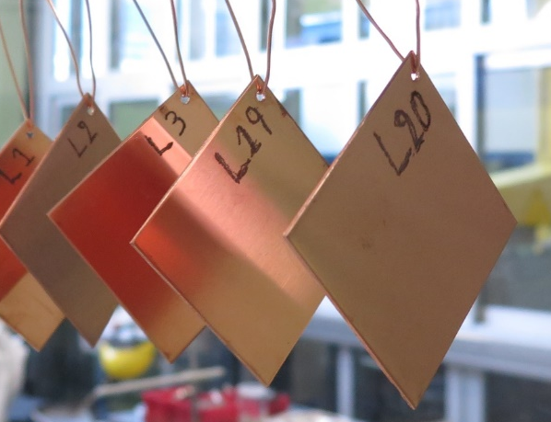
Copper Samples
1 mm thick
50 samples produced from the same sheet of OFE copper at CERN
Dimensions:
53 x 53 mm x 1 mm thick
3 mm hole at one corner (≈ 2,5 mm from edge)
Marked on the back side
CERN Samples: C XX (XX = 01-25)
LNL Samples: L XX (XX = 01-25)
Ø 3 mm
53 mm
53 mm

Slide 16
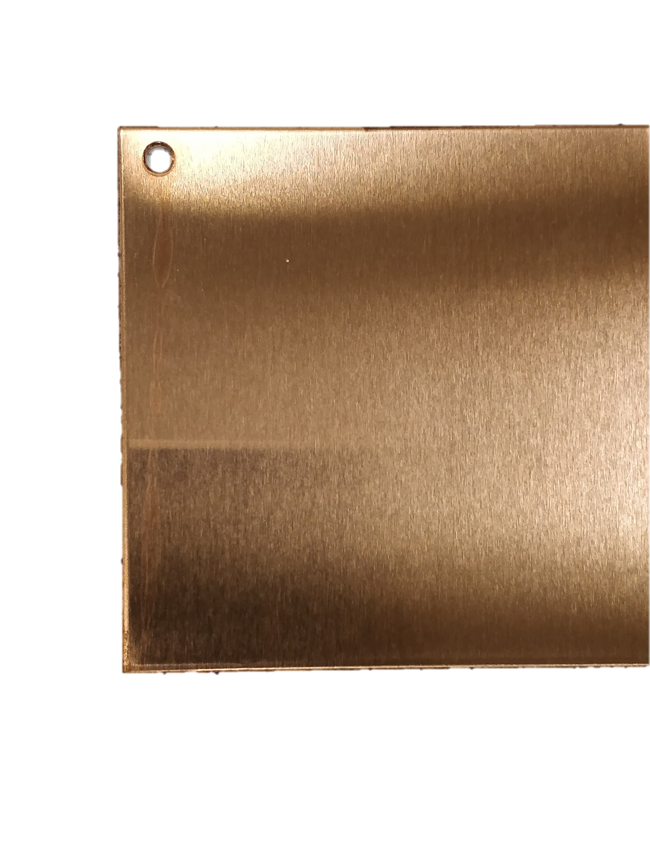
Initial Surface
Rolling texture on the surface

Slide 17
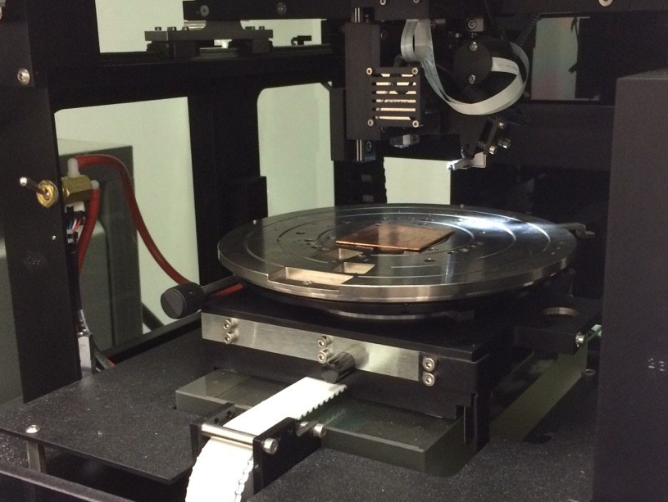
Characterization of the initial surface
Roughness Ra = 130 ± 30 nm (1 mm scan length)
Evaluated with a Veeco Dektat 8 Profilometer

Slide 18
Workflow of the experiment
SUBU
SUBU
OFE COPPER SHEET
EP
EP + SUBU
TUMBLING
Cutting
Cu Polishing

Slide 19
4 Treatments investigated
SUBU (25 samples at CERN + 4 samples at INFN)
Electropolishing (EP) (8 samples at INFN)
EP+ SUBU (5 samples at INFN)
Tumbling (6 samples at INFN)
40 microns removed (except tumbling)

Slide 20
Set Up of the 4 polishing treatments investigated

Slide 21
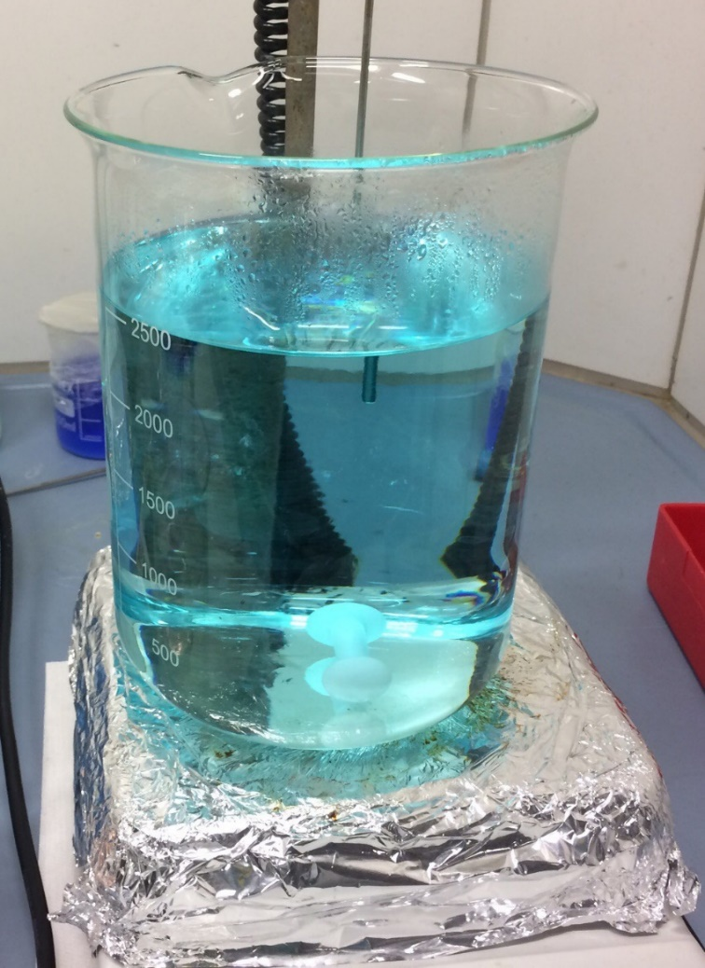
1. Chemical Polishing: SUBU5
Developed for LEP2 at CERN
Working temperature = 72° ± 2
Etching rate: (depends on the surface/solution ratio and aging)
SUBU5 composition
  sulfamic acid (5g/l)
  hydrogen peroxide 32% (50ml/l)
  n-butanol 99% (50ml/l)
  ammonium citrate (1g/l)

Slide 22
1. Chemical Polishing: SUBU5
Developed for LEP2 at CERN
Working temperature = 72° ± 2
Etching rate: (depend on the surface/solution ratio and aging)
SUBU5 composition
  sulfamic acid (5g/l) → corrodes copper forming copper sulfamate
  hydrogen peroxide 32% (50ml/l) → dissolves the copper
  n-butanol 99% (50ml/l) → moderator of the reaction (limits the pitting process on the surface)
  ammonium citrate (1g/l) → limits the bubble production

Slide 23
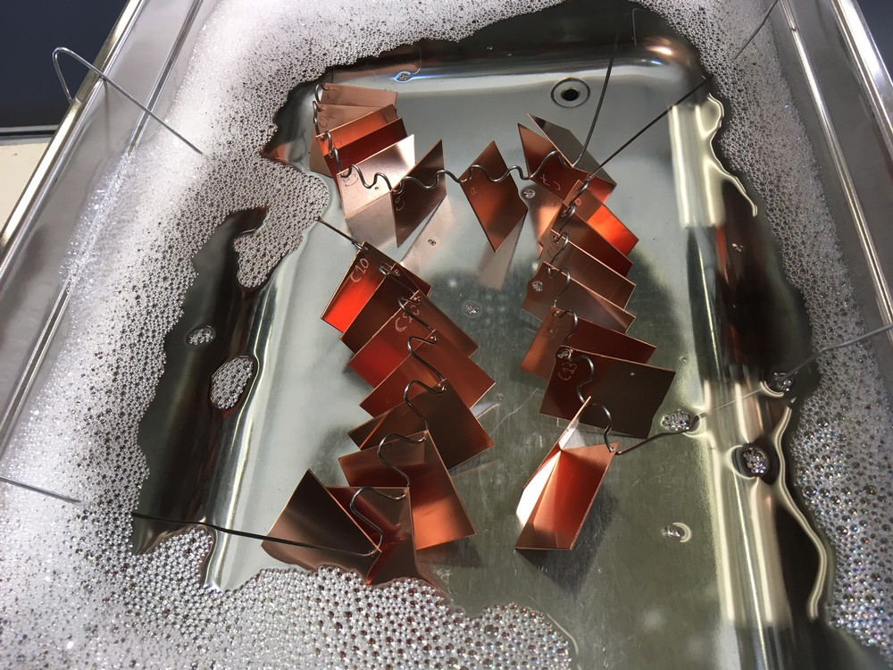
1. SUBU5 Cleaning Procedure
Degreasing: NGL 1740 bath 2 hours → 3' ultra-sonic ON at start and again 3’ min ultra-sonic ON before end
Courtesy of Alban Sublet

Slide 24
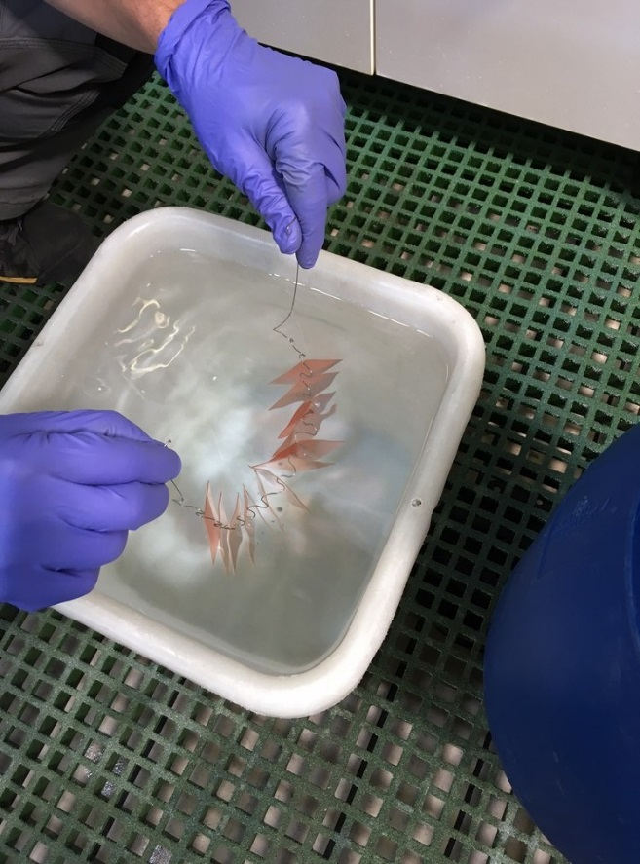
1. SUBU5 Cleaning Procedure
Degreasing: NGL 1740 bath 2 hours → 3' ultra-sonic ON at start and again 3’ min ultra-sonic ON before end
Activation: sulfamic acid (H₃NO₃S, 5 g/l) for about 3'
Courtesy of Alban Sublet

Slide 25
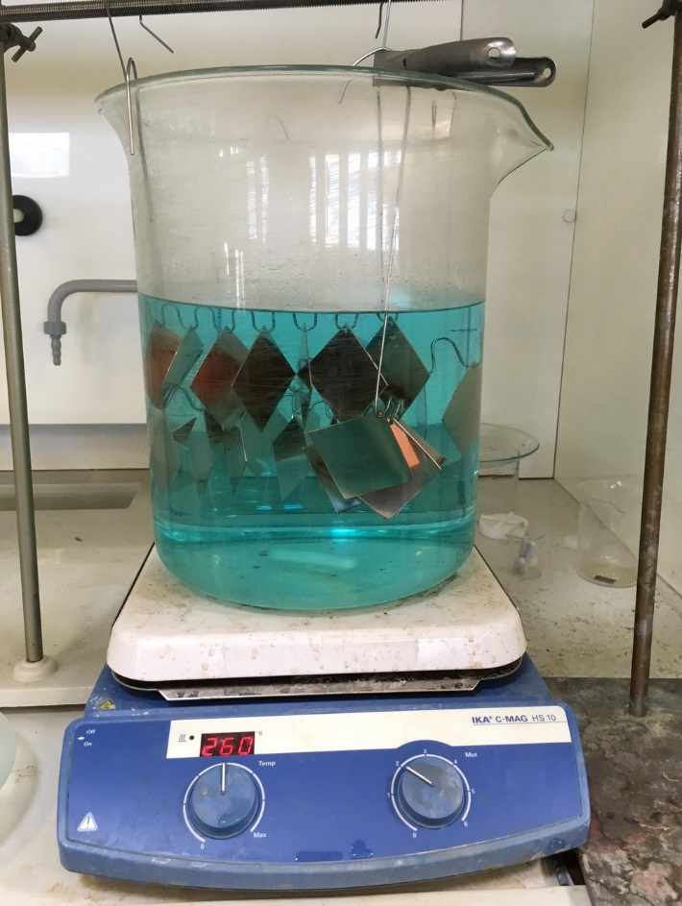
1. SUBU5 Cleaning Procedure
Degreasing: NGL 1740 bath 2 hours → 3' ultra-sonic ON at start and again 3’ min ultra-sonic ON before end
Activation: sulfamic acid (H₃NO₃S, 5 g/l) for about 3'
Polishing: 40' SUBU5 with bath agitation
Courtesy of Alban Sublet

Slide 26
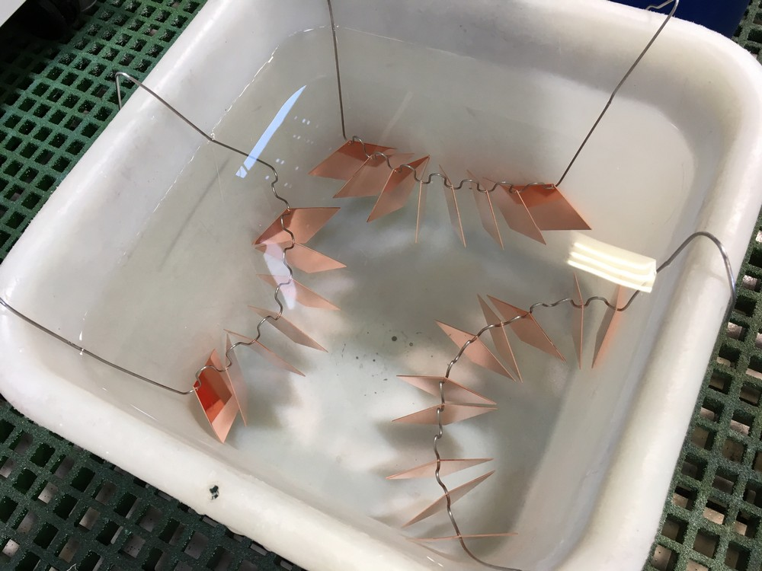
1. SUBU5 Cleaning Procedure
Degreasing: NGL 1740 bath 2 hours → 3' ultra-sonic ON at start and again 3’ min ultra-sonic ON before end
Activation: sulfamic acid (H₃NO₃S, 5 g/l) for about 3'
Polishing: 40' SUBU5 with bath agitation
Passivation: sulfamic acid (H₃NO₃S, 5 g/l) for about 1‘
Courtesy of Alban Sublet

Slide 27
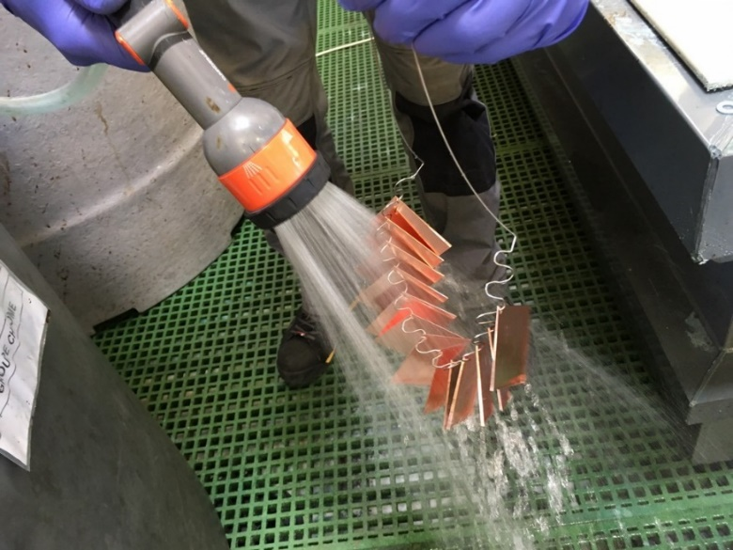
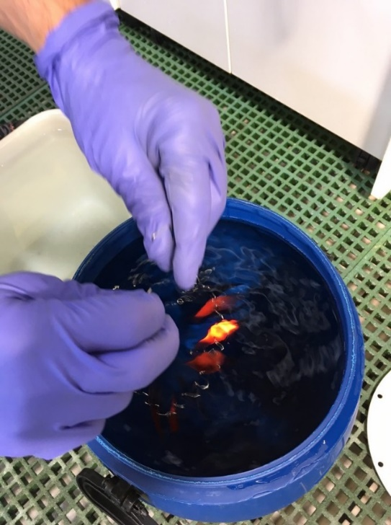
1. SUBU5 Cleaning Procedure
Degreasing: NGL 1740 bath 2 hours → 3' ultra-sonic ON at start and again 3’ min ultra-sonic ON before end
Activation: sulfamic acid (H₃NO₃S, 5 g/l) for about 3'
Polishing: 40' SUBU5 with bath agitation
Passivation: sulfamic acid (H₃NO₃S, 5 g/l) for about 1'
Rinsing with water: demineralized water for about 30s
Courtesy of Alban Sublet

Slide 28
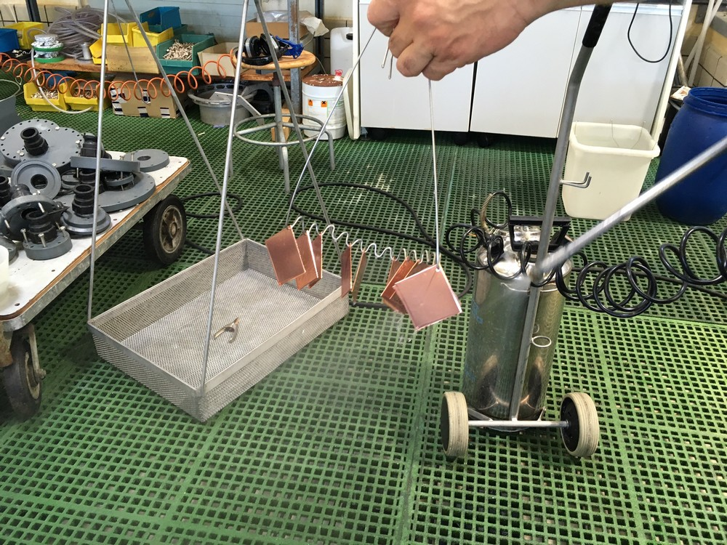
1. SUBU5 Cleaning Procedure
Degreasing: NGL 1740 bath 2 hours → 3' ultra-sonic ON at start and again 3’ min ultra-sonic ON before end
Activation: sulfamic acid (H₃NO₃S, 5 g/l) for about 3'
Polishing: 40' SUBU5 with bath agitation, 5 samples in a 10L beaker
Passivation: sulfamic acid (H₃NO₃S, 5 g/l) for about 1'
Rinsing with water: demineralized water for about 30s
Spaying with alcohol: ethyl alcohol to enhance drying
Drying with N₂
Courtesy of Alban Sublet

Slide 29
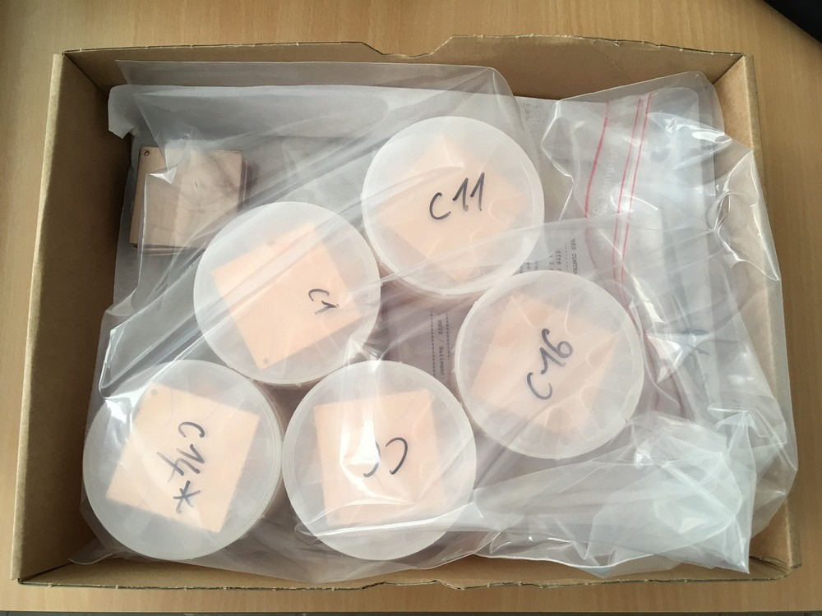
1. SUBU5 Cleaning Procedure
Degreasing: NGL 1740 bath 2 hours → 3' ultra-sonic ON at start and again 3’ min ultra-sonic ON before end
Activation: sulfamic acid (H₃NO₃S, 5 g/l) for about 3'
Polishing: 40' SUBU5 with bath agitation, 5 samples in a 10L beaker
Passivation: sulfamic acid (H₃NO₃S, 5 g/l) for about 1'
Rinsing with water: demineralized water for about 30s
Spaying with alcohol: ethyl alcohol to enhance drying
Drying with N₂
Packing in wafer box and then in plastic bag under N₂
Courtesy of Alban Sublet

Slide 30
1. SUBU5 Cleaning Procedure
Degreasing: NGL 1740 bath 2 hours → 3' ultra-sonic ON at start and again 3’ min ultra-sonic ON before end
Activation: sulfamic acid (H₃NO₃S, 5 g/l) for about 3'
Polishing: 40' SUBU5 with bath agitation, 5 samples in a 10L beaker
Passivation: sulfamic acid (H₃NO₃S, 5 g/l) for about 1'
Rinsing with water: demineralized water for about 30s
Spaying with alcohol: ethyl alcohol to enhance drying
Drying with N₂
Packing in wafer box and then in plastic bag under N₂

Slide 31
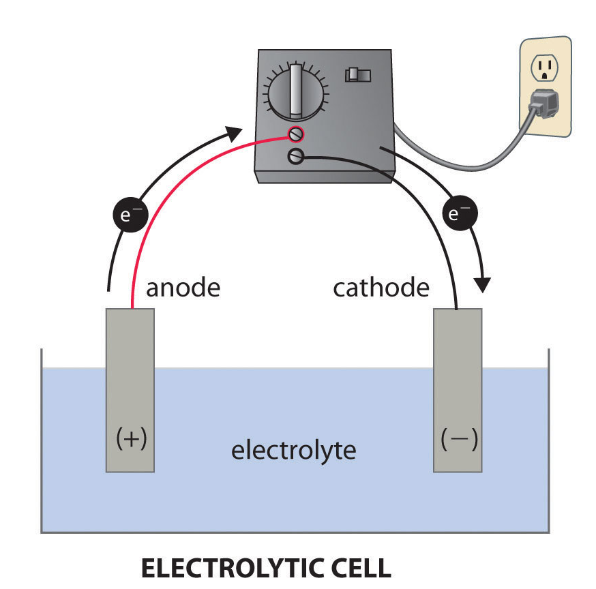
2. Electropolishing, generalities
Process inverse of electroplating
Sample is connected to + terminal of a DC Power Supply
Redox reactions occur
Current flow beetween two electrodes
The sample works as the anode (oxidised reaction)
A viscous electrolyte is used to moderate the reaction
anode
(oxidation)
catode
(reduction)

Slide 32
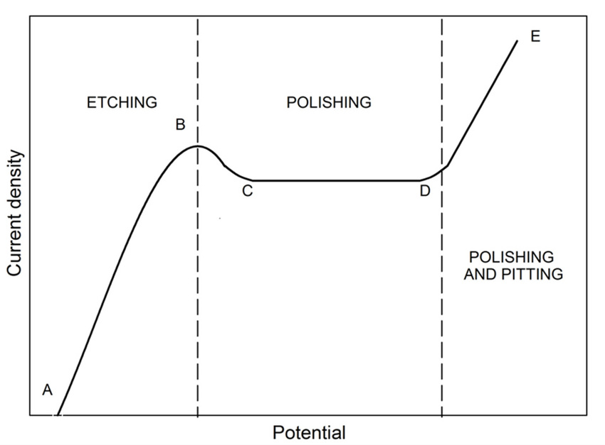
2. Electropolishing
Vander Voort G.F. (1999). Metalography Principles and Practice, ASM International
anode
(oxidation)
catode
(reduction)
Key parameter: I-V characteristic curve
A polishing effect is observed between C and D

Slide 33
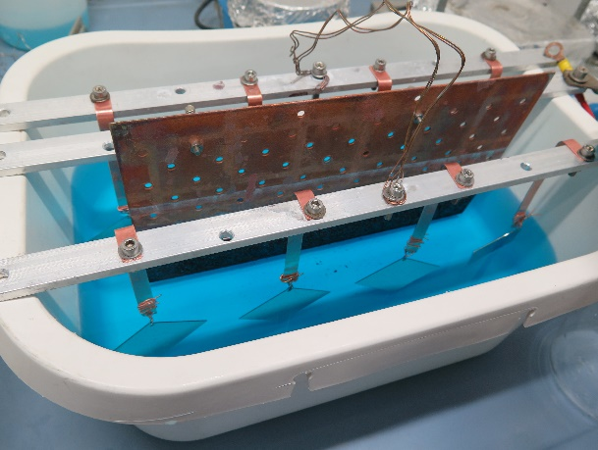
2. ARIES Samples EP Set up and Parameters
Solution: Phosphoric acid (85%) : Buthanol (99%), ratio 3:2
Anode: 8 samples at time
Cathode material: OFHC copper
Temperature: Room Temperature
No agitation (could create anisotropy in the treatment)
Process time ≈ 5 hours (2 + 3)
Etching rate ≈ 130 nm/min (Could be higher)

Slide 34
2. EP Cleaning Procedure
Degreasing: NGL 1740 bath 2 hours → 3' ultra-sonic ON at start and again 3’ min ultra-sonic ON before end
Activation: sulfamic acid (H₃NO₃S, 5 g/l) for about 3'
Polishing: 5 h EP without bath agitation
Passivation: sulfamic acid (H₃NO₃S, 5 g/l) for about 1'
Rinsing with water: demineralized water for about 30s
Spaying with alcohol: ethyl alcohol to enhance drying
Drying with N₂.
Packing in wafer box and then in plastic bag under N₂

Slide 35
3. EP+SUBU Cleaning Procedure
EP prevent pitting
SUBU remove EP texture
SUBU also acts on the masked areas during the EP (eg the electrical contacts)

Slide 36
3. EP+SUBU Cleaning Procedure
Degreasing: NGL 1740 bath 2 hours → 3' ultra-sonic ON at start and again 3’ min ultra-sonic ON before end
Activation: sulfamic acid (H₃NO₃S, 5 g/l) for about 3'
Polishing: 5 h EP without bath agitation
Rinsing with water: demineralized water for about 1 min
Polishing: 8’ SUBU5 with bath agitation, 5 samples in a 10L beaker
Passivation: sulfamic acid (H₃NO₃S, 5 g/l) for about 1'
Rinsing with water: demineralized water for about 30s
Spaying with alcohol: ethyl alcohol to enhance drying
Drying with N₂.
Packing in wafer box and then in plastic bag under N₂

Slide 37
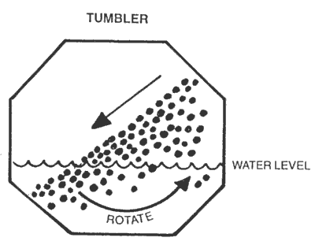
4. Tumbling, generalities
Mechanical polishing used to prepare the cavity before chemistry
In ARIES is used to evaluate the effect of mechanical treatment on Nb SC film

Slide 38
4. Tumbling, generalities
Mechanical polishing used to prepare the cavity before chemistry
In ARIES is used to evaluate the effect of mechanical treatment on Nb SC film
A barrel, filled whith the samples, is then rotated
Could be added media, water, or other lubricants

Slide 39
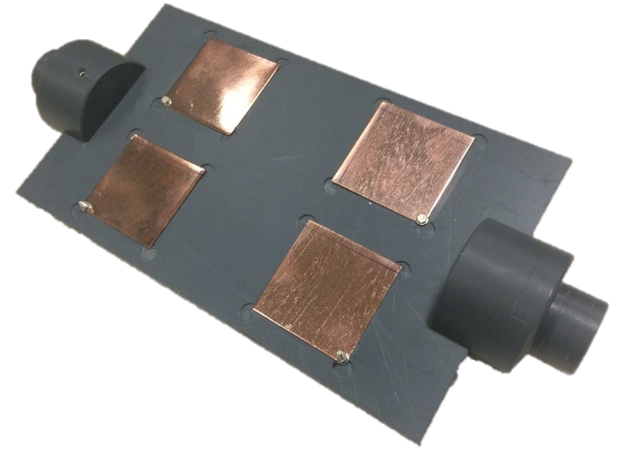
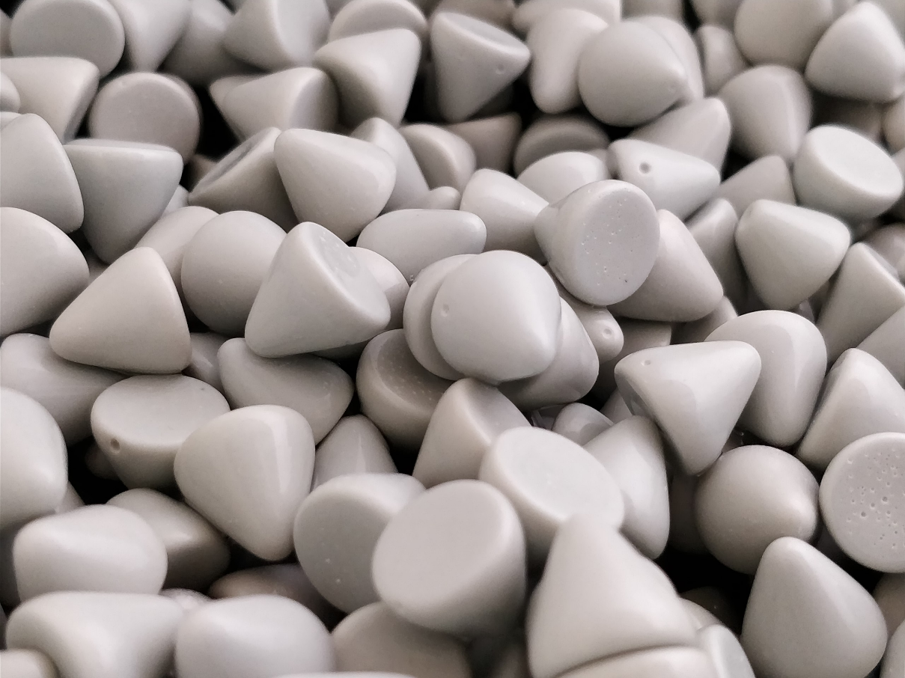
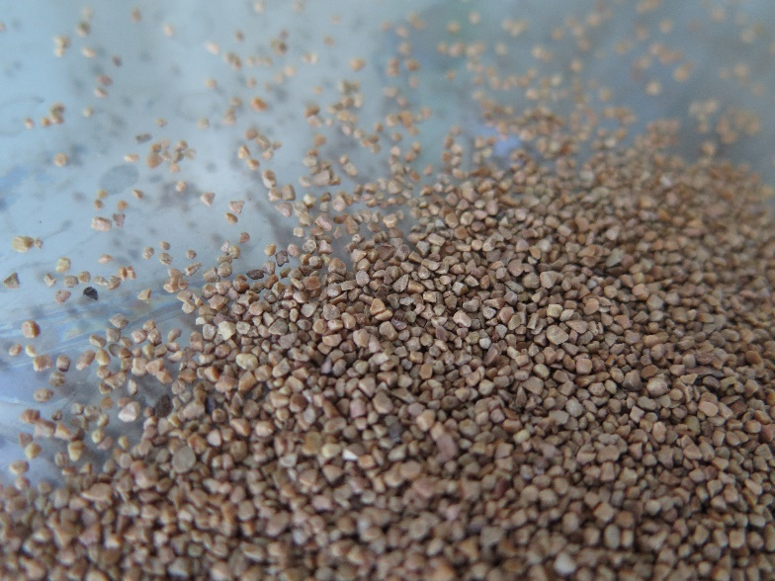
4. ARIES Samples Tumbling Set Up
Samples keeped in a sample holder to prevent bending
Two different media used:
1. Alumina embedded in ureic resin
2. Coconut powders

Slide 40
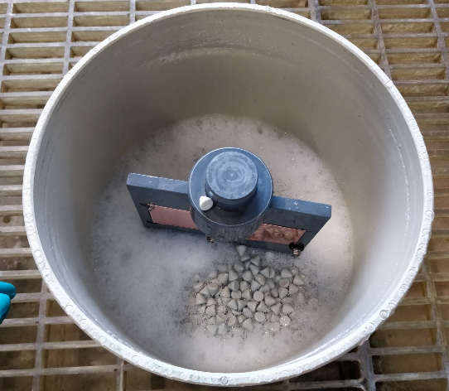
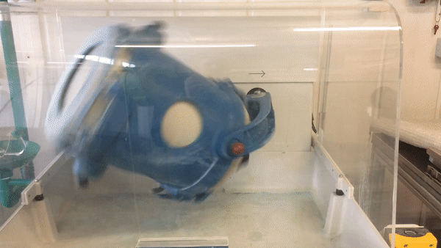
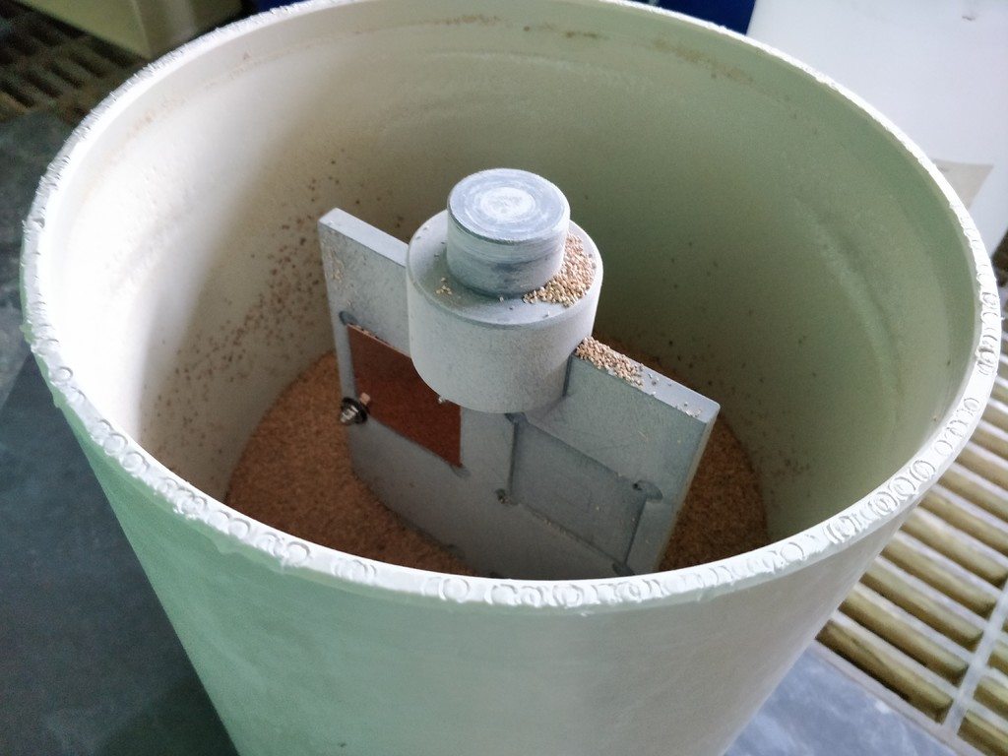
4. ARIES Samples Tumbling Set Up

Slide 41
3. Tumbling Procedure
Degreasing: NGL 1740 bath 2 hours → 3' ultra-sonic ON at start and again 3’ min ultra-sonic ON before end
Rinsing with water: demineralized water for about 1 min
Polishing: Tumbling with Alumina embedded media and Roadastel30 bath
Rinsing with water: demineralized water for about 1 min
Polishing: Tumbling with Coconut powders media
Degreasing: Rodastel bath 2 hours → 3' ultra-sonic ON at start and again 3’ min ultra-sonic ON before end
Rinsing with water: demineralized water for about 1 min
Passivation: sulfamic acid (H₃NO₃S, 5 g/l) for about 1'
Rinsing with water: demineralized water for about 30s
Spaying with alcohol: ethyl alcohol to enhance drying
Drying with N₂.
Packing in wafer box and then in plastic bag under N₂

Slide 42
Surface Characterization

Slide 43
Surface Characterizations
Optical Inspection
Reflectivity
SEM
EDS
Roughness

Slide 44
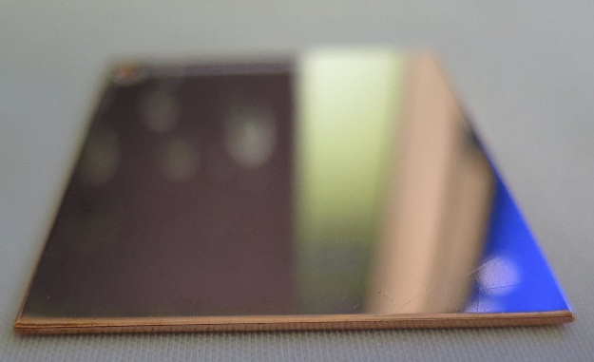
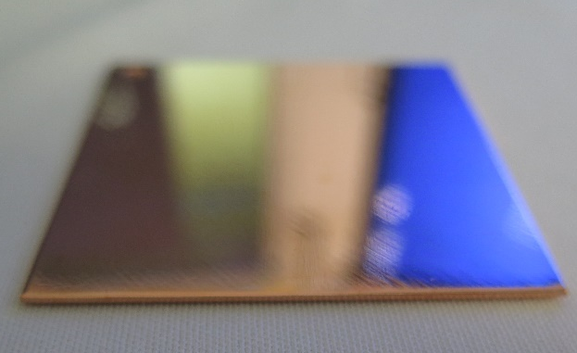
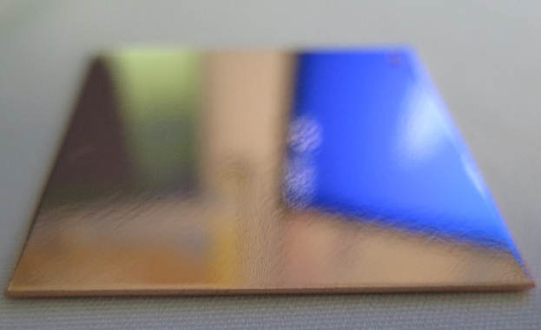
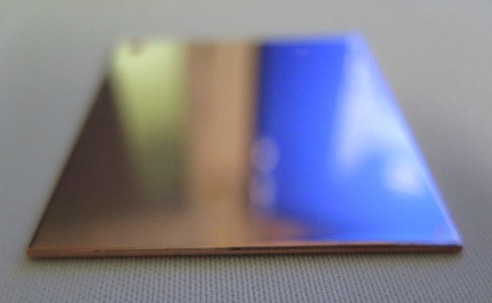
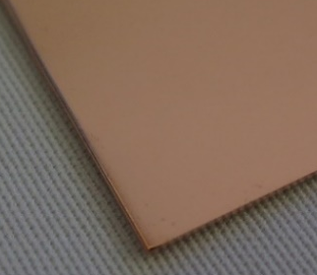
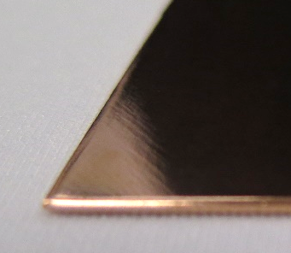
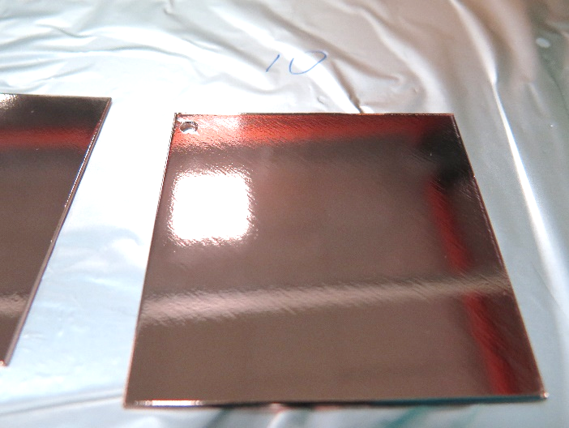
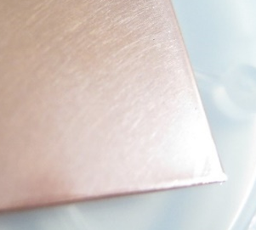
Optical inspection
Rolling texture
Initial surface
SUBU
EP
EP + SUBU
Tumbling
Mirror like surface
Reflectivity 65 ± 1 %
Mirror like surface
Texture due to oxygen evolution
Reflectivity 64 ± 1 %
Mirror like surface
Texture due to oxygen evolution reduced by SUBU
Reflectivity 66 ± 1 %
Shining surface
Small visible scratches on surface
Reflectivity 52 ± 1 %

Slide 45
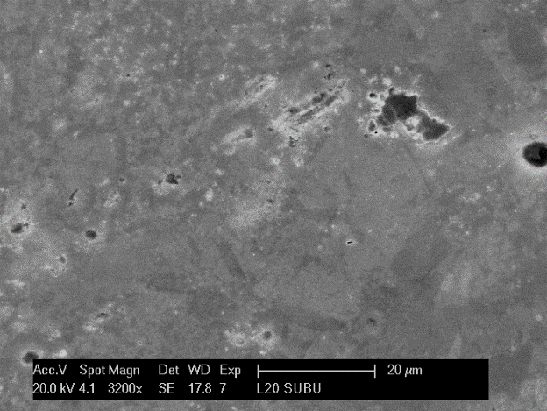
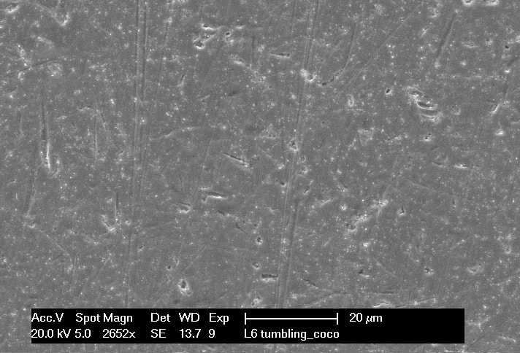
SEM Characterization
Initial surface
SUBU
EP
EP + SUBU
Tumbling

Slide 46
SEM Characterization
Rolling texture
Initial surface
SUBU
EP
EP + SUBU
Tumbling
Presence of pitting
No pitting
Presence of pitting
Presence of scratches
Possible inclusion of media

Slide 47
Energy Dispersive Spectroscopy
UNTREATED SAMPLE
POLISHED SAMPLE
No visible contaminations are revealed with EDS technique

Slide 48
Roughness
Polishing Treatment | Ra
Initial surface | 127 ± 26 nm
SUBU5 | 48 ± 7 nm
EP | 225 ± 80 nm
EP+SUBU5 | 115 ± 80 nm
Tumbling | 48 ± 13 nm
Scan length of 1 mm

Slide 49
Roughness
Polishing Treatment | Ra | Ra diagonal
Initial surface | 127 ± 26 nm
SUBU5 | 48 ± 7 nm
EP | 225 ± 80 nm | 86 ± 14 nm
EP+SUBU5 | 115 ± 80 nm | 59 ± 9 nm
Tumbling | 48 ± 13 nm
Scan length of 1 mm

Slide 50
Workflow of the experiment
SUBU
SUBU
OFE COPPER SHEET
DC Magnetron Sputtering
EP
EP + SUBU
DC Magnetron Sputtering
TUMBLING
DC Magnetron Sputtering
Cutting
Cu Polishing
Nb Coating

Slide 51
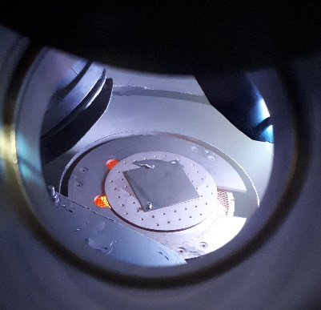
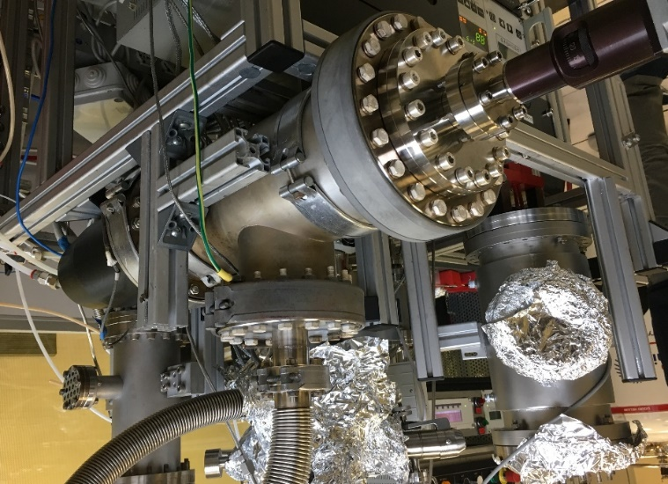
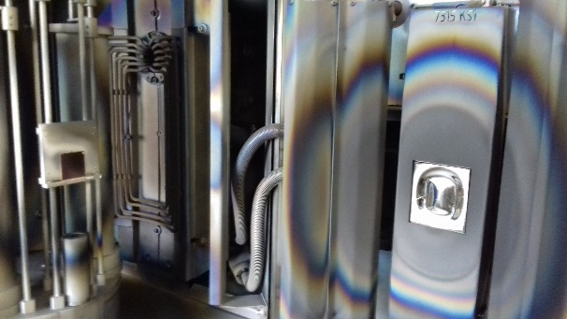
Nb coating facilities

Slide 52
Sputtering parameters
Parameter | STFC | Uni Siegen | INFN
Substrate heated | 650 °C for 12 h | 650 °C for 1.25 h | 650° for >40 h
Base pressure @ 650 °C on a substrate | <10⁻⁹ mbar | 1.22x10⁻⁵ mbar | < 9x10⁻⁸ mbar
Deposition temperature | 650 °C | 650 °C | 650 °C
Power supply | DC MS | DC MS | DC MS
Current | 0.97 A | 1.34 A | 2.1 A
Current density | 22 mA/cm² | 15 mA/cm² | 27 mA/cm²
Voltage | 411 V | 298 V | ≈ 350 V
Target power | 400 W | 400 W | ≈ 750 W
Discharge gas | Kr | Ar | Ar
Discharge gas pressure | 1.5x10⁻³ mbar | 1.5x10⁻² mbar | 5x10⁻³ mbar
Target-substrate distance | 10 cm | 6 cm | 10 cm
Substrate rotation | 4 rpm | no | no
Deposition time | 480 min | 20 min | 20 min
Deposition rate | 7 nm/min | 150 nm/min | 150 nm/min

Slide 53
Sputtering parameters
Parameter | STFC | Uni Siegen | INFN
Substrate heated | 650 °C for 12 h | 650 °C for 1.25 h | 650° for >40 h
Base pressure @ 650 °C on a substrate | <10⁻⁹ mbar | 1.22x10⁻⁵ mbar | < 9x10⁻⁸ mbar
Deposition temperature | 650 °C | 650 °C | 650 °C
Power supply | DC MS | DC MS | DC MS
Current | 0.97 A | 1.34 A | 2.1 A
Current density | 22 mA/cm² | 15 mA/cm² | 27 mA/cm²
Voltage | 411 V | 298 V | ≈ 350 V
Target power | 400 W | 400 W | ≈ 750 W
Discharge gas | Kr | Ar | Ar
Discharge gas pressure | 1.5x10⁻³ mbar | 1.5x10⁻² mbar | 5x10⁻³ mbar
Target-substrate distance | 10 cm | 6 cm | 10 cm
Substrate rotation | 4 rpm | no | no
Deposition time | 480 min | 20 min | 20 min
Deposition rate | 20 nm/min | 150 nm/min | 150 nm/min

Slide 54
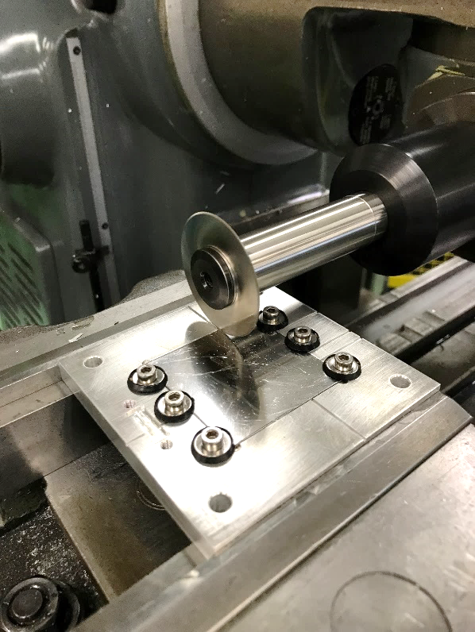
Workflow of the experiment
DC Magnetron Sputtering
DC Magnetron Sputtering
Morphological
characterization
DC Magnetron Sputtering
Nb Coating
Characterization

Slide 55
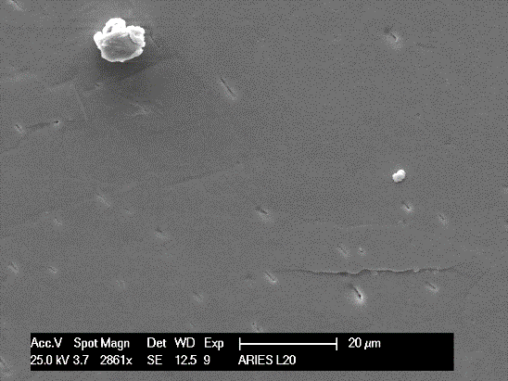
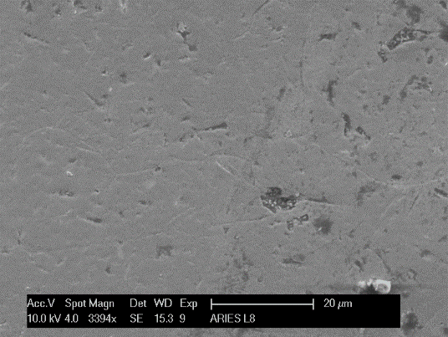
Morphology of the Nb coating on different substrate treatments
(Low Magnification)
Tumbling
SUBU CERN
SUBU INFN
EP
EP + SUBU

Slide 56
Morphology of the Nb coating on different substrate treatments
(Low Magnification)
Tumbling
SUBU CERN
SUBU INFN
PITTING
EP
EP + SUBU

Slide 57
Morphology of the Nb coating on different substrate treatments
(Medium Magnification)
SUBU CERN
On STFC samples Pitting is not visible because the Nb film is thicker than INFN and Siegen samples. (10 μm instead of 3 μm)
Also low deposition rate could help to mitigate substrate imperfections
SUBU INFN
EP
EP + SUBU

Slide 58
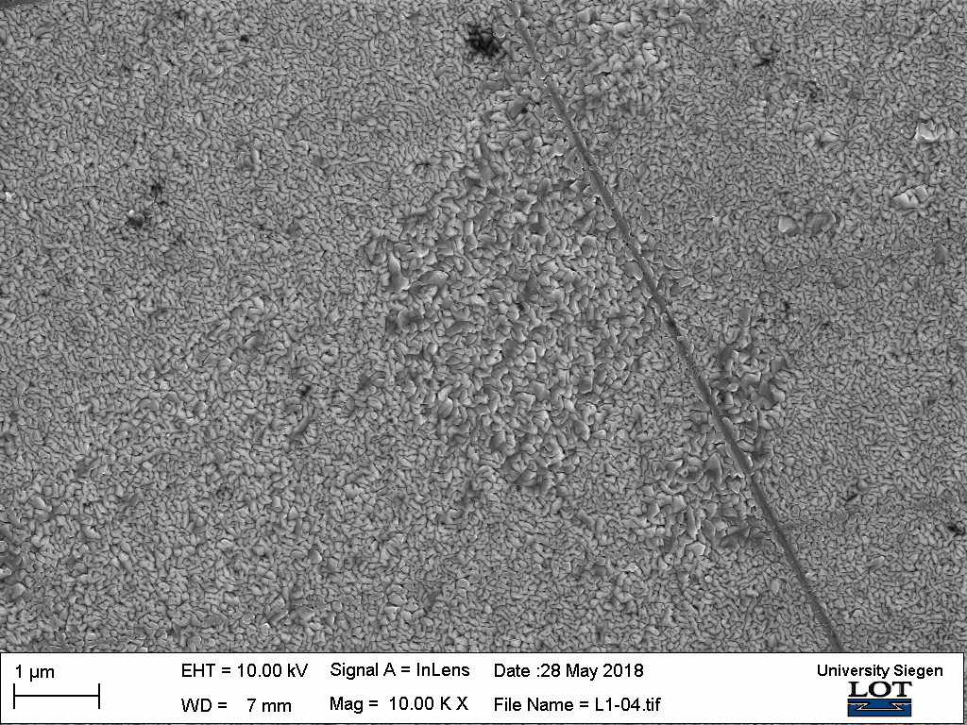
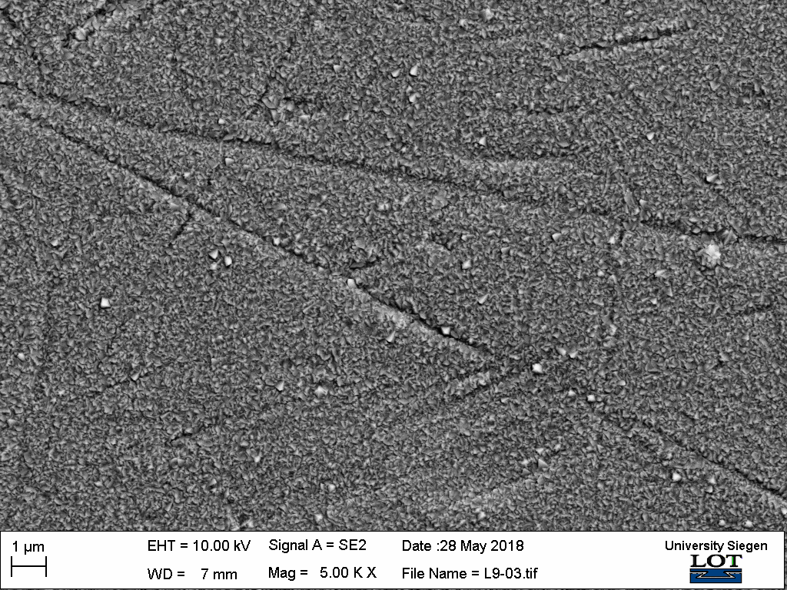
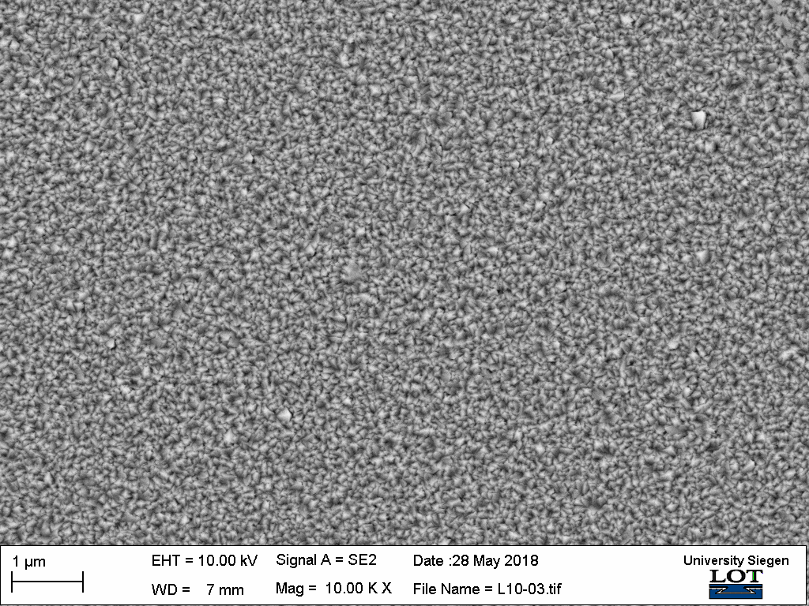
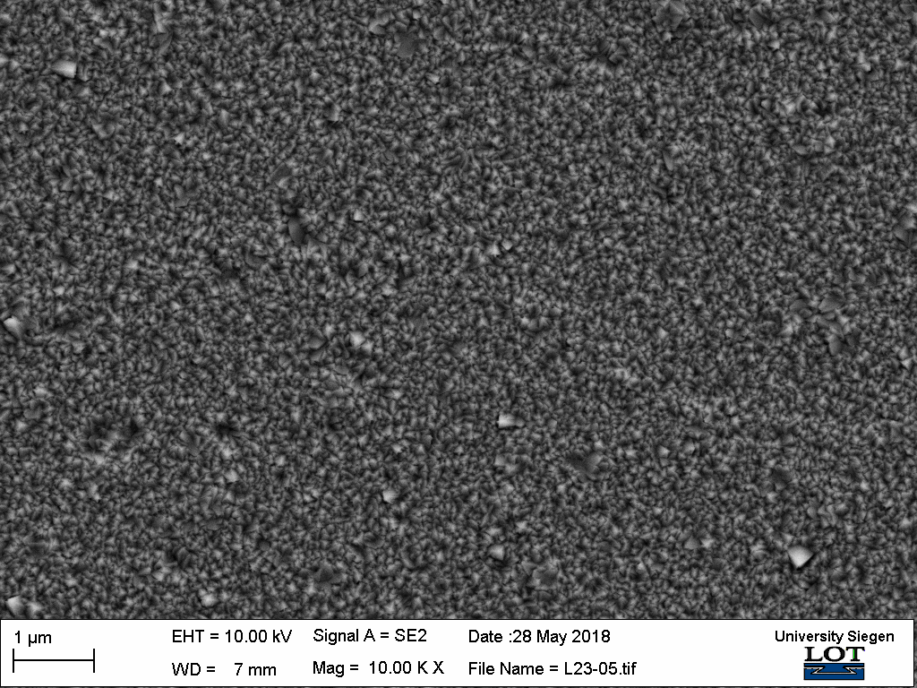
Morphology of the Nb coating on different substrate treatments
(High Magnification)
SUBU CERN
SUBU INFN
Tumbling
EP
EP + SUBU

Slide 59
Morphology of the Nb coating on different substrate treatments
(High Magnification)
SUBU CERN
SUBU INFN
Tumbling
On SUBU samples two different grain structures can be observed
EP
EP + SUBU
pitting

Slide 60
Roughness of the Nb coating on different substrate treatments
Substrate treatment | AFM Roughness (Ra) [nm] | Profilometer Roughness (Ra) [nm]
SUBU CERN | 21 ± 12.1 | 126 ± 15
SUBU INFN | 6.3 ± 1.2 | 197 ± 98
EP | 11.5 ± 0.7 | 233 ± 66 diag 254 ± 50
EP + SUBU | 14.2 ± 2.4 | 192 ± 64 diag 96 ± 18
Tumbling | 18.3 ± 1.5 | 207 ± 53
Profilometer Roughness
influenced by the sample
bending due to the cutting

Slide 61
Roughness of the Nb coating on different substrate treatments
Substrate treatment | AFM Roughness (Ra) [nm] | Profilometer Roughness (Ra) [nm]
SUBU CERN | 21 ± 12.1 | 126 ± 15
SUBU INFN | 6.3 ± 1.2 | 197 ± 98
EP | 11.5 ± 0.7 | 233 ± 66 diag 254 ± 50
EP + SUBU | 14.2 ± 2.4 | 192 ± 64 diag 96 ± 18
Tumbling | 18.3 ± 1.5 | 207 ± 53
Profilometer Roughnes
influenced by the sample
bending due to the cutting

Slide 62
Workflow of the experiment
SUBU
SUBU
PPMS
OFE COPPER SHEET
DC Magnetron Sputtering
EP
EP + SUBU
DC Magnetron Sputtering
TUMBLING
DC Magnetron Sputtering
Cutting
Cu Polishing
Nb Coating
Characterization

Slide 63
DC Magnetization curves
Field of mag. flux entry Ben 2% criterion
(applied field at which the magnetic flux starts entering the sample’s volume)

Slide 64
DC Magnetization curves
Field of MAX mag. moment in Virgin curve Bp
(proportional to the full penetration field)

Slide 65
DC Magnetization curves
Field of MAX mag. moment in Virgin curve Bp
(proportional to the full penetration field)
slight difference between deposition facilities
rather than different surface preparation

Slide 66
Conclusions
Surface characterizations show that SUBU5 reduces roughness more than the other treatments
SUBU5 produces pitting on the surface, also if used just for the etching of 5 microns (EP+SUBU)
EP treated surface does not present pitting, but roughness is influenced by the dynamic of the process
Tumbling introduces small scratches on the surface and possible inclusions
PPMS characterizations show slight difference between deposition facilities rather than different surface preparation
QPR measurements are mandatory to evaluate the effect of polishing treatment on Nb thin film SRF properties
WP15 will focus more on EP (pitting free) and SUBU5 (lowest roughness without scratches) polishing treatments

Slide 67
Thank you very much for your attention!
The authors would like to acknowledge the support provided by European Union’s ARIES collaboration H2020 Research and Innovation Programme under Grant Agreement no. 730871.

