Slide 1


Trapped Flux Sensitivity in the Low Amplitude Radio-Frequency Regime
Mattia Checchin

Slide 2
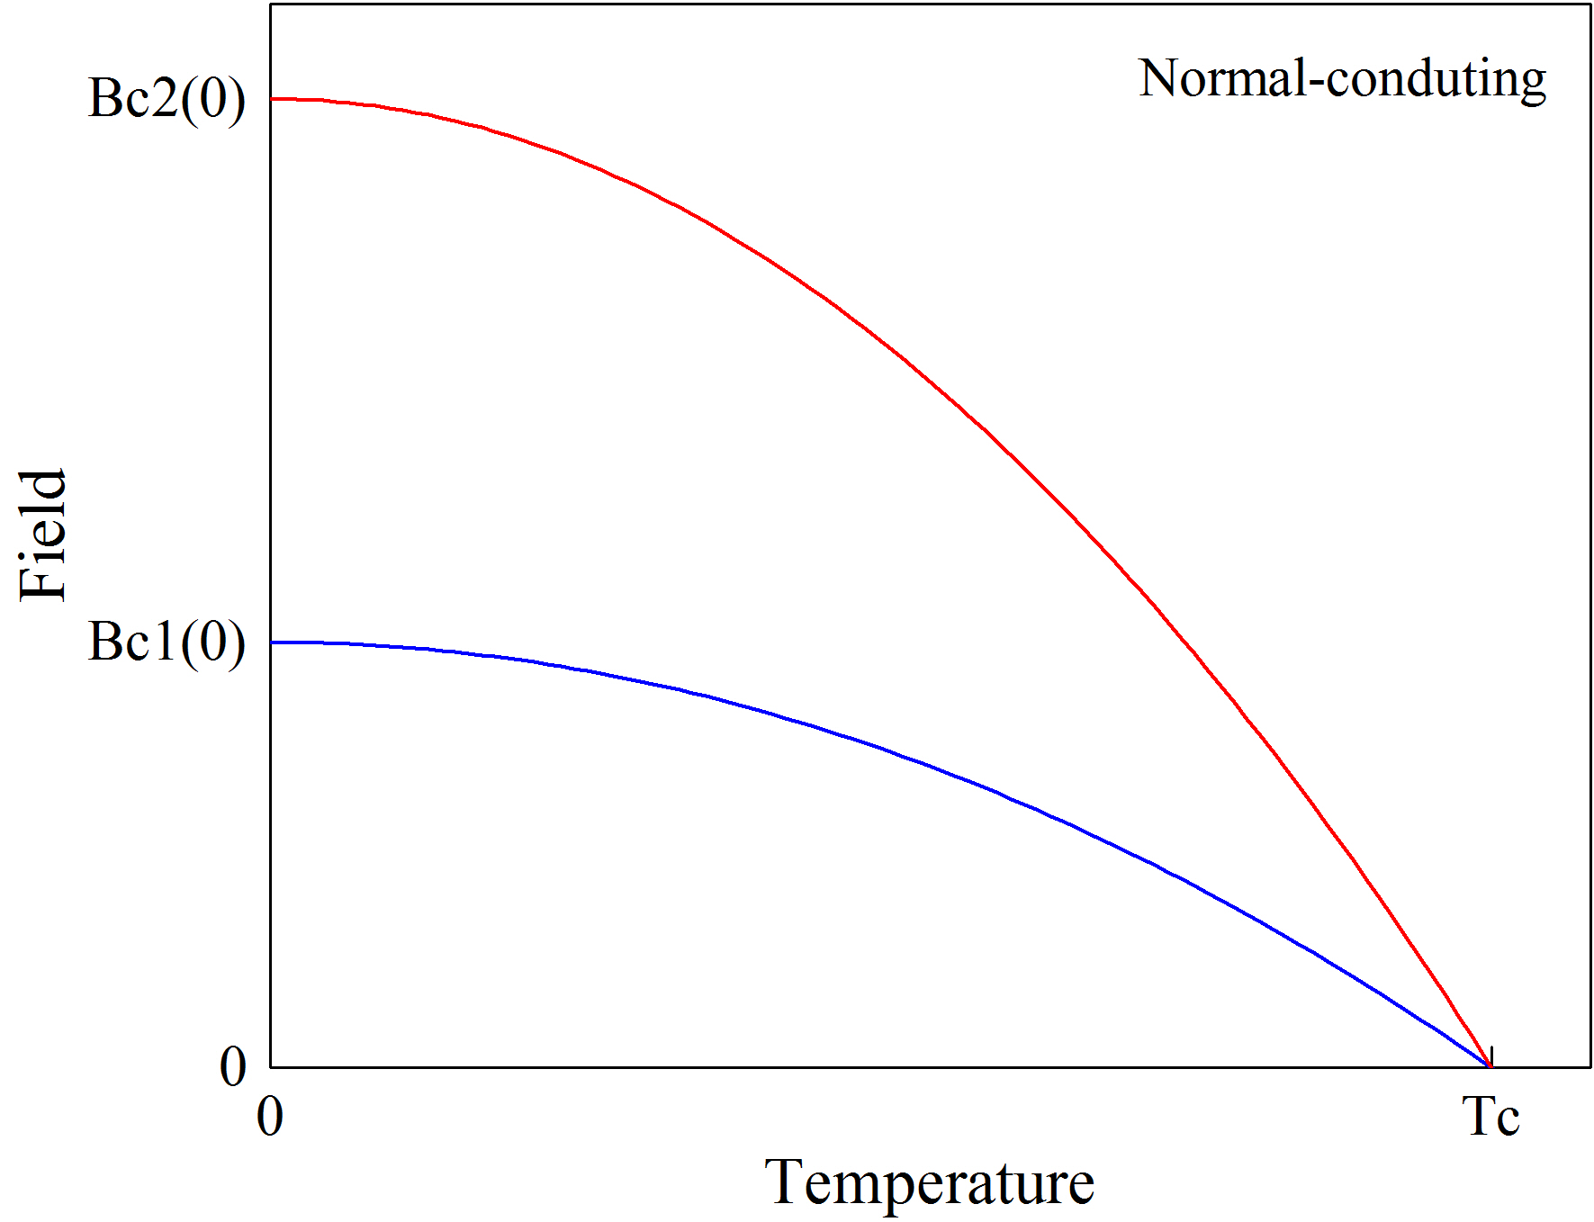
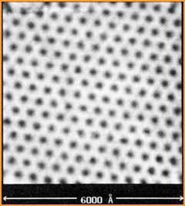

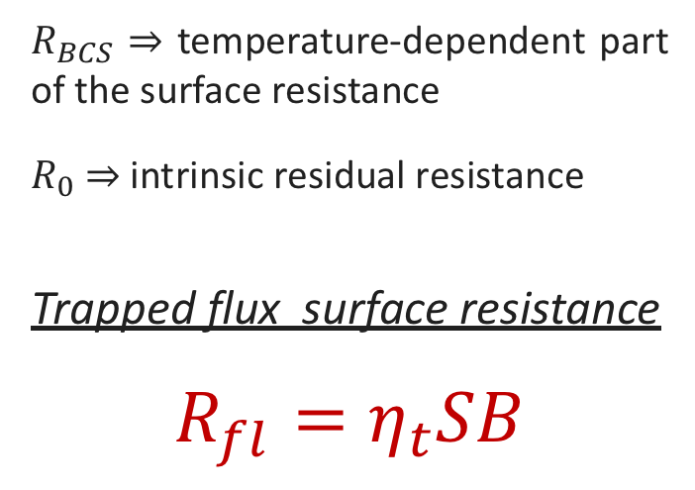

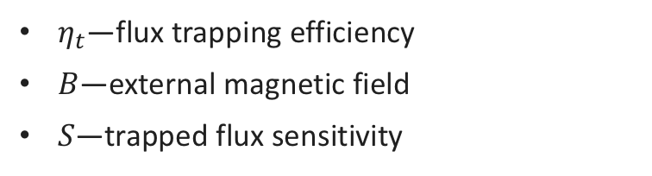




Trapped flux surface resistance
H. F. Hess et al., Phys. Rev. Lett. 62, 214 (1989)
$$R_{s}\left(T, B\right)=R_{BCS}\left(T\right)+R_{fl}\left(B\right)+R_{0}$$
$R_{BCS}$ ⇒ temperature-dependent part of the surface resistance
$R_{0}$ ⇒ intrinsic residual resistance
Trapped flux surface resistance
$$R_{fl}=η_{t}SB$$
$$B$$
Cooldown
$$y$$
Pinning points
$η_{t}$—flux trapping efficiency
$B$—external magnetic field
$S$—trapped flux sensitivity
$$T_{c_{1}}$$
$$T_{c_{2}}$$
$$x$$
Trapped vortices

Slide 3
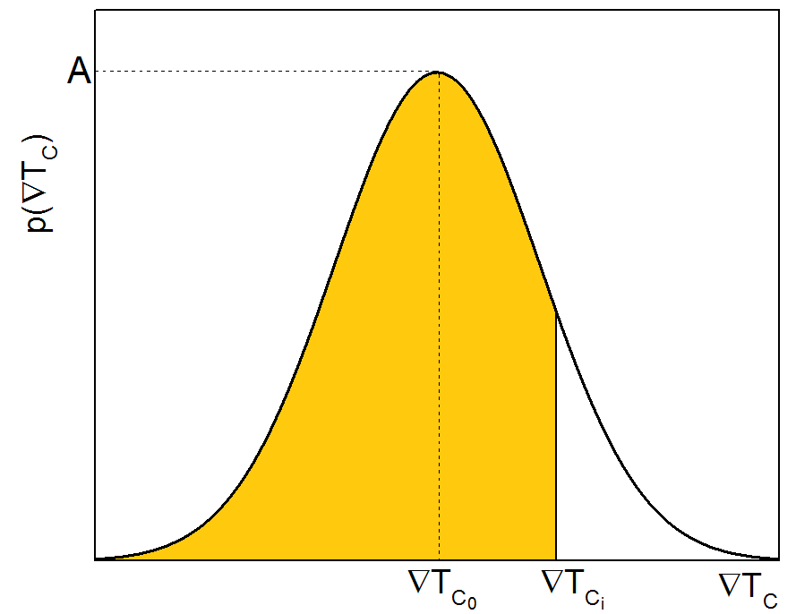
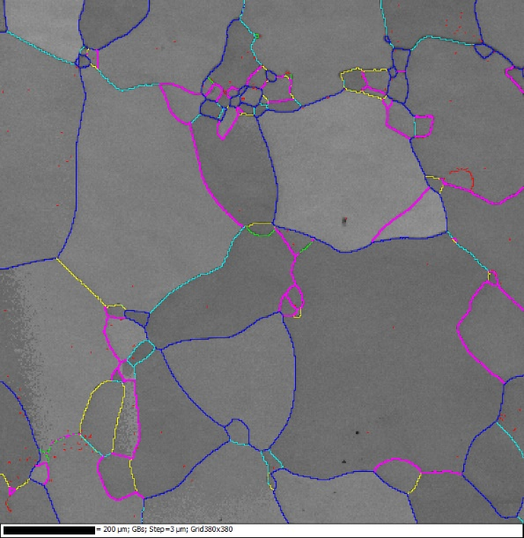
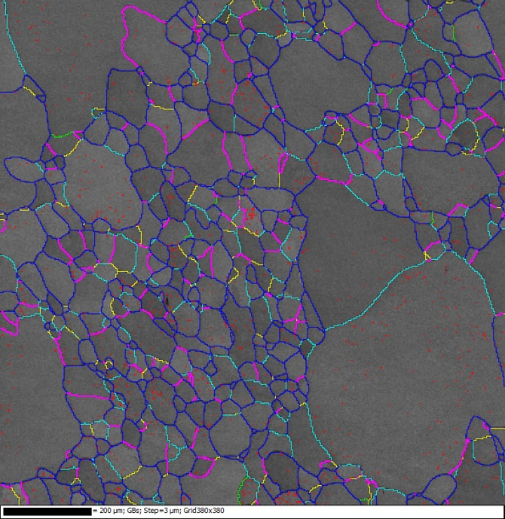
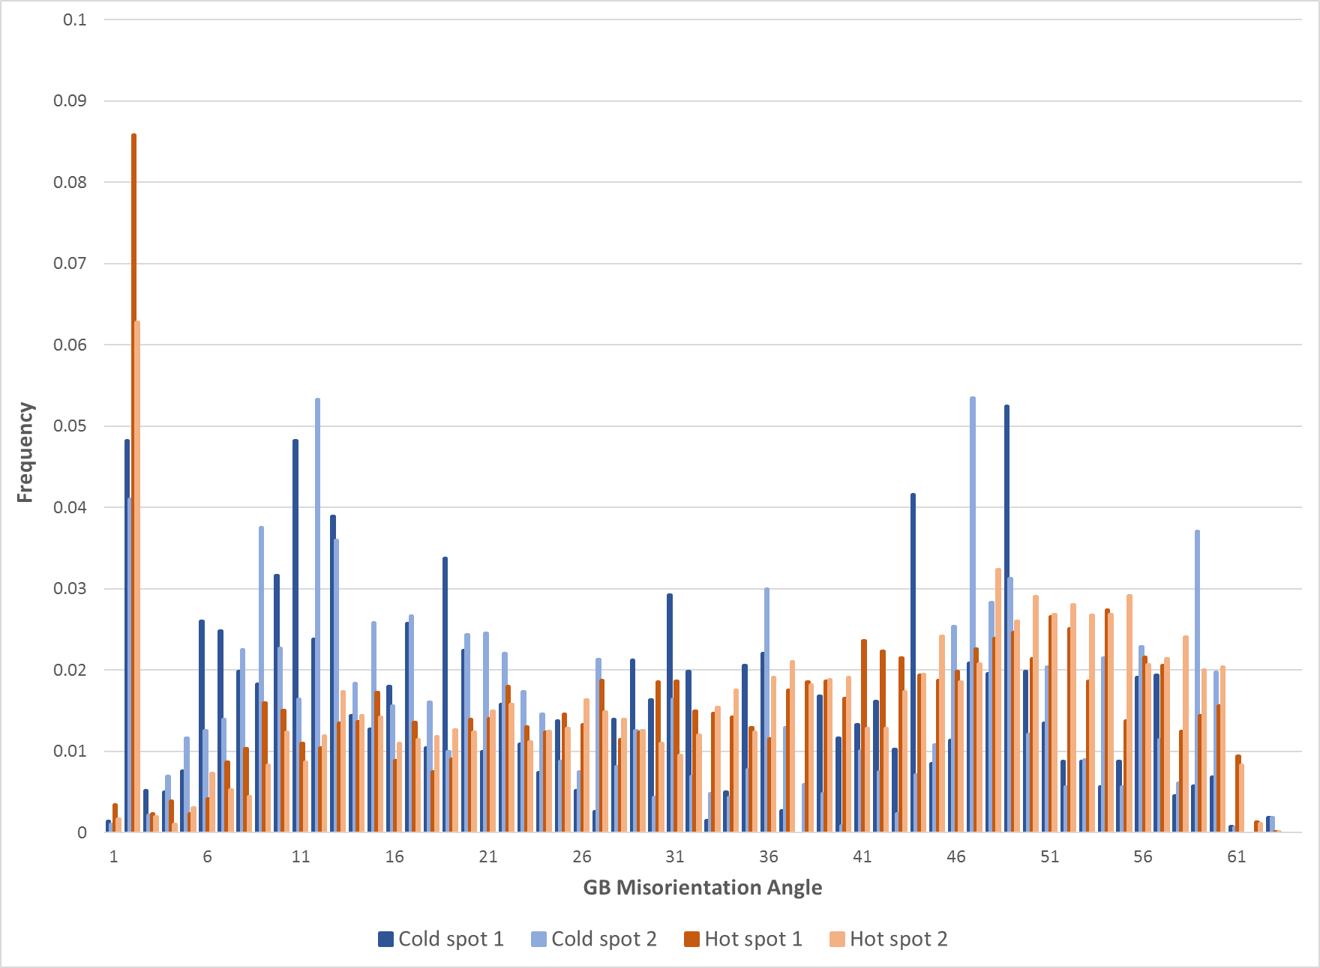
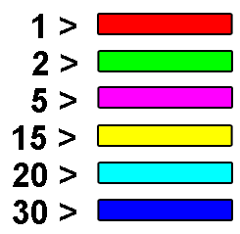
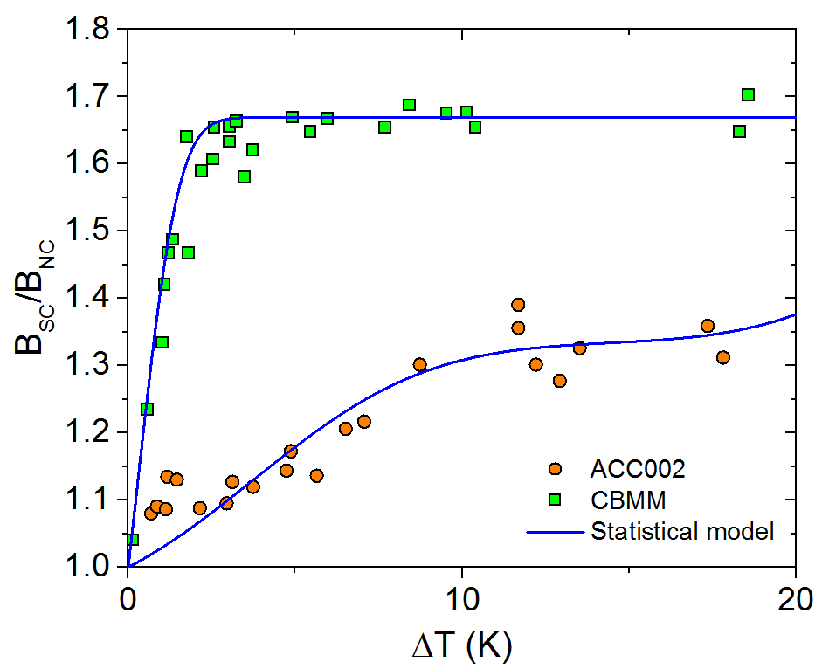



$η_{t}$—flux trapping efficiency
Seems correlated to higher number of very low angle grain boundaries
Well described by a statistical argumentation of pinning and energetics of vortex stability
$${∇T}_{c_{i}}=\frac{J_{c_{i}}T_{c}^{2}}{2H_{c_{1}}\left(0\right)T}$$
$$η_{t}$$
Low angle GBs
mis.
angle
Good expulsion
Bad expulsion
Lower $\left\langle J_{c}\right\rangle$
M. Checchin, M. Martinello et al. to be published
M. Martinello, TTC workshop RIKEN, Nishina center, Japan (2018)
S. Posen et al., J. Appl. Phys. 119, 213903 (2016)

Slide 4

Trapped Flux Sensitivity
—$S$—
Experiments

Slide 5
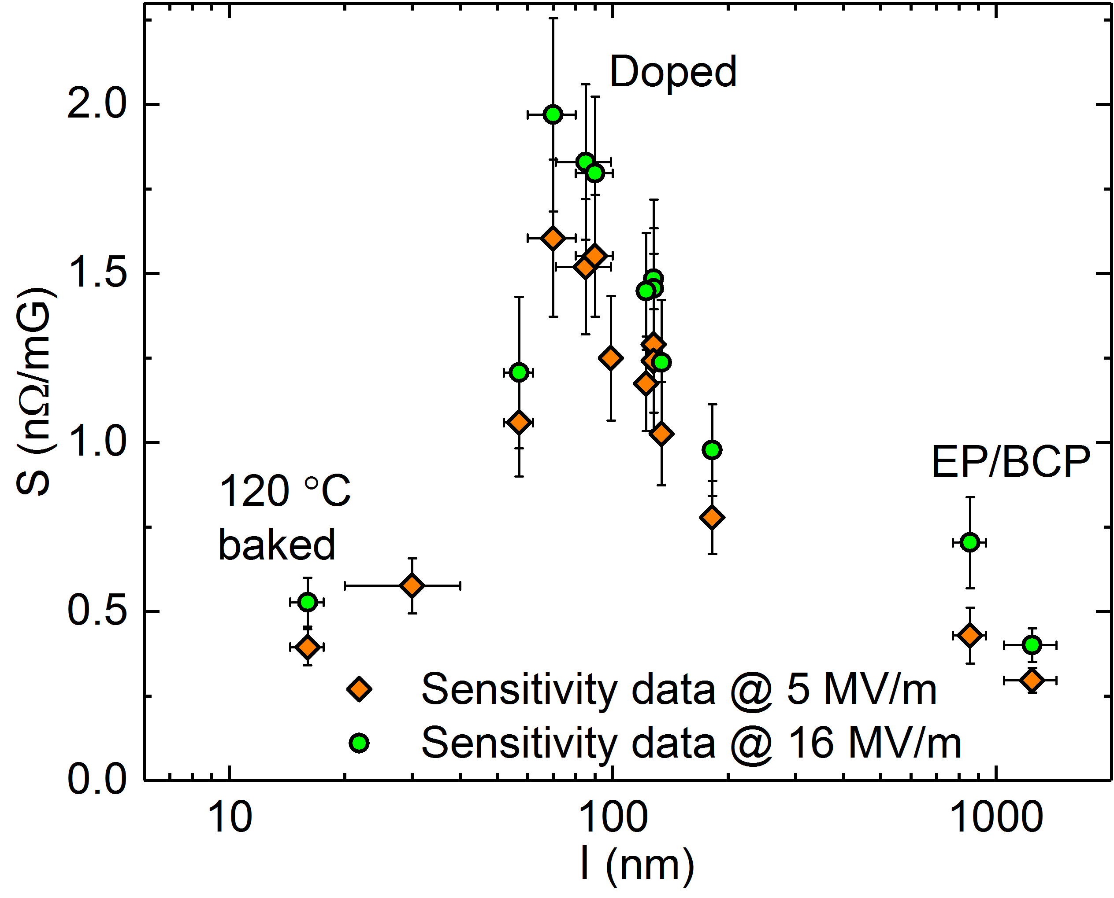
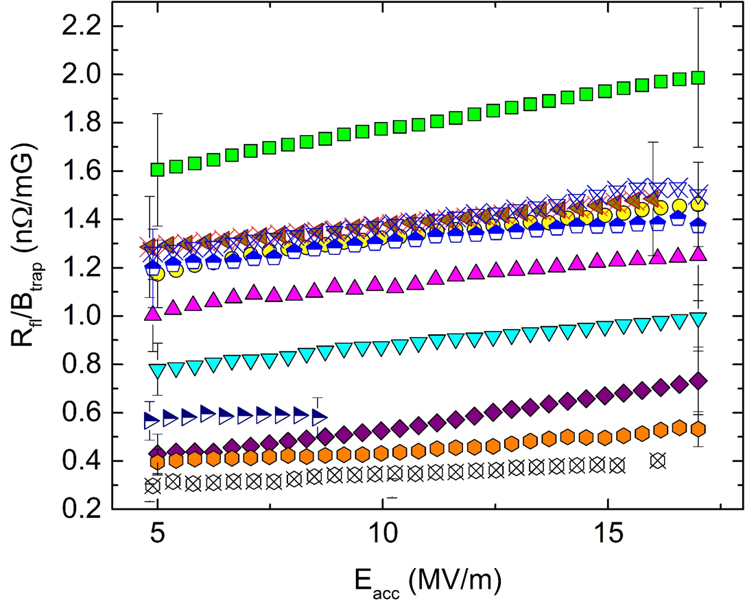
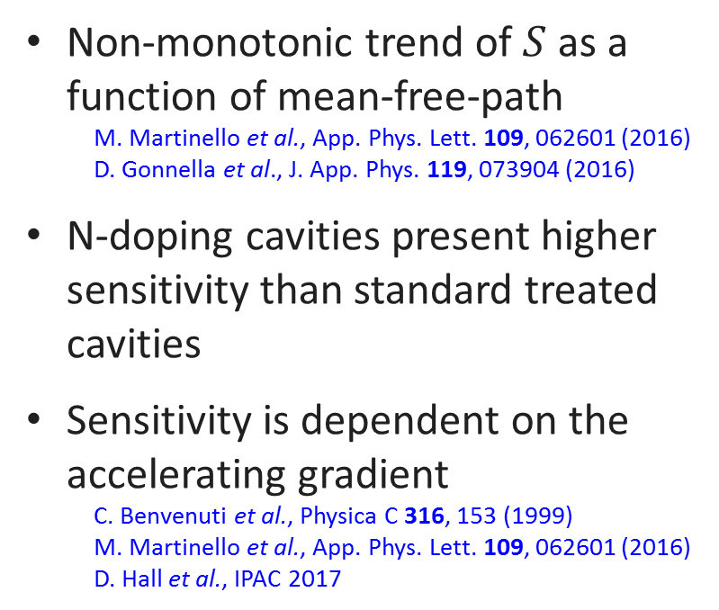
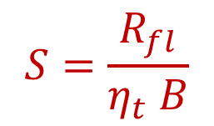
Trapped flux sensitivity at 1.3 GHz
Trapped flux sensitivity:
$$S=\frac{R_{fl}}{η_{t} B}$$
Non-monotonic trend of $S$ as a function of mean-free-path
  M. Martinello et al., App. Phys. Lett. 109, 062601 (2016)
  D. Gonnella et al., J. App. Phys. 119, 073904 (2016)
N-doping cavities present higher sensitivity than standard treated cavities
Sensitivity is dependent on the accelerating gradient
  C. Benvenuti et al., Physica C 316, 153 (1999)
  M. Martinello et al., App. Phys. Lett. 109, 062601 (2016)
  D. Hall et al., IPAC 2017

Slide 6
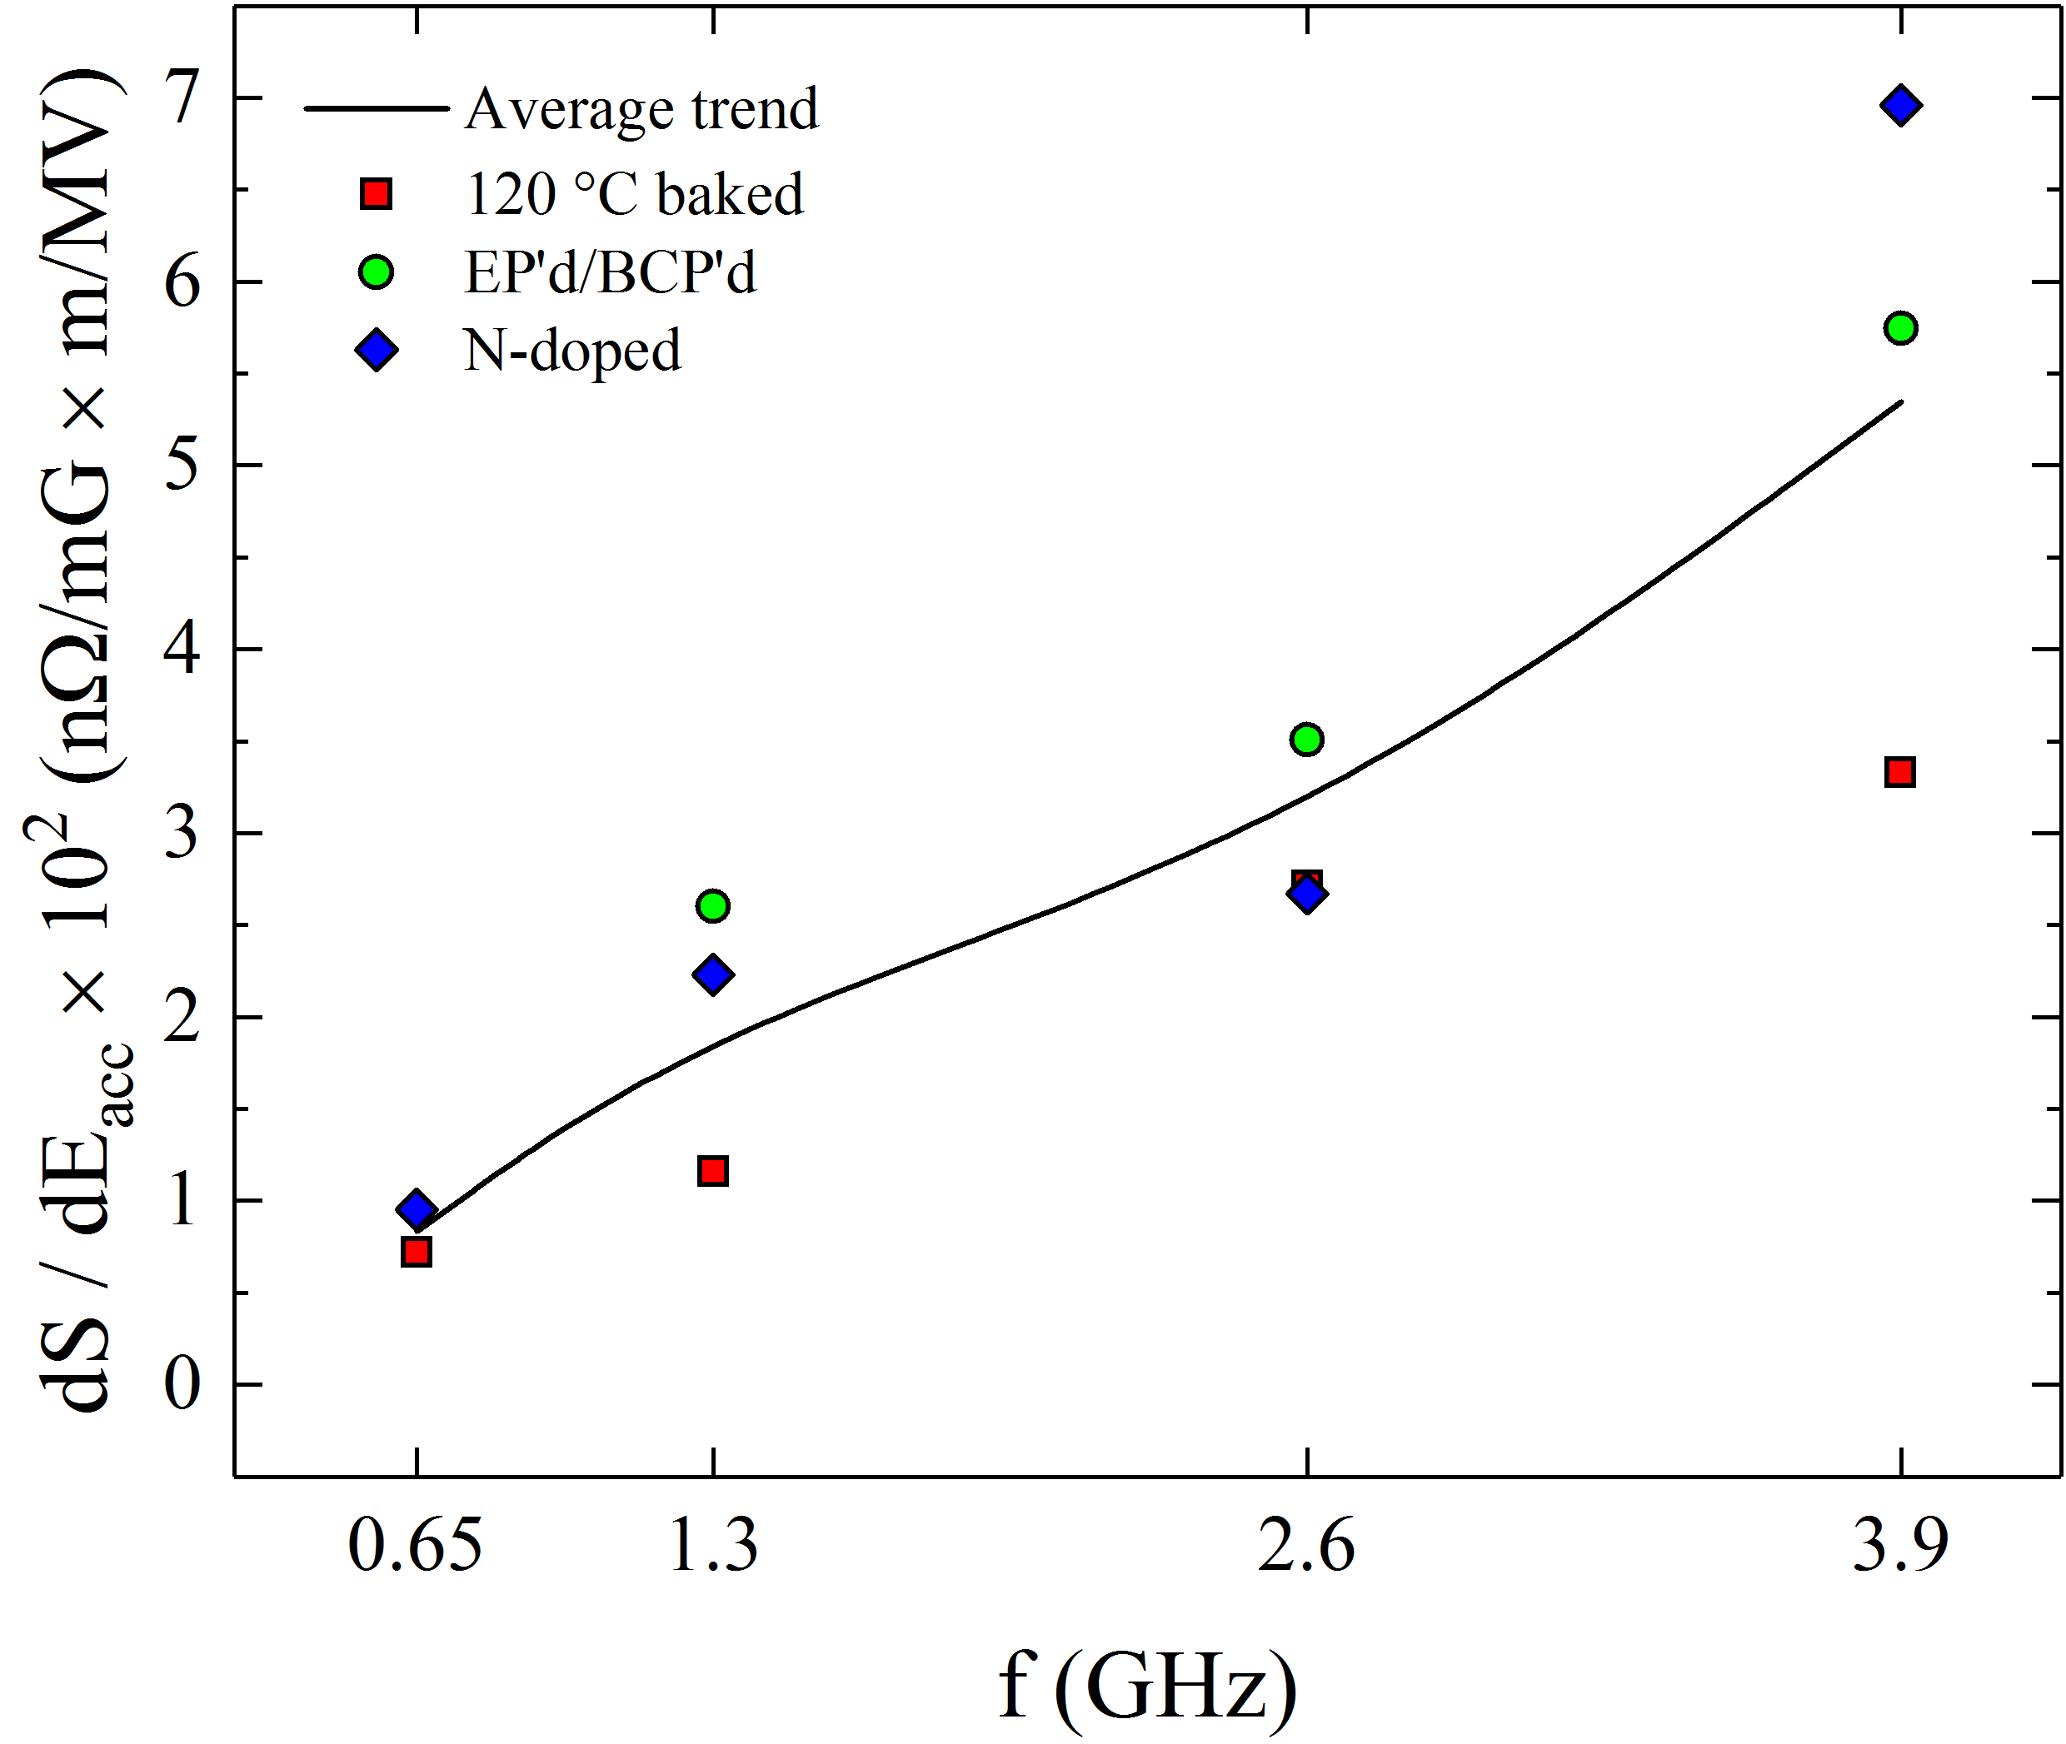
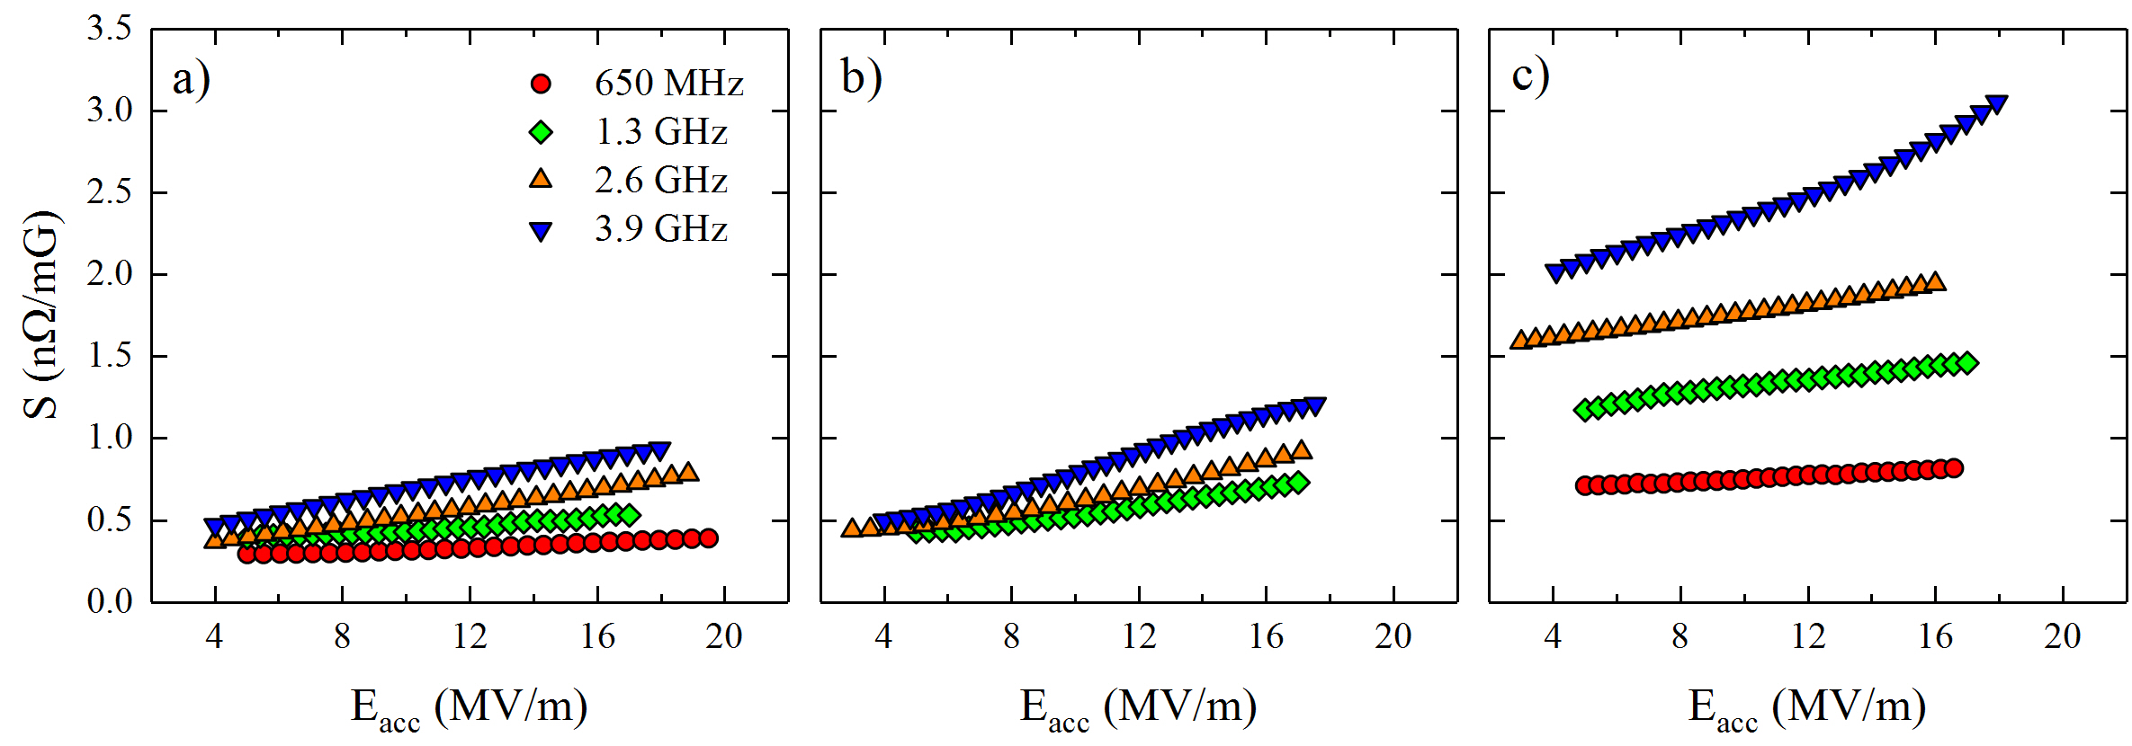
Sensitivity as a function of frequency
Higher low field sensitivity for higher frequency cavities
2/6 N-doped have higher sensitivity, as expected form 1.3 GHz data
Steeper field dependence for high frequency cavities
120 C
EP/BCP
2/6 N-doped
  M. Checchin et al., Appl. Phys. Lett. 112, 072601 (2018)

Slide 7
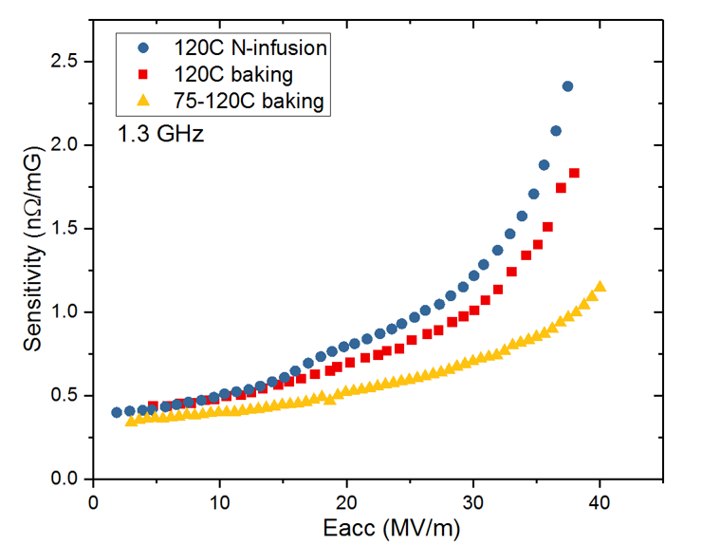
Sensitivity at high gradients @ 1.3 GHz
Change of behavior with field:
  At low field S increases linearly with the field
  At higher field the slope of S increases
  Similar trend observed in various treatments
Threshold value due to depinning current?
  M. Martinello, M. Checchin et al., to be published

Slide 8

Trapped Flux Sensitivity
—$S$—
Description at low RF Amplitudes

Slide 9
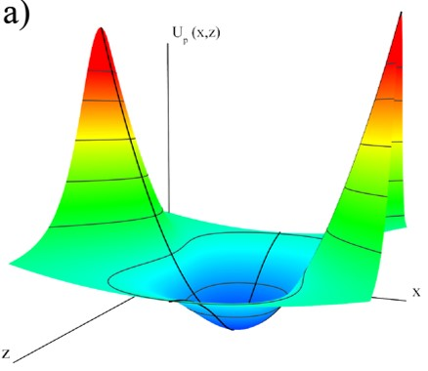
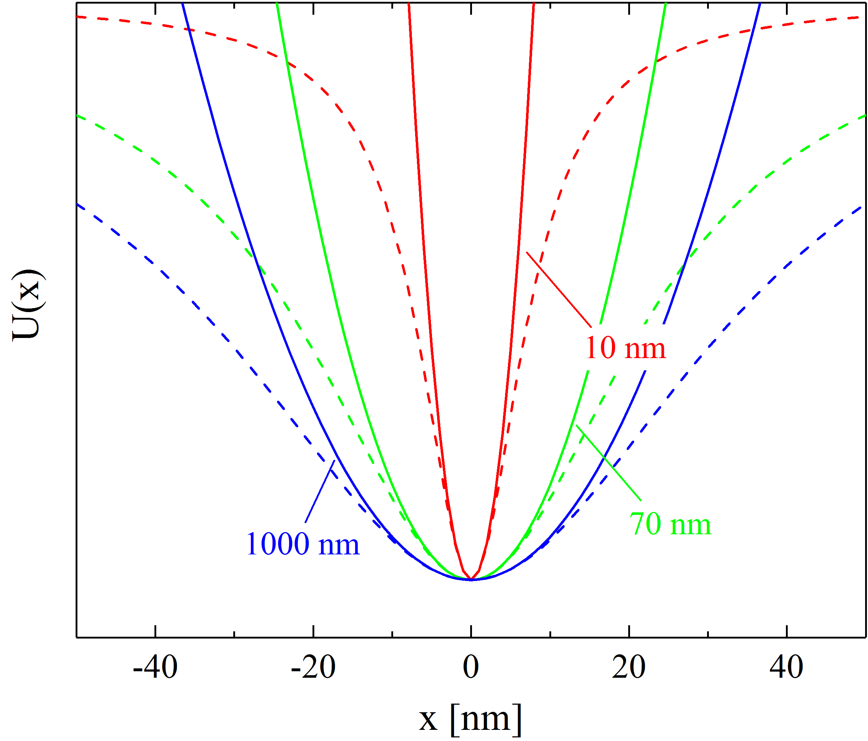


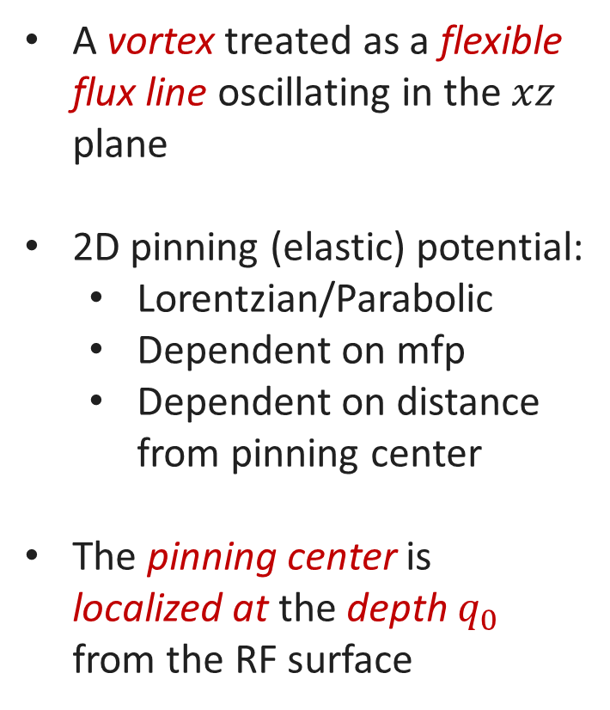



Mean-free-path dependent pinning potential
$$x$$
A vortex treated as a flexible flux line oscillating in the $xz$ plane
2D pinning (elastic) potential:
  Lorentzian/Parabolic
  Dependent on mfp
  Dependent on distance from pinning center
The pinning center is localized at the depth $q_{0}$ from the RF surface
$$j(t)$$
$$y$$
$$q_{0}$$
Pinning center
$$z$$
Pinning potential

Slide 10
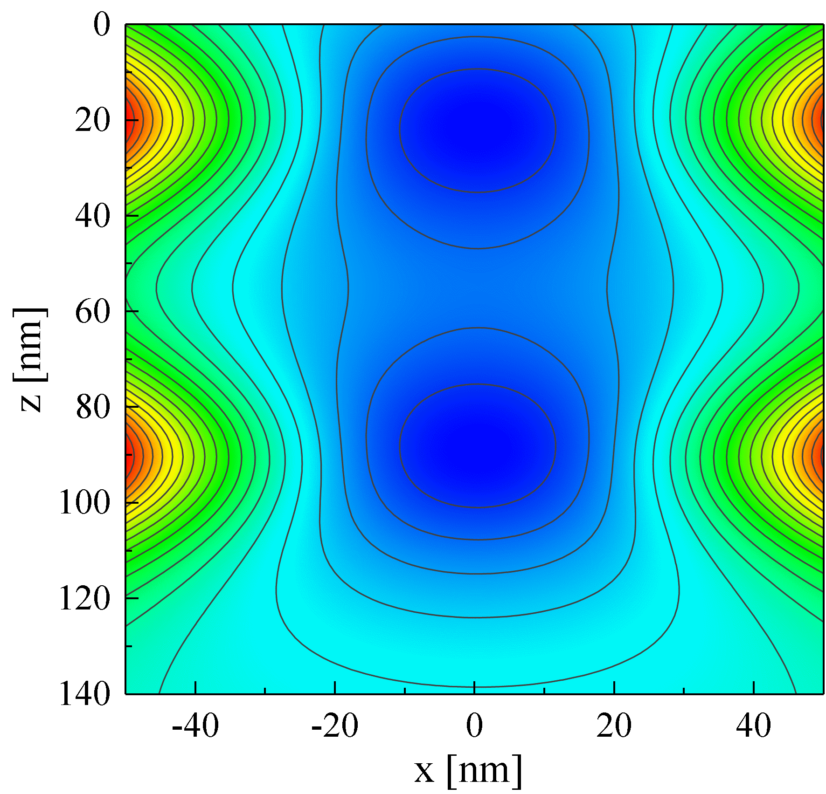
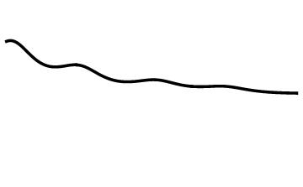


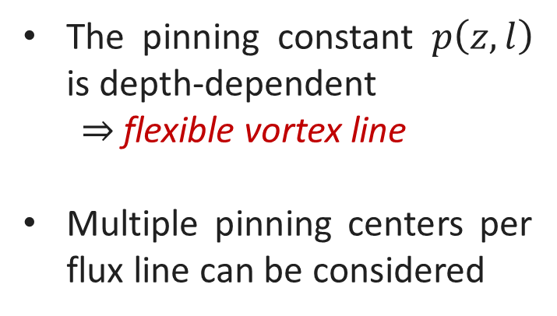

Motion equation of a vortex
$$B_{RF}(t)$$
The motion equation has form:
$$M\left(l\right)\ddot{x}+η\left(l\right)\dot{x}+p\left(z,l\right)x=f_{Lorentz}$$
Pinning Center
Solution valid for $0≤z<∞$ domain
The pinning constant $p\left(z,l\right)$ is depth-dependent
  $⇒$ flexible vortex line
Multiple pinning centers per flux line can be considered
Pinning Center

Slide 11
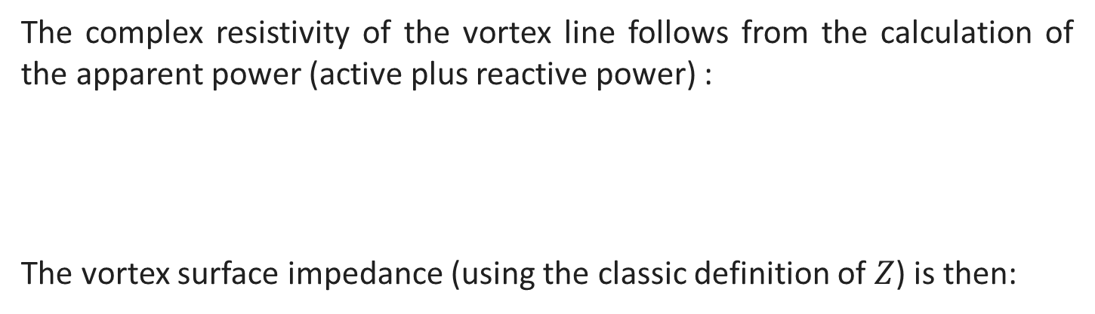
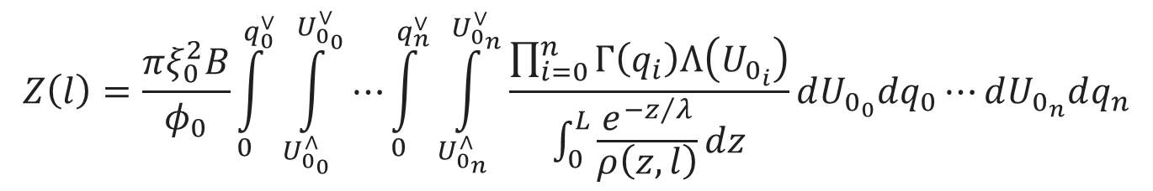
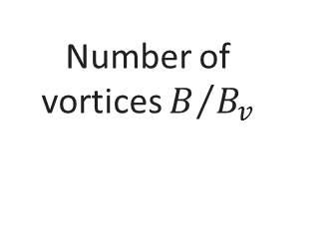
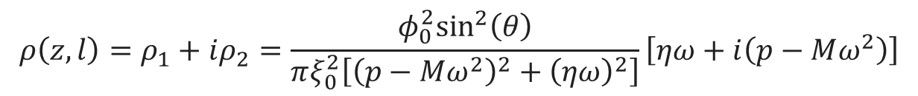
Vortex surface impedance
The complex resistivity of the vortex line follows from the calculation of the apparent power (active plus reactive power) :
The vortex surface impedance (using the classic definition of $Z$) is then:
$$ρ\left(z,l\right)=ρ_{1}+iρ_{2}=\frac{φ_{0}^{2}\sin^{2}\left(θ\right)}{πξ_{0}^{2}\left[{\left(p−Mω^{2}\right)}^{2}+{\left(ηω\right)}^{2}\right]}\left[ηω+i\left(p−Mω^{2}\right)\right]$$
$$Z\left(l\right)=\frac{πξ_{0}^{2}B}{φ_{0}}\int_{0}^{q_{0}^{∨}}{\int_{U_{0_{0}}^{∧}}^{U_{0_{0}}^{∨}}{⋯}}\int_{0}^{q_{n}^{∨}}{\int_{U_{0_{n}}^{∧}}^{U_{0_{n}}^{∨}}{\frac{\prod_{i=0}^{n}{Γ\left(q_{i}\right)Λ\left(U_{0_{i}}\right)}}{\int_{0}^{L}{\frac{e^{−z/λ}}{ρ\left(z,l\right)}}dz}}dU_{0_{0}}dq_{0}⋯dU_{0_{n}}dq_{n}}$$
Number of vortices $B/{B_{v}}$
Vortex impedance weighted over normal distributions of pinning positions and strengths
  M. Checchin et al., Supercond. Sci. Technol. 30, 034003 (2017)

Slide 12
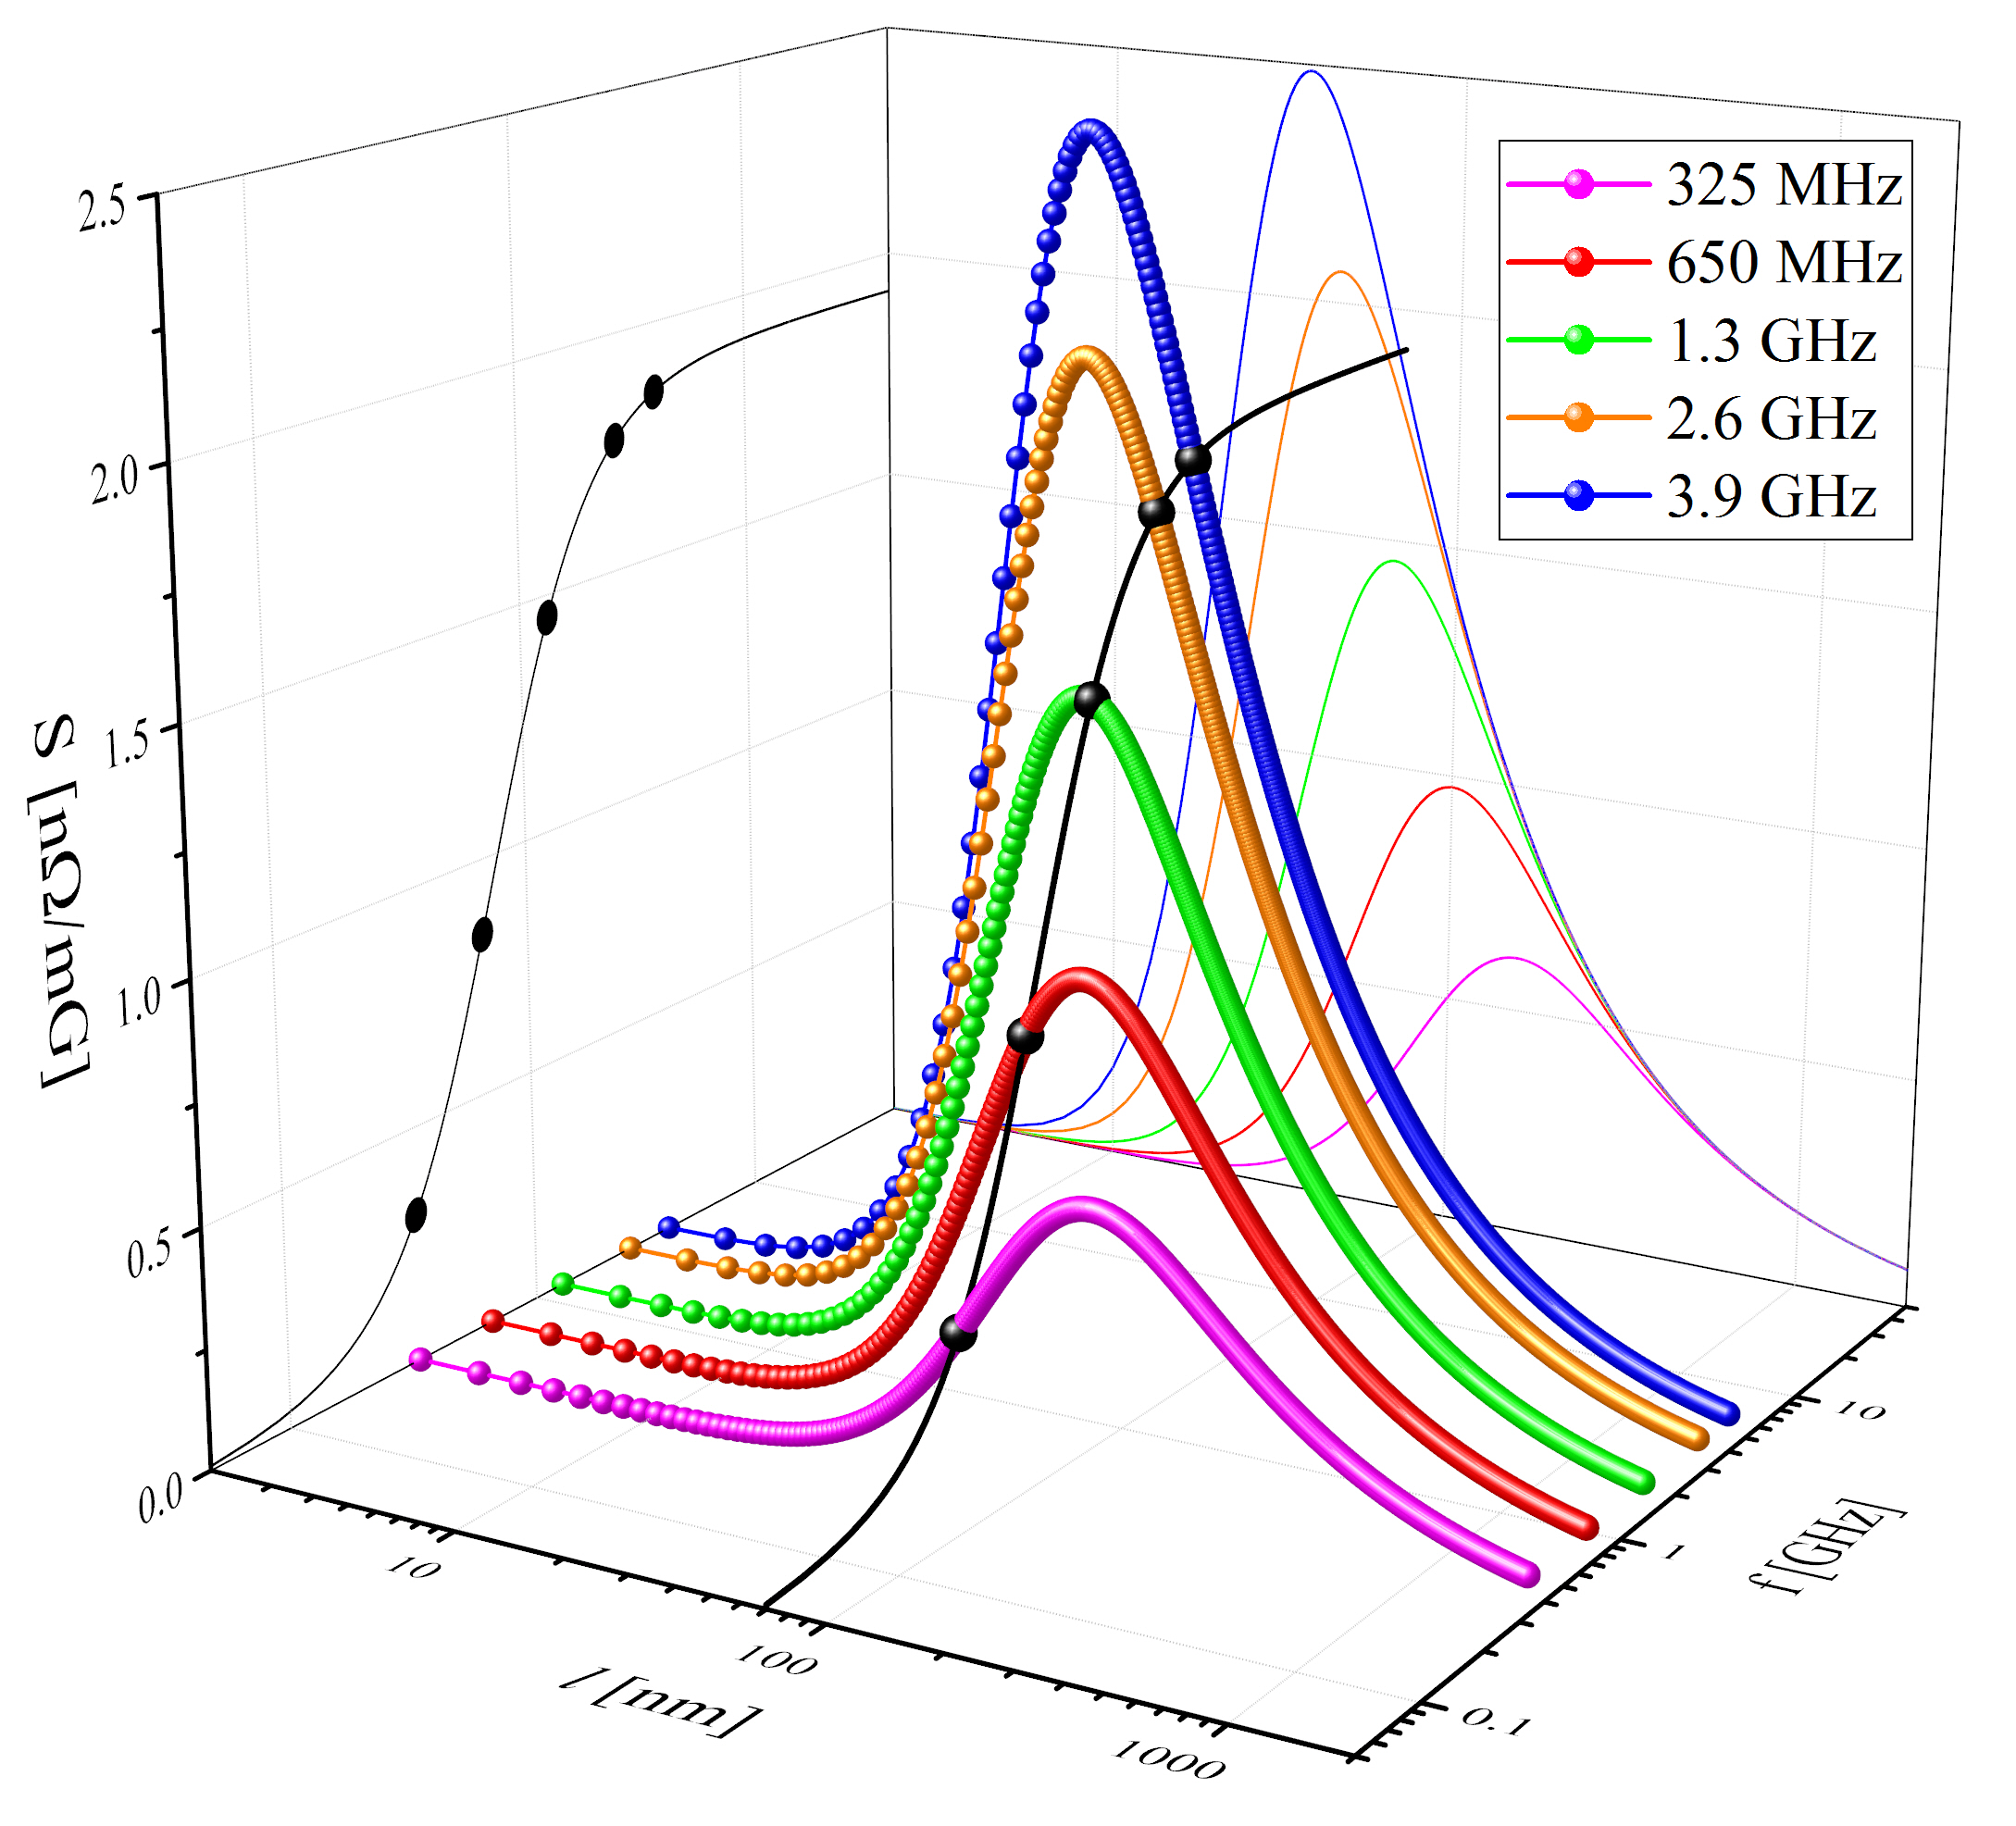
Sensitivity to trapped flux
  M. Checchin et al., Appl. Phys. Lett. 112, 072601 (2018)

Slide 13
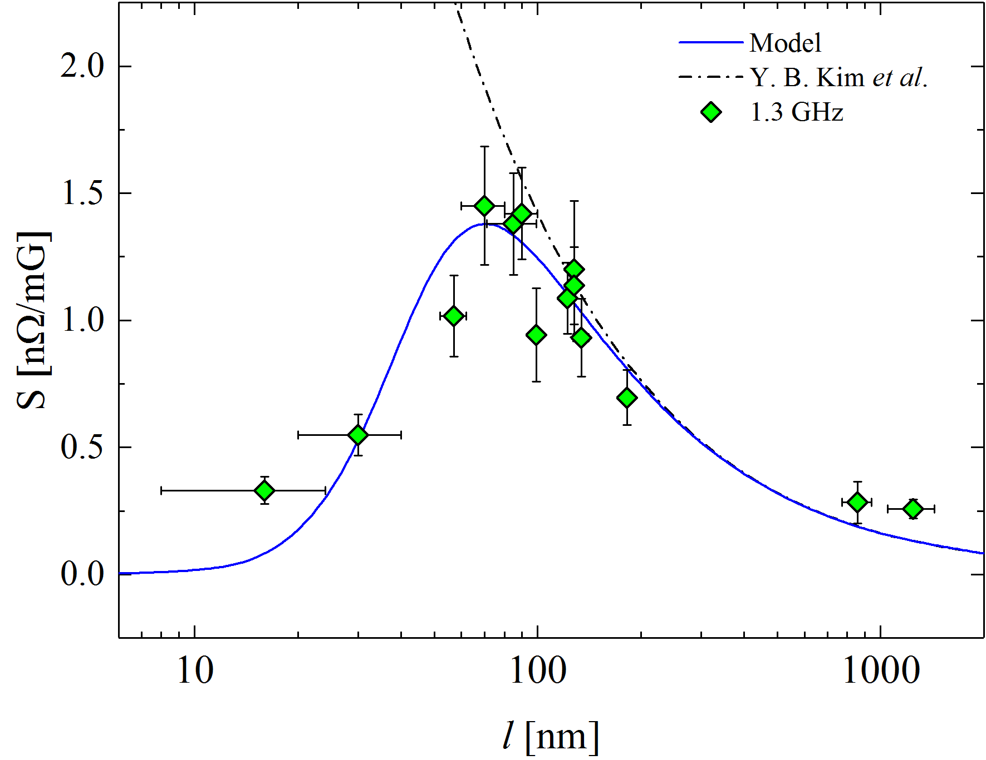
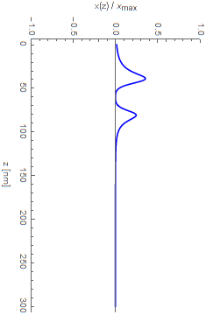
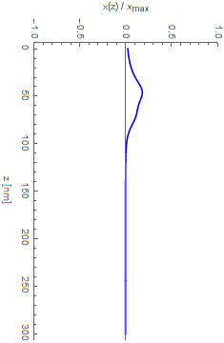
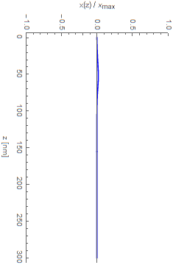
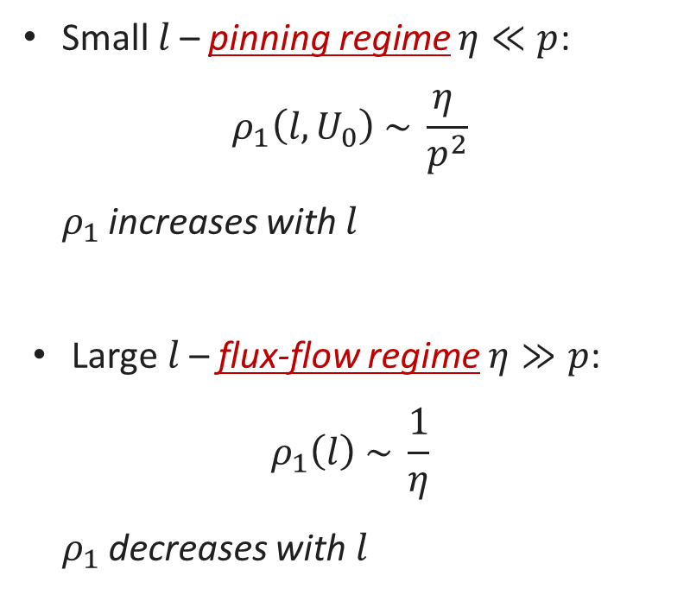



Mean-free-path dependence
Small $l$– pinning regime $η≪p$:
$$ρ_{1}\left(l,U_{0}\right) \sim \frac{η }{p^{2}}$$
  $ρ_{1}$ increases with $l$
Large $l$– flux-flow regime $η≫p$:
$$ρ_{1}\left(l\right) \sim \frac{1}{η}$$
  $ρ_{1}$ decreases with $l$
Pinning
regime
Flux-flow
regime
$$l = 5 nm$$
$$l = 70 nm$$
$$l = 500 nm$$
Pinning
  M. Checchin et al., Supercond. Sci. Technol. 30, 034003 (2017)
  M. Martinello et al., App. Phys. Lett. 109, 062601 (2016)

Slide 14
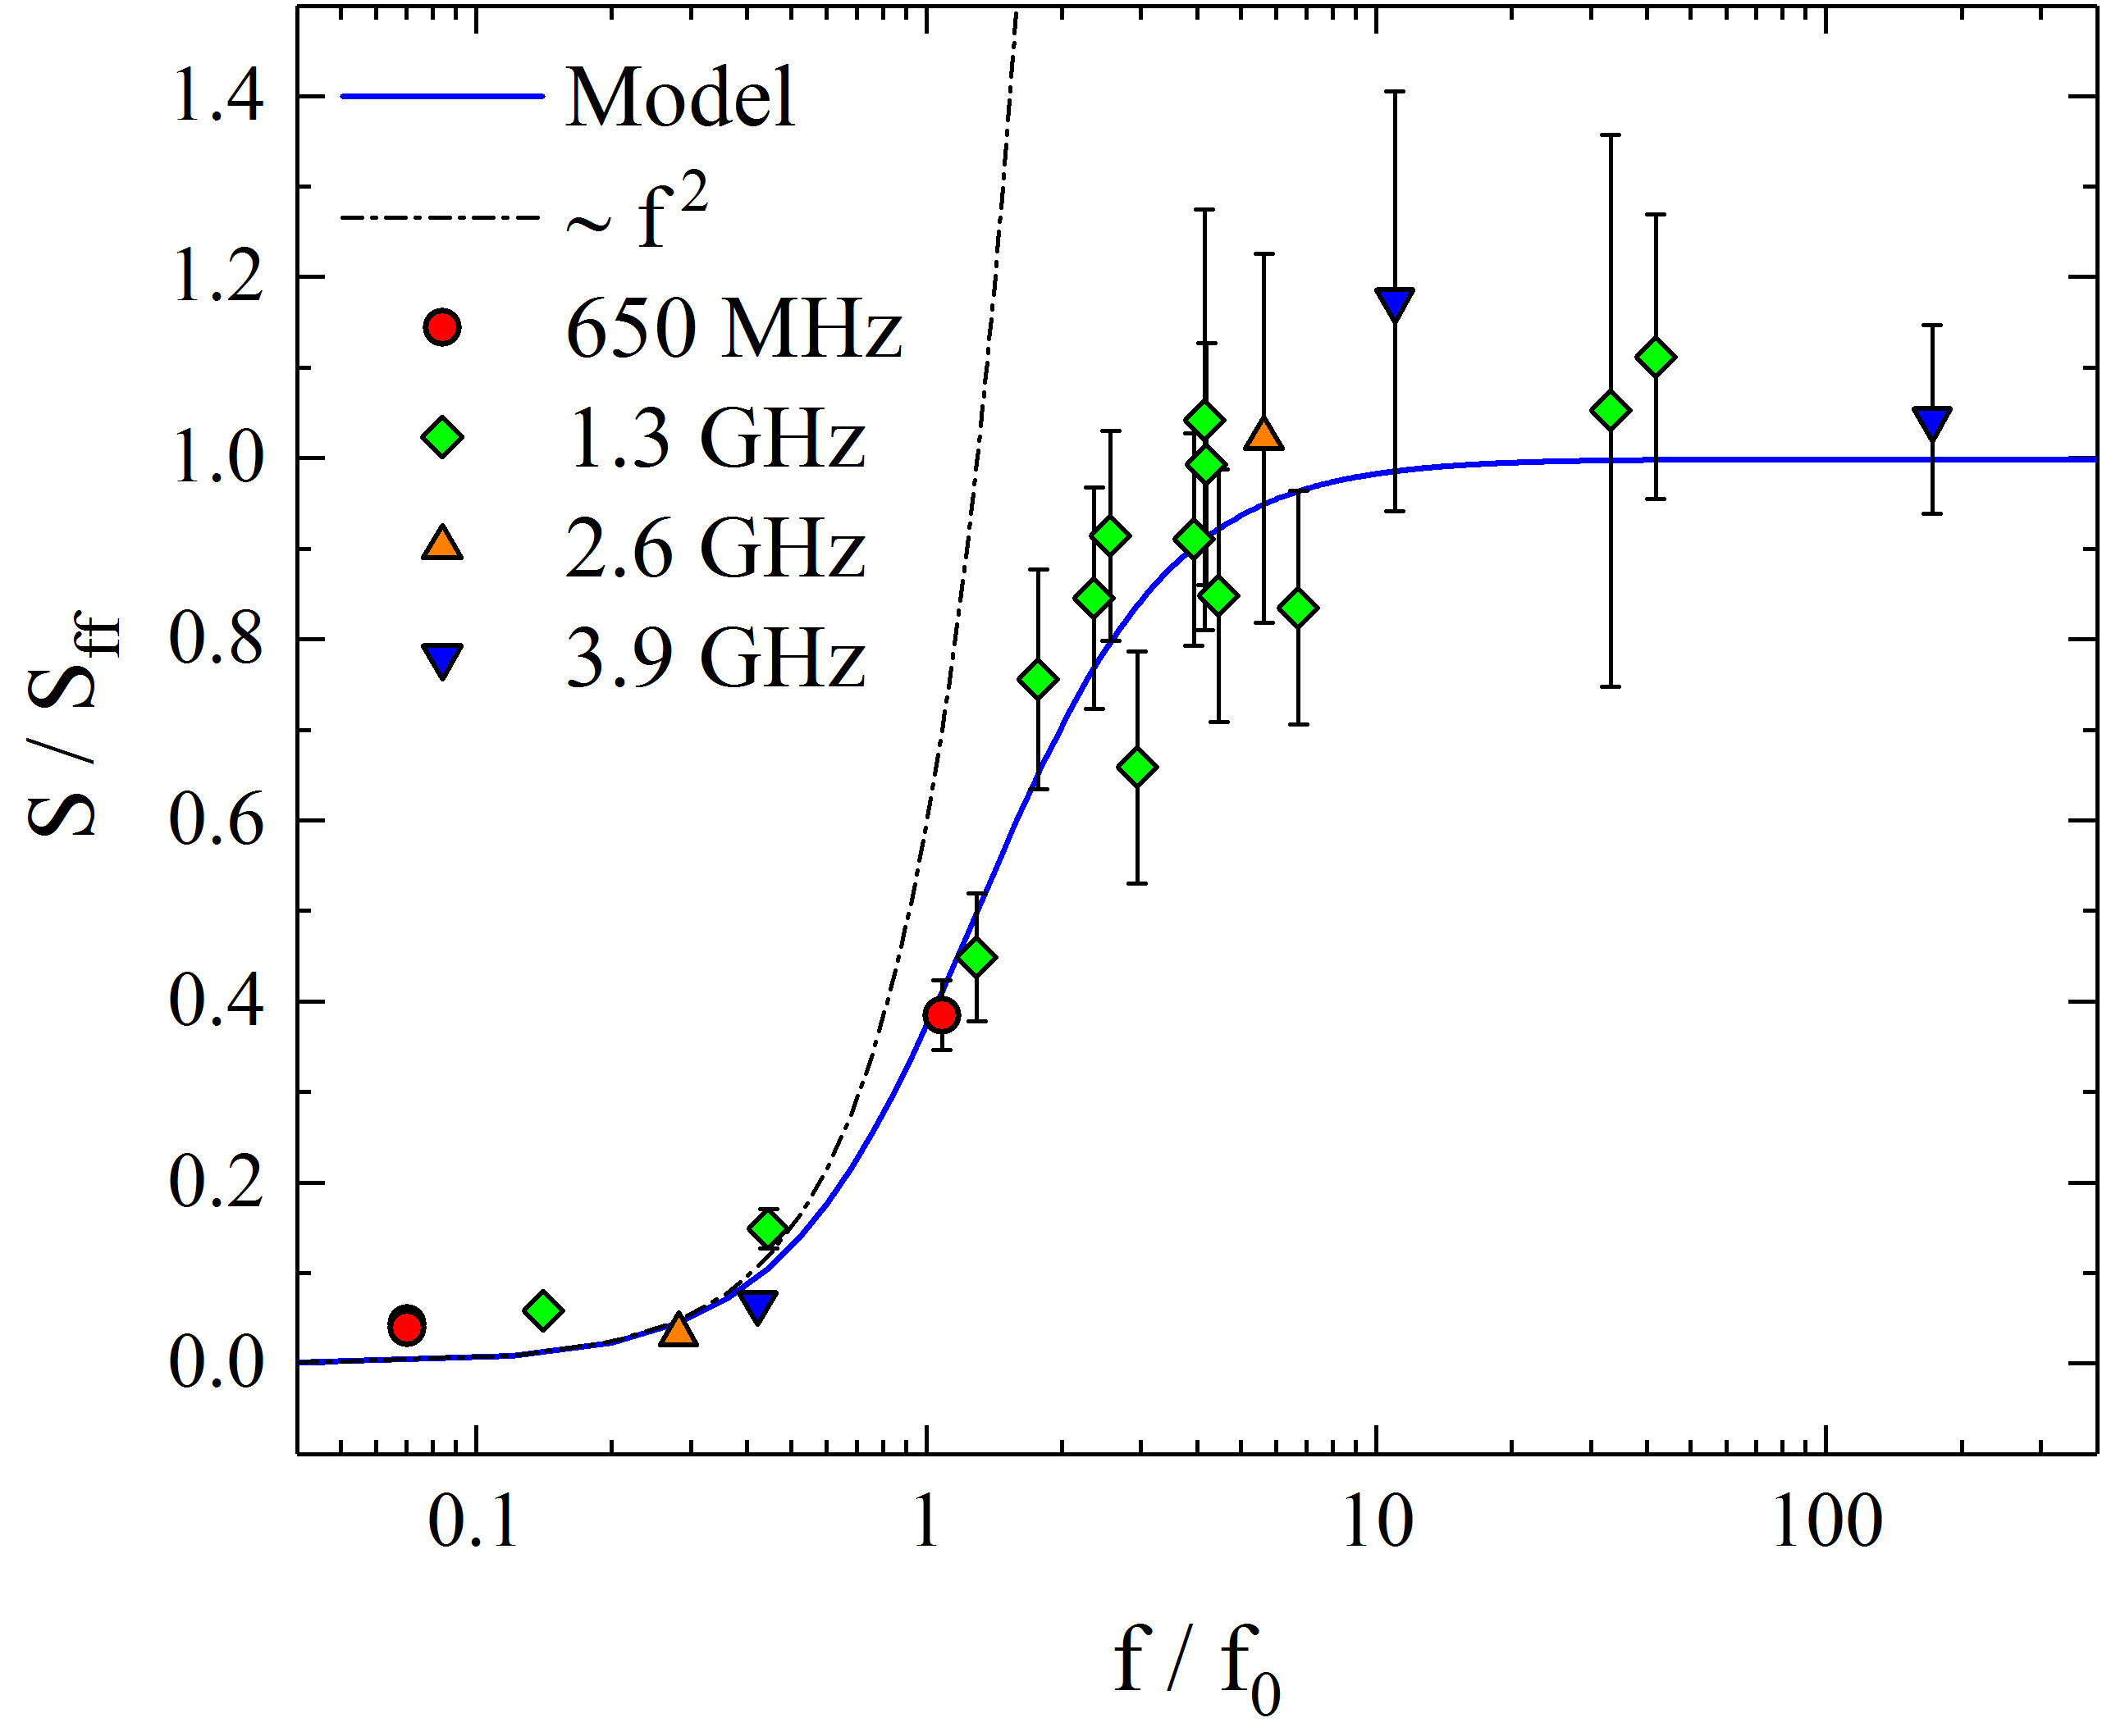
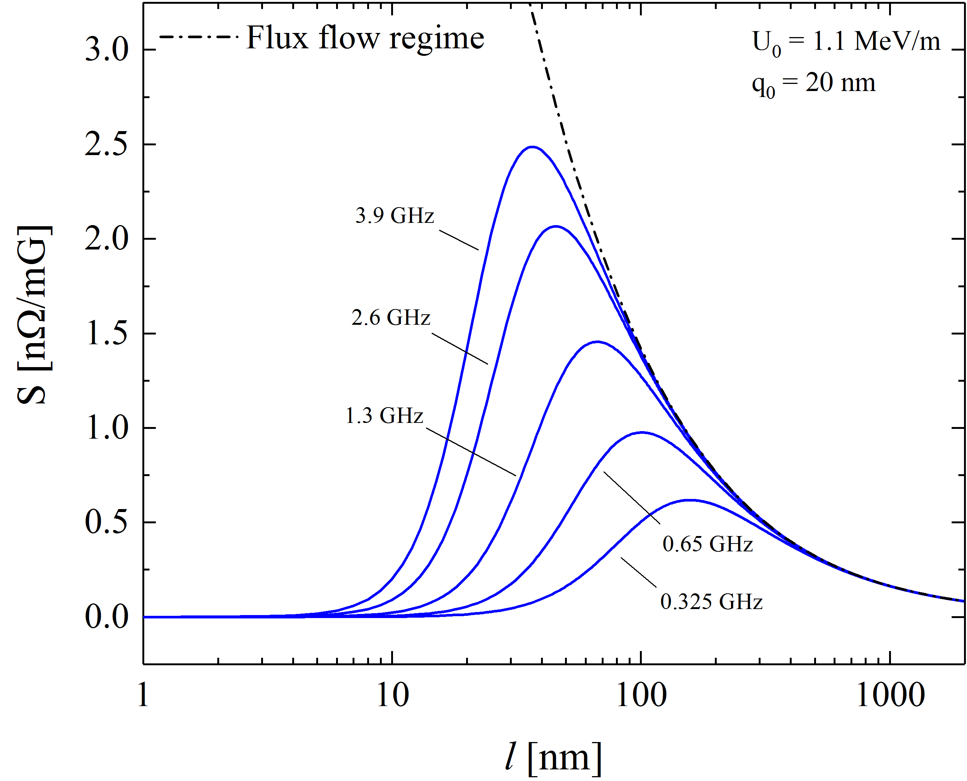
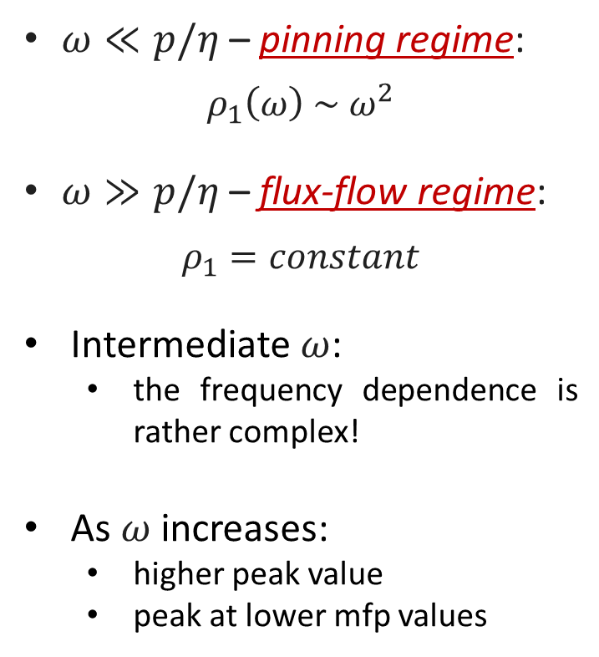
Frequency dependence
$ω≪p/η$ – pinning regime:
$$ρ_{1}\left(ω\right) \sim ω^{2}$$
$ω≫p/η$ – flux-flow regime:
$$ρ_{1}=constant$$
Intermediate $ω$:
  the frequency dependence is rather complex!
As $ω$ increases:
  higher peak value
  peak at lower mfp values
Pinning
regime
Flux-flow
regime
Increasing
frequency
  M. Checchin et al., Appl. Phys. Lett. 112, 072601 (2018)

Slide 15
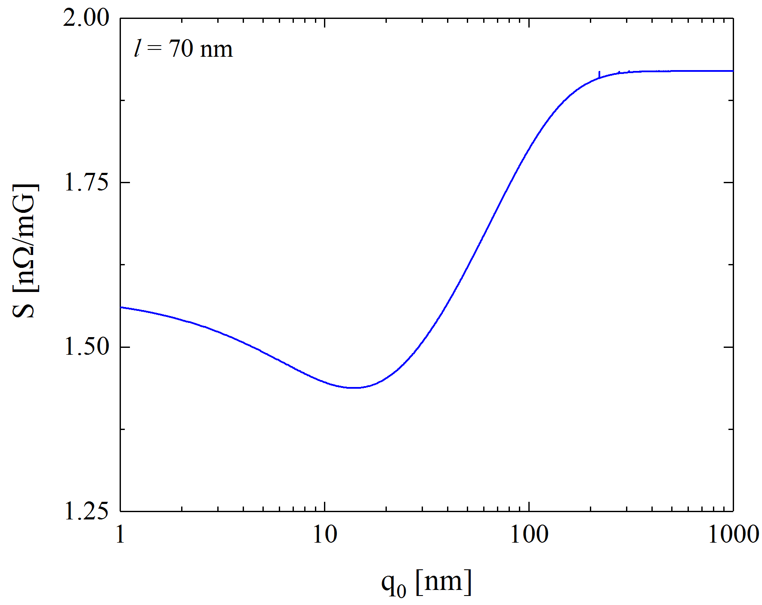
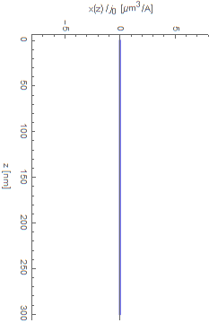
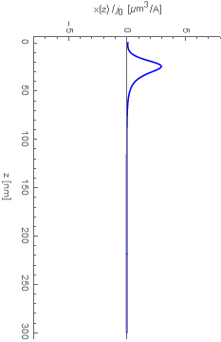
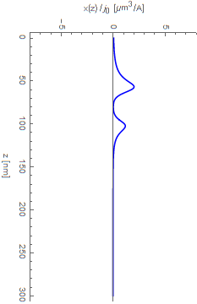




Pinning center depth dependence
$$x$$
$$j(t)$$
$$y$$
$$q_{0}$$
Pinning center
$$q_{0}=1000 nm$$
$$z$$
Sensitivity dependent on the pinning site distance from the surface
  Bulk pinning does not affect the vortex dissipation!
Pinning
Pinning
$$q_{0}=5 nm$$
$$q_{0}=80 nm$$
  M. Checchin et al., Supercond. Sci. Technol. 30, 034003 (2017)

Slide 16

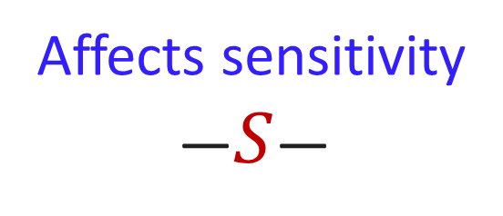

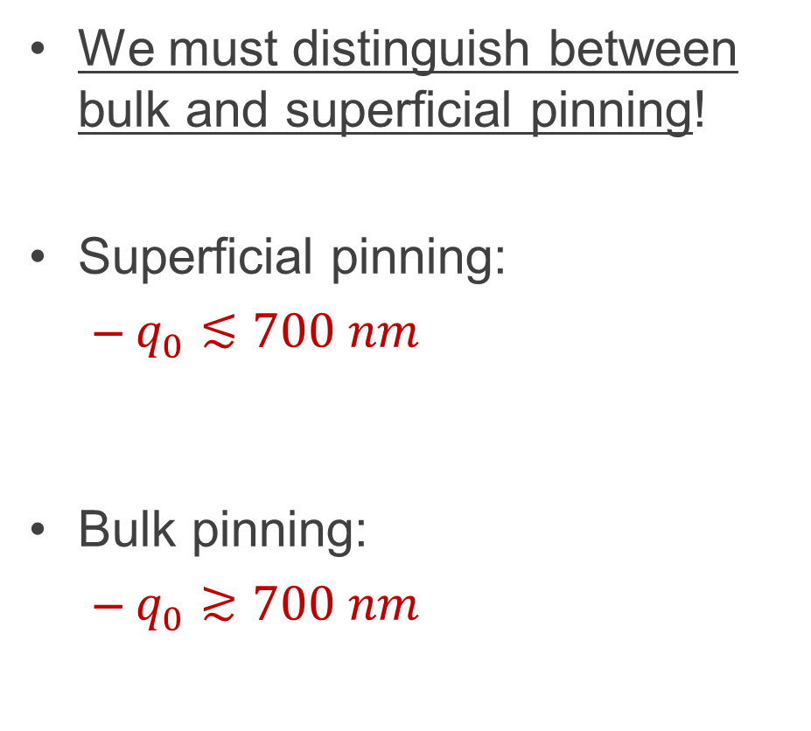




Superficial vs bulk pinning
$$x$$
$$j(t)$$
We must distinguish between bulk and superficial pinning!
Superficial pinning:
  $q_{0}≲700 nm$
Bulk pinning:
  $q_{0}≳700 nm$
$$q_{0}$$
$$y$$
Pinning center
$$z$$
Affects sensitivity
—$S$—
Affects flux trapping
—$η_{t}$—

Slide 17
Perspective on trapped flux sensitivity
in Nb thin films

Slide 18
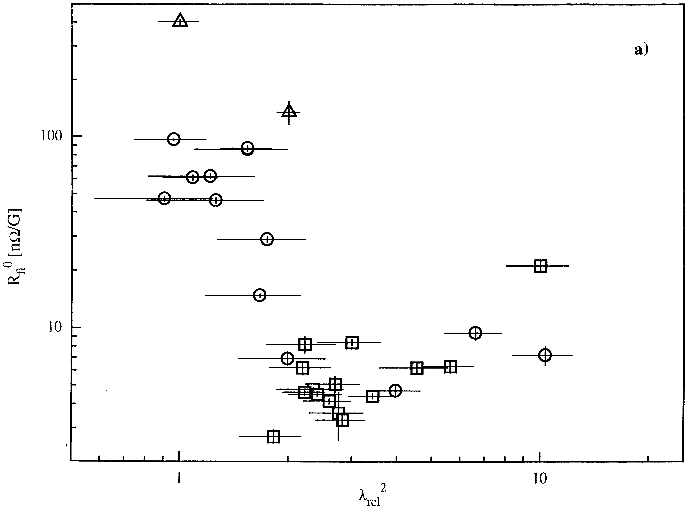

Sensitivity in Nb thin films
Nb thin films are much more defective than Nb bulk
We can expect higher pinning force for the same mean-free-path
The sensitivity is lower!
C. Benvenuti et al., Physica C 316, 153 (1999)
Porosities and defects in a Nb thin film
enhance the pinning force
$$λ_{rel}^{2}=1+\left(\frac{π}{2}\right)\left(\frac{ξ_{0}}{l}\right)$$
S. Aull et al., in Proc. SRF 2015

Slide 19
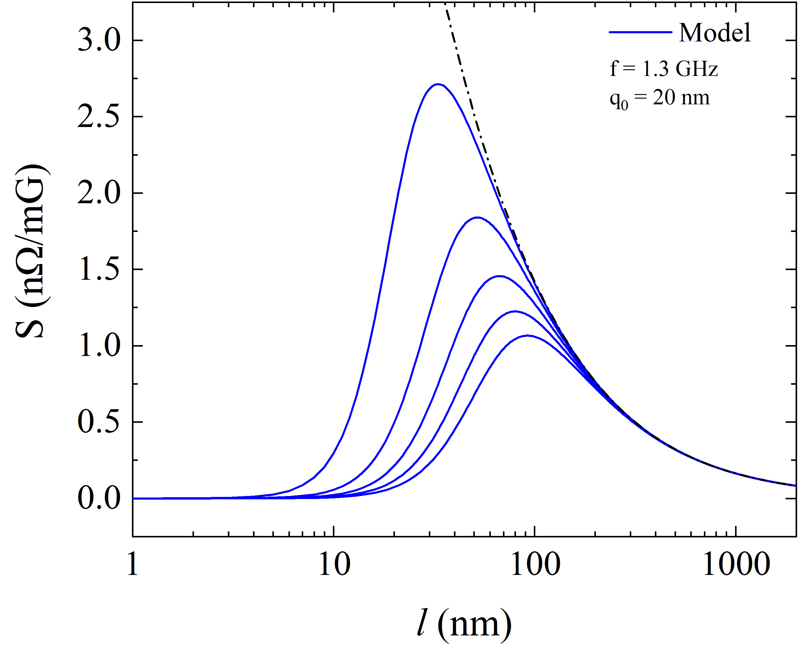
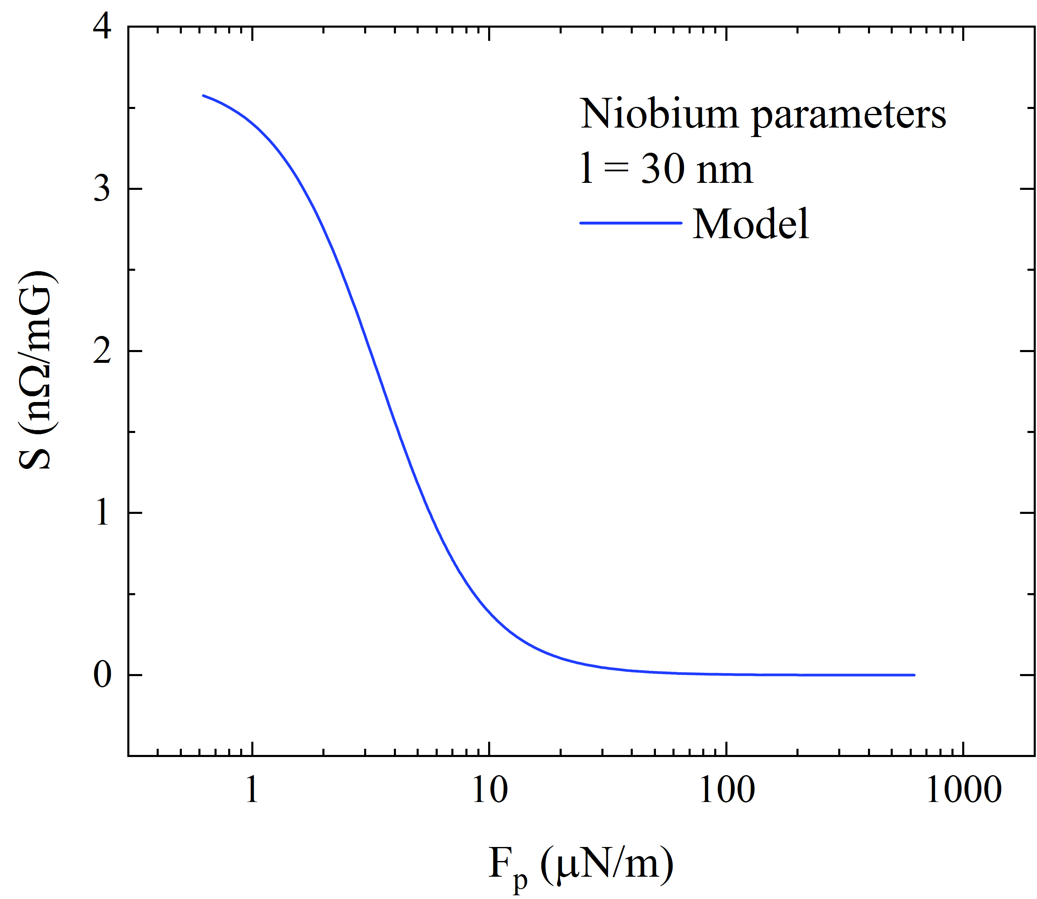
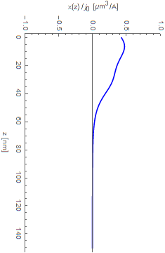
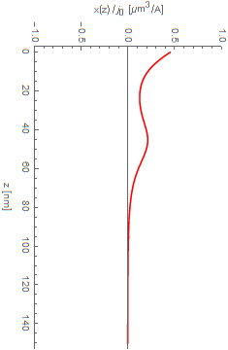
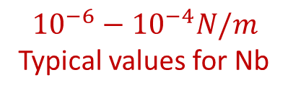


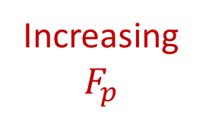
Pinning force dependence
Increasing
$$F_{p}$$
The higher the pinning force, the more constrained the oscillation
S decreases with pinning
$${10}^{−6}−{10}^{−4}N/m$$
Typical values for Nb
$$5.9∙{10}^{−6} N/m$$
$$2.5∙{10}^{−5} N/m$$
  L.H. Allen el al., Phys. Rev. B 39, 2054 (1989)
  G. S. Park el al., Phys. Rev. Lett. 68 1920, (1992)
Pinning

Slide 20


Qualitative description of the data
C. Benvenuti et al., Physica C 316, 153 (1999)
$$l=∞$$
Flux-flow regime
Pinning regime
$$λ_{rel}^{2}=1+\left(\frac{π}{2}\right)\left(\frac{ξ_{0}}{l}\right)$$

Slide 21
Qualitative description of the data
C. Benvenuti et al., Physica C 316, 153 (1999)
Mean-free-path increases
Pinning force decreases
$$l=∞$$
Flux-flow regime
Pinning regime
$$λ_{rel}^{2}=1+\left(\frac{π}{2}\right)\left(\frac{ξ_{0}}{l}\right)$$

Slide 22
Qualitative description of the data
C. Benvenuti et al., Physica C 316, 153 (1999)
Large scattering in pinning potential?
$$l=∞$$
Flux-flow regime
Pinning regime
$$λ_{rel}^{2}=1+\left(\frac{π}{2}\right)\left(\frac{ξ_{0}}{l}\right)$$

Slide 23
Conclusions

Slide 24

Conclusions
Trapped Flux Sensitivity is a near-surface property
Two regimes of dissipation:
  Pinning regime for $p≫η$ or $ω≪p/η$
    $S$ increases if $l↑$ and $ω^{2}↑$
  Flux-flow regime for $p≪η$ or $ω≫p/η$
    $S$ decreases if $l↑$, but independent on $ω$
Field dependence:
  Linear dependence up to a threshold field
  Slope increases rapidly after the threshold field
  Similar behavior for different treatments
Pinning dependence:
  The stronger the pinning the lower the sensitivity
  Lower sensitivity in thin films most likely due to stronger pinning points

Slide 25
Acknowledgments
M. Martinello, FNAL
A. Grassellino, FNAL
A. Romanenko, FNAL
S. Posen, FNAL
A. Melnychuck, FNAL
D. A. Sergatskov, FNAL
D. Bice, FNAL
S. Chandrasekaran, FNAL
Z.-H. Sung, FNAL
S. Belomestnykh, FNAL
Thank you for Your Attention

