Slide 1




Universita’ di Napoli Federico II
Dipartimento di Fisica
Istituto SPIN-CNR
Ruggero Vaglio
A simple model for the RF field dependence
of the trapped flux sensitivity
based on a non-linear pinning force
In collaboration with:
Sergio Calatroni

Slide 2
The improvement of SRF cavities has recently motivated a renewed research
effort on the effect of trapped magnetic flux on the surface resistance.
The relevant parameter is the “trapped flux sensitivity” defined as the ratio of the surface resistance due to trapped flux and the trapped magnetic field.
C. Benvenuti, S. Calatroni, I.E. Campisi, P. Darriulat, M.A. Peck, R. Russo and A-M Valente, “Study of the surface resistance of superconducting niobium films at 1.5 GHz”, Physica C 316 (1999) 153-188
A linear dependence of the flux sensitivity S is generally
experimentally observed, at least at low rf field amplitude

Slide 3
A linear dependence of the flux sensitivity is generally experimentally observed, for many different cavities shape and operating frequency
Author | Frequency [MHz] | R_{fl}º [nΩ/G] | R_{fl}¹ [nΩ/(G·mT)]
Piosczyk [1] | 91 / 160 / 290 | 3.5 / 9.5 / 28 | 0.35 / 0.55 / 0.9
Arnolds-Mayer [2] | 500 | 150 | 5
Checchin [3] | 650 / 1300 / 2600 / 3900 | 700 / 1000 / 1500 / 1900 | 1.6 / 2.6 / 6.1 / 7.4
Miyazaki [4] | 101 | 3.2 | 0.32
Benvenuti [5] | 1500 | 3.3 / 56 | 0.91 / 4.5
B. Piosczyk, P. Kneisel, O. Stoltz, J. Halbritter, "Investigation of Additional Losses in Superconducting Niobium Cavities due to Frozen-in Flux", IEEE Trans. Nucl. Sci. 20 (1973) 108-112
G. Arnolds-Mayer and W. Weingarten, “Comparative Measurements on Niobium Sheet and Sputter Coated Cavities”, IEEE Trans. Mag. 23 (1987) 1620-1623.
M. Checchin, M. Martinello, A. Grassellino, S. Aderhold, S. K. Chandrasekaran, O. S. Melnychuk, S. Posen, A. Romanenko, and D. A. Sergatskov, “Frequency dependence of trapped flux sensitivity in SRF cavities”, Appl. Phys. Lett. 112, 072601 (2018)
H. Padamsee, J. Knobloch and T. Hays, “RF Superconductivity for Accelerators”, John Wiley & Sons, New York, 1998, ISBN 978-0471154327
C. Benvenuti, S. Calatroni, P. Darriulat, M.A. Peck and A-M Valente, “Fluxon pinning in niobium films”, Physica C 351 (2001) 429-437.

Slide 4
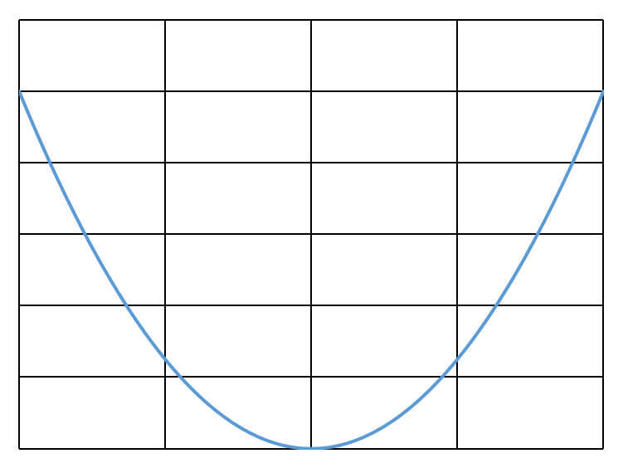
The first model describing the surface impedance due to flux flow is
due to Gittleman and Rosenblum (GL, Phys Rev. Lett. 16, 734, 1966)
y
d<<λ,δ
z
x
x
(all quoted forces are per unit lenght)

Slide 5
depinning
frequency
this result represents the so called «static model»
that well describes the experimental results for bulk SRF in that regime
( )

Slide 6
Model evolutions
- Keeping the GR approach, if the condition d<<λ,δ is removed,
one can calculate the average resistivity due to flux oscillations :
many authors
(es. Calatroni, Vaglio IEEE TAS 27 2017)
- A further improvement is to consider a non uniform Lorentz force
along the z direction, and an angle θ between field and current :
(Checchin et al SUST 30 2017)
- It is also possible to consider non-rigid fluxons:
(Gurevitch, Ciovati PRB 87 2013)
In all cases R_{fl} is independent of B_{rfo} , as expected
from first principles for linear harmonic oscillations

Slide 7
Proposed non-linear model (simple extension of the GL approach)
S. Calatroni and R.Vaglio, submitted PRE, Arxiv 1810.00540
Duffing approximation
with
(as in the linear case !)

Slide 10
Validity limits
C. Benvenuti, S. Calatroni, I.E. Campisi, P. Darriulat, M.A. Peck, R. Russo and A-M Valente, “Study of the surface resistance of superconducting niobium films at 1.5 GHz”, Physica C 316 (1999) 153-188

Slide 11
Model vs experimental results : vs correlation
C. Benvenuti, S. Calatroni, I.E. Campisi, P. Darriulat, M.A. Peck, R. Russo and A-M Valente, “Study of the surface resistance of superconducting niobium films at 1.5 GHz”, Physica C 316 (1999) 153-188
In the model the relation is strictly linear
only if the change is due to a change
in the pinning force k

Slide 12
Model vs experimental results : frequency dependence
B. Piosczyk, P. Kneisel, O. Stoltz, J. Halbritter, IEEE Trans. Nucl. Sci. 20 (1973) 108-112
M. Checchin, M. Martinello, A. Grassellino, S. Aderhold, S. K. Chandrasekaran, O. S. Melnychuk, S. Posen, A. Romanenko, and D. A. Sergatskov, Appl. Phys. Lett. 112, 072601 (2018)
(a different behavior is
predicted for )
model result for

Slide 13
Conclusions :
Linear GL-type approach to the flux flow dissipation give
a rf field amplitude (B_{rfo} ) independent surface resistance R_{fl}
Experiments clearly show a linear dependence of R_{fl} on B_{rfo},
at least at low fields
A simple non-linear extension of the GL-type approach
reproduces the correct R_{fl} linear dependence on B_{rfo}
The observed strong correlation between Rº_{fl} and R¹_{fl}
naturally emerges from the introduced non-linear model
The model predicts the linear frequency dependence of R¹_{fl} ,
observed in the experiments, but only in the limit ω<ω_{o}
The model is far too semplified to fully account for the flux flow
dissipation complex phenomena, but can give useful hints
towards the developement of a more complete treatment.

