Slide 1
Interoperability and data for open science
LODES Workshop,6 September 2018 in Frascati
Carthage SMITH
OECD Global Science Forum Lead Co-ordinator

Slide 2
Principles and Guidelines
“OECD Principles and Guidelines for Access to Research Data from Public Funding (2007)”:
H. Interoperability
Technological and semantic interoperability is a key consideration in enabling and promoting international and interdisciplinary access to and use of research data. Access arrangements, should pay due attention to the relevant international data documentation standards. Member countries and research institutions should co-operate with international organisations charged with developing new standards…
http://www.oecd.org/science/sci-tech/38500813.pdf

Slide 3
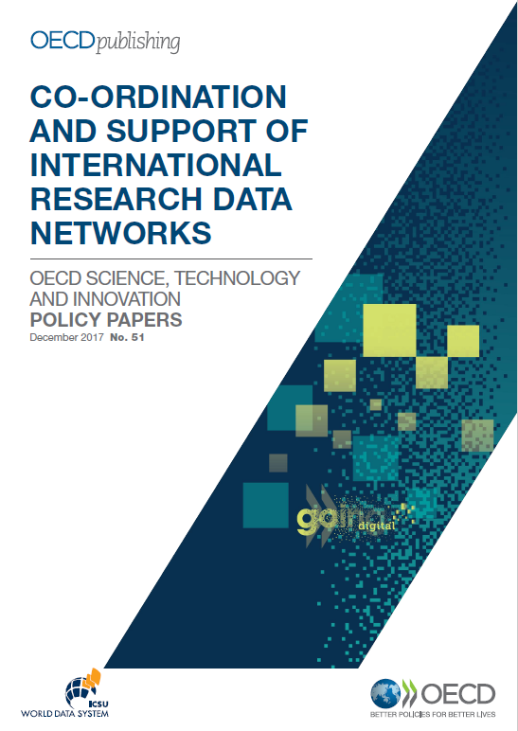
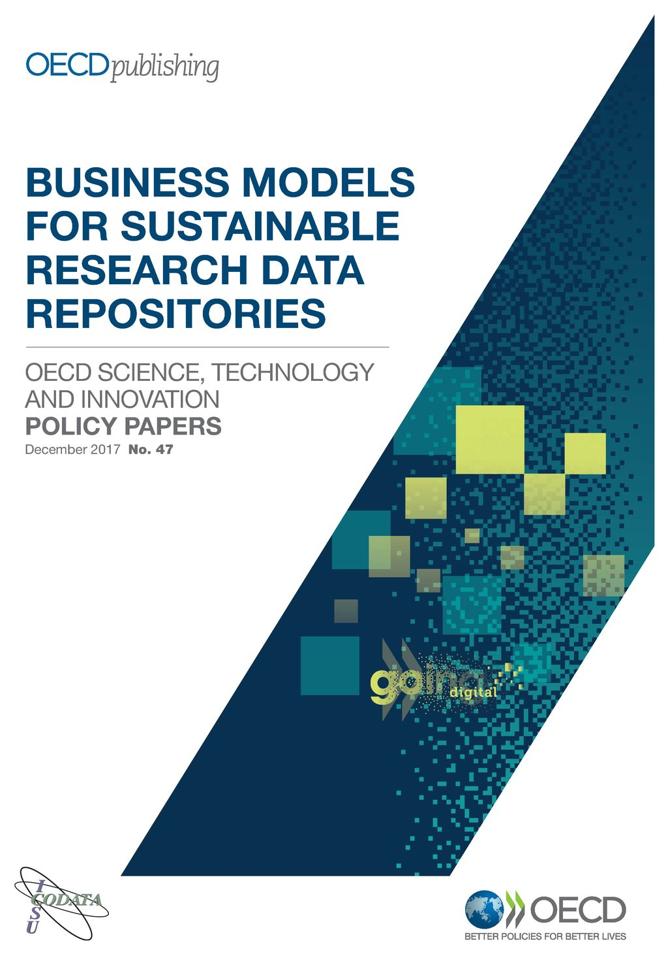
Recent OECD/GSF policy reports

Slide 4
Making Open Science a Reality (2015)
Focus on open access to publications, open research data and open collaboration enabled through ICTs
…. open science is a broader concept that also includes the interoperability of scientific infrastructure, open and shared research methodologies (such as open applications and informatics code), and machine-friendly tools allowing, for example, text and data mining.
https://doi.org/10.1787/5jrs2f963zs1-en

Slide 5
Co-ordination and Support of International Research Data Networks
Aim: Establish principles and policy actions regarding the governance and underpinning services that can accelerate the establishment of open and sustainable global science data infrastructures
April 2015 – December 2017
Case studies of 31 international networks from different domains
Multi-stakeholder workshop
Final report and Policy Recommendation (December 2017)
https://www.innovationpolicyplatform.org/open-data-science-oecd-project

Slide 6
Networks and interoperability
Another approach is to translate or broker across multiple defined standards to enable interoperability across diverse systems.
Regardless of the approach to interoperability, it works best when there is a good understanding of the different roles of the different players in the network.
In practice, it [Interoperability] is a complex process of human negotiations and trust building.
Interoperability is still largely viewed as a technical problem, but the most difficult aspects of interoperability are rooted in human relationships and trust.

Slide 7
Business Models for data repositories platforms

Slide 8
OECD Workshop on Open Research Data, March, 2018
Towards New Principles for Enhanced Access to Public Data for Science, Technology and Innovation
Agenda
Data governance and trust for science, technology and innovation
Data standards, interoperability and re-use
Definition of responsibility and ownership
Recognition and reward systems for data providers and stewards
Business models for open data provision
Building human capital and institutional capabilities

Slide 9
Research data and interoperability
Interoperability has 3 aspects:
semantic (scientific vocabulary),
legal (rights) and
technical (machine readability).
interoperability across disciplines is a challenge. It should not be over-specified but need real use cases to guide/test .
The Research Data Alliance (RDA) recommendations address a broad range of issues related to interoperability of data, data citation, data catalogues, various standards and research data publishing.
With regards to standards need flexibility and an ‘hour-glass’ approach is most compatible with speed of change in this area.

Slide 10
Five take-home messages
Don’t re-invent the wheel
Ensure complementarity with other initiatives such as EOSC.
Carefully consider your business model at the outset
Engage users (actual and potential) to define needs
Don’t just focus on the technical but also address the social aspects.

