Slide 1
Objectives of LODES and of the meeting - A recap Roberto Barbera (roberto.barbera@ct.infn.it) on behalf of the LODES Scoping Group
LODES18 Workshop
Frascati (Italy), 6 September 2018

Slide 2
Outline
Introduction and driving considerations
LODES «at a glance»
Towards the Scoping Group Report
Workshop agenda (to set the roadmap to the Report)

Slide 3
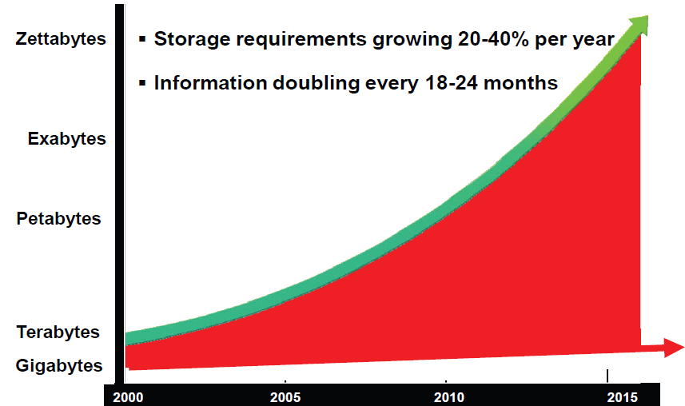
The recent global data growth…
(10²¹ Bytes)
More information created in the
last 50 years than since the
homo sapiens walks
on Earth
(10¹⁸ Bytes)
(10¹⁵ Bytes)
(10¹² B)
(10⁹ B)

Slide 4
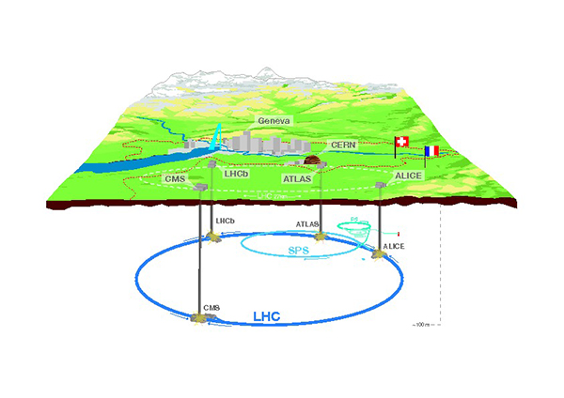
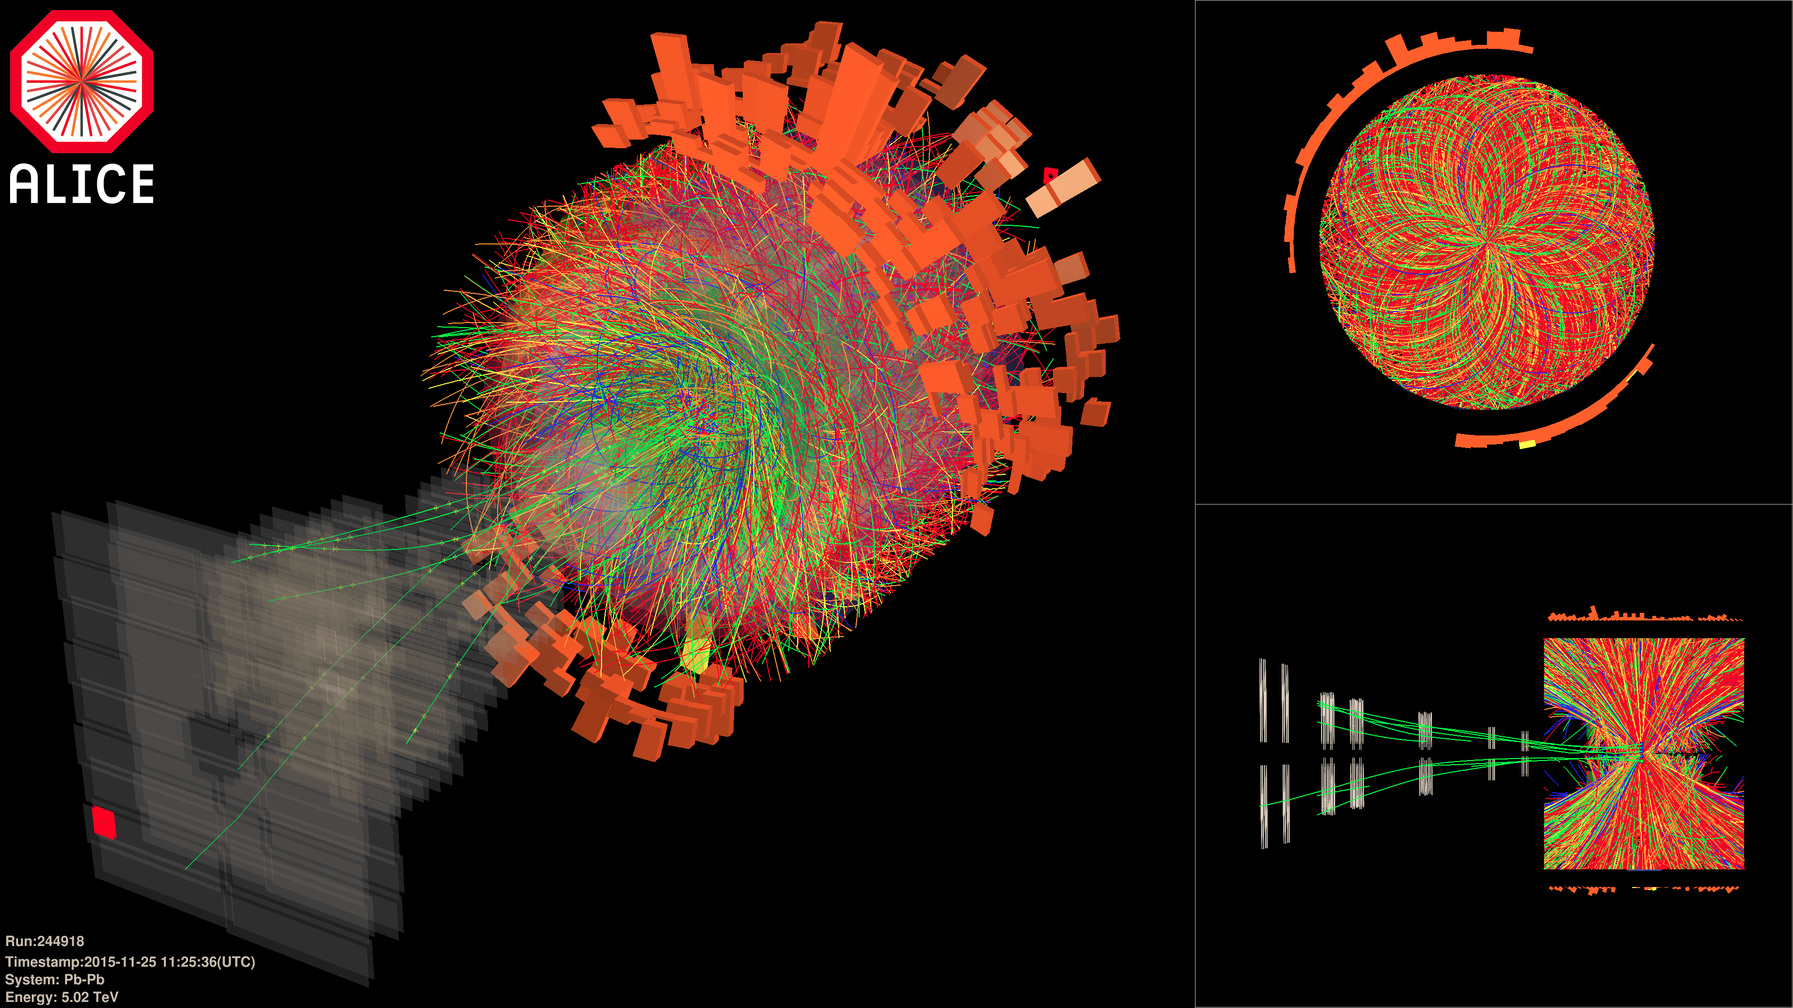
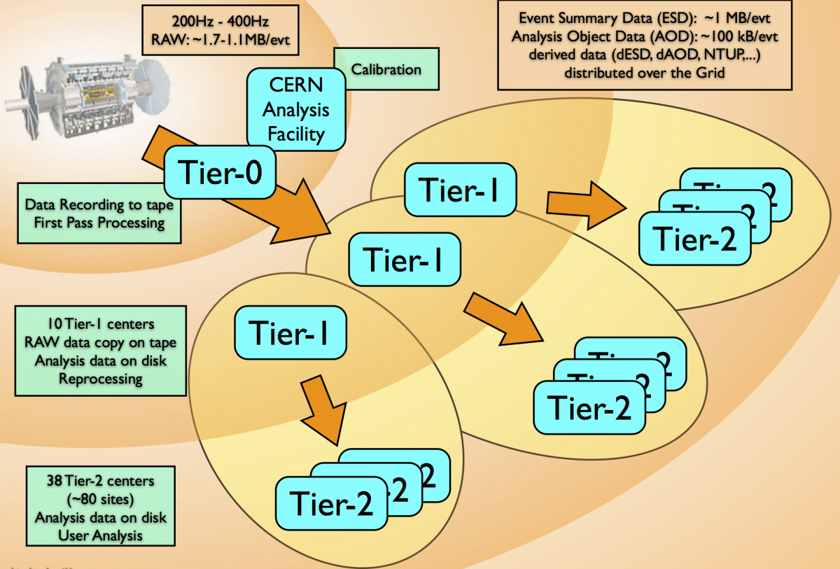
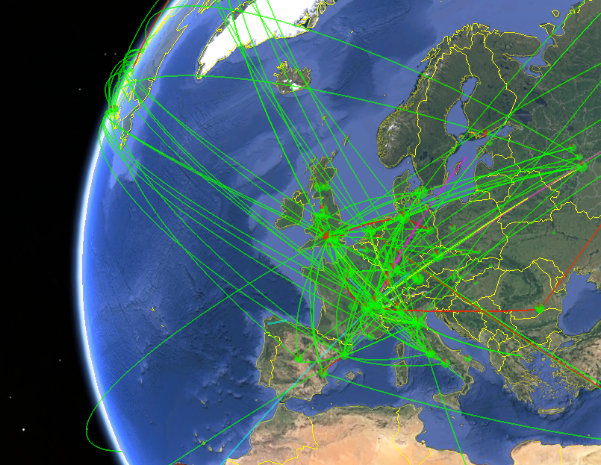
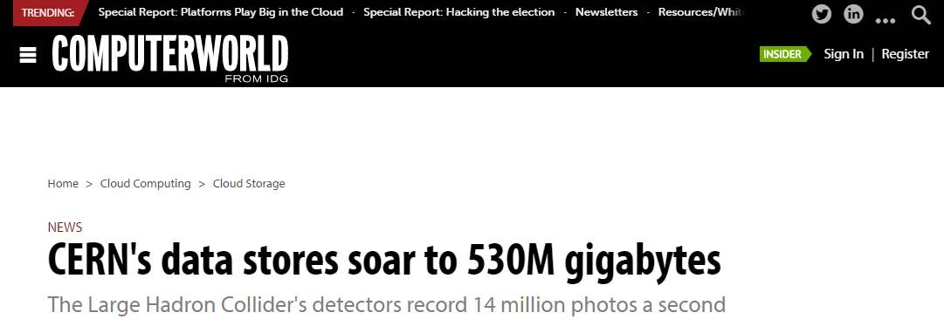
Increase of scientific data (High Energy Physics)
0.5 EB = 500 PB = 0.5·10¹⁸ Bytes
14 milion pictures a second

Slide 5
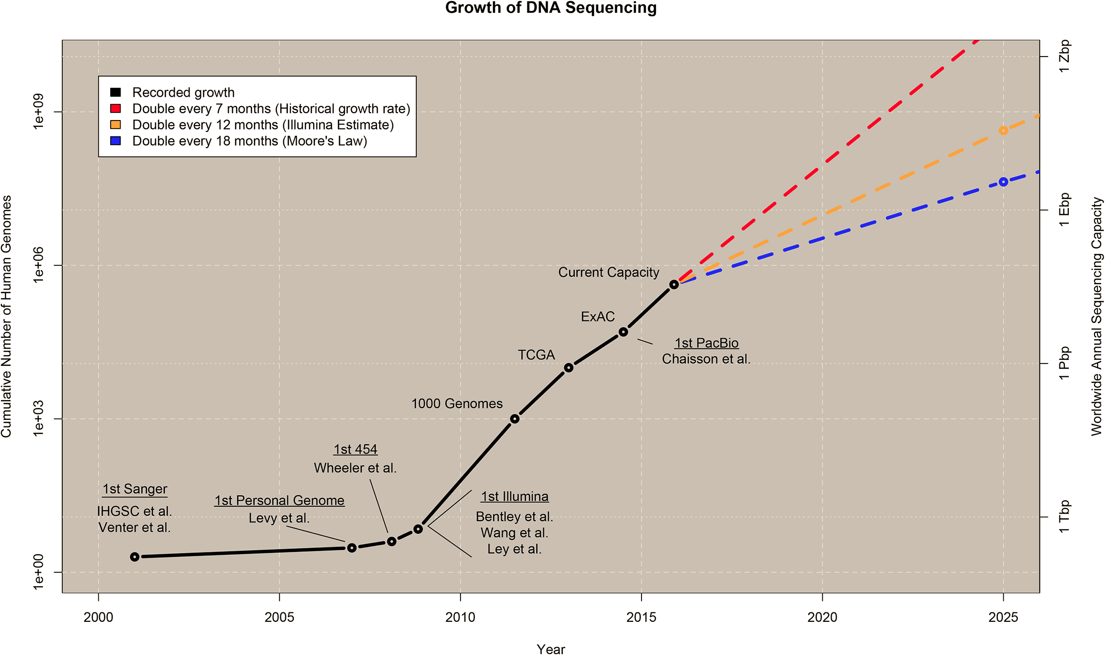
Increase of scientific data (Life Sciences)
Global growth of human DNA sequencing (per year)
1 ZB
x2 every year
x2 every 7 months
x2 every 18 months
1 EB
10⁶
1 PB
10³
1 TB
2010
2015
2020
2025

Slide 6
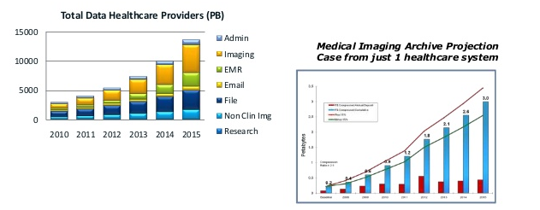
Increase of health data (Medical images – US data)
^{PB}
3
2
1
2009
2011
2013
2015
Estimate for 2020: 35 ZB, +4400% w.r.t. 2009
Source: McKinsey Global Institute Analysis – ESG Research Report 2011 –
North American Health Care Provider Market Size and Forecast

Slide 7
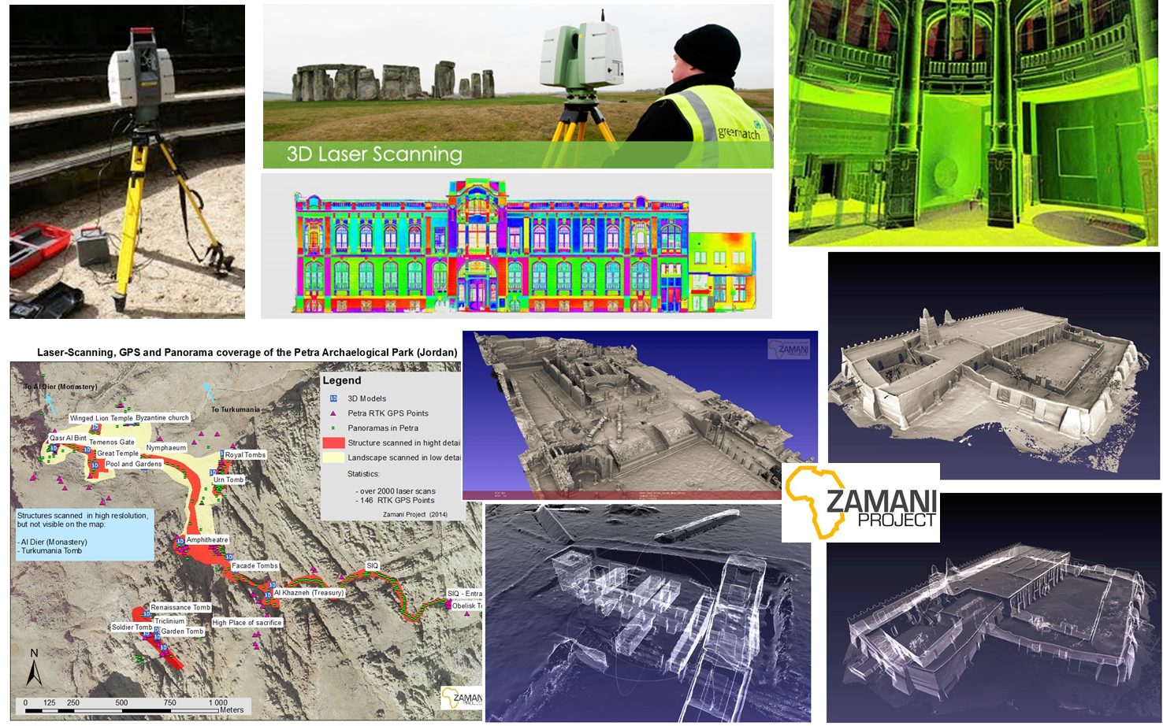
«Big Data» in Cultural Heritage

Slide 8
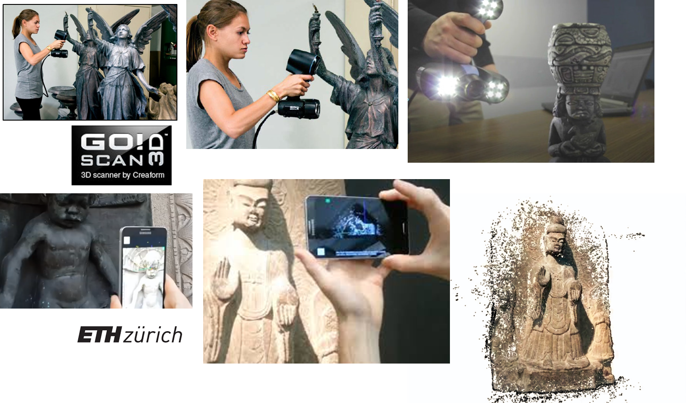
«Big Data» in Cultural Heritage

Slide 9
The «(re-)’s» of Science

Slide 10
Definitions adopted about data (FAIR data) (https://www.force11.org/group/fairgroup/fairprinciples)
To be Findable:
F1. (meta)data are assigned a globally unique and eternally persistent identifier.
F2. data are described with rich metadata.
F3. (meta)data are registered or indexed in a searchable resource.
F4. metadata specify the data identifier.
To be Accessible:
A1 (meta)data are retrievable by their identifier using a standardized communications protocol.
A1.1 the protocol is open, free, and universally implementable.
A1.2 the protocol allows for an authentication and authorization procedure, where necessary.
A2 metadata are accessible, even when the data are no longer available.
To be Interoperable:
I1. (meta)data use a formal, accessible, shared, and broadly applicable language for knowledge representation.
I2. (meta)data use vocabularies that follow FAIR principles.
I3. (meta)data include qualified references to other (meta)data.
To be Re-usable:
R1. meta(data) have a plurality of accurate and relevant attributes.
R1.1. (meta)data are released with a clear and accessible data usage license.
R1.2. (meta)data are associated with their provenance.
R1.3. (meta)data meet domain-relevant community standards.

Slide 11
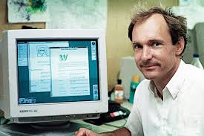
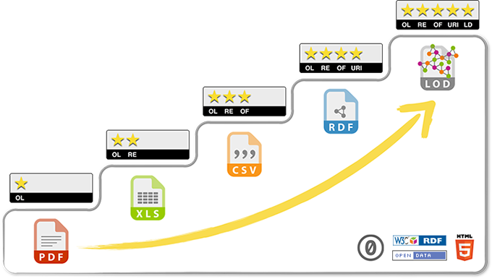
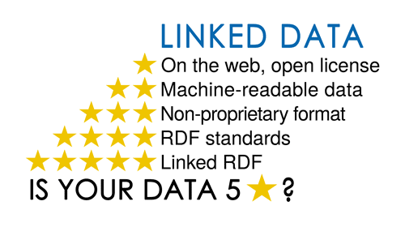
Open Data “stars” (http://5stardata.info/en/)

Slide 12
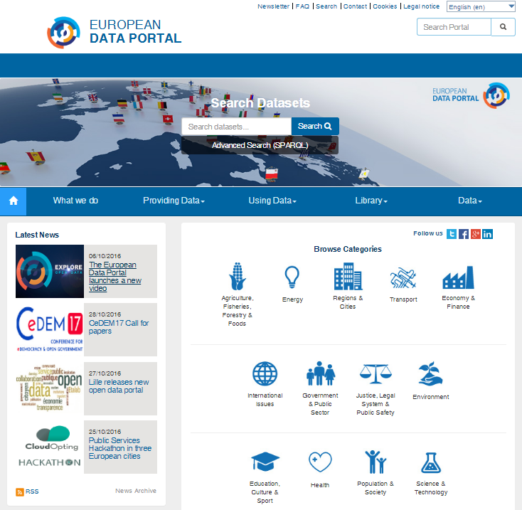
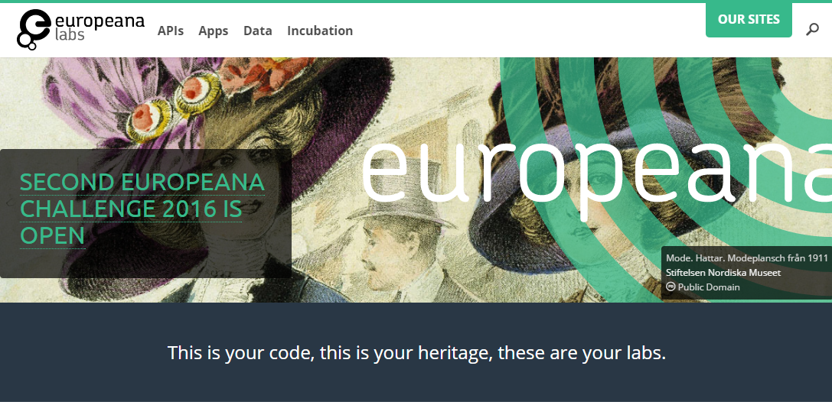
Some sources of Linked Open Data

Slide 13
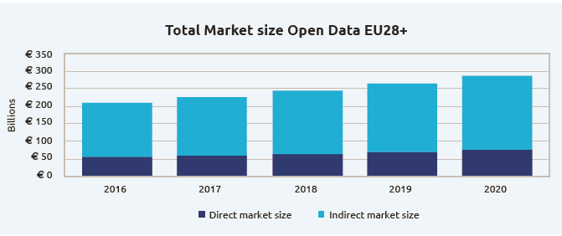
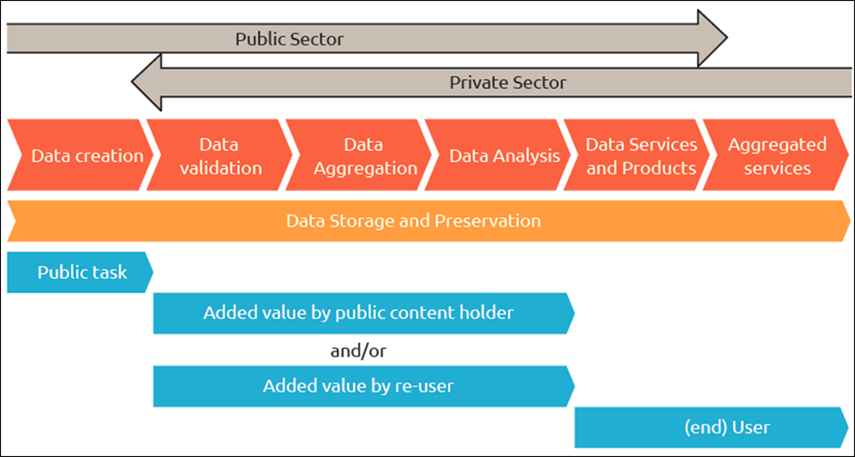
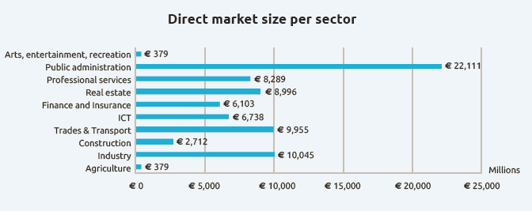
The value (chain) of Open Data
Billions of €
Millions of €
https://www.europeandataportal.eu/sites/default/files/edp_creating_value_through_open_data_0.pdf

Slide 14
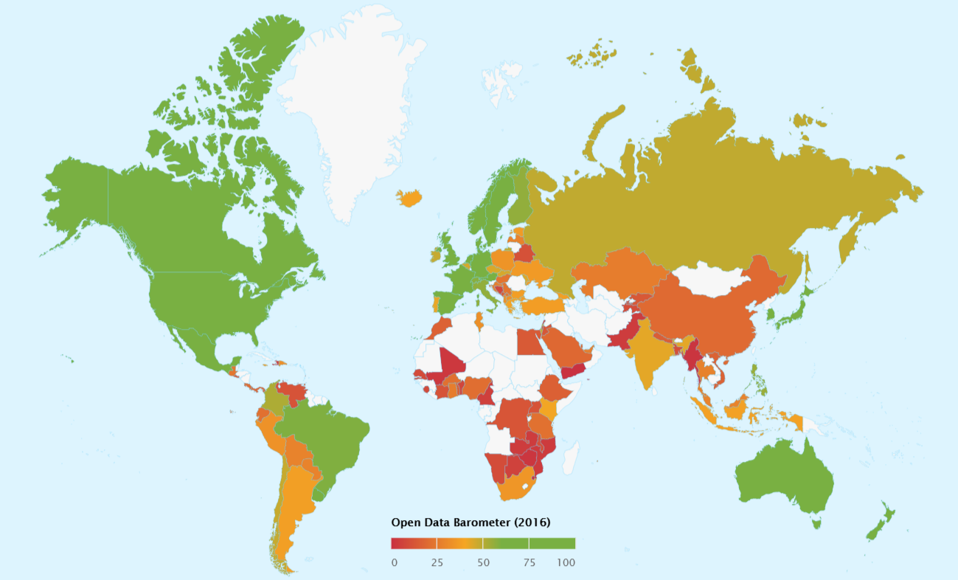
Open Data Barometer (http://opendatabarometer.org/?_year=2016&indicator=ODB)

Slide 15
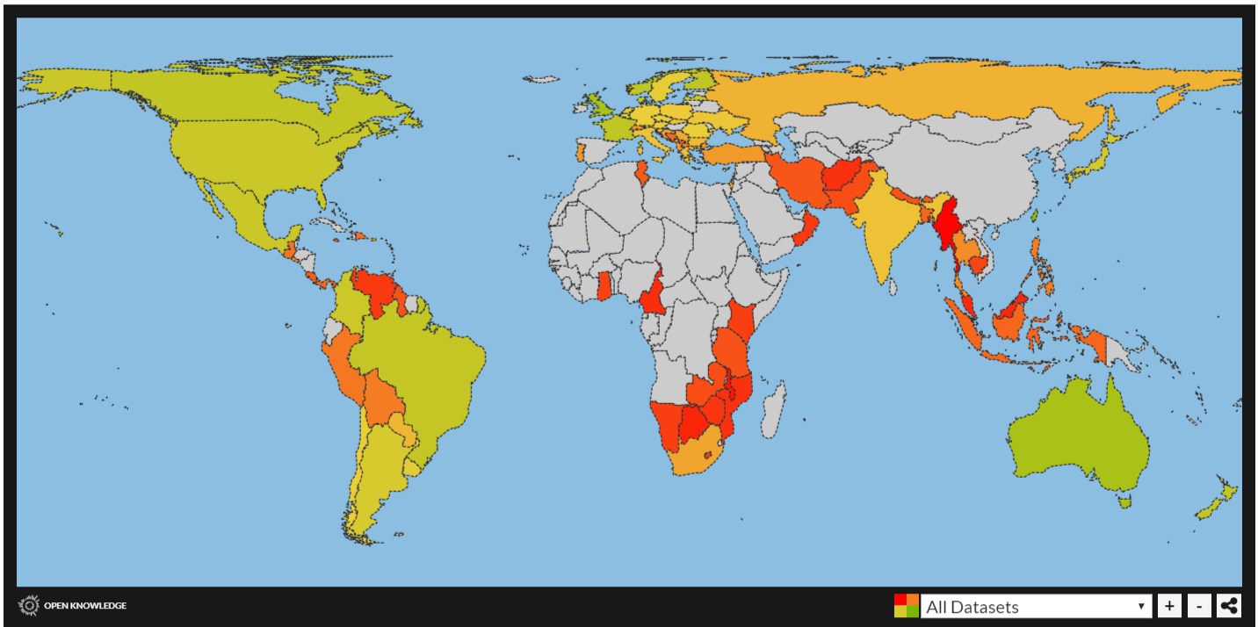
Global Open Data Index (https://index.okfn.org/)

Slide 16
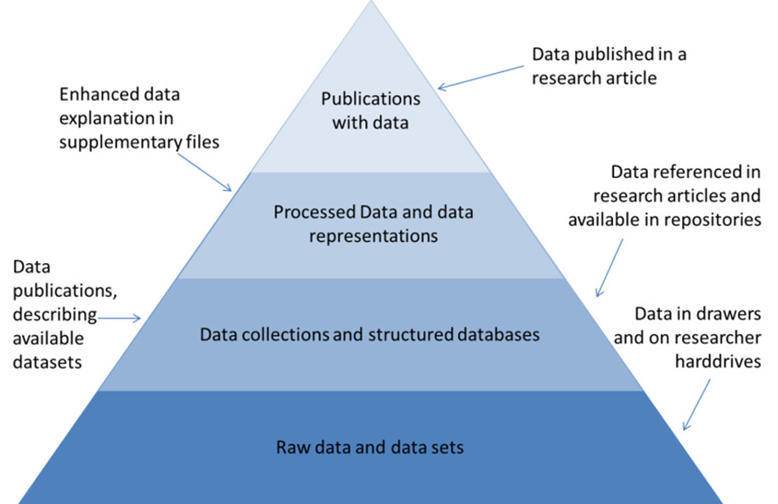
The “pyramid” of scientific data
Source: Reilly, S. et al. (2011), Report on Integration of Data and Publications, ODE, Opportunities for Data Exchange

Slide 17
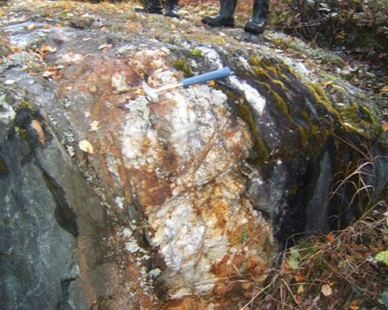
LODES
A Study to Define a Linked Open Data Platform of Interoperable Repositories to Enable Open Science (LODES)^{(*)}
^{(*)} In geology, a lode is a deposit of metalliferous ore that fills or is embedded in a fissure in a rock formation or a vein of ore that is deposited or embedded between layers of rock (Wikipedia) – Credits: Marcello Maggi)

Slide 18
LODES «at a glance» (1/2)
LOD
Federation
Standard
interface
Standard
interface
Standard
interface
Standard
interface
Semantic
Enrichment
Open Data
Repository
Standard
interface

Slide 19
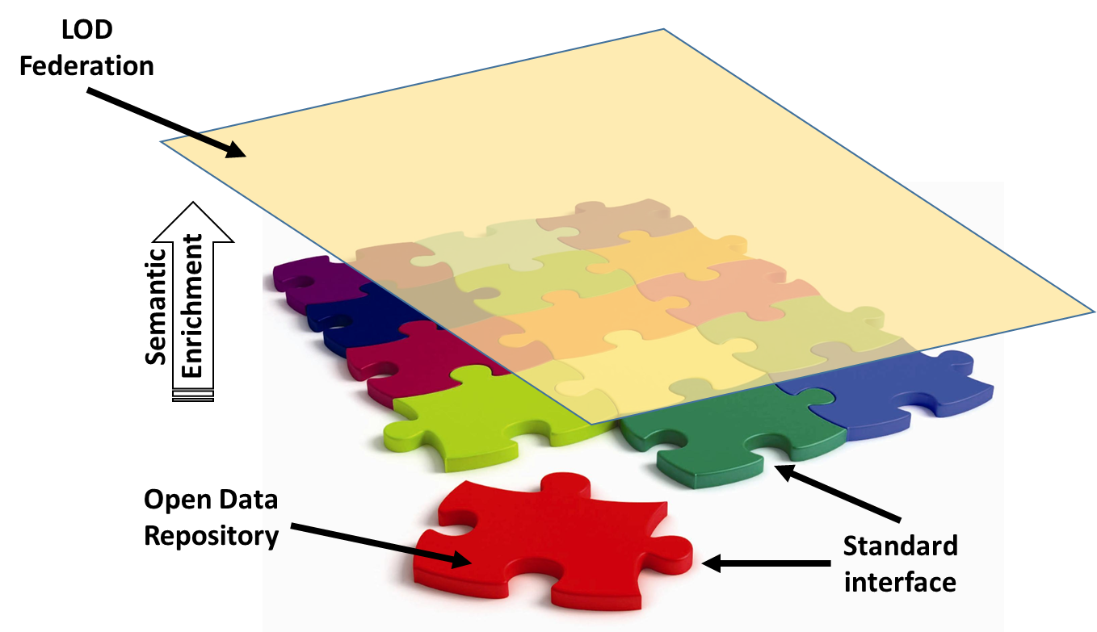
LODES «at a glance» (2/2)
Citizen scientist
Researcher
Computer code
Distributed Knowledge Infrastructure
…

Slide 20
Key points
Identify players (infrastructures, services, users)
Identify technology gaps
Identify «de jure»/«de facto» standards (e.g., Semantic Web’s, OAI-PMH, DC, DOI, ORCID, etc.)
Define recipes and guidelines based on concrete (multidisciplinary) use cases
Propose viable policies

Slide 21
Towards the Scoping Group Report
Identify stakeholders (researchers, policymakers, ICT specialists, academic institutions, citizens, enterprises, etc.
Identify and analyse a multiplicity of different cultural contexts, practices, approaches and the relative technical languages
Identify Open Data repositories and Linked Open Data services currently existing and willing to contribute to the Scoping Group and eventually to a wider OECD Working Group
Address several important questions of Open Data, such as:
In the context of data handling, what are the lessons learnt from Big Science experiments that can be applied to “Long Tail of Science” groups?
What are the technical/political challenges to achieve full interoperability among Open Science repositories?
Who are the key actors for the deployment of Open Science repositories?
What is the role of Data Stewardship?
Who owns the data?
Who is entitled to provide the certification of the quality of an Open Science repository?
Is it possible to broadly categorize the type of information in Open Science repositories (Big-Science/Research, Citizen demographics, Social and Human Sciences, Law Studies, Cultural Heritage, Health, Environment, etc.)?
Can the above disparate communities use a common infrastructure?
What is the correct granularity needed to define metadata semantics to satisfy the different community requirements?
What is the role of private companies and societal organisations?
Collect requirements and needs from the identified stakeholders in order to propose the creation of an OECD Working Group charged with the definition of standards, best practices and guidelines for a transnational science policy aimed to the definition and development of a LOD federation of repositories
Identify a few (multi-disciplinary) use cases, which could act as demonstrators in the wider context of an OECD Working Group

Slide 22
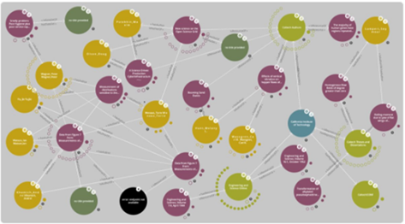
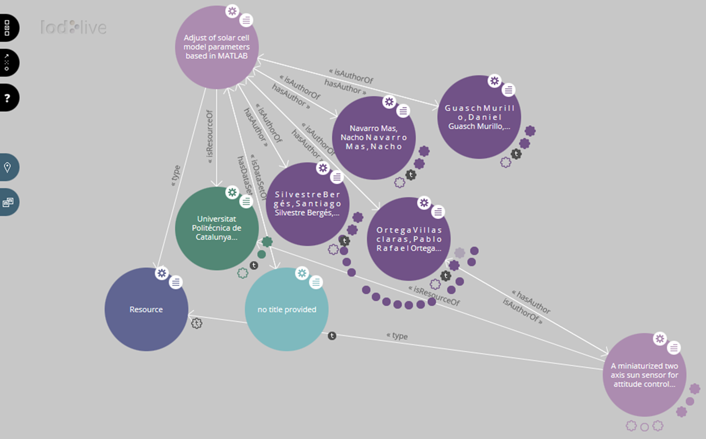
The “knowledge nexi” From an Information Society to a Knowledge Society

Slide 23
Workshop agenda (to set the roadmap to the Report)
Session 1
Reports from countries and big projects/initiatives/services
Session 2
Panel-driven open discussion on the important questions on Open Data listed in the previous slide
Session 3
Architecture of the scoping paper: desirability and feasibility
Session 4
Summary and next steps

Slide 24
Thank you!

