Slide 1
Open Data and Linked Open Data in the
Publications Office of the European Union
Notes:
As we all know, you are the link to the outside
I could imagine that there are people coming to you and moaning about the EU. For instance: The EU is in-transparent and is not handling its resources properly.
Thats the reason why I would like to present you our modest effort in overcoming ths lack of transparency by publishing as much data produces by the EU as possible. And we would like to show you what can be done concretely with it.
Therefore we will have a look at an event organised by the Publications Office last year.
Today I want to present you two ideas which are build on each other
Open data as a concept
What can be done with open data and how to get in contact with the reusers?

Slide 2
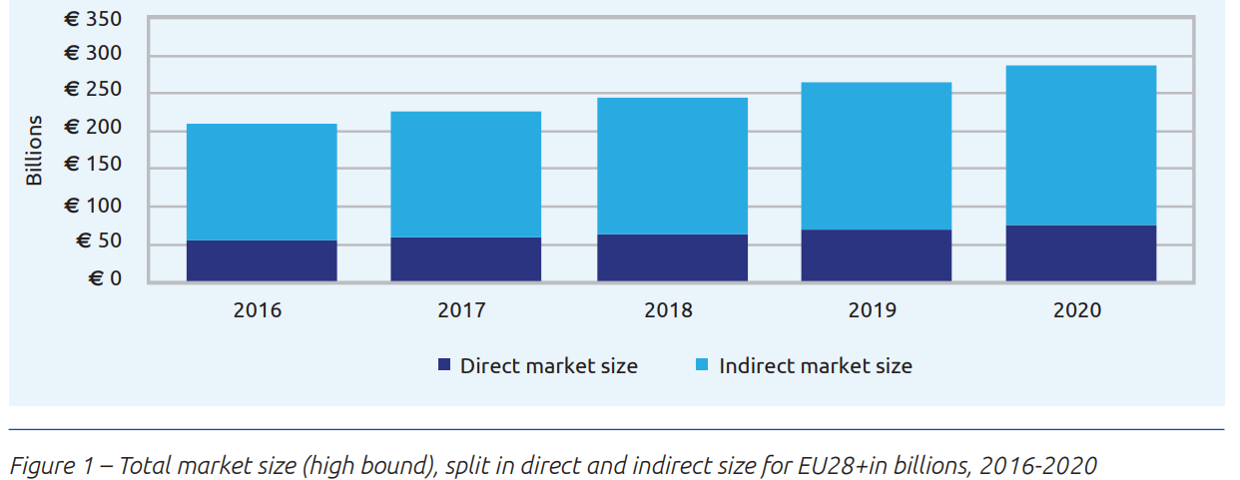
Total market size Open Data EU28+
Value of open data
Source: European Commission: Creating Value through Open Data: Study on the Impact of Re-use of Public Data Resources (2014)

Slide 3
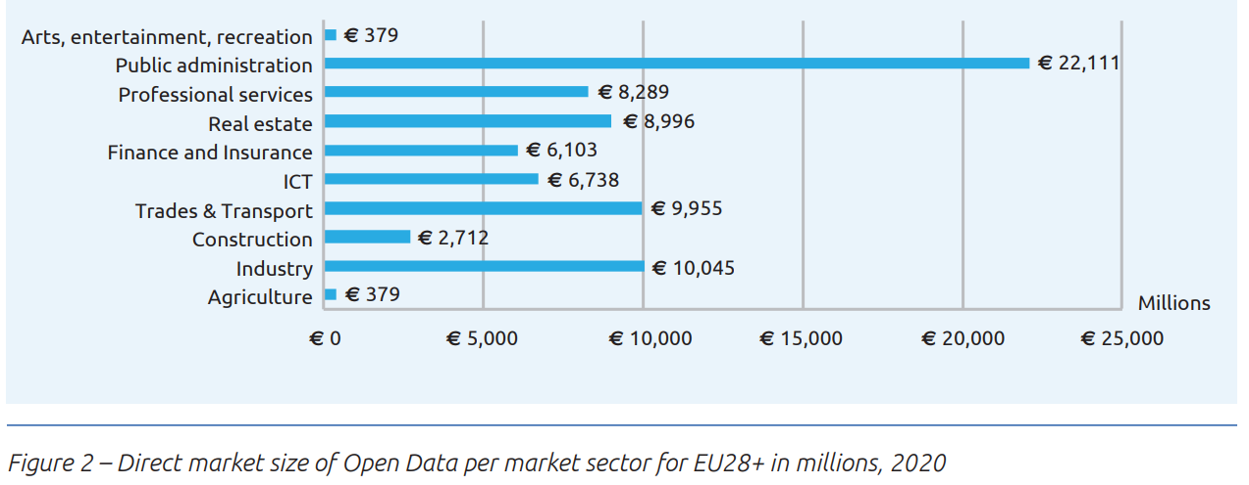
Direct market size per sector
Value of open data
Source: European Commission: Creating Value through Open Data: Study on the Impact of Re-use of Public Data Resources (2014)

Slide 4
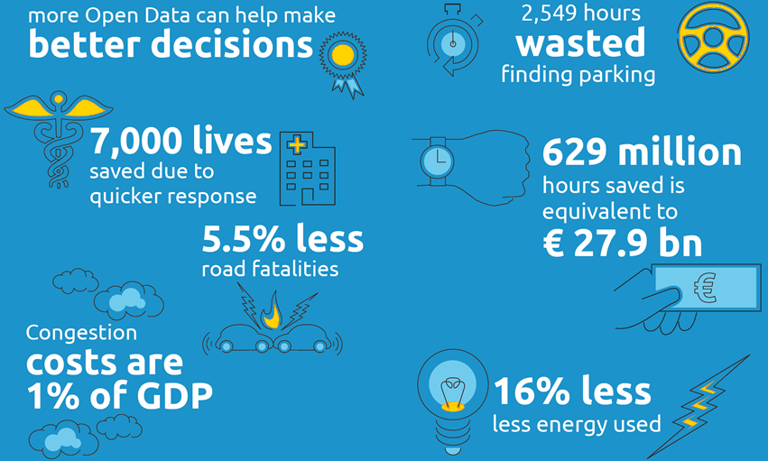
Open data matters because…
Value of open data

Slide 5




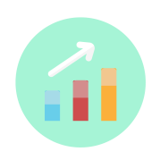
What can be found there?
EU Open Data Portal
Sets of bibliographic records
Reference Data
Data about projects, programmes, actions, measures, grants
Geographic, geospatial, meteorological data
Statistics and time series
Notes:
5
The EU Open Data Portal has collected thousands of data sets that have been used by a growing community of
data analysts,
data journalists,
policymakers and,
everyday citizens,
and developers of applications.
This portal gives you access to data and web apps that can tell you:
how your life compares with other Europeans;
or what the members of the European Parliament are doing for you and your community;
or even how EU money is being spent through the different EU funding programmes.
Reference data: thesauri, vocabularies, ontologies…
Set of bibliographic records: publications, legal documents, reports, recommendations, studies…
5

Slide 6
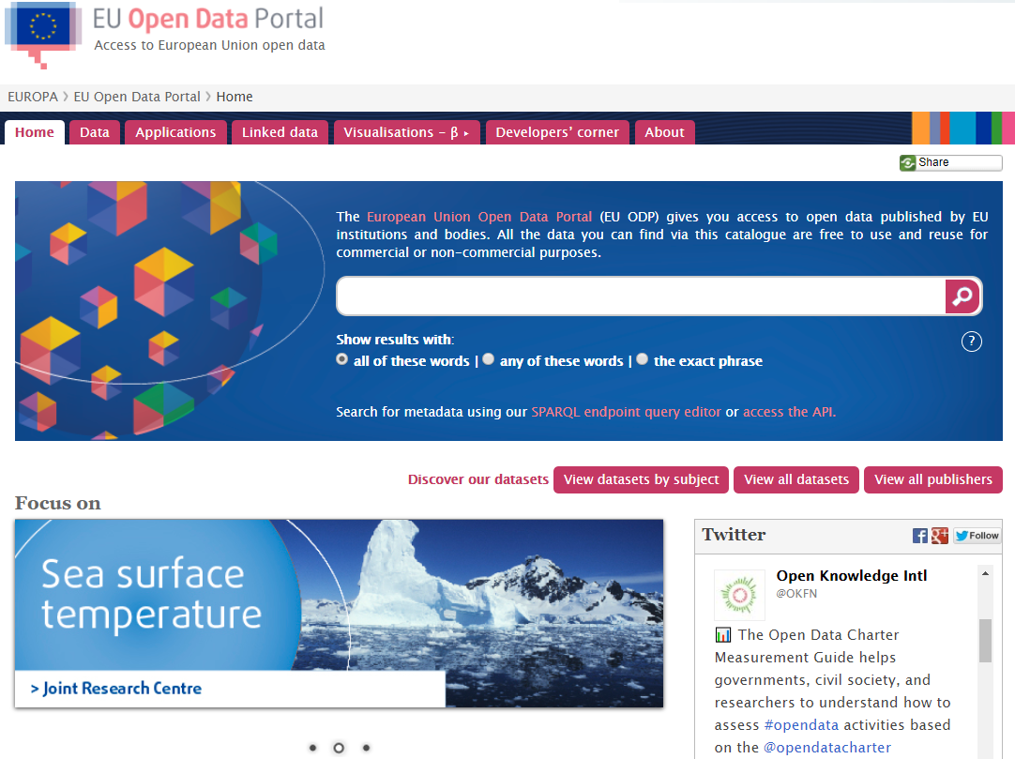
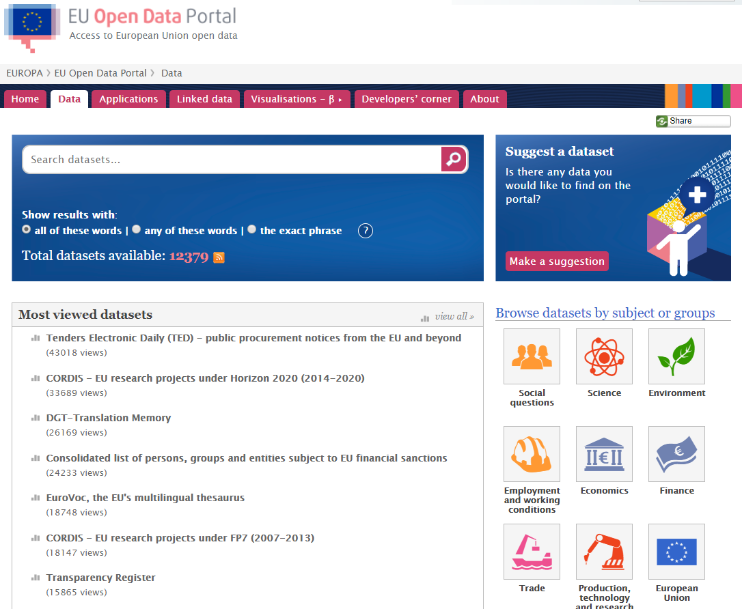
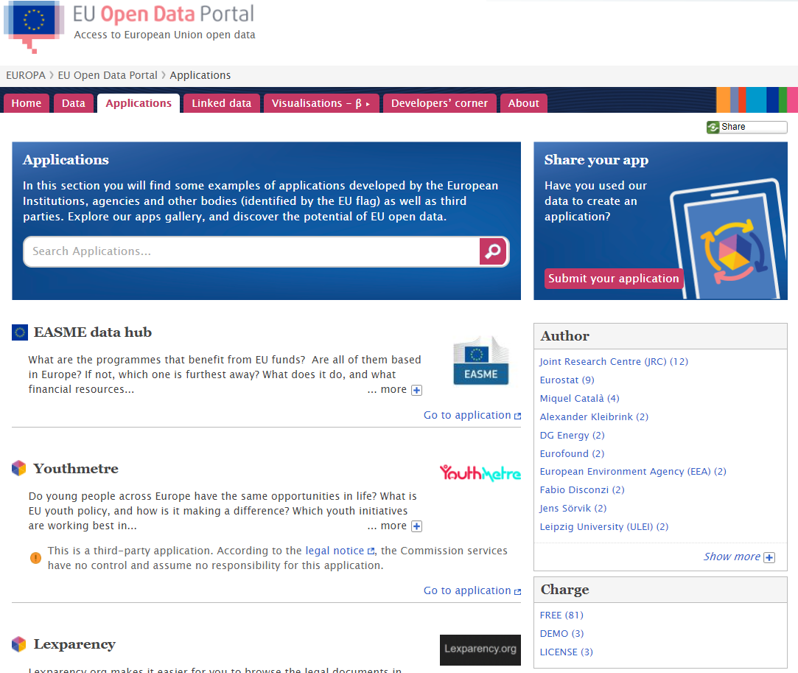
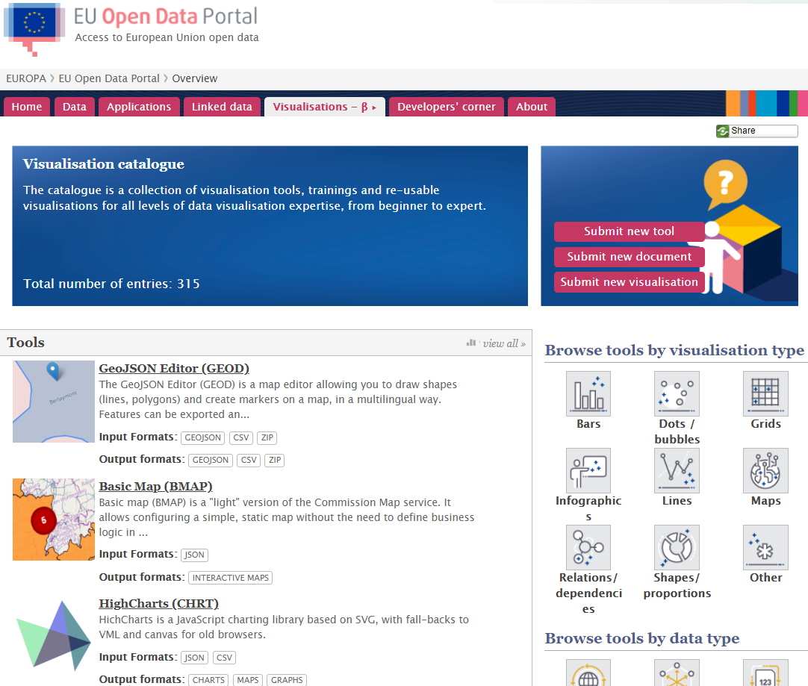
Notes:
6
6

Slide 7
Benefits and data consumers
EU Open Data Portal
Foster economic activity, jobs and growth
Citizens,
public administrations,
NGOs,
journalists,
lobbyists,
interest groups.
Businesses,
IT developers,
academia,
researchers,
statisticians.
Citizens,
journalists,
librarians.
Enhance openness and transparency of EU Institutions
Better governance and more civic participation
DRIVERS
Notes:
To sum up: Open data is information which
is available on the Internet,
free from licences and copyright restrictions,
containing no personal data,
and in a machine readable format – and this is what we try to do via the EU Open Data Portal.

Slide 8









Summary
EU Open Data Portal
Central access
point
Transparency
Promote
standards and
best practices
Multilingual
metadata
Cultural
change
Aligned
terms of use
over 12.000
datasets
Reuse policy
Support
and training
Notes:
Central access point: it is so difficult to understand and to know all the different websites, databases of the EU (we struggle ourself and how should then citizens know it?!)
Open data increases the scale of opportunities for transparency, growth and efficiency.
It allows people to put together their expertise and combine information from everywhere to generate new knowledge.
What else do we do?
Allow to search in their language by offering multilingal metadata.
To summarize: We try to improve access to data from the European Commission and other EU institutions and bodies.
We also work on improving the openness, quality and completeness of the data.
Why do we do it? Why are we passioned about it?
We believe that there’s a huge potential in opening up even more data, both within and beyond EU or national institutions.
We wanted to see the potential and not only talk about it.

Slide 9
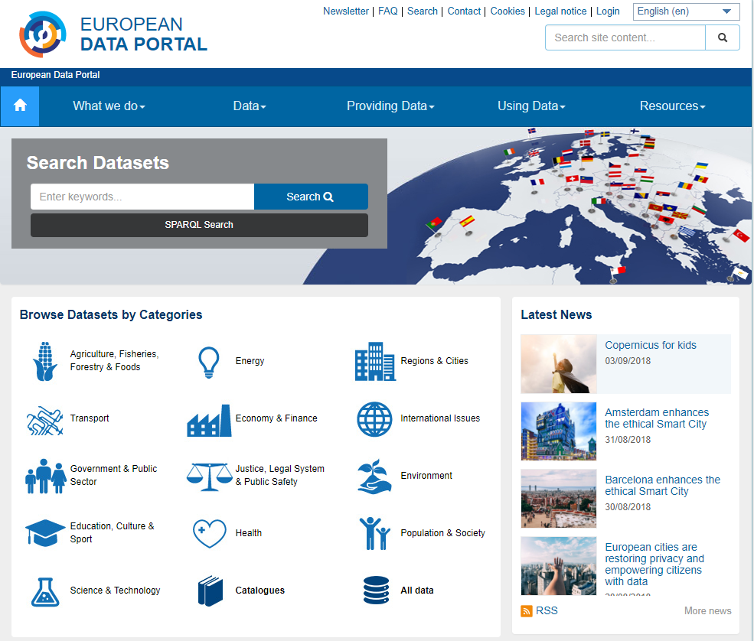
What can be found there?
European Data Portal
840 000
datasets
The meta-portal which harvests national, local and geo open data portals.
34 countries
77 catalogues
Metadata in
24 Languages
Notes:
Central access point: it is so difficult to understand and to know all the different websites, databases of the EU (we struggle ourself and how should then citizens know it?!)
Open data increases the scale of opportunities for transparency, growth and efficiency.
It allows people to put together their expertise and combine information from everywhere to generate new knowledge.
What else do we do?
Allow to search in their language by offering multilingal metadata.
To summarize: We try to improve access to data from the European Commission and other EU institutions and bodies.
We also work on improving the openness, quality and completeness of the data.
Why do we do it? Why are we passioned about it?
We believe that there’s a huge potential in opening up even more data, both within and beyond EU or national institutions.
We wanted to see the potential and not only talk about it.

Slide 10
What are the tasks of the European Data Portal?
Introduction
Offer metadata, visualisations, quality checks
Train data publishers via eLearning and workshops
Showcase events, news, best practices, reports
Measure open data maturity across Europe
Convene meetings, webinars, events
Collect open data stories, feedback
Share our source code and promote open source
Notes:
Central access point: it is so difficult to understand and to know all the different websites, databases of the EU (we struggle ourself and how should then citizens know it?!)
Open data increases the scale of opportunities for transparency, growth and efficiency.
It allows people to put together their expertise and combine information from everywhere to generate new knowledge.
What else do we do?
Allow to search in their language by offering multilingal metadata.
To summarize: We try to improve access to data from the European Commission and other EU institutions and bodies.
We also work on improving the openness, quality and completeness of the data.
Why do we do it? Why are we passioned about it?
We believe that there’s a huge potential in opening up even more data, both within and beyond EU or national institutions.
We wanted to see the potential and not only talk about it.

Slide 11
European Data Portal – Assessments
Introduction
  1
  2
Assessing the level of open data maturity
Landscaping
Peer Learning
  5
Assessing activities & findings
  3
Common Support Activities
Offering support to European countries
  4
Tailoring Support Activities
Notes:
The Objective is to provide common and tailored support to countries to accelerate the release of public data at national and local level.

Slide 12
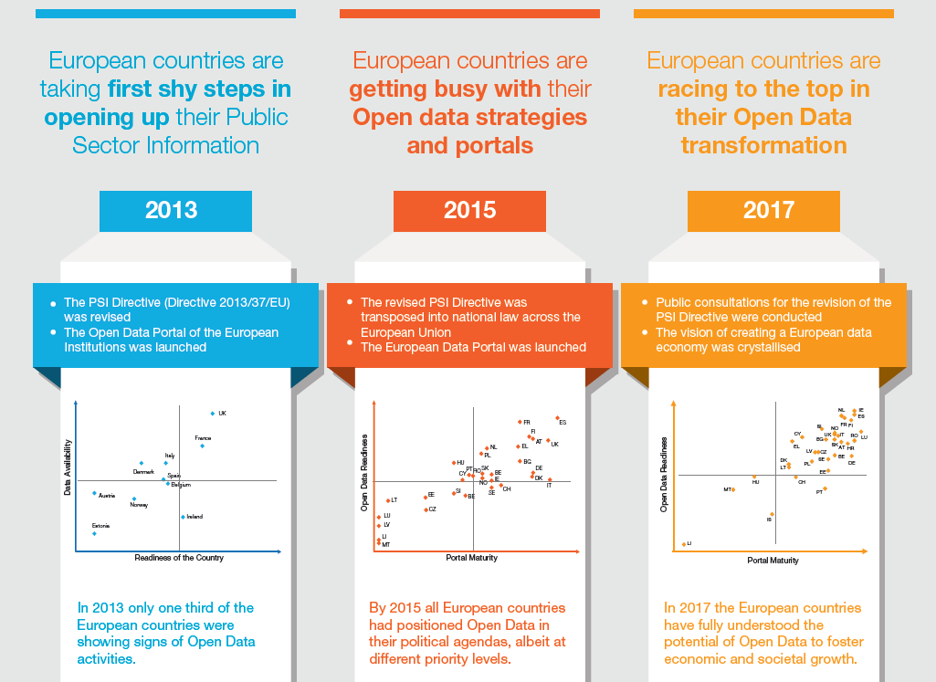

Slide 13
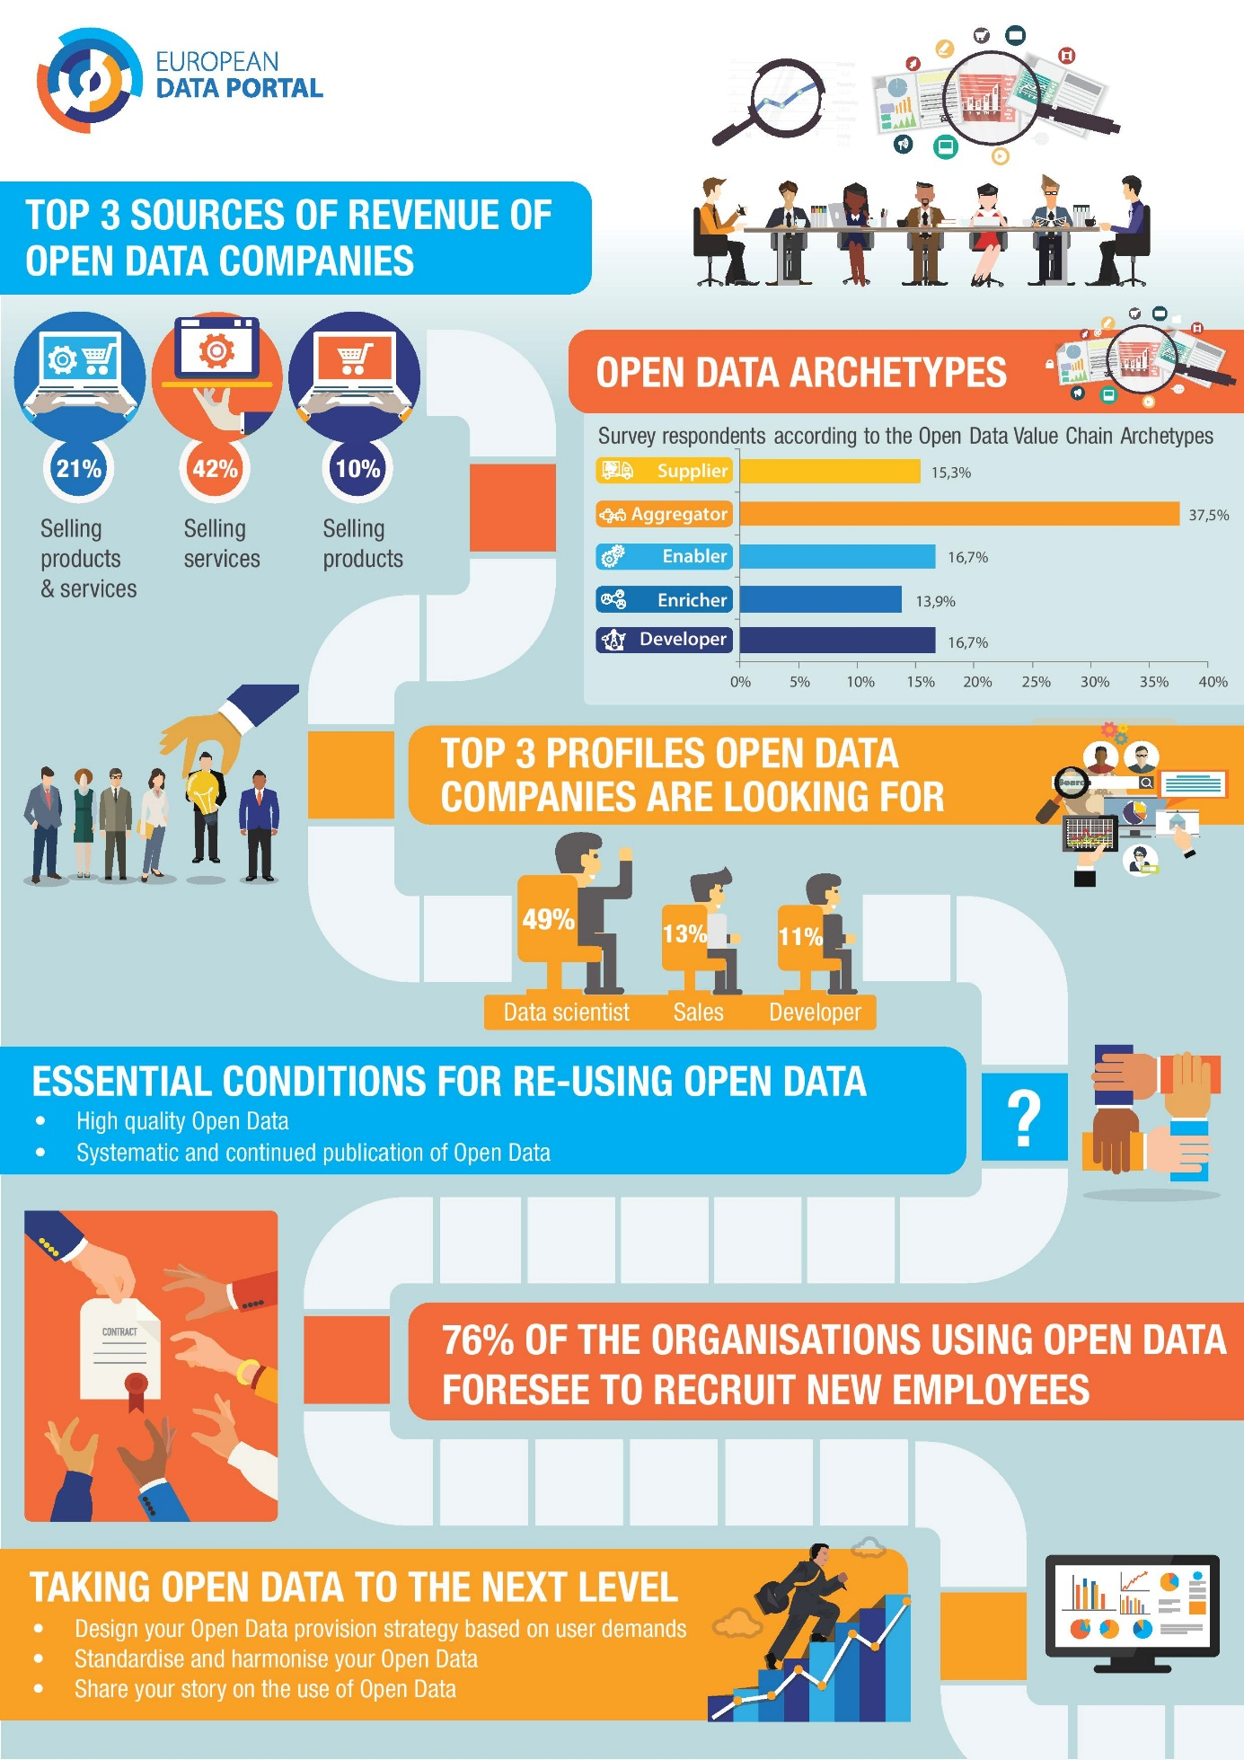
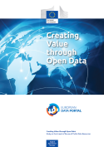
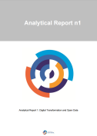
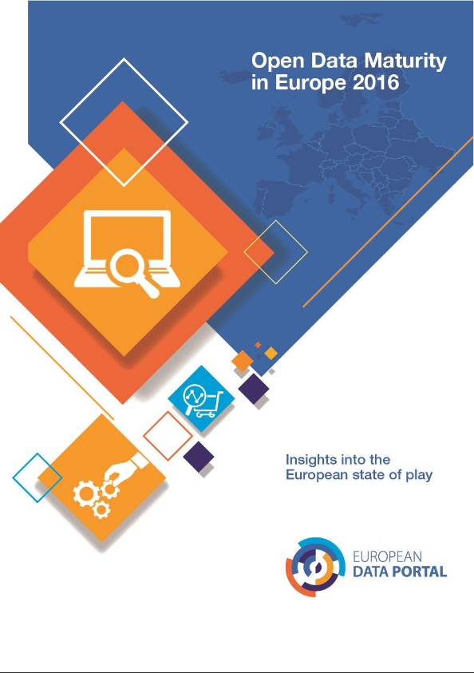
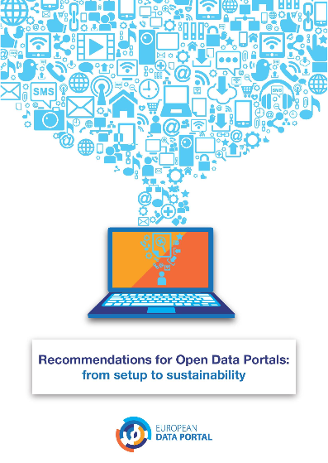
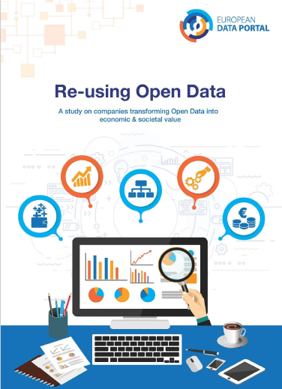
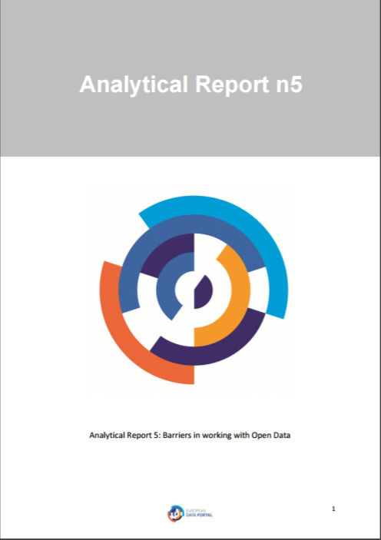
Creating Value Through Open Data
Open Data & Digital Transformation
Open Data Maturity in Europe
Recommendations for Open Data Portals
Re-using
Open Data
Barriers in working with Open Data

Slide 14
Current and planned LOD projects
Linked Open Data
EU Budget as LOD (Budget 2018 published, more years to be transformed)
EU Vocabularies as 5 star LOD (starts in October)
Study on successful LOD services in public and private organisations (starts in October)
Integration of DOI for the EU Open Data Portal to cite datasets (starts in November)

Slide 15
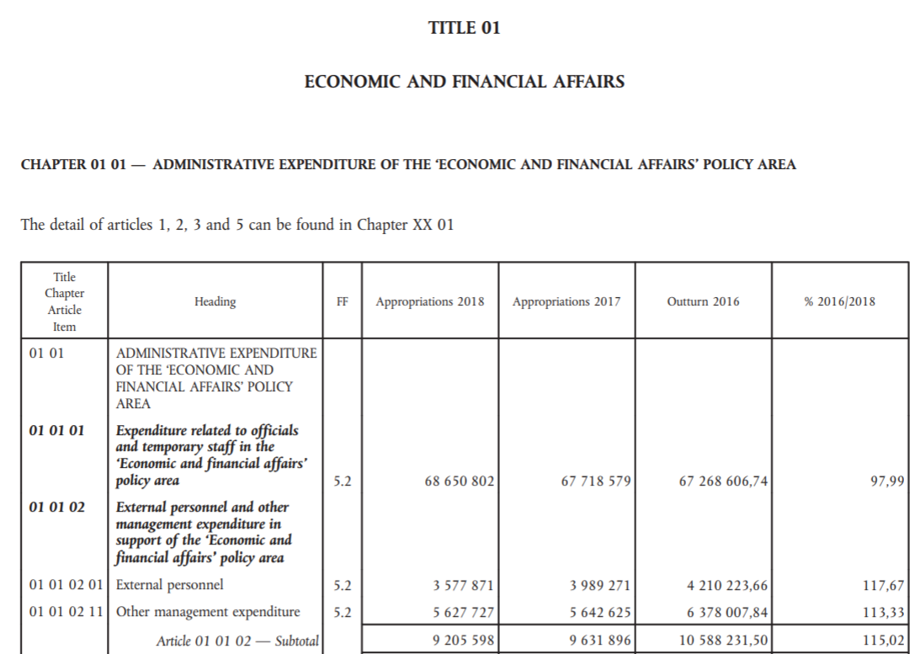
TITLE
CHATPER
MFF CODE
ARTICLE

Slide 16
EU Budget as LOD
Linked Open Data
PDF
2.000+ pages
Not machine readable
CSV
3-star open data
Complicated structure
XML
3-star open data
Unclear terminology
Not data-oriented
Data model & definitions disclosed
Use of standardised reference data, such as the Named Authority Lists
Create an integrated view with other fiscal data sets such as FTS
Data-as-a-service: flexibility
Increased reusability of the data

Slide 17
EU Budget as LOD
Linked Open Data
Challenges
Understandability
Scattered information
Low usability & interoperability
Difficult to meet user needs
Machine readability & reasoning
Solution: LOD comes with...
Data dictionaries
Linkable datasets
Common data formats
Data as a service
Machine-readable formats

Slide 18
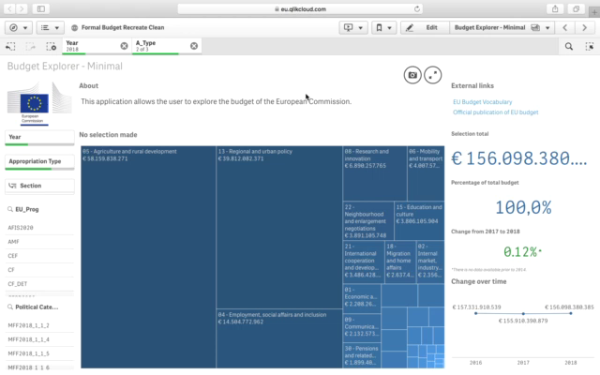

Slide 19
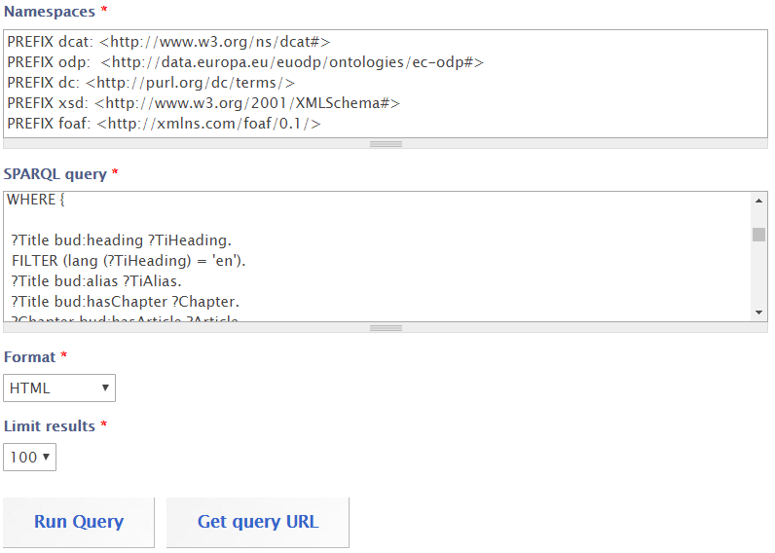
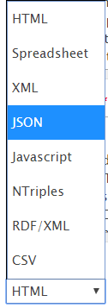
EU Budget as LOD
Linked Open Data
EU Open Data Portal SPARQL endpoint:
Define the part of the data you want to retrieve.
Select the format of your choice.

Slide 20
Contact
op-odp-contact@publications.europa.eu
Visit
data.europa.eu/euodp
europeandataportal.eu
Stay informed
Twitter: @EU_opendata
Notes:
20

Slide 21
What do we mean by open data?
Introduction
Available on the internet
Data is:
all objective, factual, non-personal, non-aggregated information that we collect or generate during our activities
No personal data
Free
Open Data
No Copyright
Open licence
Machine readable
Notes:
We all know that data is nowadays everywhere
Lets see first what we mean by data. Maybe we need to have a common definition before we talk about data. We see it covers a lot.
Data can help you to understand the world around us and make better decisions.
What is open data? It is a subset of data.
What can be done with open data?
Open data can be freely used to create new services; to improve the lives of people, to make government more accountable and do many other things.
Without realising it perhaps, you already know examples of open data, such as GPS, weather data and official statistics.
In general, data is a piece of information in any form – but it goes beyond statistics and numbers.

Slide 22
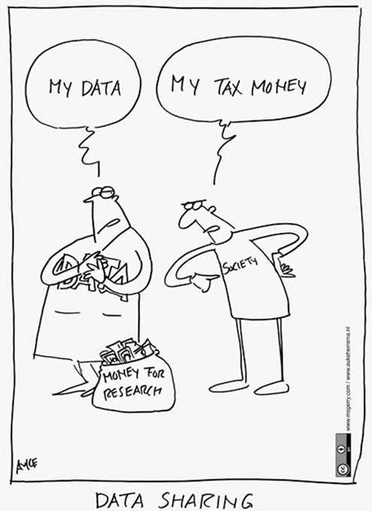
From data hugging to data sharing
Introduction
What would anyone like to do with our boring data?
It is our data and we decide!
People will draw wrong, superficial conclusions.
People may try to make money out of our data?!
We are not completely sure whether we own the rights …
Our data is wrong and people may find out it is wrong.
The data is just too large to be published and used.
Notes:
We see data hugging everywhere. And we’re aware that shifting to a culture of data sharing may be difficult, if not scary.
But we can reassure you that it is worthwhile, both for yourself and for EU citizens in general and our stakeholder groups in particular.
Boring data? No such thing – if it is already produced, then it means it was worth producing.
OUR data – well, actually, it was paid with public money, so if possible it should be made available to the public
Data is wrong – well, wouldn’t you want to know that so that you can make corrections? In addition, again the very active community could actually help validate and clean the data!
Wrong conclusions – it’s a risk, but being based on open data, and as users need to cite the data source, mistakes can be easily identified by the very active community around open data
Too large – No problem for machines if the data quality is good (no difference between 10 or 10.000 lines)
Make money – well, that’s good, that would lead to jobs and growth. The data economy is a fast growing sector.
Owning the rights – Indeed, you need to make sure you do own the rights – but your legal service can help you with that, and with making sure in the future you buy the raw data as part of the contract!

Slide 23


Notes:
To answer this question we organised the EU Datathon 2017 to showcase this variety and the added-value of EU open data.
To see what app developers can do with open data.

Slide 24
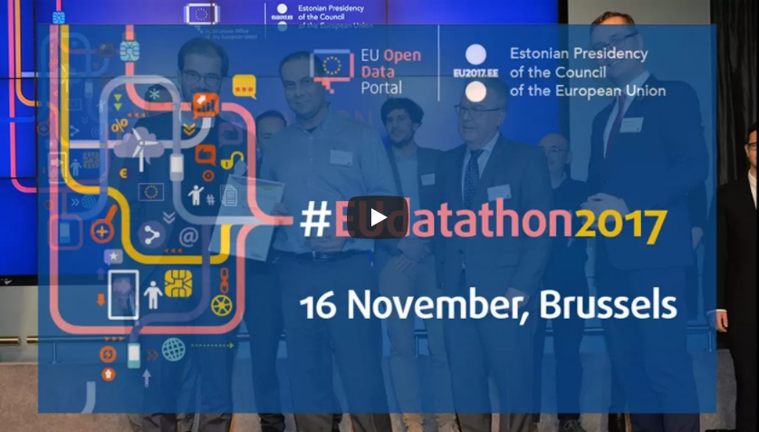
Notes:
https://www.youtube.com/watch?v=mNUuNSkWoec

Slide 25
EU Datathon 2017
What and why
Minimum number of datasets from EU Open Data Portal
Reuse open data to create applications to address specific policy or societal issues:
Three Junker priorities:
Jobs, growth and investment;
Digital single market;
Democratic change.
1
Applications submitted
34
Finalists invited to Brussels
10
Notes:
Participants were invited to develop web applications or mobile solutions working with at least one (or more) dataset produced by the EU, combined or not with others from local or national government bodies.
They should take one if the 3 selected Junker priorities.
The finalists were then be invited to develop their project and to present it in Brussels during the main event.

Slide 26
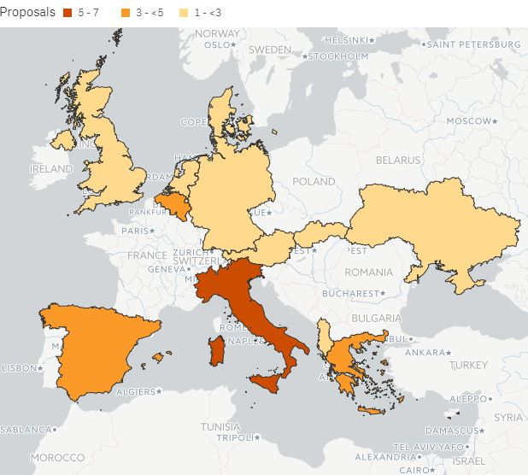
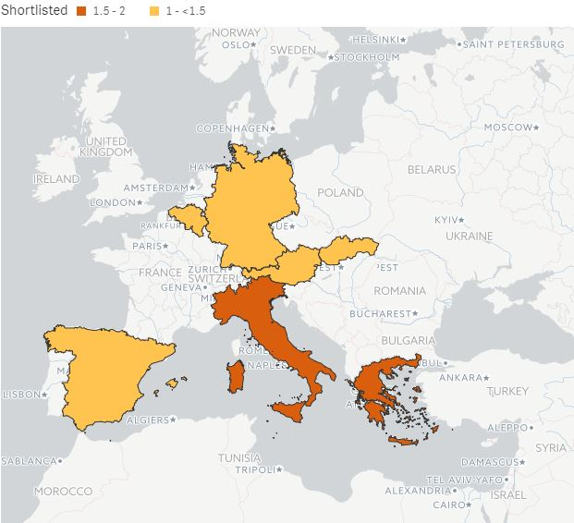
Applications: country of origin
EU Datathon 2017
Notes:
Maybe your country was not part of last year‘s event but it could be a part in the future.

Slide 27
EU Datathon 2017
Applications: datasets used
Notes:
As soon as data is open, the data can be combined with other sources or investigated from new points of view, to bring new insights into how we see ourselves, our society, and our future.
Participants tried to achieve this with those datasets.
We were really surprised by the big varity.

Slide 28
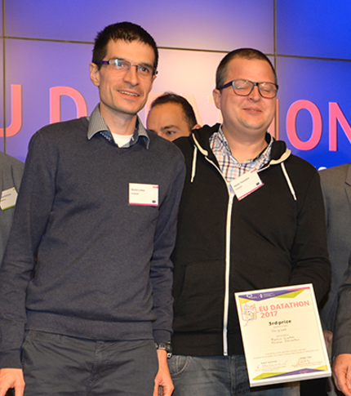
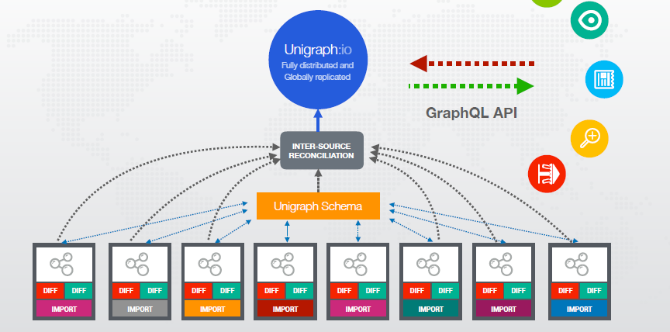
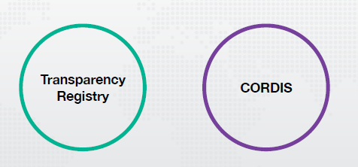
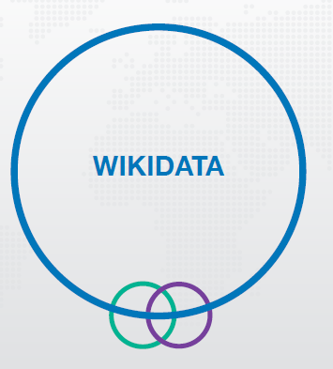
EU Datathon 2017
3rd place: Unigraph
Notes:
Unigraph developed an automated way to clean data (approximately 80% of the time is spend on cleaning up data)
Their app allows to combine different data sources very easily
They used the Transparency Register and Cordis (Universities and companies can be seen in both datasets) → They are normally not aligned
Finally they combined this dataset with Wikidata (engine behind Wikipedia and the Google Knowledge Graph on the right side when you search on Google)
Now you can query the complete data, get new insights (what percentage of the University budget is delivered by CORDIS projects) and don‘t have to go through it entry by entry
Where are certain dependencies? How important is the EU for certain regions? Those are questions we can try to answer with this tool.

Slide 29
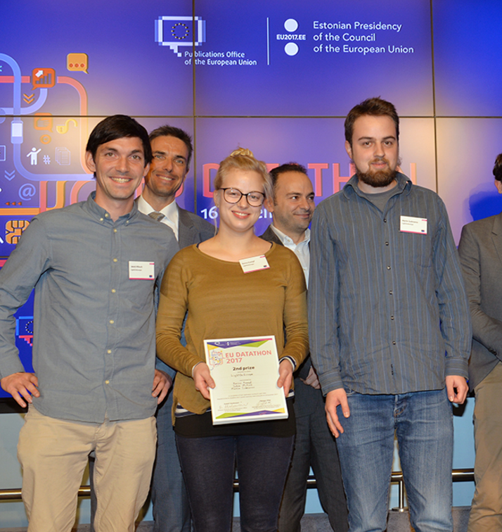
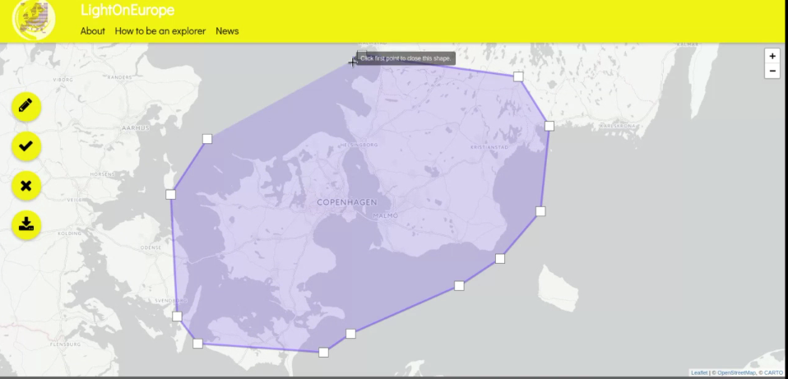
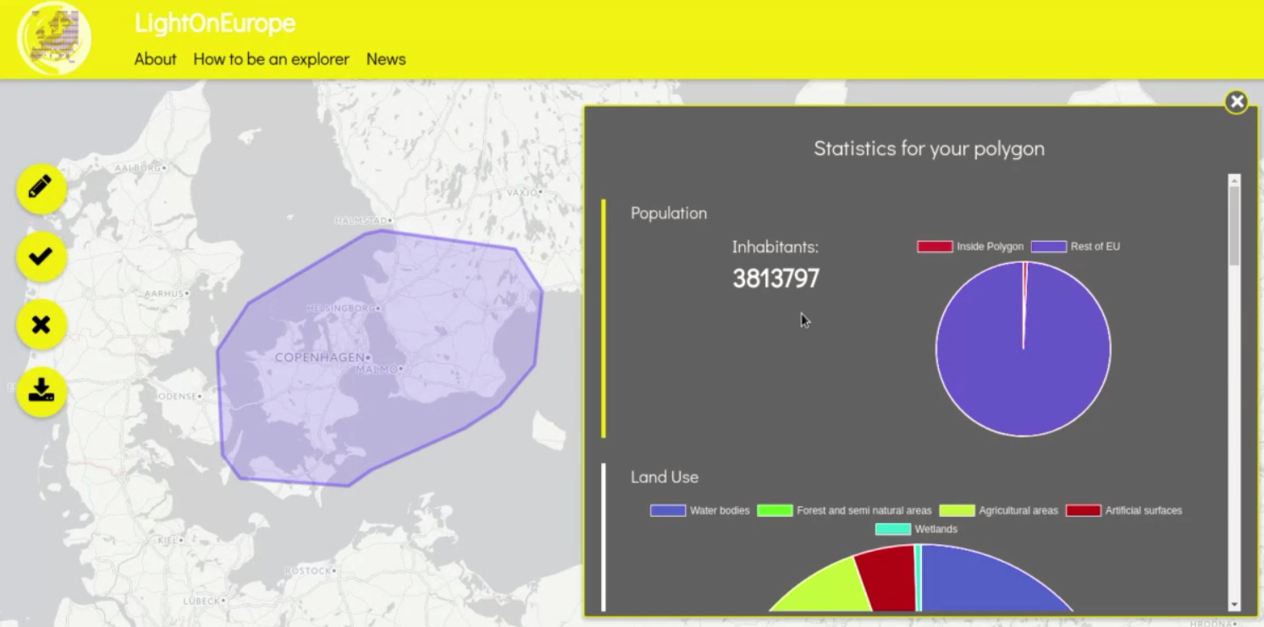
EU Datathon 2017
2nd place: LightOnEurope
Notes:
Used: Eurostat geospatial data
Their app can combine geospatial information – cross border
For example: to see how many people live in a certain area, how much of that space is forest, how many train stations, hospitals, and so on
Very important for planning cities and public transport
It is, especially for public servants, very interesting because they normally stop their thinking at the border (e.g. you cannot think of Luxembourg without including the neighbour countries)

Slide 30
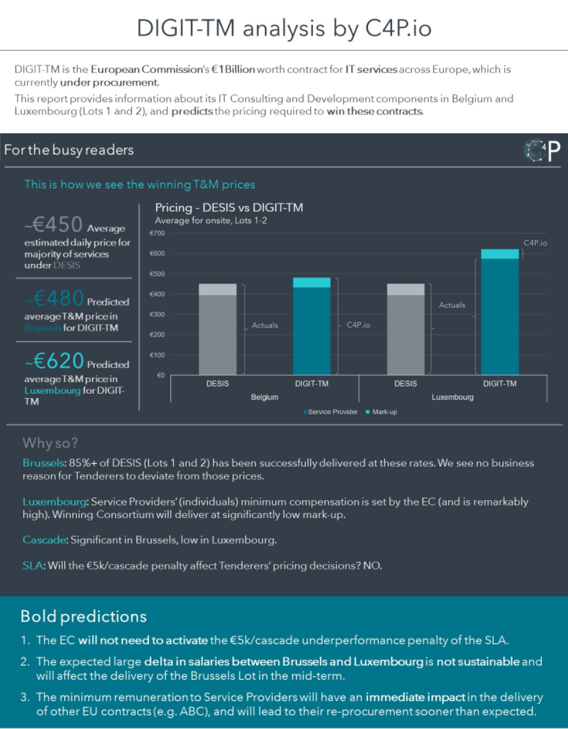
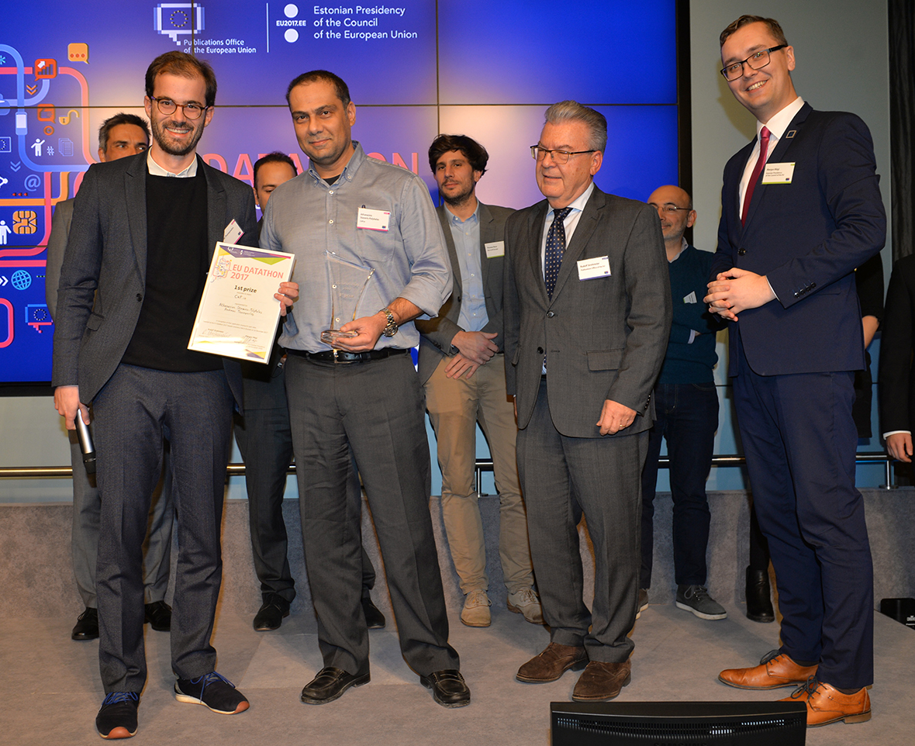
EU Datathon 2017
1st place: C4P.io
Notes:
https://platform.c4p.io/login/
username: EU-Data-Portal
password: Demo_C4P
Dataset used: Financial transparency register and TED (cleaned, linked, used machine learning and visualise the data)
How the European Public sector procures and spend its budget
Using public procurement data to help companies tap market opportunities
→ This is even a business model for them (they sell their service)
New insights:
Oligopoly phenomena: 2% of the ICT companies that serve the EUIs, consume 50% of the available ICT budget.
Without these tools, it is difficult to see those trends.

Slide 31


‘EU open data — For more innovation in Europe’
‘National and EU law — Make legislation interoperable’
‘EU public procurement — Value for citizens, value for businesses’
‘European Food Safety Authority — Fostering data reuse and innovation’
Notes:
This year we teamed up with ELI, EFSA, DG CNECT, DG DIGIT, DG GROW to develop four independant challenges with the final event on 2 October in Brussels.
We could need your help in this phase as multipliers.
We can also offer you a translated press release to promote the event in your language.

Slide 32
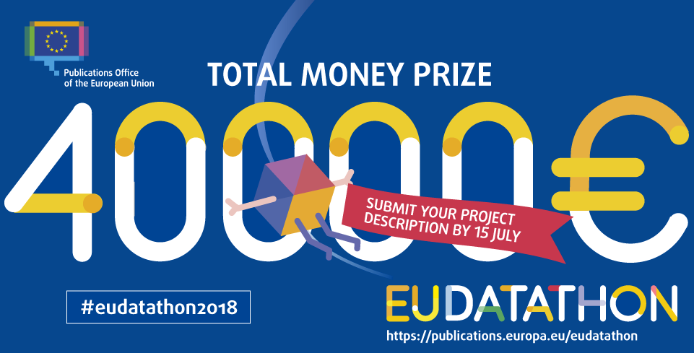
Notes:
Help us in spreading the word and promoting young data startups, students and researchers
Maybe together we can motivate teams from all EU countries

