Slide 1
human-centered, participatory, liquid open innovation research infrastructure (OI-RI)
eveline wandl-vogt, jose luis preza diaz exploration space @ ACDH @ ÖAW LODES2018 @ rome (IT), 06th september 2018

Slide 2
human-centered, participatory, liquid open innovation research infrastructure (OI-RI)
eveline wandl-vogt, jose luis preza diaz exploration space @ ACDH @ ÖAW LODES2018 @ rome (IT), 06th september 2018

Slide 3
repositories and linked data diversity
against the background of an open innovation (in science) approach
and DIY science, we-culture etc.
cross-organisational collaboration, relevance of all societal groups based on
quintuple helix model (incl environment) and machines
intended: look at RIs from a human centered approach
driven by research questions + societal challenges
cross organisational knowledge management +
„interculturural communication“ related to scientific communities

Slide 4
repositories and linked data diversity – data, methods
categorization:
human centered approach with research communities
data > knowledge conversation | view, perspectives
importance of taxonomies, thesauri
importance of non-standard data and related knowledge
matrix of sources of uncertainties
and how to deal with the unknown

Slide 5
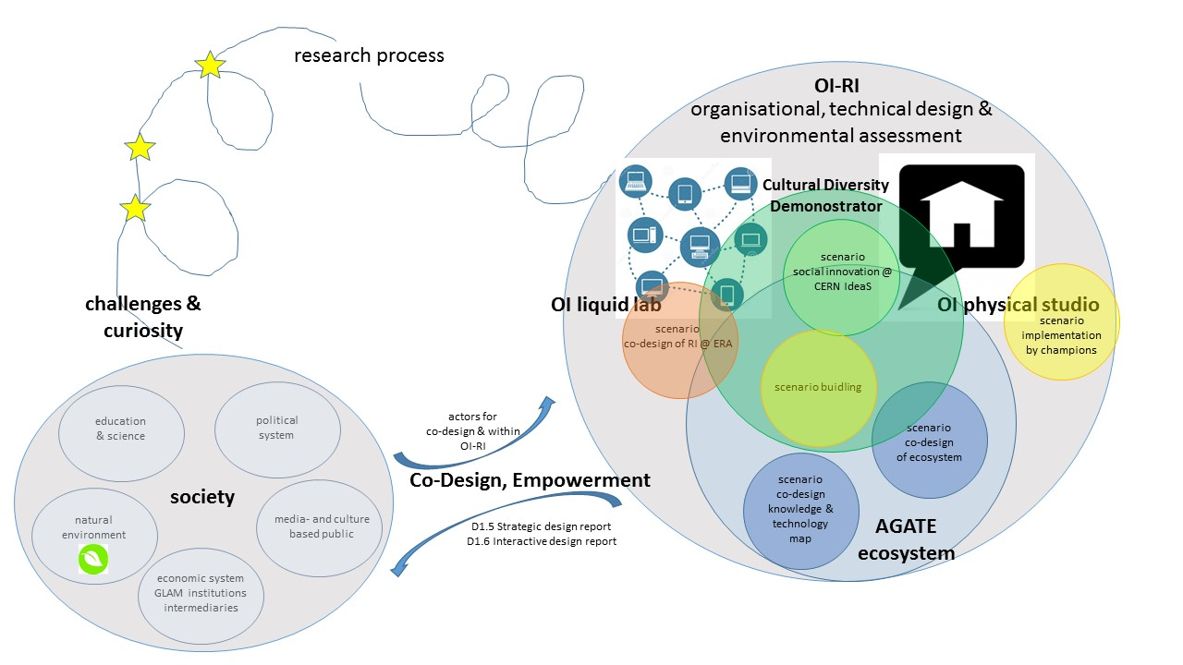
repositories and linked data OI-RI
© ewv

Slide 6
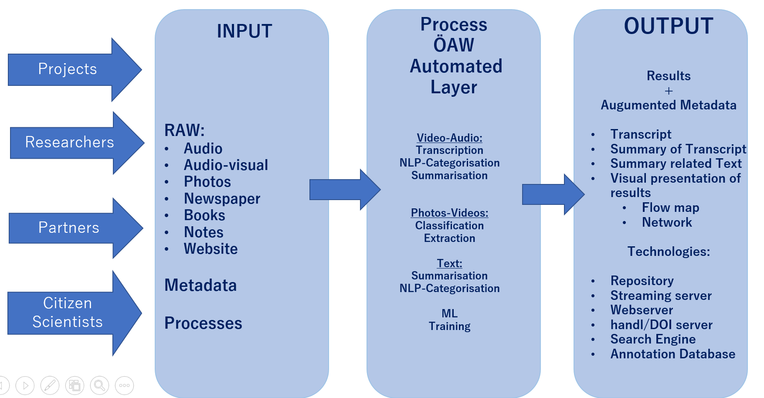
science as a service architecture
jose luis preza diaz

