Slide 1
Report from Austria
LODES18 - A 1-day Workshop on
“A Study to Define a Linked Open Data Platform of Interoperable Repositories to Enable Open Science“
Paolo Budroni (University of Vienna) Eveline Wandl-Vogt (Austrian Academy of Science)
Lodes18, INFN, Frascati, 2018.09.06

Slide 2
Knowledge about your data The „e-Infrastructures Austria Experience“ Austrian National Research Data Survey/2016
Researchers of all 21 public universities and three extra-university research institutions in Austria
From post doc level upwards
According to knowledge management report: 36.000 researchers
Response rate: 9% nationwide

Slide 3
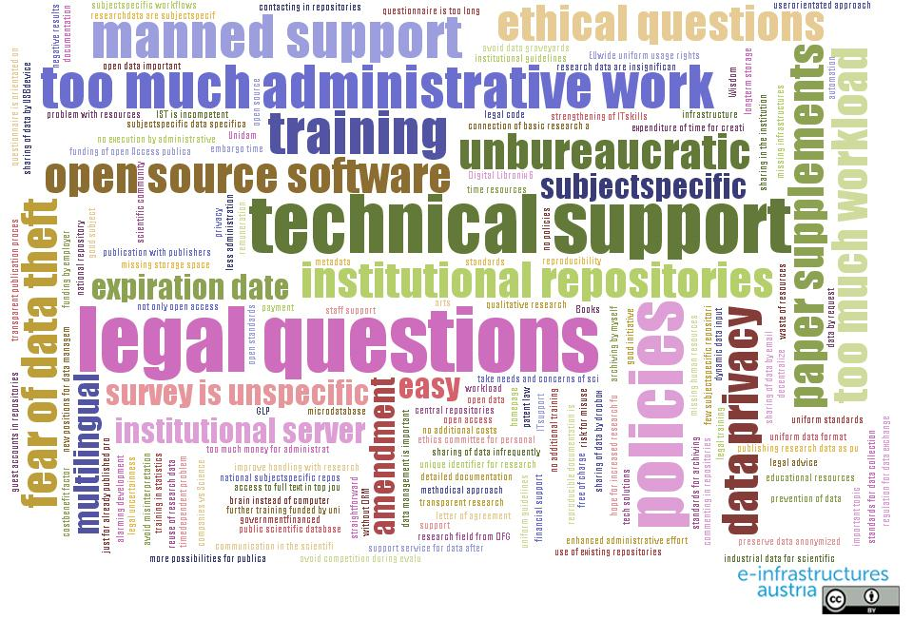
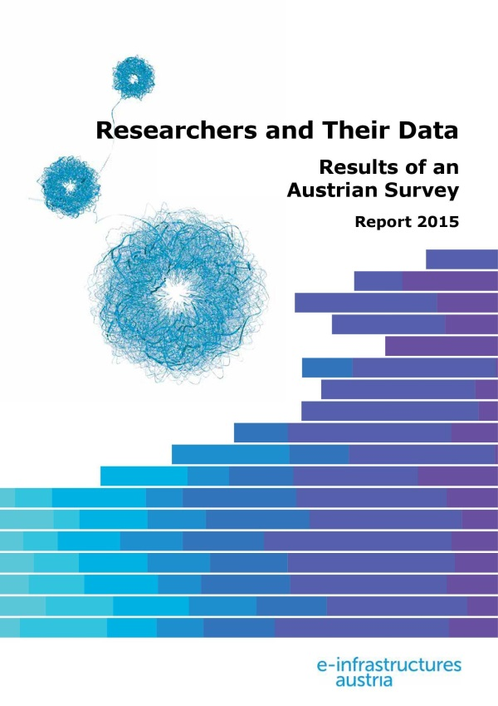
Enabling Open Science – What is really needed
Download full report:
Zenodo:
DOI 10.5281/zenodo.34005
Phaidra (e-book format):
https://phaidra.univie.ac.at/detail_object/o:409473

Slide 4
Austria Country report/ 1 Provision of e-Infrastructure
The organisation that have been given the responsibility for provisioning parts of e-infrastructure services in Austria is ACOnet.
ACOnet – the Austrian NREN (www.ACO.net) provides
high performance network infrastructure
Identity Federation services
backbone and middleware
digital certificates, eduID& eduroam.at
Operated at the University of Vienna
it does not provide storage or compute infrastructure
Report from Austria - Paolo Budroni (University o
f Vienna) Eveline Wandl-Vogt (Austrian Academy of Science) LODES18, Frascati, SEP2018

Slide 5
Austria Country report/2 - A list of the main repositories and/or data centres in Austria
Title | Type (repository/ data centre) | Link
Cross-disciplinary
Austrian State Archives | Data centre | http://www.oesta.gv.at/
BRZ - Austrian Federal Computing Center | Data centre | https://en.brz.gv.at/
IIASA – International Institute for Applied Systems Analysis | Repository | http://pure.iiasa.ac.at/
JKU ePub (University Library Linz) | Repository | http://epub.jku.at/
Phaidra - Permanent Hosting, Archiving and Indexing of Digital Resources and Assets (Univ. of Vienna) | Repository | https://phaidra.univie.ac.at/
reposiTUm (TU Wien) | Repository | http://repositum.tuwien.ac.at/
Volare | Repository | https://pid.volare.vorarlberg.at/
IST PubRep (Institute of Science and Technology) | Repository | https://repository.ist.ac.at/
Report from Austria - Paolo Budroni (University of Vienna) Eveline Wandl-Vogt (Austrian Academy of Science) LODES18, Frascati, SEP2018

Slide 6
Austria Country report/3 - Physical Sciences & Engineering, Life Sciences centres in Austria
Physical Sciences & Engineering
Architektur-Informatik | Repository | http://architektur-informatik.scix.net/
CCCA - Climate Change Center Austria | Data centre | https://www.ccca.ac.at/
EODC - Earth Observation Data Centre | Data centre | https://www.eodc.eu/
Life Sciences
 |  | http://esubmission.ema.europa.eu/psur/psur_repository.html
BBMRI ERIC | Data centre | http://www.bbmri-eric.eu/
LBI-HTA – Ludwig Boltzmann Institute of Health Technology Assessment | Repository | http://eprints.hta.lbg.ac.at/
Report from Austria - Paolo Budroni (University of Vienna) Eveline Wandl-Vogt (Austrian Academy of Science) LODES18, Frascati, SEP2018

Slide 7
Austria Country report/4 - Social Sciences and Humanities data centres in Austria
Social Sciences & Humanities
Institutional Repository of the University of Applied Arts | Repository | https://phaidra.bibliothek.uni-ak.ac.at/
Arche - A resource centre for the Humanities | Data Centre, Repository | https://www.oeaw.ac.at/acdh/tools/arche/
AUSSDA – Austrian Social Science Data Archive | Data Centre | https://aussda.at/en/
epub.oeaw - Digitales Publikationsportal der ÖAW | Repository | https://www.oeaw.ac.at/forschung-institute/verlag/epuboeaw/
Report from Austria - Paolo Budroni (University of Vienna) Eveline Wandl-Vogt (Austrian Academy of Science) LODES18, Frascati, SEP2018

Slide 8
Austria Country report/5 - Repositories and data centres in Austria
ePUBWU (Vienna University of Economics and Business) | Repository | http://epub.wu.ac.at/
Digital Repository KUG-PHAIDRA (University of Music and Performing Arts Graz – KUG) | Repository | https://phaidra.kug.ac.at/
GAMS – Asset Management System for the Humanities | Repository | http://gams.uni-graz.at/
Statistik Austria | Data centre | https://www.statistik.at/
Institutional Repository of the University of Art and Design Linz | Repository | https://phaidra.ufg.at/
Archive of Digital Art (ADA) , Donau-Universität Krems | Repository, Data Center | http://www.digitalartarchive.at/nc/home.html
Report from Austria - Paolo Budroni (University of Vienna) Eveline Wandl-Vogt (Austrian Academy of Science) LODES18, Frascati, SEP2018

Slide 9
Austria Country report/6 - Citizen driven archives and further relevant archives
ECitizen Driven Archives
Topothek. Unsere Geschichte, unser Archiv. Ansprechperson: Alexander Schatek | Repository | https://www.topothek.at/de/was-ist/
GenTeam. Die genealogische Datenbank Ansprechperson: Felix Gundacker | Repository | https://www.genteam.at/
Wikimedia (?) Europeana (?) OAPEN (?) OpenAIRE (?)
Report from Austria - Paolo Budroni (University of Vienna) Eveline Wandl-Vogt (Austrian Academy of Science) LODES18, Frascati, SEP2018

Slide 10
Austria Country report/6 - list of the main components of the e-Infrastructure (networking, computing, data and other services/tools)
Network infrastructure(s) | ACOnet – the Austrian NREN (www.ACO.net) high performance network infrastructure Identity Federation
Computing infrastructure(s) | National: nil
Data infrastructure(s) | National: nil
Other tools/services | National: nil
Report from Austria - Paolo Budroni (University of Vienna) Eveline Wandl-Vogt (Austrian Academy of Science) LODES18, Frascati, SEP2018

Slide 11
Austria Country report - main findings/1
Regarding the access model to Austrian repositories:
Generally speaking the Austrian Repositories are following the requirements foreseen by the PSI directive and the tendence is to be aligned with the FAIR principles
There is not a single point of entry
Concerning developments in Austria to foster the cooperation and coordination between e-Infrastructures and Research Infrastructures, especially with regard to the multiple data repositories:
These developments are taking place, but it is a long way, due to the fragmentation of competencies among the ministries and their Funding Agencies.
The coordination is steered by the involved Ministries

Slide 12
Austria Country report - main findings/2
Concerning mechanisms, funding and technology on already existing collaboration between e-Infrastructures and Research Infrastructures, and concerning mechanisms, funding and technology on already existing collaboration between multiple e-Infrastructures
The main funding mechanisms are steered by the two major funding agencies FWF and FFG.
FWF is mainly coordinated by the Ministry of Science, and FFG is mainly coordinated by the Ministry of Infrastructure
Interministerial groups are sometimes requested to prepare answers to specific domain crossing issues
Report from Austria - Paolo Budroni (University of Vienna) Eveline Wandl-Vogt (Austrian Academy of Science) LODES18, Frascati, SEP2018

Slide 13
Austria Country report - main findings/3 national domain-specific e-Infrastructures or other domain areas of particular interest in the country
AUSSDA – The Austrian Social Science Data Archive https://aussda.at/
BBMRI-ERIC http://www.bbmri-eric.eu/
Report from Austria - Paolo Budroni (University of Vienna) Eveline Wandl-Vogt (Austrian Academy of Science) LODES18, Frascati, SEP2018

Slide 14
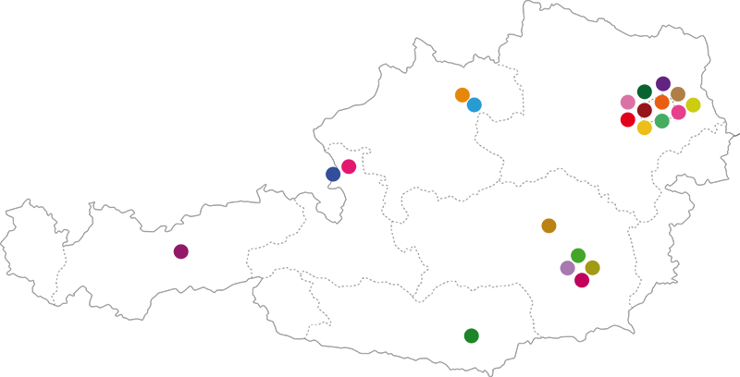
Main findings/ 4 - Diversities in the Austrian data centres and research infrastructures landscape
Clustering
4 Clusters identified for this presentation
Among them:
Structured Data Management
Research Infrastructures
Others
No structured data management
Report from Austria - Paolo Budroni (University of Vienna) Eveline Wandl-Vogt (Austrian Academy of Science) LODES18, Frascati, SEP2018

Slide 15
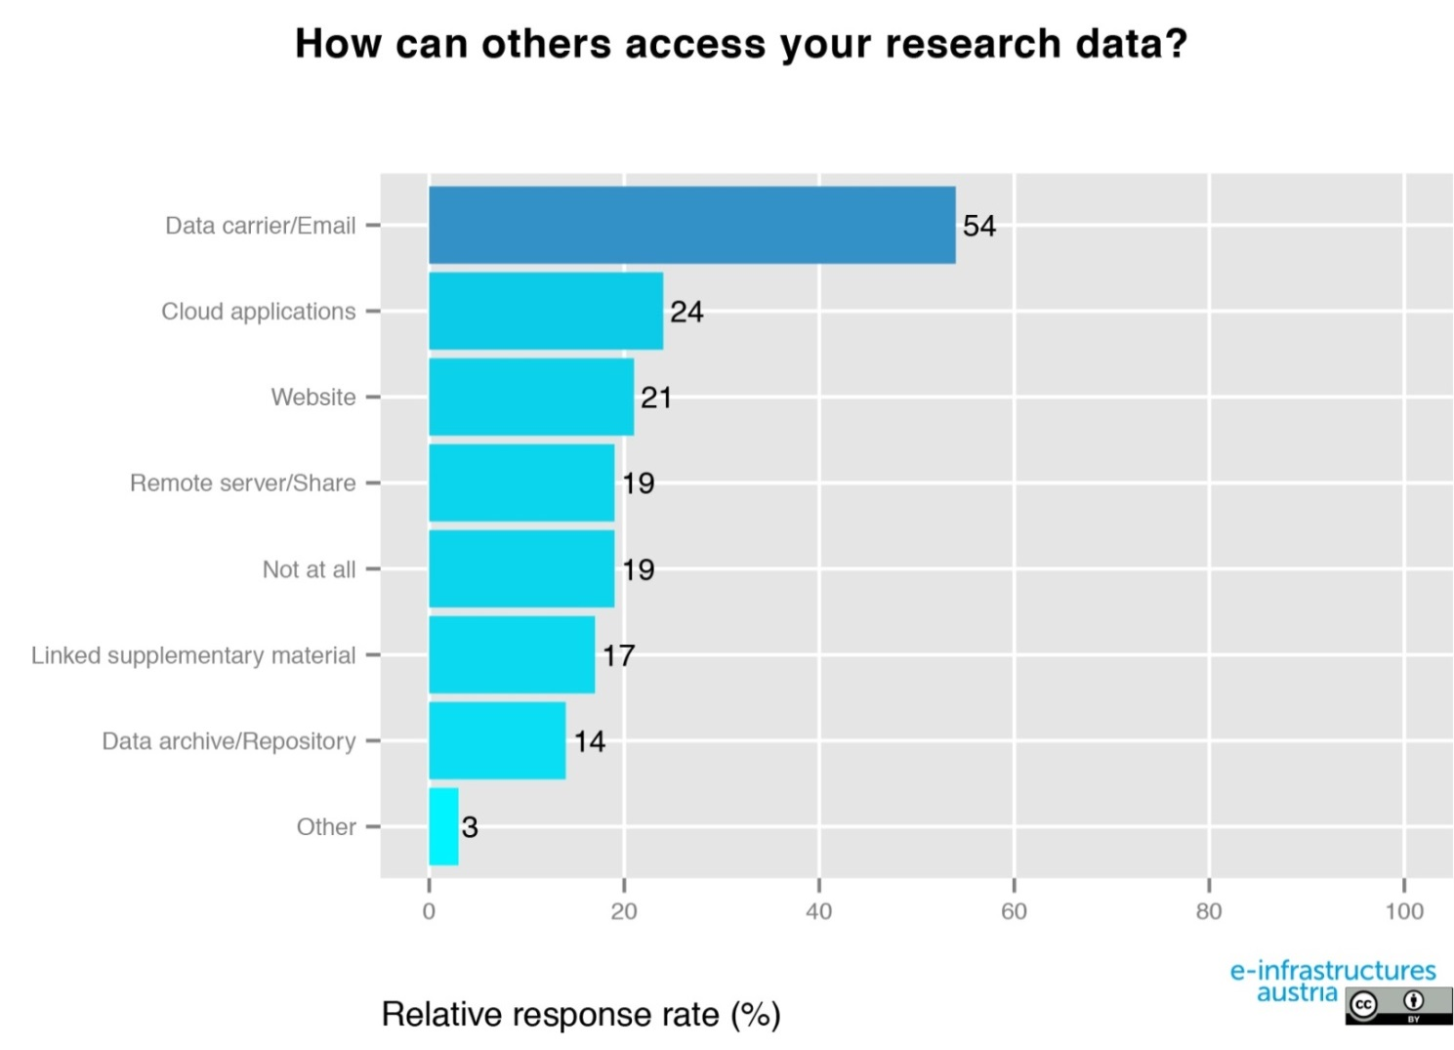
Main findings /5 - Coordination between various e-infrastructure components is needed
Repositories 14%

Slide 16
Main findings/ 6 HPC and provisioning of e-infrastructures
→ There is/are no dedicated organization/s for provisioning of e-infrastructures in Austria. Relevant players:
ACOnet – the Austrian NREN (high performance network infrastructure and Identity Federation) is operated by the University of Vienna
VSC – The Vienna Scientific Cluster is a collaboration of several Austrian universities that provides supercomputer resources and corresponding services to their users, coordinated by TU Wien, ● VSC – The Vienna Scientific Cluster (vsc.ac.at)
HPC Resources & Services
„e-Infrastructures Austria Plus“ is a project carried out by nine austrian universities, running from April 2017 to December 2019, that aims to implement infrastructure for eScience.
Report from Austria - Paolo Budroni (University of Vienna) Eveline Wandl-Vogt (Austrian Academy of Science) LODES18, Frascati, SEP2018

Slide 17
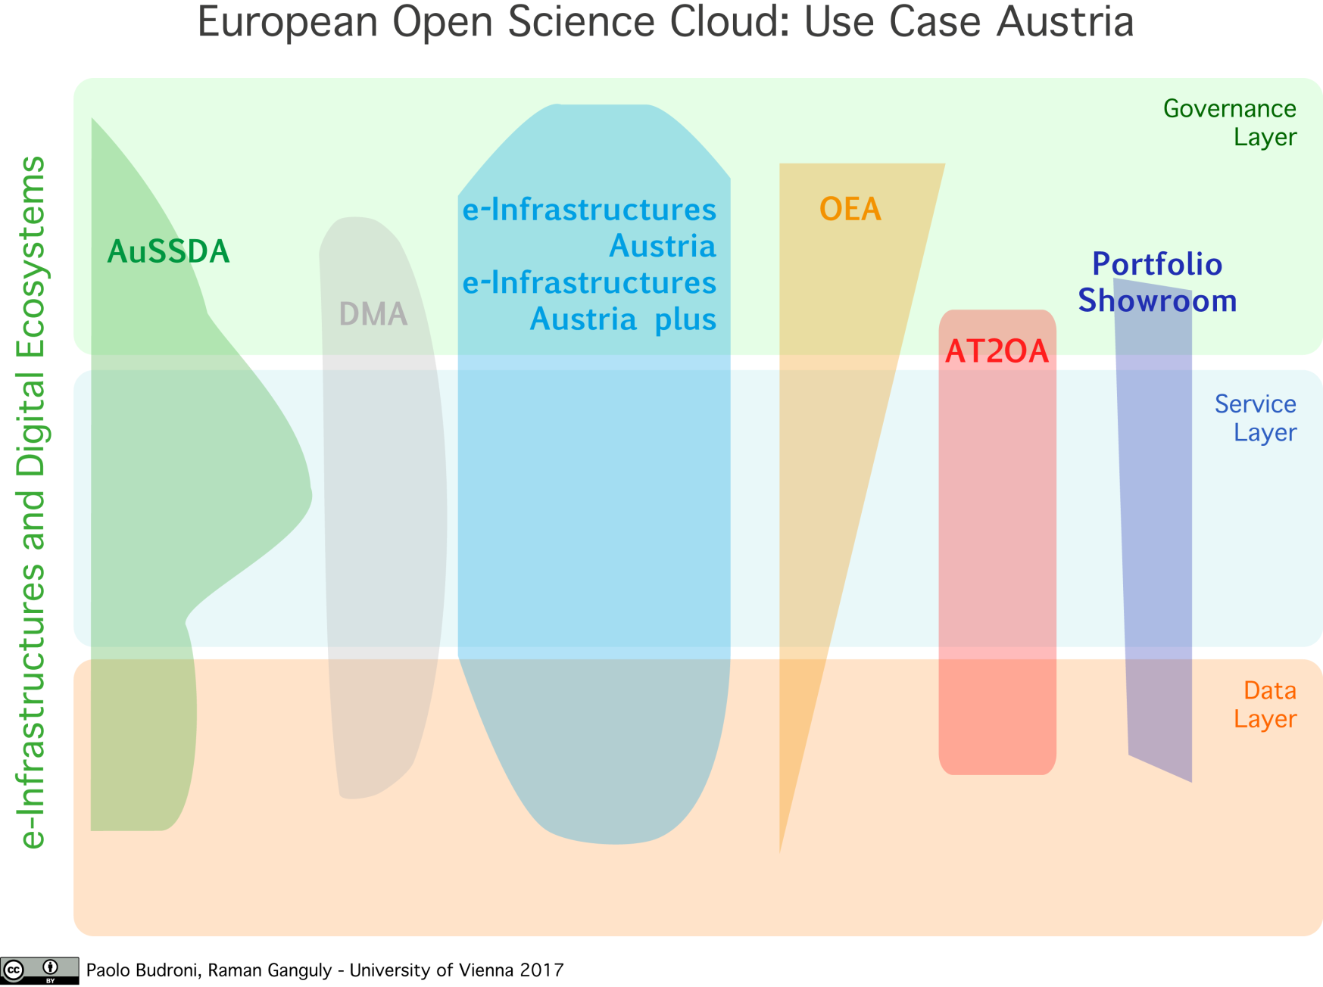
Open Science in Austria – towards the EOSC
’
This graph gives an overview of national efforts, increased visibility and interoperability of digital eco-systems like repositories., services, data, governance models, etc. all according the requirements of the EOSC as foreseen in the report of the HLEG.

Slide 18
Open Science in Austria – towards the EOSC
Several important EOSC milestones will occur during the Austrian EU presidency in the second half of 2018.
One of these events will be a conference showcasing European and Austrian organizations, infrastructure projects, and data initiatives — the material foundations on which the EOSC infrastructures will be built—that embody the EOSC themes of Governance & Funding, Data Culture and FAIR Data, and Services and Architecture.
https://eosc18-ati.univie.ac.at/home/
Report from Austria - Paolo Budroni (University of Vienna) Eveline Wandl-Vogt (Austrian Academy of Science) LODES18, Frascati, SEP2018

Slide 19
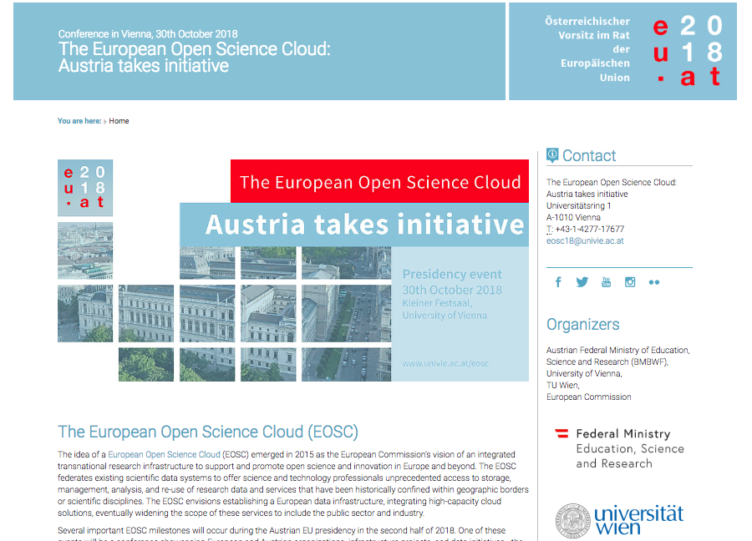
EOSC: Austria Takes Initiative Conference
https://eosc18-ati.univie.ac.at/home/

Slide 20
This project has received funding from the European Union’s Horizon 2020 research and innovation programme under grant agreement No 654139.

Slide 21
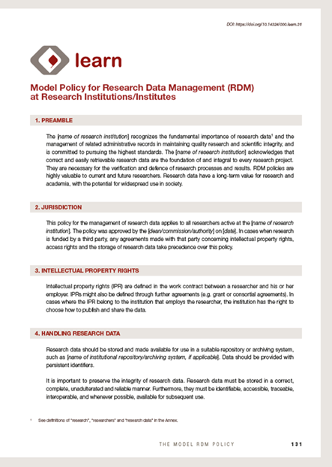
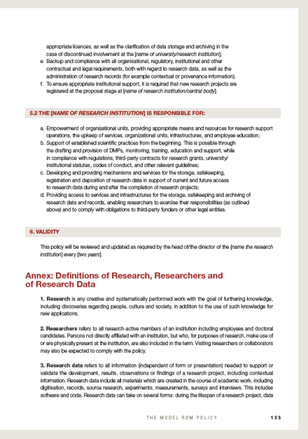
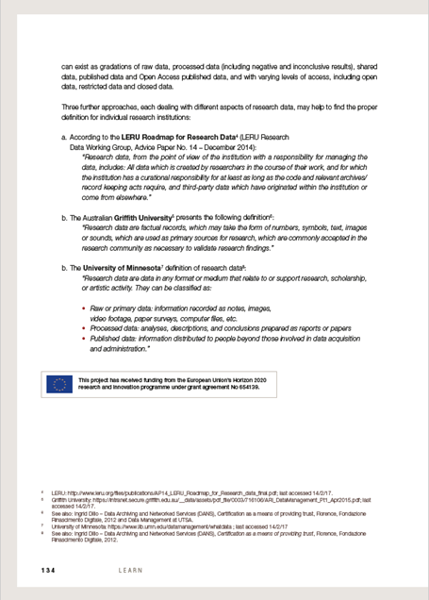
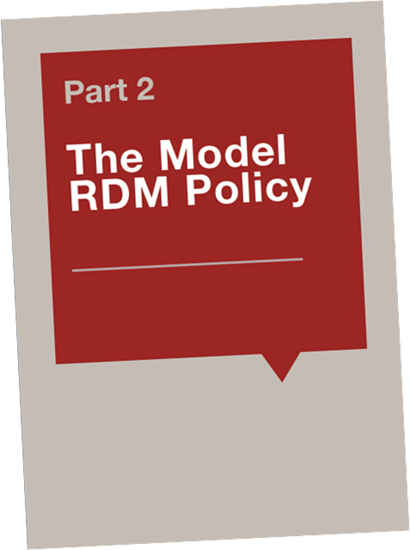
Published in LEARN Toolkit
http://learn-rdm.eu/wp-content/uploads/RDMToolkit.pdf?pdf=RDMToolkit
http://learn-rdm.eu/en/about/
This project has received funding from the European Union’s Horizon 2020 research and innovation programme under grant agreement No 654139.

Slide 22
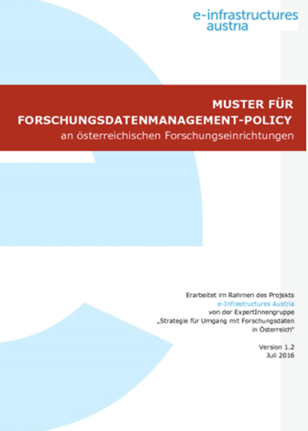
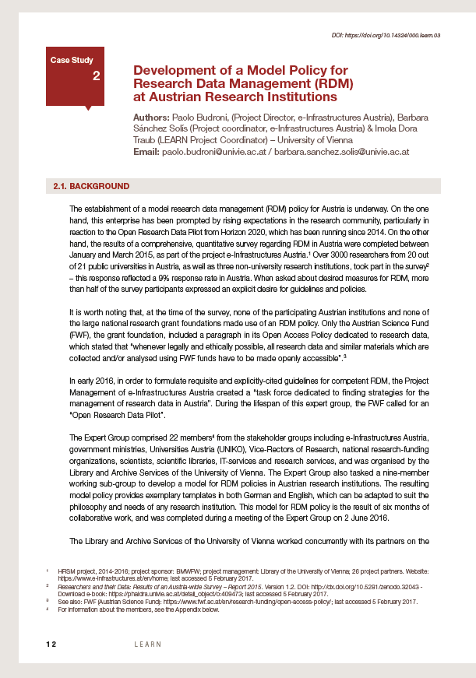
Austria Country Report /Status quo in Austria
Since March 2017:
3 Universities: published a RDM-policy
9 Universities: in development
23 Workshops for decision makers /executives on how to create RDM – policies
Average of 10 Persons/RI /Workshop have attended
This project has received funding from the European Union’s Horizon 2020 research and innovation programme under grant agreement No 654139.

Slide 23
Know-how-Transfer across the regions
Presentations or workshops on policy development in Austria, Italy, Spain, Latin America, the Caribbean, Southafrica, Lebanon, Turkey, Hungary, Germany, Ethiopia, …)
Translation into other languages (German, Italian, Spanish, Catalan, …)
Policy alignment for various disciplines (arts, medicine, technical universities…)
Policy development – outreach of project LEARN
This project has received funding from the European Union’s Horizon 2020 research and innovation programme under grant agreement No 654139.
Notes:
Unsere Arbeit für Österreich wird auch weltweit rezipiert. Unsere Mitarbeiterinnen und Mitarbeiter werden weltweit für Vorträge zu Policy-Entwicklung eingeladen. Auf der Karte sind die Einladungsorte illustriert.

Slide 24
LEARN Activities in Italy
In September 2017 and with the contribution of the University of Vienna (Austrian Open Science Support Group), representatives of the following Italian Universities have created the Italian Open Science Support Group (IOSSG) and participated to training activities
Policy Released in November 2017

Slide 25
Repositories and Linked Data
Linked Data Repositories currently in AT are
open pilot project: LOD pilot AT - data.gv.at
stakeholders are (global acting) business companies, driving Linked Data towards AI, e.g. Semantic Web Company, Deep Search
established in research mainly related to certain topics / research areas
first examples of cross-organisational linkages via Geo-Data
first examples to overcome non-standard language issues by connecting non-standard lexical resources systematically
Report from Austria - Paolo Budroni (University of Vienna) Eveline Wandl-Vogt (Austrian Academy of Science) LODES18, Frascati, SEP2018

Slide 26
Embedding into cross border networks
Social networks of trust & communities / cross-organisational collaboration:
European Universities network
European Libraries network
ALLEA (All European Academies) with WG eHumanities
Globale Akademie-Partnerschaften der ÖAW
Weitere Akademieverbünde
LIBER
Report from Austria - Paolo Budroni (University of Vienna) Eveline Wandl-Vogt (Austrian Academy of Science) LODES18, Frascati, SEP2018

Slide 27
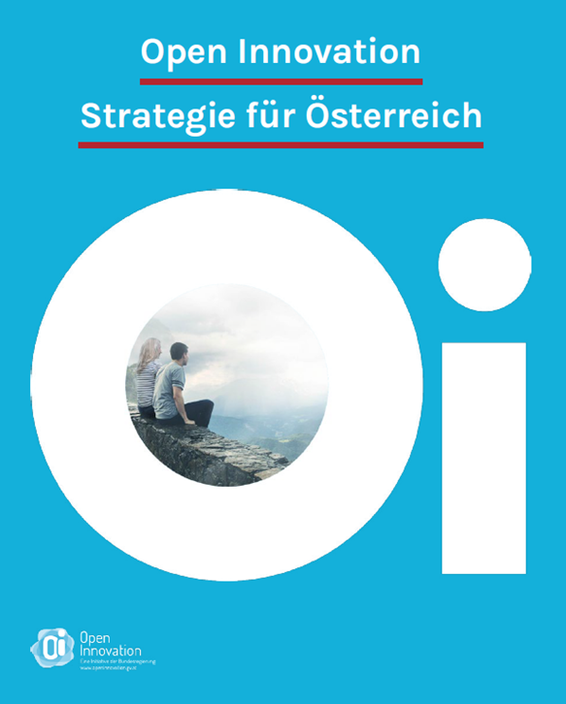
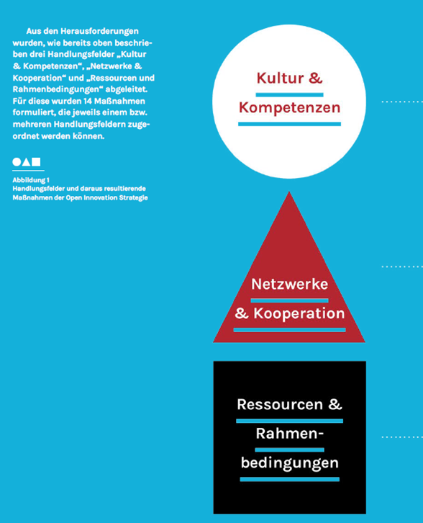
Forecast of activities
Blockchain Trust, Smart Social Contracts, Virtual Value-creation
Crowd Innovation, We-Culture
Knowledge for Development, Knowledge Society
Open Innovation strategy of Austria > Open Innovation in Science Resources, Framework > Networks, Collaborations > Culture, Competences
Report from Austria - Paolo Budroni (University of Vienna) Eveline Wandl-Vogt (Austrian Academy of Science) LODES18, Frascati, SEP2018

Slide 28
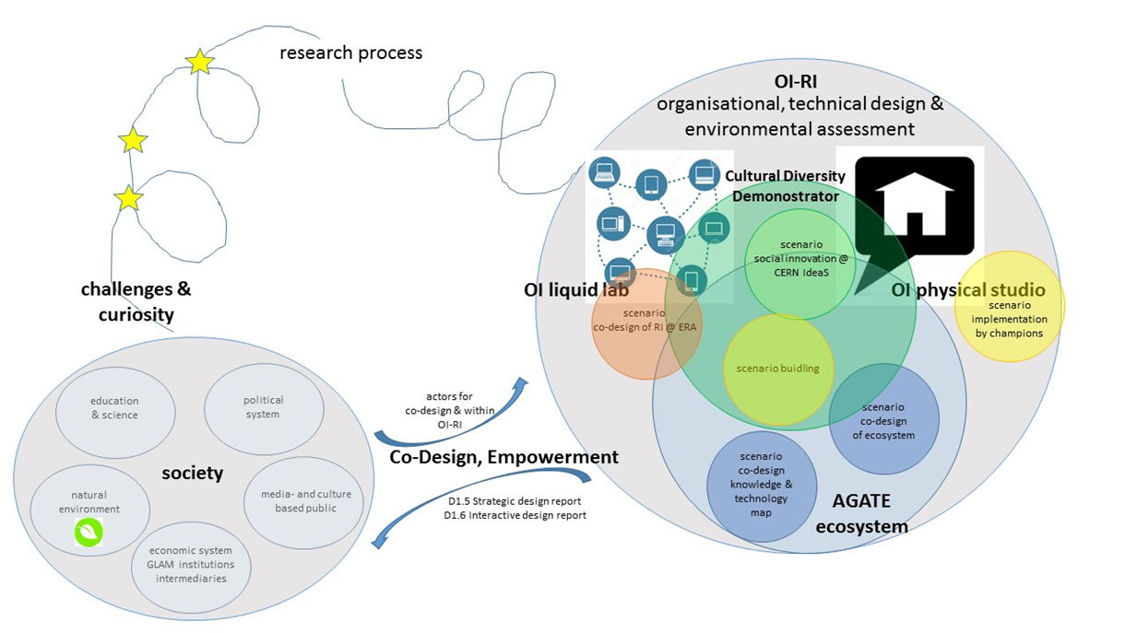
Forecast of activities: OI-RI
human centered
liquid
curiosity driven & (societal) challenge driven
participatory
open innovation methods & practices in science
CC-BY 4.0 Eveline Wandl-Vogt
Report from Austria - Paolo Budroni (University of Vienna) Eveline Wandl-Vogt (Austrian Academy of Science) LODES18, Frascati, SEP2018

Slide 29
Thank you! paolo.budroni@univie.ac.at eveline.wandl-vogt@oeaw.ac.at

Slide 30
Credits
This work is licenced under a Creative Commons Attribution 4.0 International License (CC BY 4.0). It is attributed to Paolo Budroni, Eveline Wandl-Vogt
Report from Austria - Paolo Budroni (University of Vienna) Eveline Wandl-Vogt (Austrian Academy of Science) LODES18, Frascati, SEP2018

Slide 31
The Project LEARN WP3 – „Policy development“
in a nutshell:
outreach and lessons learned
This project has received funding from the European Union’s Horizon 2020 research and innovation programme under grant agreement No 654139.

Slide 32
1
Project LEARN -
The Mission

Slide 33
Mission of WP3 – “Policy Development”
Produce an exemplar Research Data Management Policy (agreed by all Partners)
Produce a Policy and a Guidance which can be tailored by any University or Research Institution to meet their needs
Enhance Policy Coordination & Alignment
Coordination: University College London
Partners: Univ. Vienna, Univ. Barcelona, LIBER, ECLAC /UN-Commission Economic Development Latin America Caribbean
This project has received funding from the European Union’s Horizon 2020 research and innovation programme under grant agreement No 654139.

Slide 34
2
How we started

Slide 35
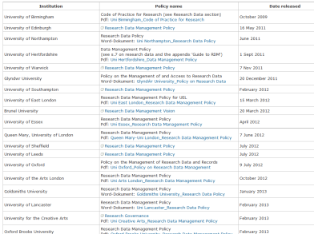
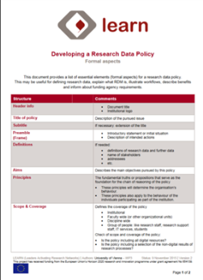
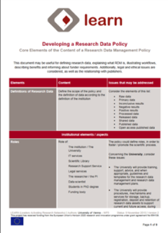
How we started
Identification of Funders in the German speaking countries (DACH)
Collection of European RDM policies and first analysis
Production of 2 grid documents for policies:
Formal elements
Content elements
of policies
This project has received funding from the European Union’s Horizon 2020 research and innovation programme under grant agreement No 654139.

Slide 36
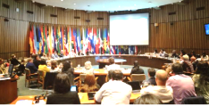
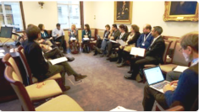
How we continued
Creation of first model policy and guidance
Continuous involvement of LEARN Partners
Discussion of policy insights and results at Partner Workshops in London, Vienna, Helsinki, Santiago de Chile and Barcelona
Co-operation in Mini-Workshops in the Latin America area to compare and standardise terminology and to foster policy alignment
12/2016 – 02/2017: Peer review process of Model Policy and Guidance
This project has received funding from the European Union’s Horizon 2020 research and innovation programme under grant agreement No 654139.

Slide 37
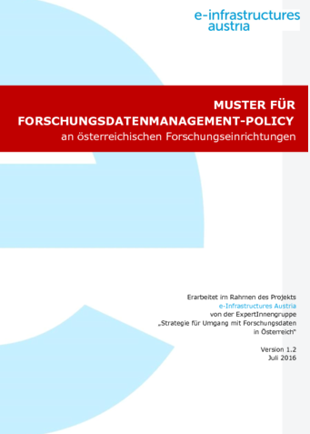
Synergies with e-Infrastructures Austria
January-June 2016: Findings of first workshops and policy analysis were applied on a national level by establishing a cross-disciplinary Expert Group in Austria (22 members)
June 2016: Release of exemplary Model RDM Policy for Austrian Research Institutions in German and English (see: http://phaidra.univie.ac.at/o:459162)
This project has received funding from the European Union’s Horizon 2020 research and innovation programme under grant agreement No 654139.

Slide 38
3
The Model Policy

Slide 39
This project has received funding from the European Union’s Horizon 2020 research and innovation programme under grant agreement No 654139.

Slide 40
Published in LEARN Toolkit
http://learn-rdm.eu/wp-content/uploads/RDMToolkit.pdf?pdf=RDMToolkit
http://learn-rdm.eu/en/about/

Slide 41
Spreading out
Presentations or workshops on policy development in Austria, Italy, Spain, Latin America, the Caribbean, Southafrica, Lebanon, Turkey, Hungary, Germany, Ethiopia, …)
Translation into other languages (German, Italian, Spanish, Catalan, …)
Policy alignment for various disciplines (arts, medicine, technical universities…)

Slide 42
Austria Country Report /Status quo in Austria
Since March 2017:
3 Universities: published a RDM-policy
9 Universities: in development
23 Workshops for decision makers /executives on how to create RDM – policies
Average of 10 Persons/RI /Workshop have attended
This project has received funding from the European Union’s Horizon 2020 research and innovation programme under grant agreement No 654139.

Slide 43
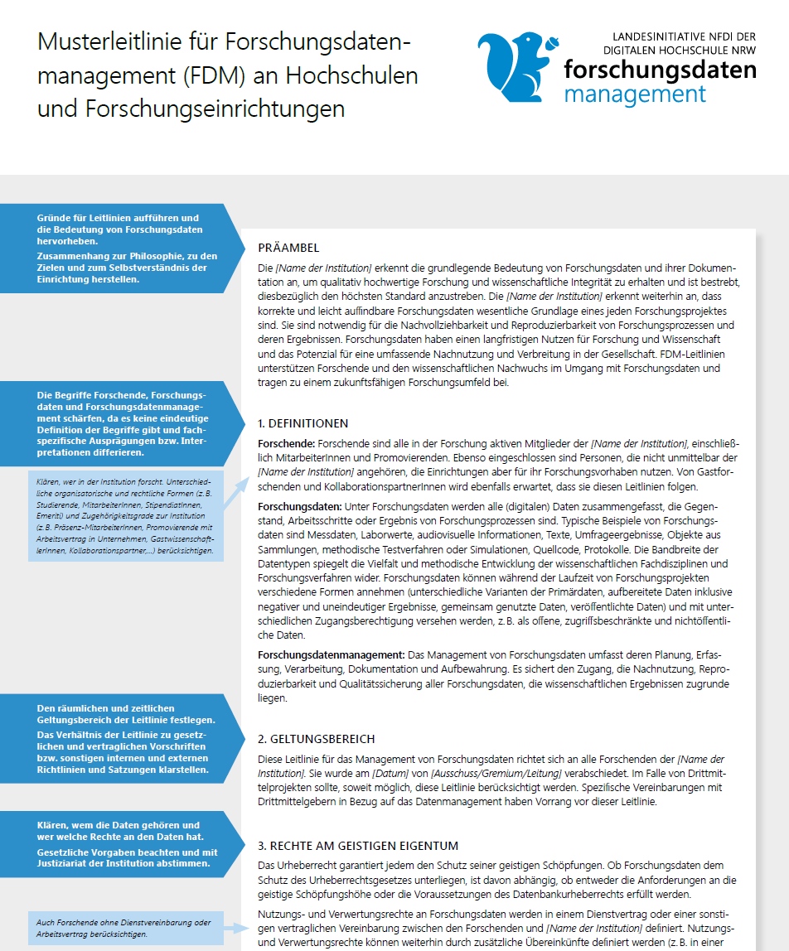
Germany
The announcement has been sent through the German DINI/Nestor Network to all 17 Universities of the Land Nordrhein- Westfalen
Released in March 2018
The Project „Landesinitiative NFDI www.fdm-nrw.de has used the Model Policy of the LEARN Project and tailored a version for German Ris.
This German version has been published in Zenodo https://doi.org/10.5281/zenodo.1149133

Slide 44
LEARN Activities in Italy
In September 2017 and with the contribution of the University of Vienna (Austrian Open Science Support Group), representatives of the following Italian Universities have created the Italian Open Science Support Group (IOSSG) and participated to training activities
Policy Released in November 2017

Slide 45
Spreading out
Presentations or workshops on policy development in Austria, Italy, Spain, Latin America, the Caribbean, Southafrica, Lebanon, Turkey, Hungary, Germany, Ethiopia, …)
Translation into other languages (German, Italian, Spanish, Catalan, …)
Policy alignment for various disciplines (arts, medicine, technical universities…)
This project has received funding from the European Union’s Horizon 2020 research and innovation programme under grant agreement No 654139.

Slide 46
Thank you! paolo.budroni@univie.ac.at

